Slide 1
C. Phil Presentation
9 June 2008
Gray Calhoun
UC San Diego
TexPoint fonts used in EMF.
Read the TexPoint manual before you delete this box.: AAAAAA

Slide 2
Introduction
Overview
  45 minutes discussing “Overfit” paper
  15 minutes for Monte Carlo and empirical exercise
  15 minutes on future research
General Plan
  Plan to be on the job market this fall
    Polish “Limit Theory for Overfit Forecasts”
    Write new job-market-paper over the summer

Slide 3
Introduction to “Overfit” paper
Main question —
How do out-of-sample tests behave for overfit models?

Slide 4
Introduction to “Overfit” paper
Present new approximation for fixed-window statistic:
notation:
¡
1
=
2
X
T
£
(
^
)
(
^
)
¤
P
L
y
s
¡
x
1
s
¢
µ
1
R
¡
L
y
s
¡
x
2
s
¢
µ
2
R
s
=
R
+
1
L
l
o
s
s
f
u
n
c
t
i
o
n
P
s
i
z
e
o
f
t
e
s
t
s
a
m
p
l
e
R
s
i
z
e
o
f
e
s
t
i
m
a
t
i
o
n
w
i
n
d
o
w
y
s
d
e
p
e
n
d
e
n
t
v
a
r
i
a
b
l
e
x
j
s
v
e
c
t
o
r
o
f
p
r
e
d
i
c
t
o
r
s
f
o
r
m
o
d
e
l
j
^
µ
j
R
O
L
S
e
s
t
i
m
a
t
o
r
u
s
i
n
g
o
b
s
e
r
v
a
t
i
o
n
s
1
R
^
;
:
:
:
;
µ
¤
p
s
e
u
d
o
-
t
r
u
e
v
a
l
u
e
o
f
µ
j
R
j

Slide 5
Introduction to “Overfit” paper
West’s (1996) asymptotic theory implies
If the models are nested, a different approximation is necessary
¡
1
X
T
£
(
^
)
(
^
)
P
L
y
s
¡
x
1
s
¢
µ
1
R
¡
L
y
s
¡
x
2
s
¢
µ
2
R
¼
s
=
R
+
1
E
£
L
(
y
¡
x
¢
µ
¤
)
¡
L
(
y
¡
x
¢
µ
¤
)
¤
s
1
s
1
s
2
s
2
¡
1
=
2
n
X
T
£
(
^
)
(
^
)
¤
P
L
y
s
¡
x
1
s
¢
µ
1
R
¡
L
y
s
¡
x
2
s
¢
µ
2
R
s
=
R
+
1
E
£
L
(
µ
¤
)
L
(
µ
¤
)
¤
o
a
N
(
0
)
¡
y
s
¡
x
1
s
¢
1
¡
y
s
¡
x
2
s
¢
2
»
;
v

Slide 6
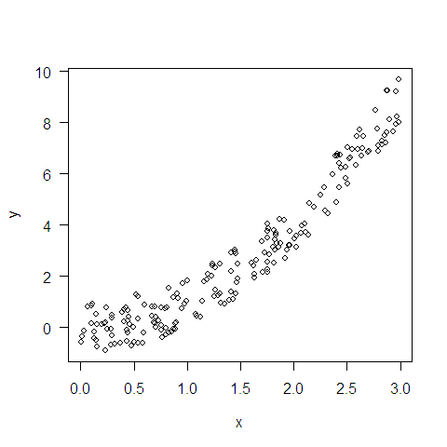
When is West (1996) Accurate?
Data Generating Process:
one model:
y
=
x
2
+
"
i
i
i
x
i
»
u
n
i
f
o
r
m
(
0
3
)
;
"
i
»
u
n
i
f
o
r
m
(
¡
1
1
)
;
f
(
x
)
a
+
a
x
+
a
x
2
i
=
0
1
i
2
i

Slide 7
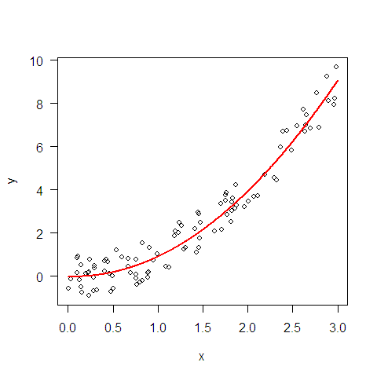
When is West (1996) Accurate?
Data Generating Process:
one model:
  Estimate a over first 100 observations
y
=
x
2
+
"
i
i
i
x
i
»
u
n
i
f
o
r
m
(
0
3
)
;
"
i
»
u
n
i
f
o
r
m
(
¡
1
1
)
;
f
(
x
)
a
+
a
x
+
a
x
2
i
=
0
1
i
2
i

Slide 8
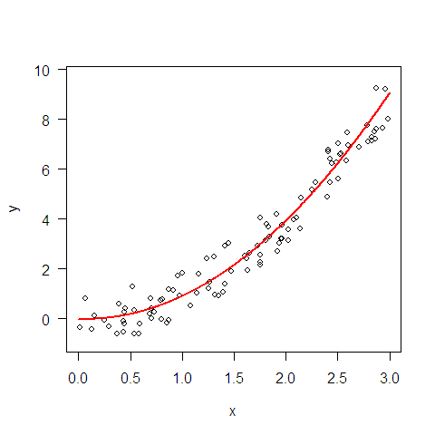
When is West (1996) Accurate?
Data Generating Process:
one model:
  Estimate a over first 100 observations
  Calculate MSE over the other 100 observations
y
=
x
2
+
"
i
i
i
x
i
»
u
n
i
f
o
r
m
(
0
3
)
;
"
i
»
u
n
i
f
o
r
m
(
¡
1
1
)
;
f
(
x
)
a
+
a
x
+
a
x
2
i
=
0
1
i
2
i

Slide 9
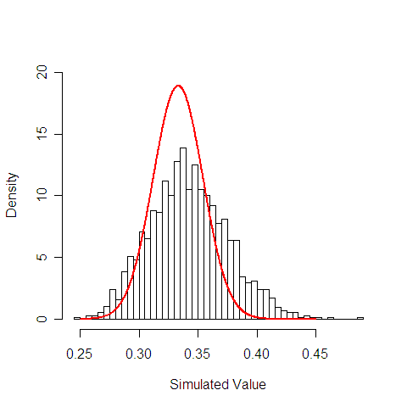
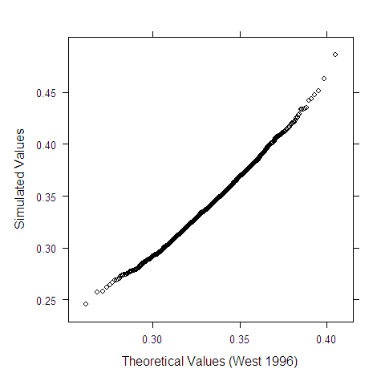
When is West (1996) Accurate?

Slide 10
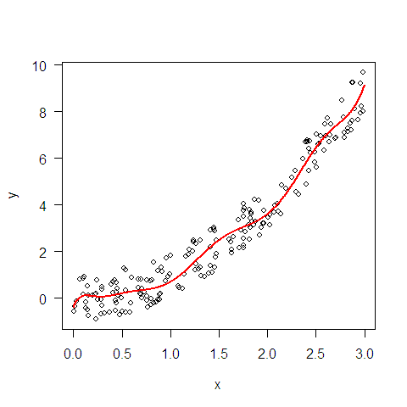
When is West (1996) Accurate?
Data Generating Process:
another model:
  Estimate a over first 100 observations
  Calculate MSE over the other 100 observations
y
=
x
2
+
"
i
i
i
x
i
»
u
n
i
f
o
r
m
(
0
3
)
;
"
i
»
u
n
i
f
o
r
m
(
¡
1
1
)
;
X
1
0
k
g
(
x
i
)
=
a
k
x
k
0
i
=

Slide 11
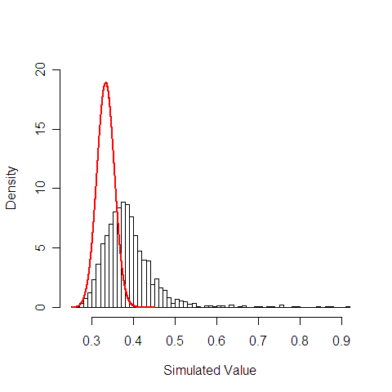
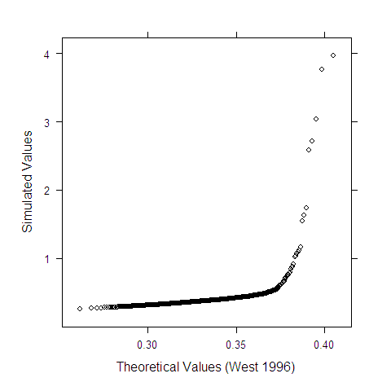
When is West (1996) Accurate?

Slide 12
What goes Wrong?
The problem is not that the additional coefficients are 0.
  pictures would look almost identical for y_{i} = (x_{i})^{2.2} + ε_{i}
Problem is that estimated coefficients are not near their pseudo-true values

Slide 13
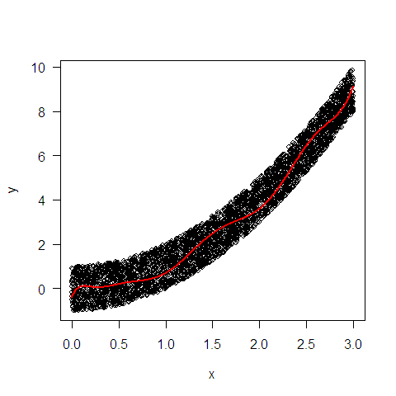
Solution
Condition on the curve used to forecast
Define:
For deterministic a,
³
X
1
0
k
´
2
M
(
a
)
´
E
y
i
¡
a
k
x
i
k
=
0
´
E
(
y
¡
g
(
x
)
)
2
i
i
N
M
(
)
l
i
N
¡
1
X
(
¡
(
)
)
2
a
=
p
m
y
i
g
x
i
N
!
1
i
1
=

Slide 14
Solution
If a is random, also have
Now
almost surely
N
M
(
)
l
i
N
¡
1
X
(
¡
(
)
)
2
a
=
p
m
y
i
g
x
i
N
!
1
i
1
=
h
³
X
1
0
k
´
2
i
M
(
a
)
=
E
y
i
¡
a
k
x
i
j
a
k
=
0

Slide 15
Solution
West’s approximation is:
with
I propose the approximation:
¡
1
=
2
X
T
£
(
)
2
(
)
¤
a
(
)
P
y
¡
a
¢
z
i
¡
M
®
¤
»
N
0
V
s
=
R
+
1
s
;
a
´
O
L
S
e
s
t
i
m
a
t
o
r
o
v
e
r
¯
r
s
t
R
o
b
s
e
r
v
a
t
i
o
n
s
®
¤
´
p
s
e
u
d
o
-
t
r
u
e
v
a
l
u
e
o
f
a
z
i
´
(
1
x
i
x
1
0
)
;
;
:
:
:
;
i
M
(
®
)
´
E
(
y
¡
®
¢
z
i
)
2
s
¡
1
=
2
X
T
£
(
)
2
(
)
¤
a
(
(
)
)
P
y
s
¡
a
¢
z
i
¡
M
a
»
N
0
V
a
s
=
R
+
1
;

Slide 16
Accuracy of New Approximation (for 10th order polynomial)
Draw 200 observations
Fit 10th degree polynomial to the first 100 observations
Calculate
  average squared error,
  std of squared error
  M(a)
Theory indicates that
10 (avg – M(a)) / std ~ N(0,1)

Slide 17
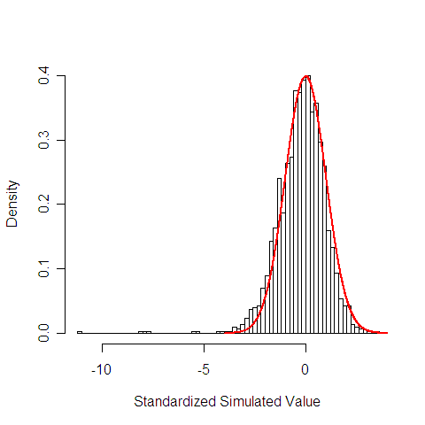
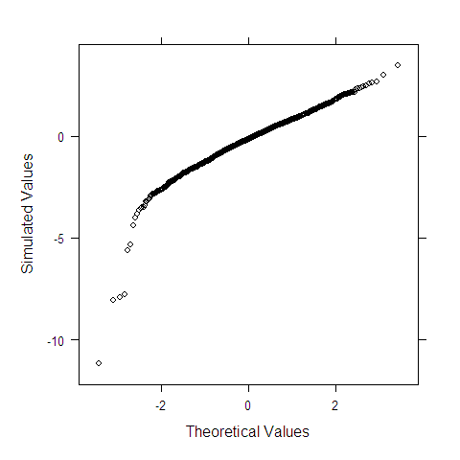
Accuracy of New Approximation (for 10th order polynomial)

Slide 18
First Result – Asymptotic Normality
Lemma 4.2 (page 10)
Σ(θ_{1,}θ₂) is the conditional variance
Assumptions listed on page 5
  Dependence and stationarity restriction
  Rules out zero forecast error (this case is not interesting)
  Restrictions on test sample loss
    Moment restriction on test-sample loss
    Smoothness of the function M(a)

Slide 19
Implications of Lemma 4.2
Fixed Window necessarily estimates
When is close to θ*, the fixed window estimates M(θ*)
Fixed window induces a change-of-measure in dependent series
  As the test sample grows, most of the observations are far from the estimation window
(
^
)
M
µ
R
^
µ
R
M
(
µ
)
=
E
L
(
y
¡
x
¢
µ
)
^
s
s
^
^
i
i
d
M
(
µ
R
)
=
E
£
L
(
y
¡
x
¢
µ
R
)
j
µ
R
¤
.
.
.
^
s
s
^
^
d
e
p
M
(
µ
)
6
E
£
L
(
y
¡
x
¢
µ
)
j
µ
¤
.
R
=
s
s
R
R

Slide 20
How do we model these curves Asymptotically?
Problem: in larger sample sizes, a model can cease to be overfit
  Under standard asymptotics,
Goal: find an asymptotic approximation that keeps the variance of the estimators positive
Solution: increase both the sample size and model complexity together.
(
^
)
(
¤
)
(
)
M
µ
R
=
M
µ
+
o
p
1

Slide 21
How do we model these curves Asymptotically?
Study the behavior of
as T → ∞ and K/T → k > 0.
  Know that (Lemma 4.2)
  So, we really need to study
    In particular, its relationship to M(θ*) and
1
=
2
X
T
(
^
)
=
P
L
y
¡
x
¢
µ
^
s
s
R
¾
s
=
R
+
1
1
=
2
X
T
£
(
^
)
(
^
)
¤
=
d
(
)
P
L
y
¡
x
¢
µ
¡
M
µ
^
¡
N
0
1
s
s
R
R
¾
!
;
s
=
R
+
1
l
(
^
)
i
m
M
µ
R
T
!
1
;
K
=
T
!
k
(
^
)
M
µ
T

Slide 22
How do we model these curves Asymptotically?
Related Papers
  K/T asymptotics – Huber (1973), Yohai and Marona (1979), Portnoy (1984, 1985)
  Optimism of in-sample loss – Efron (1986, 2004)

Slide 23
How do we model these curves Asymptotically?
Relationship to pseudo-true:
Relationship to the full-sample estimator:
  So, need P/T small to estimate the performance of the full-sample estimators
  Need P²/T small to construct a confidence interval
  Need P large enough to justify LLN or CLT
(
µ
¤
)
(
^
)
(
)
2
M
·
M
µ
R
i
f
L
e
=
e
(
µ
¤
)
l
(
^
)
M
=
i
m
M
µ
R
T
!
1
K
=
T
!
0
(
^
)
(
^
)
¡
j
^
^
j
¢
¡
p
=
¢
M
µ
R
¡
M
µ
T
=
O
p
µ
R
¡
µ
T
2
=
O
p
P
R

Slide 24
Two nested models
Assume
  that K₁ is fixed, K₂/T → k₂ > 0
  the smaller model is the true DGP and z_{t} are the additional predictors for the larger model
  i.i.d. series
Then we have
e
=
"
+
o
(
1
)
1
;
s
s
p
e
"
+
^
¢
+
(
1
)
2
s
=
s
®
R
z
s
o
p
;

Slide 25
Two nested models
What does this mean?
  So, we do not need ad hoc critical values for nested models (i.e. Clark and McCracken 2001)
(
(
)
j
^
)
V
a
r
e
1
e
2
µ
R
i
s
u
n
i
f
o
r
m
l
y
p
o
s
i
t
i
v
e
d
e
¯
n
i
t
e
;
s
;
;
s
.

Slide 26
Second Result – Nested Models
Theorem 5.1 (page 11)
To test the null hypothesis:
we can use standard normal critical values for the test statistic:
Model 1 must be a simple benchmark (e.g. a random walk)
H
0
:
L
(
y
¡
x
1
¢
µ
¤
)
·
L
(
y
¡
x
2
¢
µ
¤
)
s
s
1
s
s
2
¡
1
=
2
X
T
£
(
^
)
(
^
)
¤
=
P
L
y
¡
x
µ
¡
L
y
¡
x
µ
^
s
1
s
1
R
s
2
s
2
R
¾
s
=
R
+
1

Slide 27
Third Result – Forecast Accuracy
Lemma 6.2 (pages 13 to 14)
Loss function is smooth (left- and right-derivatives exist and are finite)
Eigenvalue conditions are analogous to rank and invertibility conditions under conventional asymptotics.

Slide 28
Summary of the Paper
Main Question (again) –
How do out-of-sample tests behave for overfit models?
Examined the fixed-window statistic
  Statistic is asymptotically normal, but centered on a random variable (the expected loss given the coefficient estimates)
  Can use standard normal critical values to compare nested models with simple benchmark
  Need P²/T to converge to zero to construct CI for the performance of the full-sample models

Slide 29
Monte Carlo
Does 90% confidence interval contain ?
DGP based on Clark and West (2007)
  Draw 480 observations from
(
^
)
M
µ
T
y
t
=
2
:
2
3
7
+
0
:
2
6
1
y
t
¡
1
+
"
1
t
z
t
=
(
0
8
0
4
¡
0
2
2
1
0
2
2
6
¡
0
2
0
5
)
¢
(
z
t
¡
1
z
t
¡
4
)
+
"
2
t
:
;
:
;
:
;
:
;
:
:
:
;
µ
µ
1
0
5
0
5
1
0
3
6
¶
¶
"
»
N
0
:
:
;
¢
0
3
6
6
:
:

Slide 30
Monte Carlo
Estimate AR(1) and VAR(4) over estimation window
Construct 90% confidence interval for difference in squared error over test sample
  Lemma 4.1 implies that this interval contains
  Theorem 6.2 implies that interval contains when
Calculate and
T
1
2
0
2
4
0
4
8
0
P
4
0
8
0
1
6
0
3
2
0
(
^
)
M
µ
R
(
^
)
M
µ
T
P
2
=
T
¼
0
^
(
^
)
M
(
µ
T
)
M
µ
R

Slide 31
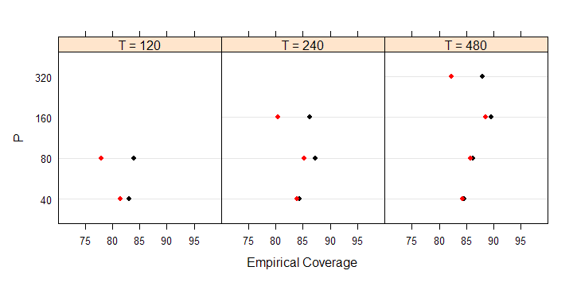
Monte Carlo Results
f
l
(
^
)
(
^
)
²
P
e
r
c
e
n
t
a
g
e
o
i
n
t
e
r
v
a
s
c
o
n
t
a
i
n
i
n
g
M
1
µ
1
R
¡
M
2
µ
2
R
f
l
(
^
)
(
^
)
²
P
e
r
c
e
n
t
a
g
e
o
i
n
t
e
r
v
a
s
c
o
n
t
a
i
n
i
n
g
M
1
µ
1
T
¡
M
2
µ
2
T

Slide 32
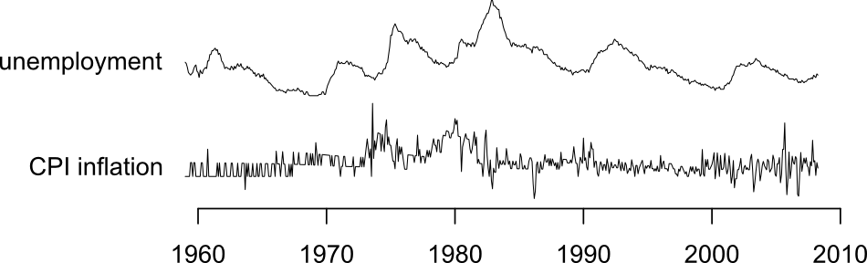
Empirical Results
Is Phillips Curve overfit?
  Bivariate VAR (inflation and unemployment)
    0 — 12 lags
  Keep test sample fixed:
    April, 1998 – April, 2008
  Vary size (and location) of estimation window
    Subset of January, 1959 – March, 1998
    Plot RMSE as a function of R.

Slide 33
Empirical Results
Is Phillips Curve overfit?
  Bivariate VAR (inflation and unemployment)
    0 — 12 lags
  Keep test sample fixed:
    April, 1998 – April, 2008
  Vary size (and location) of estimation window
    Subset of January, 1959 – March, 1998
    Plot RMSE as a function of R.

Slide 34
Empirical Results
Is Phillips Curve overfit?
  Bivariate VAR (inflation and unemployment)
    0 — 12 lags
  Keep test sample fixed:
    April, 1998 – April, 2008
  Vary size (and location) of estimation window
    Subset of January, 1959 – March, 1998
    Plot RMSE as a function of R.

Slide 35
Empirical Results
Is Phillips Curve overfit?
  Bivariate VAR (inflation and unemployment)
    0 — 12 lags
  Keep test sample fixed:
    April, 1998 – April, 2008
  Vary size (and location) of estimation window
    Subset of January, 1959 – March, 1998
    Plot RMSE as a function of R.

Slide 36
Empirical Results
Is Phillips Curve overfit?
  Bivariate VAR (inflation and unemployment)
    0 — 12 lags
  Keep test sample fixed:
    April, 1998 – April, 2008
  Vary size (and location) of estimation window
    Subset of January, 1959 – March, 1998
    Plot RMSE as a function of R.

Slide 37
Empirical Results
Is Phillips Curve overfit?
  Bivariate VAR (inflation and unemployment)
    0 — 12 lags
  Keep test sample fixed:
    April, 1998 – April, 2008
  Vary size (and location) of estimation window
    Subset of January, 1959 – March, 1998
    Plot RMSE as a function of R.

Slide 38
Empirical Results
Is Phillips Curve overfit?
  Bivariate VAR (inflation and unemployment)
    0 — 12 lags
  Keep test sample fixed:
    April, 1998 – April, 2008
  Vary size (and location) of estimation window
    Subset of January, 1959 – March, 1998
    Plot RMSE as a function of R.

Slide 39
Empirical Results
Is Phillips Curve overfit?
  Bivariate VAR (inflation and unemployment)
    0 — 12 lags
  Keep test sample fixed:
    April, 1998 – April, 2008
  Vary size (and location) of estimation window
    Subset of January, 1959 – March, 1998
    Plot RMSE as a function of R.

Slide 40
Empirical Results
Is Phillips Curve overfit?
  Bivariate VAR (inflation and unemployment)
    0 — 12 lags
  Keep test sample fixed:
    April, 1998 – April, 2008
  Vary size (and location) of estimation window
    Subset of January, 1959 – March, 1998
    Plot RMSE as a function of R.

Slide 41
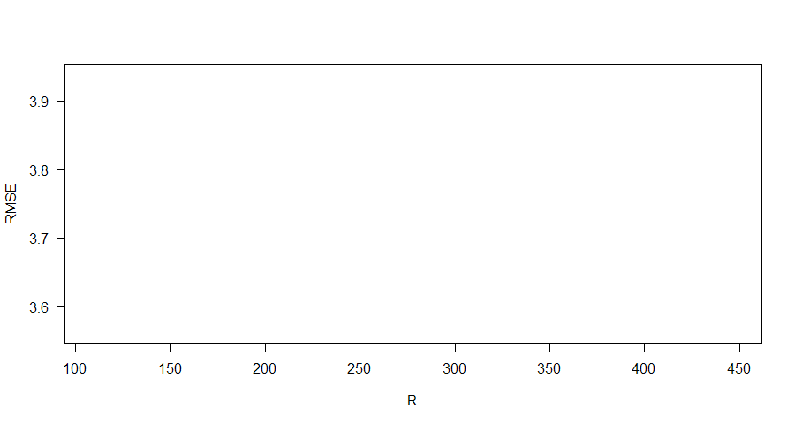
Empirical Results I Hoped to Get
RMSE
Hi
Low

Slide 42
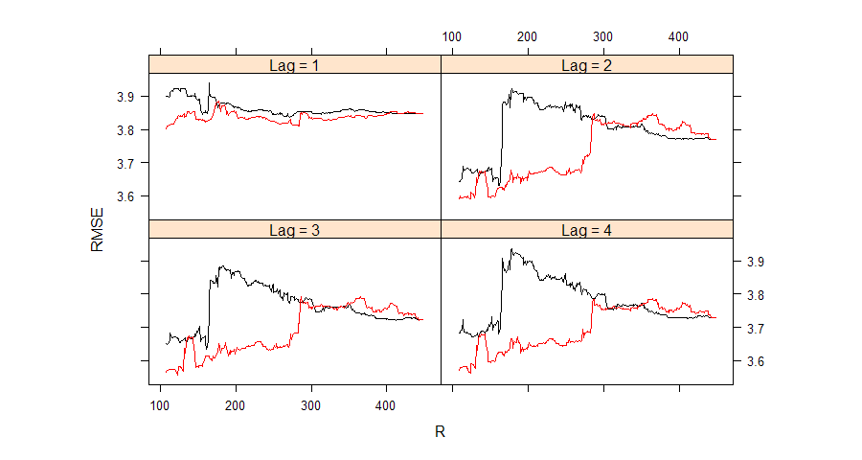
Empirical Results I Actually Got

Slide 43
Empirical Results – Summary
Similar results for more than 4 lags
Nonstationarity seems to matter a lot.
  Even when holding test sample constant
Overfit? Hard to tell (to put it charitably).
Why include these slides?

Slide 44
Future Papers
Improve Power for nested models
  Encompassing Tests (i.e. Clark and West 2006, 2007)
  F-test
Improved statistics for forecasting performance
  Resampling/cross-validation
  Additional conditioning
Other Extensions
  Nonstationarity
  Nonlinearity & M-estimators

Slide 45
Future Papers
Improve Power for nested models
  Encompassing Tests (i.e. Clark and West 2006, 2007)
  F-test
Improved statistics for forecasting performance
  Resampling/cross-validation
  Additional conditioning
Other Extensions
  Nonstationarity
  Nonlinearity & M-estimators

Slide 46
Encompassing Tests
Improvement on Clark and West (2006, 2007)
  Allow estimated benchmark model
  Allow recursive window scheme
Statistic:
If is m.d.s., then
P
¡
1
=
2
X
T
(
)
e
1
s
e
1
s
¡
e
2
s
s
=
R
+
1
¡
1
=
2
X
T
(
)
¡
1
=
2
X
T
(
^
¤
)
(
)
=
P
"
1
s
e
1
s
¡
e
2
s
+
P
x
1
s
µ
1
R
¡
µ
1
e
1
s
¡
e
2
s
s
=
R
+
1
s
=
R
+
1
f
"
1
F
g
s
;
s
P
¡
1
=
2
P
T
(
¡
)
d
N
(
0
V
)
"
e
e
¡
s
=
R
+
1
1
s
1
s
2
s
!
;

Slide 47
Encompassing Tests
Remains to show that
Why might this be true?
¡
1
=
2
X
T
(
^
)
(
)
p
P
x
µ
¡
µ
¤
e
¡
e
¡
0
R
+
1
1
s
1
R
1
1
s
2
s
!
s
=

Slide 48
F-test
Huber (1963) shows that OLS coefficients are not asymptotically normal
  F-test may still be valid
Monte Carlo
Theory

Slide 49
Future Papers
Improve Power for nested models
  Encompassing Tests (i.e. Clark and West 2006, 2007)
  F-test
Improved statistics for forecasting performance
  Resampling/cross-validation
  Additional conditioning
Other Extensions
  Nonstationarity
  Nonlinearity & M-estimators

Slide 50
Resampling
Requiring that P²/T converge to zero is too restrictive
  Quarterly data: 1958—2008 implies T = 200
Choose several random test samples
  Cross Validation
  Bootstrap

Slide 51
Resampling
Requiring that P²/T converge to zero is too restrictive
  Quarterly data: 1958—2008 implies T = 200
Choose several random test samples
  Cross Validation
  Bootstrap

Slide 52
Resampling
Requiring that P²/T converge to zero is too restrictive
  Quarterly data: 1958—2008 implies T = 200
Choose several random test samples
  Cross Validation
  Bootstrap

Slide 53
Resampling
Requiring that P²/T converge to zero is too restrictive
  Quarterly data: 1958—2008 implies T = 200
Choose several random test samples
  Cross Validation
  Bootstrap

Slide 54
Resampling
Construct fixed-window statistic for each test sample
Each statistic is asymptotically N(0,1)
Need to show that the statistics are (asymptotically) uncorrelated.
Proposed statistic:
¹
¹
1
=
2
L
1
i
¡
L
2
i
¢
i
´
P
;
;
i
=
1
n
^
;
:
:
:
;
¾
i
¡
1
=
2
P
n
¢
d
N
(
0
1
)
n
¡
i
=
1
i
!
;

Slide 55
Additional Conditioning
Using to choose between models ignores potentially useful information
  Lags
Ideally, want to know
As a first improvement
for some smaller information set
(
^
)
M
µ
T
(
(
^
)
j
)
E
L
y
T
1
¡
x
T
1
i
µ
T
i
F
T
+
+
(
(
^
)
j
)
E
L
y
T
1
¡
x
T
1
i
µ
T
i
G
T
+
+
G
T
½
F
T

Slide 56
Additional Conditioning
For example,
Weight the test sample (Nadaraya-Watson)
(
(
^
)
j
)
E
L
y
T
1
¡
x
T
1
i
µ
T
i
y
T
+
+
P
¡
1
=
2
X
k
(
¡
)
L
y
s
y
T
s

Slide 57
Future Papers
Improve Power for nested models
  Encompassing Tests (i.e. Clark and West 2006, 2007)
  F-test
Improved statistics for forecasting performance
  Resampling/cross-validation
  Additional conditioning
Other Extensions
  Nonstationarity
  Nonlinearity & M-estimators

Slide 58
Thank you!

