Slide 1
Kelly Criterion and application to the market
Giuseppe Bongiovi

Slide 2
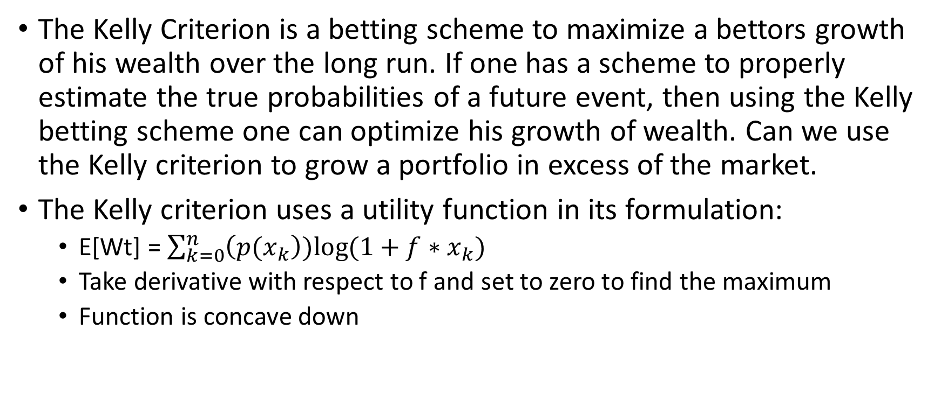
Motivations
The Kelly Criterion is a betting scheme to maximize a bettors growth of his wealth over the long run. If one has a scheme to properly estimate the true probabilities of a future event, then using the Kelly betting scheme one can optimize his growth of wealth. Can we use the Kelly criterion to grow a portfolio in excess of the market.
The Kelly criterion uses a utility function in its formulation:
E[Wt] = $\sum_{k=0}^{n}{\left(p(x_{k}\right))log⁡(1+f∗x_{k})}$
Take derivative with respect to f and set to zero to find the maximum
Function is concave down

Slide 3
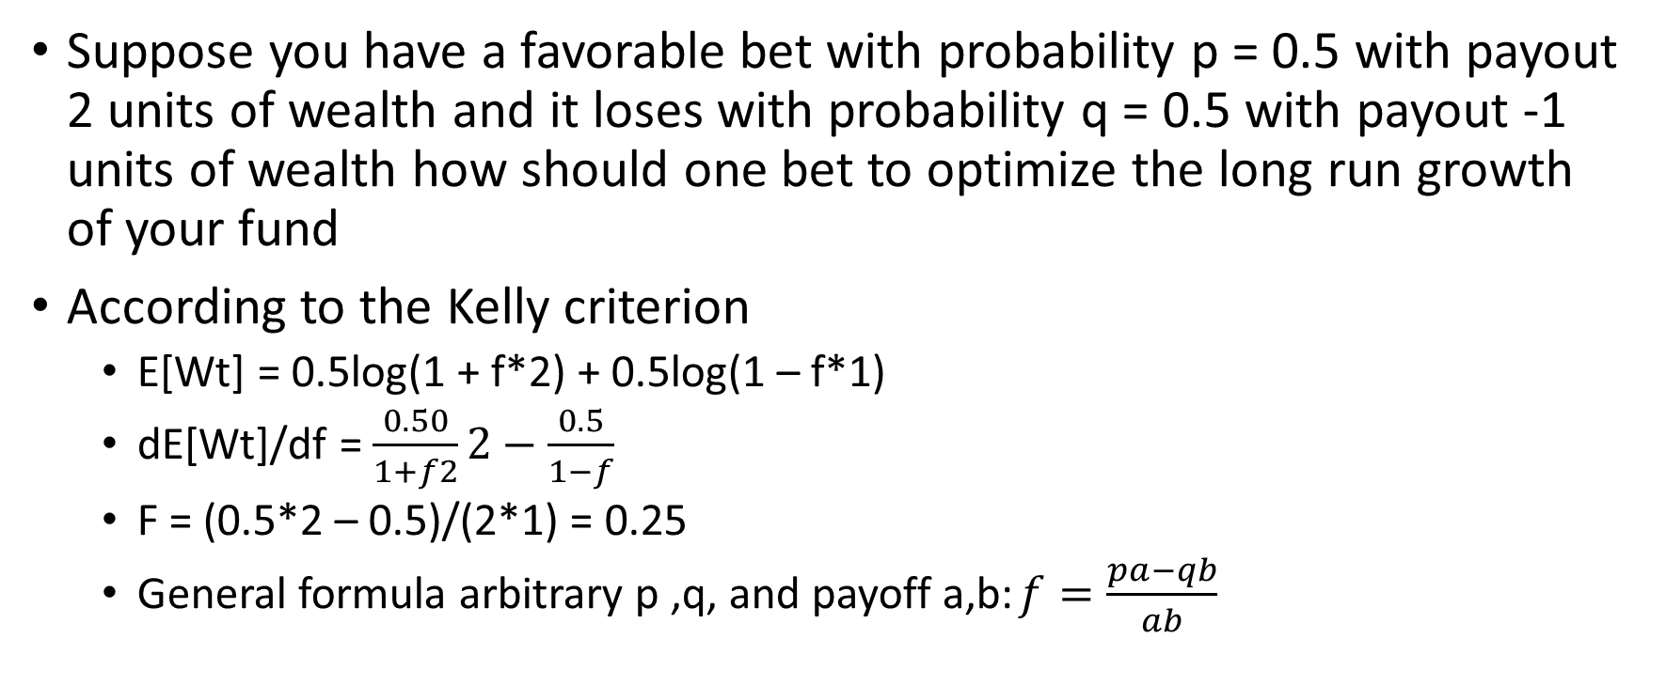
In practice
Suppose you have a favorable bet with probability p = 0.5 with payout 2 units of wealth and it loses with probability q = 0.5 with payout -1 units of wealth how should one bet to optimize the long run growth of your fund
According to the Kelly criterion
E[Wt] = 0.5log(1 + f*2) + 0.5log(1 – f*1)
dE[Wt]/df = $\frac{0.50}{1+f2}2−\frac{0.5}{1−f}$
F = (0.5*2 – 0.5)/(2*1) = 0.25
General formula arbitrary p ,q, and payoff a,b: $f=\frac{pa−qb}{ab}$

Slide 4
Good and bad of Kelly Criterion
Can never go broke, as it uses only a fraction of total wealth every bet. Aka. “Gamblers Ruin” is impossible. Assuming infinitely divisible wealth
Over the long term, guaranteed to have to the largest possible wealth along possible wealth paths
Variation in wealth can be excessive, greater than what a bettor can stomach.
In the short term, requires large bets of initial wealth.

Slide 5
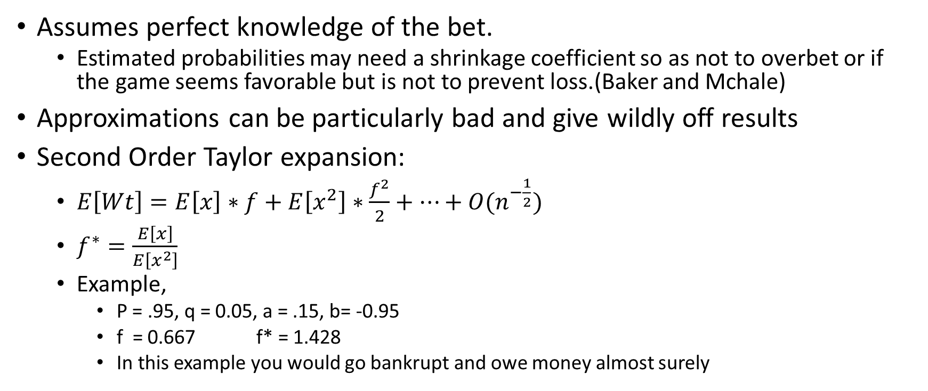
Good, Bad continued
Assumes perfect knowledge of the bet.
Estimated probabilities may need a shrinkage coefficient so as not to overbet or if the game seems favorable but is not to prevent loss.(Baker and Mchale)
Approximations can be particularly bad and give wildly off results
Second Order Taylor expansion:
$E\left[Wt\right]=E\left[x\right]∗f+E\left[x^{2}\right]∗\frac{f^{2}}{2}+…+O(n^{−\frac{1}{2}})$
$f^{∗}=\frac{E\left[x\right]}{E\left[x^{2}\right]}$
Example,
P = .95, q = 0.05, a = .15, b= -0.95
f = 0.667 f* = 1.428
In this example you would go bankrupt and owe money almost surely

Slide 6
Approximations continued
However, Kelly will recommend leverage if the situation is appropriate
P = .95, q = 0.05, a = 0.03, b= 0.0.3
f = 29.99
Total possible wealth lost in 1 bad bet is 0.03*29.99 = 89% of wealth
Second order Kelly:
f = 0.0269/0.0009 = 37
If returns are highly skewed in 1 direction or highly kurtotic, the second order gives a bad approximation.

Slide 7
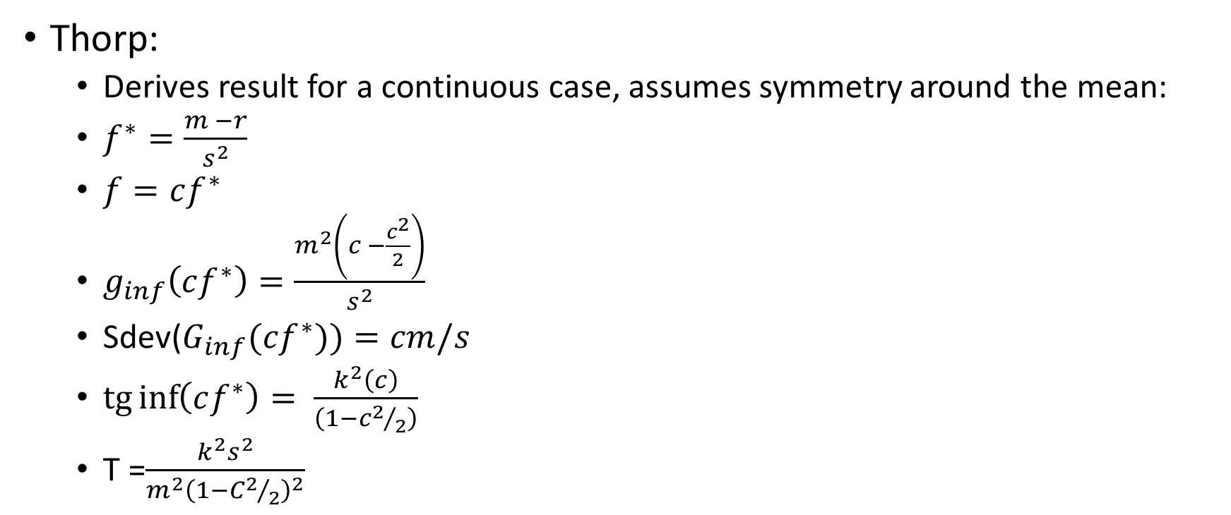
Kelly in the markets
Thorp:
Derives result for a continuous case, assumes symmetry around the mean:
$f^{∗}=\frac{m −r}{s^{2}}$
$f=cf^{∗}$
$g_{inf}\left(cf^{∗}\right)=\frac{m^{2}\left(c −\frac{c^{2}}{2}\right)}{s^{2}}$
Sdev($G_{inf}(cf^{∗}))=cm/s$
$\operatorname{tg}{\inf\left(cf^{∗}\right)= \frac{k^{2}\left(c\right)}{\left(1−c2/2\right)}}$
T =$\frac{k^{2}s^{2}}{m^{2}{\left(1−C2/2\right)}^{2}}$

Slide 8
How can we take advantage of Kelly Leverage
In many situations having high amounts of leverage, makes the bet weak to systematic pressures. i.e margin calls, changing Interest Rates
A margin call can rob a trader of the opportunity for a trade to fully develop, example of LTCM
The options Market allows a trader to leverage his position based on the strike price of the option, however the price of an option can vary based on the strike
Some Kelly Optimizations put a limit on wealth to use in a position(i.e no leverage), is it possible to limit our downside exposure in the risky asset?
Wesselhofft and Hardle presented a framework using put options for a Kelly optimal portfolio
What if we use calls in replacement for long stock?

Slide 9
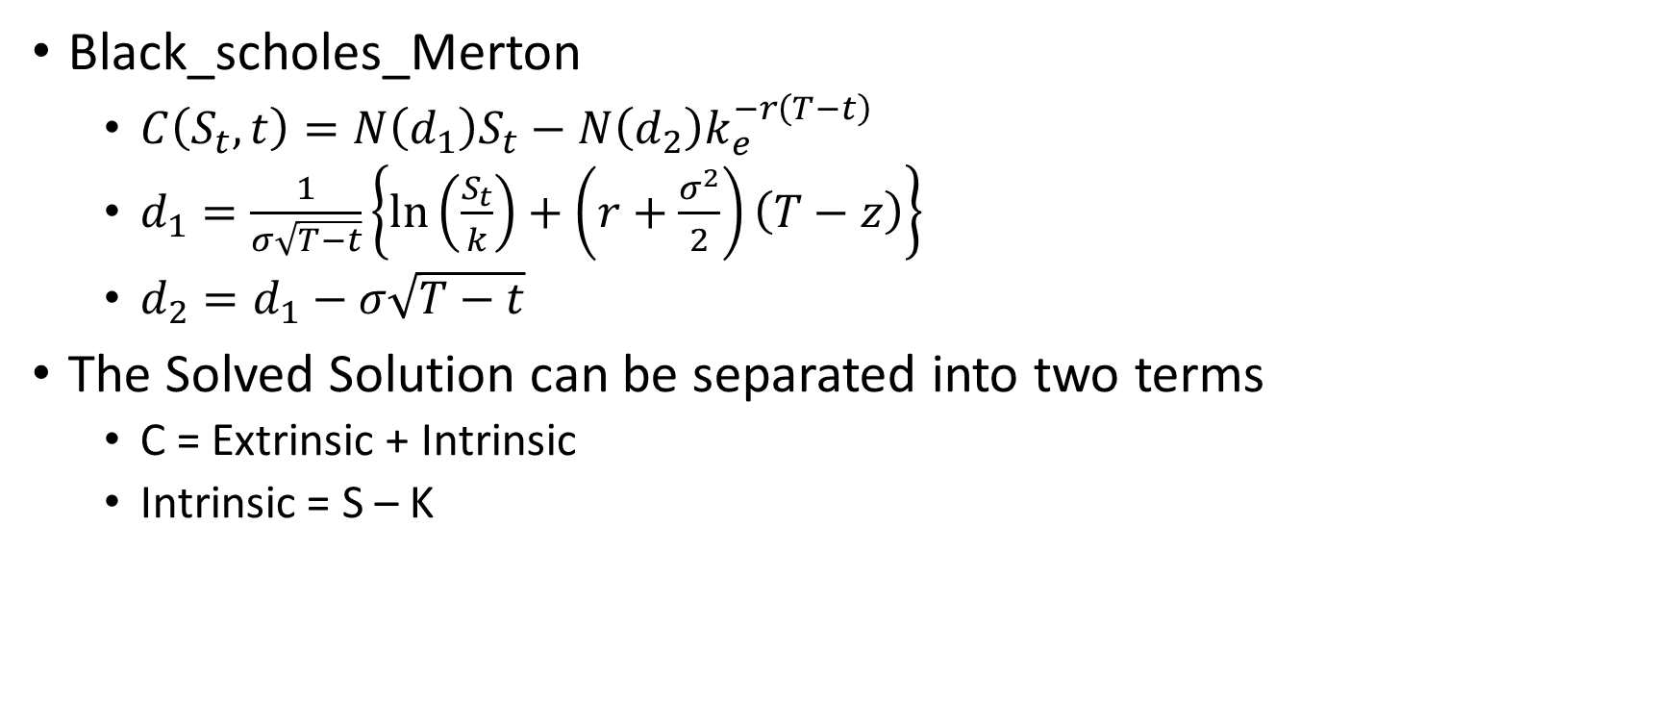
European Options
Black_scholes_Merton
$C\left(S_{t},t\right)=N\left(d_{1}\right)S_{t}−N\left(d_{2}\right)k_{e}^{−r\left(T−t\right)}$
$d_{1}=\frac{1}{σ\sqrt{T−t}}\left\{\ln\left(\frac{S_{t}}{k}\right)+\left(r+\frac{σ^{2}}{2}\right)\left(T−z\right)\right\}$
$d_{2}=d_{1}−σ\sqrt{T−t}$
The Solved Solution can be separated into two terms
C = Extrinsic + Intrinsic
Intrinsic = S – K

Slide 10
European Options Continued
We can think of Extrinsic value as the Interest Paid upfront for dollars borrowed K(strike price)
Effective Interest = Extrinsic/K
The Leverage offered by the option can be written
Leverage = S/(S-K)
We can then write an algorithm to match the Kelly leverage for each option with the actual leverage of the option to optimally get leverage. Stop when Kelly_option_F* = Leverage + error
In our calculations we assume risk_free = 0.017 and dividend = 0

Slide 11
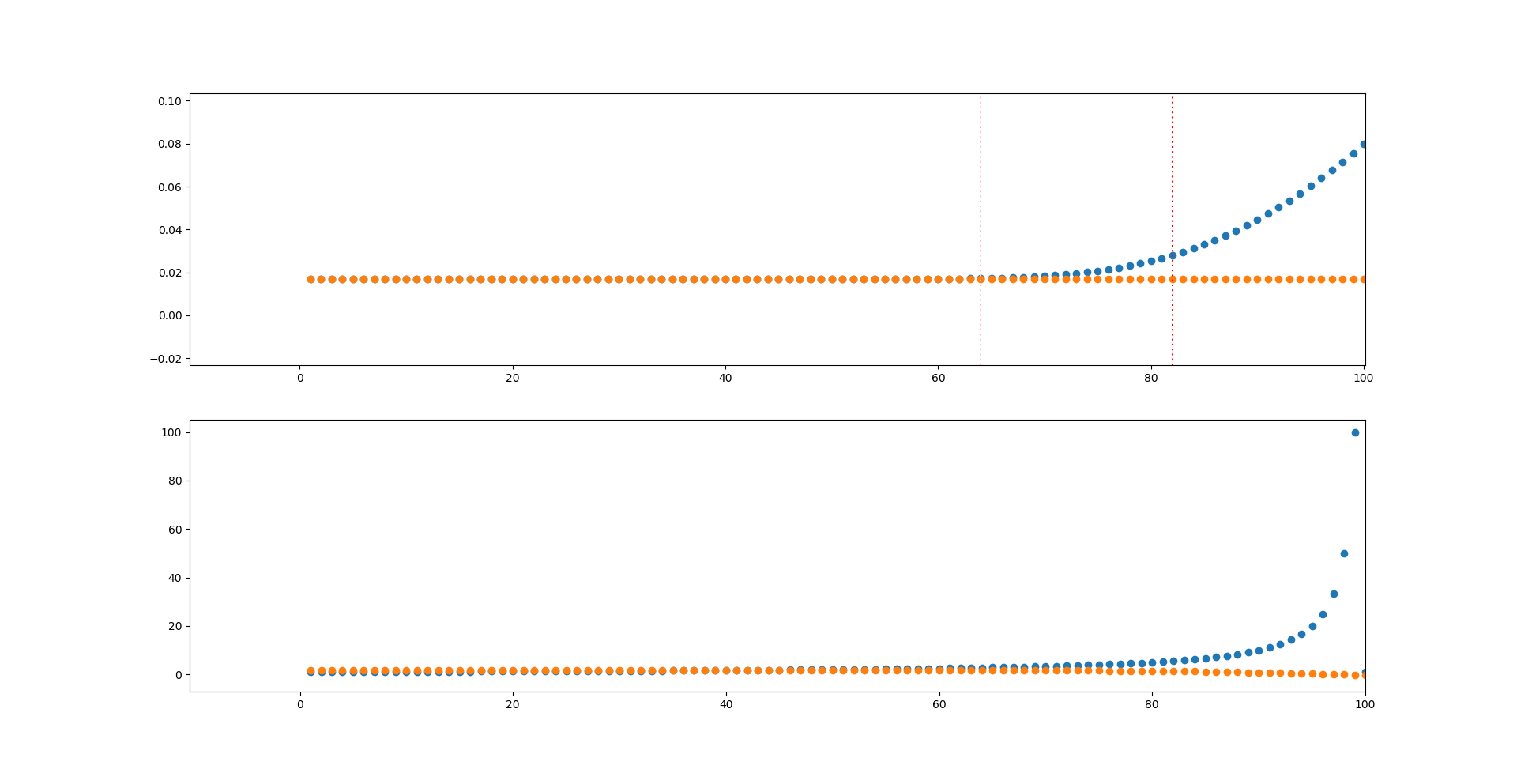
Top: Effective Interest Rate/actual, bottom: Kelly/leverage

Slide 12
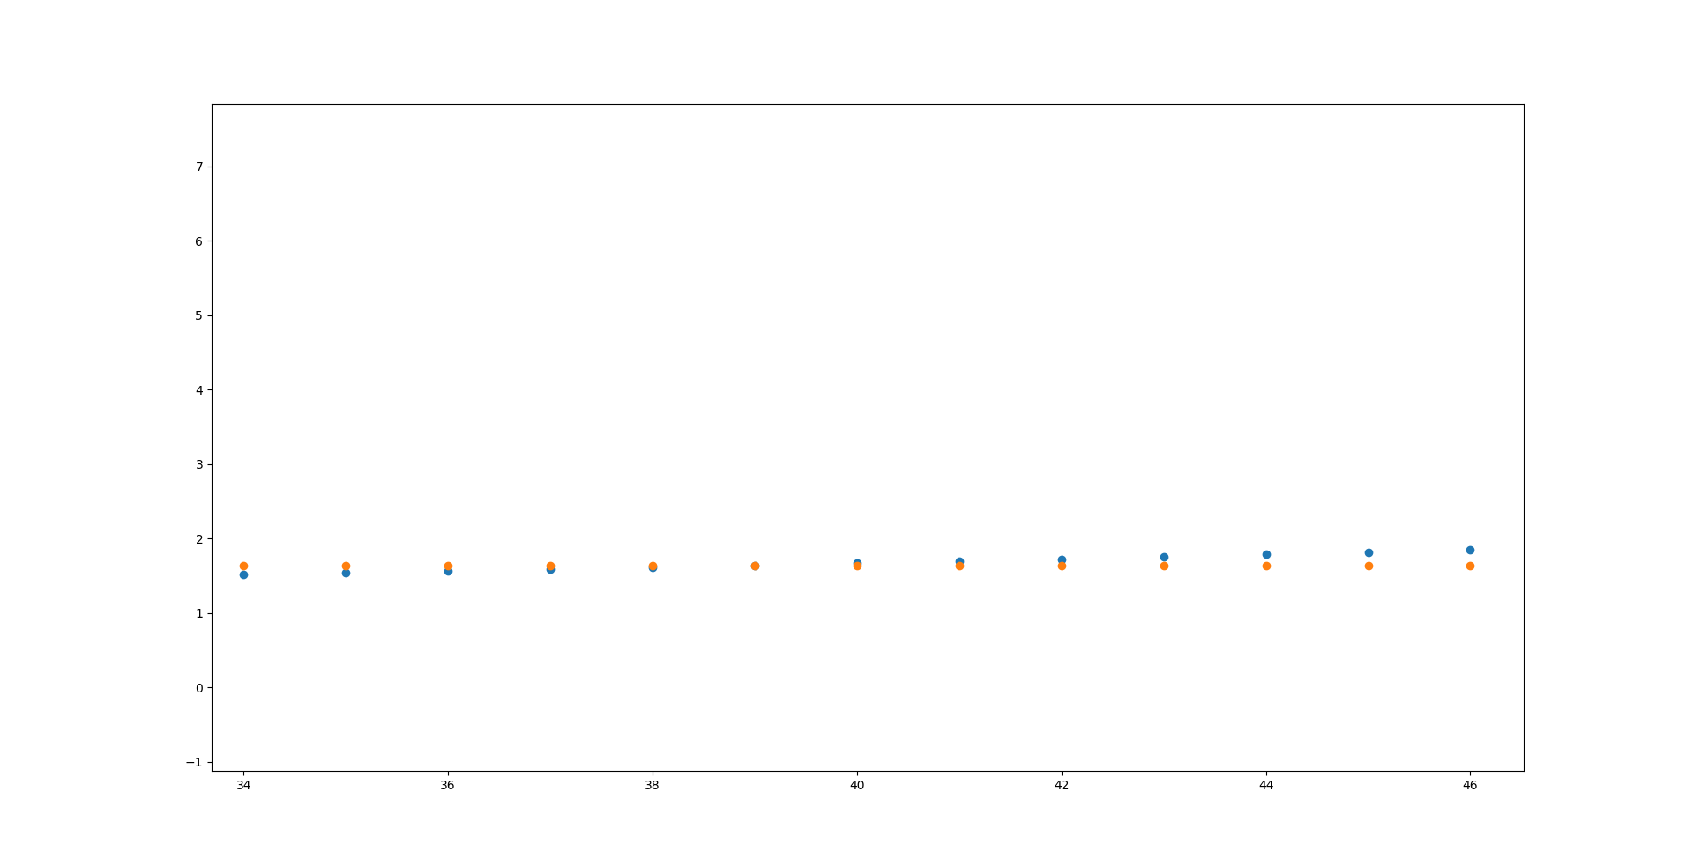
Kelly/Leverage Close up

Slide 13
Using the Kelly Leverage, Historical
Data :
Sp500 daily returns 1989 to 2019 source = yahoo
AAA bond yield source = St. Louis Federal Reserve
1 year Interest Rates source = St. Louis Federal Reserve
Calculated raw first two moments to determine Kelly leverage, no regressions, 3 years of data used for moment calculation
Benchmark:
Sp500
AAA yield Bond Fund
Tested Portfolios [Long only] :
Kelly Portfolio with options
(full Kelly and half Kelly)
Net profit only Kelly Traded Portfolio
(full Kelly and half Kelly)
Can only trade profits from previous year, everything else must be in AAA bond portfolio
VAR portfolio using options and AAA bonds
(leverage up to full portfolio value with options at VAR limit, invest rest in AAA bonds)

Slide 14
Important Caveats and Assumptions
Option prices were calculated using black Scholes using historical 1 year Interest rates, Historical Volatility estimates for previous 3 years of data
Assumed 0% default rate for AAA bonds and bond fund was well diversified to match historical yield
Assumed SP500 paid no dividend
Option prices with no dividend priced in are more expensive, we hope this would reflect more accurately a scenario with real options

Slide 15
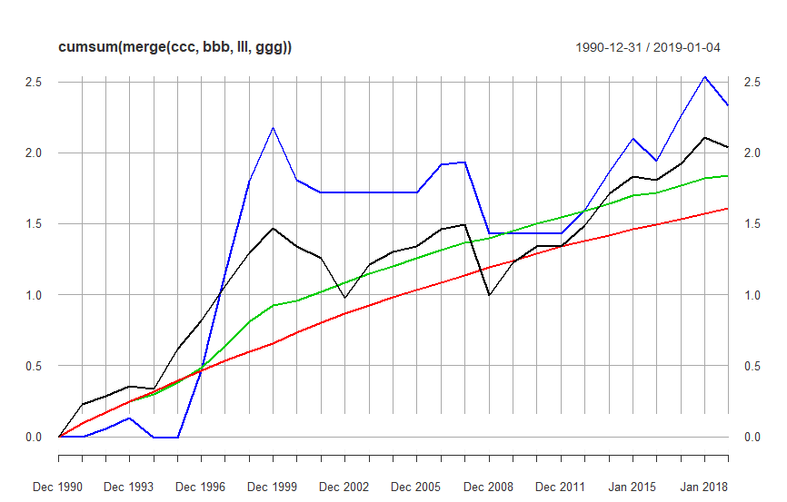
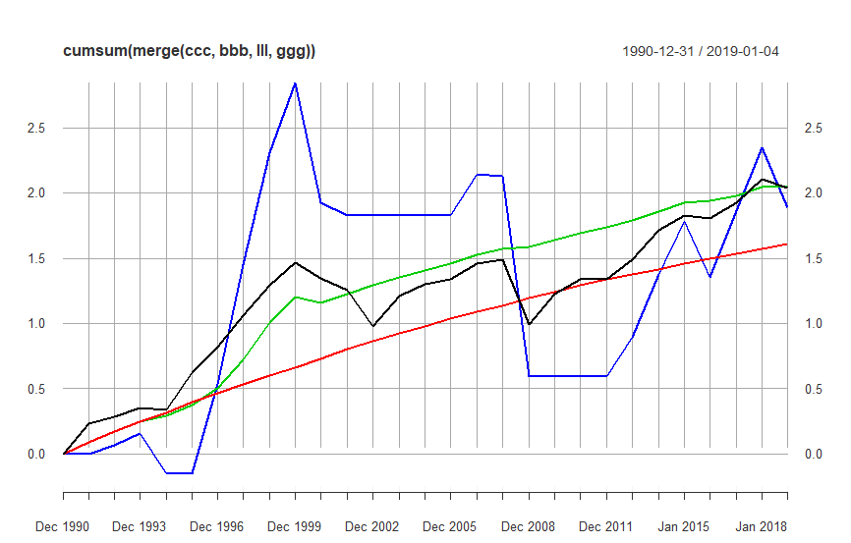
Half Kelly Full Kelly
Blue: Kelly Portfolio with options, Black: SP500, green: Profit only Kelly portfolio, Red: AAA bond portfolio

Slide 16
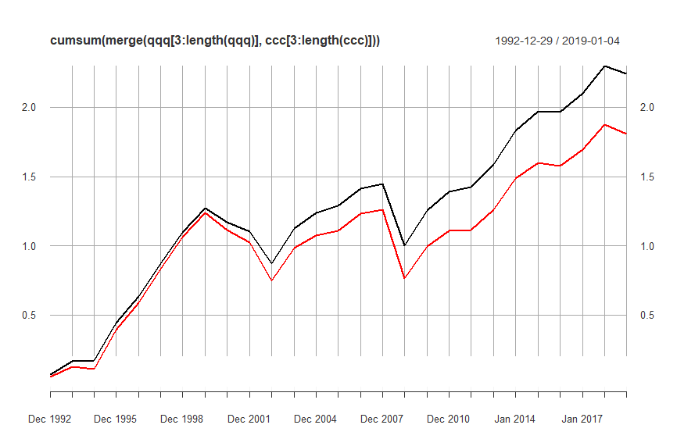
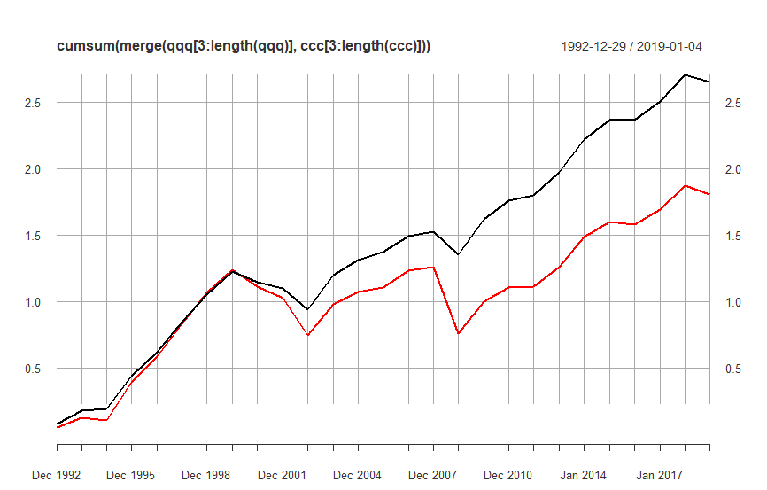
40% VAR 20% VAR
Black: VAR portfolio with AAA bonds Red: SP500

Slide 17
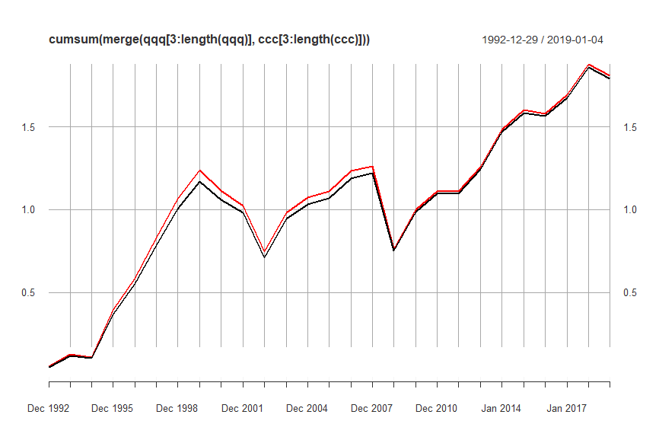
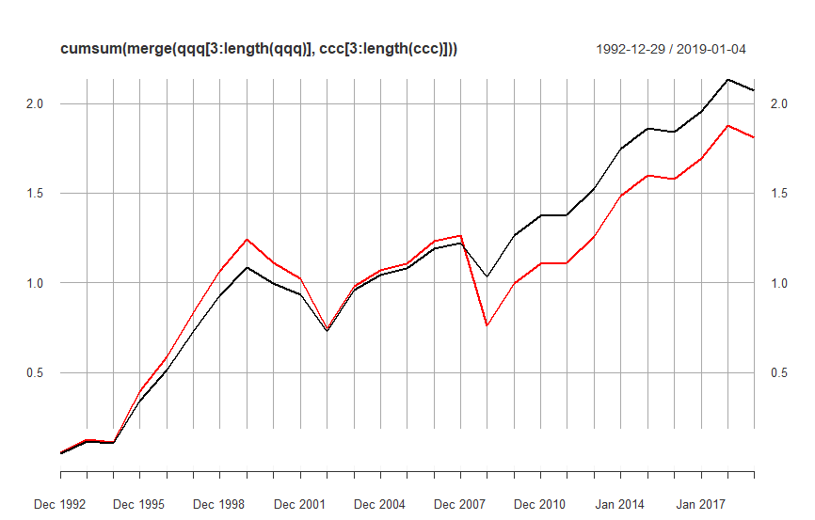
40% VAR 20% VAR
Black: VAR portfolio with 1 year T-Bills Red:SP500

Slide 18
Conclusions
Kelly Leverage can be very volatile, it is heavily reliant on your estimates, bad estimate can ruin a Kelly gambler
Full Kelly performs very poorly, compared to half Kelly
Full Kelly lost at one point 80% of the portfolio during the Financial Crises
This is consistent with errors about the assumption of normality in the derivation
Highly skewed and kurtotic distributions are bad for the Kelly approximation that thorp derives
Half Kelly performs more consistent which is in agreement with the literature
Ziemba, thorp
Full Kelly can allow a conservative portfolio trading only profits to “catch up” if a string of good bets happen. However all the “catchup” mostly happens during the bull market of the 90s
Any “conservative” Kelly portfolio trading only profits outperforms the AAA only bond fund

Slide 19
Conclusions Cont.
VAR option portfolio investing in T-bills slowly diverges away from the benchmark but mostly keeps pace. VAR 20 outperforms due to VAR constraint
This is consistent with how options are priced.
Low interest rates and the VAR cap during 2008 allowed it to keep pace with the market during the last 10 years
We can see that the market completely outpaces the t-bill portfolio during years with high interest rates
VAR option portfolio investing AAA bonds outperforms as the yield is higher than the Effective Interest rate of the option.
The VAR portfolio allows a cap on losses, it outperforms the most during financial crises and bubble pops as 2001 and 2008 were the years with most outperformance.
VAR20 keeps pace with the Half-Kelly Option Portfolio by the end of the 30 year data period, however half-Kelly and full Kelly outperform by design when the market rewards you.

