Slide 1


Impact of ChatGPT on Students’ Learning
211042 Noman Masood Khan 211064 Hamza Haroon

Slide 2

Introduction and Objectives
1
Purpose Statement
2
Target Population
The purpose of this survey is to assess ChatGPT's influence on students' learning experiences, academic outcomes, and ethical considerations..
The survey targeted undergraduate students in Islamabad, primarily from cybersecurity, software, and AI-related disciplines.
3
Objectives
Evaluate how ChatGPT assists in academic tasks such as assignments and exam preparation.
Identify its strengths, limitations, and impact on critical thinking.
Examine ethical concerns surrounding AI-assisted learning.

Slide 3

Executive Summary
Key Findings
80% students use ChatGPT daily
60% reported improved grades, skills or understanding
80% believe using ChatGPT aligns with academic ethics
Findings Explanation
Usage Patterns: 80% use ChatGPT daily, primarily for assignments, concept clarification, and exam preparation.
Impact on Academic Performance: 60% reported improved grades or understanding, while 10% noted dependency concerns.
Ethical Concerns: While 80% believe using ChatGPT aligns with academic ethics, 50% raised concerns about reduced critical thinking skills due to over-reliance.

Slide 4
Methodology
Distribution Process
1
Platform
2
Sharing
3
Follow-Ups
Google Forms.
Distributed via email and social media to ensure wide reach.
Two reminders sent to participants to maximize response rates.
Response Rate
42
90%
Total Responses
Response Rate
Data Validation
1
Sampling Error
2
Significance Levels
95% confidence level ensures statistical reliability.
All results were validated

Slide 5
Survey Questions
Demographics
Question 1: What is your age?
Question 2: What is your current education level?
Purpose: To understand the age distribution of participants.
Purpose: To identify educational stages (high school vs. undergraduate).
Findings:
Findings:
Majority (85%) were between 18–22 years.
80% were undergraduates; 20% were high school students.
Youngest: 16 years; Oldest: 24 years.
Question 3: What is your field of study?
Purpose: To determine the diversity of academic disciplines.
Findings:
Predominantly cybersecurity (75%).
Others included medical, AI, and military arts.
ChatGPT Usage Patterns
Question 4: Which city are you currently studying in?
Question 5: How often do you use ChatGPT for educational purposes?
Purpose: To ensure the geographical relevance of data.
Findings:
Purpose: To gauge usage frequency.
Most respondents were based in Islamabad,
with a few from Rawalpindi.
Findings:
80% used ChatGPT daily, 10% occasionally, and 10% weekly/rarely.
Question 6: For what purpose(s) do you use ChatGPT?
Purpose: To identify the primary academic use cases of ChatGPT.
Findings:
85% used it for completing assignments.
80% for clarifying concepts, 70% for preparing for exams, and 50% for generating project ideas.

Slide 6
Survey Questions
Helpfulness and Academic Impact
Question 7: On a scale of 1 to 5, how helpful do you find ChatGPT for educational purposes?
Purpose: To measure overall satisfaction.
Findings:
85% rated it as "4" or "5," indicating high satisfaction.
Question 8: How long have you been using ChatGPT?
Purpose: To assess familiarity with the tool.
Findings:
70% had used it for over six months.
Question 9: Has ChatGPT helped you better understand academic concepts?
Purpose: To evaluate its effectiveness in improving understanding.
Findings:
78% agreed ChatGPT improved their understanding of academic material.
Question 10: How has ChatGPT affected your academic performance?
Purpose: To determine its direct impact on grades.
Findings:
60% reported positive impacts (improved grades/understanding).
10% noted negative effects, citing dependency concerns.

Slide 7
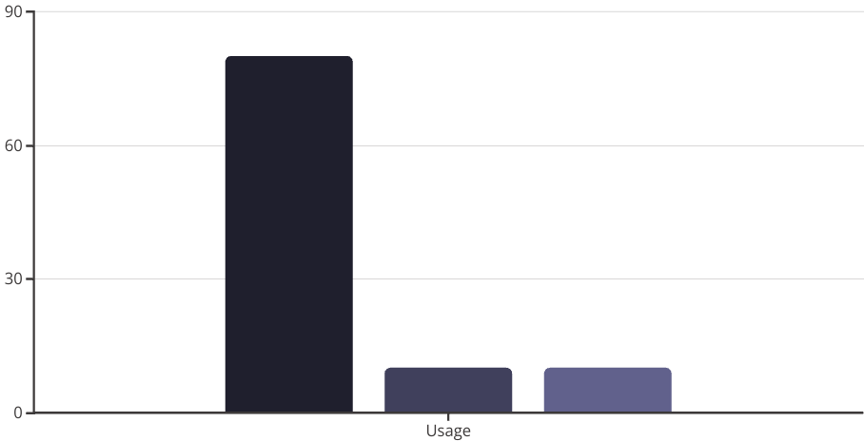
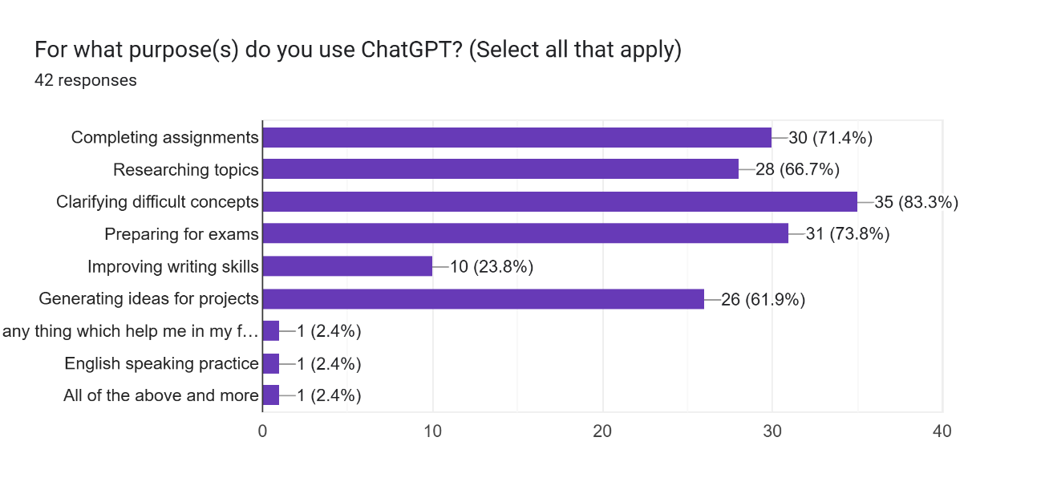
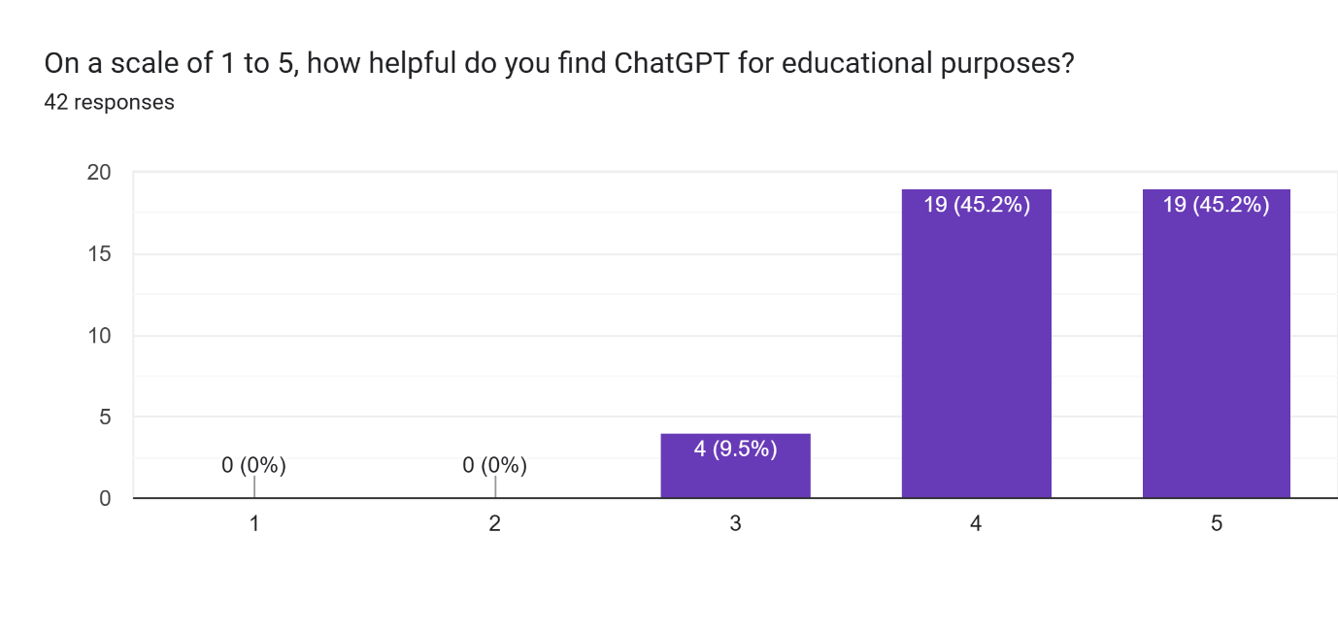
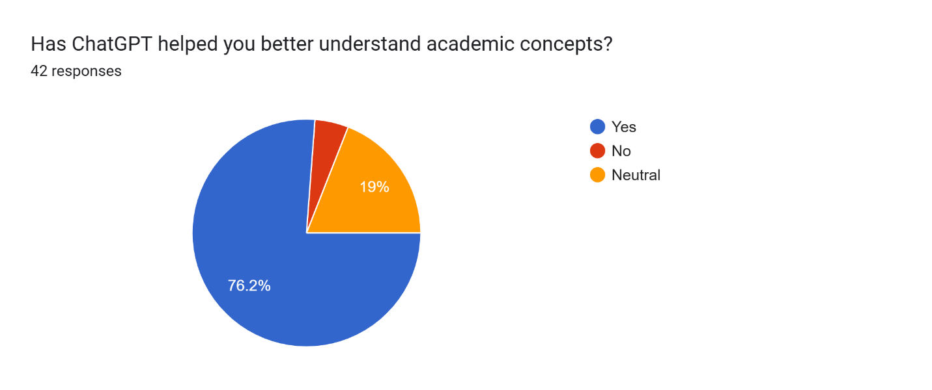
Survey Questions and Results Analysis
Daily
Occasionally
Weekly/Rarely

Slide 8
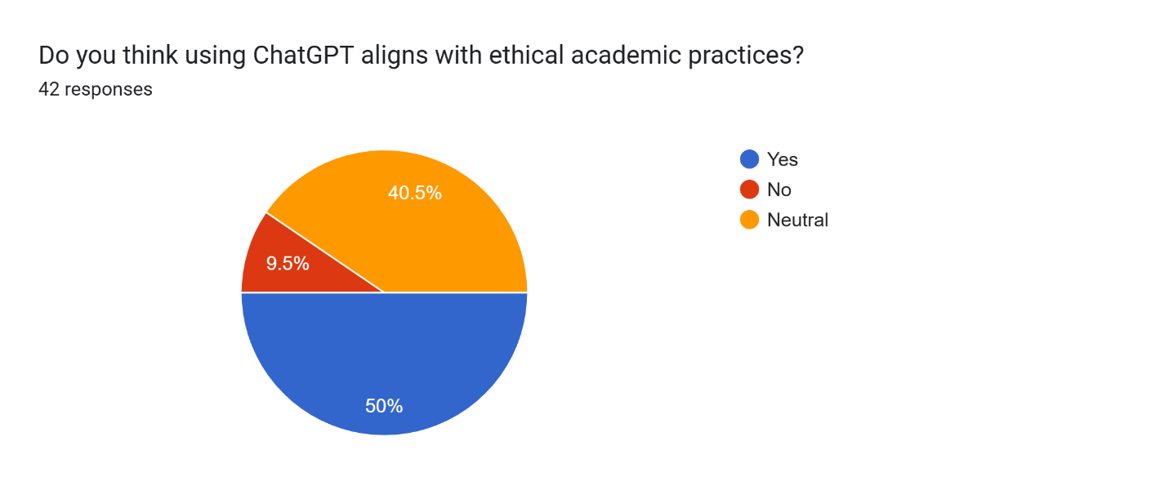
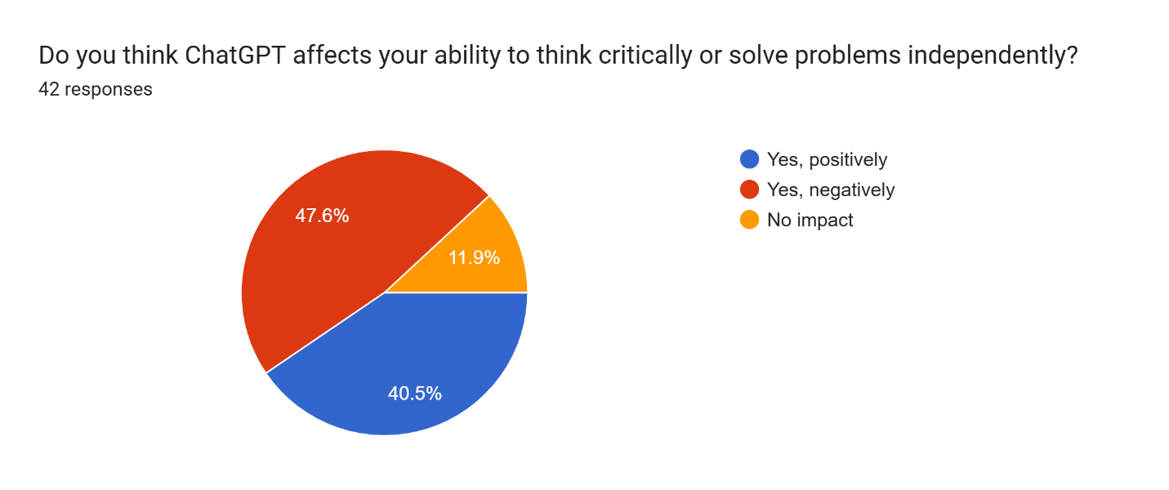
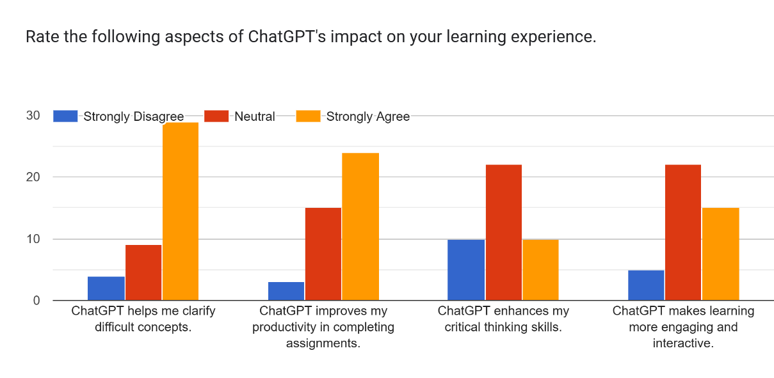
Survey Questions and Results Analysis

Slide 9
Ethics and Critical Thinking
Ethical Alignment
Critical Thinking Concerns
80% believed using ChatGPT aligns with ethical practices.
50% expressed concerns about reduced creativity and problem-solving. 40% reported no significant changes.
Biggest Limitations
Most Liked Features
Accuracy issues in technical subjects like math. Over-reliance reduces critical thinking. Difficulty with nuanced prompts.
Fast and efficient. Simplifies complex topics. Acts as a personal tutor.

Slide 10
ChatGPT Limitations
1. Accuracy Issues
2. Over-Reliance and Reduced Critical Thinking
3. Lack of Personalization
Several respondents mentioned that ChatGPT occasionally provides false resources or incorrect answers, especially in technical domains like mathematics.
A recurring concern was that students might become overly dependent on ChatGPT, affecting their ability to think critically and solve problems independently.
ChatGPT's inability to dynamically adapt to individual learning styles or provide hands-on interaction was cited as a limitation.
Example: "ChatGPT only gives knowledge, not learning."
Example: "The biggest limitation is its inability to provide hands-on learning or experiential knowledge."
Example: "Sometimes, ChatGPT gets the concepts wrong, especially in mathematics."
Example: "It limits critical thinking and makes us dependent on it for everything."
Example: "It relies on pre-existing data and lacks personalization compared to a human tutor."
Example: "One of the main issues of ChatGPT is its factual accuracy."

Slide 11



Ethical Considerations in AI-Assisted Learning
Academic Integrity
1
80% believe ChatGPT aligns with ethics
2
Critical Thinking
50% concerned about reduced creativity
3
Transparency and Accuracy
Need for verification of AI outputs
Key Ethical Issues
The survey identified several ethical concerns related to ChatGPT usage in academic settings:
1
Academic Integrity
2
Critical Thinking and Problem-Solving
3
Transparency and Accuracy
While 80% of respondents believe ChatGPT aligns with ethical practices, concerns about misuse, such as plagiarism or over-reliance, remain significant.
Half of the respondents expressed concerns about reduced creativity and independent problem-solving. Over-reliance on AI-generated solutions could hinder intellectual growth.
Some participants highlighted issues with inaccurate or incomplete information, emphasizing the need for students to verify outputs.

Slide 12



Implications for Stakeholders
For Students
For Educators
For Developers
Use ChatGPT to supplement traditional learning resources, not replace them.
Integrate ChatGPT into the curriculum to teach responsible AI usage.
Focus on enhancing ChatGPT's features to foster active learning, such as interactive tutorials or guided questioning.
Actively engage with the content provided by ChatGPT, verifying its accuracy and exploring alternative explanations.
Design assignments that encourage critical evaluation of AI-generated outputs rather than simple acceptance.
Improve accuracy in niche or technical areas like mathematics and coding to increase reliability.
The findings have significant implications for students, educators, and developers. Each group has specific considerations and actions to take in order to maximize the benefits of ChatGPT while addressing potential challenges.

Slide 13
Limitations and Future Research
Limitations of the Survey
While the survey provided valuable results, certain limitations should be noted:
Geographic Scope: The majority of participants were from Islamabad and Rawalpindi, limiting the applicability of findings to a broader population.
Sample Diversity: Cybersecurity students constituted 75% of the sample, which may overemphasize their specific academic needs and perspectives.
Response Bias: Participants may have provided socially desirable answers, particularly regarding ethical concerns or dependency.
Limited Qualitative Depth: While open-ended responses offered results, in-depth interviews could have captured more nuanced opinions.
Addressing Limitations in Future Research:
Expand the survey to include participants from diverse geographic and academic backgrounds.
Complement quantitative data with qualitative interviews to gain richer results.

Slide 14




Conclusion Thoughts
Transformative Tool
ChatGPT has emerged as a transformative tool in education, providing students with fast, efficient, and accessible assistance.
Potential Concerns
However, its over-reliance can lead to reduced critical thinking and potential ethical concerns.
Balanced Approach
Moving forward, a balanced approach is necessary:
Students should use ChatGPT as a supplement, not a replacement, for traditional learning methods.
Educators and developers must collaborate to foster responsible usage and design features that encourage active engagement and independent thinking.
Future of Education
By addressing its limitations and leveraging its strengths, ChatGPT can play a pivotal role in shaping the future of education.

