Slide 1
Chapter 1 - The Machine Learning Landscape
Slides taken from Eng Teong Cheah | Microsoft MVP for AI Based on Textbook

Slide 2
What is Machine Learning?

Slide 3
“
[Machine Learning is the] field of study that gives computers the ability to learn without being explicitly programmed.
—Arthur Samuel, 1959

Slide 4
“
A computer program is said to learn from experience E, with respect to some task T and some performance measure P, if its performance on T, as measured by P, improves with experience E.
—Tom Mitchell, 1997

Slide 5
Why Use Machine Learning?

Slide 6
Why Use Machine Learning?
Consider how you would write a spam filter using traditional programming techniques?
First you would look, at what spam typically looks like. You might notice that some words or phrases(such as “4U”, “credit card”, “free”, and “amazing”) tend to come up a lot in the subject. Perhaps you would also notice a few other
patterns in the sender’s name, the email’s body, and so on.
You would write a detection algorithm for each of the patterns that you noticed, and your program would flag emails as spam if a number of these patterns are detected.
You would test your program, and repeat steps 1 and 2 it is good enough.

Slide 7
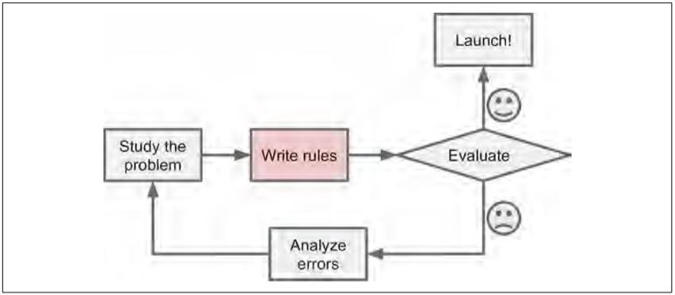
Why Use Machine Learning?
The traditional approach

Slide 8
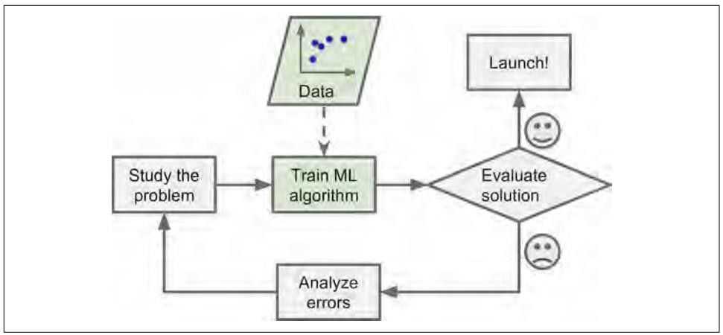
Why Use Machine Learning?
Machine Learning approach

Slide 9
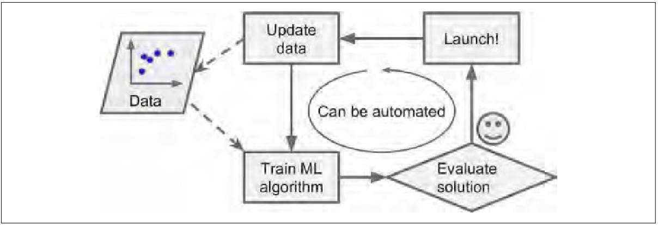
Why Use Machine Learning?
Automatically adapting to change

Slide 10
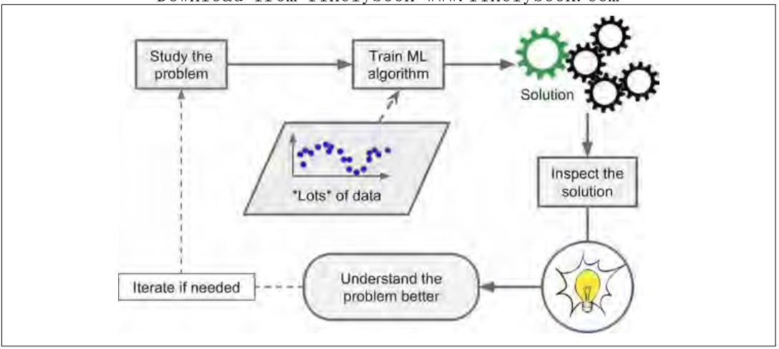
Why Use Machine Learning?
Machine Learning can help humans learn

Slide 11
Why Use Machine Learning?
To summarize, Machine Learning is great for:
Problems for which existing solutions require a lot of hand-tuning or long lists of rules: one Machine Learning algorithm can often simplify code and perform better.
Complex problems for which there is no good solution at all using a traditional approach: the best Machine Learning techniques can find a solution.
Fluctuating environments: a Machine Learning system can adapt to new data.
Getting insights about complex problems and large amounts of data.

Slide 12
Types of Machine Learning Systems

Slide 13
Types of Machine Learning Systems
There are so many different types of Machine Learning systems that it is useful to classify them in broad categories based on:
Whether or not they are trained with human supervision (supervised, unsupervised, semisupervised, and Reinforcement Learning)
Whether or not they can learn incrementally on the fly (online versus batch learning)
Whether they work by simply comparing new data points to known data points, or instead detect patterns in the training data and build a predictive mode, much like scientists do (instance-based versus model-based learning)

Slide 14
Supervised/Unsupervised Learning
Machine Learning systems can be classified according to the amount and type of supervision they get during training. There are 4 major categories: supervised learning, unsupervised learning, semisupervised learning, and Reinforcement Learning.

Slide 15
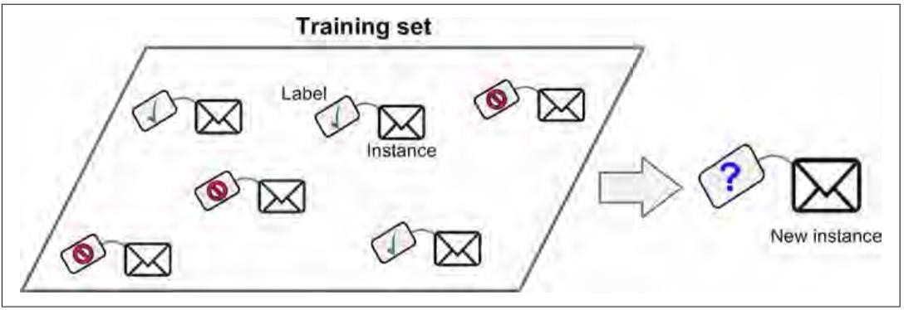
Supervised Learning
A labeled training set for supervised learning (e.g., spam classification)

Slide 16
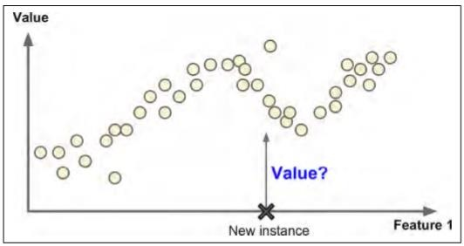
Supervised Learning
Regression

Slide 17
Supervised Learning
Here are some of the most important supervised learning algorithms:
k-Nearest Neighbors
Linear Regression
Logistic Regression
Support Vector Machines (SVMs)
Decision Trees and Random Forests
Neural networks

Slide 18
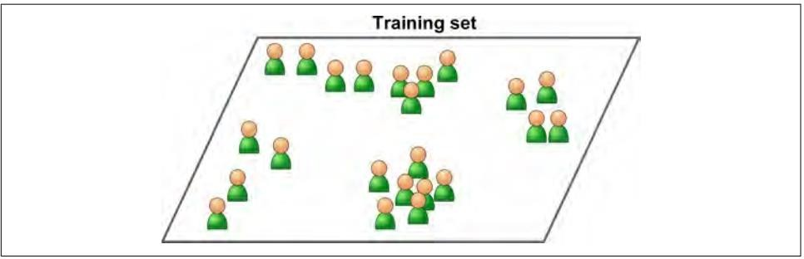
Unsupervised Learning
An unlabeled training set for unsupervised learning.

Slide 19
Unsupervised Learning
Here are some of the most important unsupervised learning algorithms:
Clustering
k-Means
Hierarchical Cluster Analysis (HCA)
Expectation Maximization
Visualization and dimensionality reduction
Principal Component Analysis (PCA)
Kernel PCA
Locally-Linear Embedding (LLE)
t-distributed Stochastic Neighbor Embedding (t-SNE)
Association rule learning
Apriori
Eclat

Slide 20
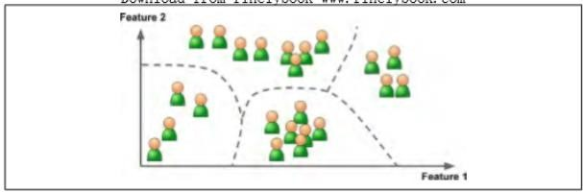
Unsupervised Learning
Clustering

Slide 21
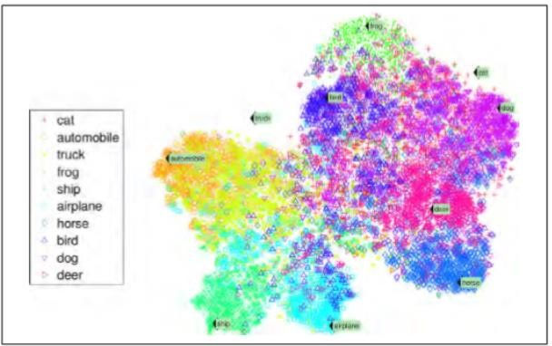
Unsupervised Learning
Example of a t-SNE visualization highlighting semantic clusters

Slide 22
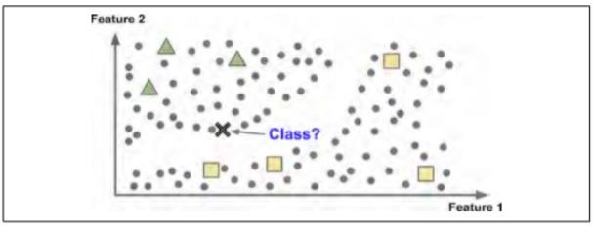
Semisupervised Learning
Some algorithms can deal with partially labeled training data, usually a lot of unlabeled data and a little bit of labeled data. This is called semisupervised learning.

Slide 23

https://scikit-learn.org/stable/tutorial/machine_learning_map/index.html

Slide 24
Difference between Supervised and Unsupervised Learning
Supervised Learning | Unsupervised Learning
Input data is labelled | Input data is unlabeled
Uses training dataset | Uses just input dataset
Used for prediction | Used for analysis
Classification and regression | Clustering, density estimation and dimensionality reduction
Source: https://kindsonthegenius.com/blog/what-is-the-difference-between-supervised-and-unsupervised-learning/

Slide 25
Reinforcement Learning
Reinforcement Learning is a very different beast. The learning system, called an agent in this context, can observe the environment, select and perform actions, and get rewards in return (or penalties in the form if negative rewards). It must then learn by itself what is the best strategy, called a policy, to get the most reward over time. A policy defines what action the agent should choose when it is in a given solution.

Slide 26
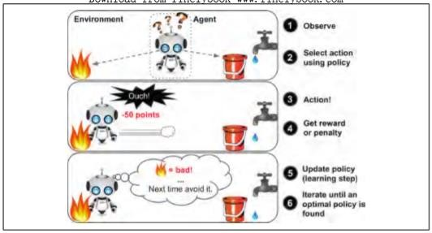
Reinforcement Learning

Slide 27
Batch Learning
In batch learning, the system is incapable of learning incrementally: it must be trained using all the available data. This will generally take a lot of time and computing resources, so it is typically done offline. First the system is trained, and then it is launched into production and runs without learning anymore; it just applies what it has learned. This is called offline learning.

Slide 28
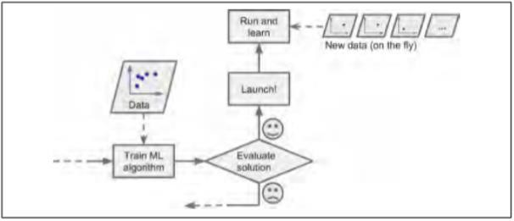
Online Learning
In online learning, you train the system incrementally by feeding it data instances sequentially, either individually or by small groups called mini- batches. Each learning step is fast and cheap, so the system can learn about new data on the fly, as it arrives.

Slide 29
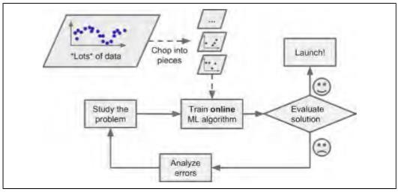
Online Learning
Using online learning to handle huge datasets

Slide 30
Instance-Based Versus Model-Based Learning
One more way to categorize Machine Learning systems is by how they generalize. Most Machine Learning tasks are about making predictions. This means that given a number of training examples, the system needs to be able to generalize to examples it has never seen before. Having a good performance measure on the training data is good, but insufficient; the true goal is to perform well on new instances.
There are two main approaches to generalization: instance-based learning and model-based learning.

Slide 31
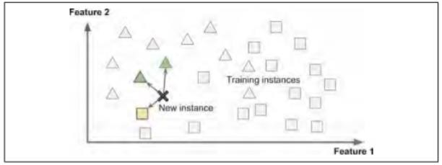
Instance-Based Learning
Instance-based learning

Slide 32
Main Challenges of Machine Learning

Slide 33
Main Challenges of Machine Learning
In short, since your main task is to select a learning algorithm and train it on some data, the two things that can go wrong are “bad algorithm” and “bad data”. Let’s start with examples of bad data.
Insufficient Quantity of Training Data
Nonrepresentative Training Data
Poor-Quality Data
Irrelevant Features
Overfitting the Training Data
Underfitting the Training Data
Stepping Back
Testing and Validating

Slide 34
Thanks!
Does anyone have any questions?

Slide 35
Resources
Hands-On Machine Learning with Scikit-Learn and TensorFlow
Slides taken from the link

