Slide 1
Deep Learning

Slide 2
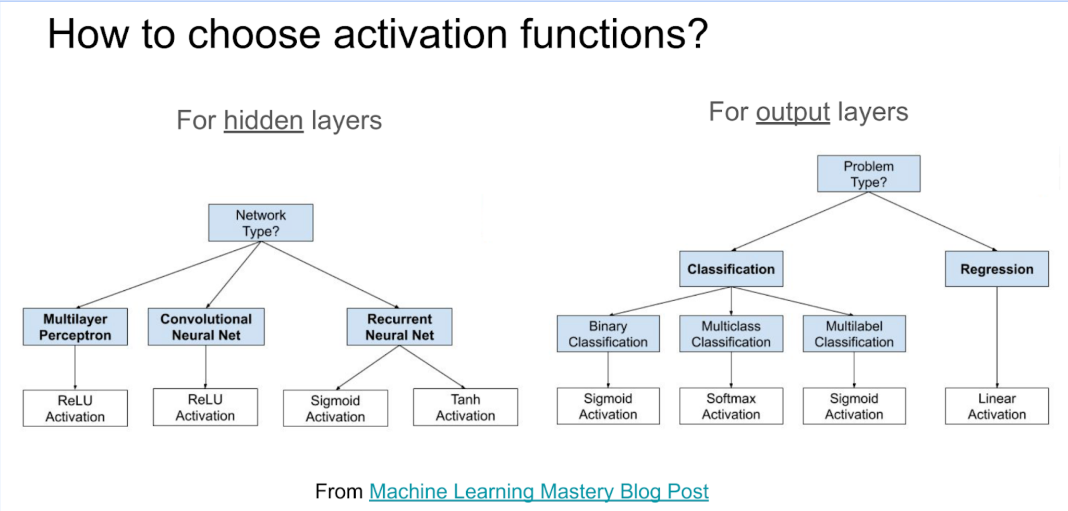
https://machinelearningmastery.com/choose-an-activation-function-for-deep-learning/

Slide 3
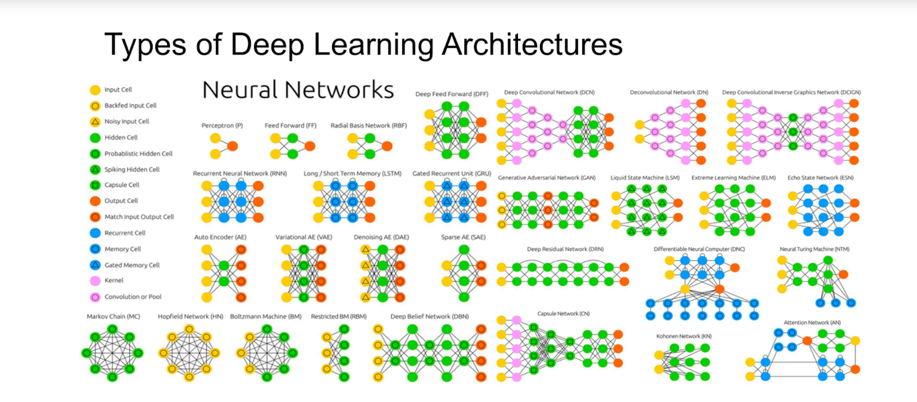
https://towardsai.net/p/machine-learning/main-types-of-neural-networks-and-its-applications-tutorial-734480d7ec8e

Slide 4
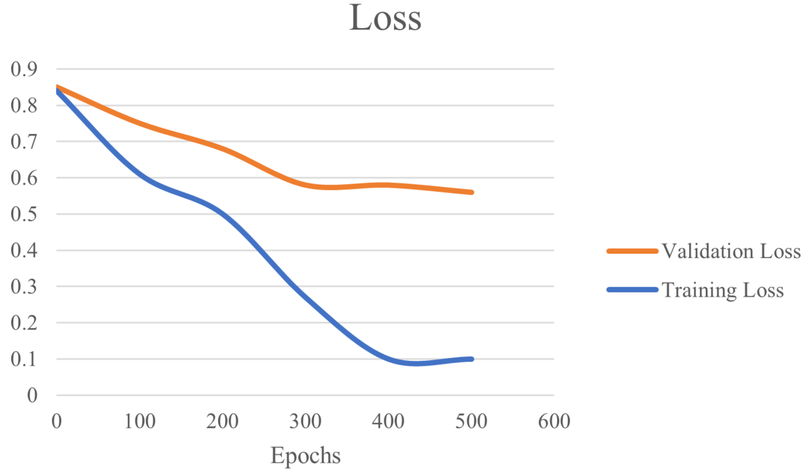
Training and Validation Loss in Deep Learning- Underfitting
https://www.baeldung.com/cs/training-validation-loss-deep-learning

Slide 5
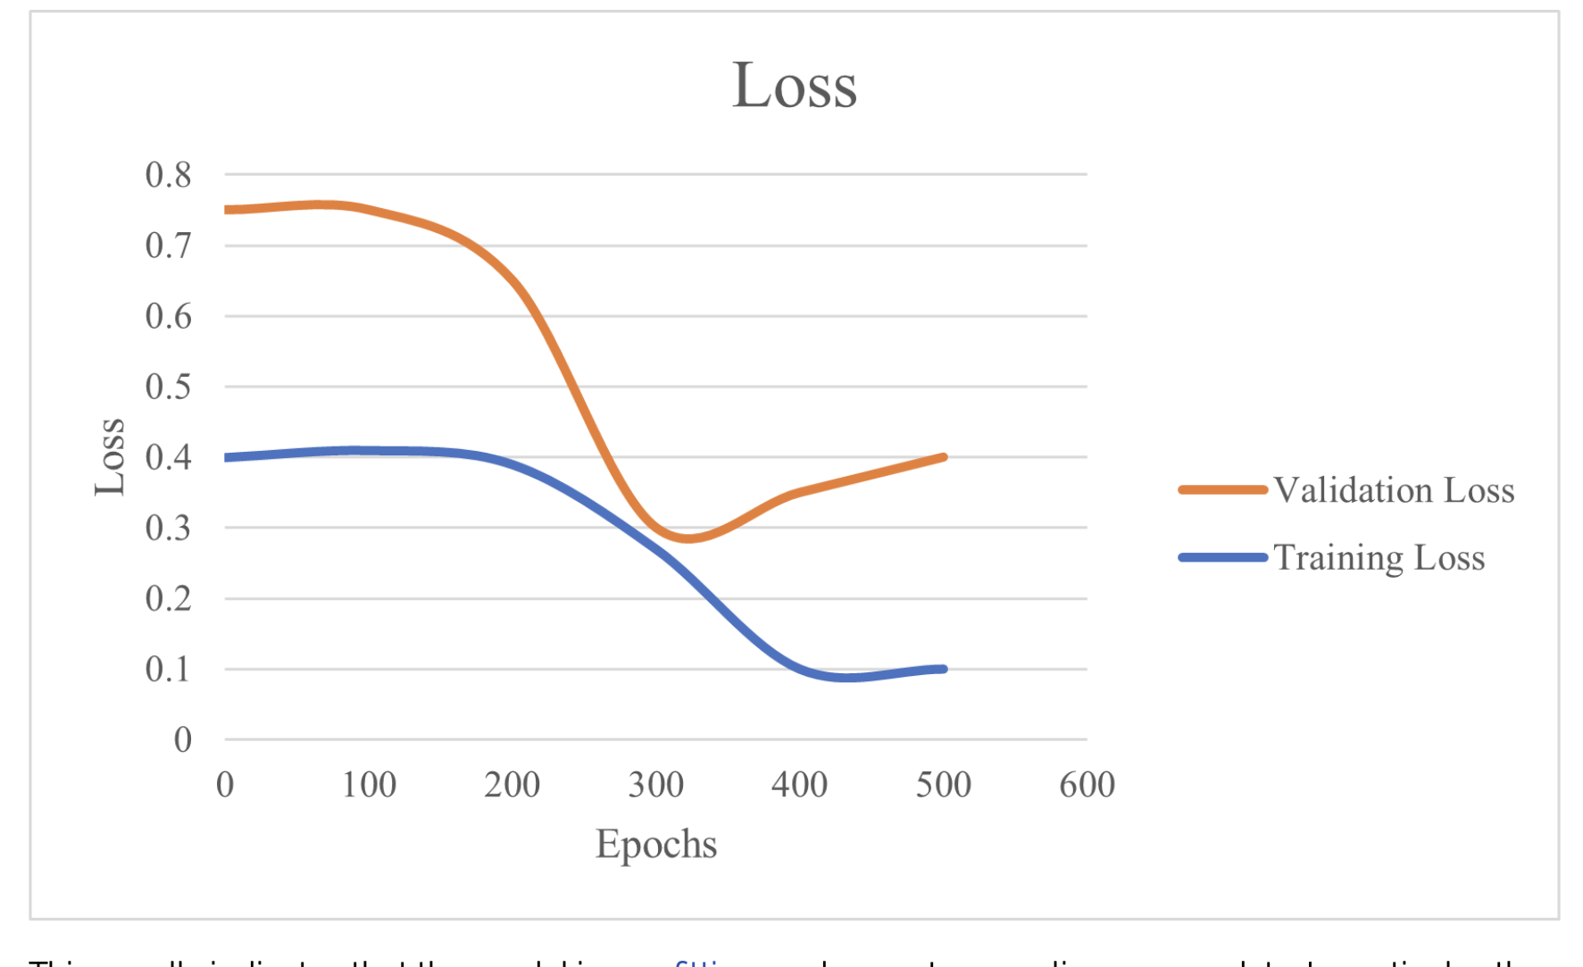
Overfitting

Slide 6
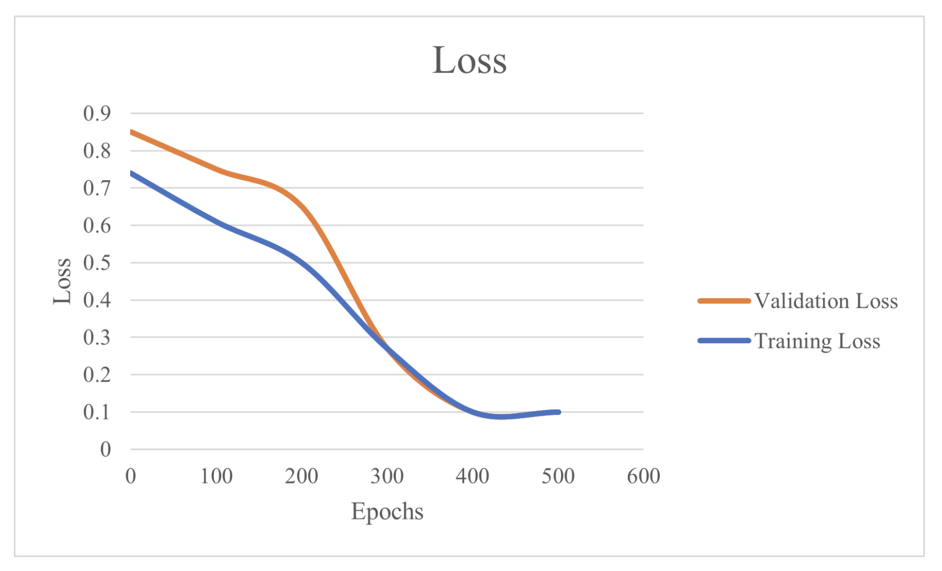
Good fit

