Slide 1
CCD Quality Tooling
Comparing climate projections

Slide 2
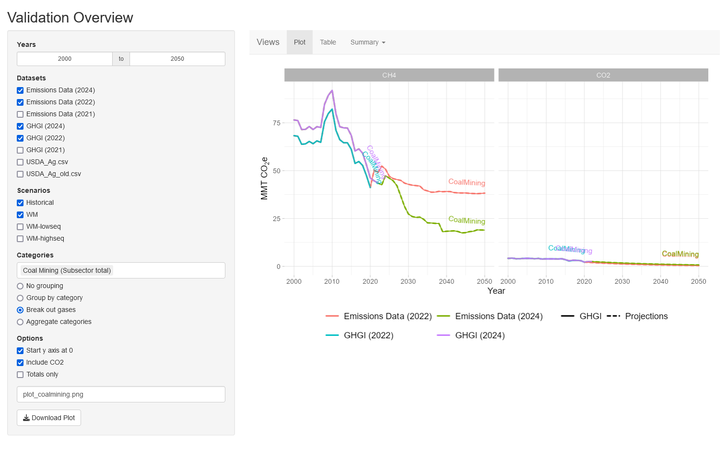
R Shiny app
Useful for:
USA and global (RGER) projections
Flexible visual comparison of multiple datasets
Does not include:
Activity drivers
Automatic analysis or comparison
Methods for handling missing or low-quality data

Slide 3
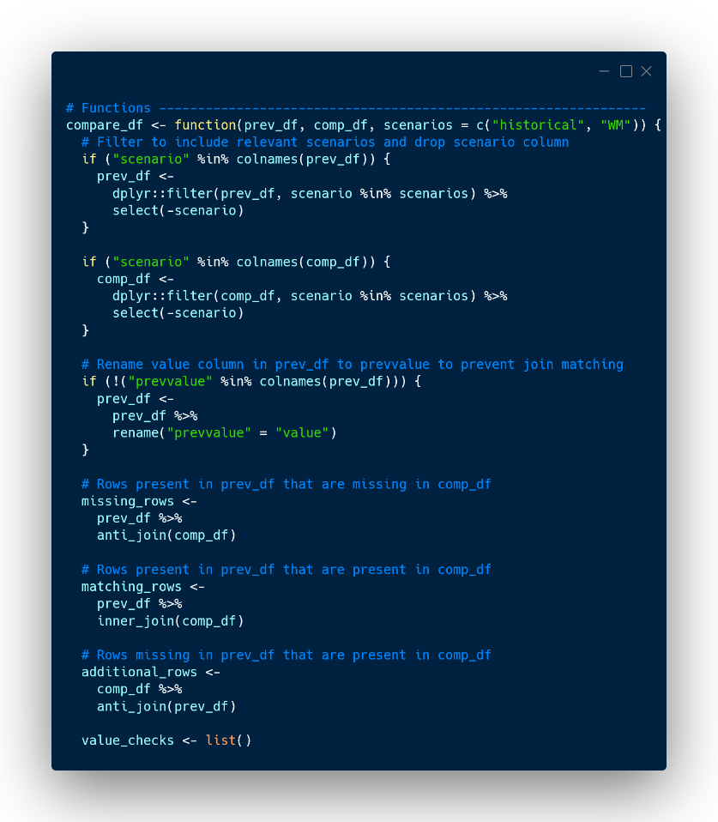
Automatic release comparison
auto_compare.R
Value analysis
Difference analysis
Anomaly detection (spikes, gaps, etc.)
Absolute and percent difference comparisons
Missing/additional years, scenarios, gases, etc.
Trend analysis and lagged differentials

Slide 4
Automatic release comparison
Category | Notes | Maximum studentized deviation | Percent deviation | Deviation | Year | Spike | GHGI alignment | GHGI trend match | GHGI shift | Historical alignment | Projected alignment | Projected trend match | Projected shift
AbandonedMines |  | 1.05 | 12.25% | 0.68 | 2023 |  | No | Yes | Up | Yes | No | Yes | Up
AbandonedWells |  | 1.80 | 25.95% | 1.92 | 2050 |  | No | Partial | Up | Yes | No | Yes | Up
Adipic | Jagged GHGI; constant projected | 0.95 | 18.68% | 1.36 | 2023
Agriculture | Very close alignment | 2.59 | 9.57% | 57.91 | 2050 |  | No | Yes | Up | Yes | No | No (positive slope) | None
AgSoils |  | 2.00 | 6.30% | 19.47 | 2050 |  | No | Partial | Down | Yes | No | No (positive slope) | Down
AgSoilsDirect | No GHGI | 2.04 | 7.18% | -22.65 | 2050 |  |  |  |  |  | No | Yes | Down
AgSoilsDirectCropland | No GHGI | 1.94 | 9.31% | -20.35 | 2050 |  |  |  |  |  | No | Yes | Down
AgSoilsDirectCroplandDOS | No GHGI | 0.69 | 14.71% | -0.50 | 2023 |  |  |  |  |  | No | Yes | Down
AgSoilsDirectCroplandMineralization | No GHGI | 0.71 | 7.19% | 4.70 | 2023 |  |  |  |  |  | No | Yes | Up
AgSoilsDirectCroplandMinSoils | No GHGI | 1.94 | 9.23% | -19.85 | 2050 |  |  |  |  |  | No | Yes | Down
AgSoilsDirectCroplandOrgAmend | No GHGI | 1.62 | 11.67% | 1.79 | 2050 |  |  |  |  |  | No | Yes | Up
Cropland | No GHGI; spike follows last reported measurement | 1.02 | 5.93% | -2.02 | 2023 | 2024 |  |  |  |  | No | Yes | Down
CroplandConvert | No GHGI; spike follows last reported measurement | 1.04 | 6.25% | 3.36 | 2050 | 2023 |  |  |  |  | No | Yes | Up
CroplandConvertCarbonStock | No GHGI; spike follows last reported measurement | 1.04 | 6.25% | 3.36 | 2050 | 2023 |  |  |  |  | No | Yes | Up
CroplandRemain | No GHGI; negative values; spike follows last reported measurement | 0.50 | 47.48% | -8.38 | 2050 | 2024 |  |  |  |  | No | No (negative slope) | Down
Automatic | Manual | Automatic | Automatic | Automatic | Automatic | Automatic | Manual | Manual | Manual | Manual | Manual | Manual | Manual
Notes:
Output from the compare_df() function in telescope, highlighting what we get automatically and what we need to check manually. As the number of categories increases, this process gets more and more complex.

Slide 5
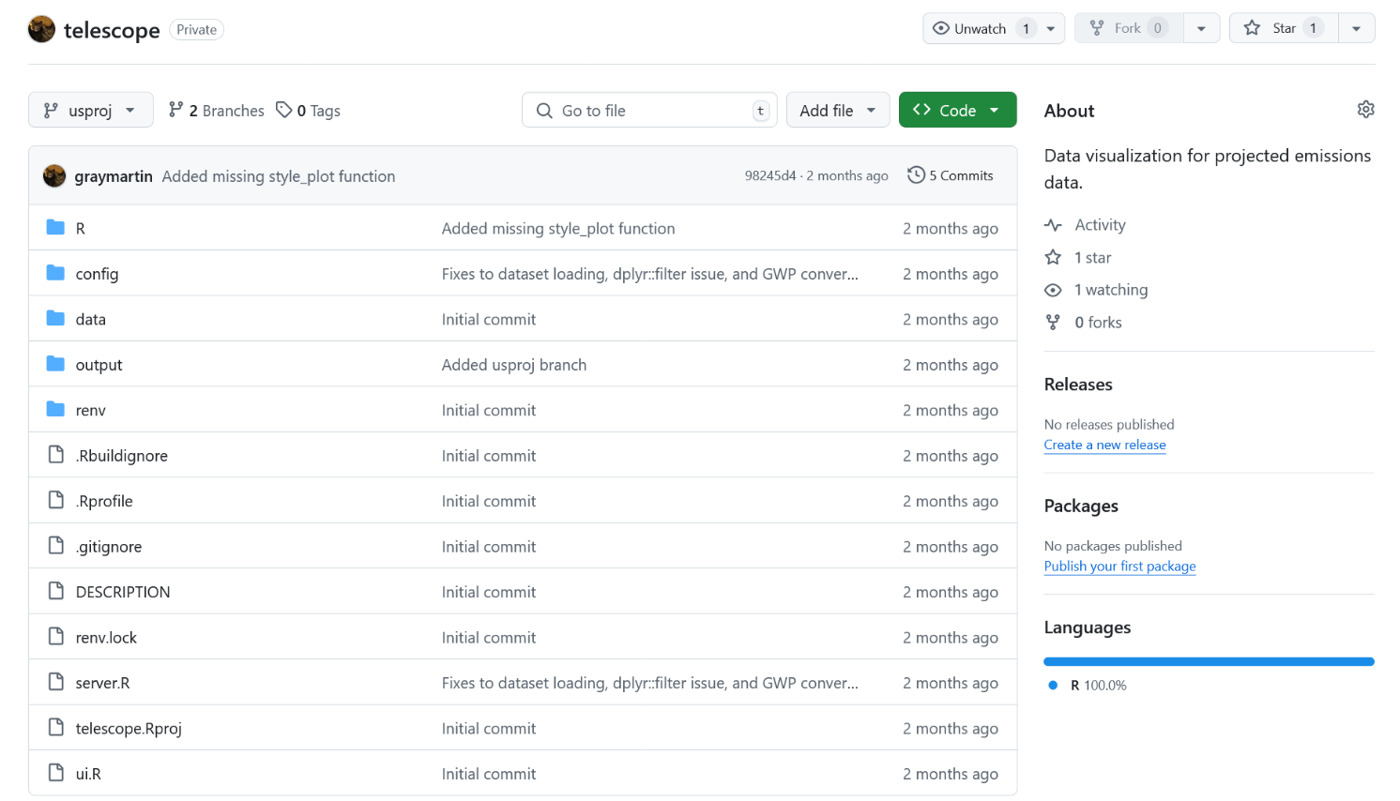
GitHub repository
Branches for USA and global projections
Personal repository currently shared with Tyler and Stanley

Slide 6
Needs and next steps
Describing projections
Comparing projections with historical data
Comparing previous and current releases
Assessing impact of inputs on outputs

Slide 7
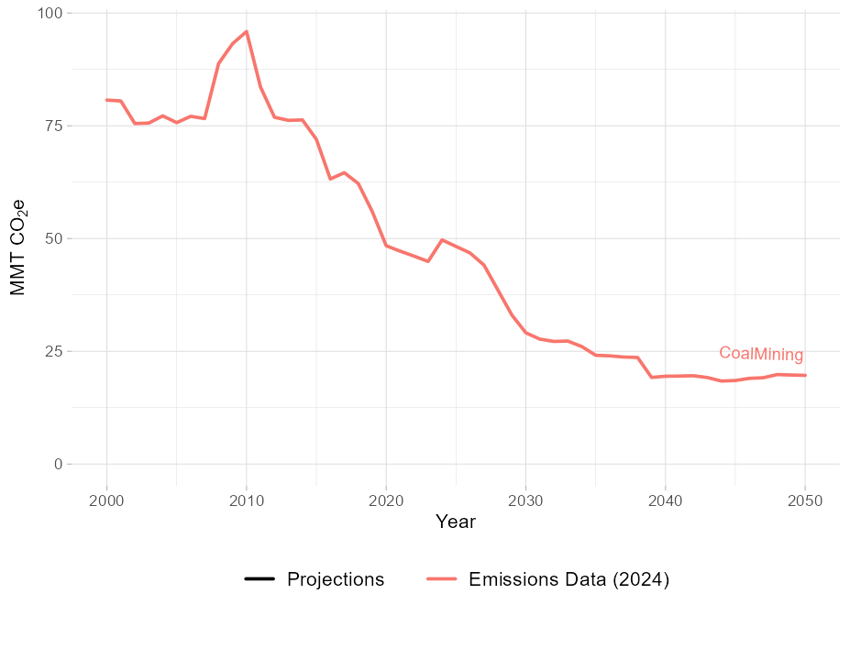
Describing projections
Spike at 2010 (historical)
Templates using natural language processing/generation
Basic statistics
Anomaly detection
ARIMA spike detection
Data quality assessment
Machine learning methods
RNN/LSTM models for time series analysis
Transformer models (BERT, GPT)
This drop in 2039 looks weird
“Decreasing trend from a peak in 2010 to around 25 MMTCO2e in 2050...”

Slide 8
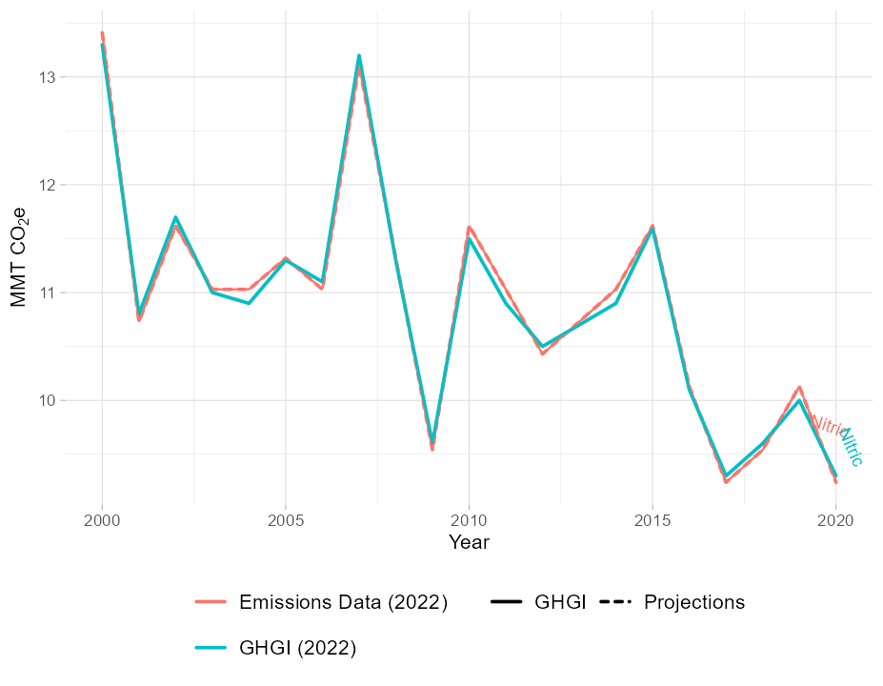
Comparing projections with historical data
Alignment/deviation detection
Direct value comparison
Residual analysis
Historical trend analysis
Understand and communicate historical narrative
Difference analysis

Slide 9
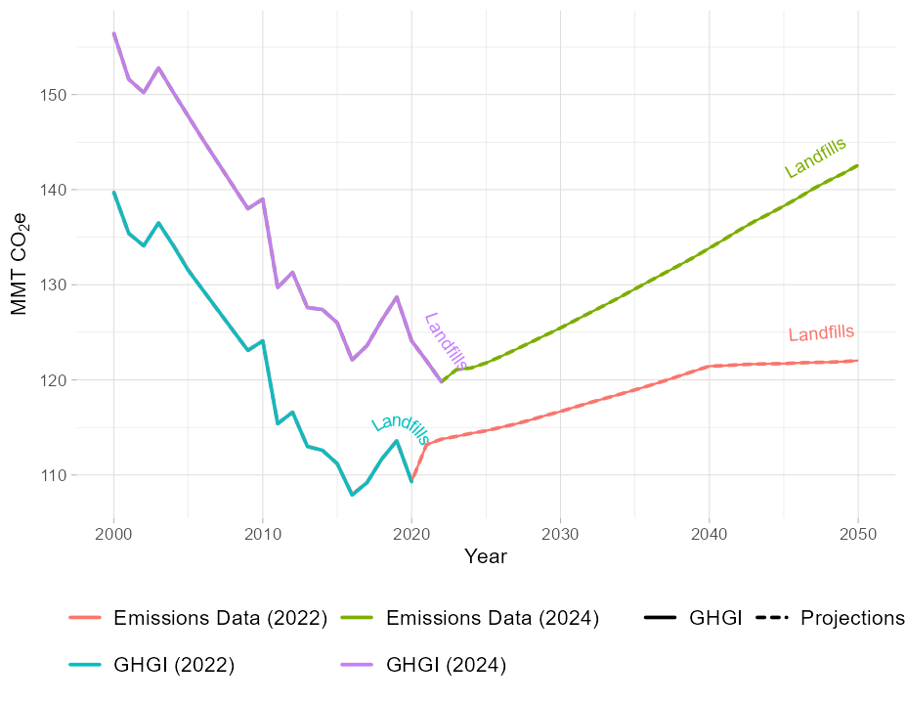
Comparing previous and current releases
Statistical comparison and description
High-level overview of differences
Autocorrelation
Basic modeling methods (ARIMA)
Differences in projections
Description/categorization of trends and differences
Capturing base year/historical impacts
Bitemporal data relations

Slide 10
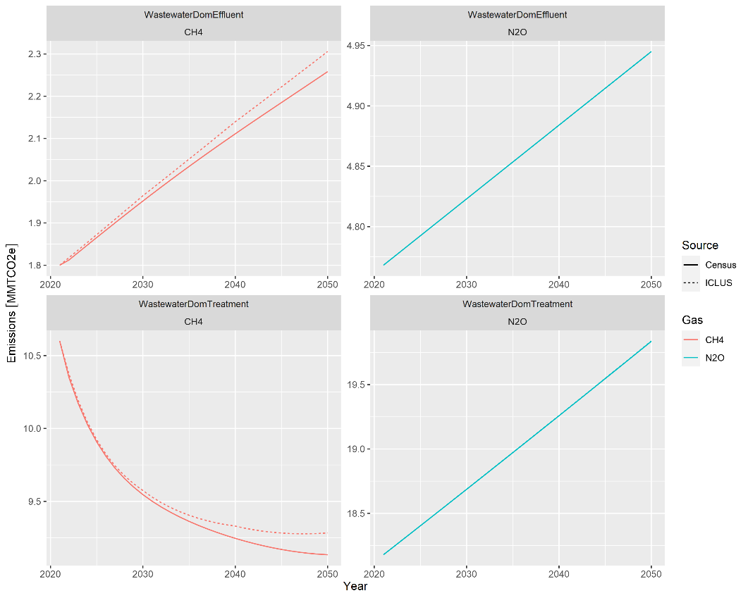
Assessing impact of inputs on outputs
Analytic/informed methods
R code analysis (automatic or hard-coded)
Checksums and input knockouts
Modeling methods
Random forest combining inputs with variable importance
Other “dark magic” machine learning methods

