Slide 1
Analogue Versus Digital
There are two basic ways of representing the numerical values of the various physical quantities with which we constantly deal in our day-to-day lives.
One of the ways, referred to as analogue, is to express the numerical value of the quantity as a continuous range of values between the two expected extreme values.
For example, the temperature of an oven settable anywhere from 0 to 100 °C may be measured to be 65 °C or 64.96 °C or 64.958 °C or even 64.9579 °C and so on, depending upon the accuracy of the measuring instrument.
Similarly, voltage across a certain component in an electronic circuit may be measured as 6.5 V or 6.49 V or 6.487 V or 6.4869 V.
The underlying concept in this mode of representation is that variation in the numerical value of the quantity is continuous and could have any of the infinite theoretically possible values between the two extremes.

Slide 2
Analogue Versus Digital
Digital, represents the numerical value of the quantity in steps of discrete values.
The numerical values are mostly represented using binary numbers.
For example, the temperature of the oven may be represented in steps of 1 °C as 64 °C, 65 °C, 66 °C and so on.
While an analogue representation gives a continuous output, a digital representation produces a discrete output.
Analogue systems contain devices that process or work on various physical quantities represented in analogue form.
Digital systems contain devices that process the physical
quantities represented in digital form.
Digital techniques and systems have the advantages of being relatively much easier to design and having higher accuracy, programmability, noise immunity, easier storage of data and ease of fabrication in integrated circuit form, leading to availability of more complex functions in a smaller size.

Slide 3
Analogue Versus Digital
The real world is analogue.
Most physical quantities – position, velocity, acceleration, force, pressure, temperature and flowrate, for example – are analogue in nature.
That is why analogue variables representing these quantities need to be digitized or discretized at the input if we want to benefit from the features and facilities that come with the use of digital techniques

Slide 4
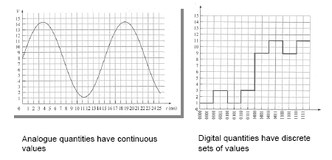
Digital and Analog Quantities

Slide 5
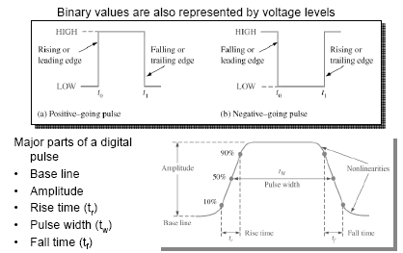
Binary Digits, Logic Levels, and Digital Waveforms

Slide 6
Number Systems
The study of number systems is important from the viewpoint of understanding how data are represented before they can be processed by any digital system including a digital computer.

Slide 7
Decimal Number System
The decimal number system is a radix-10 number system and therefore has 10 different digits or symbols.
These are 0, 1, 2, 3, 4, 5, 6, 7, 8 and 9.
All higher numbers after ‘9’ are represented in terms of these 10 digits only.
The place values of different digits in a mixed decimal number, starting from the decimal point, are 10⁰, 10¹, 10² and so on (for the integer part) and 10⁻¹, 10⁻², 10⁻³ and so on (for the fractional part).
The value or magnitude of a given decimal number can be expressed as the sum of the various digits multiplied by their place values or weights.
As an illustration, in the case of the decimal number 3586.265, the integer part (i.e. 3586) can be expressed as
and the fractional part can be expressed as

Slide 8
Binary Number System
The binary number system is a radix-2 number system with ‘0’ and ‘1’ as the two independent digits.
All larger binary numbers are represented in terms of ‘0’ and ‘1’.
The procedure for writing higher order binary numbers after ‘1’ is similar to the one explained in the case of the decimal number system.
For example, the first 16 numbers in the binary number system would be 0, 1, 10, 11, 100, 101, 110, 111, 1000, 1001, 1010, 1011, 1100, 1101, 1110 and 1111
The largest number which can be represented by n bits is 2^{n} − 1.
For example, with 4 bits the largest number is 1111₂ = 15.
The most signicant bit (MSB) is the bit representing the highest power of 2, and the LSB represents the lowest power of 2.
Arithmetic with unsigned binary is analogous to decimal.
For example 1-bit addition and multiplication are as follows: 0 + 0 = 0, 0 + 1 = 1, 1 + 1 = 0, 0 x 0 = 0,
0 x1 = 0, and 1 x 1 = 1.
Note that this is different from Boolean algebra, where 1 + 1 = 1.

Slide 9
1’s Complement & 1’s Complement Subtraction
The 1’s complement of a binary number is obtained by complementing all its bits, i.e. by replacing 0s with 1s and 1s with 0s.
For example, the 1’s complement of (10010110)₂ is (01101001)₂.
Subtraction of binary numbers can also be accomplished using 1’s complement method, which allows us to subtract using only addition
Method is follows: Subtracting smaller from larger no.
1) Determine the 1’s complement of the smaller number.
2) Add the 1’s complement to the larger number.
3) Remove the carry and add it to the result. This is called end-around carry.
Method is follows: Subtracting larger from smaller no.
1) Determine the 1’s complement of the larger number.
2) Add the 1’s complement to the smaller number.
3) The answer is negative and is the 1’s complement of the result. There is no carry.

Slide 10
2’s Complement & 2’s Complement Subtraction
The 2’s complement of a binary number is obtained by adding1 to the 1’s complement.
For example, the 2’s complement of (10010110)₂ is………………….
Subtraction of binary numbers can also be accomplished using 2’s complement method, which allows us to subtract using only addition
Method is follows: Subtracting smaller from larger no.
1) Determine the 2’s complement of the smaller number.
2) Add the 2’s complement to the larger number.
3) Discard the carry (there is always a carry in this case)
Method is follows: Subtracting larger from smaller no.
1) Determine the 2’s complement of the larger number.
2) Add the 2’s complement to the smaller number.
3) There is no carry. The result is in 2’s complement form and is negative.
4) Answer in true form, take the 2’s complement and change the sign.

Slide 11
Hexadecimal Number System
The hexadecimal number system is a radix-16 number system and its 16 basic digits are 0, 1, 2, 3, 4, 5, 6, 7, 8, 9, A, B, C, D, E and F.
The place values or weights of different digits in a mixed
hexadecimal number are 16⁰, 16¹, 16² and so on (for the integer part) and 16⁻¹, 16⁻², 16⁻³ and so on(for the fractional part).
The decimal equivalent of A, B, C, D, E and F are 10, 11, 12, 13, 14 and 15 respectively, for obvious reasons.
The hexadecimal number system provides a condensed way of representing large binary numbers stored and processed inside the computer.
One such example is in representing addresses of different memory locations.
Let us assume that a machine has 64K of memory.
Such a memory has 64K (= 2¹⁶ = 65 536) memory locations and needs 65 536 different addresses.
These addresses can be designated as 0 to 65 535 in the decimal number system and 00000000 00000000 to 11111111 11111111 in the binary number system.
The decimal number system is not used in computers and the binary notation here appears too cumbersome and inconvenient to handle.
In the hexadecimal number system, 65 536 different addresses can be expressed with four digits from 0000 to FFFF.

Slide 12
Hexadecimal Number System
The 15’s and 16’s complements are defined with respect to the hexadecimal number system.
The 15’s complement is obtained by subtracting each hex digit from 15.
For example, the 15’s complement of (3BF)₁₆ would be (C40)₁₆.
The 16’s complement is obtained by adding ‘1’ to the 15’s complement.
The 16’s complement of (2AE)₁₆ would be (D52)₁₆.

Slide 13
Sign-Bit Magnitude Representation of Decimal Numbers
In the sign-bit magnitude representation of positive and negative decimal numbers, the MSB represents the ‘sign’, with a ‘0’ denoting a plus sign and a ‘1’ denoting a minus sign.
The remaining bits represent the magnitude.
In eight-bit representation, while MSB represents the sign, the remaining seven bits represent the magnitude.
For example, the eight-bit representation of +9 would be 00001001, and that for −9 would be 10001001.

Slide 14
1’s Complement Representation in Binary Numbers
In the 1’s complement format, the positive numbers remain unchanged.
The negative numbers are obtained by taking the 1’s complement of the positive counterparts.
For example, +9 will be represented as 00001001 in eight-bit notation, and −9 will be represented as 11110110, which is the 1’s complement of 00001001.

Slide 15
2’s Complement Representation of Binary Numbers
In the 2’s complement representation of binary numbers, the MSB represents the sign, with a ‘0’used for a plus sign and a ‘1’ used for a minus sign.
The remaining bits are used for representing magnitude.
Positive magnitudes are represented in the same way as in the case of sign-bit or 1’s complement representation.
Negative magnitudes are represented by the 2’s complement of their
positive counterparts.
For example, +9 would be represented as 00001001, and −9 would be written as 11110111.
Note that, if the 2’s complement of the magnitude of +9 gives a magnitude of −9, then the reverse process will also be true, i.e. the 2’s complement of the magnitude of −9 will give a magnitude of +9.

Slide 16
Binary-to-Decimal Conversion
The decimal equivalent of the binary number (1001.0101)₂ is determined as follows:
The integer part = 1001
The decimal equivalent = ?
The fractional part = .0101
Therefore, the decimal equivalent = ?
Therefore, the decimal equivalent of (1001.0101)_{2 =?}

Slide 17
Hexadecimal-to-Decimal Conversion
The decimal equivalent of the hexadecimal number (1E0.2A)₁₆ is determined as follows:
The integer part = 1E0
The decimal equivalent =?
The fractional part = 2A
The decimal equivalent =?
Therefore, the decimal equivalent of (1E0.2A)₁₆
= (480.164)₁₀

Slide 18
Examples
Find the decimal equivalent of the following binary numbers expressed in the 2’s complement format:
(a) 00001110;
(b) 10001110.

Slide 19
Decimal-to-Binary Conversion
Find the binary equivalent of (13.375)₁₀.

Slide 20
Decimal-to-Hexadecimal Conversion
Determine the hexadecimal equivalent of (82.25)₁₀

Slide 21
Binary Coded Decimal
The binary coded decimal (BCD) is a type of binary code used to represent a given decimal number in an equivalent binary form.
BCD-to-decimal and decimal-to-BCD conversions are very easy and straightforward.
It is also far less cumbersome an exercise to represent a given decimal number in
an equivalent BCD code than to represent it in the equivalent straight binary form discussed earlier.
The BCD equivalent of a decimal number is written by replacing each decimal digit in the integer and fractional parts with its four-bit binary equivalent.
As an example, the BCD equivalent of (23.15)10 is written as (0010 0011.0001 0101)BCD.
The BCD code described above is more precisely known as the 8421 BCD code, with 8, 4, 2 and 1 representing the weights of different bits in the four-bit groups, starting from MSB and proceeding towards LSB.

Slide 22
BCD-to-Binary Conversion
A given BCD number can be converted into an equivalent binary number by first writing its decimal equivalent and then converting it into its binary equivalent.
As an example, we will find the binary equivalent of the BCD number 0010 1001.0111 0101:
BCD number: 0010 1001.0111 0101.
Corresponding decimal number: 29.75.
The binary equivalent of 29.75 can be determined to be 11101 for the integer part and .11 for the fractional part.
Therefore, (0010 1001.0111 0101)BCD =(11101.11)2.

Slide 23
Binary-to-BCD Conversion
The process of binary-to-BCD conversion is the same as the process of BCD-to-binary conversion executed in reverse order.
A given binary number can be converted into an equivalent BCD number by first determining its decimal equivalent and then writing the corresponding BCD equivalent.
As an example, we will find the BCD equivalent of the binary number 10101011.101:
The decimal equivalent of this binary number can be determined to be 171.625.
The BCD equivalent can then be written as 0001 0111 0001.0110 0010 0101.

Slide 24
CODES
Gray Code
Binary–Gray Code Conversion
Gray Code–Binary Conversion
ASCII code

Slide 25
Excess-3 Code
The excess-3 code is another important BCD code.
It is particularly significant for arithmetic operations as it overcomes the shortcomings encountered while using the 8421 BCD code to add two decimal digits whose sum exceeds 9.
The excess-3 code has no such limitation, and it considerably simplifies arithmetic operations.
The excess-3 code for a given decimal number is determined by adding ‘3’ to each decimal digit in the given number and then replacing each digit of the newly found decimal number by its four-bit binary equivalent

Slide 26
Excess-3 Code
It may be mentioned here that, if the addition of ‘3’ to a digit produces a carry, as is the case with the digits 7, 8 and 9, that carry should not be taken forward.
The result of addition should be taken as a single entity and subsequently replaced with its excess-3 code equivalent.
As an example, let us find the excess-3 code for the decimal number 597:
The addition of ‘3’ to each digit yields the three new digits/numbers ‘8’, ‘12’ and ‘10’.
The corresponding four-bit binary equivalents are 1000, 1100 and 1010 respectively.
The excess-3 code for 597 is therefore given by:

Slide 27
Excess-3 Code
Example:
Find
(a) the excess-3 equivalent of (237.75)10 and
(b) the decimal equivalent of the excess-3 number 110010100011.01110101.

Slide 28
Logic Gates
Truth Table
A truth table lists all possible combinations of input binary variables and the corresponding outputs of a logic system.
The logic system output can be found from the logic expression, often referred to as
the Boolean expression, that relates the output with the inputs of that very logic system.

Slide 29
THE NAND GATE
A manufacturing plant uses two tanks to store certain liquid chemicals that are required in a manufacturing process. Each tank has a sensor that detects when the
chemical level drops to 25% of full. The sensors produce a HIGH level of 5 V when the tanks are more than one-quarter full.
When the volume of chemical in a tank drops to one-quarter full, the sensor puts out a LOW level of 0 V.
It is required that a single green light-emitting diode (LED) on an indicator panel show when both tanks are more than one-quarter full. Show how a NAND gate can be used to implement this function.

Slide 30
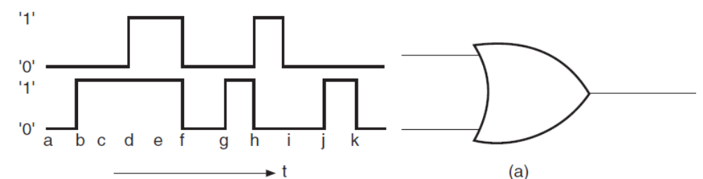
Logic Gates
How would you hardware-implement a four-input OR gate using two-input OR gates only?
Draw the output waveform for the OR gate and the given pulsed input waveforms of Fig. 1(a)

Slide 31

EXCLUSIVE-OR Gate
The EXCLUSIVE-OR gate, commonly written as EX-OR gate, is a two-input, one-output gate.
Figures 2(a) and 2(b) respectively show the logic symbol and truth table of a two-input EX-OR gate.
The output of a two-input EX-OR gate is expressed by

Slide 32
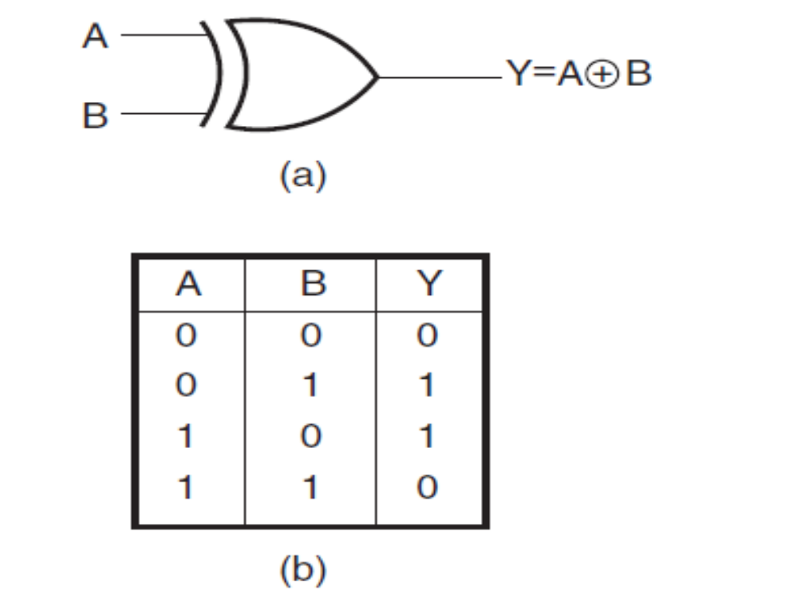
Circuit symbol and the truth table of a two-input
EXCLUSIVE-OR gate

