Slide 1
ALPhA Week 14: (4/19/19 – 4/26/19)
Gray Selby
AT-TPC Alpha – Alpha Classification

Slide 2
Plots
Waiting on Dr. Bazin to give me tilt information to improve 2D event plots
Need to get more events, correct their pad number column, and recalculate their peak charge values
Then ill need to manually classify the events for the test set
Will need to talk to someone on the team about how to do this accurately

Slide 3
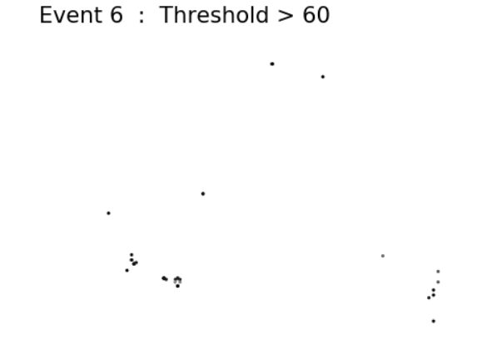
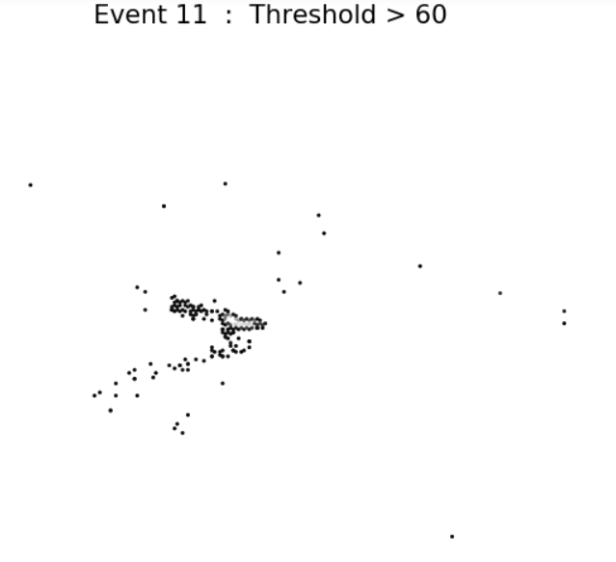
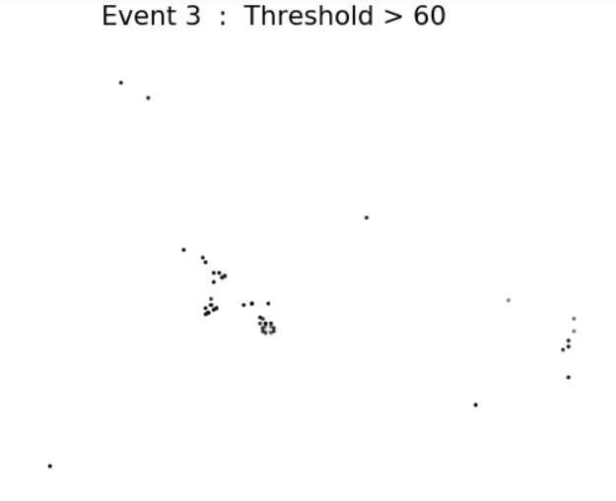
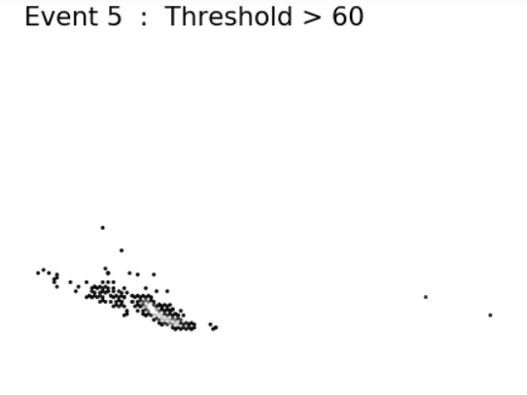
Noise Events
Events 6 and 3 are surely noise
Events 11 and 5 might be short alpha particle tracks

Slide 4
Alpha-proton Events

Slide 5
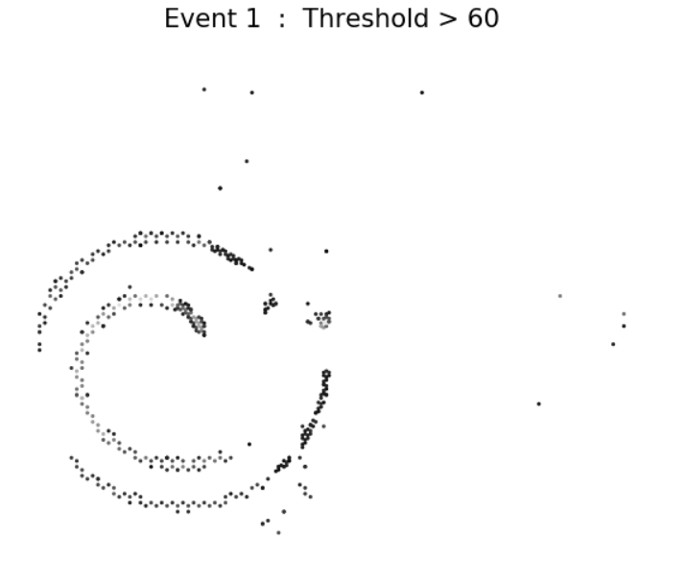
Alpha-proton?
Proton-proton?

Slide 6
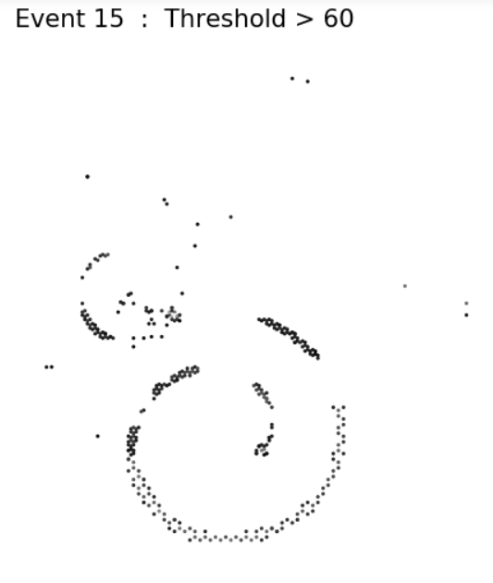
Alpha-proton?
Proton-proton?

Slide 7
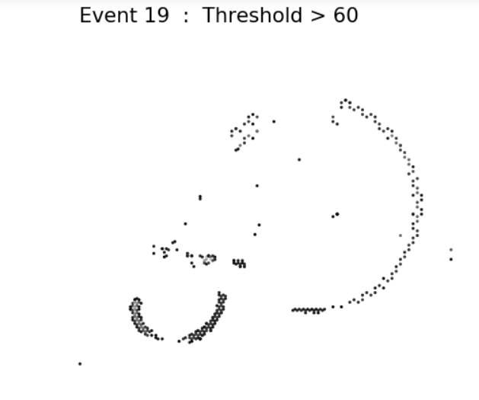
Alpha-proton?

Slide 8
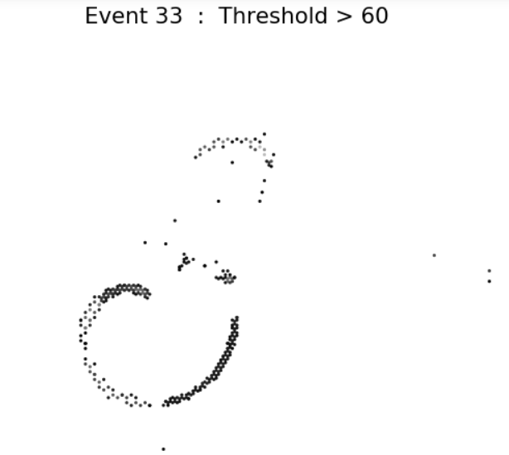
Alpha-proton?
Single alpha and/or proton?

Slide 9
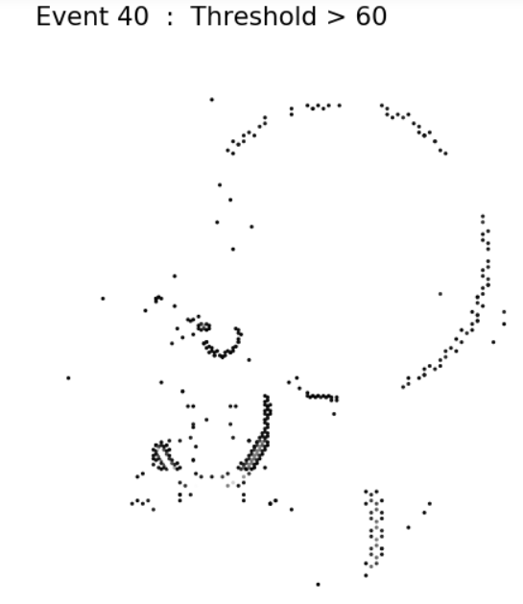
Alpha-proton?
Alpha-proton-proton?

Slide 10
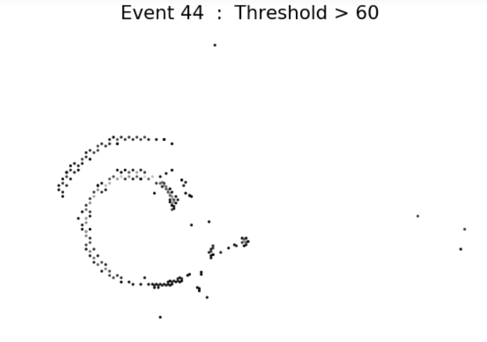
Alpha-proton?
Proton-proton?

Slide 11
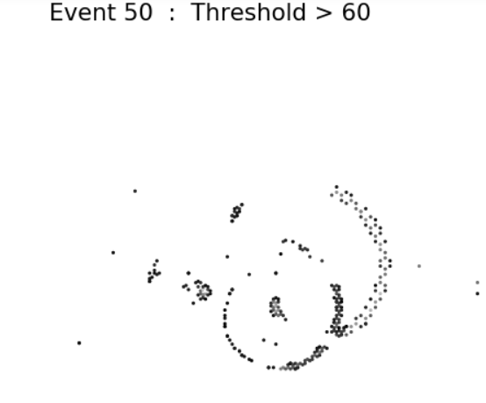
Alpha-proton?

Slide 12
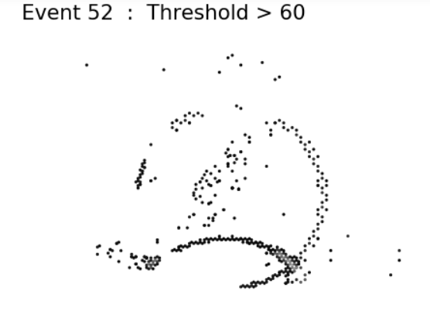
Alpha-proton?

Slide 13
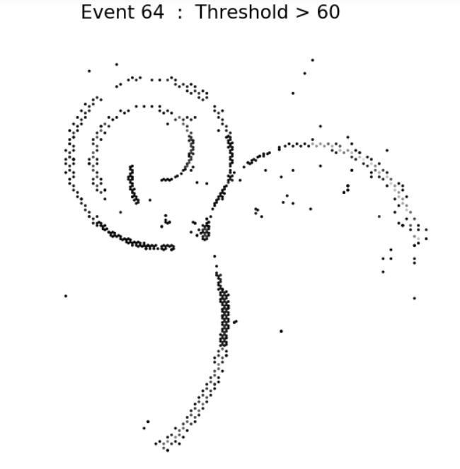
Alpha-proton-alpha-proton?
Alpha-proton-proton-proton?

Slide 14
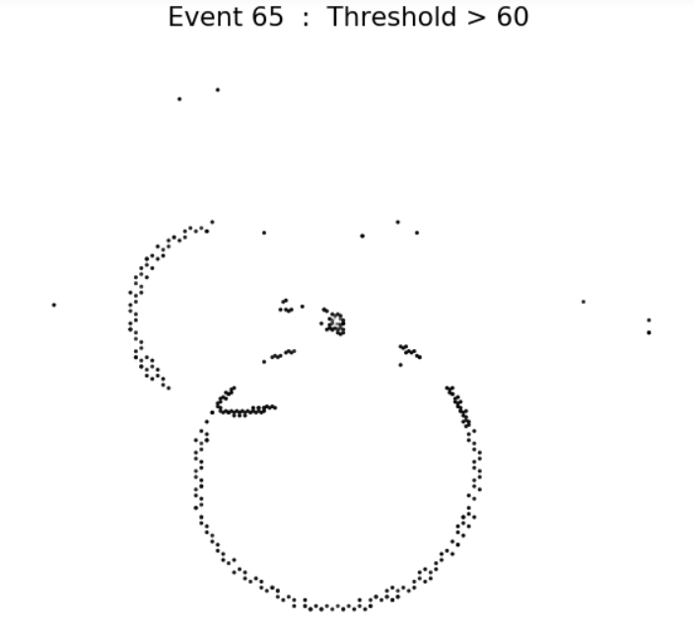
Alpha-proton?
Proton-proton?

Slide 15
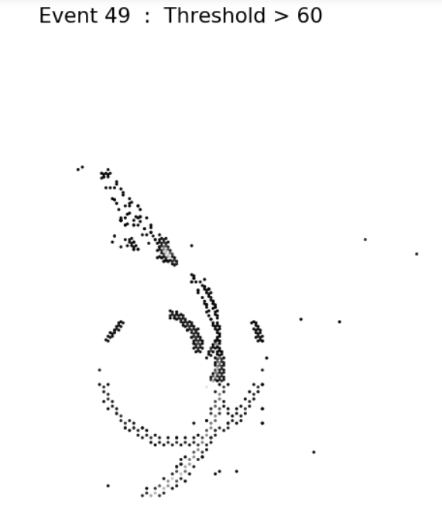
Alpha-proton?

Slide 16
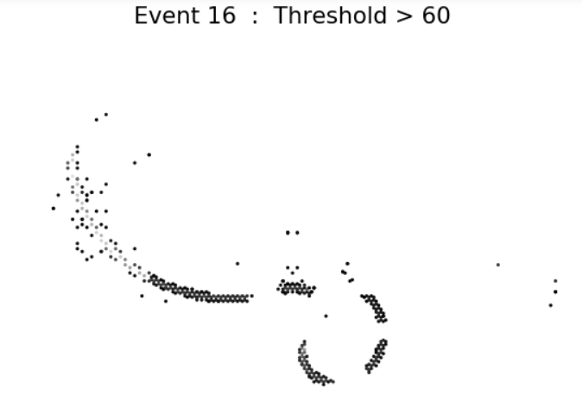
Alpha-proton?

Slide 17
Single alpha and/or proton particle tracks

Slide 18
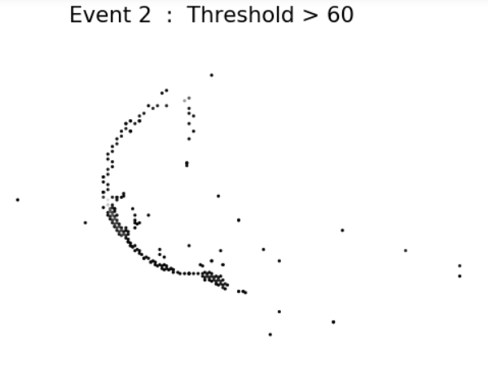
Alpha?
Proton?

Slide 19
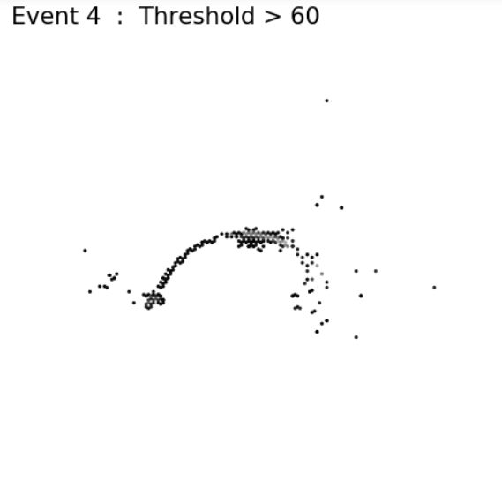
Alpha?
Proton?

Slide 20
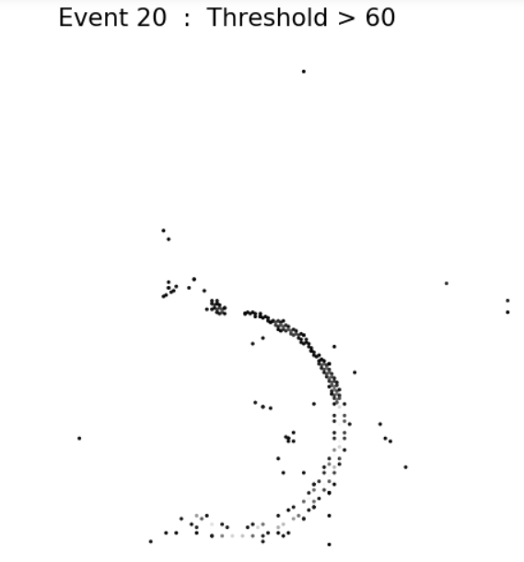
Alpha?
Proton?

Slide 21
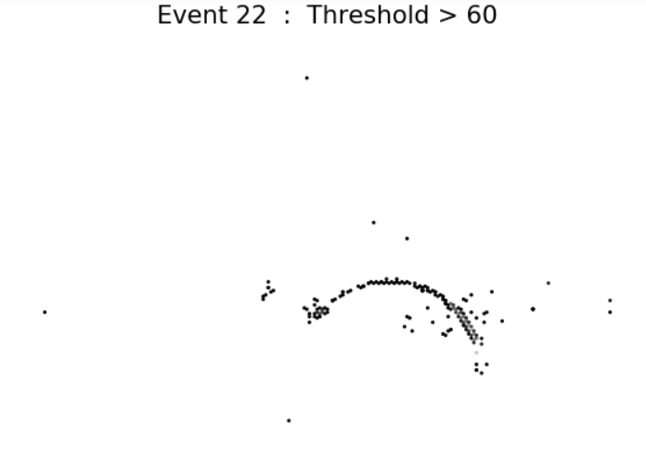
Alpha?
Proton?

Slide 22
Next Steps
Acquire tilt information to improve plots
Label a test data set to examine how well the CNN classifies alpha-proton events

