Slide 1


MemBo: Runtime Memory Borrowing on UPMEM-based Servers
Student: 李昀澤
Advisor: Da-Wei Chang, Ph. D.
July 28, 2023
Operating System and Embedded System Lab

Slide 2
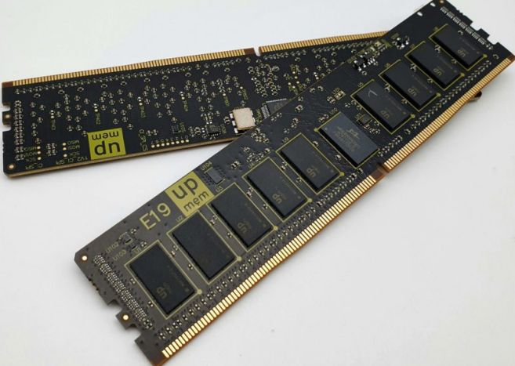
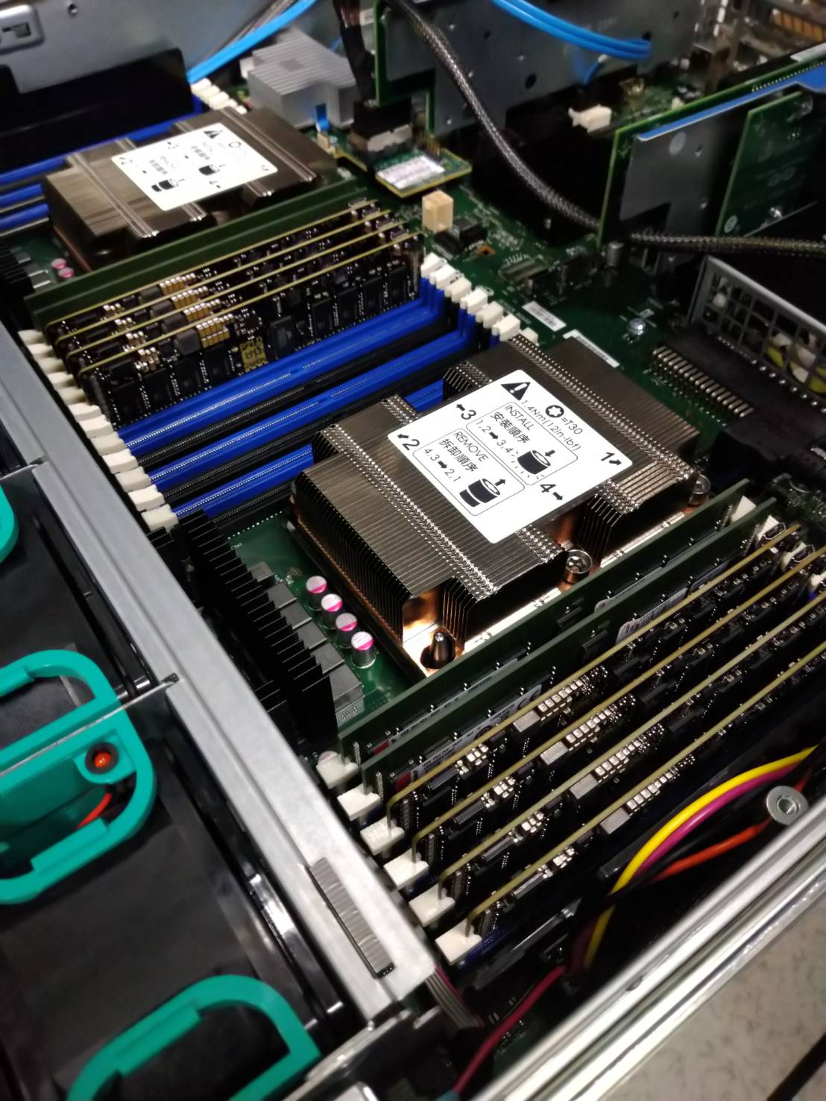
Background-UPMEM Introduction
First real-world Processing in Memory (PIM) hardware (2019)
Programmable near memory co-processors
Integrate RISC processors, called Data Processing Units (DPUs), into a DRAM DIMM
UPMEM PIM DIMMs
UPMEM, “UPMEM Website,” https://www.upmem.com, 2023.
An UPMEM-based Server

Slide 3
Background-UPMEM-based System
UPMEM PIM acceleration model
Instruction scratchpad memory
PIM Chip
Input data copy
Output data copy
Typical DRAM module
Typical DRAM module
Typical DRAM module
Conventional
DIMM
Host CPU
DPU
IRAM
Data scratchpad memory
WRAM
UPMEM DRAM module
UPMEM DRAM module
UPMEM DRAM module
Control interface
DRAM
(MRAM)
DPU application
UPMEM
PIM DIMM (16 chips)
DDR4 Interface
x8
Allocate DPUs in ranks
(64DPUs per rank).
DRAM bank used for CPU-DPU data exchange

Slide 4
Background-UPMEM-based System
Current OS design: MRAM is statically reserved for DPU applications
PIM Chip
DPU input/output data copy
Even when the DPU is idle
Typical DRAM module
Typical DRAM module
Typical DRAM module
Conventional
DIMM
Host CPU
DPU
IRAM
WRAM
UPMEM DRAM module
UPMEM DRAM module
UPMEM DRAM module
Control interface
DRAM
(MRAM)
UPMEM
PIM DIMM (16 chips)
DDR4 Interface
x8
Statically reserved for the DPU

Slide 5
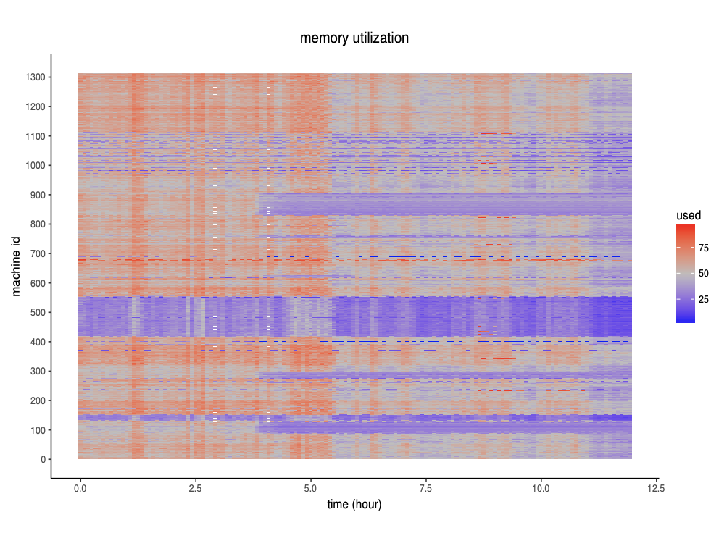
Background-Memory Usage Variance
Datacenters at Alibaba and Google reports greatly time-varying memory utilization per machine
Memory Utilization
Machines ID
C. Lu, K. Ye, G. Xu, C.-Z. Xu, and T. Bai, “Imbalance in the cloud: An analysis on Alibaba cluster trace”, in 2017 IEEE International Conference on Big Data (Big Data), 2017, pp. 2884–2892.
Time (hour)

Slide 6
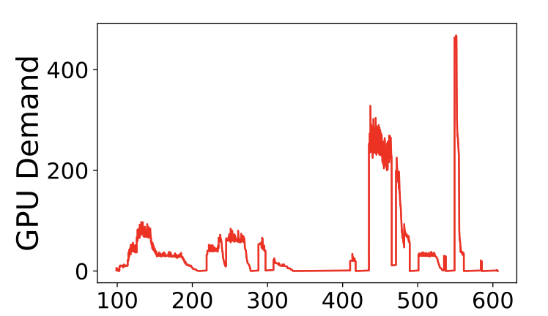
Background-Computing Resource Usage Variance
In heterogeneous computing environments such as GPU platforms or UPMEM PIM platforms, there is also a dynamic variation in the demand for computing resources
K. Mahajan et al., “Themis: Fair and efficient {GPU} cluster scheduling,” in 17th USENIX Symposium on Networked Systems Design and Implementation (NSDI 20), 2020, pp. 289–304.

Slide 7
Motivation-Addressing Memory Usage Variance on UPMEM servers
Problem: The current policy of statically reserving MRAM for DPU applications fails to fully utilize MRAM to accommodate the time-varying main memory and DPU usage
System Memory
High memory pressure!
Typical DRAM module
Typical DRAM module
Typical DRAM module
Conventional
DIMM
Trigger page swapping
Host CPUs
System throughput ☹
The idle MRAM banks are wasted!
UPMEM DRAM module
UPMEM DRAM module
UPMEM DRAM module
UPMEM
PIM DIMM

Slide 8
Solution-MemBo
Solution: we propose MemBo, a runtime memory borrowing mechanism on UPMEM-based servers
Enables the memory allocator to borrow idle MRAM as system memory when facing high memory demand
Objectives
Increase the utilization/flexibility of MRAM resources and minimize the occurrence of costly swapping operations
An OS level approach: transparent to both UPMEM server administrators and users

Slide 9
MemBo-High Level Overview
MemBo triggers MRAM borrowing when the system faces high memory pressure
High memory pressure!
System Memory
Typical DRAM module
Typical DRAM module
Typical DRAM module
Alleviate or release!
Conventional
DIMM
Host CPUs
Try to borrow idle MRAM
UPMEM DRAM module
UPMEM DRAM module
UPMEM
PIM DIMM

Slide 10
MemBo-High Level Overview
Two reclamation scenarios
When the memory pressure is released (background)
When a DPU application arrives and requires the borrowed MRAM (foreground)
System Memory
Memory pressure released
Typical DRAM module
Typical DRAM module
Typical DRAM module
Conventional
DIMM
Reclaim borrowed MRAM
Host CPUs
UPMEM DRAM module
UPMEM DRAM module
UPMEM
PIM DIMM

Slide 11
MemBo-High Level Overview
Two reclamation scenarios
When the memory pressure is released (background)
When a DPU application arrives and requires the borrowed MRAM (foreground)
System Memory
Typical DRAM module
Typical DRAM module
Typical DRAM module
Conventional
DIMM
Host CPUs
Challenge:
Minimizing the delay
Live data
Live data
Live data
UPMEM DRAM module
No enough ranks left for the DPU user due to MRAM borrowing!
Startup delay ☹
UPMEM DRAM module
UPMEM
PIM DIMM
Activate a DPU process and allocate DPU ranks

Slide 12

Current System Architecture and Design Issues
Non-DPU Applications
Design Issues
How to enable the MRAM borrowing mechanism?
Who/When to trigger MRAM borrowing/
reclamation?
3. How to minimize the overhead of foreground reclamation?
DPU Applications
Operating System User Space
UPMEM SDK
Operating System
Kernel Space
Buddy System
UPMEM Driver
Zone fallback list
ZONE DMA
ZONE
DMA32
ZONE NORMAL
ZONE DEVICE
(reserved MRAM pages)
`
Conventional
DRAM Banks
MRAM Banks
Hardware

Slide 13
Architecture of MemBo
Non-DPU Applications
DPU Applications
Operating System User Space
Modified UPMEM SDK
MemBo
Library
Operating System
Kernel Space
MemBo Kernel Threads
Modified Buddy System
Modified UPMEM Driver
MemBo Manager
Memory Pressure Detector
MRAM Borrowing Interface
MemBo Reclaimer
Modified Zone Fallback List
ZONE DMA
ZONE
DMA32
ZONE DEVICE
(reserved MRAM pages)
ZONE NORMAL
Conventional
DRAM Banks
MRAM Banks
Hardware

Slide 14
Architecture of MemBo
Non-DPU Applications
DPU Applications
Modified UPMEM SDK
MemBo
Library
Operating System User Space
Operating System
Kernel Space
MemBo Kernel Threads
Modified Buddy System
Modify the zone fallback list setup for MemBo
Modified UPMEM Driver
MemBo Manager
High Memory Pressure Detector
MRAM Borrowing Interface
MemBo Reclaimer
Modified Zone Fallback List
ZONE DMA
ZONE
DMA32
ZONE DEVICE
(reserved MRAM pages)
ZONE NORMAL
Conventional
DRAM Banks
MRAM Banks
Hardware

Slide 15

Architecture of MemBo
Non-DPU Applications
DPU Applications
Modified UPMEM SDK
MemBo
Library
Operating System User Space
Extend the UPMEM driver to provide two new MRAM page operations:
MRAM borrowing operation
MRAM reclamation operation
Operating System
Kernel Space
MemBo Kernel Threads
Modified Buddy System
Modified UPMEM Driver
MemBo Manager
Memory Pressure Detector
MRAM Borrowing Interface
MemBo Reclaimer
$$Δ$$
Modified Zone Fallback List
ZONE DMA
ZONE
DMA32
ZONE DEVICE
(reserved MRAM pages)
ZONE NORMAL
borrowed MRAM pages
Conventional
DRAM Banks
MRAM Banks
Hardware

Slide 16
Architecture of MemBo
Non-DPU Applications
DPU Applications
Introduce new kernel threads to automate the MRAM borrowing/reclamation operations
MemBo
Library
Operating System User Space
Modified UPMEM SDK
Operating System
Kernel Space
MemBo Kernel Threads
Modified Buddy System
Modified UPMEM Driver
MemBo Manager
Memory Pressure Detector
MRAM Borrowing Interface
MemBo Reclaimer
Modified Zone Fallback List
ZONE DMA
ZONE
DMA32
ZONE DEVICE
(reserved MRAM pages)
ZONE NORMAL
Conventional
DRAM Banks
MRAM Banks
Hardware

Slide 17
Architecture of MemBo
Provides MemBo compatible DPU allocation APIs, which are transparent to DPU programmers.
Non-DPU Applications
DPU Applications
Modified UPMEM SDK
MemBo
Library
Operating System User Space
Operating System
Kernel Space
MemBo Kernel Threads
Modified Buddy System
Modified UPMEM Driver
MemBo Manager
Memory Pressure Detector
MRAM Borrowing Interface
MemBo Reclaimer
Modified Zone Fallback List
ZONE DMA
ZONE
DMA32
ZONE DEVICE
(reserved MRAM pages)
ZONE NORMAL
Conventional
DRAM Banks
MRAM Banks
Hardware

Slide 18
Architecture of MemBo
Non-DPU Applications
DPU Applications
Provides optional foreground reclamation time minimization APIs
Modified UPMEM SDK
MemBo
Library
Operating System User Space
Operating System
Kernel Space
MemBo Kernel Threads
Modified Buddy System
Modified UPMEM Driver
MemBo Manager
Memory Pressure Detector
MRAM Borrowing Interface
MemBo Reclaimer
Modified Zone Fallback List
ZONE DMA
ZONE
DMA32
ZONE DEVICE
(reserved MRAM pages)
ZONE NORMAL
Conventional
DRAM Banks
MRAM Banks
Hardware

Slide 19
Architecture of MemBo
Non-DPU Applications
DPU Applications
Modified UPMEM SDK
MemBo
Library
Operating System User Space
Operating System
Kernel Space
MemBo Kernel Threads
Modified Buddy System
Modify the zone fallback list setup for MemBo
Modified UPMEM Driver
MemBo Manager
High Memory Pressure Detector
MRAM Borrowing Interface
MemBo Reclaimer
Modified Zone Fallback List
ZONE DMA
ZONE
DMA32
ZONE DEVICE
(reserved MRAM pages)
ZONE NORMAL
Conventional
DRAM Banks
MRAM Banks
Hardware

Slide 20
Memory Zone Setup in MemBo
MemBo insert ZONE DEVICE into the fallback list of buddy system during the initialization phase, but hide all the MRAM pages from the buddy system (free page lists are not built)
Fallback order design principles
MRAM pages should be used only after ZONE_DEVICE’s pages are nearly exhausted -> MRAM pages are more expensive since they need to be reclaimed
ZONE_DEVICE locates at high-memory address and can be reclaimed at any time -> MRAM pages are not compatible for performing DMA operations
Memory Zone Fallback List
ZONE DMA
ZONE
DMA32
ZONE DEVICE
ZONE NORMAL

Slide 21
Architecture of MemBo
Non-DPU Applications
DPU Applications
Modified UPMEM SDK
MemBo
Library
Operating System User Space
Extend the UPMEM driver to provide two new MRAM page operations:
MRAM borrowing operation
MRAM reclamation operation
Operating System
Kernel Space
MemBo Kernel Threads
Modified Buddy System
Modified UPMEM Driver
MemBo Manager
Memory Pressure Detector
MRAM Borrowing Interface
MemBo Reclaimer
$$Δ$$
Modified Zone Fallback List
ZONE DMA
ZONE
DMA32
ZONE DEVICE
(reserved MRAM pages)
ZONE NORMAL
borrowed MRAM pages
Conventional
DRAM Banks
MRAM Banks
Hardware

Slide 22
MRAM Borrowing/Reclamation Operations
MRAM pages borrowing operation
Re-initialize the metadata for the MRAM pages (e.g., struct page)
Insert the MRAM pages into the free lists of ZONE_DEVICE
MRAM pages reclamation operation
Migrate any live data on the MRAM pages to ZONE_NORMAL and hide the pages from the buddy system
Re-initialize the metadata for the MRAM pages
Granularity of the operations
Rank granularity is too high, leading to the following problems
Holding the locks for a long period, blocking other operations to ZONE_DEVICE
Borrowing MRAM pages that exceed the demand
We use 64MB in our current design

Slide 23
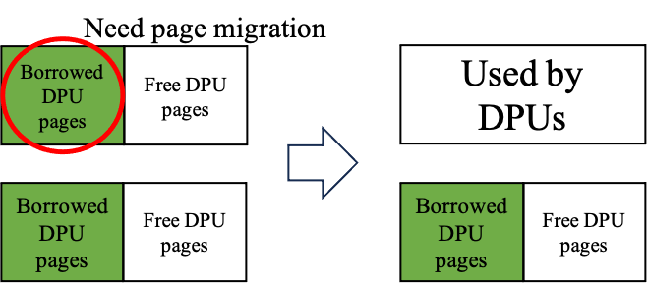
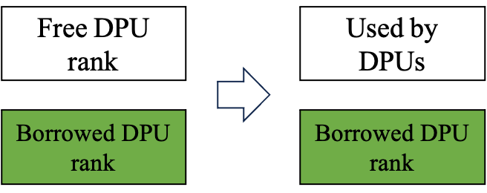
MRAM Borrowing/Reclamation Operations: Borrowed MRAM Page Placement Policy
Problem: DPU allocations and MRAM borrowing are implemented in different granularities
DPU rank allocation granularity (4GB) vs. MRAM borrowing granularity (64MB)
(a) No need of page migration
(b) Need page migration

Slide 24
MRAM Borrowing Interface: Borrowed MRAM Page Placement Policy
MemBo maintains two linked lists to manage the borrowed MRAM pages placement
unborrowed rank list
…
borrowed rank list
Used by DPU
Used by buddy system
Free

Slide 25
MRAM Borrowing Interface: Borrowed MRAM Page Placement Policy
MemBo UPMEM driver maintains two linked lists to manage the borrowed MRAM pages placement
unborrowed rank list
…
borrowed rank list
…
borrow_mram_pages/
reclaim_mram_pages
64MB
Used by DPU
Used by buddy system
Free

Slide 26
MRAM Borrowing Interface: Borrowed MRAM Page Placement Policy
MemBo UPMEM driver maintains two linked lists to manage the borrowed MRAM pages placement
unborrowed rank list
…
borrowed rank list
…
…
borrow_mram_pages/
reclaim_mram_pages
64MB
Used by DPU
Used by buddy system
Free

Slide 27
Architecture of MemBo
Non-DPU Applications
DPU Applications
Introduce new kernel threads to automate the MRAM borrowing/reclamation operations
MemBo
Library
Operating System User Space
Modified UPMEM SDK
Operating System
Kernel Space
MemBo Kernel Threads
Modified Buddy System
Modified UPMEM Driver
MemBo Manager
Memory Pressure Detector
MRAM Borrowing Interface
MemBo Reclaimer
Modified Zone Fallback List
ZONE DMA
ZONE
DMA32
ZONE DEVICE
(reserved MRAM pages)
ZONE NORMAL
Conventional
DRAM Banks
MRAM Banks
Hardware

Slide 28
Who trigger MRAM Borrowing/Reclamation Operations?
MemBo includes two kernel threads to cooperate with the buddy system to automate the borrowing/reclamation operations
MemBo manager
Wake up by the high memory pressure detector in the buddy system (low memory watermark)
initiate an MRAM borrowing operation
MemBo reclaimer (background reclamation)
Periodically check if the memory pressure of ZONE_NORMAL has released (high memory watermark)
Initiate MRAM reclamation operations

Slide 29
When to trigger MRAM Borrowing Operations?
Linux buddy system uses the memory watermark WMARK_LOW to control the fallback timing and the activation of swapping operations
Free pages # of ZONE_DEVICE
(1) Try the next zone in the fallback list
(2) If (1) fails, the free pages # drops below WMAKR_LOW, and the buddy system trigger swapping operations (wakeup kswapd)
WMARK_LOW
Time

Slide 30
When to trigger MRAM Borrowing Operations?
The buddy system makes sure that the free pages number in ZONE_DEVICE stays higher than WMARK_LOW through MemBo manager
High memory pressure detector wakeup MemBo manager for first borrowing.
High memory pressure detector wakeup MemBo manager for second borrowing.
Free pages # of ZONE_DEVICE
An allocation fallback to ZONE_DEVICE.
(indicating low free memory in ZONE_NORMAL)
WMARK_LOW
Time
t

Slide 31
Who trigger MRAM Borrowing/Reclamation Operations?
MemBo includes two kernel threads to cooperate with the buddy system to automate the borrowing/reclamation operations
MemBo manager
Wake up by the high memory pressure detector in the buddy system (low memory watermark)
initiate an MRAM borrowing operation
MemBo reclaimer (background reclamation)
Periodically check if the memory pressure of ZONE_NORMAL has released (high memory watermark)
Initiate MRAM reclamation operations

Slide 32
When to trigger Background MRAM Reclamation Operations?
The MemBo reclaimer periodically (0.1s) check if the memory pressure of ZONE_NORMAL has released and trigger MRAM background reclamation
free pages # of ZONE_NORMAL
MemBo reclaimer initiates MRAM borrowing operations, migrating live data back to free ZONE_NORMAL’s pages.
WMARK_HIGH_MEMBO
512 MB
MemBo reclaimer is activated once the first MRAM borrowing completes
WMARK_LOW
time
t

Slide 33
Architecture of MemBo
Non-DPU Applications
DPU Applications
Provides optional foreground reclamation time minimization APIs
Modified UPMEM SDK
MemBo
Library
Operating System User Space
Operating System
Kernel Space
MemBo Kernel Threads
Modified Buddy System
Modified UPMEM Driver
MemBo Manager
Memory Pressure Detector
MRAM Borrowing Interface
MemBo Reclaimer
Modified Zone Fallback List
ZONE DMA
ZONE
DMA32
ZONE DEVICE
(reserved MRAM pages)
ZONE NORMAL
Conventional
DRAM Banks
MRAM Banks
Hardware

Slide 34
Recap-Foreground Reclamation Challenge
Foreground reclamation may increase the latency of the DPU application
Typical DRAM module
Typical DRAM module
Typical DRAM module
Conventional
DIMM
Host CPUs
Live data
Live data
Live data
Startup delay ☹
UPMEM DRAM module
No enough ranks left for the DPU user due to MRAM borrowing!
UPMEM DRAM module
UPMEM
PIM DIMM
Activate a DPU process and allocate DPU ranks

Slide 35
Solution 1-Data Migration Pipelining (DMP)
Main idea: pipeline the foreground reclamation time and the DPU input data copy time
rank level data migration parallelism
CPU copies input data to DPUs
CPU retrieves result from DPUs
Without foreground reclamation
DPU execution
Foreground
reclamation
CPU copies input data to DPUs
CPU retrieves result from DPUs
DPU execution
With foreground reclamation
Latency
1-rank input data copy
CPU retrieves result from DPUs
DPU execution
Data migration pipelining
1-rank reclamation

Slide 36
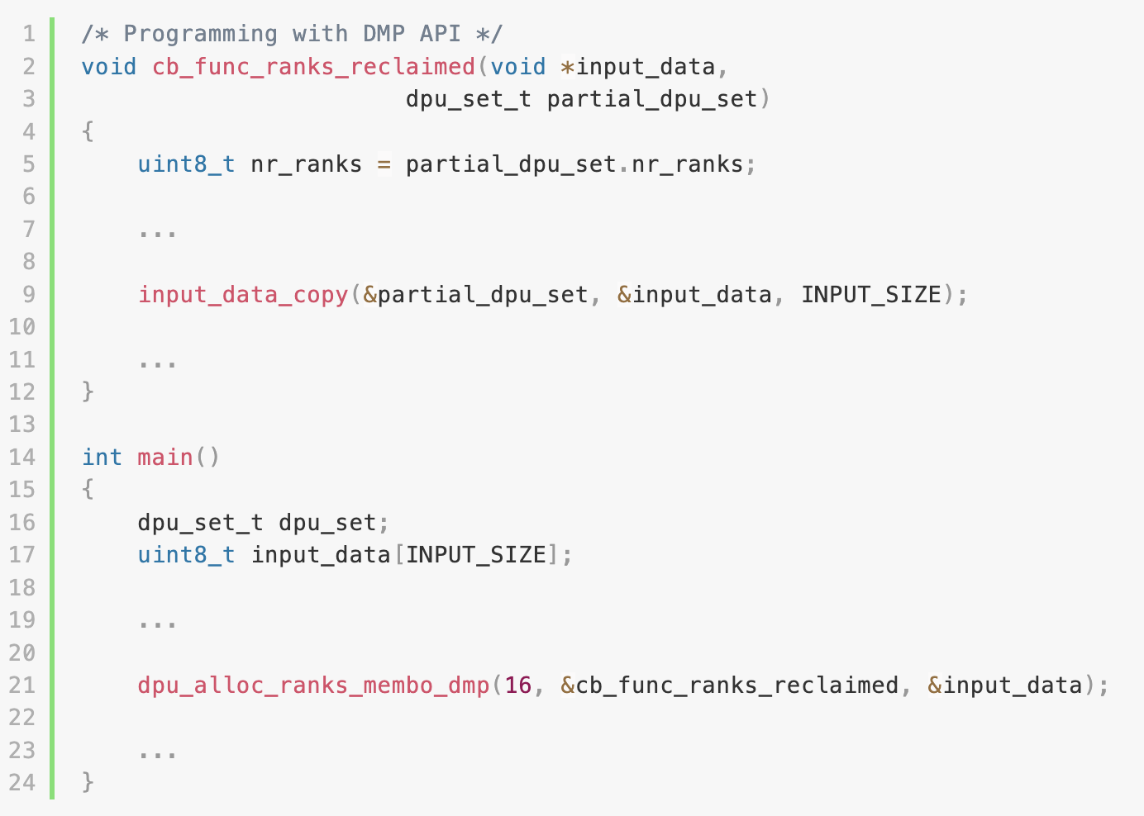
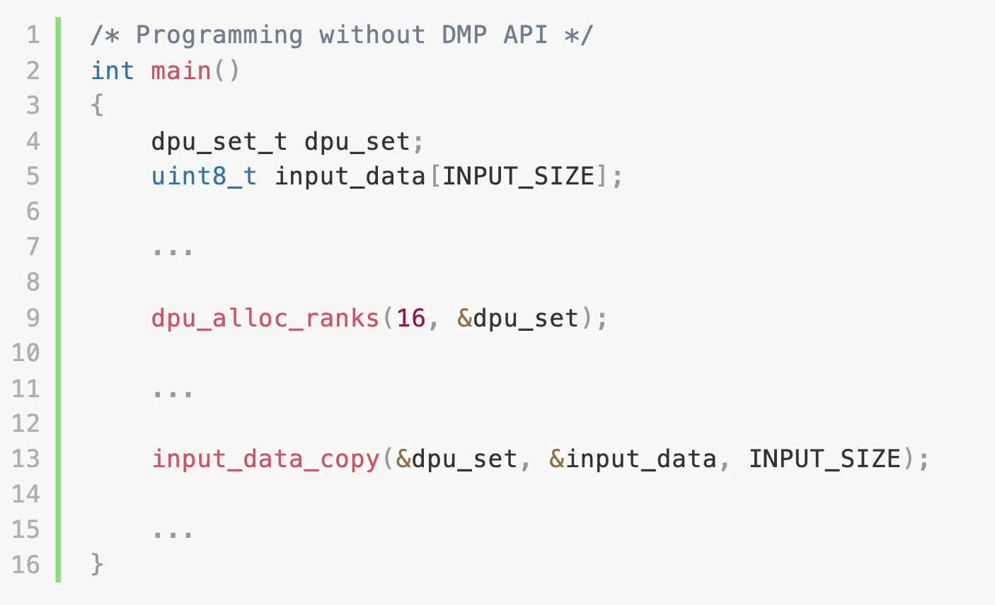
MemBo Library-DMP Implementation APIs and Coding Example
dpu_alloc_ranks_membo_dmp
Users can pass a callback function, which is called whenever a part of required ranks is reclaimed
Input data copy operations for the reclaimed rank can be initiated in the callback function

Slide 37
Solution 2-DPU Usage Prediction-based Rank Reservation (PBRR)
Main idea: periodically predict the DPU usage in the near future
Trigger MRAM background reclamation in advance and prevent foreground reclamation
MemBo borrows the idea from LirCUP, a linear regression based resource usage prediction method
Conventional DRAM DIMMs
UPMEM DRAM module
Typical DRAM module
Typical DRAM module
Typical DRAM module
Main Memory
Periodically predict the DPU usage in the near future
Host CPUs
DPU usage predictor
UPMEM DRAM module
MRAM
Prediction result: 3 ranks required in the near future
2 free ranks left
reserved
UPMEM PIM DIMMs
F. Farahnakian, P. Liljeberg, and J. Plosila, “LiRCUP: Linear Regression Based CPU Usage Prediction Algorithm for Live Migration of Virtual Machines in Data Centers”, in 2013 39th Euromicro Conference on Software Engineering and Advanced Applications, 2013, pp. 357–364.

Slide 38
MemBo Library-PBRR Implementation APIs
MemBo library provides the following DPIs for predictor implementation
get_dpu_usage
Get the current DPU usage (in rank)
set_membo_reservation_threshold
Set the number of rank reservation

Slide 39
Evaluation Setup
CPU | Intel Xeon Silver 4208 CPUs @ 2.10GHz
Conventional DIMMs | 64GB DDR4 DRAM
UPMEM PIM DIMMs | 16 dual rank UPMEM PIMM DIMMs Total DPUs: 1024 DPUs @350GHz Total MRAM: 64GB
Operating System | Distro: Ubuntu 20.04 Linux kernel: 5.15.45 (MemBo) UPMEM driver: 2021.3.0 (MemBo)
UPMEM SDK | UPMEM SDK 2021.3.0 (MemBo)
SSD | SAMSUNG 980 PRO NVMe SSD 2TB (used as swap space)

Slide 40
Workloads
YCSB workloads (left) and DPU applications from PrIM (right)
YCSB workloads are executed on Memcached, a popular key-value store
Workload | Operation | Request Distribution
A | 50% Read, 50% Write | Zipfian
B | 95% Read, 5% Write | Zipfian
C | 100% Read | Zipfian
D | 95% Read, 5% Write | Latest
F | 50% Read, 50% Read-Modify-Write | Zipfian
DPU Application | Input Size
VA | 25M elements/DPU rank
SEL
UNI
RED
SCAN-RSS
SCAN-SSA
TRNS | 12288 × 16 × 1024 × 8/16 DPU ranks
BS | 25M elements, 25M queries/DPU rank
B. F. Cooper, A. Silberstein, E. Tam, R. Ramakrishnan, and R. Sears, “Benchmarking Cloud Serving Systems with YCSB”, in Proceedings of the 1st ACM Symposium on Cloud Computing, Indianapolis, Indiana, USA, 2010, pp. 143–154.
J. Gómez-Luna, I. El Hajj, I. Fernandez, C. Giannoula, G. F. Oliveira, and O. Mutlu, “Benchmarking Memory-Centric Computing Systems:
Analysis of Real Processing-In-Memory Hardware”, in 2021 12th International Green and Sustainable Computing Conference (IGSC), 2021, pp. 1–7.

Slide 41
Experimental Groups
To evaluate the scalability of MemBo, we configure the following experimental groups
Baseline: Native UPMEM platform without MemBo
MemBo(k): MemBo is enabled, and k ranks are available for MRAM borrowing

Slide 42
Evaluation Scenarios
One YCSB workload
Throughput Improvement of YCSB
Major page faults reduction
One YCSB workload + one DPU application
DPU application runtime
Throughput Improvement of YCSB
Effectiveness of data migration pipelining
One YCSB workload + multiple DPU applications
Effectiveness of prediction-based rank reservation
Throughput Improvement of YCSB

Slide 43
Evaluation Scenarios
One YCSB workload
Throughput Improvement of YCSB
Major page faults reduction
One YCSB workload + one DPU application
DPU application runtime
Throughput Improvement of YCSB
Effectiveness of data migration pipelining
One YCSB workload + multiple DPU applications
Effectiveness of prediction-based rank reservation
Throughput Improvement of YCSB

Slide 44
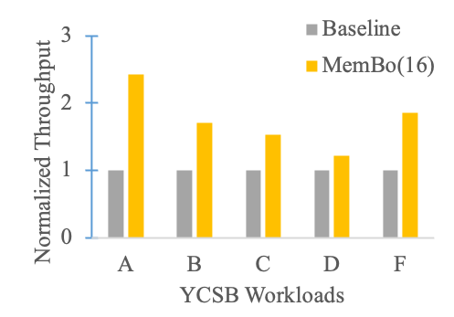
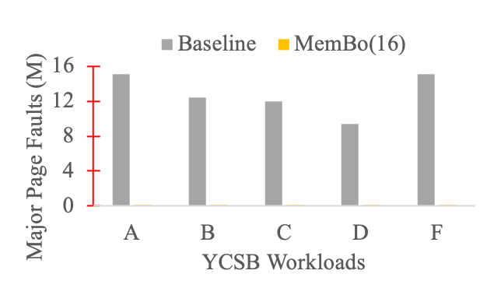
YCSB Performance Improvement: YCSB Workloads 50M items/operations
Throughput improvement (left) and major page faults reduction (right)
Workload D shows a better spatial locality, limiting the benefit of MemBo.
2.42x
1.22x

Slide 45
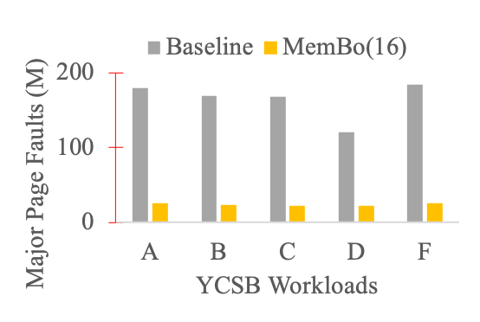
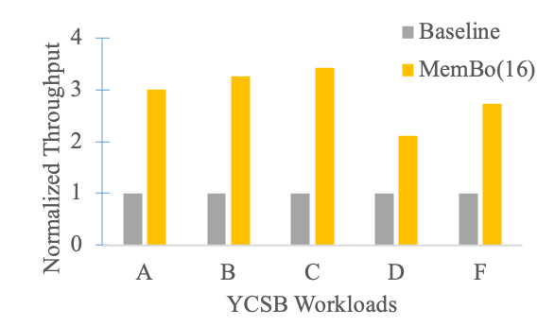
YCSB Performance Improvement: YCSB Workloads 100M items/operations
Throughput improvement (left) and major page faults reduction (right)

Slide 46
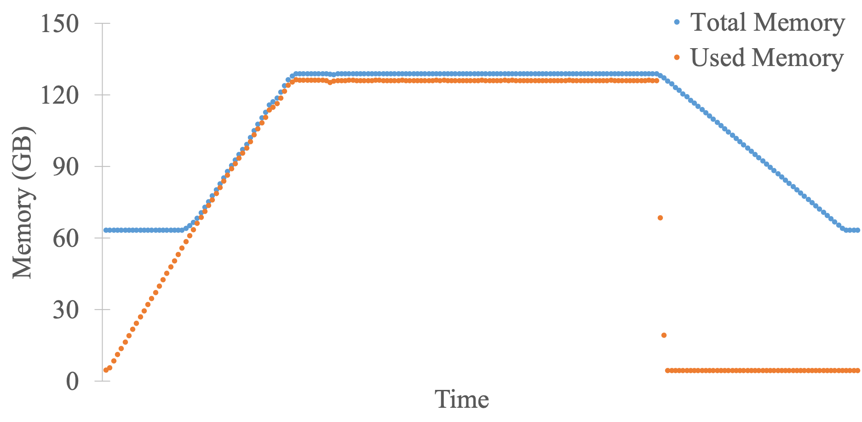
Memory Capacity Variation
MemBo can expand/shrink the memory capacity based on the memory pressure
MemBo reclaimer reclaims the borrowed pages when the memory pressure is released
MemBo trigger MRAM borrowing when facing high memory pressure, expand the memory capacity

Slide 47
Evaluation Scenarios
One YCSB workload
Throughput Improvement of YCSB
Major page faults reduction
One YCSB workload + one DPU application
DPU application runtime
Throughput Improvement of YCSB
Effectiveness of data migration pipelining
One YCSB workload + multiple DPU applications
Effectiveness of prediction-based rank reservation
Throughput Improvement of YCSB

Slide 48
Scenario 2-One YCSB workload + one DPU application
Evaluation steps
1. Launch YCSB workload A (100M items and operations)
2. After 5 minutes, activate a 16-rank DPU application, triggering MRAM reclamation
3. Collect the overall throughput of YCSB workload A and the runtime of the DPU application

Slide 49
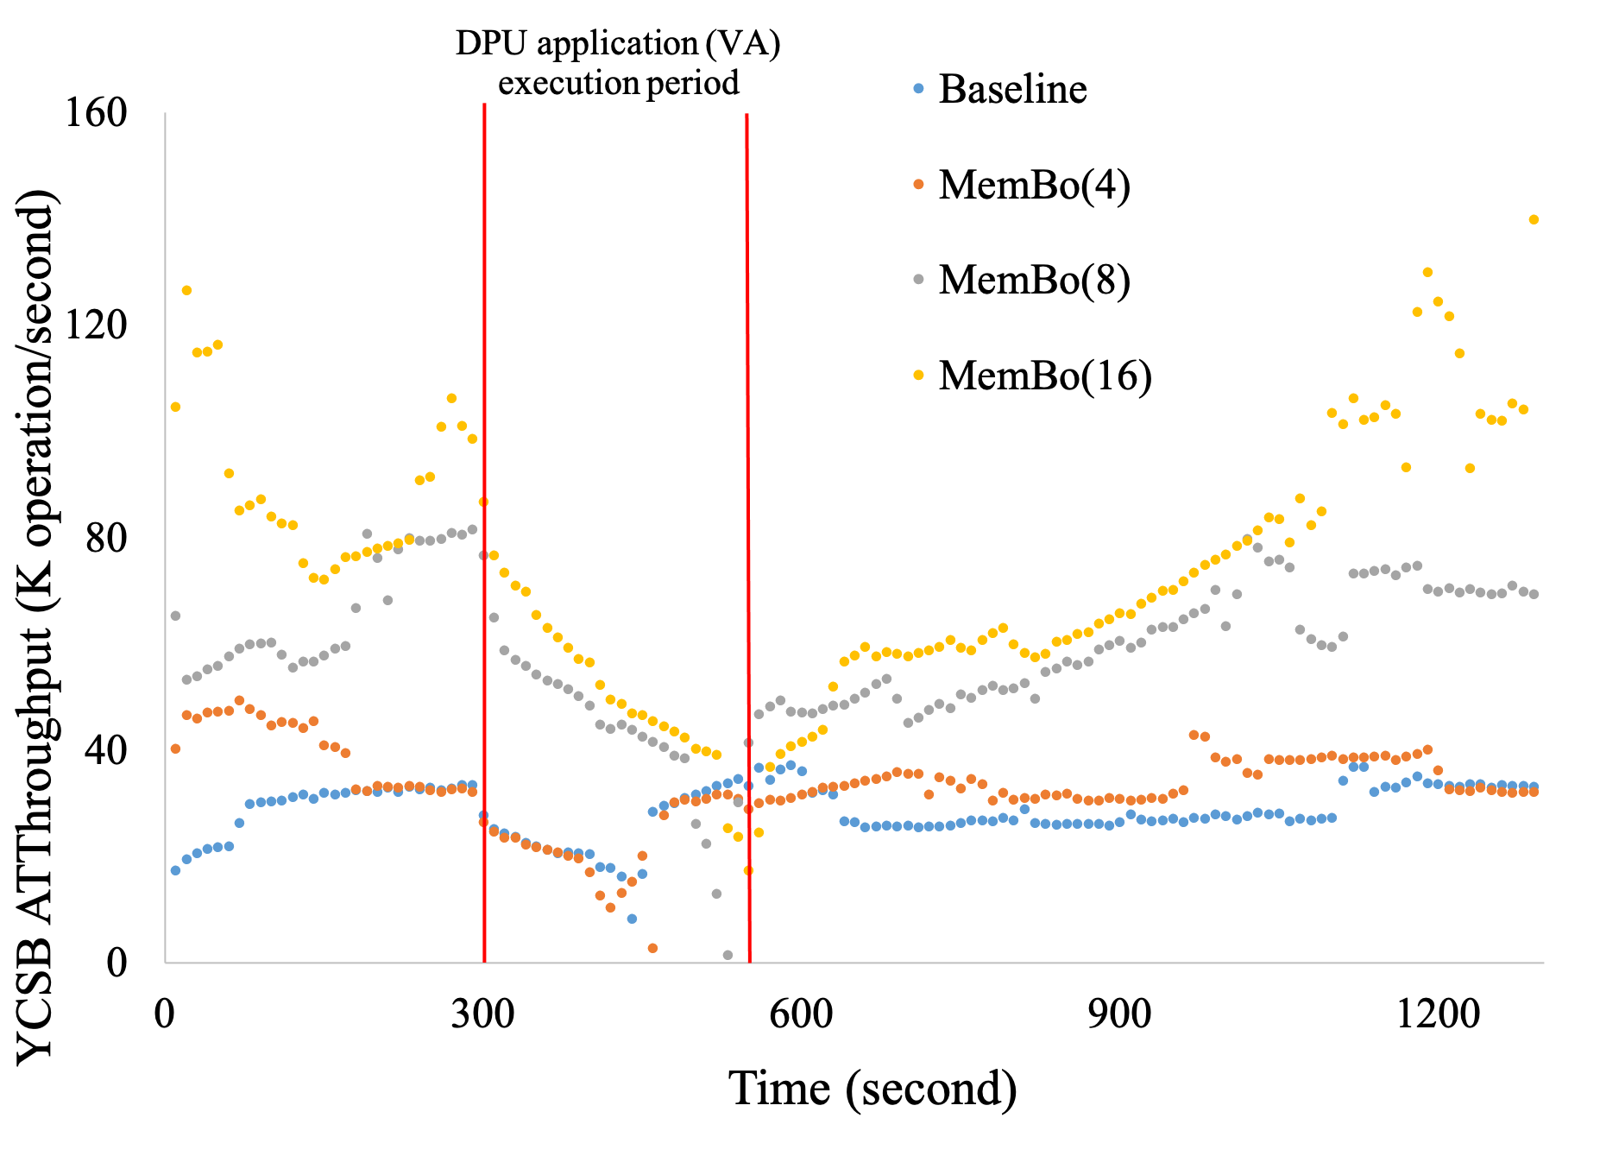
YCSB Throughput Variation in Time
Launch YCSB A

Slide 50
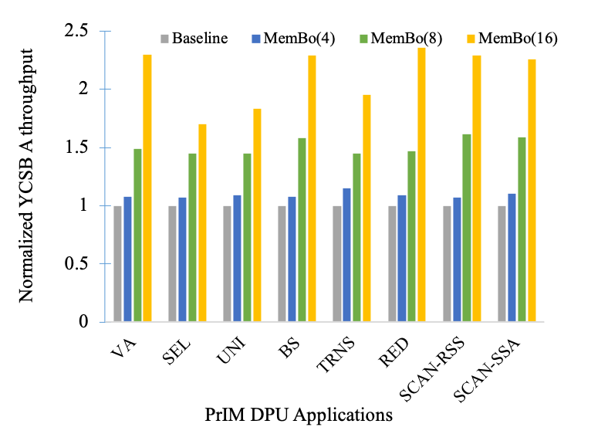
YCSB Throughput Improvement

Slide 51
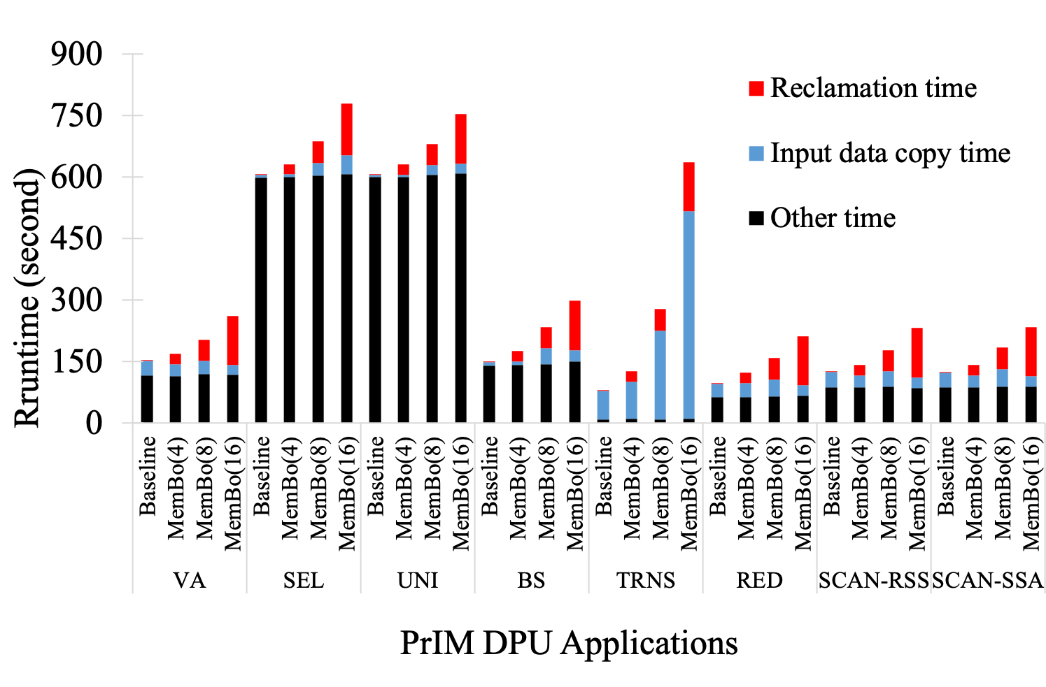
DPU Application Runtime
The latency penalty is unacceptable!
2x

Slide 52
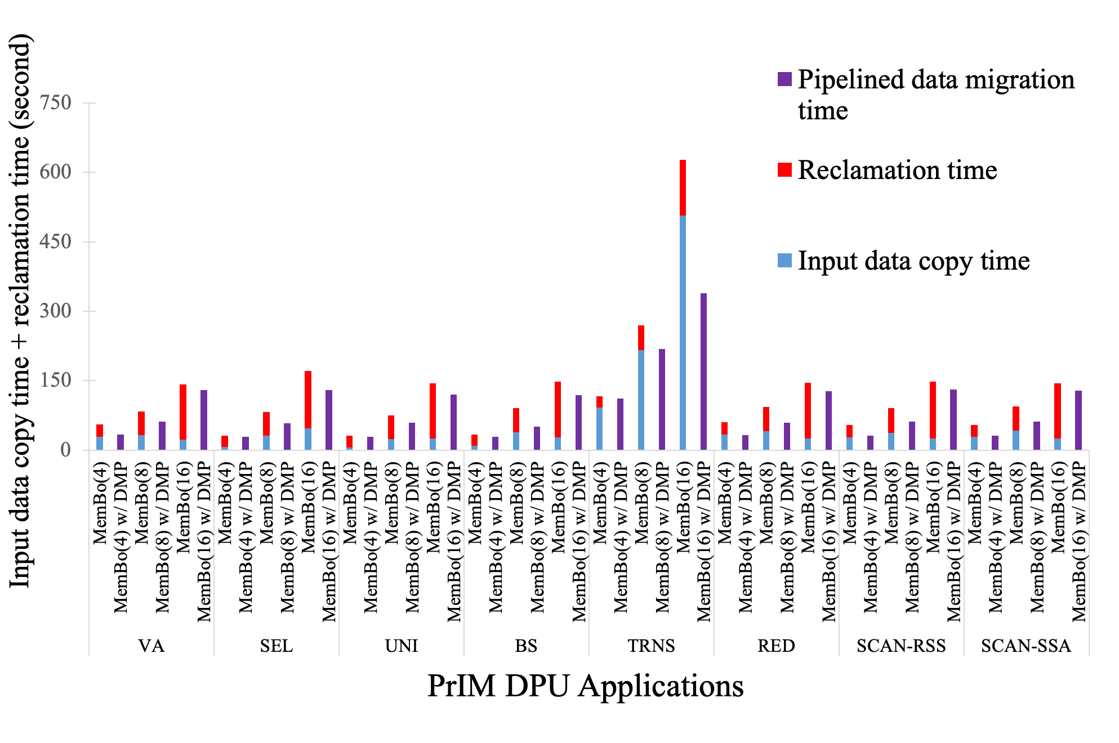
Effectiveness of Data Migration Pipelining (DMP)
We apply DMP technique to each MemBo group to evaluate its effectiveness
Conclusion: the effectiveness of DMP is workload dependent: highly related to the proportion of input data copy time and the reclamation time
DMP significantly reduces the runtime for some workloads

Slide 53
Evaluation Scenarios
One YCSB workload
Throughput Improvement of YCSB
Major page faults reduction
One YCSB workload + one DPU application
DPU application runtime
Throughput Improvement of YCSB
Effectiveness of data migration pipelining
One YCSB workload + multiple DPU applications
Effectiveness of prediction-based rank reservation (PBRR)
Throughput Improvement of YCSB

Slide 54
Scenario 3-One YCSB workload + multiple DPU applications
Evaluation steps
Launch YCSB A (100M items and operations)
After 5 minutes, launch a R-rank VA every 1 minute. Each application occupies its DPU ranks for D minutes
Collect the overall throughput of YCSB A and the reclamation time of each DPU application
Configuration | (R, D)
A | (1, 16)
B | (2, 8)
C | (4, 4)

Slide 55
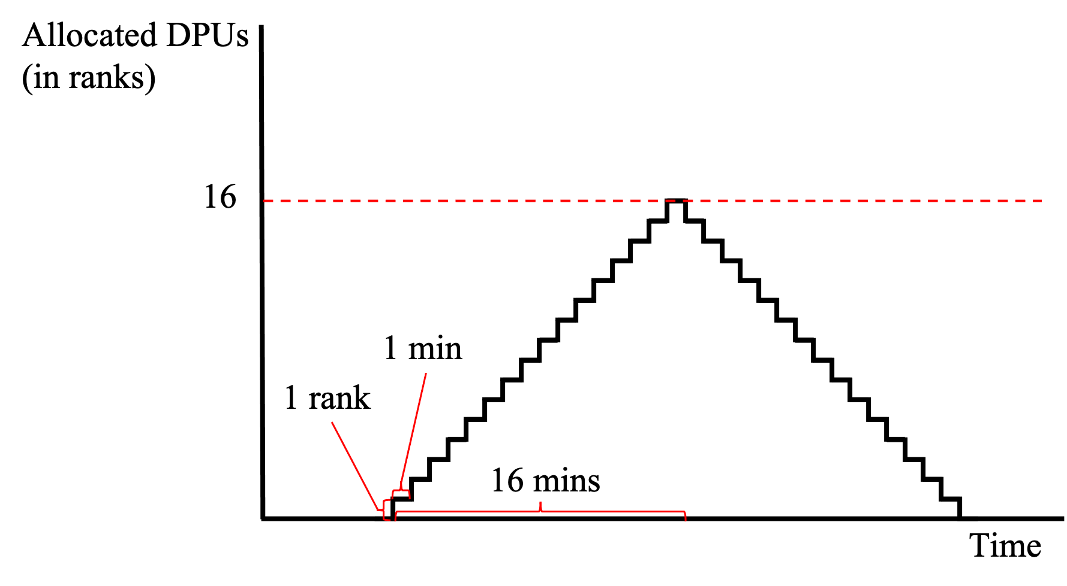
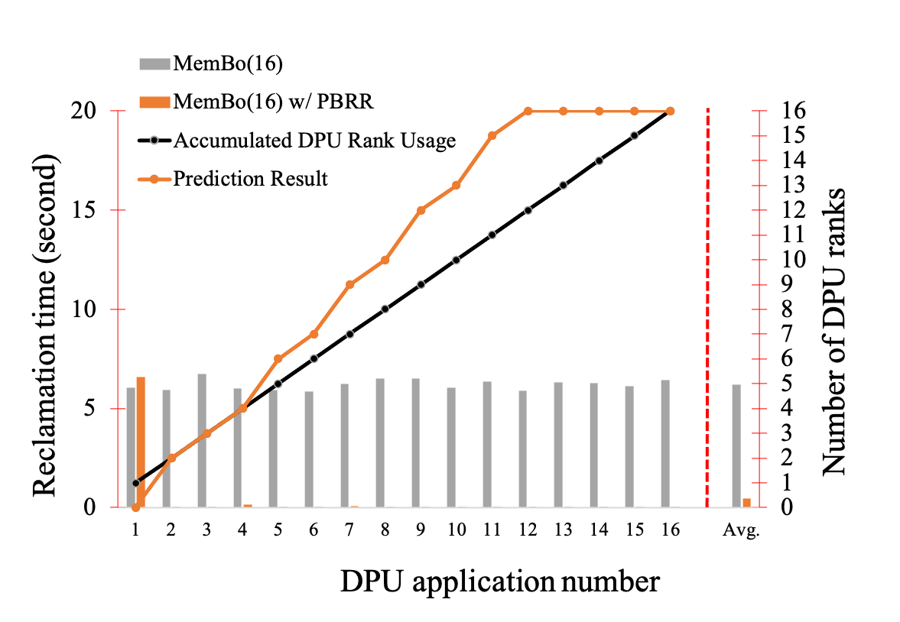
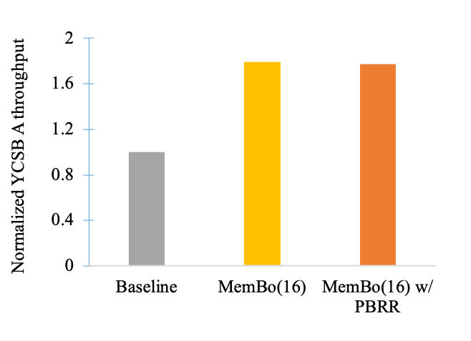
Result-Configuration A

Slide 56
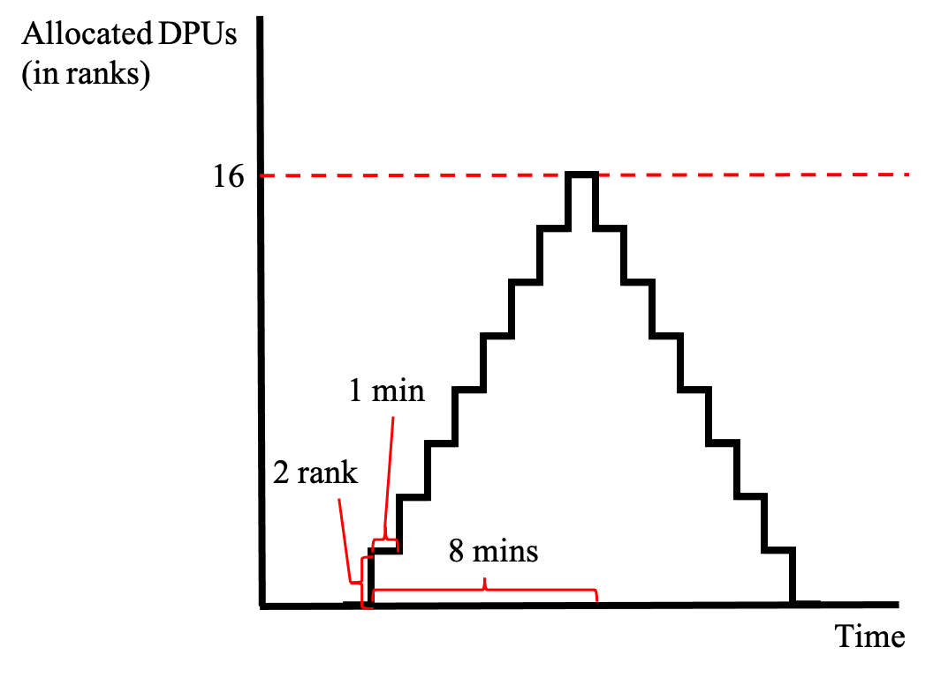
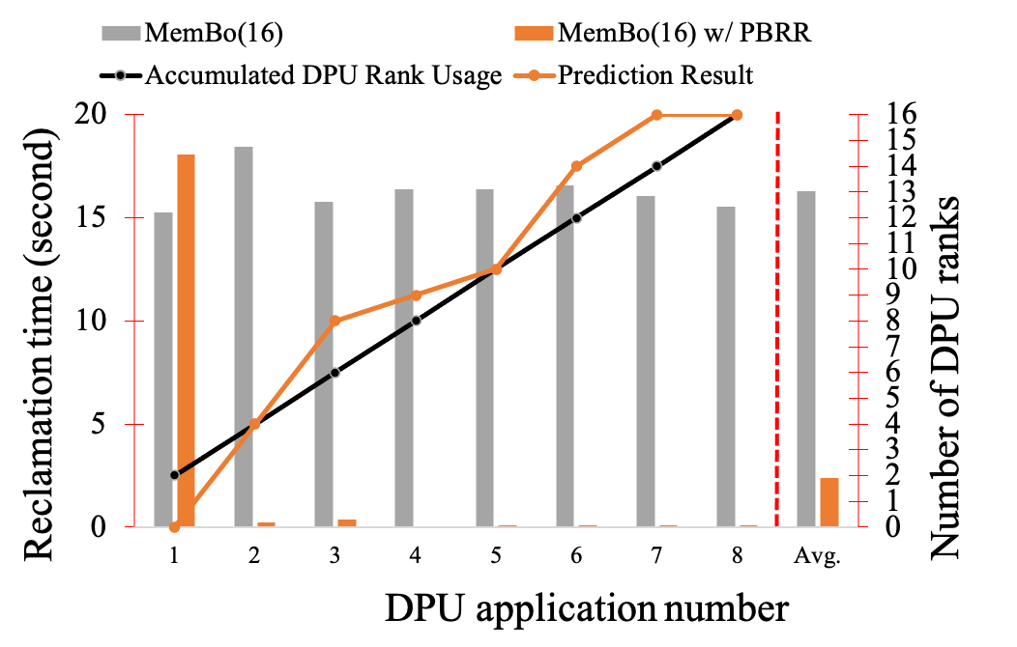
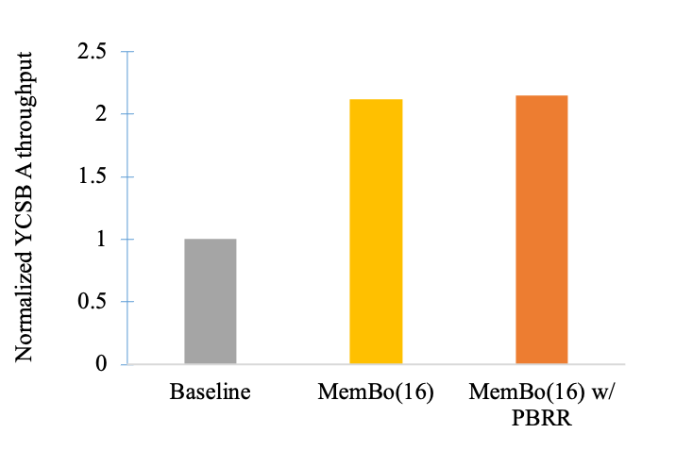
Result-Configuration B

Slide 57
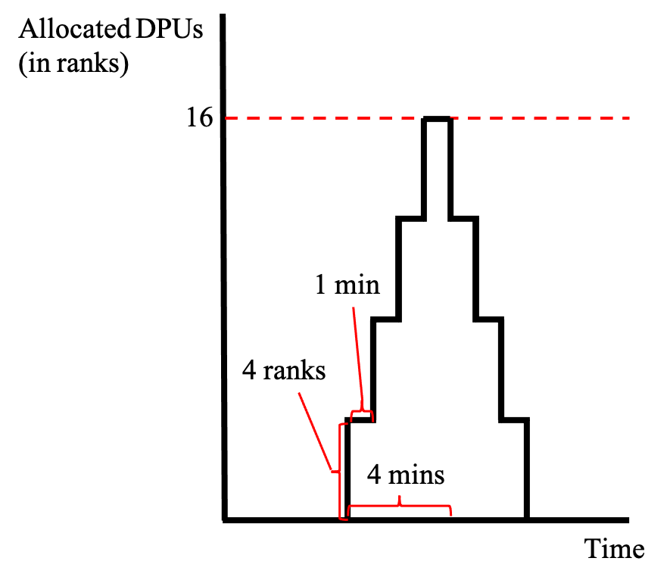
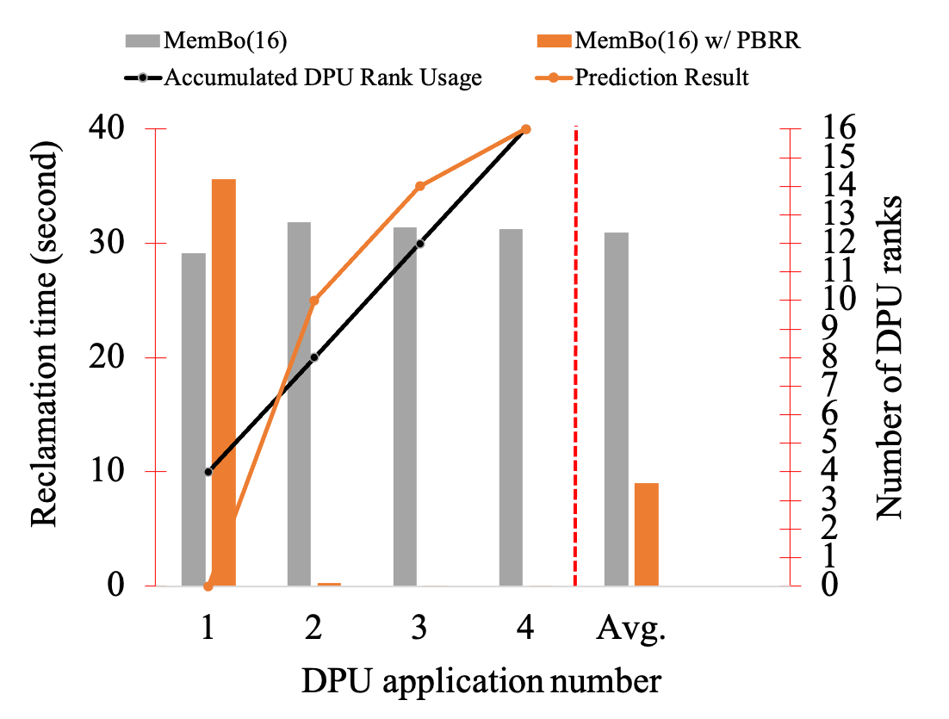
Result-Configuration C

Slide 58
Conclusion
We propose MemBo, a runtime memory borrowing mechanism that provides a solution to address memory demand variance on UPMEM servers
Enabling Runtime memory borrowing, increasing the utilization and flexibility of MRAM
MemBo achieves up to 3.43x of throughput improvement and 99.9% of page fault reduction on YCSB workloads

Slide 59
Thank You

