Slide 1



Airline Product Management Working Group
Introduction to
Product Definition and Taxonomy
G. Baues AirFrance/KLM

Slide 2
Agenda
Business problem
Base requirements
Base principles
Extended Requirements
Business processes
Business Information model layering
Notes:
As consequence we need a full flexible and extensible framework which nevertheless can be automated in terms of processing on a large industry scale as there are n:m agreeements in place
As an airline I have 1:n partner agreements and I am part
Bilateral agreements between Seller, Retailer, Supplier as well as Delivery providers
Additional principles
Full freedom on the nature and choice of products being part of such an agreement. The agreement can change ovetime wrt to products as well as the information exchanged
There will be n:m exchange channels for each participant in the ecosystem the number of bilateral partners is not the same for anyone nor the nature of the partners

Slide 3




Business problem to solve
Coorp A
Coorp B
Retail agreement
Shop A retails
Shop B retails
Notes:
As consequence we need a full flexible and extensible framework which nevertheless can be automated in terms of processing on a large industry scale as there are n:m agreeements in place
As an airline I have 1:n partner agreements and I am part
Exchange of product information for retailing purposes ( presentation, search, offer construction )
In order to make that work we need a common understanding of what the exchanged information means

Slide 4

Base requirements Retailer ← Supplier
Assuming we have n partners whose products we can retail
Coorp A
Base requirements :
Understand (read and interpret) the product management information contained in the n suppliers sets,
Align all sets including our own, so that the shop can retail them.
Notes:
As consequence we need a full flexible and extensible framework which nevertheless can be automated in terms of processing on a large industry scale as there are n:m agreeements in place
As an airline I have 1:n partner agreements and I am part

Slide 5
Base requirements Supplier ← Retailer
There are m partners retailing Coorp A products
Coorp A
*
Base requirements :
Create and transfer m sets in such a way that all can read and interpret them, m is the number of partners who can retail our products (not shown here on the schema)
Maintain up-to-date all m sets of product management information with the retailer(s)
*
I didn’t parametrize the formula it should read B_{i} ; with 1 <= I <= m
Notes:
As consequence we need a full flexible and extensible framework which nevertheless can be automated in terms of processing on a large industry scale as there are n:m agreeements in place
As an airline I have 1:n partner agreements and I am part

Slide 6
Base principles
All product management information exchange is based done on a bilateral agreement.
This agreement shall contain all cover all information required to be able to exchange product information and retail those products, such as, but not limited to,
Specific product attributes ( extensions of the std IATA model)
Alignment on language, taxonomy
Rules and constraints related to the products for use by the retailer in offer construction
In order for the agreement and the exchange to work a common flexible and extensible framework has to be established to enable the base requirements as outlined before.
A complete set of principles is available in the Product Information Exchange BRD
Notes:
As consequence we need a full flexible and extensible framework which nevertheless can be automated in terms of processing on a large industry scale as there are n:m agreeements in place
As an airline I have 1:n partner agreements and I am part

Slide 7
Extended Requirements
Opening up the base requirements
It is required that every participant in the retailer / supplier eco-system can :
Create, Update, deprecate and delete their products, in general maintain full control on the lifecycle of their products at any time.
Define any product management information needed and possibly shared between partners such as but not limited to:
Features and attributes of their products as they see fit.
The lifecycle states of their products as they see fit.
Add any other type of information they require for their business processes
In the case of the retailer, all the information received, can be used in any form or shape or combination to request offers from the supplier. Offer requests shall stay within the limits of the product management information made available by the supplier.
Considering the nature of the n:m exchanges it is required that :
A common language and business process is designed for reading and interpretation of received product management information considering that it would be unfeasible to treat every single bilateral agreement based on different syntax and semantics.
Based upon the above capabilities of the retailer / supplier ecosystem this framework has to have the capability to be flexible and extensible allowing for any type of product management information to be added, amended, deleted, etc. at any time.
It is required to design a flexible integration architecture allowing for different types of interaction between any two partners to be chosen from as they see fit ( point to point, hub and spoke etc … )
The schema on slide 4/5 denotes the complexity of bilateral point to point integration with a possibly very large number of integrations creating a considerable amount of configuration / administrative work.
Notes:
As consequence we need a full flexible and extensible framework which nevertheless can be automated in terms of processing on a large industry scale as there are n:m agreeements in place
As an airline I have 1:n partner agreements and I am part

Slide 8
Common language
The core for efficient communication between retailer and suppliers
Foremost: A grammar for defining product schemas:
A product schema provides a ‘template’ for a class of products:
Any product schema can be defined between two partners based on the grammar.
Secondary a set of product schemas ‘ready to use’ based upon the grammar:
APMWG will provide a set of ready to use product schemas e.g. Transport, Bag, Lounge,…
Taxonomy: An extensible ‘ready to use’ taxonomy
Based on taxonomy standards to enable adaptations as required for the retailer / supplier relationship
Notes:
Grammar requirement: products, features, reference systems, metadata which can bedefined flexibly between parners e.g. Delivery statuses I can expect to recieve

Slide 9
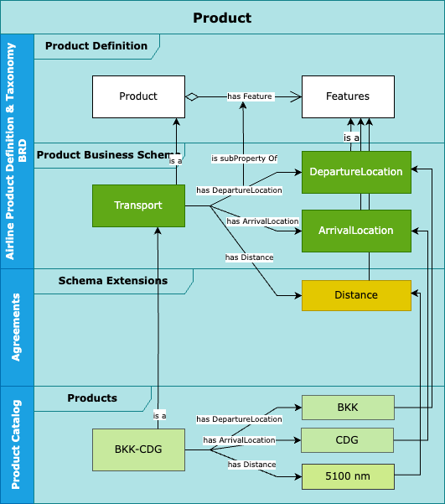
Product Definition
Describing product in the Retailer / Supplier for automated processing
Notes:
Solutioning :
Develop the grammar (in such a way that the schemas are void of interpretation, including on how to serialize the objects )
Develop the fully speced business schemas based on the grammar

Slide 10
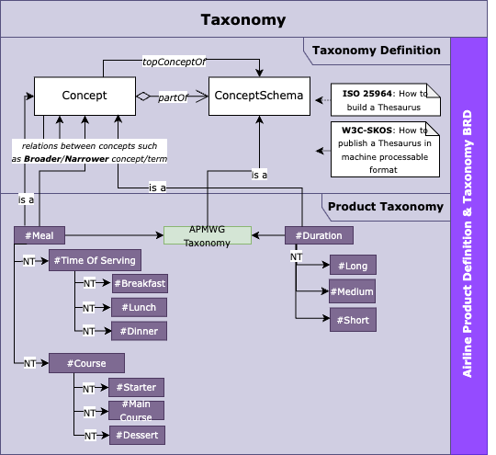
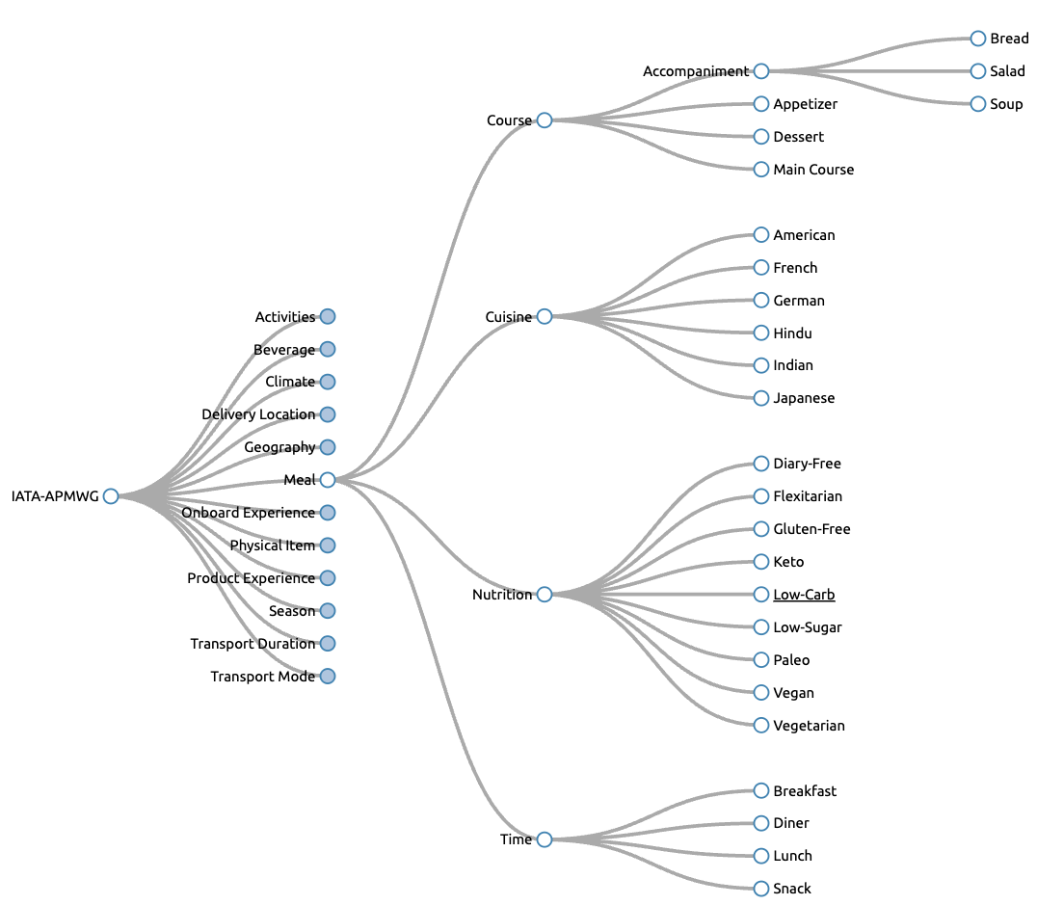
Taxonomy
Applied to the Retailer / Supplier model
Notes:
Solutioning: Implementation of the ISO standard ( own, choose from skos etc or something else in all cases we need a serialization of that as well and if possible a unique reference at IATA level to be referenced

Slide 11

Business process design
Value Chain
Enabling a retailer to market, offer and sell products from one or more suppliers
Business Processes enabling the Value Chain
Such as :
Enter into Agreement ←
Product Management ←
Supplier Offer ←
Supplier Order
Manage Delivery

Slide 12
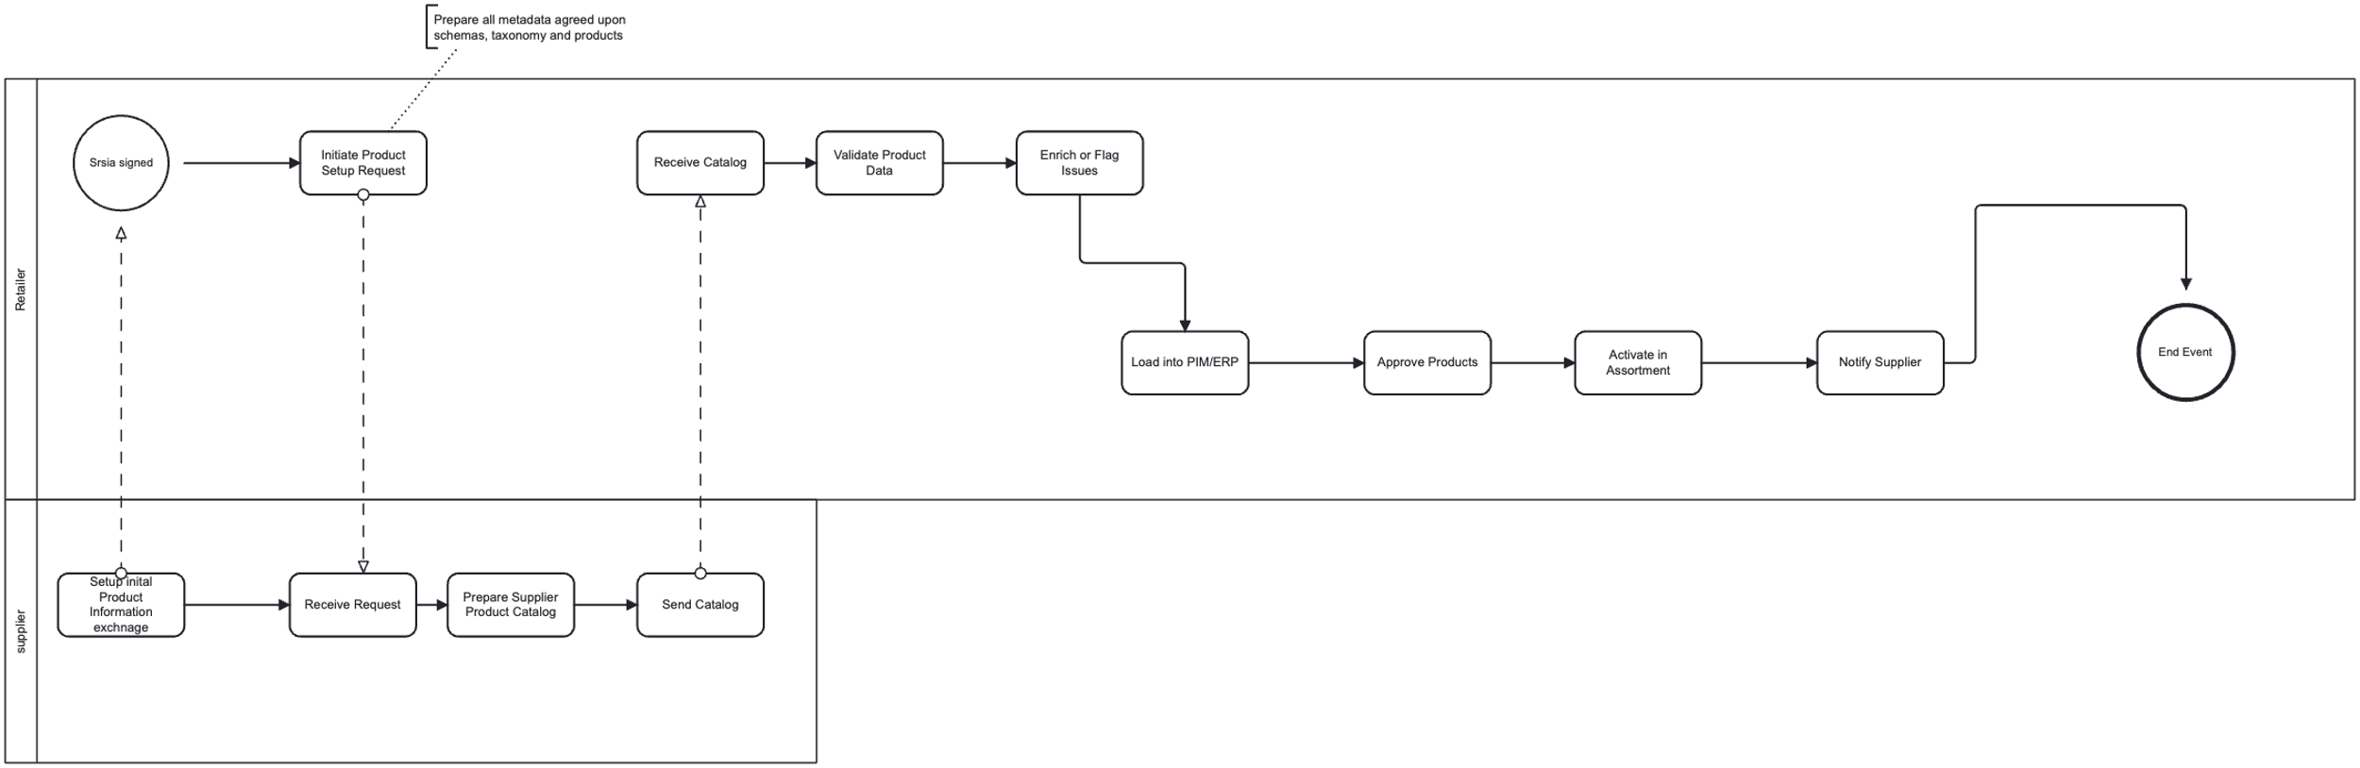
Business process design
Applied to the Retailer / Supplier model
Expected outcome : Full business process description
in BPMN format as the basis for implementation
Level 2 : Enter into Agreement
Level 3 Create -> Execute -> Maintain
Level 4 : Select set of products to be retailed by Retailer
Level 4 : Align/extend Product Schemas
Level 4: Align/extend Taxonomy
Level 2: Product Management
Level 3 : Supplier : create initial supplier catalog artefacts ( schema, taxonomie , products, … )
Level 3 send supplier catalog artefacts to retailer(s)
Level 4: Serialize -> Package -> Send
Level 4: Receive -> Unpack – Deserialize
Level 3 status change on any artefact -> maintain(s) catalog / send delta to retailer
….
➔The full process design from a business perspective is TBD
Level 2: Supplier Offer ←
Usage of the Product Catalog to request offers from a supplier for all products which are under stock/pricing and delivery control by the supplier.
➔ E2E group
Notes:
and where APMWG is in the lead and where handover is happening to implementation
For our purpose we shall only consider here the information objects ( catalogs and their information content, product definition, product schema, products as well as the taxonomy ) and highlight those in the LVL2 and LVL3 process designs as needed.

Slide 13
Execution: Layered Design Model
Notes:
As consequence we need a full flexible and extensible framework which nevertheless can be automated in terms of processing on a large industry scale as there are n:m agreeements in place
As an airline I have 1:n partner agreements and I am part

Slide 14
Layered model for product data sharing
Layer | Name | Role in Data Sharing | Typical Owner | Layer 0 Governance/architecture Strategic decisions on integration style, platform governance, ecosystem roles (e.g. peer-to-peer vs. hub-and-spoke) Defines what processes exist, who owns them, and which organization plays what role (e.g. supplier vs. retailer responsibilities).
7 | Business Semantics Layer | Understand the meaning of product data (e.g. "what does 'SKU' mean?") Understanding what fields mean: is "GTIN" the same as "EAN"? What qualifies as a “product schema”? Defines the meaning behind the process (e.g. "Product Approval", "Item Listing") — ensures all parties interpret process terms the same way. | Business / Data Governance
6 | Data Standards & Mapping Layer | Align formats & definitions (e.g. IATA, GS1, ETIM, custom mappings) Understanding what fields mean: is "GTIN" the same as "EAN"? What qualifies as a “product family”? Ensures data needed in processes is structured consistently (e.g. product lifecycle stage, availability status). | Business / Data Management / IT
5 | Data Governance & Validation | Ensure data quality, rules, validation (e.g. mandatory fields, code lists) Rules: “Short Description” must be < 100 characters; “Brand” cannot be empty; Units must be standardized. Defines rules within processes — e.g. “Every product must be approved before being published.” | Business/ Data Stewards / IT
4 | API / Data Exchange Protocols | Define how data moves (e.g. JSON over REST, XML, EDI, GS1 GDSN) REST API for real-time sync, CSV over SFTP for bulk upload, EDI for legacy partners. As decided upon in layer 0/8 | IT / Integration Architects
3 | Service Layer / Orchestration | Business logic & workflows (e.g. sync updates, batch processing) Middleware that routes incoming data, applies business logic (e.g. deduplication, version control). Executes the actual workflows (e.g. product onboarding, change propagation). This is where BPM tools, middleware, and workflow engines operate. | IT / Middleware / Integration
2 | Connectivity Layer | Network & endpoint connections (e.g. HTTPS, VPN, AS2) Secure data transport, network protocols, firewall configuration. | IT Infrastructure
1 | Infrastructure Layer | Physical systems, cloud, storage, uptime, etc. Cloud platforms (AWS/Azure), database storage, message queues (Kafka), etc. | IT Ops / Cloud Teams

Slide 15
Layered model for product data sharing
Typical Decision Points and Questions at Layer 0 (Governance)
Integration Topology:
Point-to-point (P2P): Each participant manages their own connections
Hub-and-spoke: One central service handles routing and transformation
Federated (like DNS or blockchain-style registry): Shared responsibility, distributed data
Who owns orchestration?
Central party (retailer, supplier platform, standards body)?
Each party builds their own logic?
Third-party service provider?
Scalability and onboarding
How easy is it to onboard new partners?
Who pays for integration efforts?
Resilience and auditability
Is the system fault-tolerant?
Who can trace and audit changes?

Slide 16
ANNEX
Notes:
As consequence we need a full flexible and extensible framework which nevertheless can be automated in terms of processing on a large industry scale as there are n:m agreeements in place
As an airline I have 1:n partner agreements and I am part

Slide 17
Layered model for product data sharing
In this model for product data sharing, architecture decisions on how information is exchanged (e.g., point-to-point vs. centralized/distributed hub like DNS-style) typically sit at Layer 3 (Service Layer/Orchestration), but are strongly influenced by architecture principles defined at an overarching “Layer 0” — the Enterprise Architecture or Governance Layer.
Notes:
Clarifying roles and responsibilities in the overall process and system design – Requirements , Process, Design vs Implementation

Slide 18
Product management information exchange process
Send
Serialize → Package → Send
Serialize ( PMI(Type) ) // transform the information into a ‘text’ format information to be send // aka like writing the letter
Package ( Serialize(PMI(Type)), Transaction) // what to do with the information // aka putting the letter into an envelope together with instructions // what to do with the letter as well as any other information needed
Ship (Package (Serialize(PMI(Type) ), Transaction), Destination) // send to destination
Receive
Unpack → Deserialize → Apply
Unpack()
Deserialize()
Apply()
Notes:
As consequence we need a full flexible and extensible framework which nevertheless can be automated in terms of processing on a large industry scale as there are n:m agreeements in place
As an airline I have 1:n partner agreements and I am part

Slide 19
Business problem to solve
Coorp A
Coorp B
Retail agreement
Shop A retails
Shop B retails
Notes:
As consequence we need a full flexible and extensible framework which nevertheless can be automated in terms of processing on a large industry scale as there are n:m agreeements in place
As an airline I have 1:n partner agreements and I am part
Exchange of product information for retailing purposes ( presentation, search, offer construction )
In order to make that work we need a common understanding of what the exchanged information means

Slide 20
Layered model for product data sharing with Layer 0 – other omitted for brevity
Layer | What Happens | Who’s Involved | Examples
Layer 0 (Governance/Architecture) | Strategic decisions on integration style, platform governance, ecosystem roles (e.g. peer-to-peer vs. hub-and-spoke) Defines what processes exist, who owns them, and which organization plays what role (e.g. supplier vs. retailer responsibilities). | Enterprise Architects, Business Architects, IT Architects, possibly Legal | “Should we build a decentralized model like GDSN, or a central integration hub?”
Layer 3 – Orchestration Layer | Implementation of the chosen integration pattern: workflows, routing, transformations | Solution Architects, Integration Developers | Microservices, pub-sub messaging, managed APIs, workflow engines
Layer 4 – API / Protocol Layer | Design of technical interfaces and messaging protocols | Integration Architects, API Owners | REST, GraphQL, EDI, etc.

Slide 21
Business process design
Basic Levels of business processes design (EPC based):
LVL 0 Business Domaining / Capability Mapping
0.1 Sub Domains / Capability
LVL 1 Value Streams / Main Processes
Purpose is to provide the entry for the process breakdown for processes such as Customer Journey, Order to Cash
Business Goals
LVL 2 Event driven process flows / Work process
Purpose is to model process flows e.g. Check-in flow
End to end processes
LVL 3 Event driven process flows / Interaction process
Purpose is to detail sub processes e.g. do payment in the order flow
More detailed activities & roles
LVL 4 Function Allocation / Interaction model
Purpose is to capture any other related aspect of a process like e.g. information objects, systems or organizational aspects implementation & automation, systems integration
LVL 0 and 0.1 is typically build by business architecture
LVL 1,2,3,4 design is typically done by
Subject Matter experts, Business Analysts , Business Process Managers or similar with the support of business architecture
Notes:
As consequence we need a full flexible and extensible framework which nevertheless can be automated in terms of processing on a large industry scale as there are n:m agreeements in place
As an airline I have 1:n partner agreements and I am part
capture related aspects
of a process, like data, systems, organization etc
Lvl ‘ mmore in // rather than at the bottom …

Slide 22
Layered model for product data sharing Realworld analogies
Approach | Like | Implication
Point-to-Point | Airlines sharing bilateral NDC APIs | Flexible but brittle — high effort per new partner
Central Hub | Amazon Vendor Central, GS1 GDSN, Sabre | One API to many — easier to scale, central governance required
Federated (DNS-style) | DNS, blockchain-based sharing, directory models | Distributed trust, complex but scalable if governed well

Slide 23
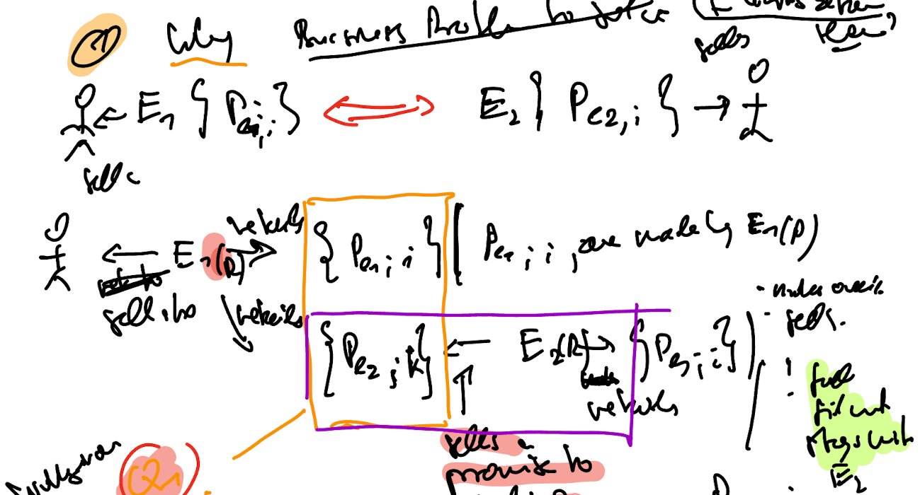
Business problem to solve
Schema recap
Notes:
As consequence we need a full flexible and extensible framework which nevertheless can be automated in terms of processing on a large industry scale as there are n:m agreeements in place
As an airline I have 1:n partner agreements and I am part

Slide 24
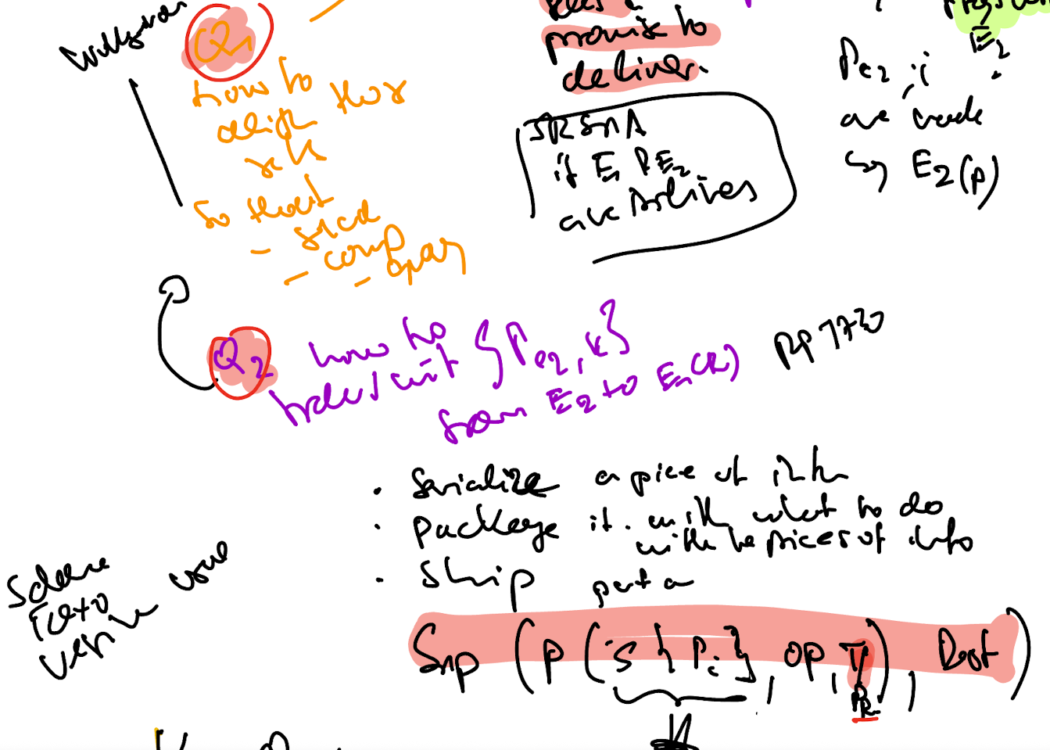
Key Questions which arise from the Business problem

