Slide 1



Airline Product Management Working Group
Introduction to
Product Definition and Taxonomy
G. Baues AirFrance/KLM

Slide 2
Agenda
Business problem
Base requirements
Base principles
Extended Requirements
Business processes
Business Information model layering
Notes:
As consequence we need a full flexible and extensible framework which nevertheless can be automated in terms of processing on a large industry scale as there are n:m agreeements in place
As an airline I have 1:n partner agreements and I am part
Bilateral agreements between Seller, Retailer, Supplier as well as Delivery providers
Additional principles
Full freedom on the nature and choice of products being part of such an agreement. The agreement can change ovetime wrt to products as well as the information exchanged
There will be n:m exchange channels for each participant in the ecosystem the number of bilateral partners is not the same for anyone nor the nature of the partners

Slide 3




Business problem to solve
Coorp A
Coorp B
Retail agreement
Shop A retails
Shop B retails
Notes:
As consequence we need a full flexible and extensible framework which nevertheless can be automated in terms of processing on a large industry scale as there are n:m agreeements in place
As an airline I have 1:n partner agreements and I am part
Exchange of product information for retailing purposes ( presentation, search, offer construction )
In order to make that work we need a common understanding of what the exchanged information means

Slide 4

Base requirements Retailer ← Supplier
Assuming we have n partners whose products we can retail
Coorp A
Base requirements :
Understand (read and interpret) the product management information contained in the n suppliers sets,
Align all sets including our own, so that the shop can retail them.
Notes:
As consequence we need a full flexible and extensible framework which nevertheless can be automated in terms of processing on a large industry scale as there are n:m agreeements in place
As an airline I have 1:n partner agreements and I am part

Slide 5
Base requirements Supplier ← Retailer
There are m partners retailing Coorp A products
Coorp A
*
Base requirements :
Create and transfer m sets in such a way that all can read and interpret them, m is the number of partners who can retail our products (not shown here on the schema)
Maintain up-to-date all m sets of product management information with the retailer(s)
*
I didn’t parametrize the formula it should read B_{i} ; with 1 <= I <= m
Notes:
As consequence we need a full flexible and extensible framework which nevertheless can be automated in terms of processing on a large industry scale as there are n:m agreeements in place
As an airline I have 1:n partner agreements and I am part

Slide 6
Base principles
All product management information exchange is based done on a bilateral agreement.
This agreement shall contain all cover all information required to be able to exchange product information and retail those products, such as, but not limited to,
Specific product attributes ( extensions of the std IATA model)
Alignment on language, taxonomy
Rules and constraints related to the products for use by the retailer in offer construction
In order for the agreement and the exchange to work a common flexible and extensible framework has to be established to enable the base requirements as outlined before.
A complete set of principles is available in the Product Information Exchange BRD
Notes:
As consequence we need a full flexible and extensible framework which nevertheless can be automated in terms of processing on a large industry scale as there are n:m agreeements in place
As an airline I have 1:n partner agreements and I am part

Slide 7
Extended Requirements
Opening up the base requirements
It is required that every participant in the retailer / supplier eco-system can :
Create, Update, deprecate and delete their products, in general maintain full control on the lifecycle of their products at any time.
Define any product management information needed and possibly shared between partners such as but not limited to:
Features and attributes of their products as they see fit.
The lifecycle states of their products as they see fit.
Add any other type of information they require for their business processes
In the case of the retailer, all the information received, can be used in any form or shape or combination to request offers from the supplier. Offer requests shall stay within the limits of the product management information made available by the supplier.
Considering the nature of the n:m exchanges it is required that :
A common language and business process is designed for reading and interpretation of received product management information considering that it would be unfeasible to treat every single bilateral agreement based on different syntax and semantics.
Based upon the above capabilities of the retailer / supplier ecosystem this framework has to have the capability to be flexible and extensible allowing for any type of product management information to be added, amended, deleted, etc. at any time.
It is required to design a flexible integration architecture allowing for different types of interaction between any two partners to be chosen from as they see fit ( point to point, hub and spoke etc … )
The schema on slide 4/5 denotes the complexity of bilateral point to point integration with a possibly very large number of integrations creating a considerable amount of configuration / administrative work.
Notes:
As consequence we need a full flexible and extensible framework which nevertheless can be automated in terms of processing on a large industry scale as there are n:m agreeements in place
As an airline I have 1:n partner agreements and I am part

Slide 8
Common language
The core for efficient communication between retailer and suppliers
Foremost: A grammar for defining product schemas:
A product schema provides a ‘template’ for a class of products:
Any product schema can be defined between two partners based on the grammar.
Secondary a set of product schemas ‘ready to use’ based upon the grammar:
APMWG will provide a set of ready to use product schemas e.g. Transport, Bag, Lounge,…
Taxonomy: An extensible ‘ready to use’ taxonomy
Based on taxonomy standards to enable adaptations as required for the retailer / supplier relationship
Notes:
Grammar requirement: products, features, reference systems, metadata which can bedefined flexibly between parners e.g. Delivery statuses I can expect to recieve

Slide 9
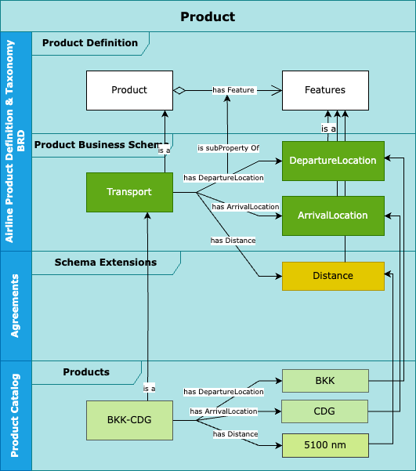
Product Definition
Describing product in the Retailer / Supplier for automated processing
Notes:
Solutioning :
Develop the grammar (in such a way that the schemas are void of interpretation, including on how to serialize the objects )
Develop the fully speced business schemas based on the grammar

Slide 10
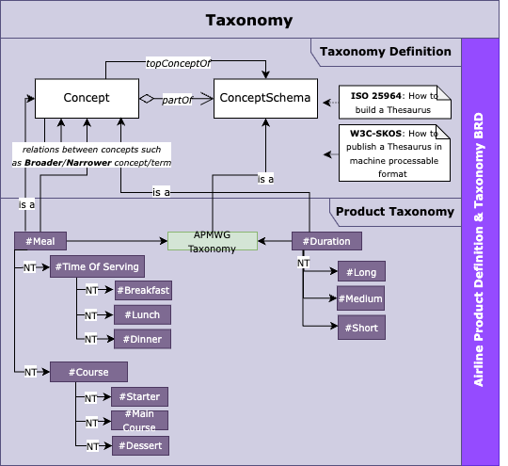
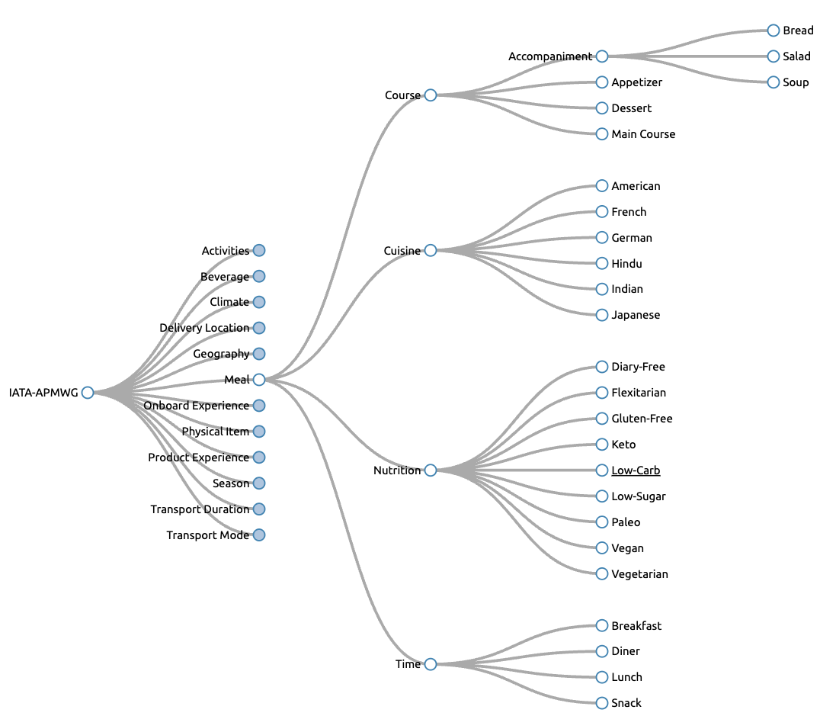
Taxonomy
Applied to the Retailer / Supplier model
Notes:
Solutioning: Implementation of the ISO standard ( own, choose from skos etc or something else in all cases we need a serialization of that as well and if possible a unique reference at IATA level to be referenced

Slide 11

Business process design
Value Chain
Enabling a retailer to market, offer and sell products from one or more suppliers
Business Processes enabling the Value Chain
Such as :
Enter into Agreement ←
Product Management ←
Supplier Offer ←
Supplier Order
Manage Delivery

Slide 12
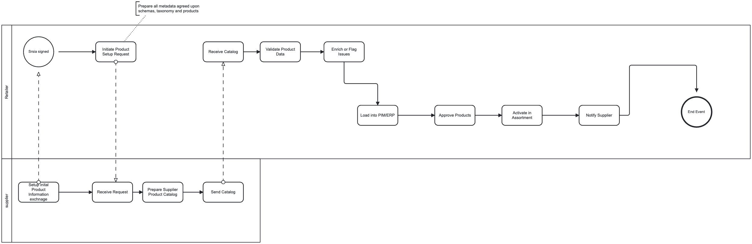
Business process design
Applied to the Retailer / Supplier model
Expected outcome : Full business process description
in BPMN format as the basis for implementation
Level 2 : Enter into Agreement
Level 3 Create -> Execute -> Maintain
Level 4 : Select set of products to be retailed by Retailer
Level 4 : Align/extend Product Schemas
Level 4: Align/extend Taxonomy
Level 2: Product Management
Level 3 : Supplier : create initial supplier catalog artefacts ( schema, taxonomie , products, … )
Level 3 send supplier catalog artefacts to retailer(s)
Level 4: Serialize -> Package -> Send
Level 4: Receive -> Unpack – Deserialize
Level 3 status change on any artefact -> maintain(s) catalog / send delta to retailer
….
➔The full process design from a business perspective is TBD
Level 2: Supplier Offer ←
Usage of the Product Catalog to request offers from a supplier for all products which are under stock/pricing and delivery control by the supplier.
➔ E2E group
Notes:
and where APMWG is in the lead and where handover is happening to implementation
For our purpose we shall only consider here the information objects ( catalogs and their information content, product definition, product schema, products as well as the taxonomy ) and highlight those in the LVL2 and LVL3 process designs as needed.

