Slide 1

Airline Product Management Working Group Update
21 November 2025

Slide 2
AGENDA
Why Product Management matters – Arina Soloveva (Air Canada)
What is Product Management – Arina Soloveva (Air Canada)
Introduction to APMWG - Arina Soloveva (Air Canada)
Overview of the product catalogue – Pranathi Karanam (Emirates)
What is in scope and what is out of scope - Pranathi Karanam (Emirates)
How is product defined : Product Definition Vs Taxonomy Definitions – Gregor Baues (Air France)
Diagrammatic representation of supplier catalogue - Gregor Baues (Air France)
Diagrammatic representation of Airline profile – Navid Abassi (ATPCO)
Flow between retailer and supplier - Navid Abassi (ATPCO)
Base principles and extended requirements - Gregor Baues (Air France)

Slide 3
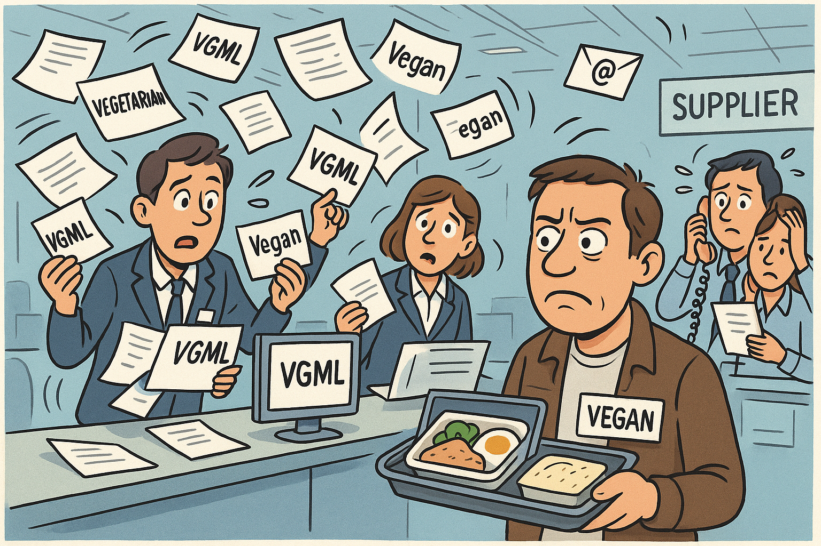
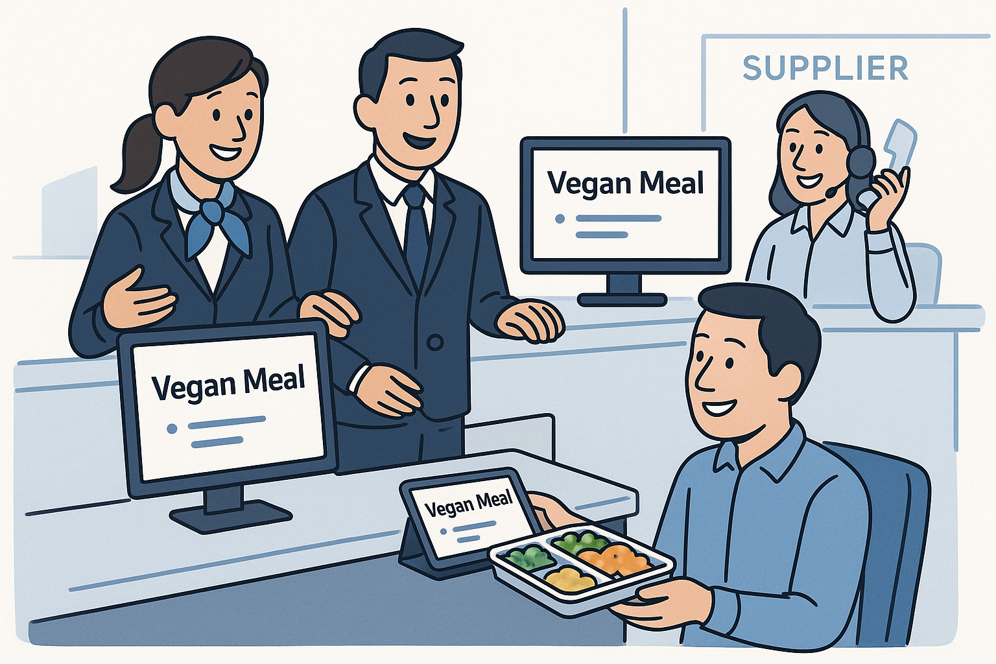
Why Product Management Matters
vs.
When definitions don’t align…
When Product means the same for everyone…

Slide 4
Product Management in Modern Airline Retailing
Consistent Interpretation
Guarantees all parties understand products the same way
Information Sharing
Ensures consistent communication across partners
Product Structure
Organizes how products are presented
Product Definition
Defines what the airline sells

Slide 5




APMWG Work Streams
Supplier Catalogue
Taxonomy
Airline Profile
End-to-End
Delivery of initial BRD focused on taxonomy schemas :
Standardization and Consistency
Extensibility
Ontology and Semantic Relationships
Interoperability Standards
Controlled Vocabulary Management
Initial BRD delivered March 2024 for Data Exchange. Supplier Catalog BRD refinement needs identified:
Taxonomy Concept Integration
Product Description Use Cases
Data Exchange Refactoring
The group focus is on developing the use cases and establishing the overall scope based on the following:
Use Case Development
Optimize System Load
Enhance Query Routing
Dedicated research of implementing the new PM framework for the end-to-end business needs of the airline:
Scope Definition
Ecosystem Impact Analysis
Intergroup Dependencies
Stakeholder Collaboration

Slide 6
Product Catalogue | Variants
Purpose
Content
Usage
Internal master source for all product and service data
All airline-owned products and services
Offer creation and internal distribution
Airline own catalogue
Facilitates exchange between supplier and retailer
Products suppliers allow retailers to sell
Exchange between supplier and retailer
Supplier Catalogue
Used for distribution to sellers
What products/services the retailer wants offer requests for
Airline Profile
Distribution to sellers

Slide 7
Product Catalogue | Out of scope
Prices
Prices are excluded.
Stock keeping (Inventory)
Inventory levels not available in the catalogue.
Out of scope
Offers
Third parties cannot create offers independently.
Schedules
Complete schedules not in Supplier Catalogue.

Slide 8
Product Definition vs Taxonomy Definitions
Product
Characteristic
Product Definition
Product Taxonomy
Product definition
Taxonomy definition
Purpose
Promise to customer
Customer-facing tags
[HealthyChoice], [PlantBased]
[Tags categorize the product effectively]
Example
Meal → Type: Vegan
Features
Concepts
Interoperability between Partners
Makes Products easier to find, compare and manage
Benefit
Values
Tags
Type: Vegan
Taste: #spicey
Meal
Seat Pitch: 60 inches
Experience: #spacious leg rom
Seat
Destination: Miami
Weather: #sunny beaches
Transport

Slide 9
Airlines own Product Catalogue vs. Supplier Catalogue
Supplier
Retailer
Airline A
Supplier catalogue between A&B
Transport : Seg1/Seg2
Airline B
Airlines A’s Product catalogue
Transport: Seg1/Seg2/Seg3
Lounge: Lounge1/Lounge2
Meal: Meal1/Meal2
Seat: Seat1/Seat2/Seat3
Bag: Bag1/Bag2
Supplier catalogue between A&C
Transport : Seg3
Bag : Bag2
Airline C
Supplier catalogue between A&D
Transport : Seg1
Railways D
The airline’s full product set is selectively shared through partner-specific Supplier Catalogues. Each defines which products are exchangeable between two parties.
Notes:
This diagram illustrates the difference between an Airline’s Own Product Catalogue and the Supplier Catalogues it shares with partner airlines or intermodal operators.
On the left, we have Airline A, which acts as a supplier. It owns and maintains a comprehensive Product Catalogue, containing all of its products — flights, seats, bags, meals, and lounges. This internal catalogue is the airline’s master source of truth for everything it can offer — but not everything in it is shared externally.
When Airline A collaborates with partners — such as Airline B, Airline C, or Railways D — it establishes a Supplier Catalogue for each partnership. Each Supplier Catalogue contains a subset of Airline A’s products that are relevant for that particular retailer relationship.
For example:
With Airline B, Airline A shares Flight Legs 1 and 2 through a Supplier Catalogue, enabling B to include those flights in combined itineraries.
With Airline C, the shared catalogue includes Flight Leg 3 and Bag 2, reflecting that partnership’s scope.
With Railways D, only Flight Leg 1 is included — perhaps as part of a rail–air intermodal connection.
Each Supplier Catalogue therefore serves as a mutually agreed “data contract” between two parties, governed by standards such as SRSIA (Standard Retailer–Supplier Interline Agreement). It defines which products can be exchanged, how they’re described, and how they’re used in offer creation.
In short:
The Airline’s Own Catalogue = complete, internal source of all products.
The Supplier Catalogues = filtered, relationship-specific subsets shared with other retailers.
This structure ensures that each partner receives only the data that is relevant, while maintaining global consistency through standardised product definitions (as defined by RP1730).

Slide 10


Airlines own Product Catalogue vs. Airline profile
Retailer
Seller
Airline A
Travel Agent
Airlines A’s Product catalogue
Transport: Seg1/Seg2/Seg3
Lounge: Lounge1/Lounge2
Meal: Meal1/Meal2
Seat: Seat1/Seat2/Seat3
Bag: Bag1/Bag2
Airline profile
O&D Pair : OD1/OD2/OD3
OTA
Tour Operator
The Airline Profile communicates to sellers which products and routes the airline is ready to offer, guiding how external partners can request offers.
Seller
Supplier
Airline A
Airlines A’s Product catalogue
Transport: Leg1/Leg2/Leg3
Lounge: Lounge1/Lounge2
Meal: Meal1/Meal2
Seat: Seat1/Seat2/Seat3
Bag: Bag1/Bag2
Airline profile
Transport : OD1/OD2/OD3
Notes:
This diagram shows how an airline’s internal product management connects to the external marketplace via the Airline Profile.
On the left, Airline A acts as both the supplier and retailer of its own products. It maintains an Airline Own Product Catalogue, which includes every element the airline can sell or deliver — flights (transport legs), seats, bags, meals, and lounges. This catalogue is the master source of all product and service data and is primarily used internally — for offer creation, operational processes, and fulfilment.
However, when Airline A wants to make its products visible to the external marketplace — such as travel agents, online travel agencies (OTAs), and tour operators — it doesn’t share the entire internal catalogue. Instead, it publishes an Airline Profile, which is a filtered and structured view of the airline’s product data.
The Airline Profile describes what kinds of offers the airline is willing to respond to — essentially defining the scope of what sellers can request. For example:
The Airline’s own catalogue may list every possible flight leg (Leg1, Leg2, Leg3).
The Airline Profile may describe them in terms of offerable transport combinations (OD1, OD2, OD3 — Origin-Destination pairs).
This means sellers like Expedia, Amadeus, or corporate travel agents can see where and what the airline can offer, but not operational details like seat inventory, internal identifiers, or pricing rules.
By doing this, the Airline Profile:
Filters out irrelevant data (so sellers only request meaningful offers).
Enables faster, cleaner offer requests and responses.
Keeps sensitive internal data (e.g., configurations or rules) private.
In short:
The Own Product Catalogue is about defining and managing all airline products internally.
The Airline Profile is about exposing those products in a standardized way to external sellers — controlling how the airline is seen and requested in the market.

Slide 11


Flow between Seller, Retailer and Supplier
Request offers based on Airline Profile
Retailer Airline A Offer Engine
Airline Profile
Seller
Traveler
Request sub-offers based on Supplier Catalog
Retailer Airline B Offer Engine
Request offers based on Airline Profile
Supplier Airline C
Notes:
This diagram shows how an offer (what the traveler ultimately sees and buys) is assembled and distributed across the airline retailing ecosystem.
Let’s walk through it step by step:
The Traveler begins the journey by searching for a trip, for example, a flight from Frankfurt to New York.
This request goes to a Seller such as an online travel agency (OTA), a travel agent, or a metasearch engine.
The Seller doesn’t create offers itself.
It uses the Airline Profile Database, which contains standardized information about what each airline (acting as a retailer) wants to receive offer requests for e.g., “Flights from Europe to North America,” “Meal upgrades,” “Extra baggage,” etc.
The Seller uses this profile to request offers from multiple Retailer Airlines that match the search.
Each Retailer Airline (for example, Airline A or Airline B) has an Offer Engine.
This engine builds a customized offer for the traveler using the airline’s own product catalogue (flights, seats, meals, etc.).
However, the retailer may also need to combine content from Supplier Airlines to complete the journey (e.g., Lufthansa selling a ticket that includes a United Airlines leg).
When that happens, the Retailer Airline sends sub-offer requests to its partner airlines (suppliers) using the Supplier Catalogue which defines what those partners allow it to sell.
For example, Airline B might request a sub-offer for a connecting leg from Airline C.
The Supplier Airline (Airline C) returns the sub-offer to the retailer.
The retailer’s Offer Engine then combines all elements - its own flight, the supplier’s leg, plus ancillaries like bags or meals - into one final offer.
The Retailer Airline sends that complete offer back to the Seller, which displays it to the Traveler for purchase.

Slide 12

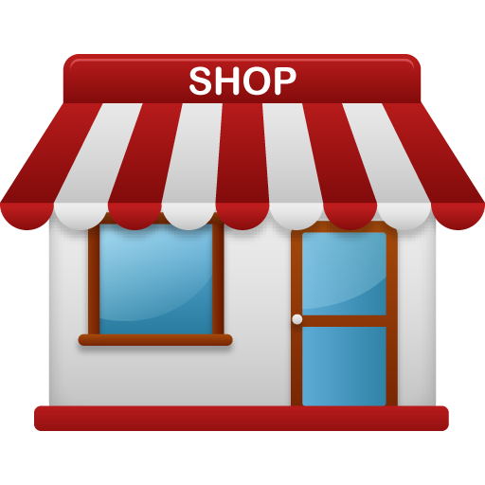
Business Problem to solve
Corp A
Corp B
Retail agreement
Traveler
Traveler
Shop A production
Shop B production
Shop A retails
Shop B retails
Notes:
This slide sets up the context and motivation.
It explains that:
In airline retailing, there are two key roles:
Retailer → sells products to the traveler.
Supplier → provides or produces the product that is sold.
Every retailing relationship is a bilateral agreement (one retailer + one supplier).
Each airline can act as both a retailer and a supplier, depending on the context.
Example:
Lufthansa (Retailer A) sells a combined journey that includes a leg operated by United (Supplier B). To make this work, Lufthansa’s “shop” needs product data from United’s “production.”
The customer only sees one offer but in the background, multiple airlines exchange and align product data and offer logic.
The business problem is that:
Each of these relationships requires a consistent and interpretable exchange of product information and when you multiply this across hundreds of partners, the complexity explodes.
Hence, airlines need:
A flexible and extensible framework (like the IATA Product Catalogue standards).
A shared language and structure for product information across all retailing relationships.

Slide 13
Base requirements | Retailer - Supplier
Corp A
Assuming we have n partners whose products we can retail
Traveler
Base requirements :
Understand (read and interpret) the product management information contained in the n suppliers sets,
Align all sets including our own, so that the shop can retail them.
Notes:
Now we look at the retailer’s perspective- the airline that sells products from others.
In the diagram:
Coorp A = the retailer airline.
The shop represents its retail platform (e.g., airline website or offer engine).
To the right, there are n suppliers - other airlines or partners who provide products that the retailer can sell.
Meaning of “n”:
“n” represents the number of supplier partners the retailer works with. So, if Lufthansa sells products from 50 different partners, n = 50.
What the slide shows:
For Coorp A to sell partner products, it must:
Understand each partner’s product data model (read and interpret the product management information from n suppliers).
Align all of them with its own catalogue structure, so its “shop” can combine and retail those products consistently.
That means Coorp A needs to:
Integrate data from all suppliers’ catalogues.
Map attributes like “Seat Type,” “Meal Type,” “Service Class,” etc.
Ensure compatibility across partners.
Without standardization, this becomes a massive technical and operational burden.
In short:
As a retailer, I must interpret and align n different supplier catalogues so my shop can retail all partner products consistently.
This is the first half of the industry problem: the retailer challenge.

Slide 14
Base requirements | Supplier - Retailer
Corp A
There are m partners retailing Corp A products
Traveler
Base requirements :
Create and transfer m sets in such a way that all can read and interpret them, m is the number of partners who can retail our products
Maintain up-to-date all m sets of product management information with the retailer(s)
Notes:
This slide flips the perspective, now we’re the supplier airline providing products to multiple retailers.
In the diagram:
Coorp A = the supplier (producer airline).
There are m retail partners on the right who sell Coorp A’s products.
Meaning of “m”:
“m” represents the number of partners who retail Coorp A’s products. For example, United’s flights might be sold by 30 different partners (m = 30).
What the slide shows:
As a supplier, Coorp A must:
Create and transfer m product data sets so that each retailer can correctly interpret and sell Coorp A’s products. That means Coorp A needs to adapt its product information for every partner it collaborates with.
Keep all m product sets up to date as products change (new ancillaries, fare attributes, updates, etc.).
This creates enormous data maintenance and synchronization challenges if there’s no common product data standard.
In short:
As a supplier, I must create and maintain m consistent product catalogues so all my retailers can read, interpret, and sell my products correctly.
This is the second half of the problem- the supplier challenge.

Slide 15
Base Principles
Common Framework
Flexible, extensible grammar, shared taxonomy definitions, interoperability for all bilateral links
Product Exchange
Product features, Alignment on taxonomy & language, Data representation (schema)
Bilateral Agreement
Between Seller, Retailer and Supplier; defines exchange scope, rules, permissions
Every bilateral agreement relies on a shared framework that defines how product information is structured and understood, ensuring that each partner can exchange and retail products consistently.
Notes:
As consequence we need a full flexible and extensible framework which nevertheless can be automated in terms of processing on a large industry scale as there are n:m agreeements in place
As an airline I have 1:n partner agreements and I am part

Slide 16
Extended Requirements
Control and Lifecycle Management
Each participant must be able to create, update, deprecate, or delete products at any time, maintaining full control over their own product lifecycle.
1
Product Information Definition
Participants may define and share any required product management data, including product features and attributes, lifecycle states & additional business-relevant metadata.
2
Retailer Data Usage
Retailers may use received supplier information in any valid form or combination to construct Offers, within the limits of the data shared through the Supplier Catalogue.
3
Common Language and Business Process
A shared interpretation framework must exist for reading and processing exchanged product information, ensuring semantic consistency across all bilateral agreements.
4
Flexible Integration Architecture
The framework must support multiple interaction models (point-to-point, hub-and-spoke, or hybrid) to accommodate different implementation choices between partners.
5

Slide 17
Common Language
Common Structure
Standardized Templates
Shared Vocabulary
Defines a shared framework for product definitions.
Offers ready-to-use schemas for quick implementation.
Establishes a flexible language for product definitions.

Slide 18
Thank you!

Slide 19
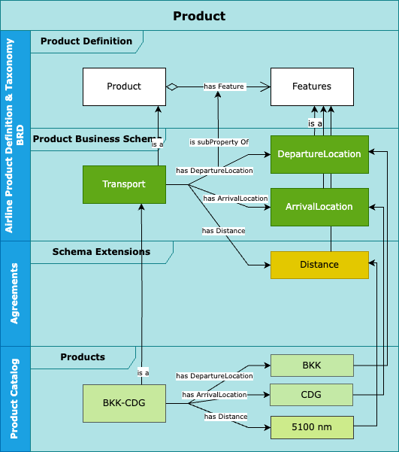
Product Definition: Describing product in the Retailer / Supplier for automated processing

Slide 20
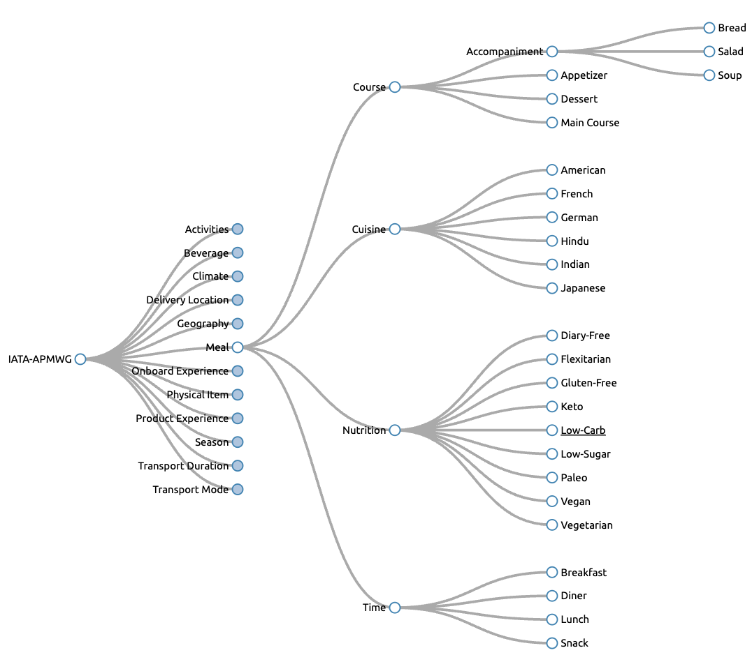
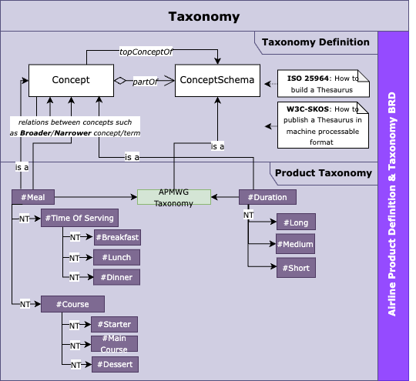
Taxonomy: Applied to the Retailer / Supplier model

Slide 21

Business Proces Design
Value Chain
Enabling a retailer to market, offer and sell products from one or more suppliers
Business Processes enabling the Value Chain
Such as :
Enter into Agreement ←
Product Management ←
Supplier Offer ←
Supplier Order
Manage Delivery

Slide 22
Business Process Design
Expected outcome: Full business process description as the basis for implementation
Level 2 : Enter into Agreement
Level 3 Create -> Execute -> Maintain
Level 4 : Select set of products to be retailed by Retailer
Level 4 : Align/extend Product Schemas
Level 4: Align/extend Taxonomy
Level 2: Product Management
Level 3 : Supplier : create initial supplier catalog artefacts ( schema, taxonomie , products, … )
Level 3 send supplier catalog artefacts to retailer(s)
Level 4: Serialize -> Package -> Send
Level 4: Receive -> Unpack -> Deserialize
Level 3 status change on any artefact -> maintain(s) catalog / send delta to retailer
….
➔The full process design from a business perspective
Level 2: Supplier Offer
Usage of the Product Catalog to request offers from a supplier for all products which are under stock/pricing and delivery control by the supplier.
➔ E2E group
Notes:
and where APMWG is in the lead and where handover is happening to implementation
For our purpose we shall only consider here the information objects ( catalogs and their information content, product definition, product schema, products as well as the taxonomy ) and highlight those in the LVL2 and LVL3 process designs as needed.
Level 2: Enter into Agreement
Meaning:
This is the foundation step when two parties (e.g., Lufthansa and Singapore Airlines) establish their bilateral retailing relationship. They define:
Which products can be sold
How they are described
How both sides interpret and exchange product information
Levels of detail:
Level 3: Create → Execute → Maintain → The lifecycle of the agreement — it’s created, put into effect, and updated as needed.
Level 4 details:
Select which products the retailer will sell from the supplier’s catalogue
Align or extend product schemas (so both parties speak the same structural “language”)
Align or extend the taxonomy (so they use the same terminology, e.g., “seat type,” “meal type,” etc.)
✅ In practice: This ensures that Airline A and Airline B both interpret “Premium Seat” or “Lounge Access” the same way before they ever exchange data.
Level 2: Product Management
Meaning:
Once the agreement exists, both parties must manage their product data on an ongoing basis.
This covers:
Defining, packaging, and sharing the supplier’s catalogue with the retailer(s)
Ensuring data stays synchronized across updates
Levels of detail:
Level 3: Supplier creates initial supplier catalogue artefacts
Includes: product schemas, taxonomy, product definitions, and rules.
Level 3: Send supplier catalogue artefacts to retailer(s)
Level 4 actions:
Serialize → Package → Send (supplier side)
Receive → Unpack → Deserialize (retailer side)
Level 3: Status change
Whenever a product changes (e.g., updated meal type, new seat option), the supplier maintains its catalogue and sends “delta updates” to the retailer(s).
In practice: This ensures that when an airline changes, adds, or removes a product, all partner systems remain aligned and consistent.
Level 2: Supplier Offer
Meaning:
At this stage, the retailer requests actual offers from the supplier using the catalogue as the basis.
Now that the data is standardized and aligned, the retailer can dynamically generate offers for customers.
This is the operational use case of all the previous steps.
Details:
The product catalogue is used to request offers from the supplier.
This applies to all products controlled by the supplier (stock, pricing, delivery).
This process is part of the End-to-End (E2E) offer flow- from product definition to offer creation.
✅ In practice: When a traveler searches for a flight on a retailer’s site (e.g., a partner airline or OTA), the retailer’s system requests offers from the supplier airline using the aligned product catalogue and profile definitions.

Slide 23
Product Catalogue | Variants
Purpose
Content
Usage
Example
Facilitates exchange between supplier and retailer
Products suppliers allow retailers to sell
Exchange between supplier and retailer
Air Canada defines the “Vegan Meal” and “Transport Product”
Supplier Catalogue
Internal master source for all product and service data
All airline-owned products and services
Offer creation and internal distribution
Lufthansa uses “Vegan Meal” and “Transport Product”
Airline own catalogue
Used for distribution to sellers
What products/services the retailer wants offers for
Expedia uses “Transport product” provided by Lufthansa
Airline Profile
Distribution to sellers

