Slide 1



Making scientific research accessible using AI and Big data
Team Members :
1. Ganesh Rajendra Bajaj
2. Pratyush Sinha
3. Krunal Dubey
4. Audrey Fernandes

Slide 2
Problem statement:
Raiders of the lost Manuscript
As a scientific editing business unit, we get anything and everything to be worked on right from that 100 word abstract to 10000 words heavy dissertation.
As there are countless of online platforms where people publish their research and in different format, it becomes difficult to identify what type of manuscript it is without someone going through the document manually and deciding/tagging it as one of many. Sounds familiar to a certain group of unique document(s) used for identification of an individual, doesn’t it?
Well the idea is to not only detect what type of manuscript document it is but to also identify the structure it contains. To get the summarization and keywords from a document.

Slide 3
For example, a typical IEEE computer science paper follows a 2 column structure with a fixed sequence of Title, authors, abstract, keywords, introduction and so on.
What if we can also identify these structures and extract information/text per section? Well that is the next logical step given we are dealing with different types of media – PDFs, Infographics, Figures, Animated GIFs.
The idea over here is then simple –
We need to find how many manuscript doc types can we detect and structure. Obtain a summarization of given doc and also extract keywords.

Slide 4
APPROACH
Pytesseract OCR ( OPTICAL CHARACTER RECOGNITION ) to extract the text from document image.
Fine-tuning the LayoutLMForSequenceClassification model from Huggingface with RVL-CDIP dataset.
Built simple Extract-based-summarization using frequency count to get the summary of text.
Calculate the Tfidf scores for words from each category of document and get the top n (100) features.
Using the Tfidf scores we get the keywords from the text.
Create API using FastAPI.

Slide 5
Why should one choose our solution?
We used the LayoutLMForSequenceClassification model for document classification.
LayoutLM model makes use of the transformer network to capture the semantic relationship among words.
This state-of-the-art model can give accuracy from 93-94 %.
Further we also suggest to use text summarization to obtain a summary which can ease the document search.
Also the keywords obtained using tfidf scores can be used to narrow down the search in this big data era.

Slide 6
Limitations
Due to limited resources and time, we train the model on a small dataset of 50 docs for each of 16 category. Whereas the RVL-CDIP dataset contains 2500 docs images for each category.
Over the time, there may be data drift and concept drift due to the new emerging areas and big data. The environment may adapts new styles of writing docs or the underlying concepts of document may change leading to drift in data.
Unlike the semantic meaning, Tfidf scores captures the probabilistic importance.
This approach does not provide information on per section.

Slide 7
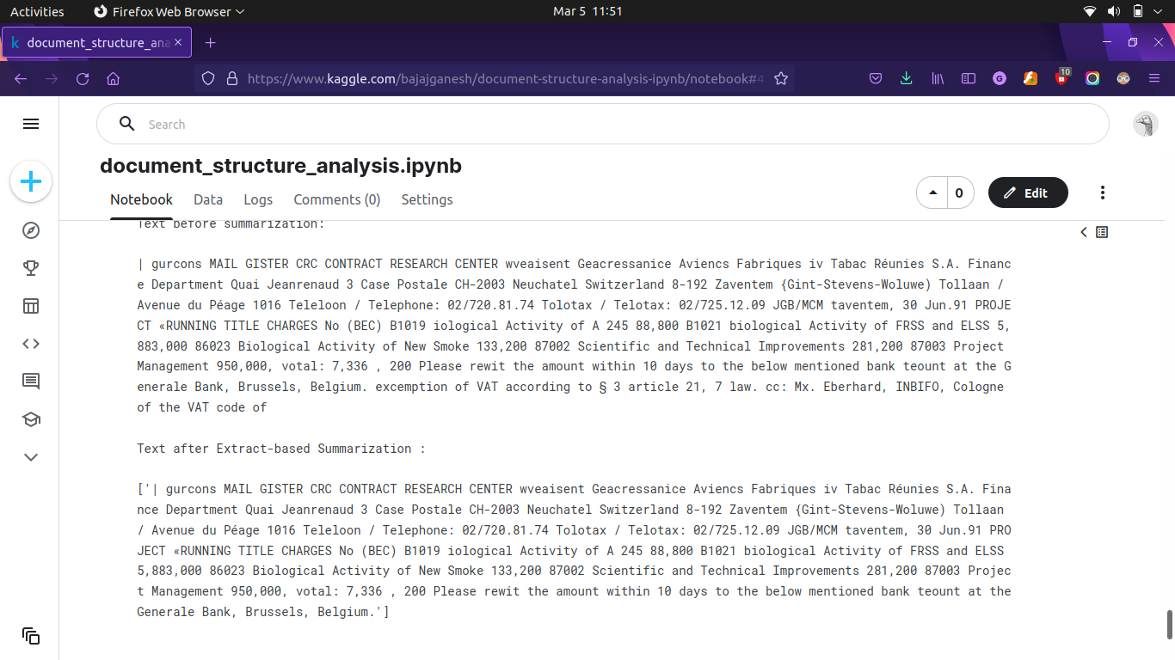

Slide 8
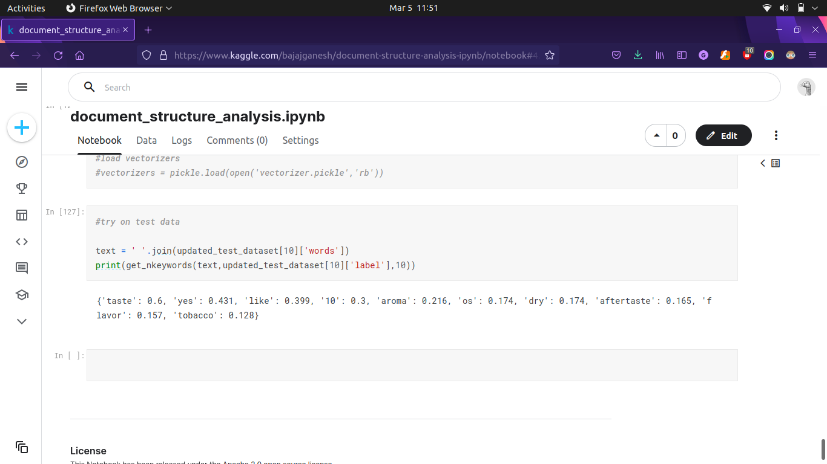

Slide 9
Future Scope
With enough resources preferably GPU LayoutLM model can be trained on big dataset achieving accuracy around 95 % as stated in research paper.
Panoptic segmentation can be used on the document image to extract information on per section basis like abstract, intro, advantages etc.
We can have abstract-based summarization using some advance deep learning model for a better performance.
We can use Named-entity-recognition to extract more meaningful keywords from the document.

Slide 10
References :
https://arxiv.org/abs/1912.13318
https://www.editage.com/insights/how-can-i-identify-the-article-type-for-a-manuscript-i-am-reviewing
https://scikit-learn.org/stable/modules/classes.html#module-sklearn.feature_extraction.text

