Slide 1
Mix-and-Match Composition in the Gamma Framework
Bence Graics, Vince Molnár
Budapest University of Technology and Economics,
Fault Tolerant Systems Research Group
Notes:
Good morning everyone! My name is Bence Graics and I am going to talk about the Gamma Statechart Composition Framework. Gamma is a modeling framework for the development and analysis of component-based reactive systems, thus supporting model-driven development. This presentation is about the new synchronous and asynchronous composition semantics and the mixing of such semantics in Gamma.

Slide 2
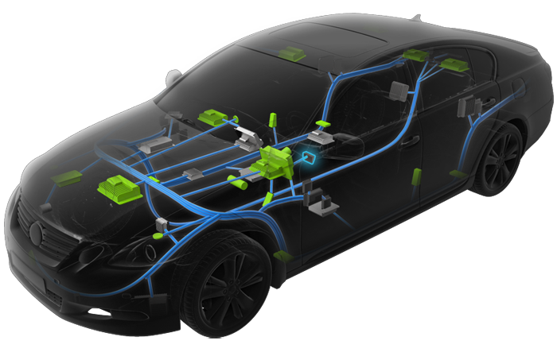
Introduction
Distributed embedded systems
Critical domains: automotive, railways
Multiple components in the system
Communicating with each other
Adhering to different semantics
Problem
Heterogeneous systems, complexity
Correct behavior is important
Modeling and V&V techniques
Notes:
Nowaydays, the model-driven paradigm is frequently applied during the development of distributed, embedded systems.
Critical domains are included, such as automotive and railway systems.
These systems are complex, and consist of multiple communicating components that adhere to different semantics. Therefore, they are considered heterogeneous systems.
Complexity can be handled using models, which also enable the analysis of system and component design.

Slide 3
Model-driven development
High-level modeling language
Supporting component-based,
hierarchical design
Formal semantics
Modeling tool
Validation during design
(Formal) verification of models
Automatic code generation
Controller component
Sensor
Controller
Notes:
The definition of models can be aided with high-level modeling languages that support component-based, hierarchical design.
The language must have a formal semantics to enable the analysis of created models.
In such cases the modeling tools supporting the language can be capable of validating and verifying the created models. Also source code generation can be supported.

Slide 4
Modeling tools
Ptolemy II
Hierarchical composition using multiple semantincs
BIP
Formal analysis
Supports engineering languages (transformation toolset)
Matlab Stateflow
Statechart formalism
Code generation
Gamma Statechart Composition Framework
Merging the strengths of these tools
Notes:
There are several modeling languages that support component-based design and mixing of semantics. Here I am going to talk about Ptolemy, BIP, and Stateflow.
Ptolemy supports hierarchical composition with the mixing of multiple semantics. Unfortunately, it does not support code generation.
BIP supports formal verification on the basis of Petri-Nets. Moreover, it enables the import of models from other engineering modeling languages, for example Simulink and AADL. Petri-Nets is a low-level formalism not suitable for the definition of complex models.
Stateflow supports the composition of statcharts, the simulation of the resulting models and code generation. Unfortunately, Stateflow is a commercial tool, and is not extensible.
(„ANIMATION”)
Our goal with Gamma, inspired by the above tools, is to create a modeling framework that supports hierarchical compositional modeling and mixing of semantics based on statecharts.

Slide 5
Gamma framework – beginning
Model-checking:
Formal analysis technique
Explores the entire state-space
Firing sequence to reach the erroneous state
Component design
Validation
Statechart
Statechart
Model-transformation
Formal model
Notes:
To make the results of our current work explicit and understandable, I would like to shortly present the evolvement of the Gamma framework.
(„ANIMATION”)
Gamma started with the definition of validation rules for a statechart langauge. (This is now the Gamma Statechart Language). Validation is a static analysis technique, which gives feedback on the quality of created models at runtime. These rules include for example non-determinism and race-conditions in terms of transitions.
(„ANIMATION”)
Next, we implemented a model-transformation that maps Gamma statecharts to analysis models, more specifically timed automata, making model-checking feasible.
(„ANIMATION”)
Model-checking is a formal analyis technique. A model-checker is capable of exploring the entire state-space of the input model and investigating whether certain erroneous states are reachable. If so, the model-checker returns a firing sequence that specifies the transitions that have to be fired so the model gets into the certain erroneous state. Its advantage against testing is that model-checking can prove the absence of faults in addition to their presence.

Slide 6
Gamma framework – composition
System design
Composition language
Synchron
Validation
Component design
Statechart
Statechart
Formal model
Source code
Notes:
The next step regarding the evolvement of Gamma was the creation of a composition language, which supported the composition of statecharts in accordance with a synchronous semantics.
The design of compsoite models was also aided with validation rules.
Also, source code and formal model generation from the composition model was introduced.

Slide 7
Gamma framework – present
System design
Formal semantics
Composition language
Asynchron
Synchron
Validation
Cascade
Multiple semantics
Component design
Statechart
Statechart
Automatic
Formal model
Source code
Notes:
The results of our current research are the redesign of the Gamma Composition Language and the formal definition („ANIMATION”) of the composition semantics. These are the asynchronous, synchronous and cascade semantics. We are currently working on extending the code generation („ANIMATION”) and automatic formal verification („ANIMATION”) functionalities to the new semantics.
Now I would like to introduce the three composition semantics.

Slide 8

Asynchronous semantics
Independently executed components
Communication
Messages and queues
Application
Communication of isolated processes (communication with the cloud)
Consumer 1
Producer
Consumer 2
Notes:
The asynchronous composition can be used to model independently executed components.
In such cases, the components communicate with messages stored in message queues, as presented by the animation.
(„ANIMATION”)
This semantics is useful for the modeling of isolated processes, where a single process can be modeled with an asynchronous component.
This semantics could be used in the development of a modern car. In a modern car the electronic system is connected with cloud services, but these two systems run independently and communicate asynchronously using messages.

Slide 9
Asynchronous semantics
Independently executed components
Communication
Messages and queues
Application
Communication of isolated processes (communication with the cloud)
Consumer 1
Producer
Consumer 2
Notes:
The asynchronous composition can be used to model independently executed components.
In such cases, the components communicate with messages stored in message queues, as presented by the animation.
(„ANIMATION”)
This semantics is useful for the modeling of isolated processes, where a single process can be modeled with an asynchronous component.
This semantics could be used in the development of a modern car. In a modern car the electronic system is connected with cloud services, but these two systems run independently and communicate asynchronously using messages.

Slide 10
Synchronous semantics
Coherent unit with a well-defined functionality
Concurrent (but not independent) execution of components
Communication with signals
No message queues
Controller compoent
Sensor
Controller
Consumer 1
Producer
Consumer 2
Notes:
Synchronous composition can be used to model a coherent unit consisting of multiple components. The components are executed in a concurrent, but NOT paralel manner.
There are no messages here, the components communicate with signals similarly to synchronous networks of digital technique systems, as presented by the animation.
(„ANIMATION”)
This semantics is useful for the modeling of HW-related components.
(„ANIMATION”)
A controller unit of a modern car could be modeled with this semantics. A single controller unit can be composed of multiple components, such as sensors and acuators and these components have to communicate with each other in a synchcronous manner.

Slide 11
Cascade semantics
Special synchronous systems
Sequential execution of components
Sequential processing of dispatched signals (data)
Application
Pipeline-like systems: components as filters
1.
Producer
Source
Target
Processing signals immediately
Processing signals immediately
Processing signals immediately
2.
3.
Processing
Consumer & Producer
Consumer
Target
Notes:
Cascade composition can be used to create synchronous-like components. In such models components are executed sequentially.
This means that signals dispatched by a component can be processed immediately by receiving components that are executed after the sending component. This way, („ANIMATION”) signals are NOT delayed („ANIMATION”) unlike in concurrent systems („ANIMATION”) with pure synchronous semantics.
(„ANIMATION”)
This semantics is suitable for the description of pipeline-like systems where the components serve as filters. Thus, such models define a data-flow.
(„ANIMATION”)
This semantics could be used to model the dispatch and transformation of data originating from the sensors of a modern car. Such data travel thorugh multiple processing nodes and can have multiple targets.

Slide 12
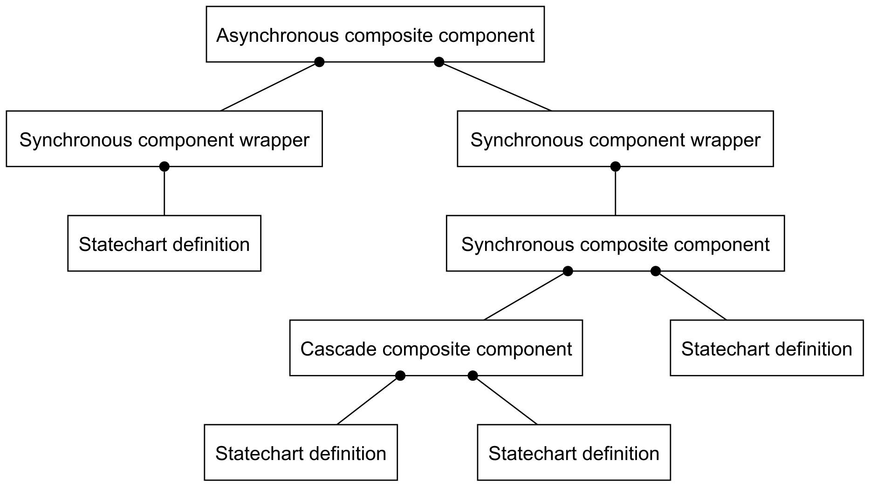
Mixing of semantics
Asynchronous composite
Synchronous wrapper
Bridge
Synchronous/ Cascade composite
Statecharts
Synchronous
Can be wrapped directly
Notes:
So how can these semantics be mixed?
Statecharts, which are synchronous components, are the atomic elements in the composite models. Such statecharts can bec ontained by synchronous and cascade composite components or can be wrapped directly by synchronous wrappers. Synchronous wrappers are asynchronous components and serve as the bridge between the synchronous and asynchronous domain. Finally, asynchronous composite components can be assembled form synchronous wrappers.

Slide 13
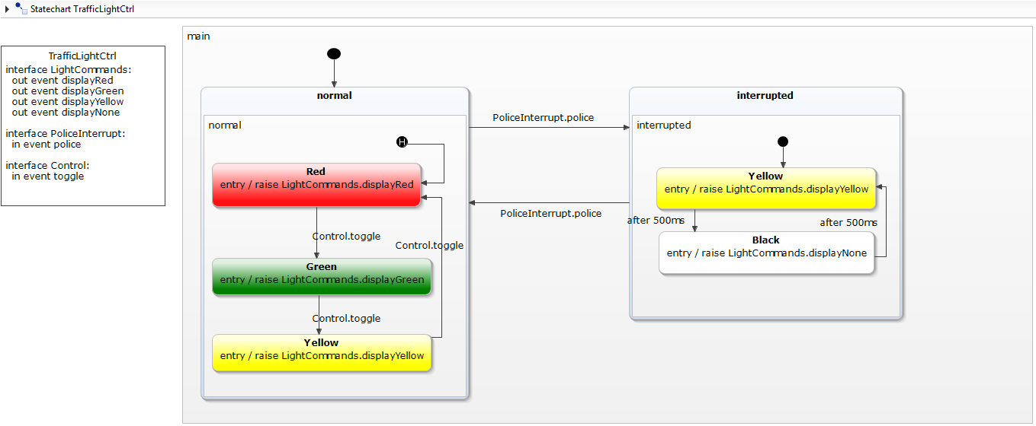
Functionalities
Engineering statechart
Engineering statechart
Notes:
And now I would like to introduce the workflow according to which the Gamma framework can be used.
The design starts with the definition of high-level statecharts. It is possible to do it in the Gamma Statechart Language or an other modeling language integrated to Gamma, for example Yakindu.
(„ANIMATION”)
The Yakindu statechart depicted in the figure, models a traffic light. As an example, we are going to create a composite model from traffic light models describing a crossroad controller using the Gamma Compostion Language.

Slide 14
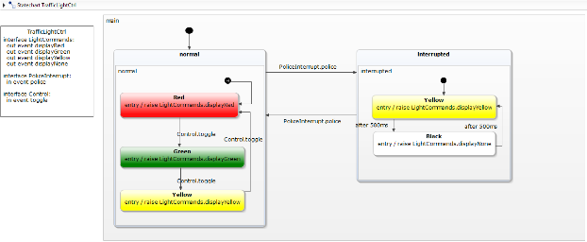
Functionalities
Engineering statechart
Engineering statechart
Gamma Statechart Language
(GSL)
Supporting extensibility
Gamma statechart
Gamma statechart
Validation
Notes:
If we define statecharts in an integrated language, we have to transform them to the Gamma Statechart Language.
(„ANIMATION”)
This can be done using model transformers.
(„ANIMATION”)
The Gamma Statechart Language supports the extensibility of the framework with additional modeling tools. To integrate them, only this model transformer has to be implemented.
(„ANIMATION”)
On this level, Gamma statecharts can be validated.

Slide 15
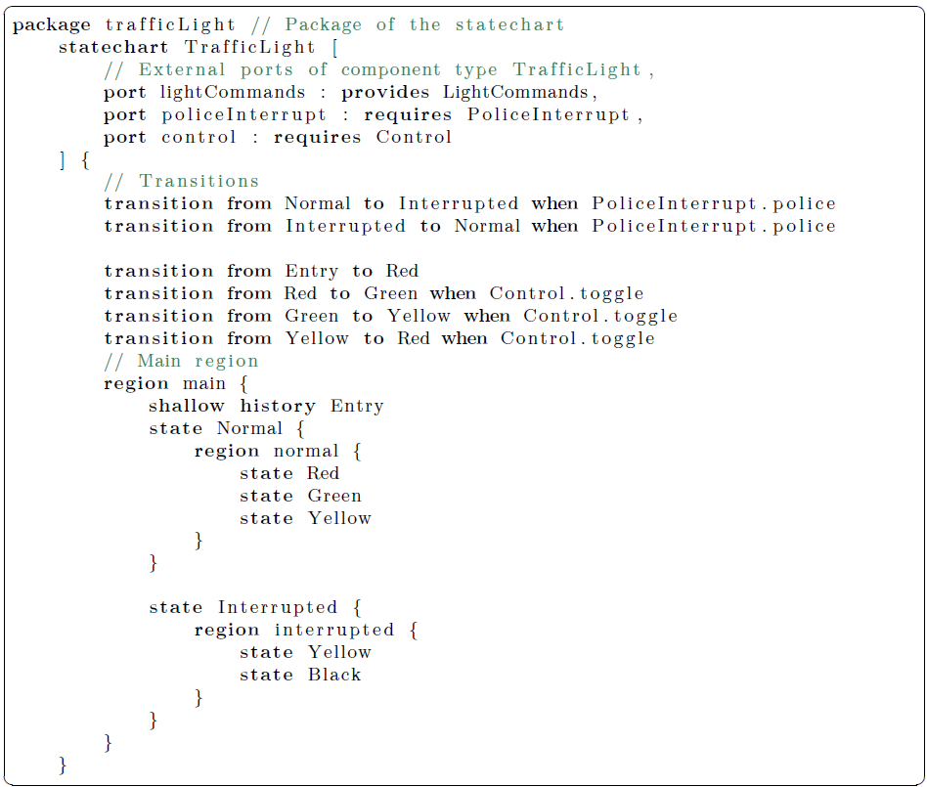
Statechart language
Notes:
A Gamma statechart can be defined using a textual syntax.
(„ANIMATION”)
This language has traditional statechart elements, such as states and transitions.
(„ANIMATION”)
Statecharts communicate with each other via ports. In terms of composition, only these attributes are regarded.
A port realizes a single interface either in provided or required mode. If two ports realize the same interface, one in provided, the other one in required mode, then the two ports can be connected.

Slide 16
Functionalities
Engineering statechart
Engineering statechart
Gamma Statechart Language
(GSL)
Gamma statechart
Gamma statechart
Validation
Gamma Composition Langauge (GCL)
Notes:
(„ANIMATION”)
Gamma statecharts can be hierarchically composed using the Gamma Composition Language according to the previously introduced asynchronous, synchronous and cascade semantics.
(„ANIMATION”)
Validation is carried out on this level as well.

Slide 17
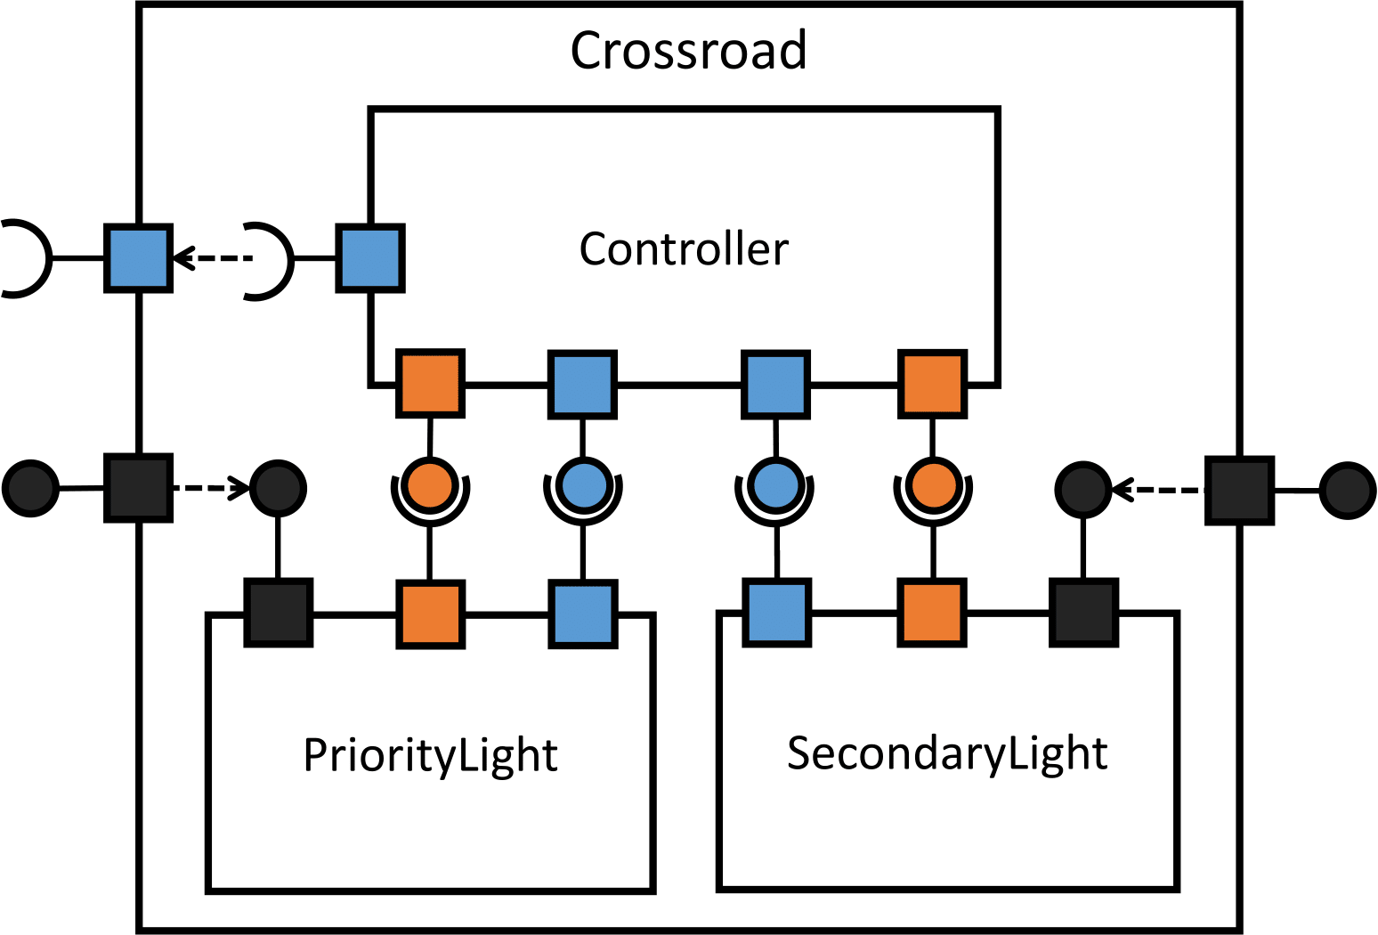
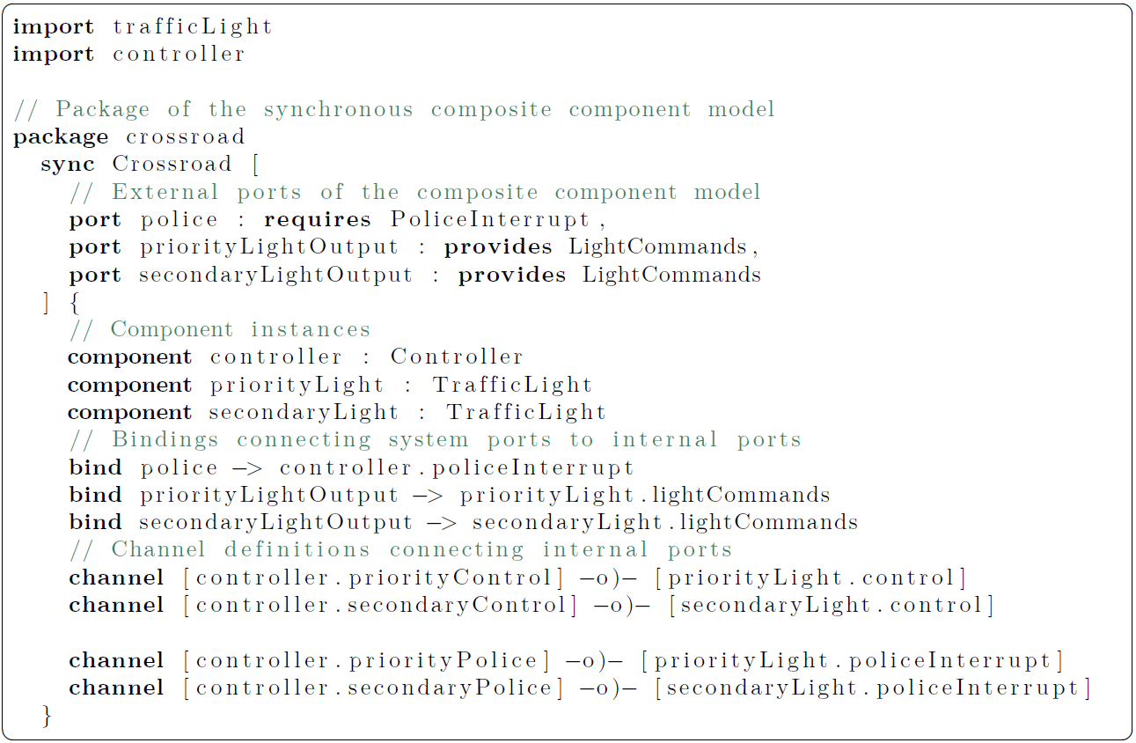
Composition
Interfaces
^{PoliceInterrupt}
^{LightCommands}
^{Control}
Notes:
Let us see how this is done in practice while defining the previously mentioned composite crossroad controller model.
The composite model can be defined using a textual syntax, as depicted in the lower-left figure. The graphical representation of the model is depicted in the right figure.
(„ANIMATION”)
Every composite model has ports. These ports work excatly like statechart ports, that is, they realize an interface in either required or provided mode.

Slide 18
Composition
Interfaces
^{PoliceInterrupt}
^{LightCommands}
^{Control}
Notes:
The behavior of a composite model is defined by the contained components, in this example two traffic light models and a controller model.

Slide 19
Composition
Interfaces
^{PoliceInterrupt}
^{LightCommands}
^{Control}
Notes:
The ports of the composite model can be bound to the ports of the contained components.

Slide 20
Composition
Interfaces
^{PoliceInterrupt}
^{LightCommands}
^{Control}
Notes:
Finally, channels can be defined that connect ports of contained components enabling their communication.

Slide 21
Functionalities
Engineering statechart
Engineering statechart
Gamma Statechart Language
(GSL)
Generated source code
Gamma statechart
Gamma statechart
Validation
Gamma Composition Langauge (GCL)
Notes:
(„ANIMATION”)
Source code can be automtically derived from the created composite model. In case of synchronous and cascade components this functionality is already available. The asynchronous part of the code generator is currently under implementation.

Slide 22
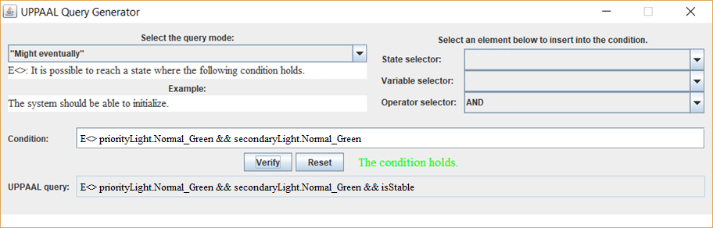
Functionalities
Engineering statechart
Engineering statechart
Gamma Statechart Language
(GSL)
Generated source code
Gamma statechart
Gamma statechart
Validation
Gamma Composition Langauge (GCL)
Analysis model
Analysis model
···
Requirement
Analysis language
Requirement
Notes:
Additionally, using model transformers, composite models can be transformed to analysis models on which model-checking can be carried out.
(„ANIMATION”)
The model-checking process is hidden from the user by means of a graphical interface.
(„ANIMATION”)

Slide 23
Functionalities
Engineering statechart
Engineering statechart
Gamma Statechart Language
(GSL)
Generated source code
Gamma statechart
Gamma statechart
Validation
Gamma Composition Langauge (GCL)
Firing sequence
Back-annotation
Analysis model
Analysis model
···
Requirement
Test cases
Analysis language
Requirement
Notes:
(„ANIMATION”)
The firing sequences produced by the model-checker are automatically back-annotated to the Gamma langauge, so the users can investigate them in a familiar domain.
(„ANIMATION”)
Moreover, the framework generates test-cases on the basis of firing sequences, so these firing sequences can be executed on the generated source code as well. Thus, conformancy can be checked, that is the analysis model and the source code are indeed equivalent.

Slide 24
Technologies
Yakindu statechart
Yakindu statechart
Xtext grammar
Java source code
Gamma statechart
Gamma statechart
VIATRA
Xtext grammar
Xtend
UPPAAL model
UPPAAL model
···
CTL exp.
JUnit
UPPAAL
CTL exp.
Notes:
This figure depicts the technologies used by the Gamma framework. Gamma uses Eclipse and Java technologies. For example, the metamodels of the statechart and composition langauges are defined in Eclipse Ecore, and the textual syntax is defined in Xtext. Additionally, Gamma uses UPPAAL for model-checking.

Slide 25
Summary
Gamma Statechart Composition Framework
Design support
Code generation
V&V (formal analysis)
Extension of the compsosititon language
Asynchronous
Synchronous
Cascade
Notes:
In conclusion, Gamma is modeling framework that supports the design of reactive systems on the basis of statecharts, supports code generation, validation and formal verification functionalities.
The main topic of this presentation was the Gamma Composition Language, which has been extended with three formal semantics: asynchronous semantics for the modeling of independent processes, synchronous semantics for the modeling of a coherent unit consisting of multiple components, and cascade semantics for a sequential, pipeline-like behavior.

Slide 26
Future work
Implementation of the code generator
Asynchronous composition
Supporting model-checking
Asynchronous composition
Supporting additional programming languages
C++
Integration of additional modeling languages
Engineering language: Stateflow
Analysis language: Spin
Notes:
What future plans do we have?
Currently, we are implementing the asynchronous part of the code generator. Moreover, we would like to extend the model-checking functionality to asynchronous models, this area is currently under research.
Additionally, we plan to support additional programming languages, such as C++ with the code generator, and plan to integrate additional engineering and analysis languages to Gamma.

Slide 27
goo.gl/ae7V63
Notes:
A working version of Gamma and a tutorial can be found under the above link.
Thank you for your attention!

