Slide 1
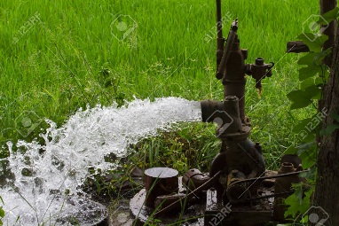
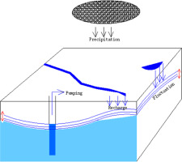


Location 1
Location 2
Location 1
Location 2
Org 1
Org 4
Org 2
Org 3
Gov
Location 3
Location 4
Location 1
Location 2

Slide 2
Later Level Management using Government
User Name
Password
Login

Slide 3

Later Level Management using Government
Water Level
Location
Pump Control
Weather Details
Water Consumed | Water Consumption Limit | Date
Water Level
 | Cleate
 | View

Slide 4
Later Level Management using Government
Water Level
Location
Pump Control
Water Consumed | Water Consumption Limit | Date
Water Level
 | Cleate
 | View

