Slide 1
Single frame object detection and classification
Deep Berlin AI Hackathon Team A

Slide 2
Subteams – Overview
Sliding Window (Tom, Sarah)
Augmentation (Sebastian, Abdul, María, Marc)
Resnet 50 & Densenet 121 (Daniel, Doreen)
Mininet (Aswin, Cornell, Graziella)

Slide 3
Basic Concepts
Preprocessing: Bounding Boxes → Sliding Window → Augmentation

Slide 4
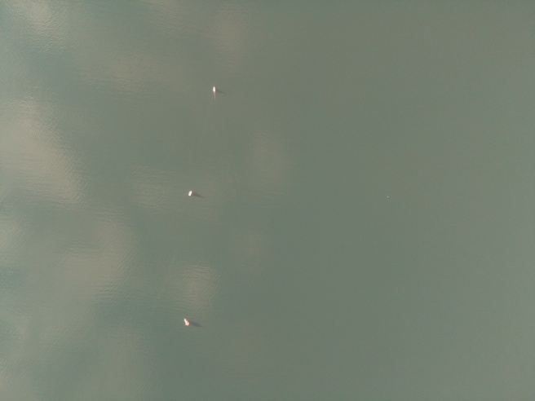
Sliding Window
Given: Bounding Boxes for Boats on Images (yellow)
Idea: Move sliding window (red) all over image for each case:
classify window as boat/no boat
(boat: more than 25% of the bbox is within the small picture no boat: less than 25% is within the picture)

Slide 5
Augmentation – Basic Idea
Varying existing training data to get more input for the Machine Learning approach
Possible ways of varying are for example:
Flipping in x- or y-direction
Translation
Rotating
Scaling
Varying color channels

Slide 6
Augmentation – Implementation ideas
Neural-Net Style (Abdul)
Issue processing time → massive
Autoaugment (paper from Google)
Issue: translation, rotation could remove boat from the image → bad data
Idea: pass bounding boxes to augmentation algorithm → not possible with autoaugment
Deepaugment

Slide 7

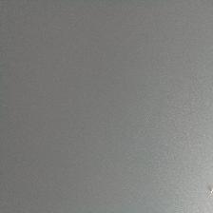


Resnet 50 & Densenet 121 approach - model
Input: 224x224x3
Input values between 0 and 255
Output: sigmoid
Loss: binary cross entropy
Learning rate: 3·e⁻⁴ (→ Andrej Karpathy)
Transfer imagenet, trained whole network
Implementation with keras (tensorflow)

Slide 8
Resnet 50 performance
Bodensee test data:

Slide 9
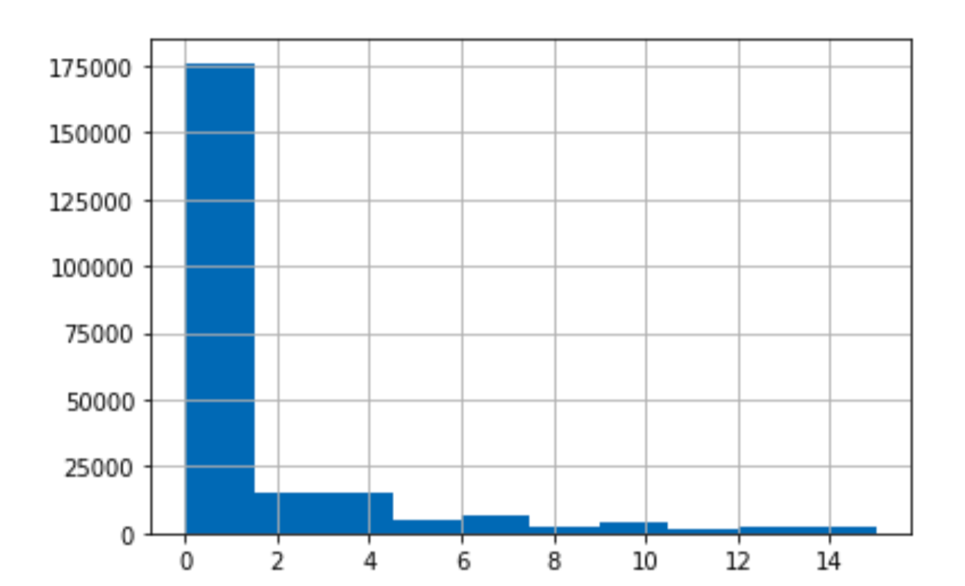
Densenet 121 unbalanced data performance
Bodensee test data:
Reflection data:
Bodensee proposals:
 | Ground truth boat | Ground truth no boat
Estimate boat
Estimate no boat

Slide 10
Densenet 121 balanced data performance
Bodensee test data:
Reflection data:
Bodensee proposals:
 | Ground truth boat | Ground truth no boat
Estimate boat
Estimate no boat

