Slide 1
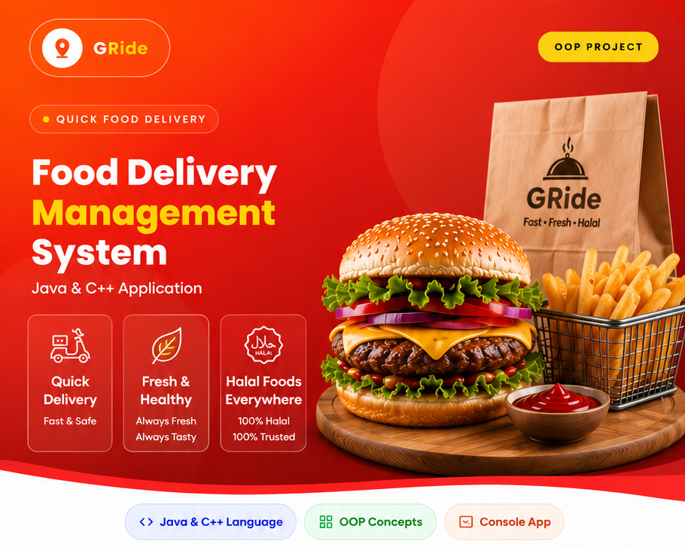


GRide QuickBite
Fast Food Ordering System for Everywhere Anywhere
NO WAIT NO LATE
INSTRUCTOR: SIR NOUMAN SYED SIR ALI HAFEEZ MALIK
Notes:
Links:
https://pixabay.com/vectors/connection-internet-digital-network-4166469/

Slide 2


Project Members
Ghulam Rasool
Muizz Dhilion
Hafiz Muneeb
Gulab Gohar
Moula Bakhsh
Notes:
Links:
https://www.pexels.com/photo/smiling-middle-aged-man-using-tablet-and-holding-apple-near-window-in-office-3931603/
https://www.pexels.com/photo/smiling-woman-with-notebook-in-office-hall-4173256/
https://www.pexels.com/photo/cheerful-woman-smiling-while-sitting-at-table-with-laptop-4467687/

Slide 3
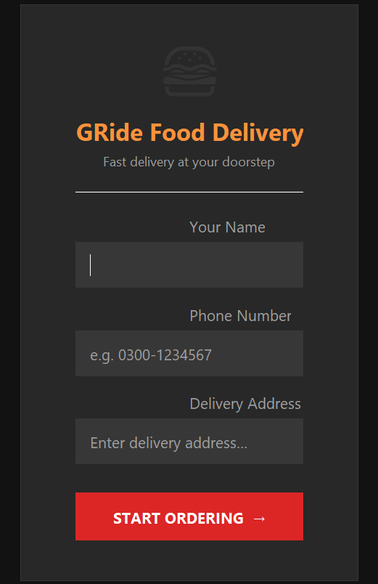


PROJECT VISION AND SOLUTION
Our Vision
To digitize the GRide Food Delivery System experience for speed, accuracy, and convenience.
Our Solution:
GRide Food Delivery System A web-based platform that allows:
Viewing a Fast-Ready Menu
Digital ordering without standing in queues
Live order tracking for perfect pickup timing

Slide 4
Project Objectives
To simulate an online food ordering system.
To implement Object-Oriented Programming concepts.
To manage customer and restaurant interactions.
To calculate the total bill automatically.
To provide a simple and user-friendly ordering process.
Notes:
Links:
https://www.pexels.com/photo/smiling-middle-aged-man-using-tablet-and-holding-apple-near-window-in-office-3931603/
https://www.pexels.com/photo/smiling-woman-with-notebook-in-office-hall-4173256/
https://www.pexels.com/photo/cheerful-woman-smiling-while-sitting-at-table-with-laptop-4467687/

Slide 5
The Food Delivery Management System is a Java based application developed using Object-Oriented Programming concepts.
ORDER ALLOW
View the food menu
Select food items
Add items to the cart
View the total bill
Place an order successfully
Notes:
Links:
https://www.pexels.com/photo/photo-of-people-looking-on-laptop-3182812/

Slide 6
Classes Used in the Project
FoodItem
Stores food name and price.
Customer
Stores customer information.
Restaurant
Manages the restaurant menu.
Cart
Stores selected items and calculates the total bill.

Slide 7
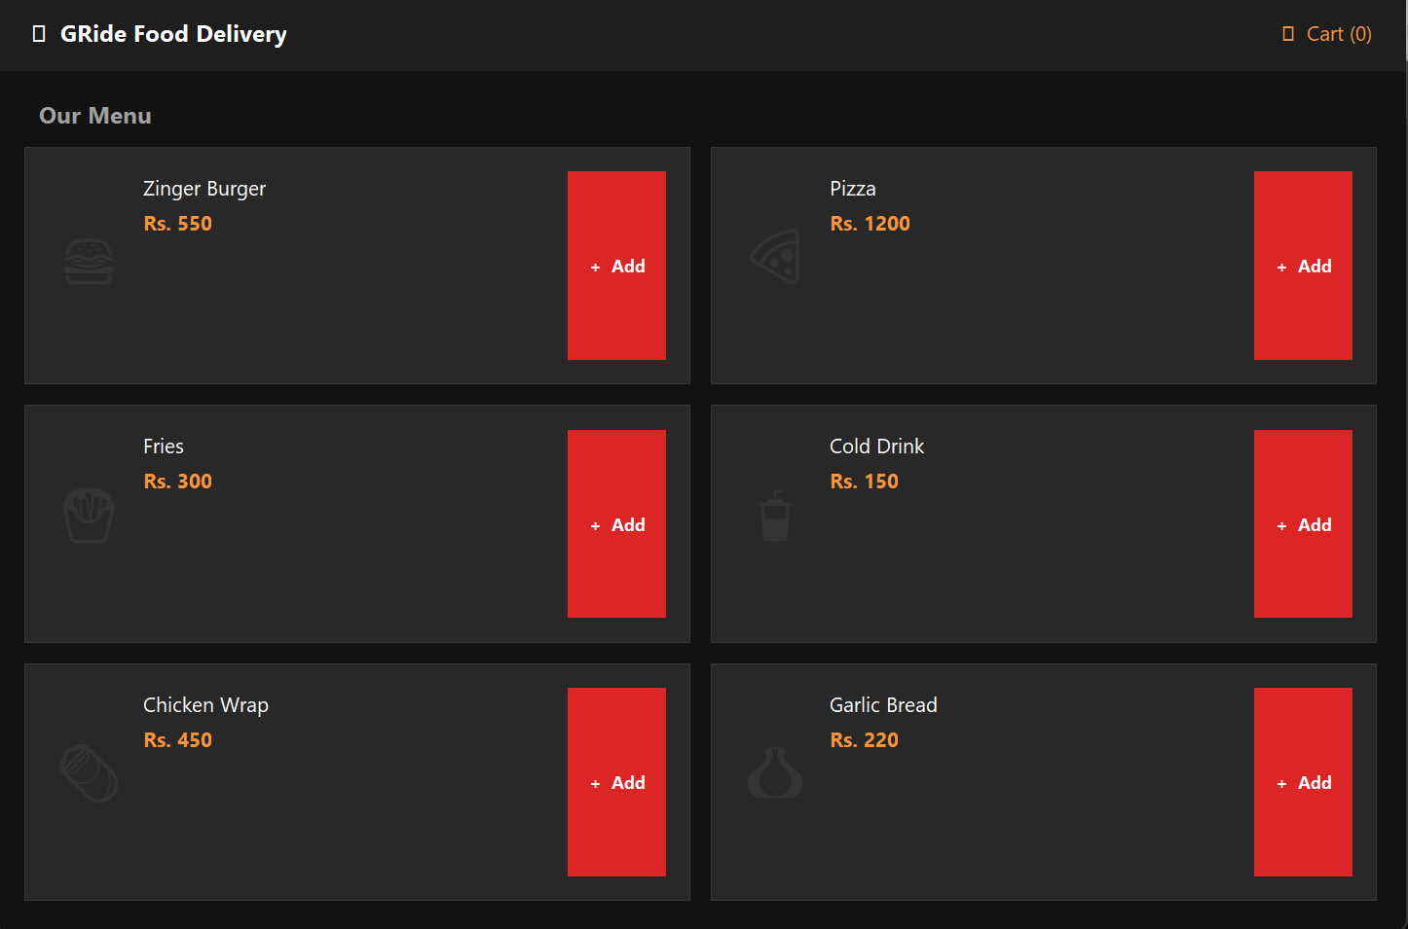

MENU OVERVIEW
Designed for speed and convenience during short breaks
Includes only Fast-Ready items (30–45 minutes prep time) Fries, Burgers, Pizza, Cold Drink
Estimated preparation time shown for each item
Role-based ordering:
Students: Quick self-pickup
Teachers: Parcel / delivery option
Helps users order quickly, avoid queues, and arrive on time
Notes:
Links:
https://pixabay.com/vectors/connection-internet-digital-network-4166469/

Slide 8
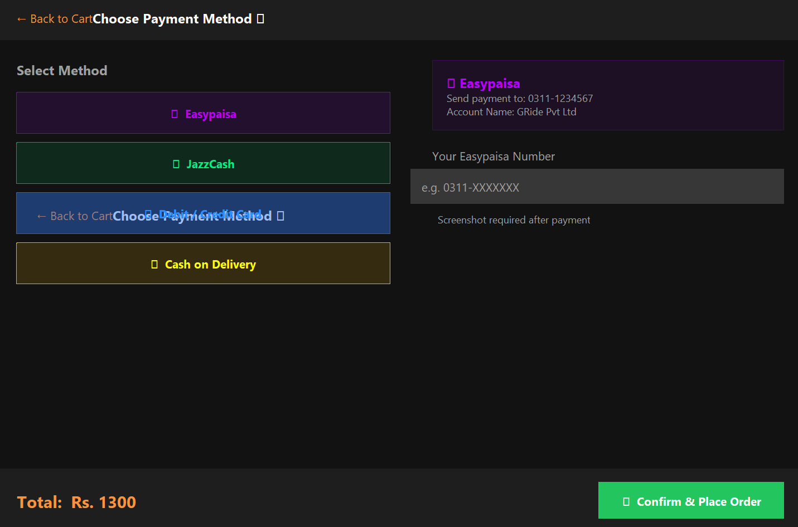
PAYMENT AND BILLING SYSTEM
GRide QuickBite
Bill is generated automatically after placing an order
Users can pay by cash or online
Online payment options: EasyPaisa & JazzCash
Makes billing faster and more accurate
Easy to use for students, teachers, and cafe staff
Notes:
Links:
https://www.pexels.com/photo/top-view-of-people-at-the-meeting-3184287/

Slide 9
GRide QuickBite
Main Classes
FoodItem
Stores food name and price.
Customer
Stores customer information.
Restaurant
Manages the restaurant menu.
Cart
Stores selected items and calculates the total bill.
System Workflow
Customer
↓
Enter Name & Phone Number
↓
View Food Menu
↓
Select Food Item
↓
Add Item to Cart
↓
View Cart
↓
Checkout
↓
Order Placed Successfully
Notes:
Links:
https://www.pexels.com/photo/top-view-of-people-at-the-meeting-3184287/

Slide 10
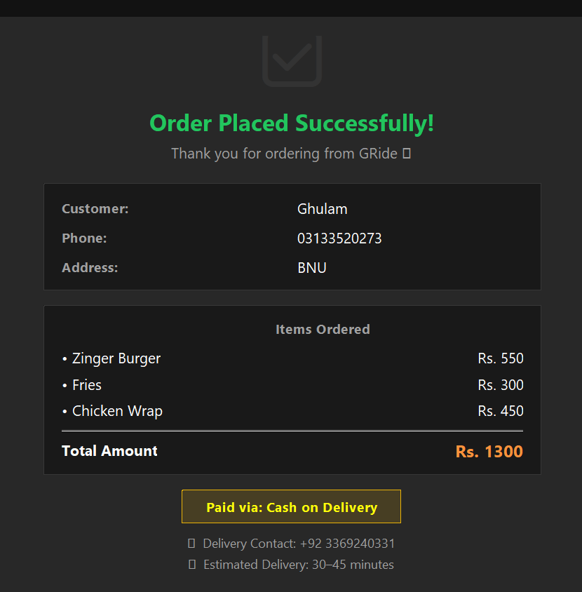
ORDER STATUS
Shows real-time order updates
Displays remaining preparation time
Helps users avoid waiting at the café
Replace Order for quick reordering
Notes:
Links:
https://www.pexels.com/photo/photo-of-people-looking-on-laptop-3182812/

Slide 11
OOP Concepts Used
Classes and Objects
Used to create FoodItem, Customer, Restaurant, and Cart.
Encapsulation
Data members are kept private and accessed through functions.
Constructors
Used for object initialization.
Reusability
FoodItem objects are reused in Restaurant and Cart classes.
Modularity
Project is divided into multiple header files for better organization.

Slide 12
User Interface (GUI)
Login Screen
Customer enters personal information.
Menu Screen
Displays available food items.
Cart Screen
Shows selected items and total bill.
Payment Screen
Allows users to select a payment method.
Success Screen
Displays order confirmation.

Slide 13
CONCLUSION
The Food Delivery Management System successfully demonstrates OOP concepts in JAVA + C++
It allows customers to order food efficiently.
The system manages menu items, customer details, cart operations, and billing.
The project can be enhanced in the future by adding a database and graphical user interface (GUI).
Notes:
Links:
https://www.pexels.com/photo/smiling-middle-aged-man-using-tablet-and-holding-apple-near-window-in-office-3931603/
https://www.pexels.com/photo/smiling-woman-with-notebook-in-office-hall-4173256/
https://www.pexels.com/photo/cheerful-woman-smiling-while-sitting-at-table-with-laptop-4467687/

Slide 14
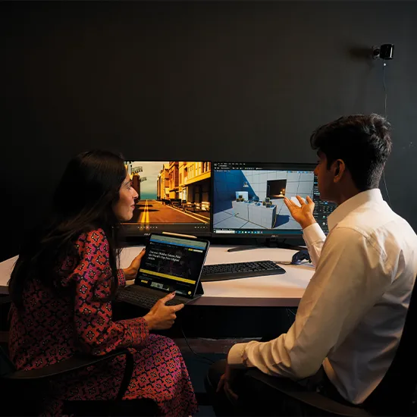
PROBLEM STATEMENT
Students face significant challenges during short breaks.
Key Features
Dynamic food menu management
Add food items to cart
Customer information management
Automatic bill calculation
Order confirmation system
Menu-driven interface
Notes:
Links:
https://www.pexels.com/photo/photo-of-people-looking-on-laptop-3182801/

Slide 15
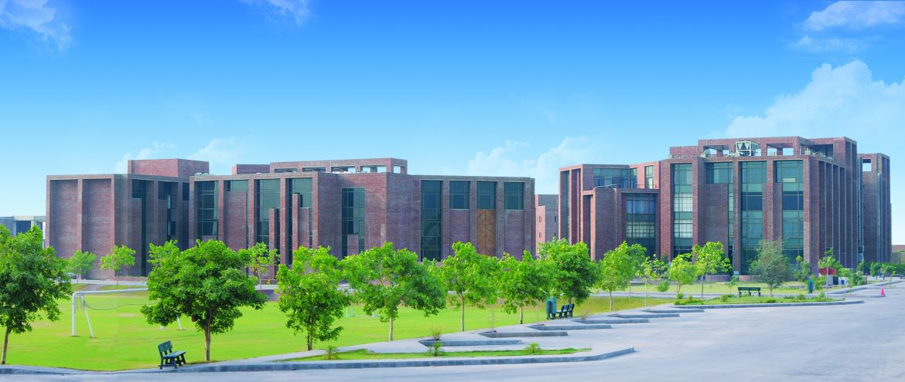


THANKS
Notes:
Links:
https://www.pexels.com/photo/multi-cultural-people-3184419/

