Slide 1



Viper: A High-Performance I/O Framework for Transparently Updating, Storing, and Transferring Deep Neural Network Models
Jie Ye¹, Jaime Cernuda¹, Neeraj Rajesh¹, Keith Bateman¹,
Orcun Yildiz², Tom Peterka², Arnur Nigmetov³, Dmitriy Morozov³, Xian-He Sun¹, Anthony Kougkas¹, Bogdan Nicolae²
¹ Illinois Institute of Technology
² Argonne National Laboratory
³ Lawrence Berkeley National Lab

Slide 2




Increasing Requirement of DL in Scientific Workflows
Deep Learning (DL) has been employed at least partially in many scientific workflowsc
Climate Modeling
Particle Physical
Simulations
Computational Fluid Dynamics
Virtual Drug Response Prediction

Slide 3
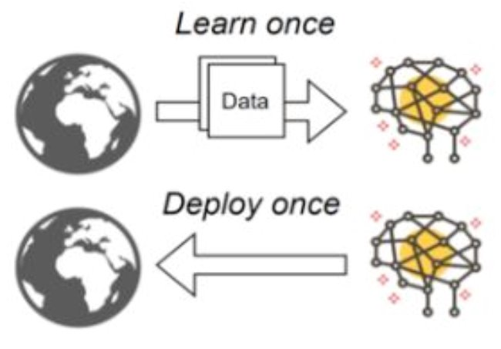
How does Traditional Scientific Workflow use DL?
Traditionally, DL is done in offline fashion
  Model is trained offline until it is converged, then deployed once to serve inferences
  The pre-trained model is usually stored in a model repository (e.g., PFS)
Fig. 1 Offline training and deployment of the model for inference

Slide 4
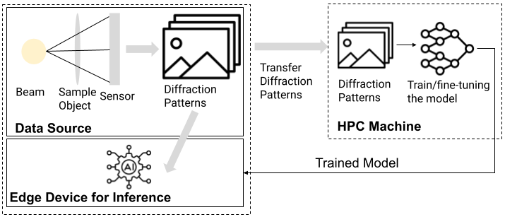
Requirement of Online Training and Deployment
Real-time training and deploying the model for inferences are increasingly needed in scientific workflows, e.g., Ptychographic image reconstruction
Ptychographic image reconstruction
  Edge device: Diffraction patterns are captured by a sensor as the beam source passes through an object
  HPC machine: Analyze the diffraction patterns to obtain the equivalent of an X-ray image
  PtychoNN model is usually used to accelerate data analysis for image reconstruction
Fig 2. Ptychographic image reconstruction

Slide 5
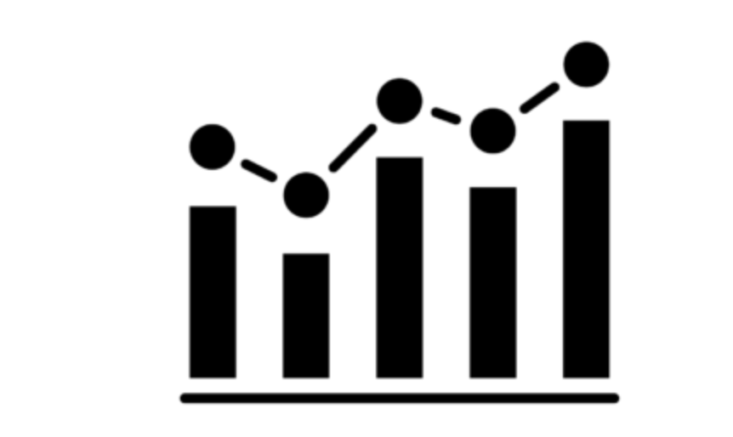

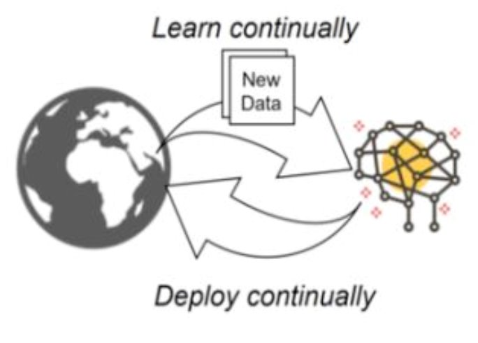
Requirement of Online Training and Deployment
Obviously, offline training and deployment DL is infeasible in the dynamic environment
  Constantly changing input data and fluctuating learning patterns necessitate the on-the-fly training or refining of the model
  For example, in ptychographic image reconstruction use-case,
    Each object is unique and the beam cannot be stopped, so pre-trained model or pause the workflow to wait until trained one is infeasible
Input data constant changing
Learning pattern fluctuate
Thus, online training and deployment is required
Fig. 3 Online training and deployment of the model

Slide 6
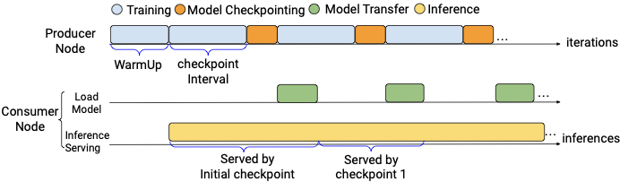
Example of Ptychographic Image Reconstruction
The online ptychographic image reconstruction workflow typically consist of three steps.
  Step 1: training warm-up
    Transfer the full diffraction patterns from edge device to HPC machine, and train the ptychoNN model
  Step 2: switch to inferences
    Send a checkpoint of the model to the edge device, then use the model for inference to predict the phase of an image
  Step 3: fine-tuning
    HPC machine continue receive a subset of diffraction patterns, fine-tune the model with the new incoming data (i.e., continue training the model)
    Periodically send a checkpoint of the model to the edge to improve the quality of the inferences
After warm-up stage, training and inferences run in parallel.
  Training (producer) and inference server (consumer) continuously synchronize model checkpoints during workflow running
Fig 4. An example scenario that training and inference run in parallel on producer and consumer nodes

Slide 7


Motivation
How often to checkpoint a model on producer and send it to the consumer after the warm-up stage to improve the inference quality?
Frequent Updates
Infrequent Updates
Improve inference quality because of early updates
Less precise inference results
Slow down training due to checkpoint interruption
Faster training due to less checkpoint interruption
Trade-off
Need to find a near-optimal checkpoint schedule to balance this trade-off and improve the inference quality

Slide 8
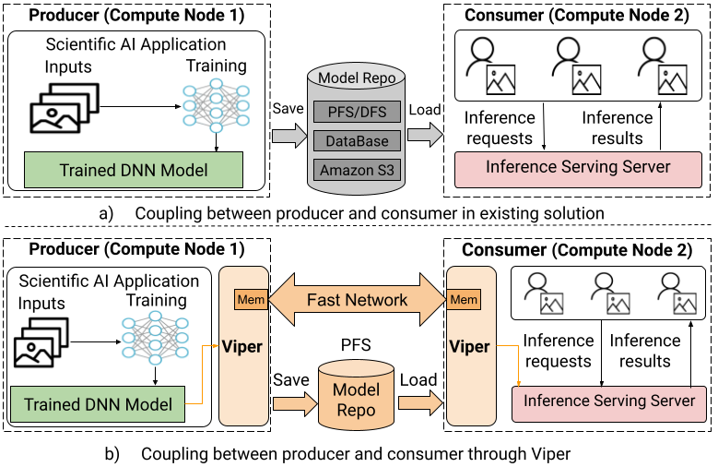


Motivation
Current method couples training (producer) with inference serving system (consumer) via a model repository (e.g., PFS)
Fig 5. Traditional producer-consumer communication
Limitations
Model updates can be delayed due to I/O bottlenecks in the PFS, caused by many uncoordinated, small I/O accesses
Consumers are unaware of changes of DNN models promptly due to the the use of a fixed-interval, pull-based approach, delaying access of the up-to-date model
Need an efficient strategy (i.e., creating a direct communication channel) to accelerate model data transfer from producer to consumer
Fig 6. Viper-enhanced communication

Slide 9
Viper - Design Objectives
To address the limitations, we propose Viper, an I/O framework for updating, storing, and transferring DNN models.
It is designed two design objectives:
Balance the trade-off between training runtime and inference quality by building an Inference Performance Predictor to find a near-optimal checkpoint schedule
Accelerate model data transfer by using a direct memory-to-memory communication channel along with a lightweight notification mechanism

Slide 10
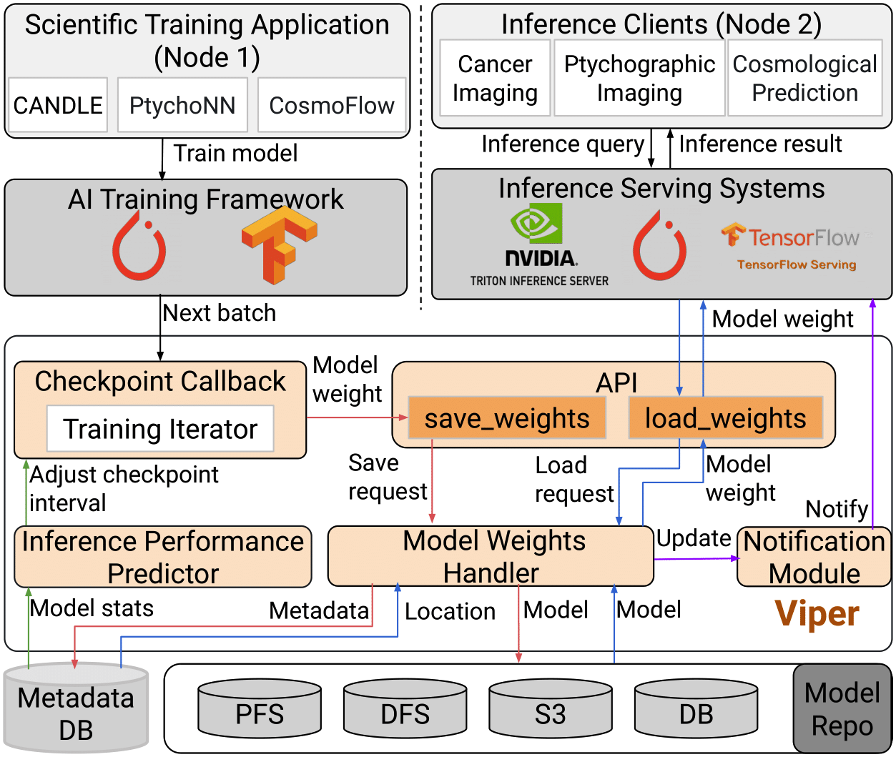
Viper - High-level Architecture
Viper serves as an I/O library
Provides APIs to interact with the producer and consumer
  save_weights(): for producer to save the current model state into storage
  load_weights(): for consumer to load an updated model state from storage
Consists of four major components:
  Checkpoint Callback
  Inference Performance Predictor (IPP)
  Model Weights Handler
  Notification Module
Fig 4. The High-level Architecture of Viper

Slide 11
Viper - High-level Architecture
Checkpoint Callback
  A custom callback to monitor and track the training quality of each iteration
    E.g., training loss/accuracy of each iteration
  Capture the model’s current state
  Trigger model update at specified iteration
Fig 4. The High-level Architecture of Viper

Slide 12
Viper - High-level Architecture
Inference Performance Predictor
  Predict the inference quality based on
    The training quality during training
    overhead of transferring and updating a new checkpoint from producer to consumer
  Find a near-optimal checkpoint schedule based on the predicted inference quality via an algorithm
Fig 4. The High-level Architecture of Viper

Slide 13
Viper - High-level Architecture
Model Weights Handler
  A memory-first engine designed to accelerate the model data transfer
  Process the save requests from producer and load requests from consumer
  Select the most suitable data transfer strategy (e.g., GPU-to-GPU memory, Host-to-Host memory, or PFS) to transfer the model data
Notification Module
  Actively notify consumer about the model updates, avoid frequent polling of the model repository to detect changes
Fig 4. The High-level Architecture of Viper

Slide 14
Viper - Why do we need IPP?
In online learning, it’s crucial to continuously synchronize model checkpoints between the producer and consumer after the warm-up stage, however
  Frequent model updates enhance inference quality but may slow down training
  Infrequent model updates may lead to less precise inference results
Goal: optimize the checkpoint schedule to strike a balance between minimizing training slowdown and maximizing inference quality.
  To achieve this, we must predict the inference quality for any given checkpoint schedule
Inference Performance Predictor (IPP)
  Help to identify a near-optimal checkpoint schedule by predicting the cumulative inference quality based on input parameters
    I.e., at what iteration to take a checkpoint on producer and synchronize to consumer
  The final selected checkpoint schedule is a list of iteration ids that represent the moment to perform a model update
    should maximize cumulative inference quality without adding significant overhead to the training process.

Slide 15

Viper - How do we design IPP?
IPP relies on two assumptions to predict the cumulative inference quality:
Training quality (e.g., loss/accuracy) of the DNN model can be predicted as a function of the number of training iterations
1
Existing literature indicates learning curves can describe model performance by training iterations/time
Training quality (e.g., loss/accuracy) can be used as a proxy to estimate the inference quality
2
Observations indicate that training and inference quality curves usually show similar trends in DNN models

Slide 16
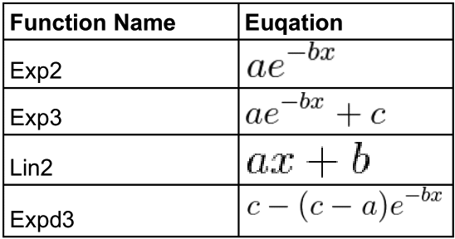
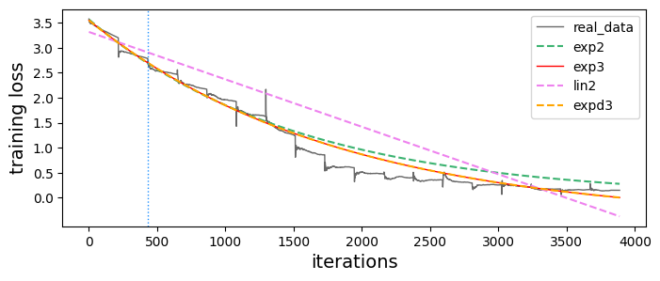
Viper - Training Loss Predictor (TLP)
According to the first assumption,
  Viper should be able to predict how the training converges over training iterations through a function
Viper introduces a Training Loss Predictor (TLP):
  Estimate the training quality at a specific iteration x
  TLP is defined as
Table 1. The curve functions that Viper used
x is the training iteration Id, while a, b, and c are used to control the shape.
TLP function is determined by modeling the training loss curve with different curve functions (Table 1)
  Use warm-up stage training loss to fit these functions (Fig 5)
  Select the one with minimal MSE as “TLP”
Allow user to define its custom TLP predictor function
Fig 5. Fitting the learning curve for TC1 with the warm-up training loss

Slide 17
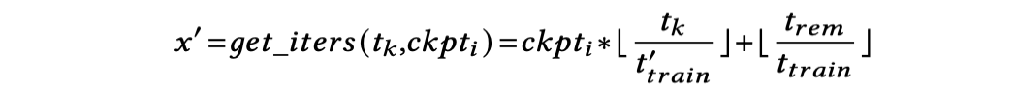

Viper - Mapping between time and training iteration
Based on the second assumption:
  If we know the training loss of a request, we can estimate its inference quality
  However, it is difficult to get the training loss of a request
Fortunately, it is easy to determine the timestamp when each inference request occurs
To estimate inference quality, we need a function that, given the timestamp of an inference, returns the loss of the most recent checkpoint
  This loss acts as an estimate of the quality for all inferences until the next checkpoint is taken
There is a direct mapping between training time t and training iteration id
  Given timestamp t_{k} → easy to calculate the corresponding training iteration id x’ using the formula:
Thus, the training quality observed at time t_{k} corresponds to that at training iteration 𝑥′

Slide 18
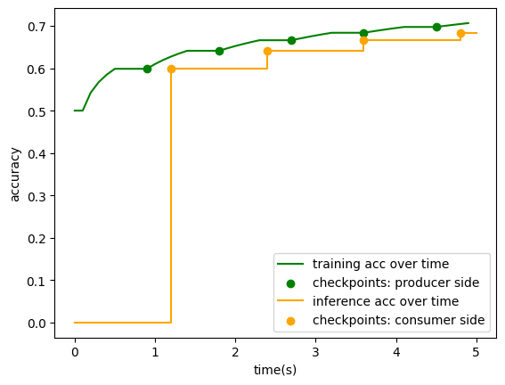
Viper - Training Quality vs. Inference Quality Over Time

Slide 19
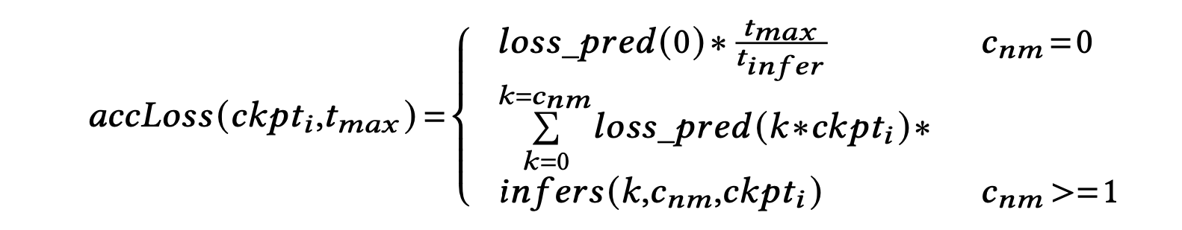
Viper - Cumulative Inference Loss Predictor (CILP)
Assumption: inferences query rate is constant on consumer side during the serving period
To estimate the cumulative inference quality over a duration t_{max}, Viper builds a Cumulative Inference Loss Predictor (CILP)
  Cumulative Inference Loss (CIL) is used to evaluate the cumulative inference quality, referring to sum of the inference quality of all inference requests served within [0, t_{max}]
Viper allows consumer to handle inference requests simultaneously while loading the new model
  Implement this through double buffering together with multi-threads
  Segregate the inference serving thread from the model updating thread
Thus, the formula of CILP to estimate the cumulative inference loss within [0, t_{max}] is:

Slide 20
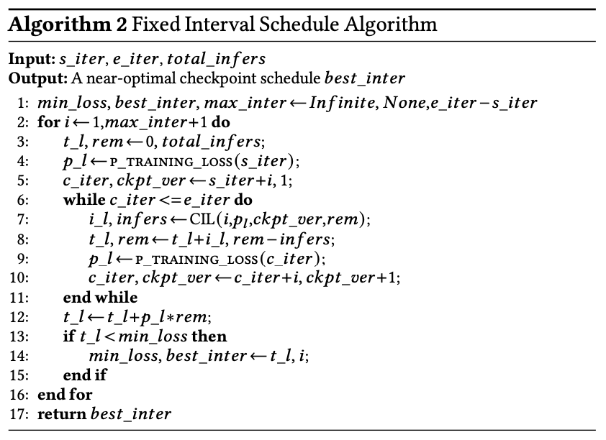
Viper - Near-Optimal Checkpoint Schedule Algorithm
Based on CILP formula, IPP implemented two algorithms to determine and find the near-optimal checkpoint schedule:
  Fixed-interval schedule algorithm
    A checkpoint schedule with fixed gaps between checkpoints
  Adaptive-interval schedule algorithm
    A checkpoint schedule with variable gaps between checkpoints
Fixed-interval schedule algorithm
  Checkpoints are taken at regular intervals (i.e., the number of iterations)
  The checkpoint schedule with the returned interval can get minimal CIL and lower training overhead
  Pros
    Simple and easy to implement
  Cons
    Lack of flexibility
    Overlook the inference quality improvement between two consecutive checkpoints

Slide 21
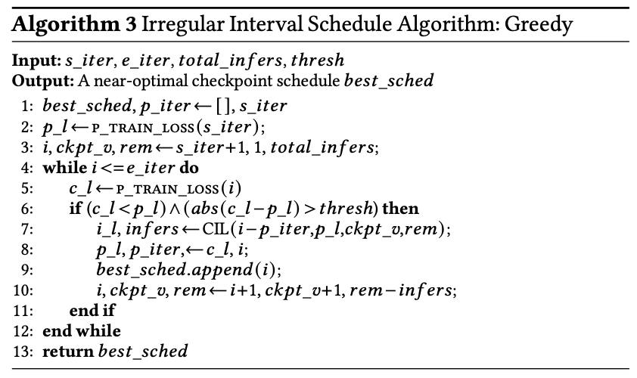
Viper - Near-Optimal Checkpoint Schedule Algorithm
Motivation: training loss doesn’t decrease at the same rate
  E.g., typically decreases rapidly at the start of training while slowly as it approaches convergence
An optimal checkpoint schedule should have variable intervals between checkpoints to adapt to these changes in training loss
Adaptive-interval schedule algorithm
  Checkpoints are taken at irregular interval
  Solution: performs checkpoint and model update when the improvement between two consecutive checkpoints exceeds a threshold
  Pros: more flexible than fixed-interval approach
  Cons: It is heuristic-based and selecting the appropriate threshold can be difficult

Slide 22
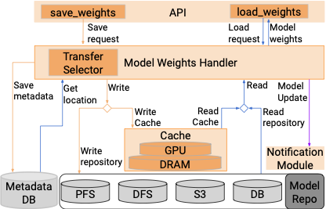
Viper - Accelerate Model Data Transfer
During training, DNN models can be cached on multiple alternative locations
  E.g., GPU memory, Host memory, and PFS
Asynchronous memory-first engine
  Utilize the cached models on different locations to accelerate data movement between producer and consumer
  Creates a direct communication channel to transfer the model data
    Supports both direct GPU-to-GPU memory and host-to-host memory data transfer strategy
    Implemented based on the MPI library
  How to select the suitable data transfer strategy?
    If available, direct GPU-to-GPU memory strategy is used
    If GPU memory is not available, direct host-to-host memory strategy is selected
    Otherwise, PFS will be used to transfer the model data
Fig 5. Viper’s memory-first transfer engine

Slide 23
Viper - Prompt Notification of Model Updates
In addition to using various strategies to speed up data transfer, it is crucial for the consumer to quickly detect model updates.
A lightweight publish-subscribe notification module
  Producer proactively informing consumers of model updates instead of passively periodic queries
    Reduce model discovery latency
  Implemented based on Redis, achieving < 1ms notification latency
Fig 6. Viper’s memory-first transfer engine

Slide 24
Experimental Setup
Testbed: ALCF Polaris Platform
  Per Node: 4xA100-40G GPUs interconnected via NVLink, and 512 GB DDR4 DRAM
  Nodes are interconnected using the Slingshot 10 network
  Parallel File System: Luster, with a aggregated I/O bandwidth of 650 GB/s
  Two nodes are used in our experimental evaluations
Software
  DL Framework: Tensorflow-2.9
  Communication: Cray-MPI
  Metadata storage: Redis-7.4

Slide 25
Applications
CANDLE-NT3 and CANDLE-TC1 are pilot 1 benchmarks from the CANDLE project to predict drug response
PtychoNN is a real application used in ptychographic image reconstruction
CANDLE-NT3
CANDLE-TC1
PtychoNN
Binary classification: Classify RNA-seq gene expression profiles into normal or tumor tissue
Dataset: 1120 samples for training, 280 samples for inference
Multiple classification: Classify RNA-seq gene expression profiles into 18 balanced tumor types
Dataset: 4320 samples for training, 1080 for inference
A model that simultaneously predicts real-space amplitude and phase from input diffraction data
Dataset: 16100 samples for training, 3600 samples for inference

Slide 26
Performance Metrics
End-to-End Model Update Latency
  The total time of the checkpointing duration (measured on producer side) and model data delivery duration (measured on consumer side)
Cumulative Inference Loss (CIL)
  The total inference loss accumulated across a set of inference requests
  A lower value indicate a better result
  For CANDLE-NT3 and CANDLE-TC1,
    The inference loss of a request is measured using Cross-Entropy loss function
  For PtychoNN,
    The inference loss of a request is measured using MeanAbsoluteError loss function

Slide 27
Model Update Latency
Objective: showcase the end-to-end model update latency across different model transfer strategies
Methodology
  Deploy a producer and a consumer on two separate nodes. After the warm-up stage, the producer and consumer starts running in parallel, and the producer will synchronize the model to consumer
  Evaluate the data transfer latency using six different approaches across three transfer strategies respectively.
    PFS: h5py(baseline), Viper-PFS
    Host-to-Host Memory: Viper-Sync, Viper-Async
    GPU-to-GPU Memory: Viper-Sync, Viper-Async
  Measure the end-to-end model update latency metric of each approach
Evaluated Applications
  CANDLE-NT3 (model size: 600 MB)
  CANDLE-TC1 (model size: 4.7 GB)
  PtychoNN (model size: 4.5 GB)

Slide 28
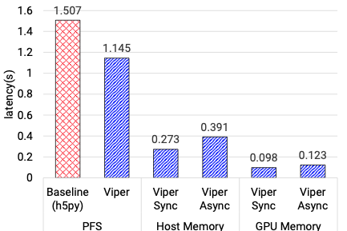
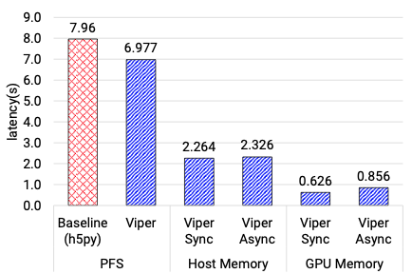
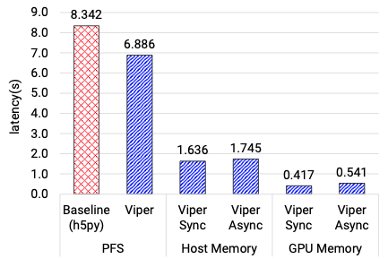
Model Update Latency - Results
CANDLE-NT3 (size: 600 MB)
CANDLE-TC1 (size: 4.7 GB)
PtychoNN (size: 4.5 GB)
Fig. The end-to-end model update latency across three different model data transfer strategies
Observation
Both GPU-to-GPU and Host-to-Host memory strategies achieve better performance than PFS
  GPU-to-GPU outperforms the baseline by 12x for NT3, 9x for TC1, and 15x for PtychoNN using Viper-Async approach
  Host-to-Host using Viper-Async approach is at least 3x better than baseline
  This is attributed to high I/O bandwidth of the fast memory tiers and the high-speed network
Viper-PFS approach is also ~1.2x faster than baseline since it only writes model weights and closely related metadata into the file
Viper-Async is slower than Viper-sync because it uses a separate thread for data transfer to reduce training interruption, requiring an extra data copy

Slide 29
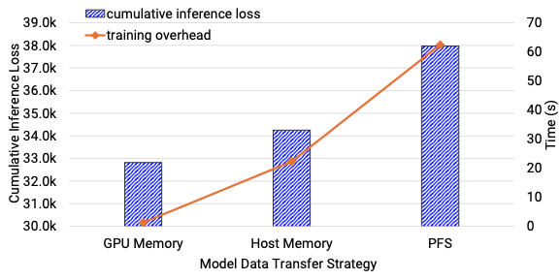
Benefits of Low-latency Model Update
Objective: showcase low-latency transfer strategy can improve inference quality
Evaluated Application: CANDLE-TC1 (model size: 4.7 GB)
Methodology
  Deploy a producer and a consumer on two separate nodes
  Evaluates the CIL and training overhead time over fixed-number of inferences across three different transfer strategy
Fig : Impact of a low-latency model update on inference and training performance (update interval: epoch boundary)
Observation
For same number of checkpoints, both GPU-to-GPU memory and Host-to-Host memory exhibit lower CIL and less training overhead time than PFS
  GPU-to-GPU memory strategy achieves the best performance with only 1s training overhead time
Indicate delivering a model with low-latency strategy is required and useful as it can improves the inference quality and minimizes the overhead on training time

Slide 30
Inference Performance Predictor
Objective: showcase the checkpoint schedule identified by the Inference Performance Predictor (IPP) can achieve lower CIL compared to baseline
Methodology
  Deploy a producer and a consumer on two separate nodes. After the warm-up stage, the producer and consumer starts running in parallel, and the producer will synchronize the model to consumer
  Evaluates the CIL over a fixed number of inferences using the GPU-to-GPU memory strategy based on three checkpoint schedules:
    Epoch-boundary (Baseline): checkpointing at epoch-boundary
    Fixed-interval: checkpointing every fixed-interval identified by the fixed-interval algorithm
    Adaptive-interval: checkpointing at adaptive-interval found by the greedy algorithm
Evaluated Applications
  CANDLE-NT3 (model size: 1.7 GB)
  CANDLE-TC1 (model size: 4.7 GB)
  PtychoNN (model size: 4.5 GB) - real application

Slide 31
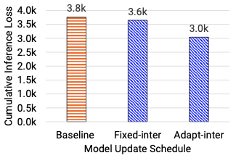
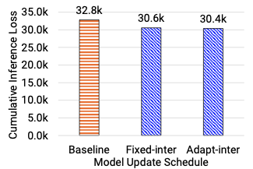
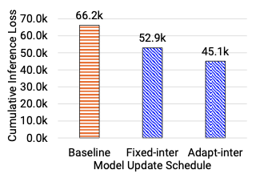
Inference Performance Predictor - Results
NT3.B over 25,000 inferences
TC1 over 50,000 inferences
PtychoNN over 40,000 inferences
Fig. Cumulative inference loss over a fixed number of inferences using different checkpoint schedule methods
Observation
Both fixed-interval and adaptive-interval checkpoint schedule can achieve better CIL compared with the baseline (i.e., epoch-boundary checkpoint schedule)
Adaptive-interval checkpoint schedule is better than fixed-interval approach
  For NT3 model, adaptive-interval schedule reduces the CIL from 3.8k to 3.0k
  For TC1 model, adaptive-interval schedule reduces the CIL from the 32.8k to 30.4k
  For PtychoNN model, adaptive-interval schedule reduce the CIL from the baseline of 66.2k to 45.1k

Slide 32
Viper - Conclusions & Future Work
Conclusions
  Viper builds an intelligent inference performance predictor
    To identify the near-optimal checkpoint schedule, balancing the trade-off between training runtime and inference quality
Viper creates an asynchronous memory-first model transfer engine alongside a push-based notification module
  To accelerate checkpoint of a model delivery and notification
Experimental results show up to 9x faster model updates with GPU-to-GPU transfer, and the predictor-driven checkpoint schedule improves overall inference quality
Future Work
  Extend Viper for multi-producer, multi-consumer data transfer to speed up large LLM or DNN models
    Enable sharding of large models across GPUs during training and inference (e.g., using tensor, pipeline, and data parallelism)

Slide 33
Thanks
Any Questions
Contact: Jie Ye (jye20@hawk.iit.edu)

