Slide 1
Identifying Technological Spillovers and Product Market Rivalry
Nick Bloom (Stanford, CEP & NBER)
Mark Schankerman (LSE, CEP & CEPR)
John Van Reenen (LSE, CEP & NBER)
November 2006

Slide 2
Introduction
Two broad types of R&D “spillover” effects
  Technological spillovers
  Product market spillovers
    Business stealing
    Strategic interactions
These typically emphasized individually in various strands of
the literature, but rarely jointly
We try to model and empirically identify these jointly to:
Estimate the signs and magnitude and signs of technological and product market spillovers
Assess is there over or under investment in R&D
Examine different technology policy analysis

Slide 3
Summary of the paper (1/2)
Build a general theory framework for making a range of predictions on product and technology spillovers
Estimate these predictions combining two techniques:
  Measures of technological closeness (patent classes) and product market closeness (SIC4 sales shares)
  Multiple outcome variables: market value, R&D, patents and productivity
Take measures to try to deal with the reflection problem:
  Parametric definitions of neighbors and industry controls
  Lagged variables and fixed effects
  Comparisons across equations
  Pre-sample information tests and bias signing

Slide 4
Summary of the paper (2)
Find evidence for:
  Large positive technology market spillovers
  Large negative product market spillovers
  Weak strategic complementarities in R&D
Investigate robustness across 3 hi-tech industries, and find results reasonably consistent
R&D tax credit policy experiments and find subsidizing small-firms generates lower modelled TFP benefits

Slide 5
Structure
Analytical Framework
Data
Econometrics
Results
Policy Simulations

Slide 6
Analytical framework – the basics
Two stage game.
Stage 1: Firms choose level of R&D, r
Firms knowledge (patents), k, is then determined by
firms R&D knowledge pool
Stage 2: Short run variable (price/quantity), x, chosen
Three firms:
0, τ and m.
- Firms 0 and m compete in the same product market.
- Firms 0 and τ operate in same technology area.
Can generalise to many firms with non-binary interactions

Slide 7
Product Market Competition (Stage 2 )
Profit of firm 0, π(k₀,x₀,k_{m},x_{m}) depends on its:
Own short-run variable (price or quantity), x₀
Product market rivals short-run variable, x_{m}
Own knowledge stock (patents), k₀
Product market rivals knowledge stock (patents), k₀
Assume Nash, but not what x is (Cournot or Bertrand).
Best responses of x*₀ and x*_{m} then yield reduced-form profit functions that depend on k₀ & k_{m}: Π⁰(k₀,k_{m}) = π (k₀,x*₀, k_{m},x*_{m})
Firm 0’s profit, Π⁰(k₀,k_{m}), concave, increasing in k₀ and declining in k_{m}
We allow for R&D strategic substitution or complementarity, i.e.
Π₁₂(k₀,k_{m}) 0
>
<

Slide 8
Knowledge Production (Stage 1)
K₀ = Φ(r₀,r_{τ}), produced with own R&D, r₀, and firm τ’s R&D, r_{τ},
k₀ is concave & increasing in both arguments, but r_{τ} may increase, reduce or not change the marginal product of r₀, i.e.,
Φ₁₂(r₀,r_{τ}) 0
Firm 0 sets r_{o} to maximise market value, V=Π⁰(Φ(r₀,r_{τ}),k_{m}) – r_{o}, so that the FOC is:
Π₁ Φ₁ – 1 = 0
Derive predictions from comparative statics on this FOC
>
<

Slide 9
Predictions by Technology/Product Market Links
Theory | Empirical counterpart | No Tech Spillover |  |  | Some Tech Spillover
 |  | No PM Spillover | PM Spillover
 |  |  | Strategic complmnt | Strategic substitute | Strategic complmnt | Strategic substitute
∂V₀/∂r_{τ} | Market value & SPILLTECH | Zero | Zero | Zero | Positive | Positive
∂V₀/∂r_{m} | Market value & SPILLSIC | Zero | Negative | Negative | Negative | Negative
∂k₀/∂r_{τ} | Patents/TFP & SPILLTECH | Zero | Zero | Zero | Positive | Positive
∂k₀/∂r_{m} | Patents/TFP & SPILLSIC | Zero | Zero | Zero | Zero | Zero
∂r₀/∂r_{τ} | R&D & SPILLTECH | Zero | Zero | Zero | Ambig-uous | Ambig- uous
∂r₀/∂r_{m} | R&D & SPILLSIC | Zero | Positive | Negative | Positive | Negative

Slide 10
Predictions by Technology/Product Market Links
Theory | Empirical counterpart | No Tech Spillover |  |  | Some Tech Spillover
 |  | No PM Spillover | PM Spillover
 |  |  | Strategic complmnt | Strategic substitute | Strategic complmnt | Strategic substitute
∂V₀/∂r_{τ} | Market value & SPILLTECH | Zero | Zero | Zero | Positive | Positive
∂V₀/∂r_{m} | Market value & SPILLSIC | Zero | Negative | Negative | Negative | Negative
∂k₀/∂r_{τ} | Patents/TFP & SPILLTECH | Zero | Zero | Zero | Positive | Positive
∂k₀/∂r_{m} | Patents/TFP & SPILLSIC | Zero | Zero | Zero | Zero | Zero
∂r₀/∂r_{τ} | R&D & SPILLTECH | Zero | Zero | Zero | Ambig-uous | Ambig- uous
∂r₀/∂r_{m} | R&D & SPILLSIC | Zero | Positive | Negative | Positive | Negative

Slide 11
Predictions by Technology/Product Market Links
Theory | Empirical counterpart | No Tech Spillover |  |  | Some Tech Spillover
 |  | No PM Spillover | PM Spillover
 |  |  | Strategic complmnt | Strategic substitute | Strategic complmnt | Strategic substitute
∂V₀/∂r_{τ} | Market value & SPILLTECH | Zero | Zero | Zero | Positive | Positive
∂V₀/∂r_{m} | Market value & SPILLSIC | Zero | Negative | Negative | Negative | Negative
∂k₀/∂r_{τ} | Patents/TFP & SPILLTECH | Zero | Zero | Zero | Positive | Positive
∂k₀/∂r_{m} | Patents/TFP & SPILLSIC | Zero | Zero | Zero | Zero | Zero
∂r₀/∂r_{τ} | R&D & SPILLTECH | Zero | Zero | Zero | Ambig-uous | Ambig- uous
∂r₀/∂r_{m} | R&D & SPILLSIC | Zero | Positive | Negative | Positive | Negative

Slide 12
Predictions by Technology/Product Market Links
Theory | Empirical counterpart | No Tech Spillover |  |  | Some Tech Spillover
 |  | No PM Spillover | PM Spillover
 |  |  | Strategic complmnt | Strategic substitute | Strategic complmnt | Strategic substitute
∂V₀/∂r_{τ} | Market value & SPILLTECH | Zero | Zero | Zero | Positive | Positive
∂V₀/∂r_{m} | Market value & SPILLSIC | Zero | Negative | Negative | Negative | Negative
∂k₀/∂r_{τ} | Patents/TFP & SPILLTECH | Zero | Zero | Zero | Positive | Positive
∂k₀/∂r_{m} | Patents/TFP & SPILLSIC | Zero | Zero | Zero | Zero | Zero
∂r₀/∂r_{τ} | R&D & SPILLTECH | Zero | Zero | Zero | Ambig-uous | Ambig- uous
∂r₀/∂r_{m} | R&D & SPILLSIC | Zero | Positive | Negative | Positive | Negative

Slide 13
Predictions by Technology/Product Market Links
Theory | Empirical counterpart | No Tech Spillover |  |  | Some Tech Spillover
 |  | No PM Spillover | PM Spillover
 |  |  | Strategic complmnt | Strategic substitute | Strategic complmnt | Strategic substitute
∂V₀/∂r_{τ} | Market value & SPILLTECH | Zero | Zero | Zero | Positive | Positive
∂V₀/∂r_{m} | Market value & SPILLSIC | Zero | Negative | Negative | Negative | Negative
∂k₀/∂r_{τ} | Patents/TFP & SPILLTECH | Zero | Zero | Zero | Positive | Positive
∂k₀/∂r_{m} | Patents/TFP & SPILLSIC | Zero | Zero | Zero | Zero | Zero
∂r₀/∂r_{τ} | R&D & SPILLTECH | Zero | Zero | Zero | Ambig-uous | Ambig- uous
∂r₀/∂r_{m} | R&D & SPILLSIC | Zero | Positive | Negative | Positive | Negative

Slide 14
Structure
Analytical Framework
Data
Econometrics
Results
Policy Simulations

Slide 15
Combine Compustat and NBER Patents Data
Compustat data (all listed US firms) to measure R&D, Tobin’s Q, Sales, Capital, Labor etc from 1980 to 2001
Compustat line-of business data to define sales by SIC’s
  Sample covers 623 4-digit SIC classes, 1993-2001.
  Average number of LOB/SIC classes per firm is 4.7/5.4
Also use an alternative BVD establishment/subsidiary data measure as a robustness check
NBER USPTO for patent counts, citations and distribution by patent technology classes (Hall, Jaffe & Trajtenberg, 2002)
Sample all 795 firms with at least one patent and LOB data

Slide 16
Measuring Technology Spillovers
Following Jaffe (1986) compute technology closeness by uncentred correlation of firm patent nclass distribution
  Define T_{i} = (T_{i1,} T_{i2 ,}, ……, T_{i426}) where T_{ik} is % of firm i’s patents in technology class k (k = 1,..,426) averaged 1968-1999.
  TECH_{i,j} = (T_{i} T’_{j})/[(T_{i} T_{i}’)^{1/2}(T_{j} T’_{j})^{1/2}]; ranges between 0 and 1 for any firm pair i and j.
  Working on other distance measures (i.e. Pinkse, Slade and Brett, 2002), and more disaggregated patent data (i.e. Thompson and Fox-Kean, 2004)
Technology spillover pool defined as TECH weighted R&D:
  SPILLTECH_{it} = Σ_{j,j≠i}TECH_{i,j}G_{jt} where G_{jt} is the R&D stock of firm j at time t

Slide 17
Product Market Spillovers
Analogous construction of product market “closeness”
  Define S_{i} = (S_{i1,} S_{i2 ,}, ……, S_{i623}), where S_{ik} is the % of firm i’s total sales in 4 digit industry k (k = 1,…,623)
  SIC_{i,j} = (S_{i} S’_{j})/[(S_{i} S_{i}’)^{1/2}(S_{j} S’_{j})^{1/2}]
Product market “spillovers” pool defined as SIC weighted R&D:
  SPILLSIC_{it} = Σ_{j,j≠i} SIC_{i,j} G_{jt} where G_{jt} is the R&D stock of firm j at time t

Slide 18
Identification of product market and technological spillovers
How distinct are TECH and SIC?
  TECH,SIC correlation is only 0.46 (see figure 1)
  SPILLTECH, SPILLSIC correlation is:
    0.42 in total cross section
    0.17 in within correlation (relevant for empirics which control for fixed effects)
Examples (slide after next)

Slide 19
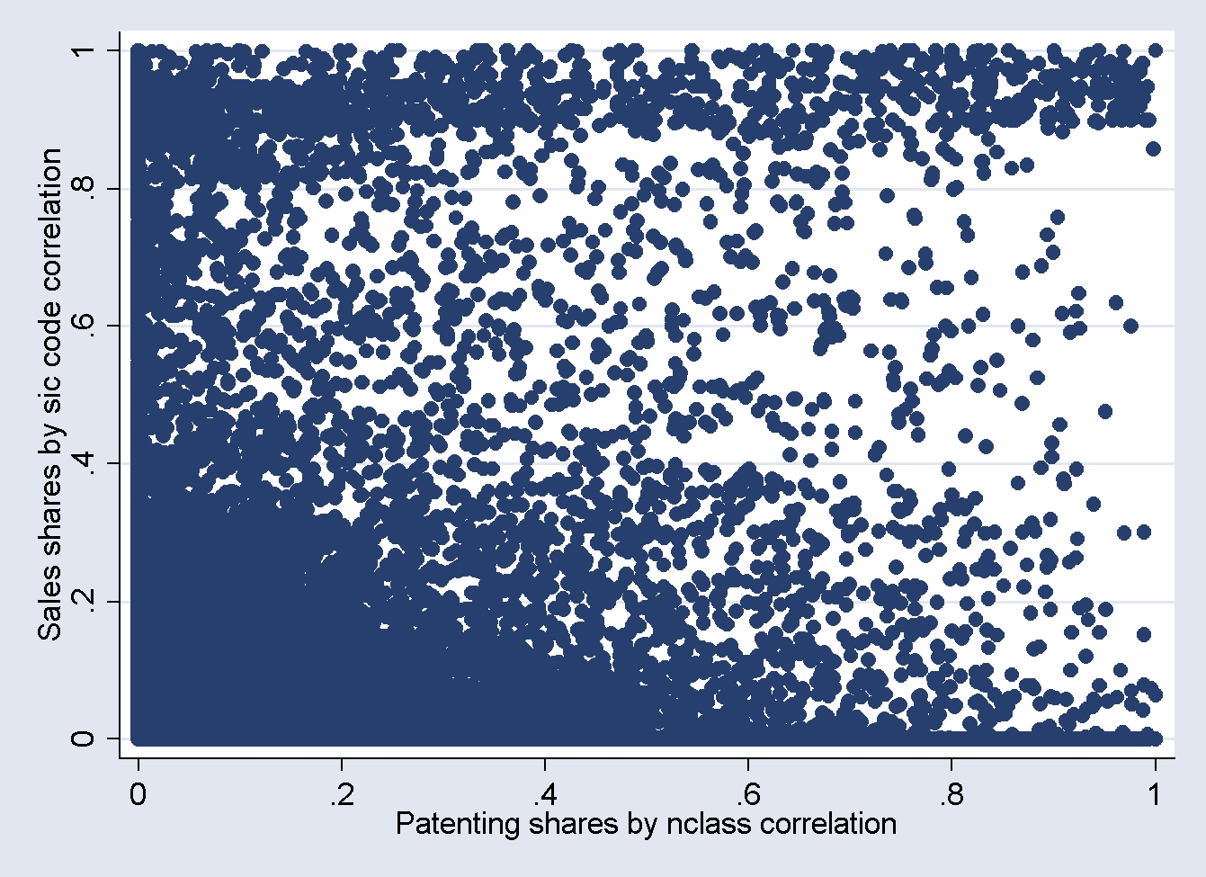
Figure 1: Correlation between SIC and TEC across all firm pairs

Slide 20
Examples (high TECH, low SIC): Computer and chip makers
 | Correlation | IBM | Apple | Motorola | Intel
IBM | SIC TECH |  | 0.32 0.64 | 0.01 0.47 | 0.01 0.76
Apple | SIC TECH |  |  | 0.02 0.17 | 0.01 0.47
Motorola | SIC TECH |  |  |  | 0.35 0.46
Intel | SIC TECH
IBM, Apple, Motorola and Intel all close in TECH
But a) IBM close to Apple in product market (.32, computers)
b) IBM not close to Motorola or Intel in product market (.01)

Slide 21
Other examples (high SIC, low TEC)
Gillette and Valance Technologies compete in batteries (SIC=.33, TECH=.01). Gillette owns Duracell but does no R&D in this area (mainly personal care R&D). Valence Technologies uses a phosphate technology (rather than Lithium ion) technology for its batteries
High end hard disks. Segway with magnetic technology Philips with holographic technology.

Slide 22
Structure
Analytical Framework
Data
Econometrics
Multiple equation estimation
Reflection problem
Identification
Results
Policy Simulations

Slide 23
Multiple equation estimation: general issues
Test theoretical predictions using four estimating equations
Market value: use Tobin’s Q estimation
R&D: use R&D estimation
Knowledge: use patents and productivity estimations
Generic issues to try and deal with:
Unobserved heterogeneity (fixed): used firm fixed effects
Endogeneity: use lagged explanatory variables to reduce this (also experiment with IV/GMM approach)
Dynamics: allow lagged dependent variable
Demand controls: include time dummies and SIC weighted industry sales

Slide 24
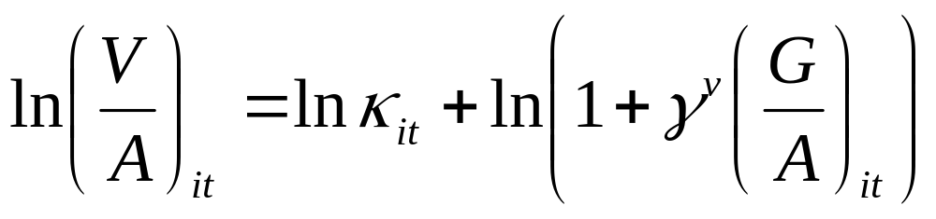
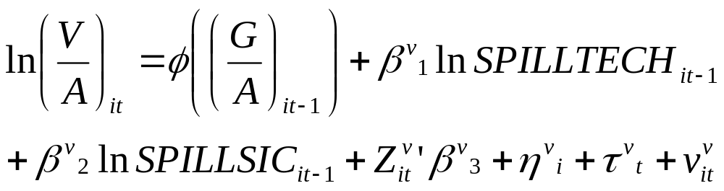
Market value equation
Use Griliches (1981) Tobin’s Q parameterisation:
R&D stock/
Fixed assets
With a 6th order expansion in (G/A) to allow FEs

Slide 25
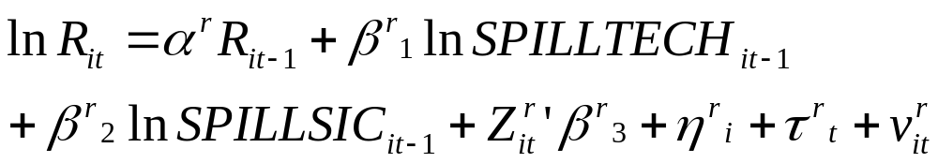
R&D Expenditure Equation

Slide 26
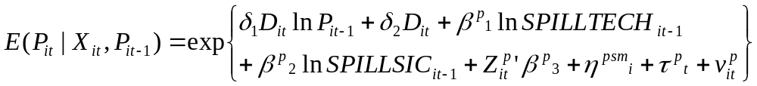
Patent Count Equation
Allow for overdispersion via Negative Binomial
Use a multiplicative feedback model to allow for dynamics
Use Blundell, Griffith and Van Reenen (1999) control for fixed effects through pre-sample mean patents (1968-1984)
Compare with citation weighted patents (similar)

Slide 27
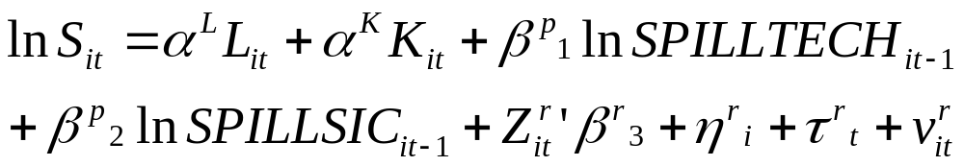
Productivity equation
Test using different SIC-2 industry coefficients on labor and capital
Tested various different specifications using value-added (rather than sales) and/or controlling for materials

Slide 28
Reflection Problem (Manski, 1993)
Main concerns technological opportunity (supply) and demand
shocks are common to all firms.
To address this we:
Use parametric determination of neighbors and firm level industry-weighted sales controls
Include firm fixed effects
Lag spillover variables one (or two) periods
Compare across multiple equations (particularly value eq.)
Another related issue is endogenous group selection:
Use pre-sample TEC measure and little difference
Any sic endogeneity biases against our results
But remains an issue do we identify spillovers or supply shocks?

Slide 29
Identification
Ideally use a natural experiment, but nothing obvious exists
So identification driven of variations in firms R&D due to
changes in costs, demand, strategy, technology, tax…
Two ideas for alternative identification we are working on:
The peace dividend (Scott Stern)
The R&D tax credits

Slide 30
Structure
Analytical Framework
Data
Econometrics
Results
Tobin’s Q equation
Patents equation
R&D equation
Productivity equation
Industry-level results
Policy Simulations

Slide 31
Table 3: Tobin’s Q
Dependent variable: Ln (V/A) | (1) | (2) | (3) | (4)
 |  | Fixed Effects | Fixed Effects Only SPILLTEC | Fixed Effects Only SPILLSIC
Ln(SPILLTECH_{t-1}) | -0.046 (0.028) | 0.149 (0.066) | 0.116 (0.064)
Ln(SPILLSIC_{t-1}) | 0.045 (0.015) | -0.043 (0.021) |  | -0.033 (0.020)
Ln(Industry Sales_{t}) | 0.330 (0.072) | 0.197 (0.041) | 0.196 (0.041) | 0.199 (0.041)
Ln(Industry Sales_{t-1}) | -0.413 (0.070) | -0.148 (0.042) | -0.153 (.041) | -0.140 (0.042)
Notes: Up to sixth-order terms in ln(R&D/Capital) and time dummies included. Estimation period is 1981-2001. NT=10.011. Newey-West heteroskedasticity and first-order auto-correlation robust standard-errors

Slide 32
Quantification of value eq
$1 own R&D raises V by $1.18 cents
$1 of SPILLTECH raises V by $0.043
  $1 SPILLTECH worth $0.036 of own R&D
$1 of SPILLSIC reduces V by $0.043

Slide 33
Table 4: Patent Model
Dependent var: Patent Count | (1) | (2) | (3) | (4)
 |  | Initial conditions | Initial conditions, dynamics | Initial conditions, dynamics
Ln(SPILLTECH) _{t-1} | 0.342 (0.079) | 0.237 (0.070) | 0.157 (0.035) | 0.164 (0.035)
Ln(SPILLSIC) _{t-1} | 0.064 (0.032) | 0.072 (0.029) | 0.027 (0.016)
Ln(R&D Stock) _{t-1} | 0.502 (0.043) | 0.289 (0.044) | 0.105 (0.025) | 0.106 (0.025)
Ln(Sales) _{t-1} | 0.335 (0.052) | 0.222 (0.045) | 0.113 (0.024) | 0.115 (0.024)
Ln(Patents) _{t-1} |  |  | 0.571 (0.026) | 0.572 (0.027)
Note: Time dummies and 4 digit industry dummies included. Estimation period is
1985-1998. Negative binomial model; NT=9,122. Standard errors clustered by firm

Slide 34
Quantification of patent eq
$1 of R&D stock generates 7.0 x10⁻⁶ extra patents per year.
$1 of SPILLTECH generates 0.22 x10⁻⁶ extra patents per year
  $1 of SPILLTECH worth (in patents) about $0.03 own R&D
SPILLSIC does not affect patents

Slide 35
Table 5: R&D Equations
Dep Var: ln(R&D) | (1) | (2) | (3) | (4)
 |  | Fixed Effects | Fixed Effects, Dynamics | Fixed Effects, Dynamics
Ln(SPILLTECH) _{t-1} | 0.225 (0.017) | 0.119 (0.072) | 0.018 (0.040)
Ln(SPILLSIC) _{t-1} | 0.292 (0.012) | 0.109 (0.026) | 0.025 (0.013) | 0.027 (0.013)
Ln(Sales) _{t-1} | 0.796 (0.009) | 0.801 (0.017) | 0.217 (0.015) | 0.217 (0.015)
Ln(R&D) _{t-1} |  |  | 0.695 (0.015) | 0.695 (0.015)
Ln(Industry Sales) _{t} | 0.699 (0.083) | 0.134 (0.030) | 0.134 (0.022) | 0.134 (0.022)
Ln(Indstry Sales) _{t-1} | -0.879 (0.083) | -0.082 (0.031) | -0.108 (0.023) | -0.107 (0.022)
Notes: Estimation period is 1981-2001. NT=8,565/8,395. Newey-West heteroskedasticity and first-order auto-correlation robust standard-errors

Slide 36
Quantification of R&D eq
SPILLSIC and own R&D are positively correlated, implying strategic complementarity
SPILLTECH does not significantly affect the own R&D decision after including fixed effects and dynamics

Slide 37
Table 6: Multifactor Productivity Equation
Dep Var: Ln(Sales) | (1) | (2) | (3)
 |  | Fixed effects | Fixed effects
Ln(SPILLTECH) _{t-1} | -0.040 (0.080) | 0.160 (0.038) | 0.158 (0.037)
Ln(SPILLSIC) _{t-1} | -0.010 (0.003) | -0.002 (0.011)
Ln(Capital) _{t-1} | 0.297 (0.008) | 0.179 (0.010) | 0.179 (0.010)
Ln(Labour) _{t-1} | 0.641 (0.011) | 0.634 (0.013) | 0.634 (0.013)
Ln(R&D Stock) _{t-1} | 0.054 (0.005) | 0.041 (0.006) | 0.041 (0.006)
Ln(Industry Sales) _{t} | 0.187 (0.036) | 0.181 (0.021) | 0.181 (0.021)
Ln(Industry Sales) _{t-1} | -0.073 (0.036) | -0.026 (0.021) | -0.026 (0.021)
Note: Time dummies and industry deflators included. Estimation period is 1981-2001; NT=10,092. Newey-West first order serial correlation and heteroskedasticity robust SEs

Slide 38
Quantification of prod eq
With fixed effects SPILLTEC is significantly related to productivity
SPILLSIC insignificant (with basically zero point estimate)

Slide 39
Table 7: Theory vs. empirics: with tech spillovers, product market spillovers and strategic comps
 | Partial correlation of: | Theory | Empirics | Consistent?
∂V₀/∂r_{τ} | Market value with SPILLTECH | Positive | .144* | Yes
∂V₀/∂r_{m} | Market value with SPILLSIC | Negative | -.043* | Yes
∂k₀/∂r_{τ} | Patents/TFP with SPILLTECH | Positive | .157* | Yes
∂k₀/∂r_{m} | Patents/TFP with SPILLSIC | Zero | .027 | Yes
∂r₀/∂r_{τ} | R&D with SPILLTECH | Ambiguous | .018 | -
∂r₀/∂r_{m} | R&D with SPILLSIC | Positive | .025* | Yes
*significant at 5% level in preferred specifications

Slide 40
What about industry heterogeneity?
Main focus of the paper is across a number of sectors
  Look across all sectors before analysing single industries
  Important for policy which often works at the macro level
But interesting question is how this extends to the underlying industry level
We look at the three main hi-tech sectors and find results which are reasonably similar to the aggregate results
  Also range of future industry-level structural extensions that would be a good complement to investigate

Slide 41
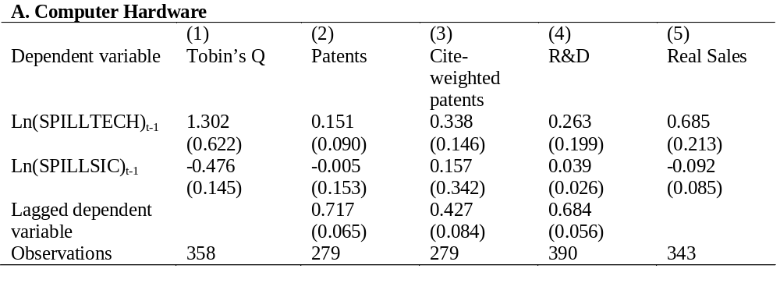
Table 9A. Computer Hardware

Slide 42
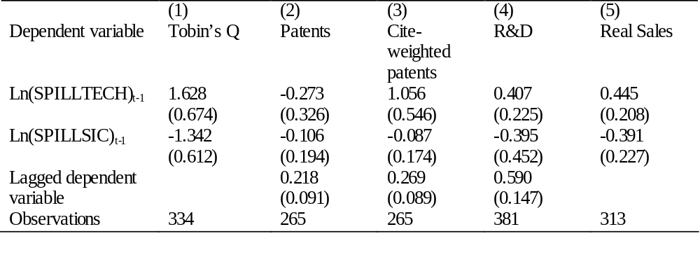
Table 9B. Pharmaceuticals

Slide 43
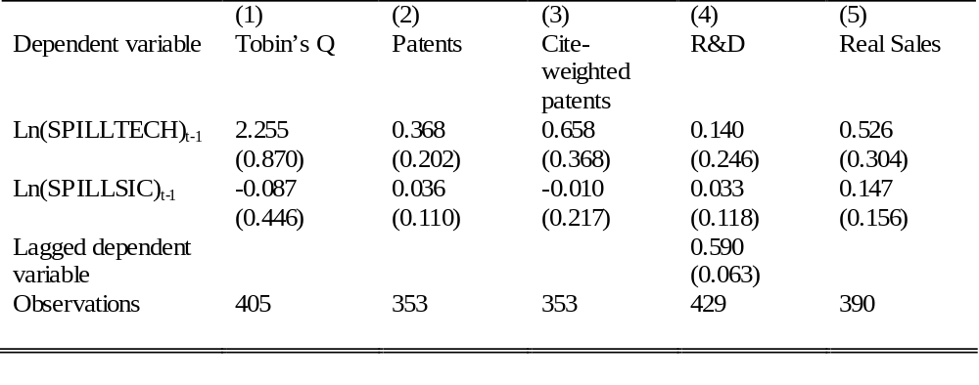
Table 9C. Telecommunications Equipment

Slide 44
Summary on results for 3 main high tech sectors
Evidence of technological spillover effects in all sectors
Evidence for product market spillovers in computers and pharma, but not in telecoms equipment
Less clear evidence of strategic complementarity
Private returns to R&D similar to overall sample ($1.18) in telecoms ($1.23), lower in computers ($0.77) and much higher in pharma ($3.65)

Slide 45
Robustness to another sales-share measure
Create sales breakdown shares using detailed 2006 global establishment/subsidiary sales data from Bureau Van Dyjk
  Covers about 73% the firms (95% weighted by R&D)
The BVD and Compustat sales-shares correlated at 0.70
Using BVD sales-share figures results seem broadly robust
 | Tobin’s Q | Patents | R&D | Productivity
Ln(SPILLTECH) _{t-1} | 0.290 (0.109) | 0.192 (0.049) | 0.146 (0.079) | 0.096 (0.052)
Ln(SPILLSIC) _{t-1} | -0.059 (0.034) | 0.059 (0.016) | 0.096 (0.036) | 0.010 (0.013)
Note: All specifications the same as the final column in each individual table, except SPILLTEC and SPILLSIC both included. Sample size about 75% of main data set.

Slide 46
Structure
Analytical Framework
Data
Econometrics
Results
Simulations
Quantification
Tax-credit simulation

Slide 47
Simulation of model to quantify impacts
Calculate long-run equilibrium response of all variables to an exogenous increase in R&D
Complex because of depends on firm-level distribution of R&D and linkages in TECH and SIC space
Consider first a 1% increase in R&D of all firms and examine responses in equilibrium of all variables using a log-linear approximation around current state
Distinguish between
  “autarky”: effects solely from firm changing own R&D
  “amplification”: effects of SPILLTECH and SPILLSIC

Slide 48
Table 8: impact of a 1% increase in R&D
Variable (% increase) | Autarky Effect | Amplification Effect | Total Effect (Amplification + Autarky)
R&D | 1 | 0.096 (0.051) | 1.096 (0.051)
Patents | 0.248 (0.031) | 0.445 (0.067) | 0.693 (0.075)
Market Value | 0.357 (0.095) | 0.161 (0.075) | 0.518 (0.124)
Productivity | 0.041 (0.006) | 0.177 (0.026) | 0.218 (0.032)
All numbers are % changes. Standard errors in brackets below calculated using the delta method

Slide 49
Policy Simulations
Baseline: 1% R&D shock to all firms (volume credit)
Policy 1: Existing US R&D tax credit
Policy 2: target small firms (many EU programs)
Policy 3: targets large firms

Slide 50
Table 9A: “Policy” simulations
Target Group | Total R&D stimulus, $m | Total R&D Spillovers $m | Total Productivity spillovers, $m
Baseline (1% higher, all firms) | 870 | 81.4 | 3,674
US R&D Tax Credit (firms eligible in median year) | 870 | 81.6 | 3,728
Smaller Firms (smallest 50%) | 870 | 78.3 | 2,113
Larger Firms (largest 50%) | 870 | 81.3 | 3,743

Slide 51
Table 9B, Descriptive statistics. Smaller firms “less connected”
Target Group | % firms | SIC | TEC
Baseline (all Firms) | 100 | 0.046 | 0.127
US R&D Tax Credit (firms eligible in median year) | 40 | 0.052 | 0.131
Smaller Firms (<50%) | 50 | 0.041 | 0.074
Larger Firms (>50%) | 50 | 0.047 | 0.129

Slide 52
Conclusions and Extensions
Find both technological spillovers and product market rivalry effects of R&D, consistent with predictions of simple analytical framework.
Using both technology and product market closeness measures AND multiple outcome indicators, can help to identify the different effects.
Useful for analysing impacts of policies – e.g. alternative forms of R&D subsidies to SMEs
Extensions – particular sectors; international dimension; specific equilibrium model
NIKZBLOOM EMMA123

Slide 53
General Predictions from the Model for Firm 0
Product market interactions mean that market value falls in r_{m}
Technology spillovers mean market value and knowledge (patents) rise in r_{τ}
Knowledge (patents) unaffected by r_{m}
Strategic product market [complementarity / substitution] means r_{o} [rise / falls] with r_{m}

Slide 54
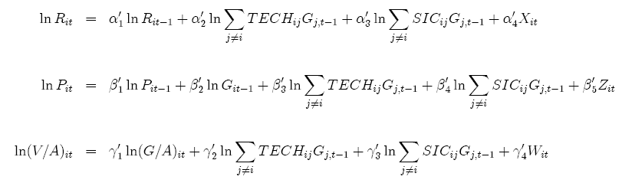
Our basic 3 equations

Slide 55
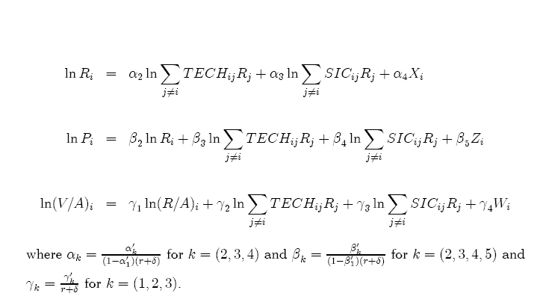
Re-write in terms of R&D flows in steady state

Slide 56
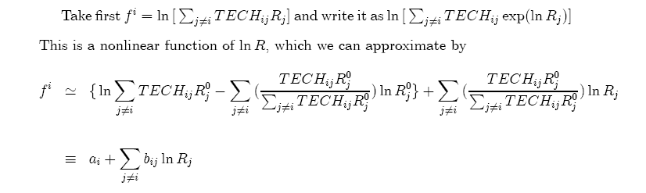
First order Taylor series expansion of SPILLTEC term

Slide 57
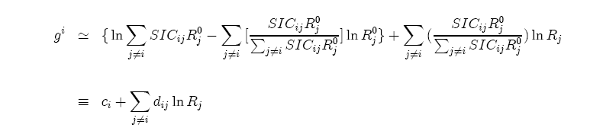
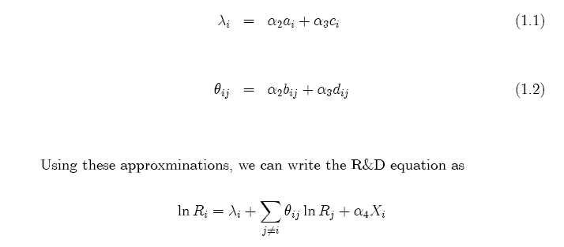
First order Taylor series expansion of SPILLSIC term

Slide 58
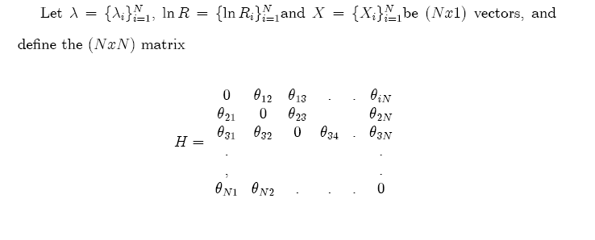

Slide 59
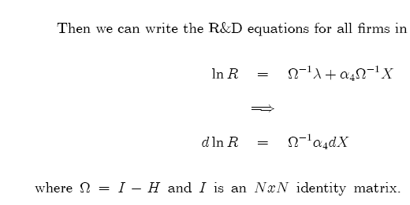
Final “reduced form” of R&D equation

Slide 60
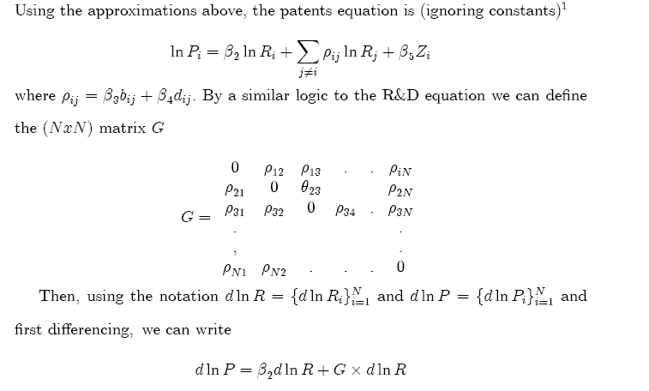
Deriving effect of R&D increase on patents

Slide 61
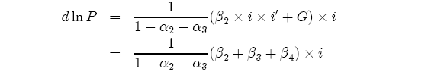
Final reduced form for steady state impact on patents
From spillover terms in R&D equation
From patent equations

