Slide 1
AI for Manufacturing
GRCC Training
AI for Workforce

Slide 2
Welcome!
Get all the content at:
https://github.com/grcc-resendiz/ai-manufacturing-muskegon
Notes:
Alright, let’s get into the course.
As you have probably gathered, today we have a lot to cover in a short amount of time so please forgive me if I start to talk a little fast.

Slide 3
Day 2 Agenda
0:00 Welcome and Day 1 recap
0:10 Computer vision in manufacturing
0:40 Hands on: train a model to spot defective cast parts
1:25 Debrief and your first pilot
1:40 Break
1:45 Vibe coding: build a simple app by describing it
2:50 Next session and questions
Notes:
Quick recap of Day 1 (2 minutes): who used their skill since yesterday? What happened?
Today is about quality: computer vision first, then a simple app for defect and downtime data.

Slide 4
What is Computer Vision?

Slide 5
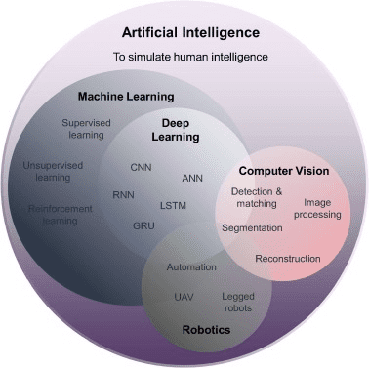
What is Computer Vision?
Computer vision is a subset of Artificial Intelligence that trains computers to automatically process, extract, and manipulate visual data from images and videos.
Notes:
Image Source: M.Q. Huang., et.al. (2021) BIM, machine learning and computer vision techniques in underground construction: Current status and future perspectives, Tunnelling and Underground Space Technology. Vol 108. ISSN 0886-7798. https://doi.org/10.1016/j.tust.2020.103677
Anything to do with manipulation of vision/image manipulation
Computer vision solves complex problems such as facial recognition (used, for example, by Snapchat to apply filters), detailed image analysis that allows for visual searches like the ones Google Images performs, or biometric identification methods.

Slide 6
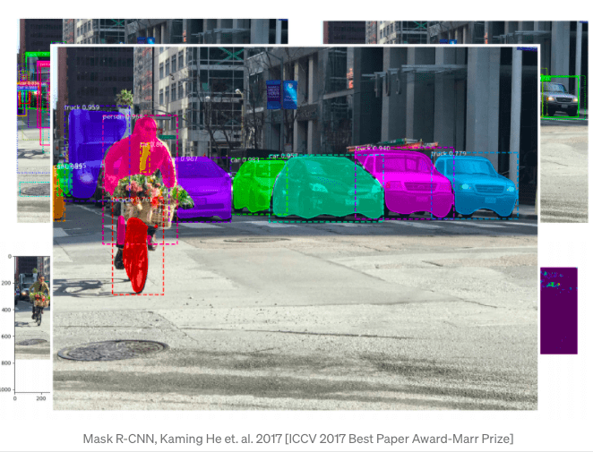
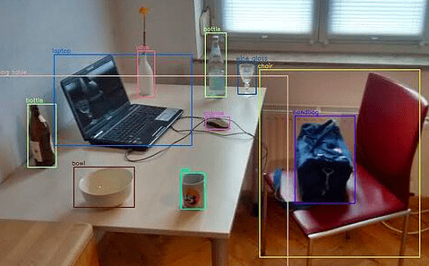
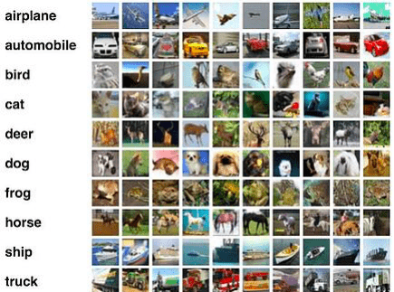
What is Computer Vision?
Common tasks that CV can perform:
Object identification
Object classification
Image segmentation
Notes:
Image Source: Oberoi, A. (2019, December 17). Vision AI: What is it and Why does it Matter? Daffodilsw.com. https://insights.daffodilsw.com/blog/vision-ai-what-is-it-and-why-does-it-matter
Ask the students to identify which image refers to which CV task.
Provide a definition for each:
Object identification: CV can identify or detect objects of interest in a still image or a video.
Object classification: CV can classify objects into the category that they belong to. Sometimes Object classification and detection are performed together. Identification locates the position of the classified object in the scene or frame of reference.
Image segmentation: It is the method of segmenting (or dividing) an image into various sub-groups called image segments. Image segmentation reduces the complexity of processing.

Slide 7
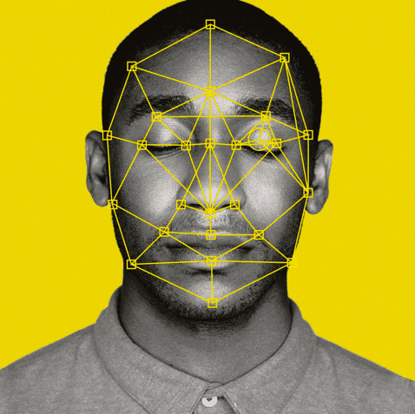


What is Computer Vision?
Common tasks that CV can perform:
Facial recognition
Edge Detection
Pattern recognition
Notes:
Image Source: No title. (n.d.-b). Sourcesecurity.com. Retrieved September 13, 2023, from https://www.sourcesecurity.com/insights/live-finger-detection-technology-reinforces-future-advanced-biometric-authentication-co-2366-ga.20449.html
Facial recognition: CV can perform facial recognition to identify and categorize individuals based on their features and biometric markers.
Edge detection: Is finding the boundaries/perimeter of an object in an image or video. It functions by detecting discontinuities in brightness. It is used in image segmentation to segment the image and also in object identification.
Pattern Recognition: Is to identify a recurring series of data or find similarities in data based on pre-existing information. Ex. speech recognition, color patterns, multi-media document recognition, fingerprint scanning are some examples of pattern recognition.

Slide 8
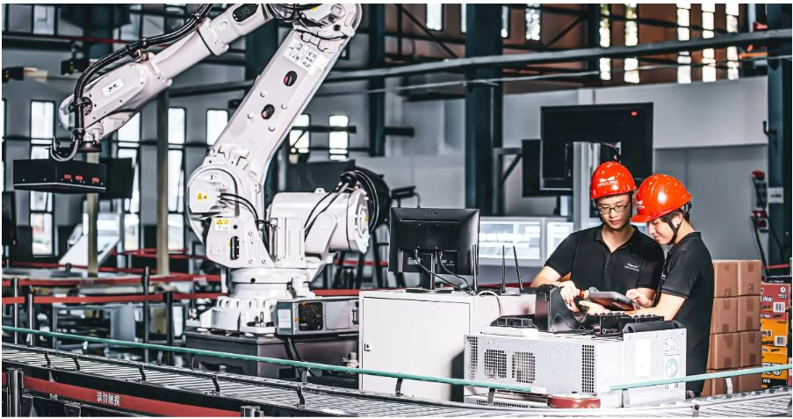
Computer Vision in the Manufacturing Industry
Existing Use Cases - Quality Inspection
One of the most common use cases of computer vision in manufacturing is to inspect and validate the quality of products during the manufacturing process.
This involves using computer vision algorithms to detect defects and deviations from specifications.
Why defect detection is hard?
Image source : piotr.sember@uico.pl. (2022, August 24). Quality inspections of the production line using computer vision and Flow –. Novacura. https://www.novacura.com/computer-vision-quality-inspections/
Notes:
The most common use of computer vision in manufacturing is inspecting and validating product quality: finding defects and deviations from spec.
Ask: where on your floor do people inspect parts by eye today?

Slide 9
Computer Vision in the Manufacturing Industry
Existing Use Cases - Quality Inspection
What makes CV valuable
More consistent inspection
Faster decision-making
Scalable across shifts and sites
Better traceability
Supports operators rather than replacing judgment
Image source : piotr.sember@uico.pl. (2022, August 24). Quality inspections of the production line using computer vision and Flow –. Novacura. https://www.novacura.com/computer-vision-quality-inspections/
Notes:
Stress that CV supports operators instead of replacing their judgment. The inspector decides what counts as a defect.

Slide 10
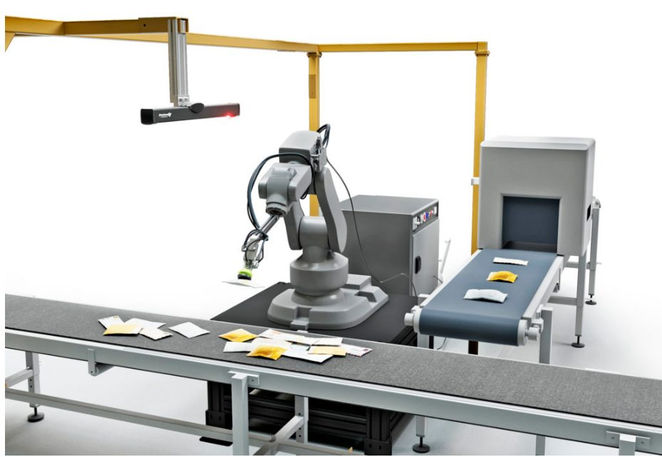
Computer Vision in the Manufacturing Industry
Existing Use cases - Object Recognition and Sorting
Computer vision is used to recognize objects and sort them into categories, such as by size, shape, color, or material.
This can help to streamline the manufacturing process and improve efficiency.
Atos Group. (2017, June 19). Predictive Maintenance for Manufacturing. YouTube. https://www.youtube.com/watch?v=QStfd20NH3I​
​
Notes:
There is also object recognition for sorting objects along an assembly line.

Slide 11
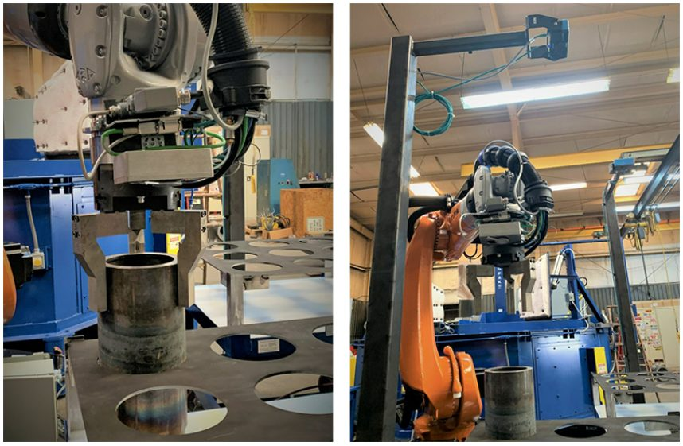
Computer Vision in the Manufacturing Industry
Existing Use cases - Robotic Guidance and Automation
Computer vision is used to guide robots and automate tasks in the manufacturing process, such as pick-and-place operations or assembly tasks.
This helps to improve efficiency and reduce the need for manual labor.
Image source : SICK USA. (2020, December 19). Robot Vision and Guidance Can Take Automation to the Next Level. SICK USA BLOG. https://sickusablog.com/robot-vision-guidance-can-take-automation-next-level/
Notes:
Using CV for robotic guidance

Slide 12


Computer Vision in the Manufacturing Industry
Advantages
Advantages
Increased Efficiency
By automating repetitive tasks, computer vision can increase manufacturing speed and efficiency while reducing labor costs.
Reliability
The computer system's effectiveness remains constant despite limitations like fatigue or disease.
Better Data Collection and Analysis
Computer vision technology can collect and analyze large amounts of data in real-time, providing manufacturers with important insights into their processes and operations.
Safety
Computer vision technology can help detect potential safety hazards in the manufacturing process, making a secure work environment for employees.
Notes:
As with anything there is always advantages and disadvantages.
Earlier in the course we’ve talked about the advantages and disadvantages of AI in manufacturing in general but in this week we focus on specifically CV.
The various advantages of using CV systems are:
Increase Efficiency due to automation of repetitive tasks
Better Data Collection and Analysis because CV applications can take in real-time data and process the incoming data to make decisions
Safety due to the real-time monitoring, CV applications can detect hazards or identify risks to employees quickly
And Reliability because a CV system can provide 24/7 support and are perfect for the controlled conditions manufacturing plant/factory

Slide 13

Computer Vision in the Manufacturing Industry
Disadvantages
Disadvantages
Privacy Concerns
Some employees may have concerns about their privacy when being monitored by computer vision systems, leading to potential pushback or resistance to adoption.
High Initial Cost
Implementing computer vision technology in manufacturing requires significant investment in hardware, software, and personnel training.
Dependence on Lighting and Environment
Computer vision systems require consistent lighting conditions and a clear view of the manufacturing process to work accurately.
Limitations in Object Recognition
Computer vision may have limitations in recognizing complex objects or identifying subtle differences in product features, leading to inaccuracies in detecting defects.
Notes:
However, nothing is ever perfect.
The main disadvantages are:
The high initial cost for purchasing the hardware and software to manage these types of applications, especially at scale
In general light and environmental dependencies are a challenge for cameras, but this is particularly crucial for AI applications because decisions are being made based on the captured image. If the lighting or environment change drastically, this can mean significant variations in performance for a CV model.
CV applications also can be limited by how detailed the work required is. This particular limitation can be addressed through good application design, model training, and image processing as well as camera placement, however, it is significant to point out. You can’t just put a CCTV camera up in the corner, give it a model, and expect it to catch a small rip on a piece of fabric or dent in a sheet of metal. Therefore, it’s a limitation but a manageable one with proper design.
And of course privacy. It is always possible employees may have concerns regarding their personal privacy due to being monitored constantly by the CV applications.

Slide 14
Hands on Activity
Notes:
Hands on: we follow the AI project cycle from start to finish with a real quality dataset.

Slide 15
Let’s Recall the AI Project Cycle
Problem Scoping
Data Exploration
Evaluation
Data Acquisition
Deployment
Modeling
Notes:
Walk the cycle once with today's problem: is a cast part OK or defective?
Problem scoping: which defect matters? Data: images of good and bad parts. Modeling: Teachable Machine. Evaluation: test images. Deployment: webcam demo.

Slide 16
Hands - On Activity
Problem
Scoping
Teachable Machine Image Project Development
Train a model that tells OK cast parts from defective ones.
Download casting_data.zip from the course GitHub page and unzip it.
Notes:
Dataset: casting_data.zip on the course GitHub page. It holds images of cast parts, sorted into ok_front and def_front, with train and test folders.
Open https://teachablemachine.withgoogle.com/ and choose Image Project, Standard image model.

Slide 17
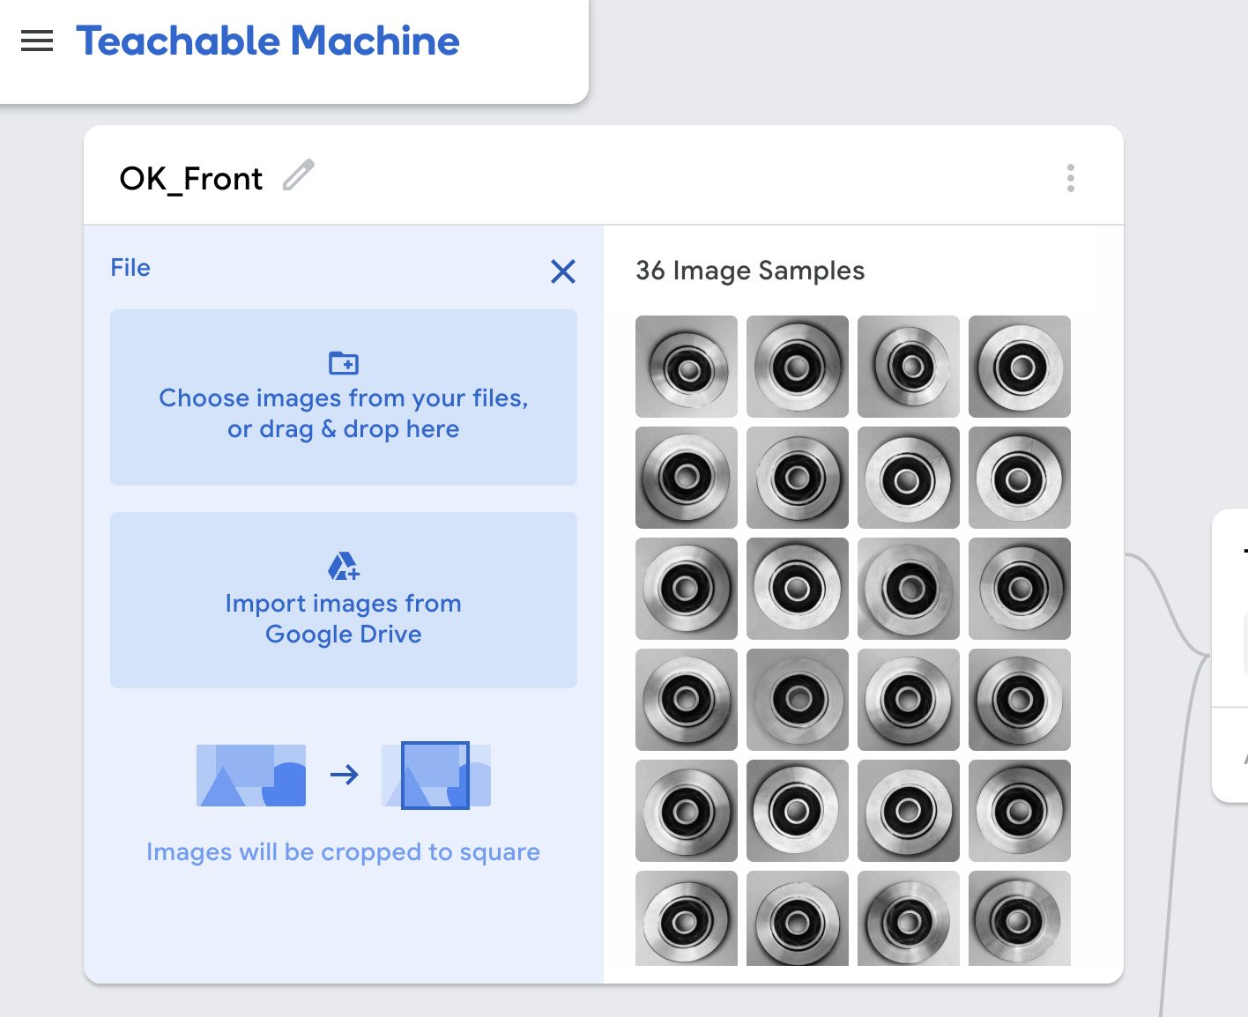
Hands - On Activity
Data Acquisition
Teachable Machine Image Project Development
Click the pencil icon and rename Class 1 to OK.
Upload the images from train/ok_front.
Notes:
Class 1 is OK. Upload everything in train/ok_front.

Slide 18
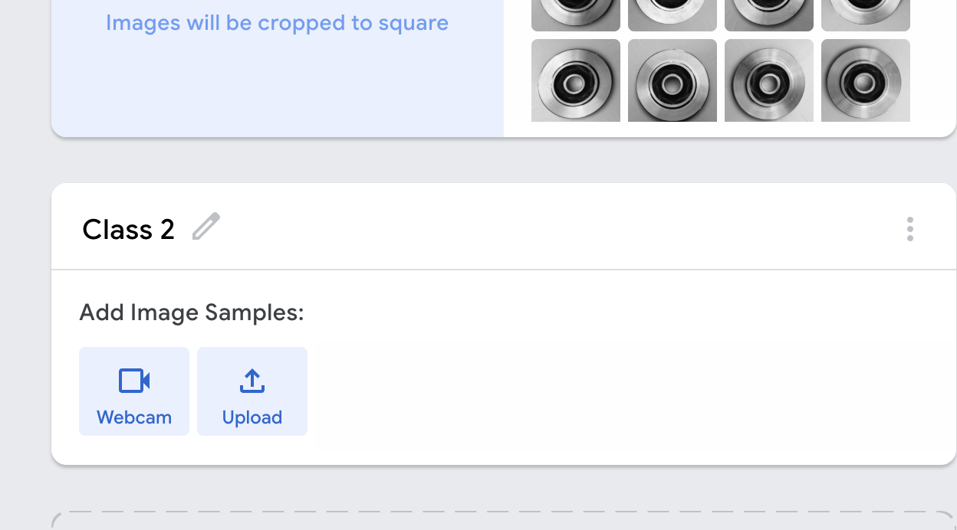
Hands - On Activity
Teachable Machine Image Project Development
Rename Class 2 to Defective.
Click Upload and add the images from train/def_front.
Notes:
Class 2 is Defective. Upload everything in train/def_front.
Two classes only, so the model learns one question: OK or defective?

Slide 19
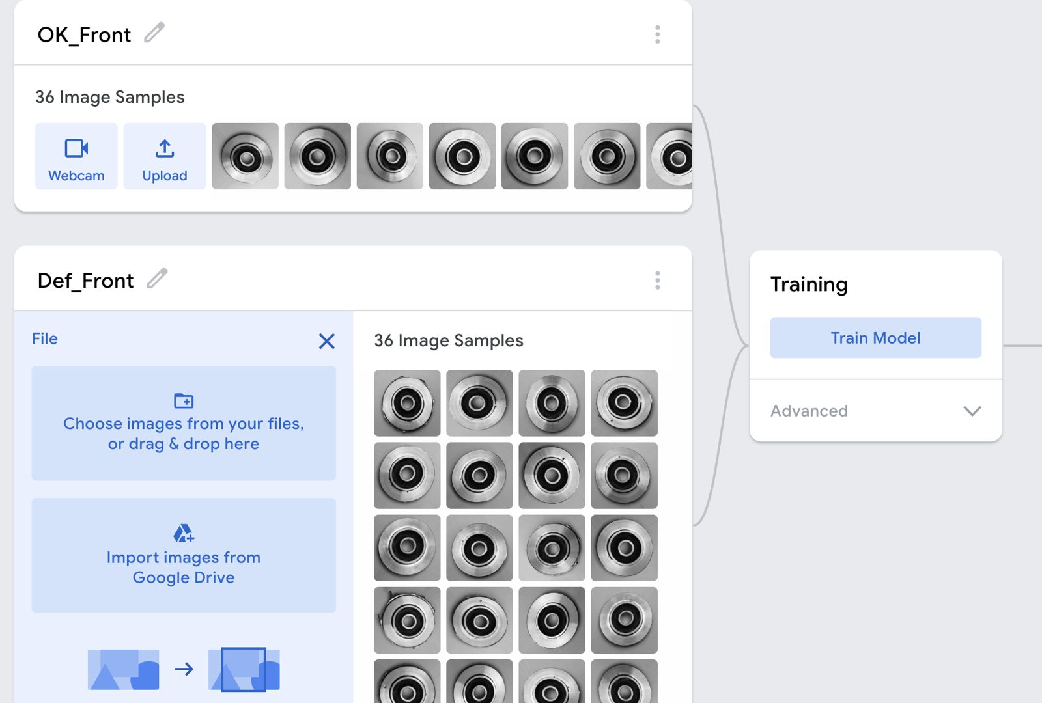
Hands - On Activity
Modeling
Teachable Machine Image Project Development
Click Train Model.
Keep the browser tab open while it trains.
Notes:
Training takes a minute or two. Advanced settings show accuracy per class and a confusion matrix; save that for Day 3.

Slide 20
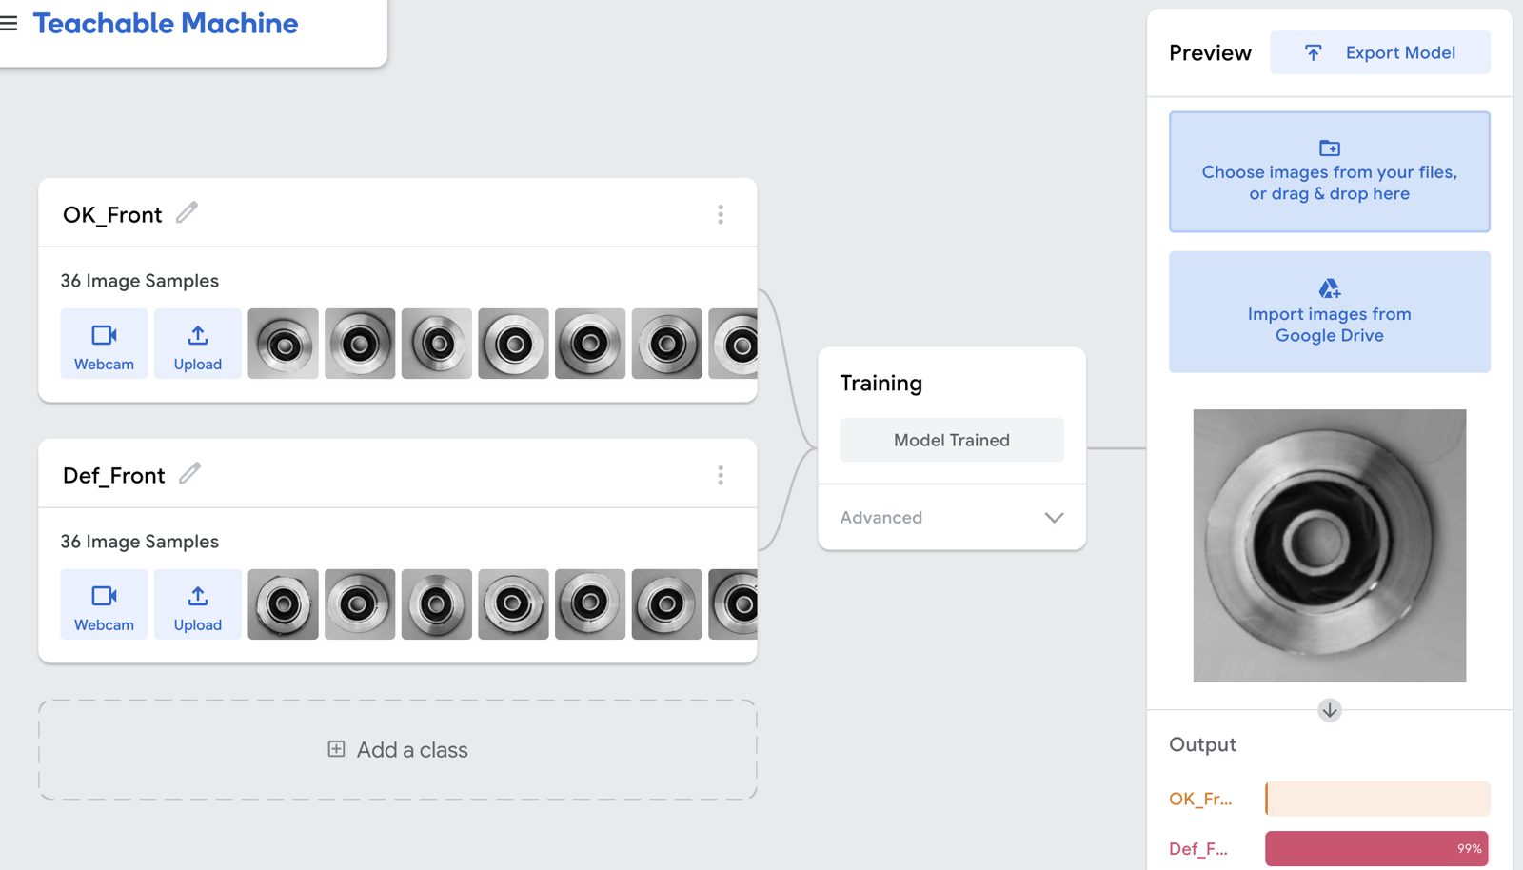
Hands - On Activity
Evaluate
Teachable Machine Image Project Development
Notes:
Test with images from the test folders, which the model has never seen. Ask: which defects fooled it?

Slide 21
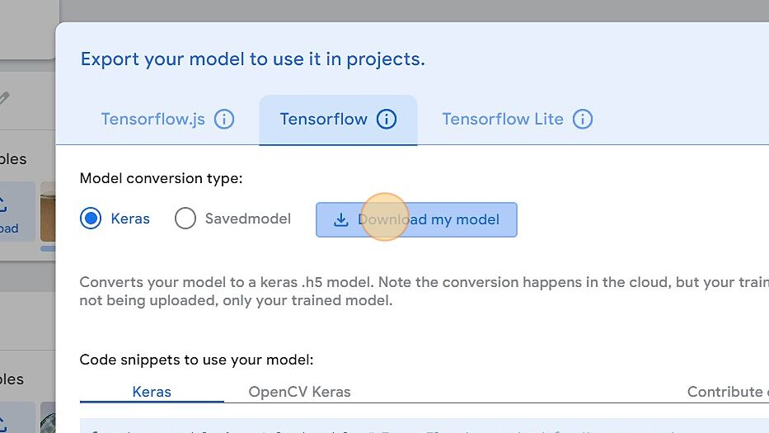
Hands - On Activity
Deployment
Teachable Machine Image Project Development
Click Export Model, then Upload my model.
Copy the shareable link.
Paste it into the Codespaces demo to test with your webcam.
Notes:
Export Model > Upload my model creates a shareable link. Paste that link into the Codespaces demo (Day 2 Computer Vision Demo on the GitHub page), start it, and hold a part or a picture up to your webcam.

Slide 22
Reflection
Notes:
Step back from the tool: what would it take to use this on a real line?

Slide 23
Hands - On Activity
Teachable Machine Image Project Development
Debrief
What did your model get right—and wrong?
Which defects were easiest?
Which cases confused the model?
Did lighting matter?
Did data balance matter?

Slide 24
Technology Adoption Gap
Questions for a first pilot
Which defect matters most?
What images do we already have?
What decision will the system trigger?
What error is more costly: miss or false alarm?
Who owns data, labeling, and validation?
How will we measure pilot success?
Notes:
Facilitate discussion.

Slide 25
Key Takeaways
Start small, learn fast, scale what works
Don’t begin with enterprise-wide transformation
Begin with one painful inspection point
Use data discipline
Build confidence with a pilot
Let operations lead the use case
Notes:
Summarize confidently.

Slide 26
Vibe Coding
Notes:
Second half of Day 2: build a simple app by describing it in plain language.

Slide 27
What Is Vibe Coding?
You describe the app in plain language.
The AI writes the code and shows you a working preview.
You test it and ask for changes until it does the job.
Great for quick prototypes. Not a replacement for IT or production software.
Notes:
Same skill as Day 1: a clear prompt (RTFC) gets a better app.

Slide 28
Prompt, Skill, or App?
Prompt: a one time question or task
Skill: the same question again and again, using your documents
App: a repeated workflow with data in and a result out, like a dashboard
Start with the simplest one that solves the problem.
Notes:
Tie back to Day 1. Most tasks only need a prompt or a skill. Build an app when people repeat the same steps with the same kind of data.

Slide 29
Demo: Defect and Downtime Dashboard
Data: manufacturing_data_export_2026-05-01.csv (course GitHub page)
Columns: date, machine, quantity, defects, downtime, energy, operator, shift, revenue, cost
Goal: see which machine and shift lose the most time and parts
Tool: Google AI Studio, Build mode (aistudio.google.com/apps)
Notes:
Sample production data from the May cohort repo: 32 rows, one per machine, shift, and day in April 2026.

Slide 30
The Prompt
Build a web app for a manufacturing supervisor.
Let me upload a CSV with these columns: date, machineId, productionQuantity, defects, downtimeMinutes, energyConsumption, operator, shift, revenue, cost.
Show defect rate and downtime by machine and by shift as bar charts.
List the top 3 problems in plain language with one suggested action each.
Keep it simple, one page, large text.
Notes:
Point out the RTFC parts: role (supervisor), task (dashboard), format (bar charts, top 3 list), constraints (one page, large text).
Paste this prompt in Build mode, run it, then upload the CSV in the preview.

Slide 31
Build It in Google AI Studio
Go to aistudio.google.com/apps and sign in with a Google account.
Paste the prompt and run it. The code and a live preview appear.
Upload the CSV in the preview and check the numbers.
Ask for one change in the chat, for example: add a filter by date.
Claude, ChatGPT, and Gemini can also build small apps right in the chat.
Notes:
Source for Build mode steps: https://ai.google.dev/gemini-api/docs/aistudio-build-mode
Check the app math against the CSV for one machine. AI built apps can be wrong too.

Slide 32
Map Your Workflow
Is the task part of a bigger workflow?
Can you write the steps down clearly?
Are the inputs and outputs the same every time?
Is it simple enough to build without IT help?
Rate your tasks on time spent, frequency, and repetition. High on all three is your best app idea.
Notes:
Worksheet: Map your workflow, https://docs.google.com/document/d/11CKnpIsUIB6B4AfStJ97ySWpeWfLDXb0A8uEMAIT0n8/edit?usp=sharing
Give 10 minutes. Pairs work well.

Slide 33
Build Your Own
Pick one task from your worksheet.
Write the prompt with RTFC: who it is for, what it does, what it shows, and the limits.
Use made up or sample data. Never upload confidential company data.
Start small, test with real questions, and ask for one change at a time.
Notes:
About 30 minutes of build time. Walk the room. Ask two people to share their app at the end.

Slide 34
Prototype Is Not Production
Check the results against the real numbers.
Ask who will maintain it and where the data lives.
Bring IT in before real company data goes in.
A working prototype is a great way to start that conversation.
Notes:
Same message as the pilot questions earlier today: start small, prove value, then involve the right people.

Slide 35
Next Session: Predictive Maintenance
You will predict machine failures from sensor data.
You will build the model in Orange, no coding needed.
You will plan your first AI pilot.
Notes:
Install Orange before Day 3: https://orangedatamining.com/download/

Slide 36
Questions?
‹#›
Notes:
Are there any questions?

Slide 37


Notes:
With that I’d like to thank you all for your time today.

