Slide 1
AI for Manufacturing
GRCC Training
AI for Workforce

Slide 2
Welcome!
Get all the content at:
https://github.com/grcc-resendiz/ai-manufacturing-muskegon
Notes:
Alright, let’s get into the course.
As you have probably gathered, today we have a lot to cover in a short amount of time so please forgive me if I start to talk a little fast.

Slide 3
Day 3 Agenda
0:00 Welcome and Day 2 recap
0:10 Why downtime matters and how predictive maintenance works
0:20 Machine learning basics and how to judge a model
0:50 Hands on: predict machine failures in Orange
1:35 Break
1:45 Demo: the same model in Python
2:00 Implementation: AI readiness and your first pilot
2:45 Key takeaways and questions
Notes:
Quick recap of Day 2: did anyone open their app or model again? What would they change?
Today ties everything together and ends with a pilot plan each person takes back to work.

Slide 4
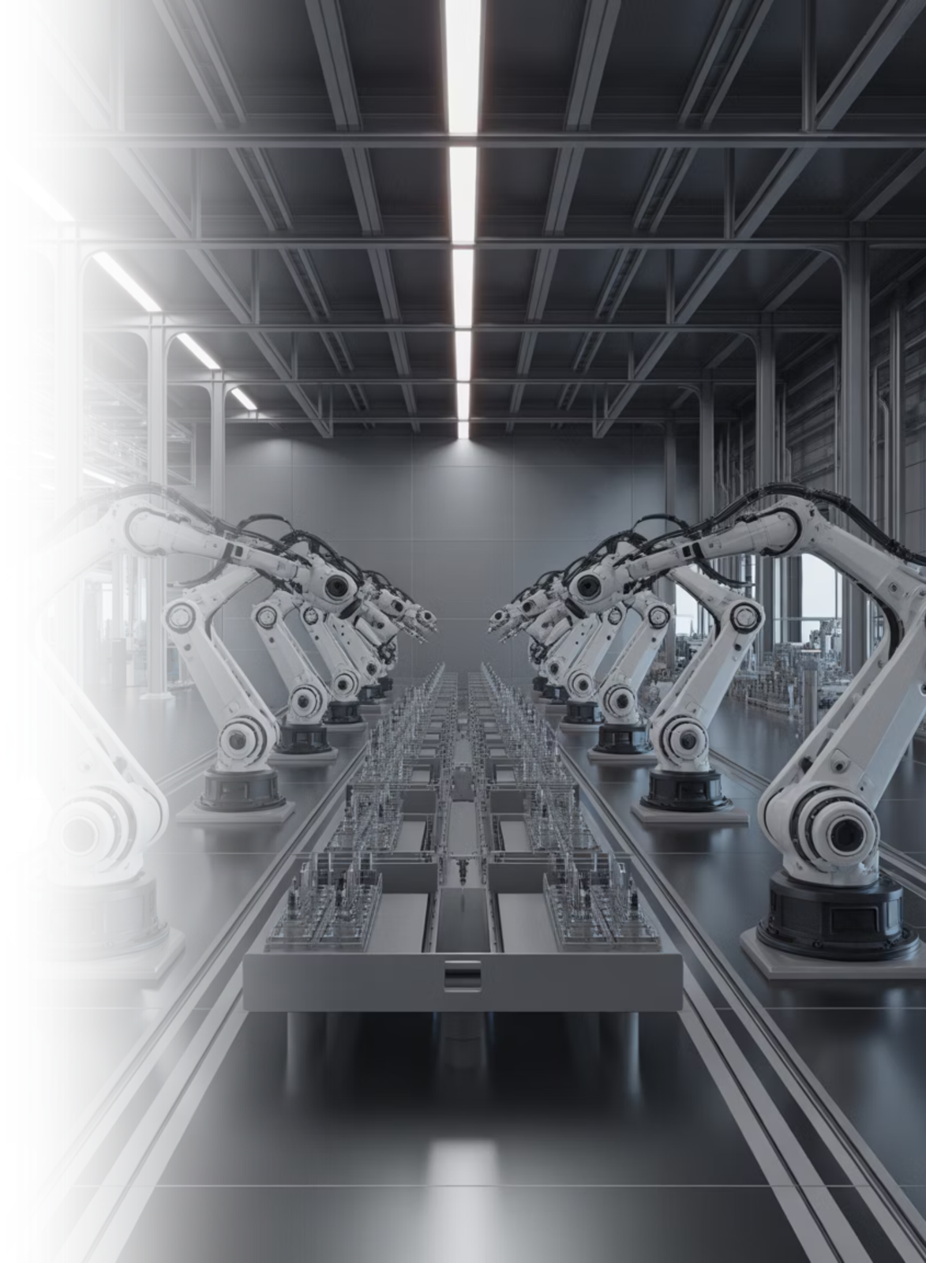
Predictive Maintenance with Machine Learning
Using Data to Predict Equipment Failure
Notes:
Opening song: https://youtu.be/7_oRyGmsioc?si=89sv1PxZDn-gfcso

Slide 5
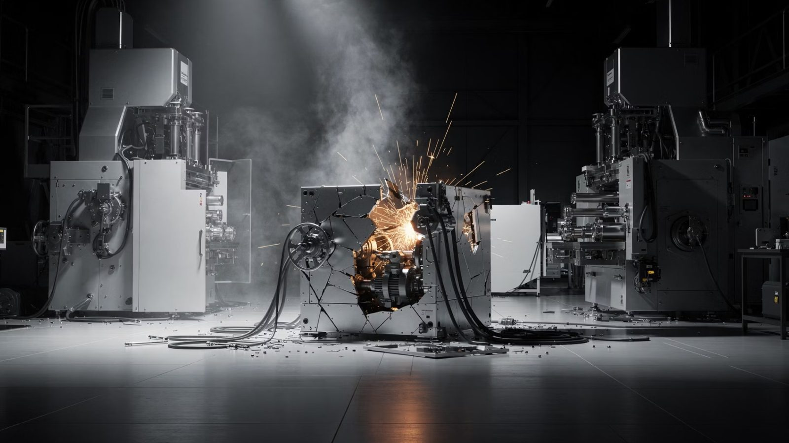
The Problem (manufacturing)
Cost of Downtime¹
Cost per Hour¹
Unplanned downtime costs the world's 500 largest companies about $1.4 trillion a year.
A large automotive plant loses about $2.3 million for every hour it stands still.
Notes:
[1] Siemens, The True Cost of Downtime 2024: https://assets.new.siemens.com/siemens/assets/api/uuid:1b43afb5-2d07-47f7-9eb7-893fe7d0bc59/TCOD-2024_original.pdf
Slide: The Problem, Unplanned Downtime
$1.4 trillion is about 11% of revenue for the Fortune Global 500.
Ask: what does an hour of downtime cost on your floor?

Slide 6

The Solution – Predictive Maintenance
Impact³
Definition
Predict failures before they happen using data.
27
How it works
Downtime Hours
Collect data from machines (temperature, vibration, etc.)
Analyze the data to find patterns
Predict when a failure is likely and take action.
Per plant each month in 2024, down from 39 in 2019
2x
More PdM Teams
Almost half of firms now have predictive maintenance teams
Notes:
[3] Siemens, The True Cost of Downtime 2024: https://assets.new.siemens.com/siemens/assets/api/uuid:1b43afb5-2d07-47f7-9eb7-893fe7d0bc59/TCOD-2024_original.pdf
Siemens credits predictive maintenance going mainstream as a critical factor in the drop from 39 to 27 hours.
Almost half of firms surveyed have PdM teams, twice the share in 2019.

Slide 7

Machine Learning (ML)
Machine learning is a branch of artificial intelligence that focuses on building systems that learn patterns from data and use those patterns to make predictions or decisions without being explicitly programmed for each task.
The three major areas of ML are:
1
2
Supervised Learning
Unsupervised Learning
The model learns to make predictions from labeled data, where the correct output (label) is known. Ex: predicting machine failure
The model learns from unlabeled data, without predefined outputs. Ex: grouping similar machines
3
Reinforcement Learning
The model learns by interacting with an environment and receiving rewards or penalties. Ex: game-playing AI such as AlphaGo

Slide 8
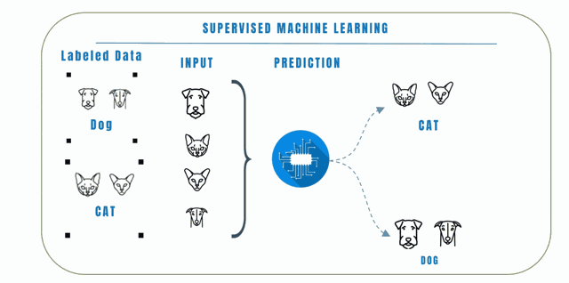
Supervised Learning Classification Example
Notes:
From Intel Elements of ML Slide 60

Slide 9
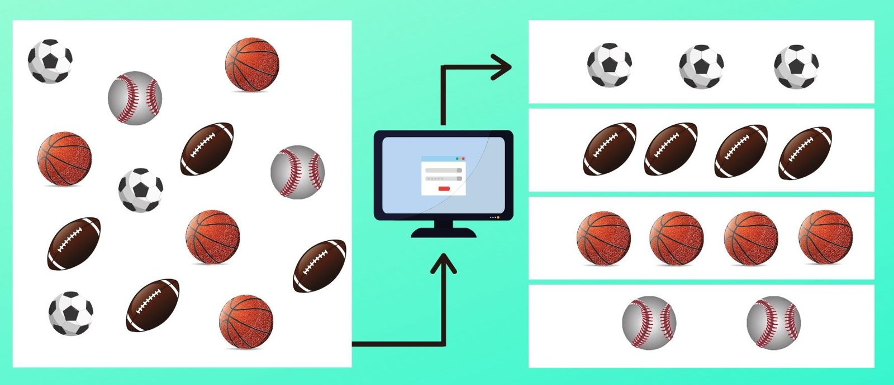
Unsupervised Clustering Example
Notes:
Intel Machine Learning Slide 86

Slide 10
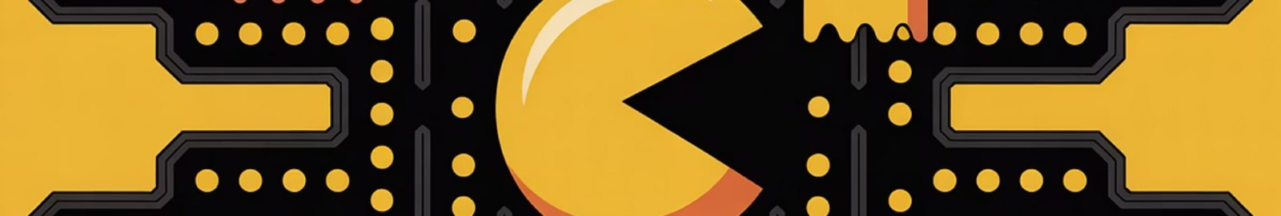
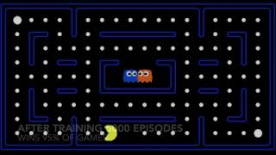
Reinforcement example – Pac-Man
Notes:
Intel Machine Learning slide 112

Slide 11
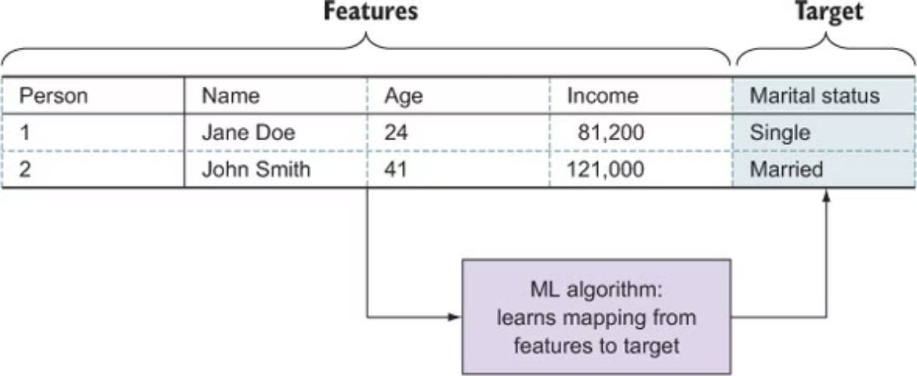
Supervised Learning with Statistical Data

Slide 12
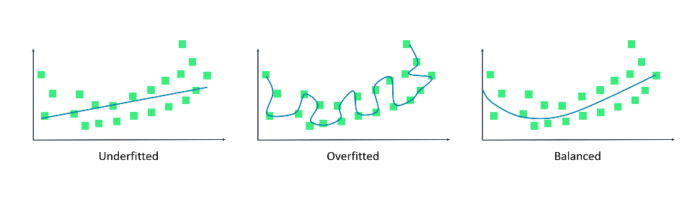
Key Machine Learning Terms
Training
Prediction
The process of using data to teach the model patterns
The output produced by a trained model on new data
Overfitting
Underfitting
When a model learns the training data too well and performs poorly on new data
When a model is too simple
to capture patterns in the data
Notes:
Image from AWS AI practitioner course: Responsible Artificial Intelligence Practices
Training and prediction happen at different times and often on different data.
A model that performs extremely well on training data can still perform poorly in practice.
Overfitting and underfitting represent two different ways a model can fail.
The goal is not perfect fit to past data, but good performance on new, unseen data.
Model evaluation is how we detect these issues, which becomes important later in the course.

Slide 13

Machine Learning & Supervised Learning
What is Machine Learning?
Example (simplified data)
Allowing a machine to learn patterns from data (pre-set algorithms)
Use those patterns to make predictions
Temperature (K)
Vibration (mm/s)
Failure (0 or 1)
308.5
4.3
0
310.0
4.2
1
What is Supervised Learning?
309.2
2.5
0
A type of machine learning that learns from labeled data
Data includes: Inputs (machine measurements) and Outputs or Labels (failure or no failure)
310.7
3.9
1
311.3
2.4
0
308.9
3.8
0
311.5
4.3
1
310.1
2.2
0

Slide 14

Confusion Matrix
A Confusion Matrix compares predicted labels to actual labels.
Suppose a model predicts whether a machine will fail during the next shift, across 100 machine shifts.
  87, True Negatives (TN):
  Healthy machines correctly predicted to keep running.
  2, False Positives (FP):
  False alarms: predicted a failure, but the machine was fine.
  3, False Negatives (FN):
  Missed failures: predicted fine, but the machine failed.
  8, True Positives (TP):
  Failures caught before they happened.
CONFUSION MATRIX
Predicted
no
yes
87 (TN)
2 (FP)
no
Actual
yes
3 (FN)
8 (TP)
Notes:
Ask: on your floor, which costs more, a missed failure or a false alarm? Same question as the Day 2 pilot discussion.

Slide 15
Confusion Matrix Evaluation Metrics (No Calculations)
Accuracy tells us the proportion of all predictions that are correct.
  Ex: Out of 100 machine shifts, what percent did the model get right?
Precision focuses on minimizing false positives. It finds the proportion of positive predictions that are correct.
  Ex: Of the 10 failure warnings, how many were real failures?
Recall focuses on minimizing false negatives. It finds the proportion of true positives that are correctly identified.
  Ex: Of the 11 real failures, how many did the model catch?
F1 Score balances precision and recall into a single metric.
CONFUSION MATRIX
Predicted
no
yes
87 (TN)
2 (FP)
no
Actual
yes
3 (FN)
8 (TP)

Slide 16
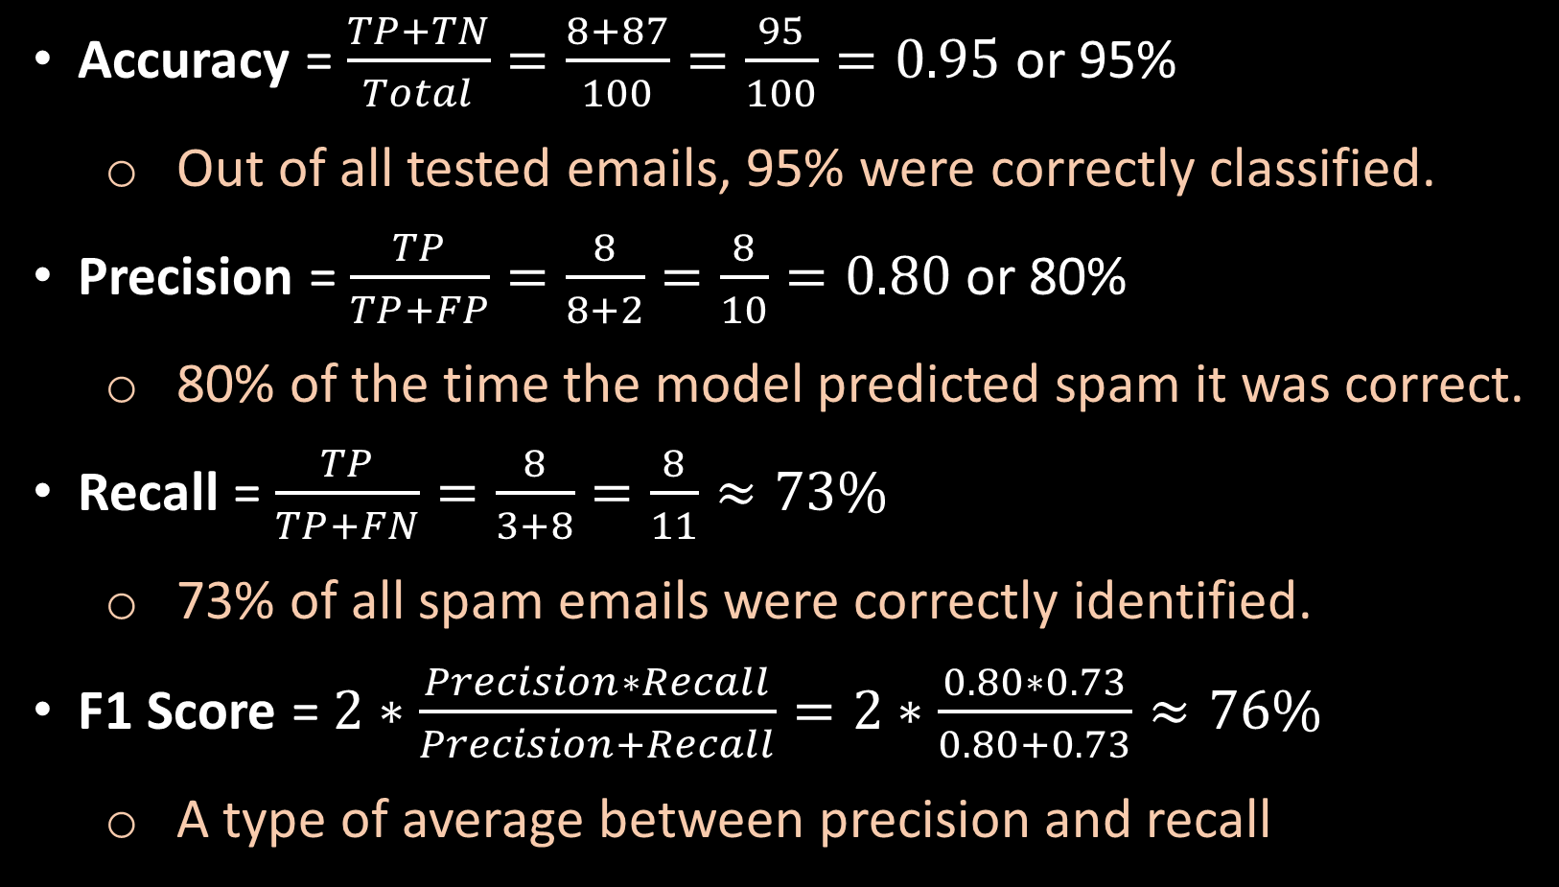
Confusion Matrix Evaluation Metrics (Calculations)
Accuracy = (TP + TN) / Total = (8 + 87) / 100 = 95%
  95 of 100 predictions were right.
Precision = TP / (TP + FP) = 8 / (8 + 2) = 80%
  When the model warned of a failure, it was right 80% of the time.
Recall = TP / (TP + FN) = 8 / (8 + 3) = about 73%
  The model caught 73% of real failures. It missed 3.
F1 Score = 2 x (0.80 x 0.73) / (0.80 + 0.73) = about 76%
  One score that balances catching failures and avoiding false alarms.
CONFUSION MATRIX
Predicted
no
yes
87 (TN)
2 (FP)
no
Actual
yes
3 (FN)
8 (TP)
Notes:
Check: (8 + 87) / 100 = 0.95. 8 / 10 = 0.80. 8 / 11 = 0.727. F1 = 2 x 0.80 x 0.727 / 1.527 = 0.762.
For maintenance, recall usually matters most: a missed failure means unplanned downtime.

Slide 17
Introduction to Orange Data Mining
Notes:
Hands on, about 45 minutes. Everyone uses the same dataset so we can compare results.

Slide 18
Introduction to Orange Data Mining
Install Orange before class: orangedatamining.com/download
Getting Started with Orange Data Mining
Exploring the Canvas
Notes:
But back to week 8, here’s the agenda for the ODM section. As you can see, just like python and streamlit, we slowly but surely walk the students through how to install ODM and use it.

Slide 19
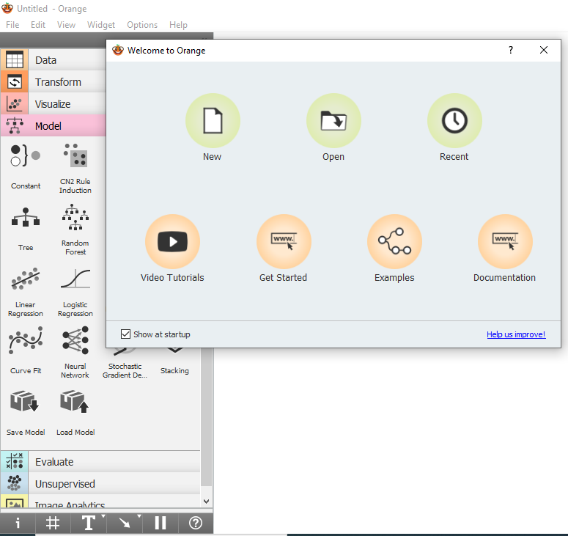
Create a New Project
Open the Orange Data Mining application
Welcome to Orange Page will appear
Click on New to open a new project
Notes:
And so we take the students through ODM to go from

Slide 20
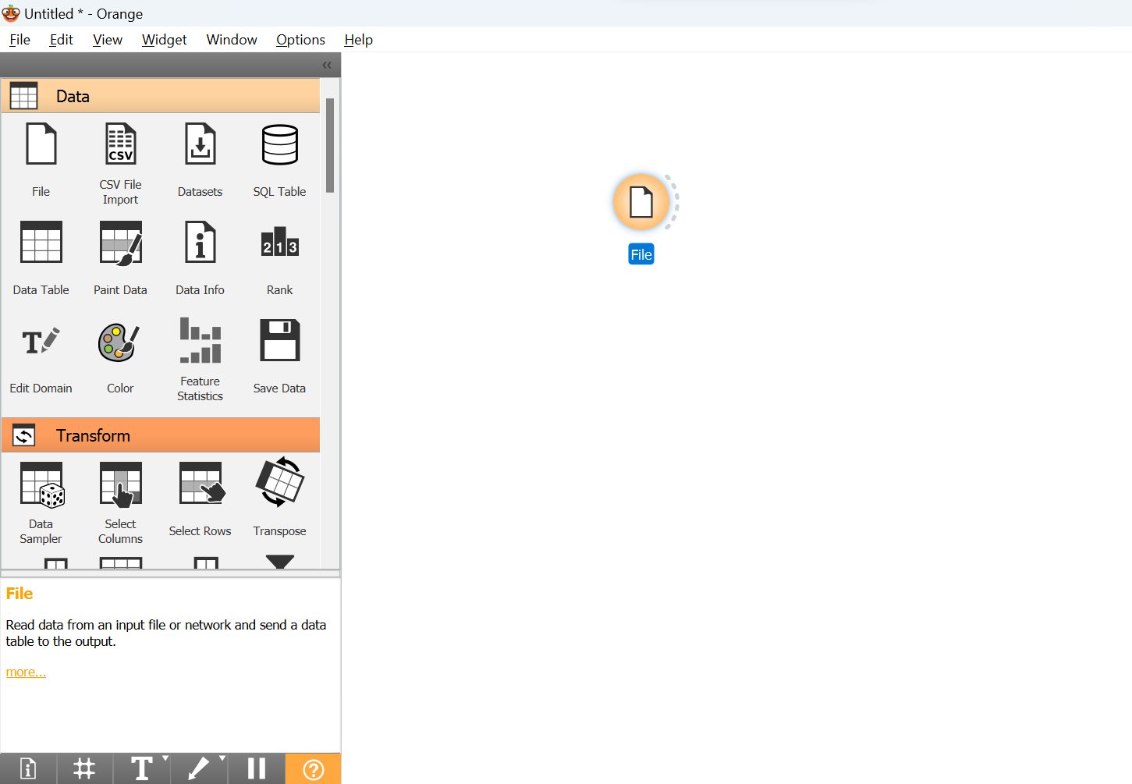
Import Dataset
Click on the file widget
Grab the dataset:
github.com/grcc-resendiz/ai-manufacturing-muskegon
Notes:
Dataset: data/predictive_maintenance.csv on the course GitHub page. Columns include air and process temperature, rotational speed, torque, tool wear, Target (failure or not), and Failure Type.
Set Target as the target variable and ignore UDI and Product ID.

Slide 21
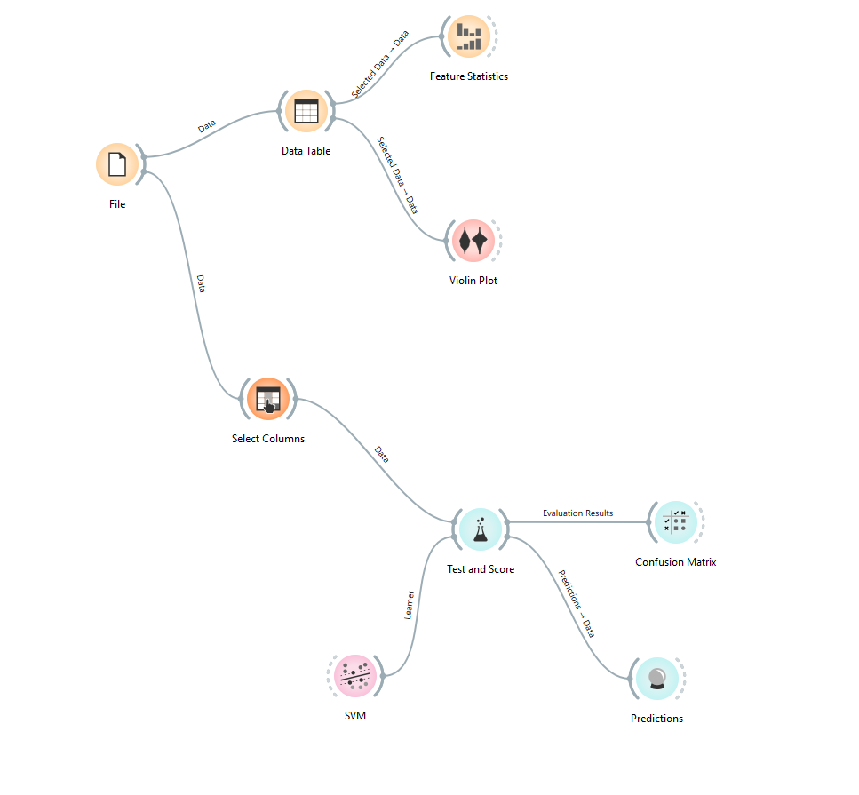
Making Predictions
Notes:
Their final product that can actively make predictions.

Slide 22
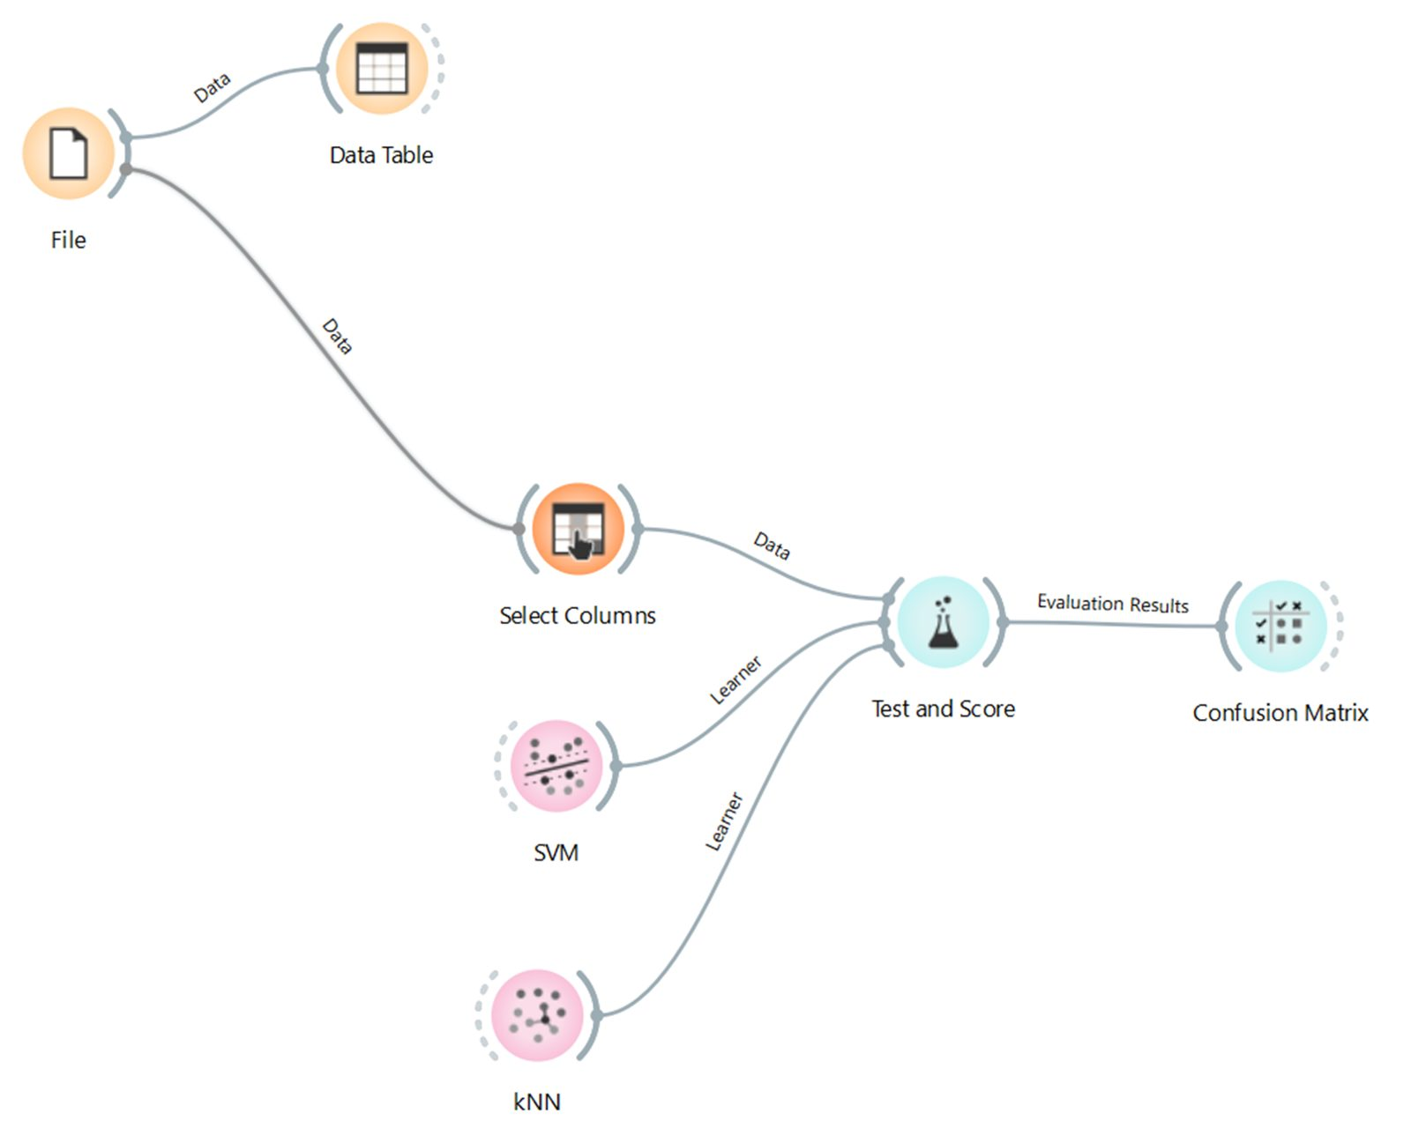
Orange Canvas

Slide 23
Demo: The Same Model in Python
Open the Predictive Maintenance ML Demo on the course GitHub page.
Click Open in Codespaces, open the notebook, and click Run All.
Same idea as Orange: sensor data in, failure prediction out.
You do not need to code. This is what a data team would build next.
Notes:
Instructor demo, about 15 minutes. Repo: github.com/grcc-resendiz/kaggle-example (milling machine data with the same sensor columns as the Orange file).
Point out the confusion matrix in the notebook and compare it to the one from Orange.

Slide 24
Implementation and Next Steps
Notes:
Last section: move from learning to doing.

Slide 25
Technology Adoption Gap
What technology do you already have that is underused?
  PLC logs
  MES systems
  ERP data
  Sensors
  Maintenance logs
Adoption is the bottleneck.
Notes:
Ask each table: what data do you already collect but never use?

Slide 26
AI Readiness Reflection
If you tried this tomorrow:
Do you have reliable data?
Is it centralized?
Is it clean?
Who owns it?
Notes:
Use these four questions to rate the pilot ideas on the next slide.

Slide 27
Your First AI Pilot
Pick one problem from your Day 1 list.
Match it to a tool: prompt, skill, app, vision model, or predictive model.
Name who owns it and what data you already have.
Define success in numbers: minutes, scrap, or dollars.
Commit to one step in the next 30 days.
Notes:
Give 15 minutes to write, then ask 3 or 4 people to share.
This is the main takeaway of the training: one small, owned, measurable pilot.

Slide 28
Key Takeaways
Workforce shortage is real.
Technology exists.
AI learns from patterns.
Data quality matters.
Adoption is leadership-driven.
Notes:
Summarize confidently.

Slide 29
Questions?
‹#›
Notes:
Are there any questions?

Slide 30


Notes:
With that I’d like to thank you all for your time today.

