Slide 1

Claude SMB Workshop
Notes:
TIPS
Before the room fills, test the Wi-Fi under load and keep a backup hotspot ready, confirm there’s power at every table, and run your demo, the demo video and the Workshop App links (A2 in the Delivery Guide: partnerhub.anthropic.com, then Content, then Claude for SMB Workshop) once, with screenshots as a backup.
Sign in to Luma before people arrive and mark attendance as they check in, because your Luma attendance (or, if your host organization uses its own registration page, the attendee list you send us) is how this workshop counts toward your minimum.
At check-in, help anyone who hasn’t installed the Claude desktop app or redeemed their Claude Max code on the web at claude.ai, so nobody loses build time later.
Leave this slide up while people settle in, since there's no talk track for it. Time: on screen while people arrive, before you start.

Slide 2

Hello,
Muskegon!
1
Notes:
Hello, and welcome back Muskegon. You know me by now: I'm Jonnathan Resendiz, I direct the AI Incubator at Grand Rapids Community College, and I'm an Approved Claude SMB Trainer.
I should be clear about that second part, because it shapes how you should hear the next three hours. I don't work for Anthropic. I teach, I run a department, and I went through their trainer program because this changed how I run my own work. I think it will do the same for some of your shops.
This is our third and last session together. The first two were about what AI is. Today is about putting it to work on one real job from your plant. Let's get into it.
TIPS
Open with your own business / background before you open with Claude. The room is full of owners who've been sold to by software people all year. You are not that, and the fastest way to prove it is to name what you do for a living in the first ten seconds.
Say "I don't work for Anthropic" explicitly. It buys credibility, and it also protects you, because you can't make commitments on Anthropic's behalf, so don't let the room believe you can.
60 seconds.

Slide 3




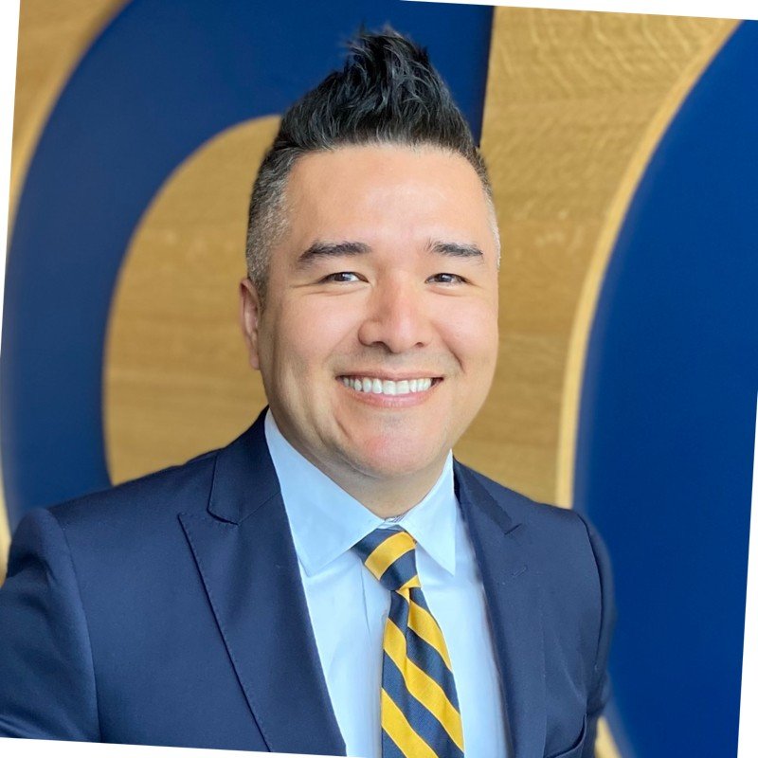


Your hosts, our partner, and the lab behind Claude
Who we are
A Public Benefit Corporation, whose purpose is the responsible development and maintenance of advanced AI for the long-term benefit of humanity.
AI Incubator
Safety
Security
YOUR HOSTS
Designed to say when it doesn't know.
No training on Team plan data by default.
Jonnathan Resendiz - AI Incubator Faculty Director
GRCC - Approved Claude SMB Trainer
Trust
Research
CC
Clayton Corrello - Co-teacher
Honest answers. Ad-free.
AI research lab.
Muskegon Community College
In partnership with The Right Place and Muskegon Community College
2
Notes:
Two thank-yous before we start properly.
First, our partners. The Right Place and Muskegon Community College put this training together and got all of you in one room three weeks in a row, which is not easy to do with production schedules. Clayton Corrello has been teaching this series with me and is here to help during the build.
Second, a word about Anthropic, since it's their product we'll be working in. They're a public benefit corporation, which is a legal structure rather than a marketing line: the charter commits them to the mission ahead of the return.
Four things about them that are worth knowing.
They build for safety, which in practice means Claude is designed to tell you it doesn't know rather than invent an answer.
On Team and Enterprise plans, they don't train their models on your business data by default, and we'll come back to that properly in a few slides because it was the most common question from every room before this one. There are no ads in Claude, so no advertiser is paying to steer the answers you get. And they're an AI safety and research company, which is why Claude keeps getting better at the kind of work you'll do today.
TIPS
Replace the host block with your name, your business, and "Approved Claude SMB Trainer" before the workshop. If you leave the original in, the room reads you as staff and hears everything afterward as a pitch.
Give the community partner a real 1-2 min (or however much time is agreed upon prior).
Don't get drawn into security here since a later slide covers it in detail. If a hand goes up, say it's coming and move on.
90 seconds.

Slide 4
Three things you'll learn today
01
An approach to AI fluency
Put AI to work.
The 4D framework and power moves that work on any model
02
An AI workflow
A real thing, on a real problem from your business, that takes input and produces output
03
Confidence to execute
Time spent through the learning with your peers
3
Notes:
This workshop today isn't a class on how to chat with AI. Everyone here has typed something into a chatbot at some point, so that isn't the gap. The gap is between using it occasionally and actually putting it to work on something that matters: one of those jobs you do every week that you'd happily pay someone else to take off your hands.
So there are three things we want you leaving with:
The first is a way of thinking about this that isn't tied to a particular product. It's four ideas, and they'll still hold when the tools change, which they will.
The second is something that actually works. Not a demo of mine, but one of yours. A real problem from your business, where something goes in and something useful comes out. You'll build it here, with help, today.
The third is the part that's hard to get anywhere else, which is time on the learning curve alongside people who run businesses like yours. It's a lot easier to get through together in a room than on your own on a Sunday night.
TIPS
90 seconds.

Slide 5
The mental model.
The lens you'll carry into the build room. It works on any AI tool.
4
Notes:
I want to share with you a simple mental model or lens that’s helped many of us get started.
TIPS
10 seconds.

Slide 6
A mental model
Think of AI as a brilliant new hire.
Working with AI well isn't technical. It's a management skill you already have.
5
Notes:
This mental model is straightforward: treat AI like a brilliant new hire on their first day.
Think about what that new person actually is. They're sharp, they work fast, and they've read more than you have. They also know nothing whatsoever about your business: not your customers, not the fact that the Tuesday delivery always runs late, not which of your suppliers you handle differently and why.
So what do you do with someone like that? You don't hand them the keys. You give them a job with clear edges, you tell them what a good result looks like, you check their work, and you widen the lane as they earn it.
That's the whole skill, and everyone in this room already has it, because everyone here has trained somebody. Nobody needs to learn to code today. What you need is to get comfortable delegating to something that's capable and completely new at the same time.
TIPS
This is the most important two minutes of the morning, and everything after it depends on the analogy holding. Take your time.
Replace my examples with your own. The Tuesday delivery, the supplier you handle differently (those should be from your business). Specific examples get people talking to you at the break; generic ones get polite nods.
Watch the room when you say "everyone here already has it." That's usually the moment the non-technical attendees decide to stay engaged.
Don't push the analogy into "it's basically a person." It isn't and it won't remember between sessions unless you set that up, and it'll be wrong with more confidence than a person would be.
2 minutes.

Slide 7




Your scaffolding for the recipe ahead
Anthropic’s AI Fluency Framework: The 4Ds
Outer loop
Inner loop
Around your AI use
In your AI conversations
Delegation
Description
What to hand AI
Tell AI what you need
·
Which pieces benefit from AI?
·
Who is it for?
·
Which pieces need your judgment?
·
What format?
·
What's the cost of getting it wrong?
·
What does “good” look like?
·
What shouldn't it do?
Diligence
Discernment
Own the outcome
Judge what you got
·
Validate against past correct results
·
Is it accurate?
·
Be transparent about AI's role
·
Does it sound like you?
·
Don't ship what you don't stand behind
·
What's missing?
·
What needs pushback?
One continuous cycle: delegate → describe ⇄ discern → act with diligence.
6
Notes:
To break this down, I want to share four ideas, which Anthropic calls the “AI Fluency Framework.” This is the foundation for everything you'll build today, so I'll go through it once and then you'll see it doing real work in a few minutes.
Two of them sit outside the conversation.
Delegation is deciding what to hand over (which parts of a job benefit from AI, which parts need your judgment, and what it costs you if it gets something wrong. That last question does most of the work, because a bad first draft costs you five minutes and a bad payment costs you a supplier.)
Diligence is owning the outcome. You check the work against results you already know are right, you're honest with people about what AI touched, and you don't send anything you wouldn't defend.
The other two sit inside the conversation, and they loop.
Description is telling it what you need: who it's for, what format, what good looks like, and what it shouldn't do. It's the same brief you'd give a new hire, and in my experience most people give it one of those four things and skip the rest.
Discernment is judging what comes back. Is it right, does it sound like you, what's missing, where does it need pushing back on.
Those last two go round: you describe, you look at what you got, you describe it better, you look again. When it lands, diligence, and then it ships.
TIPS
Three minutes maximum. Frameworks don't land until someone sees one working, and slides 13 and 14 are where that happens. This slide exists so the room recognizes the pattern when it shows up.
Flag Description as the hard one now. "Most people give it one of those four things" is the line they'll remember in the build block when their output is vague and they can't work out why.
If only one of the four lands, make it Discernment. Over-trusting the output in week one is what burns people, and people who get burned quit.
Show the loop with your hands. It reads as a cycle much faster than it reads as a list.
3 minutes.

Slide 8

How trust gets built
Start with the busywork. Grow into a partner.
THIS WEEK
WITHIN A MONTH
BY MONTH THREE
Busywork
Routine you review
Strategic partner
Pick the one job you’d be glad to never do by hand again.
It runs on a schedule. You approve, you don’t assemble.
You start asking it what you’re missing.
·
Data entry and reformatting
·
Customer replies and follow-ups
·
Pricing and margin scenarios
·
First drafts of anything
·
Weekly and monthly reports
·
Which customers to focus on
·
Summarizing long documents
·
Reminders and chasing
·
What the numbers are telling you
·
Pulling numbers together
·
The brief waiting on Monday
·
Pressure-testing a decision
Nobody starts at month three. Everybody starts this week.
7
Notes:
The practical question is where to start, and our suggestion is to start with the busywork, this week.
This week, pick the one job you'd be glad never to do by hand again. Retyping information from one system into another, first drafts of anything, reading a long document you don't have time for, pulling numbers together from three different places. The stakes are low, so nobody gets hurt if it's wrong, and you find out quickly whether this is any good.
Within about a month, some of that becomes routine that you review rather than assemble. It runs on a schedule, it hands you something, and you approve it. Instead of building the weekly report, you're signing it off. That's a real difference in how your week feels.
By around month three, and this is the part people don't anticipate: you start asking it what you're missing. Pricing scenarios, which customers are actually worth your time, what the numbers have been telling you that you've been too busy to sit down with, pressure-testing a decision before you make it.
Nobody starts at month three. Everybody starts this week.
TIPS
This slide prevents two failure modes: the owner who tries to automate everything in week one and quits when it breaks, and the one who's still asking it for jokes in March.
If someone in the room is already at month two, bring them in: "is anyone already doing something like this?" A peer saying it is worth more than you saying it.
If you’d like to, feel free to bring in your workshop experience (e.g., I started with what irritated me the most: emails… then go on to explain how you went from “this week” to “month three.)
Be careful with month three. Frame it as pressure-testing the owner's thinking, not as the AI making calls. Owners who hand over judgment get hurt, and you'd have pointed them there.
2 minutes.

Slide 9
Owners tell us this is their #1 concern
Is your business data safe with Claude?
Not training data
Your permissions hold
Independently audited
Team and Enterprise plans: not used for training by default. Pro and Max: you choose in Settings. You own what goes in and what comes out.
Claude reads only what your account can already see. Encrypted in transit and at rest.
SOC 2 Type II, ISO 27001 and ISO 42001 on business plans. Reports at trust.anthropic.com.
For Team and Enterprise, it's in Anthropic's commercial terms. On Max, you control it in Settings.
8
Notes:
This was the most common question from every room before this one, so rather than hope nobody raises it, we'll deal with it directly.
Three important reminders:
It isn't training data. On Team and Enterprise plans, Anthropic doesn't train its models on your business data by default. On Pro and Max, which is what you'll be on with today's free month, you choose in Settings, then Privacy, whether your chats can be used to improve Claude, so it's worth checking that setting tonight. What you put in stays yours, and so does what comes out.
Your permissions hold. Claude reads only what your account in each tool can already see, so if an employee can't see something in QuickBooks or Google Drive today, they can't see it through Claude either. Your data is also encrypted in transit and at rest.
And it's independently audited. Anthropic holds SOC 2 Type II, ISO 27001 and ISO 42001 for its business plans, all checked by outside auditors, and you can request the reports at trust.anthropic.com if you want to read them properly.
The part I'd underline is that for Team and Enterprise plans, this is contractual: it's in Anthropic's commercial terms, not just a claim on a slide. On the Max plan you're using today, you control it yourself in Settings.
TIPS
Don't rush this even if the room looks unbothered.
Stay within what's on the slide. For questions about a specific clause, a regulated industry, HIPAA, or someone's particular contract, the right answer is that you don't know and you'd rather not guess at their compliance. Then point them at trust.anthropic.com and offer to route the question (very important). For HIPAA and other compliance questions, point them to Claude's buying specialist at claude.ai/buying-specialist.
Never say "completely secure" or "nothing can go wrong."
If you get asked a question that you don’t know the answer to, write it down and tell them you will get back to them. If someone asks where their data is stored, don't name a single country, and point them to Anthropic's Privacy Policy at anthropic.com/legal/privacy instead. For Canadian attendees, the policy says personal data may be transferred or disclosed outside Canada for processing and storage, including to the United States and the countries on Anthropic's Subprocessor List. The help article that says data is stored in the US covers commercial products like Claude Enterprise and the API rather than Pro or Max, so don't quote it for today's Max accounts.
Please try to not compare Claude to another LLM / we are encouraging AI fluency more than promoting Claude.
2–3 minutes, more if hands go up.

Slide 10
Watch it work
Live demo.
9
Notes:
Let me show you one end to end, in my own business.
The next section is my demo: my own workspace, live, the way I really use it. Keep it to about fifteen minutes. Then everyone builds their own.
TIPS
Use your own business / examples (your data, your problem, a workflow you genuinely run). A room can tell the difference between a rehearsed demo and an owner showing them their Monday, and only one of those persuades.
Choose something with a visible before and after. Concrete and boring beats clever and abstract.
Narrate the four Ds as you go: where your delegation line is, what your brief was, and a moment of you pushing back on the output. You're modeling what they're about to do.
If it gets something wrong, show it. That's the most instructive thirty seconds of the morning and it makes everything else credible.
Rehearse it that morning (connectors drop and sessions expire). Have screenshots as a fallback. Run your demo from the Claude Max account we gave you, because your attendees will be on Max too, so what they see on their screens will match yours.
8–10 minutes.

Slide 11
How I run my work with Claude.
Folders, two plain text files, and a routing map. I call each folder an HQ.
10
Notes:
This is my demo, and it is not a rehearsed one. This is how I run a department, a federal grant, my courses, and a doctoral program at the same time. Everything you are about to see is plain folders and plain text files. No code.

Slide 12
The problem
A new hire who forgets everything overnight
Chat alone
With an HQ
You explain your business again every morning
Yesterday's correction is gone
Results depend on how well you typed today
Nothing is written down
The rules are read before every task
"Remember this" sticks
A one line prompt gets the whole job done right
The folder is the training manual
Same model. The difference is what it reads before it answers.
11
Notes:
Remember the mental model from earlier: a brilliant new hire. Here is the part nobody tells you. In a plain chat, that new hire forgets everything overnight. Tomorrow you explain your business again. The correction you made today is gone.
The fix is not a smarter prompt. It is what Claude reads before it answers. Anthropic calls this context engineering. I call it writing the training manual once.

Slide 13
The building block
An HQ is a folder with a job
what's inside
Instructions · CLAUDE.md
Quoting HQ/
├── CLAUDE.md instructions
├── MEMORY.md memory
└── Quoting HQ Resources/
├── price-list.md knowledge
└── past-quote.md knowledge
Rules that always apply. Who Claude is here, the steps, what it never does.
Memory · MEMORY.md
What changes over time. Customers, open work, decisions and why.
Knowledge · Resources folder
Reference material. A price list, a past quote, a template.
The .md files are plain text. If you can make a folder and read a text file, you can build one.
12
Notes:
An HQ is a folder with a job. Inside it are three things, and keep an eye on these three words, because every build step today adds one of them. Instructions, knowledge, memory. CLAUDE.md is the rules: who Claude is in this folder, the steps to follow, what it never does. MEMORY.md is the notepad: contacts, decisions, and the reasons behind them. And a Resources folder holds the files the work needs, like a rate card or a template.
That is the whole idea. If you can make a folder and read a text file, you can do this.

Slide 14
Two files, two tests
Rules go in one file. Facts go in the other.
CLAUDE.md
MEMORY.md
Does it tell Claude how to behave?
Is it a fact that could change?
Look for always, never, before you do X.
Contacts, status, decisions, things you said to remember.
If you're not sure about something, say so. Don't guess.
Give me one strong recommendation.
My company uses Google Workspace.
I'm a department head and I direct the AI Incubator.
Not sure which file? Claude asks.
13
Notes:
People ask how I decide which file something goes in. Two tests. Does it tell Claude how to behave? Words like always, never, before you do this. That is a rule, and it goes in CLAUDE.md. Is it a fact that could change? A contact, a status, a decision. That goes in MEMORY.md.
The examples on screen are from my real files. And when Claude is not sure which file something belongs in, my rules tell it to ask me.

Slide 15
My real setup
Nine HQs, one Routing Map
One HQ per hat I wear. Each row of the map starts: "Route here when I..."
My courses
Department head
Federal grant
...edit course content and pages
...handle scheduling, budget, hiring, meetings
...work on grant reporting and deliverables
My doctorate
Workshops
Apprenticeships
...do coursework or dissertation work
...prepare and run workshops like this one
...work on an employer apprenticeship partnership
Faculty council
Faculty evaluation
Personal
...prepare for faculty governance business
...work on the faculty evaluation process
...handle family and personal matters
I say what I'm working on. Claude picks the folder.
14
Notes:
This is my real workspace. Nine HQs, one per area of my work. At the top sits a Routing Map, which is just a table: one row per HQ, each starting with route here when I. I never pick the folder myself. I say what I'm working on, Claude checks the table, and it loads the right one.
On my screen the folders have my own shorthand names, so I spelled them out here. Notice these are not AI categories. They are the hats I already wear. Yours will be the departments you already have.

Slide 16
Loading an HQ
What happens before Claude answers me
01
02
03
04
05
Open the workspace
Say the task
Claude routes it
Reads top to bottom
Then it works
A new chat, with my one workspace folder selected.
"Draft the agenda for Thursday's department meeting."
Checks the Routing Map and picks the HQ.
Root rules, then the HQ's rules and memory, then the subfolder's.
Shows me a plan and waits for my OK.
Three folders deep means three rule files and three memory files. Every time.
15
Notes:
Here is what loading an HQ looks like, and I'll do it live right after this slide. I start a new chat in the Claude desktop app and select my one workspace folder. I say the task in one sentence. Claude checks the routing table and picks the HQ. Then it reads top to bottom: the root rules, then that HQ's rules and memory, then any subfolder's. Only then does it start, and my guardrails make it show me a plan and wait.
The rule at the bottom is one I had to add. Claude skipped a folder's rules twice, so now the instruction is by folder structure, every level, no exceptions.
LIVE: open the Claude desktop app, start a new chat, click Work in a folder, pick the workspace, and give it one real task.

Slide 17
How the rules grow
Every rule has a date and a reason
From my CLAUDE.md, shortened
Before building a deliverable from scratch, show the proposed structure first and wait for approval.
When a document goes to someone outside this workspace, spell out internal jargon and cut internal tracking.
After saving a file to my computer, read it back to confirm the change landed.
Added 2026-09-23 after I asked to see the plan before a schedule summary was built.
Added 2026-09-23 after an internal abbreviation went out in a summary.
Added 2026-10-04 after three saves reported success and left the old version.
I don't write the rulebook. I correct Claude once, and it writes the rule.
16
Notes:
This is my favorite part of the system. Every rule in my CLAUDE.md has a date and a reason next to it. These three are real, shortened to fit.
I did not sit down and write a rulebook. Something went wrong, I corrected Claude, and it wrote the rule with the date and what happened. That is the discernment step from the four Ds, except I only have to catch each mistake once.
Six weeks in, the file reads like the notes you would leave for whoever takes over your job.

Slide 18
Your turn. Build it.
Everything you paste today is in the guide, with a copy button.
17
Notes:
That was my system. Now you build yours. Nobody types a prompt from a slide today: every prompt is in the guide with a copy button. The slides show you what to do and what you should see when it worked.
Clayton and I will be walking the room the whole time.

Slide 19
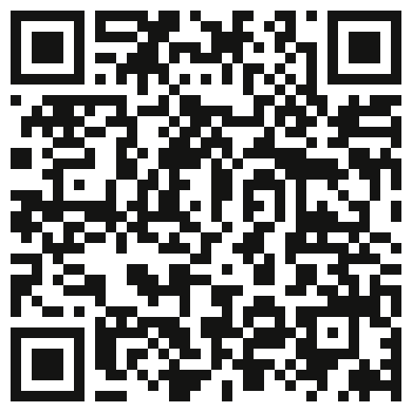
Start here
Open the guide
SCAN, OR TYPE
BEFORE WE START
github.com/
grcc-resendiz/
ai-manufacturing-
muskegon
Claude desktop app open, and you're signed in
Your Claude Max code redeemed at claude.ai
The guide open next to Claude
Our training page, same as Days 1 and 2. Go to Day 3.
Follow your company's AI policy before company information goes into any AI tool.
18
Notes:
Open the guide first. The code takes you straight to it. It is our training page, the same one from Days 1 and 2. If you type the address, click the Day 3 link at the top of the page. Keep the guide open next to the Claude desktop app. Every prompt has a copy button, so nobody types from a slide.
Three checks before we start. The Claude desktop app is open and you are signed in. Your Claude Max code is redeemed, on the web at claude.ai, since codes do not work in the phone app. And the guide is open.
Hands up if any of the three is not true for you. Pair anyone who is stuck with a neighbor while Clayton helps.
About 3 minutes.

Slide 20
Part 1 · Step 1
ADDS: INSTRUCTIONS
Let Claude interview you
Start a new chat. Paste the interview prompt from Step 1.
1
EXPECT
An "About Me" section
A "How to Work With Me" section
Under 300 words, ready to paste
It applies to every chat from now on
Answer four quick questions, one at a time.
2
Paste the result in Settings, then Your Claude, under Instructions.
3
You didn't write a prompt. Claude interviewed you.
19
Notes:
Instead of writing your preferences from scratch, let Claude interview you. That is one of the power moves: let it ask you the questions. Four questions: your role and company, how you like answers, how technical to get, and whether to ask or assume.
To save it: click your initials in the lower left, then Settings, then Your Claude, and paste it under Instructions. Some versions of the app say Account and Instructions for Claude. Same box. Roam with Clayton. When most people are done, ask one or two to read theirs out loud.
About 8 minutes.

Slide 21
Part 1 · Step 2
ADDS: INSTRUCTIONS
Add your guardrails
Copy the guardrails from Step 2.
1
WHAT CHANGES
Reads your folder's rules and memory first
Asks before deleting, overwriting, or renaming
Shows a plan before multi step work
Asks before sending anything
Same Instructions box: paste them below your preferences. Save.
2
From now on, Claude shows you a plan and waits.
3
When Claude stops and waits, say: "Looks good, go ahead."
20
Notes:
Seven lines, and they change how the whole day feels. They go in the same Instructions box as Step 1, right below your preferences. The first line matters most today: it tells Claude to read the CLAUDE.md and MEMORY.md in your folder before it does anything. I will show the box on screen, slowly, twice. Anyone whose app still has a separate Cowork tab pastes them in Settings, Cowork, Global instructions.
Say this out loud before anyone moves on: from now on Claude will stop, show you a plan, and wait. That is not a problem. That is the guardrails working. Read the plan and say looks good, go ahead.
About 4 minutes.

Slide 22
Before Part 2
Claude works in one folder you pick
One folder
Claude sees only the folder you pick. No folder, no files.
GOOD TO KNOW
Files Claude reads are processed on Anthropic's servers, like anything you type.
Your guardrails still apply: it asks before deleting or renaming.
Work laptop blocks it? That's IT policy. Pair with a neighbor today.
Read and write
Inside it, Claude can read, create, and change files. That's how it writes your rules and memory.
Start empty
We make a brand new folder, so nothing of yours is in reach today.
An empty folder today. Your real files only when you decide.
21
Notes:
Before anyone clicks, say this out loud, because it is the moment people on a work laptop get nervous. Claude is about to work inside one folder on your computer. Not your whole computer. One folder, the one you pick.
Inside that folder it can read, create, and change files. That is the point: it writes your rules and memory files for you. Outside that folder it sees nothing unless you add another one.
That is why we start with a brand new, empty folder. Nothing of yours is in reach today. You add real files later, when you decide to.
Two honest notes. The files Claude reads are sent to Anthropic's servers to be processed, the same as anything you type, so the data rules from earlier this morning apply to files too. And if your company laptop blocks the folder step, that is your IT policy doing its job. Pair with a neighbor today and take the question back to IT.
About 2 minutes.

Slide 23
Part 2 · Steps 3 and 4
ADDS: INSTRUCTIONS + MEMORY
Create your workspace
Make an empty folder called Claude Workspace.
1
you should see
Claude Workspace/
├── CLAUDE.md the rules
├── MEMORY.md the notepad
└── 00_Resources/
└── voice-principles.md
(how you write)
New chat. Click "Work in a folder" and pick it.
2
Paste the Step 3 prompt. Then the Step 4 interview.
3
Every chat today starts this way: new chat, then "Work in a folder."
22
Notes:
Now the root folder. Make an empty folder. Start a new chat in the Claude desktop app, click Work in a folder in the chat bar, and pick it. Some versions of the app say Work in a project or folder. Watch for people pasting the prompt without picking the folder first. That is the most common miss, and it is the same two clicks at the start of every chat for the rest of today.
The Step 3 prompt writes three starter files. The Step 4 prompt interviews you with four questions and sorts your answers: rules into CLAUDE.md, facts into MEMORY.md.
About 12 minutes for both steps.

Slide 24
Part 3 · Step 5
ADDS: MEMORY
Test it: "Remember this"
type
LOOK FOR
Remember this: I don't take meetings before my second cup of coffee.
Claude confirms it saved the line to MEMORY.md
In a new chat, it steers you away from early morning
It used the fact. It didn't just repeat it.
then, in a new chat (same folder)
When's a good time to schedule a meeting with me?
Your first win. It will still know this next week.
23
Notes:
First win, and everyone can relate to it. Type the first line. Claude should confirm it wrote it to MEMORY.md. Then start a brand new chat, pick the same folder, and ask the question.
If it steers you away from first thing in the morning, your memory works. Notice it did not just repeat the fact, it used it.
About 4 minutes.

Slide 25
A fictional company for today's build
Meet Example Equipment Co.
Who
Quoting
The pain
Its HQ
60 people in West Michigan. Custom conveyors for food and industrial plants.
Request by email. Engineer scopes it, estimator prices it, quote goes out.
Customer details live in people's heads and get retyped every quote.
Instructions, a price list, a past quote, and a memory file.
Customers: A, snack food plant. B, pet food plant. C, automotive parts plant.
24
Notes:
Here is the company we will use for the next half hour. It is made up, and the prices are made up too, so don't quote me. But does this sound like your week? Requests come in by email, someone works up the estimate, and the important customer details live in people's heads.
Its HQ has the three parts: instructions, knowledge, which is a price list and a past quote, and memory.
About 2 minutes.

Slide 26
Part 3 · Step 6
ADDS: ALL THREE PARTS
Build the HQ
Open Step 6 in the guide and copy the one prompt.
1
you should see
Example Equipment Co. HQ/
├── CLAUDE.md instructions
├── MEMORY.md memory
└── ...HQ Resources/
├── price-list.md knowledge
└── past-quote.md knowledge
Paste it in a new chat with your workspace folder selected.
2
Read the plan. Say: "Looks good, go ahead."
3
Three parts. One paste.
25
Notes:
One prompt builds all three parts. Say it before they paste: it will stop and show you a plan. Read it, then say looks good, go ahead.
When it finishes, have everyone open the folder in Finder or File Explorer and look. Instructions in CLAUDE.md. Memory in MEMORY.md. Knowledge in the Resources folder. In Copilot you would upload these by hand. Here Claude writes them.
About 6 minutes.

Slide 27
Part 3 · Step 7
Prompt 1: Draft a quote
type
EXPECT
Draft a quote for this Example Equipment Co. request:
Our quote format
Painted steel prices
The 5 percent surcharge
A total of about $35,070
Then paste Customer A's request from the guide. Start a new chat in your folder first.
The surcharge isn't in the past quote. It came from memory.
26
Notes:
Start a new chat with the folder selected first, so Claude starts fresh. Type the first line, then paste Customer A's request from the guide.
Watch for three things: our format, our prices, and the surcharge we decided on in October. Nobody typed a single rule. It all came from the folder.
Then ask the room: is this quote right? Not yet. Claude does not know Customer A's washdown rule. Hold that thought.
If someone's total is off, have them ask Claude to show the math line by line. About 5 minutes.

Slide 28
Part 3 · Step 7
Prompt 2: What's open
type
EXPECT
What Example Equipment Co. quotes are open, and what's due first?
Customer C, due November 12
Customer A, due November 13
A still shows as open
Use it like a coordinator, not just a quote machine.
27
Notes:
Now use it like a coordinator. Point out that we just quoted Customer A, but it still shows as open. Memory only changes when we tell it something changed. We will come back to that.
About 2 minutes.

Slide 29
Part 3 · Step 7
Prompt 3: The guardrail
type
EXPECT
Customer A also wants a metal detector on this conveyor. Add it to the quote.
"Not on the price list, needs an estimate from engineering"
No made up price
The total stays at $35,070
One line in the instructions: never give a price that isn't on the price list.
28
Notes:
Before anyone sends it, ask the room: what do you think it will do, make up a number or admit it does not know?
One sentence in the instructions, and it held. That is the difference between a tool you can trust with quotes and one you can't.
About 4 minutes.

Slide 30
Part 3 · Step 7
ADDS: MEMORY
Now, remember this
type
EXPECT
Remember this: Customer A requires stainless steel frames and guarding on every conveyor in their plant because of daily washdown.
Claude tells you where it saved it
Ask: "Show me that memory file." The fact is on Customer A's line.
Nothing else changed
You didn't open the file. Claude did the upkeep.
29
Notes:
Customer A has a rule we never told Claude. Type it, then ask Claude to show you that memory file. Asking is easier than hunting for the file, and it works the same on a Mac or a PC.
You did not open the file. You did not decide where the fact goes. Claude did the upkeep, and it put it exactly where it belongs.
About 3 minutes.

Slide 31
Part 3 · Step 7
Ask again
type
EXPECT
Redo the Customer A quote for Example Equipment Co.
Stainless frame and guarding
A washdown rated motor, on its own
About $64,785
Start a new chat in your folder first, so nothing carries over.
Same request. Same tool. A different answer.
30
Notes:
Start a new chat with the folder selected before you type, so nothing carries over from before.
Same request, same tool. And look: it picked the washdown motor on its own. Nobody told it to. It connected daily washdown to the motor.
If someone gets about $63,420 instead, Claude kept the standard motor. That is a discernment moment, not a failure: have them ask whether a daily washdown plant should get the washdown rated motor.
About 3 minutes.

Slide 32
Debrief
Before and after
Before
After
Conveyor frame, 40 ft
$18,000
$40,000
Guarding, 40 ft
$5,000
$10,000
Motor
$2,200
$3,500
Total with surcharge
$35,070
$64,785
Same request. Same tool. One saved fact nearly doubled the quote.
31
Notes:
That is a thirty thousand dollar difference from one fact. Either money left on the table, or a quote the customer would have rejected.
Ask the room: what is the Customer A fact in your shop? The thing everybody knows and nobody wrote down.
About 2 minutes.

Slide 33
Why it worked
An HQ is the 4Ds, written down once
01
02
03
04
Delegation
Description
Discernment
Diligence
The Identity paragraph and the Routing Map say what goes to Claude and what stays with you.
CLAUDE.md is the brief. Written once, read every time.
Each correction becomes a rule, so you only catch a mistake once.
MEMORY.md records decisions and why. Guardrails make Claude wait for your OK.
The brief stops living in your head and starts living in the folder.
32
Notes:
So why did that work? Because the HQ you just built is the four Ds from this morning, written down once so you don't repeat them.
Delegation is the identity paragraph and the routing table: what goes to Claude and what stays with you. Description is the CLAUDE.md, the brief you write once and Claude reads every time. Discernment is every correction that becomes a rule. Diligence is the memory file recording decisions and why, plus guardrails that make Claude wait for your OK.

Slide 34
Q&A Pause.
33
Notes:
Let's stop there. What questions are on your mind?
TIPS
If nothing comes, prime it with a question you've actually had: "the one I get most is what this costs, so [answer]." That usually opens it up.
Park workflow-specific questions. "Hold that one, you'll be building it in a bit." Be kind, and invite that person’s question yourself once that section starts.
Cap at 5 minutes. If hands are still up, offer the break / offer to let them go first in the next Q&A.
If you don't know, say so and write it down. A trainer who admits that twice is trusted more than one who never does.

Slide 35
Description: the unlocks
Four power moves
When output is "fine but not great": reach for one of these.
Think first
Meta-prompt
"Before you answer, think step-by-step about what I'm actually asking." Forces reasoning, not pattern-matching.
"What questions should I be asking you to get a better output?" Let it interview you. Free consulting.
Ask for three
Show an example
"Give me three different approaches, then tell me which you'd pick and why." Options beat a single guess.
"Here's one I wrote that worked. Match this voice." Examples beat instructions every time.
34
Notes:
Four tips to reach for when what comes back is fine but not good. Everyone hits that point, and these are the ways out of it.
The first is asking it to think first: "before you answer, think step by step about what I'm actually asking." You get reasoning rather than pattern-matching, and it costs you a sentence.
The second is the meta-prompt: "what questions should I be asking you to get a better output?" You're letting it interview you. This is the one nobody believes until they try it, because it'll come back with five things you hadn't thought to mention, and the next output is substantially better.
The third is asking for three. "Give me three different approaches, then tell me which one you'd pick and why." A single answer looks like the answer. Three options and a recommendation gives you something you can actually judge.
And the fourth is showing it an example. "Here's one I wrote that worked. Match this." Examples beat instructions almost every time. If you want it to sound like you, stop describing how you sound and paste in something you've written.
TIPS
Pause and let people write these down. This is the slide that gets photographed.
Feel free to mention which one of these is your favorite / which one helped with your “aha” moment.
3 minutes.

Slide 36
Your turn, out loud
What's the one task you'd hand off first?
Picture this week. The job you'd give away if you could. Think for ten seconds, then shout it out.
35
Notes:
Now it’s your turn! Think about the week you're actually having. Not a big strategic project, but the annoying job you'd hand over today if someone walked in and offered to take it.
[pause]
Show of hands, who wants to share? Call them out. [then pick people who are raising their hand].
If the room is quiet, prime it with shop examples: answering an RFQ, writing up a nonconformance report, building the weekly preventive maintenance plan, rewriting a work instruction, chasing a supplier on a late PO, turning production meeting notes into action items.
TIPS
Take three to five quickly and repeat each one back so the whole room hears it. Half the value is people realizing their problem is everyone's problem.
If the room is cold, answer first yourself, then go to someone you've already spotted as talkative.
If someone names something genuinely large, like "I want it to do my books", don't shut it down. Ask what the day one version of it looks like (e.g., chasing invoices).
3-4 minutes.

Slide 37
Part 4 · Your own HQ
Which HQ would you build first?
Name the folder. Then write one rule, one fact, and one file it needs.
36
Notes:
The demo HQ was practice. Now the real one. Thirty seconds on your own: take the job you just named. Give its folder a name. Then write down three things: one rule Claude must always follow there, one fact it needs to know, and one file it needs to do the work.
If you can write those three lines, you have your first HQ. Who wants to share theirs?
Then everyone opens Part 4 of the guide.

Slide 38
Part 4 · Step 8
Pick a starter, or start from scratch
01
02
03
04
Requests and Quotes
Quality
Maintenance
Safety and Training
RFQs, estimates, quotes, follow ups.
Nonconformance reports, corrective actions, customer responses.
Downtime, preventive maintenance, work orders.
Work instructions, toolbox talks, onboarding.
None of them fit? Step 8 builds your own from five questions. Fill in one blank and paste.
One HQ per job. Start with the job you'd hand off first.
37
Notes:
Four starters in the guide, each one a single paste. Requests and Quotes if you quote. Quality if you write up nonconformances. Maintenance if downtime is your problem. Safety and Training if you write work instructions.
None of them fit? Step 8 builds one from scratch with five questions. Coach question three, your steps, and question four, what stays with you. Short answers make a thin HQ.
The next few slides preview each starter. Leave whichever one the room asks about on screen while they build. About 20 minutes of build time.

Slide 39
Starter HQ · 01
Requests and Quotes HQ
Route here when I am answering an RFQ or building a quote
CLAUDE DOES
once it's built, try
Reads the request and lists every requirement
Flags what is missing or tighter than standard
Builds the cost breakdown from your price list, math shown
Drafts the quote and the cover email
Work the RFQ I just dropped in.
YOU KEEP
good files to add
The margin and the final price
Every lead time promise
Hitting send
Your price list or rate card, two or three past quotes, your standard terms.
38
Notes:
This is the Example Equipment Co. HQ, made yours. Same pricing guardrail, plus one stop that matters: Claude never picks the margin. It builds the breakdown and waits for you.

Slide 40
Starter HQ · 02
Quality HQ
Route here when I am writing up a nonconformance, a corrective action, or a customer response
once it's built, try
CLAUDE DOES
Start the write up for last night's issue. Ask me what you need.
Drafts the nonconformance report on your template
Walks you through 5 Whys, one question at a time
Checks your log for repeats in the last 90 days
Drafts the corrective action and the customer response
good files to add
YOU KEEP
Your blank report template, an export of your log, one past report done well.
Disposition: use as is, rework, or scrap
Every measurement and quantity
Your signature
39
Notes:
Quality is where people worry most about AI making things up, so look at what this starter forbids. Claude never fills in a measurement, a quantity, or a lot number. It never says parts meet spec unless you gave it the inspection data.

Slide 41
Starter HQ · 03
Maintenance HQ
Route here when I am planning preventive maintenance or looking at downtime
CLAUDE DOES
once it's built, try
Finds the top causes of downtime by minutes
Matches them against overdue PM tasks
Recommends one fix first, with the math
Drafts the work order, lockout and tagout as step one
What should we fix first?
YOU KEEP
good files to add
Approving every work order
PM intervals: never skipped, never stretched
Who works on which machine
Last month's downtime log, your PM schedule, one manual's troubleshooting section.
40
Notes:
Four words once it is built. The downtime log and the PM schedule are plain exports, the kind you can pull out of any system. One rule in this starter is worth reading out loud: Claude never tells anyone how to bypass a guard or an interlock.

Slide 42
Starter HQ · 04
Safety and Training HQ
Route here when I am writing a work instruction, a toolbox talk, or onboarding material
once it's built, try
CLAUDE DOES
Turn the notes I just dropped in into a work instruction for a new operator.
Turns a lead's rough notes into a work instruction
Puts each safety point next to its step
Lists the gaps for you to check on the floor
Offers a toolbox talk, a quiz, and a Spanish draft
good files to add
YOU KEEP
Your work instruction template, a lead's rough notes on one job, one instruction people follow.
Every safety requirement: none invented, none removed
Safety lead review before anything is posted
Fluent speaker review of any translation
41
Notes:
Every shop has a lead tech who knows the job cold and has never written it down. This starter turns those rough notes into a work instruction a new operator can follow.
Claude drafts the document. A person owns the safety. Anything touching lockout and tagout, guarding, or PPE gets flagged for the safety lead before anyone uses it.

Slide 43
More HQ ideas
Three every business can use
Email HQ
Meetings HQ
HR and Hiring HQ
Sorts the inbox into four groups and drafts the routine replies in the right thread.
Turns raw notes into decisions, action items with owners and dates, and open questions.
Drafts the job posting, interview questions, and a day by day first week plan.
Drafts only. Never sends, deletes, or archives.
Never guesses an owner.
Never screens or ranks real applicants.
Email HQ is where a connector earns its keep.
42
Notes:
Three more that have nothing to do with manufacturing and everything to do with running a business. Read the last line on each card, because that is where the trust comes from. The Email HQ drafts and never sends. The Meetings HQ never guesses an owner for an action item. The HR and Hiring HQ never screens or ranks a real applicant.
Email HQ is also where a connector earns its keep. With the email connector on, Claude reads the real inbox instead of what you paste in.

Slide 44
Before you trust it
Guardrails for Claude, and for you
TELL CLAUDE
ASK YOURSELF BEFORE IT GOES IN THE FOLDER
Before deleting, overwriting, or renaming a file, show me and wait.
On any multi step task, outline a plan first.
Before sending email or taking any outside action, show me and wait.
If you are unsure which file to change, stop and ask.
Customer drawings and specs under NDA: read the agreement first.
Export controlled work: talk to your compliance lead first.
Personnel and medical records: keep them out.
Passwords and access tokens: never.
You own what goes in. So decide what goes in.
43
Notes:
Two kinds of guardrails. On the left, the ones you give Claude. These go in Settings, and they are why Claude kept stopping to show me a plan during the demo. Loosen them later, once you trust how it behaves.
On the right, the ones you give yourself. You own what goes in, so decide what goes in. If a customer drawing is under an NDA, read the agreement first. If you do export controlled work, talk to whoever owns compliance at your company before any of it touches an AI tool. Personnel and medical records stay out. Passwords and access tokens never go in a chat or a file.
I am not your lawyer or your compliance lead. These are the questions to take back to them.

Slide 45
Part 4 · Step 9
Make it yours: one file, one line
Drag one safe file into your Claude Workspace folder.
1
EXPECT
Your steps, followed in order
A stop where you told it to stop
A mistake or two. Correct it, then say "remember this."
Tell Claude you dropped it. It files it in the right HQ.
2
New chat, same folder. Give your HQ a one line job.
3
Show and tell: what job does your HQ do, and where does it stop?
44
Notes:
Now feed it. One safe file, dragged into the workspace folder. Tell Claude you dropped it and it files it in the right HQ. Then a new chat with the folder selected and a one line job in your own words.
No safe file handy? Describe a made up example in a sentence. Real files can wait until you are back at the shop.
At the end, show and tell. Ask two or three people: what job does your HQ do, and where does it stop and wait for you? Write the HQ names on the board.
About 15 minutes including show and tell.

Slide 46
Connectors in plain terms
A connector is a plug
It lets Claude read, and with your OK act, inside a tool you already use.
Read
Claude can look. It cannot change anything.
WITHOUT ONE
Export, copy, paste, repeat.
Write
Claude can act, and it asks you first.
WITH ONE
Ask about the real thing:
"What are my most recent emails about? Summarize the top 5."
Yours to switch off
You sign in to each tool yourself. Claude never sees your password. Disconnect anytime.
Start with one: email or calendar. Add the next when you miss it.
45
Notes:
Next level. So far Claude has worked from files you put in a folder. A connector lets it work from the tools themselves. A connector is how Claude reads and acts in one of your tools. Think of it as a plug.
Two permission levels. Read means Claude can look and not change anything. Write means Claude can act, and it asks you first. You sign in to each tool yourself, Claude never sees your password, and you can switch any of it off whenever you want.
Without a connector you export, copy, and paste. With one, Claude works from the real thing. Start with one, email or calendar. Heads up for the build: locked down work accounts often get blocked by your own IT, so a personal account is fine for today, and sign in windows like to open behind the app.

Slide 47
Part 5 · Step 10
ADDS: A CONNECTOR
Connect a tool and test it
type
EXPECT
What are my most recent emails about? Summarize the top 5.
Your real inbox, summarized
Nothing sent, nothing changed
Work account blocked? Use a personal one today.
Or: What does my schedule look like this week? Any conflicts?
This is your real data, not a template.
46
Notes:
I will show you where connectors are in the Claude desktop app. Pick email or calendar, sign in, approve.
Two warnings before hands go up. Locked down work accounts often get blocked by your own IT, so use a personal account today or watch a neighbor. And sign in windows like to open behind the app.
If you finish early, Step 11 in the guide gives your inbox its own HQ: it sorts and drafts, and never sends.
About 10 minutes. This step has the highest failure rate of the day, so pair people up.

Slide 48

Introducing the plugin
WHAT
A plugin in Claude
43 ready-to-run workflows and
37 connectors that put Claude inside the tools small businesses depend on.
WHY
An AI “new hire” for your team
Claude does the work and you approve before anything sends, posts or pays.
Claude for
Small Business
HOW
Four steps to turn it on
In the Claude desktop app:
Customize
Plugins
Install “Small Business”
Then type /smb-onboard.
Works in the Claude desktop app on any paid plan (Pro, Max, Team and Enterprise plans)
47
Notes:
Quick show of hands: who's already installed the Claude for Small Business plugin? [Pause.] By the time you leave today, we want every one of you to know what it is, how to turn it on, and which job you'd hand it first.
So what is it? Claude for Small Business is a package of connectors and ready-to-run workflows that put Claude inside the tools you already use. It's a plugin you toggle on inside Claude. There's nothing separate to buy. Once it's on, Claude can work in QuickBooks, PayPal, HubSpot, Canva, Google Workspace and the rest of the tools you run your business on.
Why use it? Because of the work that piles up after hours. Planning payroll, closing the month, chasing invoices, getting a campaign out the door. You run the business, and Claude helps take that late-night work off your plate.
And here's the part I want you to hear clearly. You toggle it on, connect your tools and pick the job. Claude does the work, and you approve before anything sends, posts or pays.
TIPS
Take the show of hands first. If several hands go up, ask one person what they've used it for and let them tell the room.
The approval line is the most important sentence in this section. Say it slowly. Some owners have heard AI will run their business for them, and that worries them more than it excites them.
Save the setup steps for the next slide. Point at the How row and say "I'll show you where in a second" rather than reading it out.
If someone asks about cost: it's available on every paid Claude plan, and we recommend the Team plan for businesses with more than one person. If nonprofits are in the room, Anthropic released a separate Claude for Nonprofits plugin on October 26, and it's installed automatically for nonprofits on Team and Enterprise plans at no extra cost.
Language here follows the May launch post and the September 15 release post, which is also the source for the 43 workflows and 37 connectors. Stick close to it.
1.5 minutes.

Slide 49
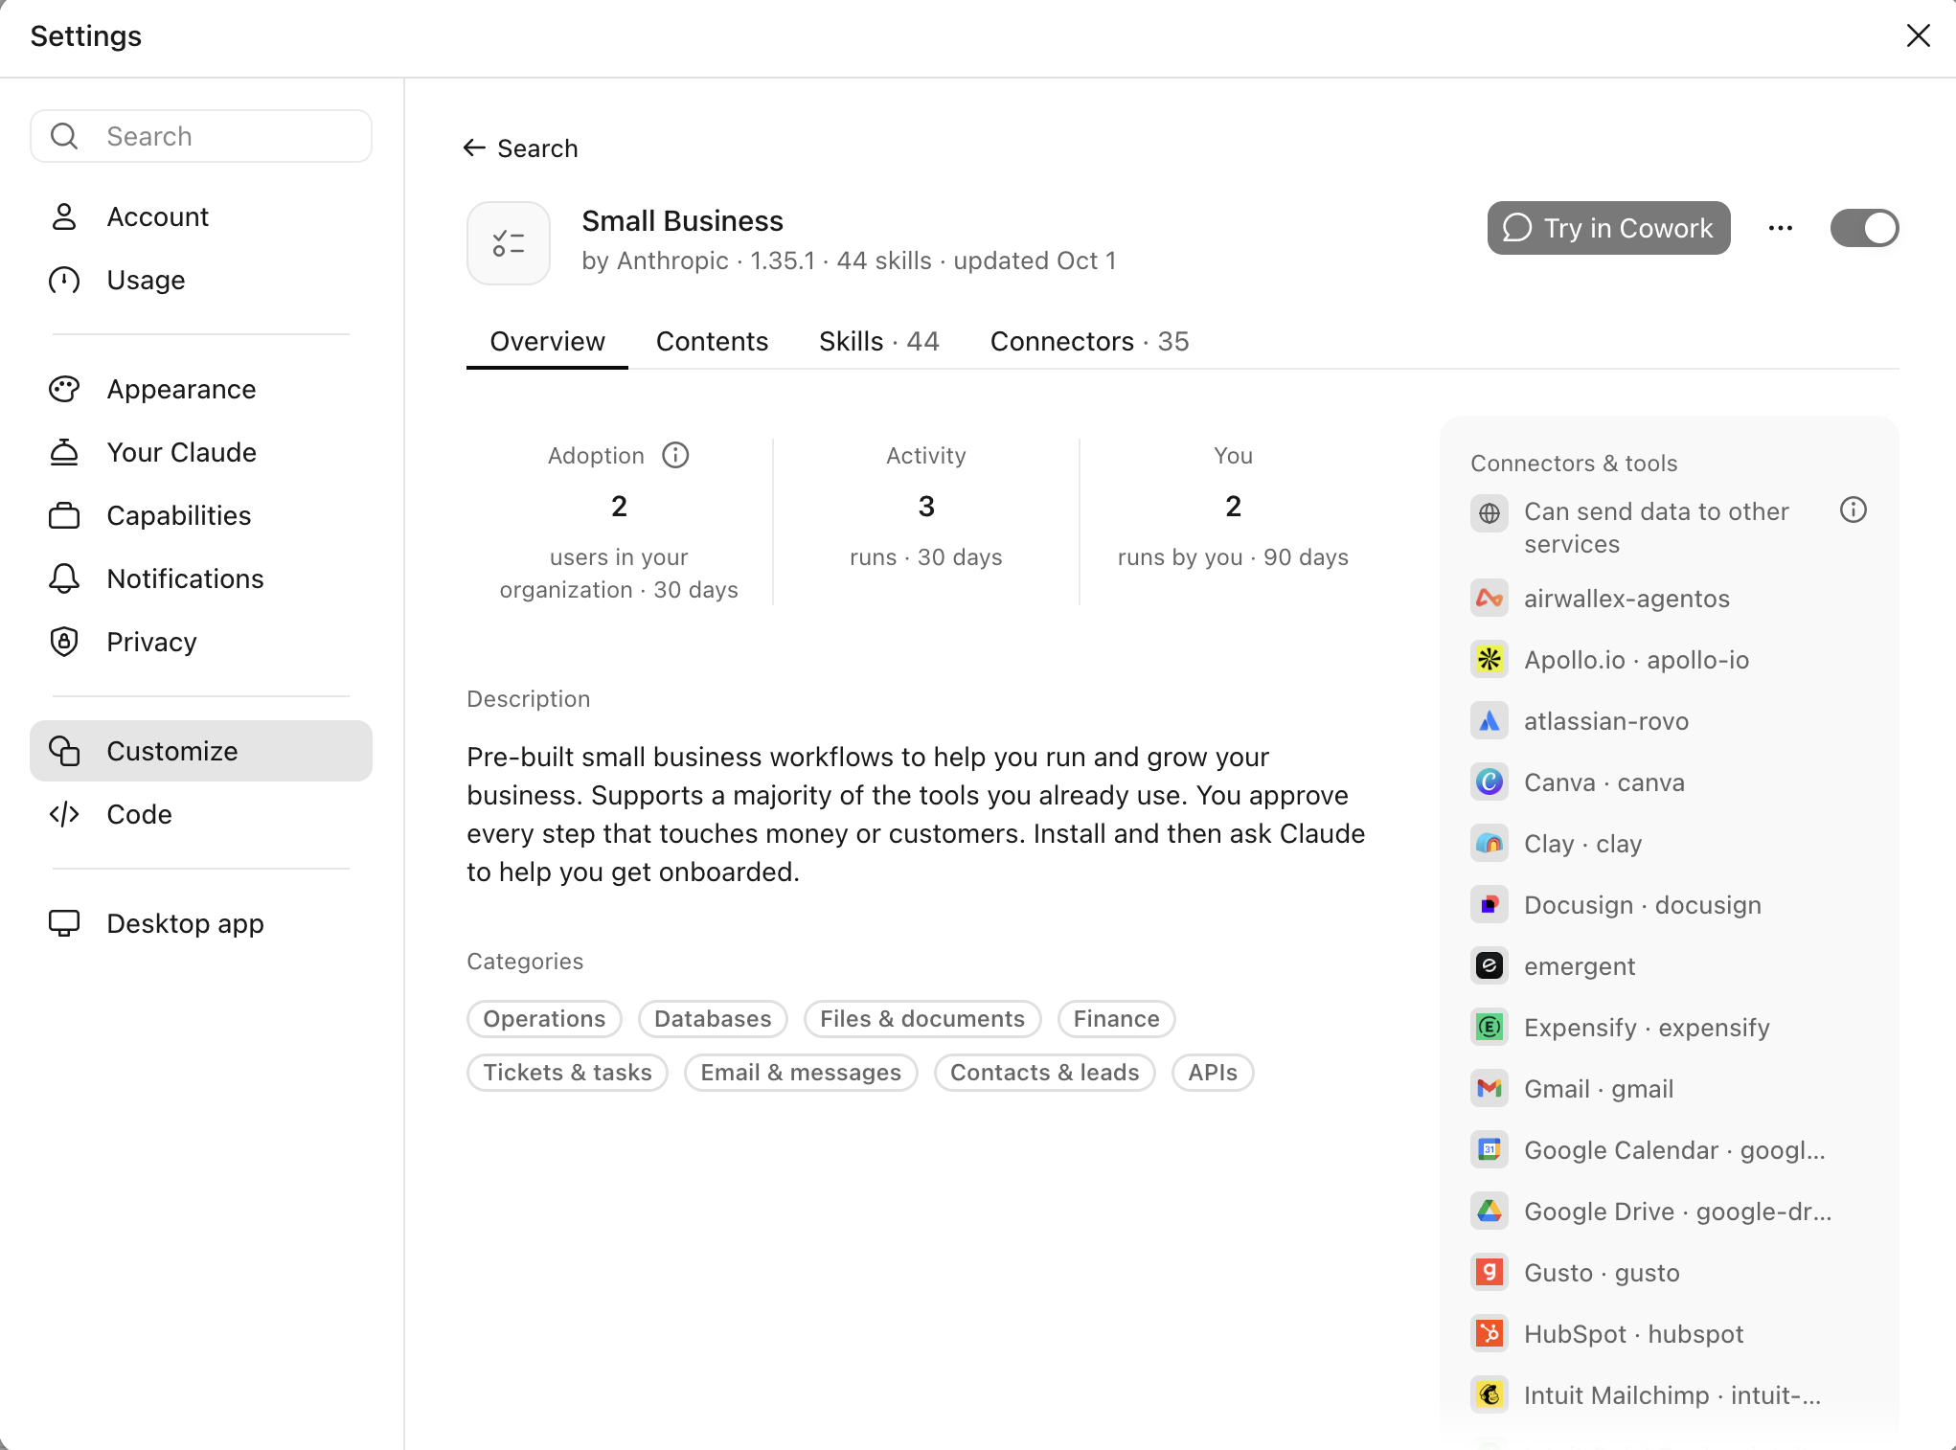
48
Notes:
Here's where it lives. In the Claude desktop app, open Customize in the left sidebar, go to Plugins, click the plus and install Small Business. This is the page you'll land on. [Point to the toggle, top right.] When that toggle is blue, it's on.
Then just say "set me up," or type /smb-onboard. Claude asks you a few questions about your business and helps you connect a tool or two. A good place to start is wherever your money lives, like QuickBooks or PayPal, and wherever your customers live, like your email or your CRM. You don't need everything in that list on the right. Then you pick your first task.
You'll do all of this yourselves in the hands-on session, with us in the room to help.
TIPS
Show it live if the Wi-Fi is solid. The screenshot is the backup.
Don't read out the skill and connector counts on screen. They change with each update. If someone asks how to fit the workflows to their business, show them Customize, then Plugins, then Claude for Small Business, then Customize, and Claude rewrites the defaults around how they work.
It runs in the Claude desktop app and is available on every paid Claude plan. Mention it if someone asks why they can't find it.
1 minute.

Slide 50


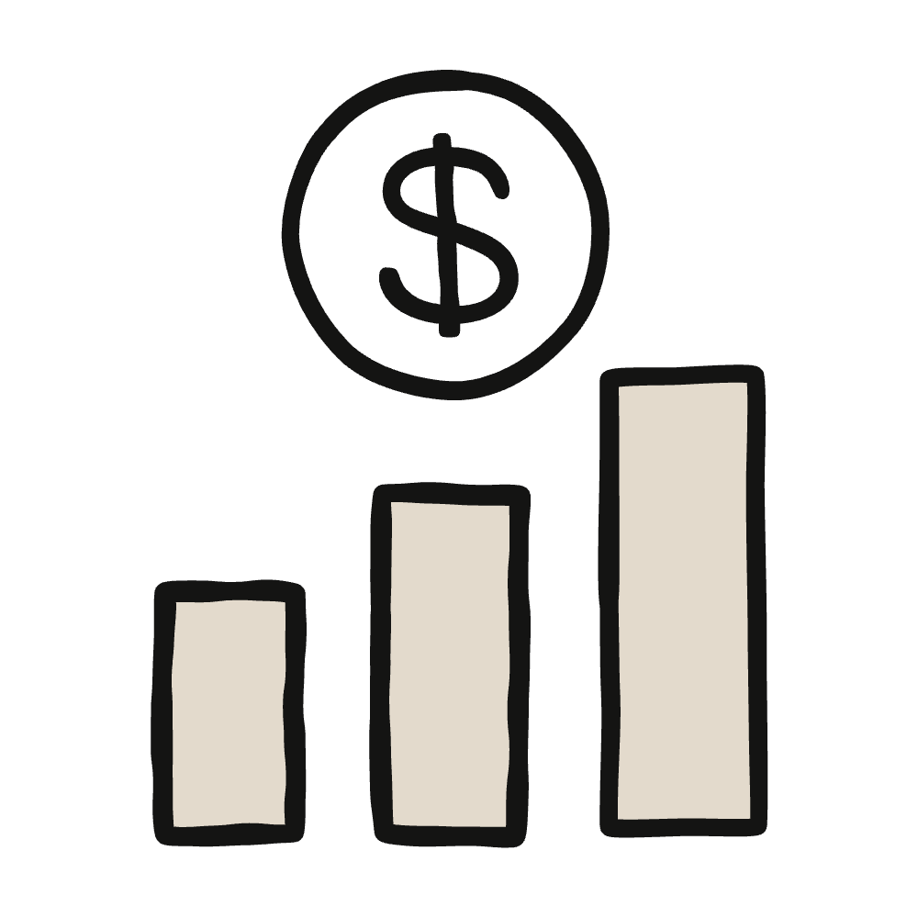
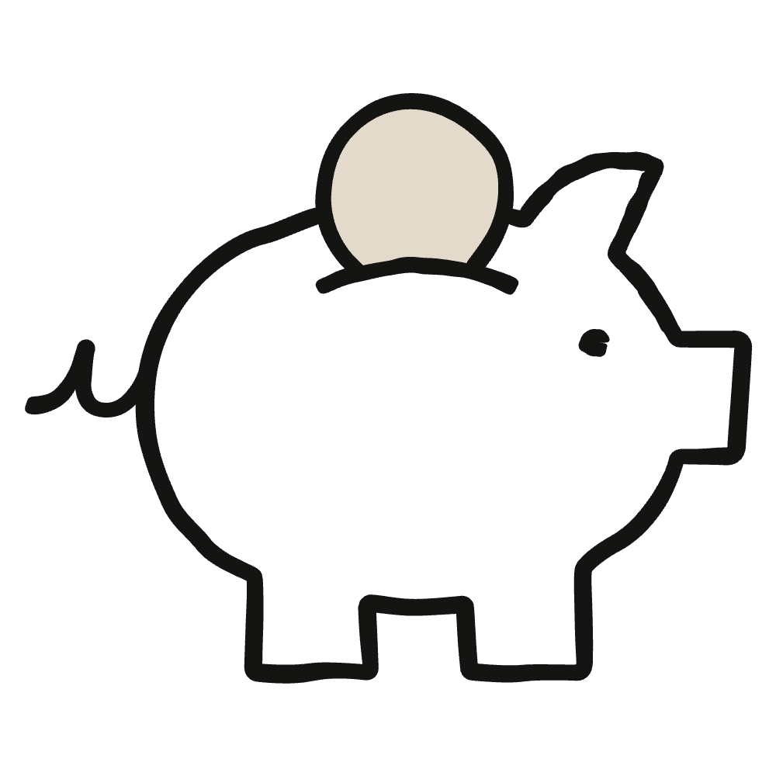

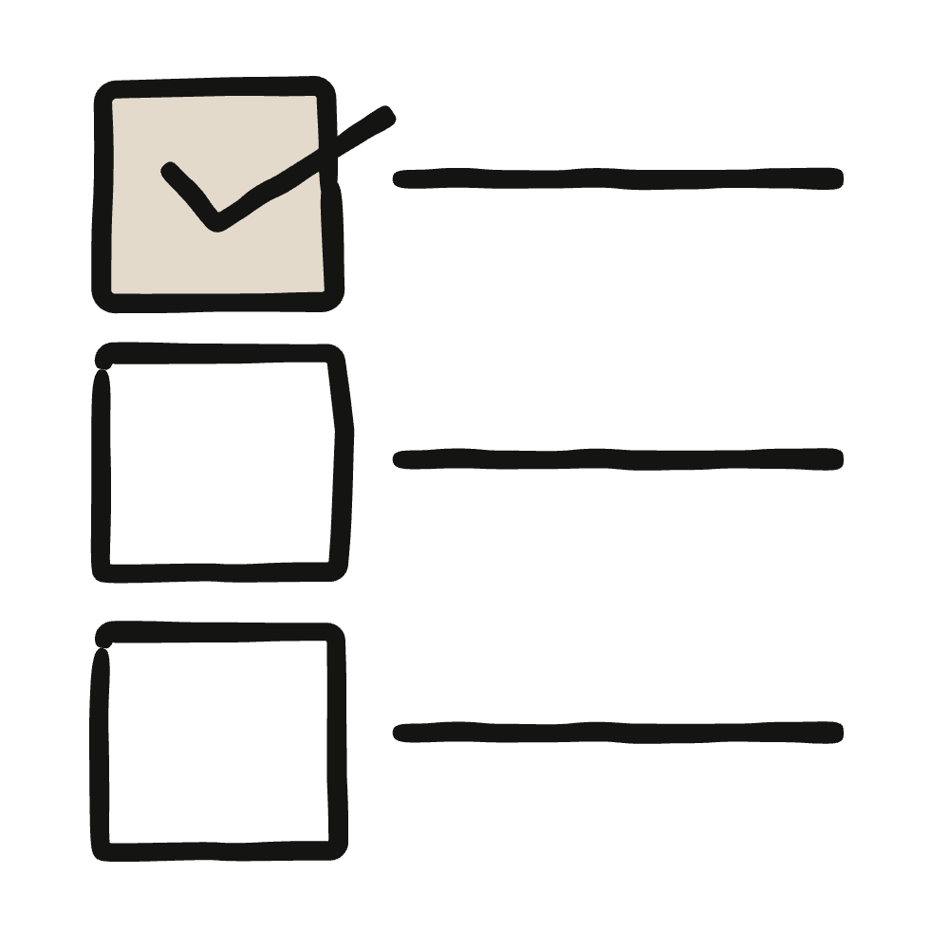
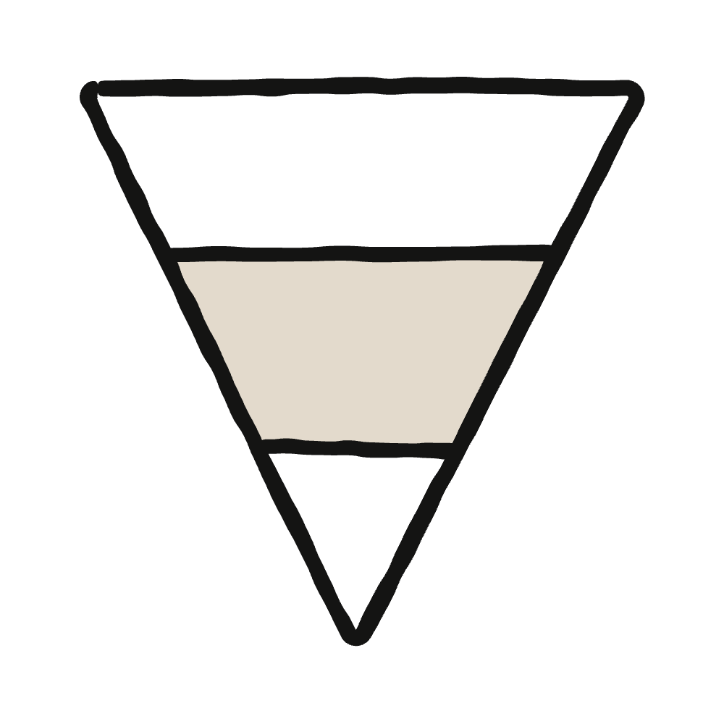


The Small Business plugin
Claude for Small Business Workflows
Common Claude workflows for small businesses
Reporting on the business
/business-pulse
/monday-brief
/sales-brief
Cash, sales, pipeline, and this week on one page.
The week ahead and your top 3, every Monday.
What's selling, what isn't, and what to push.
Running the business
/social-content-engine
/invoice-chase
/close-month
Drafts next week's posts for your OK.
Overdue reminders, sent via PayPal on approval.
Reconciles the books, writes the P&L story.
/speed-to-lead
/proposal-builder
/customer-pulse-check
Growing the business
Qualifies new inquiries and drafts a reply with open times.
Builds a priced proposal from a voice memo, photos, or RFP.
Feedback themes, with a draft reply for each.
49
Notes:
So once it's on, what do you actually hand it? The September release takes Claude from running the back office to helping you grow the business. I won't read every card. Think of it as three kinds of work.
First, knowing where you stand. business-pulse puts your cash, sales, pipeline and week on one page. monday-brief has the week ahead and your top three waiting for you on Monday morning, because you can set a workflow to run on a schedule you choose. sales-brief shows what's selling and what isn't, and drafts a plan to push the winners.
Second, running the business. invoice-chase writes the reminders for overdue invoices, and they go out through PayPal once you approve them. close-month reconciles your books and tells you, in plain English, what happened that month. social-content-engine drafts your posts and lines them up for you to approve.
Third, growing the business. speed-to-lead qualifies a new inquiry and drafts a reply with real openings from your calendar, which matters because whoever answers first often gets the job. proposal-builder turns a voice memo or a few job-site photos into a priced proposal. customer-pulse-check pulls the themes out of your reviews and feedback and drafts replies.
Different jobs, same deal every time. By default, every workflow starts in approval mode: Claude drafts the work, stages it and waits for your OK. Some stop short of the last step on purpose. Payroll, for example, gets staged in Gusto for you to submit yourself.
Which one would you hand off first? Hold onto that, because next I'll show you what this looked like for one owner.
TIPS
Tie it back to the room. If people shouted out tasks on the "What's the one task you'd hand off first?" slide, connect them here: "Someone said invoices. That's invoice-chase."
If someone asks whether it can run without them: once you're comfortable with a workflow, you can choose to let it run on its own. You make that choice one workflow at a time and can switch it back whenever you want. Answer it if asked, but don't lead with it.
The blue links go to YouTube demos for each workflow. Pick one or two that match what the room asked for.
Watch the verbs: drafts, stages, waits for your OK. Keep the approval attached every time. Nobody needs to memorize the names, because in Claude you can type / to see every skill, or describe the job in plain English and Claude picks the one that fits.
Read both posts beforehand so you can answer questions: anthropic.com/news/claude-for-small-business and claude.com/blog/claude-for-small-business-launches-new-workflows-integrations-and-training-programs
2 minutes.

Slide 51
The plugin in a manufacturer's front office
Where the workflows fit in a shop
My mapping for this room. Check the connector list for the systems you run.
/proposal-builder
/speed-to-lead
An RFQ email becomes a priced first draft quote
A new customer inquiry gets a same day reply
/monday-brief
/close-month
Monday morning: the week ahead and your top three
Month end reconciliation and the story in the numbers
/customer-pulse-check
/job-post-builder
Themes in customer feedback, with a draft reply for each
A posting for the operator or tech you need to hire
The plugin covers the front office. Your HQs cover the floor.
50
Notes:
The plugin was built for small business in general, so here is where I think it fits a manufacturer on day one. These are my mappings, not Anthropic's.
proposal-builder takes an RFQ and gives you a priced first draft. speed-to-lead gets a same day reply out to a new inquiry. monday-brief puts the week on one page. close-month and customer-pulse-check do what they say. job-post-builder is there when you are hiring.
Notice what is on this list: the front office. Quality, maintenance, and the floor are not here, and I can't tell you your ERP has a connector, so check the connector list for the systems you actually run before you plan around it. That gap is what the HQ you just built is for.

Slide 52
Part 6 · The Small Business plugin
The plugin and your HQs do different jobs
The Small Business plugin
Your HQs
Ready made workflows you run with a command
Connects to the tools your front office runs on
Type it, review it, approve it
Your rates, machines, customers, and rules
Works from files you drop in a folder
Covers what no ready made workflow knows about your shop
Use both. Your HQ is built. Now turn on the plugin.
51
Notes:
So which one do you use, the plugin or HQs? Both. The plugin knows small business: ready made workflows, connected to the tools a front office runs on. Your HQs know your shop: your rates, your machines, your customers, your rules. No ready made workflow knows that Press 4 has had an air problem since the compressor moved.
You built your HQ. Now you turn on the plugin and let it handle the front office work.

Slide 53
Part 6 · Steps 12 and 13
Turn on the plugin
Customize, then Plugins. Click the plus.
1
EXPECT
The Small Business toggle is on
A short interview about your business
Help connecting a tool or two
Install Small Business.
2
Type /smb-onboard and answer its questions.
3
Then try /monday-brief or /proposal-builder, and judge it with the four Ds.
52
Notes:
Last build of the day. In the Claude desktop app: Customize, then Plugins, click the plus, install Small Business. Then type slash smb-onboard and answer its questions.
When onboarding is done, try one workflow. monday-brief if you have email or calendar connected. proposal-builder if you have an RFQ handy. Then judge what comes back the way you did all morning: is it accurate, what is missing, what needs pushback.
About 15 minutes.

Slide 54
How they did it.
Two real operators. One repeatable recipe. Watch the 4Ds do the work.
53
Notes:
Let’s look at two owners, both with real businesses and real problems, who put Claude to work.
Before we get into them, here's a quick reminder of the 4Ds and how they break down into practical steps.
TIPS
Telling them what to watch for turns two anecdotes into one pattern, which is the point of the section.
15 seconds.

Slide 55
The 4Ds as a recipe: you'll see it twice
Every automation, same four Ds
01
02
03
04
Delegation
Description
Discernment
Diligence
Write down the steps you do by hand. Which go to AI, which stay with you. Draw the line on purpose.
Output, audience, style, behavior. Brief it like a new hire. Give it context and connect your tools.
Judge what comes back. What’s wrong, what’s missing, what needs pushback. Fix the brief, go again.
Run it on work you’ve already done. Trust only what you’ve checked. You own what ships.
Keep iterating if you're not getting the output you want. Talk to the AI, show it what's off, and workshop it together until it lands.
Delegate → Describe → Discern → Diligence. That's the whole thing. Now watch two people do it.
54
Notes:
These are the 4D’s we discussed earlier and how they can become a step by step process for any business.
Delegation: Write down the steps you currently do by hand, including the boring ones, and then draw a line through that list. These go to AI, these stay with me. The point is to draw it deliberately rather than discover it later.
Description: Brief it the way you'd brief a new hire. Output, audience, style, what not to do. Give it context, and connect it to your actual tools so it's working from your real data rather than inventing examples.
Discernment: Judge what comes back. What's wrong, what's missing, where does it need pushing back on. Then fix the brief and run it again.
Diligence: Try it on work you've already done and know the answer to. Trust what you've checked. You own whatever ships.
And underneath all four, keep going. If the output isn't right, don't abandon it and don't start from scratch. Tell it what's off, show it what you meant, and work it out. That back-and-forth is the job.
TIPS
"Draw the line deliberately rather than discover it later" is the line here. Most people never decide what they're delegating; they find out afterward.
The iteration point at the bottom prevents the main dropout cause, which is one disappointing output and the conclusion that it doesn't work. Say plainly that the first output is a draft, not a verdict.
2 minutes. You did the framework on slide 6; this is the applied version, not a second lecture.

Slide 56
How they did it · 01
Turning accounts payable into a Monday routine
Corey · Prospect Butcher Co. · Brooklyn · 2 locations · ~30 vendors · 2 billing systems
"Paying bills wasn't on the calendar, it followed me home."
01 · Delegation
02 · Description
03 · Discernment
04 · Diligence
The task, the split
The brief
What came back
Before trusting it
2–3 evening hours a week, two billing systems
"Every Monday: snapshot, then vendor-by-vendor suggestions with reasoning shown. Everything’s a recommendation. Assume nothing."
It defaulted to pay-biggest-first: sensible-sounding, but backwards for his business. Only the owner catches that. Fixed the logic, re-ran.
Tested on past months where he knew the right answer before it touched a live week. Payments still go out on his say-so.
AI
Pull invoices, scan email, compute cash, recommend
COREY
Every payment decision, every vendor call
Three scattered evening hours → 45 focused minutes on Monday. Vendors get paid consistently now.
55
Notes:
Corey runs Prospect Butcher Co. in Brooklyn at two locations, around thirty suppliers, and two billing systems that don't talk to each other.
Problem:
The way he describes it, paying bills was never on the calendar, it just followed him home and took two or three hours of his evenings every week.
I suspect that's familiar to a few people here.
Delegation:
Claude pulls the invoices, reads the email, works out the cash position and makes a recommendation.
Corey makes every payment decision and every supplier phone call. Notice where the line is: the gathering goes across, the judgment stays with him.
Description on Claude:
Every Monday, snapshot first, then supplier by supplier with the reasoning shown, and everything is a recommendation. Assume nothing.
There are three things in that sentence. When it runs, what shape the output takes, and "assume nothing," which is him telling it the limits of its own authority up front.
Discernment:
The first version defaulted to paying the biggest bills first, which sounds sensible and was completely backwards for his business, because the small suppliers are the ones who'll stop delivering.
That's not something the model can know. He corrected the logic and ran it again.
Diligence:
Before it touched a live week he ran it against past months where he already knew the right answer.
Payments still go out on his say-so, and always have.
Impact: Three scattered evening hours became about forty-five focused minutes on a Monday, and his suppliers get paid on time now, which was the actual problem underneath the time.
TIPS
The pay-biggest-first mistake is the most useful thing on this slide. It's AI being plausibly, confidently wrong, and an owner catching it because he knows his business. Give it room, it's Discernment in a single example.
Do not describe this as running on its own. Corey approves every payment. If anyone leaves thinking Claude pays their bills, that's a false description of the product and it will come back on you and on the program. The phrasing is "it recommends, he decides."
Figures cleared for use. Don't round them up; three evening hours to forty-five minutes doesn't need help. If his story lands, Prospect Butcher Co. also teaches in Anthropic's free AI Fluency for Small Businesses course at academy.claude.com.
3 minutes.

Slide 57
How they did it · 02
Bidding a 99-unit building from a PDF blueprint
Tony · Professional Painters · Chicago suburbs · 5 employees · painting contractor since 1984
"I wouldn’t just let it output stuff. All along I’d say, ‘Show me your work.’"
01 · Delegation
02 · Description
03 · Discernment
04 · Diligence
The task, the split
The brief
What came back
Before trusting it
Blueprint in; wall, ceiling, door, window and woodwork counts out before he can price
"Walls and ceilings separately. Woodwork in linear feet. Count every window and frame. Break it out floor by floor so I can spot-check any hallway."
First pass used floor area × a multiplier: "we don’t do it that way." Re-briefed it on how his company measures.
Did one two-bed unit by hand first and compared the numbers. "Show me your work" at every step, then let it run the other 98.
AI
Read the blueprint, do the takeoff, list it floor by floor
OWNER
Pricing per sq ft and gallon; the final number
~$500,000 itemized bid. Dropped a $200/month estimating tool.
56
Notes:
Tony has been painting in the Chicago suburbs since 1984. Five employees. A ninety-nine unit building comes up to bid, and the plans arrive as a PDF.
Problem: For anyone who hasn't done a takeoff: before you can price a job like that, somebody has to count every wall, every ceiling, every door, every window and every bit of woodwork, across ninety-nine units. It's roughly a week of someone's time.
Delegation on Claude:
Claude reads the blueprint and does the takeoff floor by floor, and Tony prices it (dollars per square foot, gallons, the final number). He never handed the pricing over, and he'd tell you the pricing is the business.
Listen to how specific his brief is. Walls and ceilings counted separately. Woodwork in linear feet. Every window and frame. Broken out floor by floor so he can spot-check any hallway he likes. That last instruction is him designing his own audit before he needs it.
Discernment:
First pass, it took the floor area and multiplied it by a factor, and his response was that they don't do it that way.
So he re-briefed it on how his company actually measures (decades of method that had never been written down anywhere, and he had to say it out loud for the first time.)
Diligence: He did one two-bedroom unit by hand and compared the numbers, and his line about it is worth writing down: he wouldn't just let it output things, he'd say "show me your work" at every step. Once the first unit matched, he let it run the other ninety-eight.
Impact: It came out to a roughly five-hundred-thousand-dollar itemized bid, and he also dropped a two-hundred-dollar-a-month estimating tool he'd been paying for.
TIPS
Explain what a takeoff is even if you assume the room knows. Half of them aren't in the trades and the story doesn't land unless they feel the week of work.
"Show me your work" is the most portable thing in this deck. Tell them to write it down as it applies to every workflow they'll ever build and it's the cheapest diligence there is.
The decades-of-unwritten-method point deserves a beat. Most owners have exactly that, and saying it out loud is Description. It's also why this isn't a technical skill.
Figures cleared. Say "roughly" on the $500K, because it was an itemized bid, not a signed contract, and the difference will matter if someone asks.
Don't imply he replaced an estimator. He dropped a $200/month software tool, and the room will hear the difference.
3 minutes.

Slide 58
Win story
Rancho Cordova, CA
Bedroom & Sofa Discounters
The owner attended the San Jose Claude for Small Business workshop in June 2026. These are the results so far.
THE BUSINESS
WHAT RUNS NOW · NINE SAMPLE WORKFLOWS
Retail · furniture
Open since 2001
5–10 employees · no technical staff
24,000 sq ft showroom
smb-onboard
speed-to-lead
one-time setup
on demand
business-pulse
Mon 8am
close-month
25th, 9am
customer-pulse-check
Thu 4pm
margin-analyzer
assisted
WHAT IT GIVES BACK SO FAR
≈23 hrs/mo
social-content-engine
Wed 10am · 25th
contract-review
on demand
back per month ≈ $690/mo at $30/hr
$3–5K/mo saved since June SMB workshop
proposal-builder
on demand
job-post-builder
when hiring
Projected, and being tested against a time log. Counts time saved only, not what those hours earn once reinvested.
“Claude gave me my Sundays back.”
Co-Owner, Bedroom & Sofa Discounters
57
Notes:
One more example, and this one's a furniture showroom in Rancho Cordova, California. Retail, open since 2001, five to ten employees, nobody technical on staff, twenty-four thousand square feet.
The owner came to the Claude for Small Business workshop in San Jose in June (a room much like this one) and this is what they were able to accomplish by month three:
Beyond the one-time setup, they have nine workflows running.
Some of them scheduled: business-pulse on Monday morning, customer-pulse-check on Thursday afternoon, close-month on the twenty-fifth.
Some on demand: proposal-builder, speed-to-lead, contract-review, and job-post-builder when they're hiring.
Impact:
That's roughly 23 hours a month back, which at $30 an hour is about $690 of time, and they put the total saving at $3,000 to $5,000 a month once you include the tools and outside help they stopped paying for.
This demonstrates that using AI can have a domino effect. You can save hard dollars that you would have spent paying other software or vendors, and you can free up time. Those resources can be reinvested how you’d prefer.
This particular owner was pleased that Claude gave them their Sundays back.
TIPS
This win story is optional. It comes from another owner's business, a furniture showroom in Rancho Cordova, so present it as theirs and never as yours or a client's. If you've used Claude for Small Business in your own business and have similar results, you're welcome to share your own win story here instead.
If someone asks whether they'll get 23 hours back: no, and that it depends entirely on what they run and how much of it they were doing by hand.
2-3 minutes.
You can skip this slide if you’re running short on time.

Slide 59
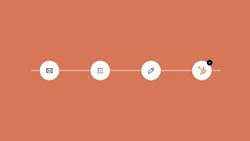
See it in action
video:
youtube.com/watch?v=D2FcNf2v9KY&feature=youtu.be
58
Notes:
Let’s watch a quick demo of our new hire working with its new employer. Watch what the owner does, not just what Claude does.
[play video]
So, what did you notice?
TIPS
Test this before the room fills: sound, screen, link. It's the most common technical failure in the workshop.
Give them something to watch for or it washes over them.
Ask the question straight afterward. One answer is better than clicking silently onward. Time: 3 to 5 minutes, depending on the video.
You can also show a different demo. The Delivery Guide (A3) has six demo videos (Partner Hub, then Content, then Claude for SMB Workshop), so pick the one closest to what the room asked about.

Slide 60
Keep it sharp
Three habits that keep it sharp
01
02
03
Teach it once
Audit the session
Right file, right place
After any correction, say "remember this." Claude writes it to the right file.
At the end, ask "what did we miss?" Claude proposes what to save and where. You approve.
Every few weeks, have Claude flag facts sitting in the rules file and rules sitting in memory.
Five minutes of upkeep. A new hire that gets better every week.
59
Notes:
Three habits keep the system getting better instead of going stale. First, teach it once. Any time you correct Claude, say remember this. Second, at the end of a session ask what did we miss. Claude scans the conversation for corrections and decisions and proposes what to save and where, and you approve it. Third, every few weeks have Claude check that rules are in the rules file and facts are in the memory file.
That is five minutes of upkeep for a new hire that gets better every week.

Slide 61
Get the Delivery Guide before your workshop.
Three things to know
01
Sign in and open Content
Go to partnerhub.anthropic.com, select Content, and open Claude for SMB Workshop
02
Use your Partner Hub address
Sign in with the email your invite went to, which may not be the one you write from
It lives in the Partner Hub.
03
Can’t see the Guide?
If Content is empty or shows an access error, email partner-support@anthropic.com
Notes:
Before you run any of this, you need the Delivery Guide, which holds the Workshop App links, the demo videos and the email templates. It lives in the Partner Hub.
Go to partnerhub.anthropic.com, sign in, select Content, and open Claude for SMB Workshop. Sign in with the email your Partner Hub invite went to, which may not be the address you usually write from. If Content is empty, or you see “You do not have access to this content,” email partner-support@anthropic.com with your company name and the email you sign in with.
TIPS
Trainer-only slide. Skip it in your workshop copy (right-click the slide, then Skip slide).
Open the Guide well before your workshop, not the night before, so there’s time to fix access if you need to.
1 minute.

Slide 62
Q&A Pause.
60
Notes:
Second pause. Now you've seen it working, what questions do you have?
TIPS
Expect different questions than slide 9. These tend to be practical: cost, whether it works with their system, how long setup takes, whether they're too non-technical for it.
If you don't know whether a specific tool is supported, don't guess. Write it down and follow up afterward. That follow-up is most of how trainers build a reputation.
On cost: it's included on every paid Claude plan. If they push into plan pricing and you're not certain, send them to the pricing page rather than half-remembering a number.
Cap at 5 minutes. The build block is what they came for.

Slide 63





Stay involved with Anthropic
Today is just the start of the journey!
Four ways to keep building and learning
Come to another workshop or webinar
In person and virtual, in cities across the country.
anthropic.com/events
Take a free AI Fluency course
AI Fluency for Small Businesses, built on today's four Ds.
academy.claude.com
Try new products and programs
Claude Motion, Claude Duet, Claude Tag, and more!
anthropic.com/news
See what's built for small business
Everything Claude offers owners and operators, in one place.
Visit anthropic.com for news, events, and courses
claude.com/solutions/small-business
Notes:
Today is the start, so here are four ways to keep going once you leave.
First, come to another workshop or webinar. Anthropic runs them in person and online, and the partner webinars show how each connector works inside Claude, so check anthropic.com/events for what’s coming up near you.
Second, take the free AI Fluency for Small Businesses course on academy.claude.com. It’s built on the same four Ds you used today, so it’s a good way to lock them in.
Third, keep an eye on anthropic.com/news, where Anthropic shares new products and programs as they launch.
Fourth, everything Claude offers small businesses is in one place at claude.com/solutions/small-business.
TIPS
Don't promise availability for specific products, since what's included changes by plan and changes often. Point people to anthropic.com/news instead.
1 minute.

Slide 64
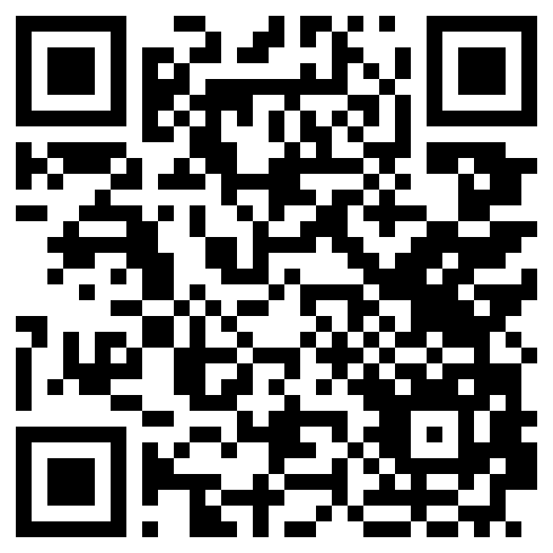
Your Claude for Small Business Community
Keep building with
owners like you.
Scan to join
Join the Claude for Small Business Community on Alignable. Members get:
01
Plugin updates
See new Claude for Small Business workflows and connectors as they ship.
02
Upcoming tour stops
Find dates for upcoming workshops and webinars.
03
Ideas from other owners
Claude for Small Business
Alignable Community
Learn how owners use the plugin, and share what you've built.
Free to join
04
Owner Q&A
New to Alignable? Create a free account first.
Already a member? Log in, then scan.
Ask questions and talk through ideas with other small business owners.
Notes:
Before you go: today doesn't have to be the end. We've set up a community on Alignable for owners who've come to a Claude for Small Business workshop. Members get updates on the Claude for Small Business plugin as new workflows and connectors ship, dates for upcoming tour stops and partner webinars, and a place to see what other owners set up and ask questions when you hit a wall. It's free to join. Take out your phone and scan the code now; it takes a minute. If you're already on Alignable, log in first, then scan.
Not a support channel: for account or billing help, point people to support.claude.com. Time: 1 minute.

Slide 65
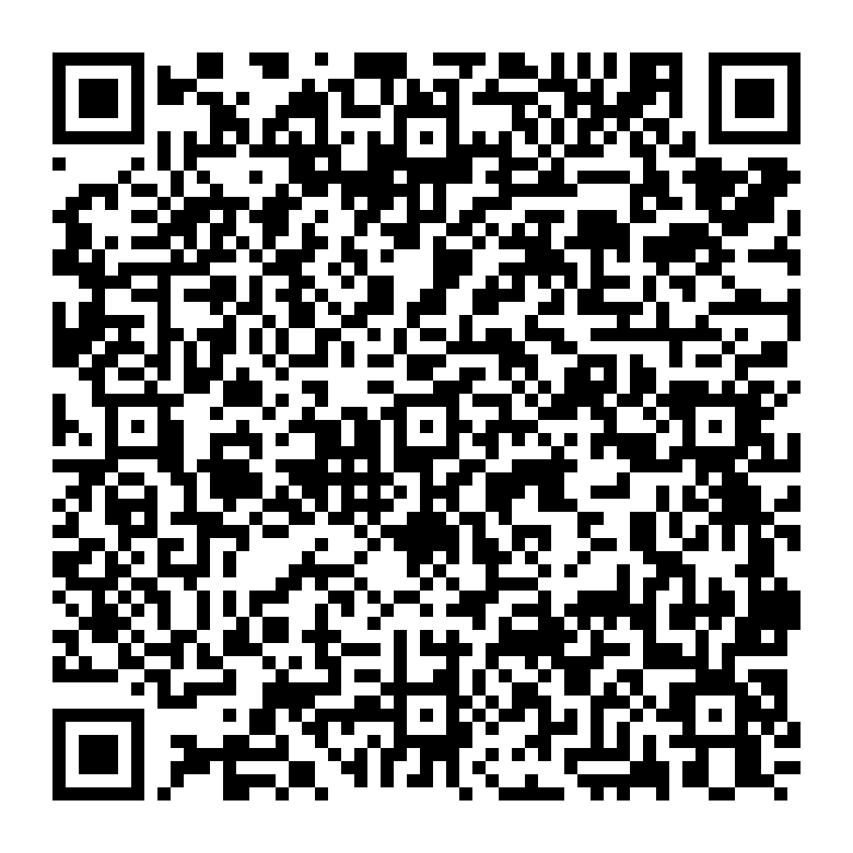
That's a wrap
Thank you, Muskegon!
Complete the survey to share your feedback!
Questions or follow-ups? Reach out:
Jonnathan Resendiz, jonnathanresendiz@grcc.edu
63
Notes:
Thank you, Muskegon, and thank you again to The Right Place and Muskegon Community College for putting this series together.
Three things before you go.
First, everyone in this room gets a free month of Claude Max. Your code came in my email yesterday, so if you haven't redeemed it yet, do it today on the web at claude.ai, since codes don't work in the mobile app. Use it on the thing you built today.
Second, please do the survey. It's how the next one of these gets better, and it's part of how we work out where to run them.
Third, my contact is on the screen.
Thank you so much again for making time to come and learn today! We invite your feedback.
TIPS
Update highlighted with your details.
Get your Claude Max codes in time. Email SMBtrainers@anthropic.com at least two business days before your workshop with the subject line "Claude Max Codes Request for GRCC AI Incubator", then email each attendee their own code the day before using template C4 in the Delivery Guide (Partner Hub, then Content, then Claude for SMB Workshop). Codes redeem on the web at claude.ai, not in the mobile app.
Add the survey QR code before the session. A URL read aloud gets a fraction of the responses a code on screen does.
Put your own contact in the contact line, not Anthropic's, since you're the follow-up.
Stay a few minutes afterward, as the best conversations happen in an emptying room. Within a week, email SMBtrainers@anthropic.com with the subject line "Claude SMB Follow-Up for GRCC AI Incubator" and your survey results and wins, and check that everyone who came is marked as attended in Luma, since that's how the workshop counts toward your minimum.
2 minutes.

