Slide 1



AI FOR MANUFACTURING
Day 1: Build Your AI HQ
Montcalm Community College
Jonnathan Resendiz, CIS Department Head
grcc.edu | (616) 234-2206
Notes:
Welcome back from the break. This part of the day is about one idea: getting AI to remember how you work, so you stop explaining yourself every time. First I'll show you how I do it, then you'll build your own in Copilot.

Slide 2


WELCOME!
Get everything for today here:
Today's guide
github.com/grcc-resendiz/ai-mcc
grcc.edu | (616) 234-2206
Notes:
Welcome everyone. Today has a lot of hands-on work, so the most important thing is this code. Everything you'll copy and paste today is in this guide, with a copy button next to each block.
Give people a minute to scan it and open the page.
About 2 minutes.

Slide 3
YOUR INSTRUCTORS
Jonnathan Resendiz
Assistant Professor and Computer Information Systems Department Head, Grand Rapids Community College
Faculty Director, GRCC AI Incubator
M.S. in Computer Science, University of Texas at Dallas
Cheyenne Beach
Automation and Advanced Industrial Technology Instructor, Montcalm Community College
Notes:
Introduce yourself briefly, then hand it to Cheyenne for a sentence or two about her automation and industrial technology work.
Then go around the room quickly: name, company, and one thing you use AI for today.
About 5 minutes.

Slide 4

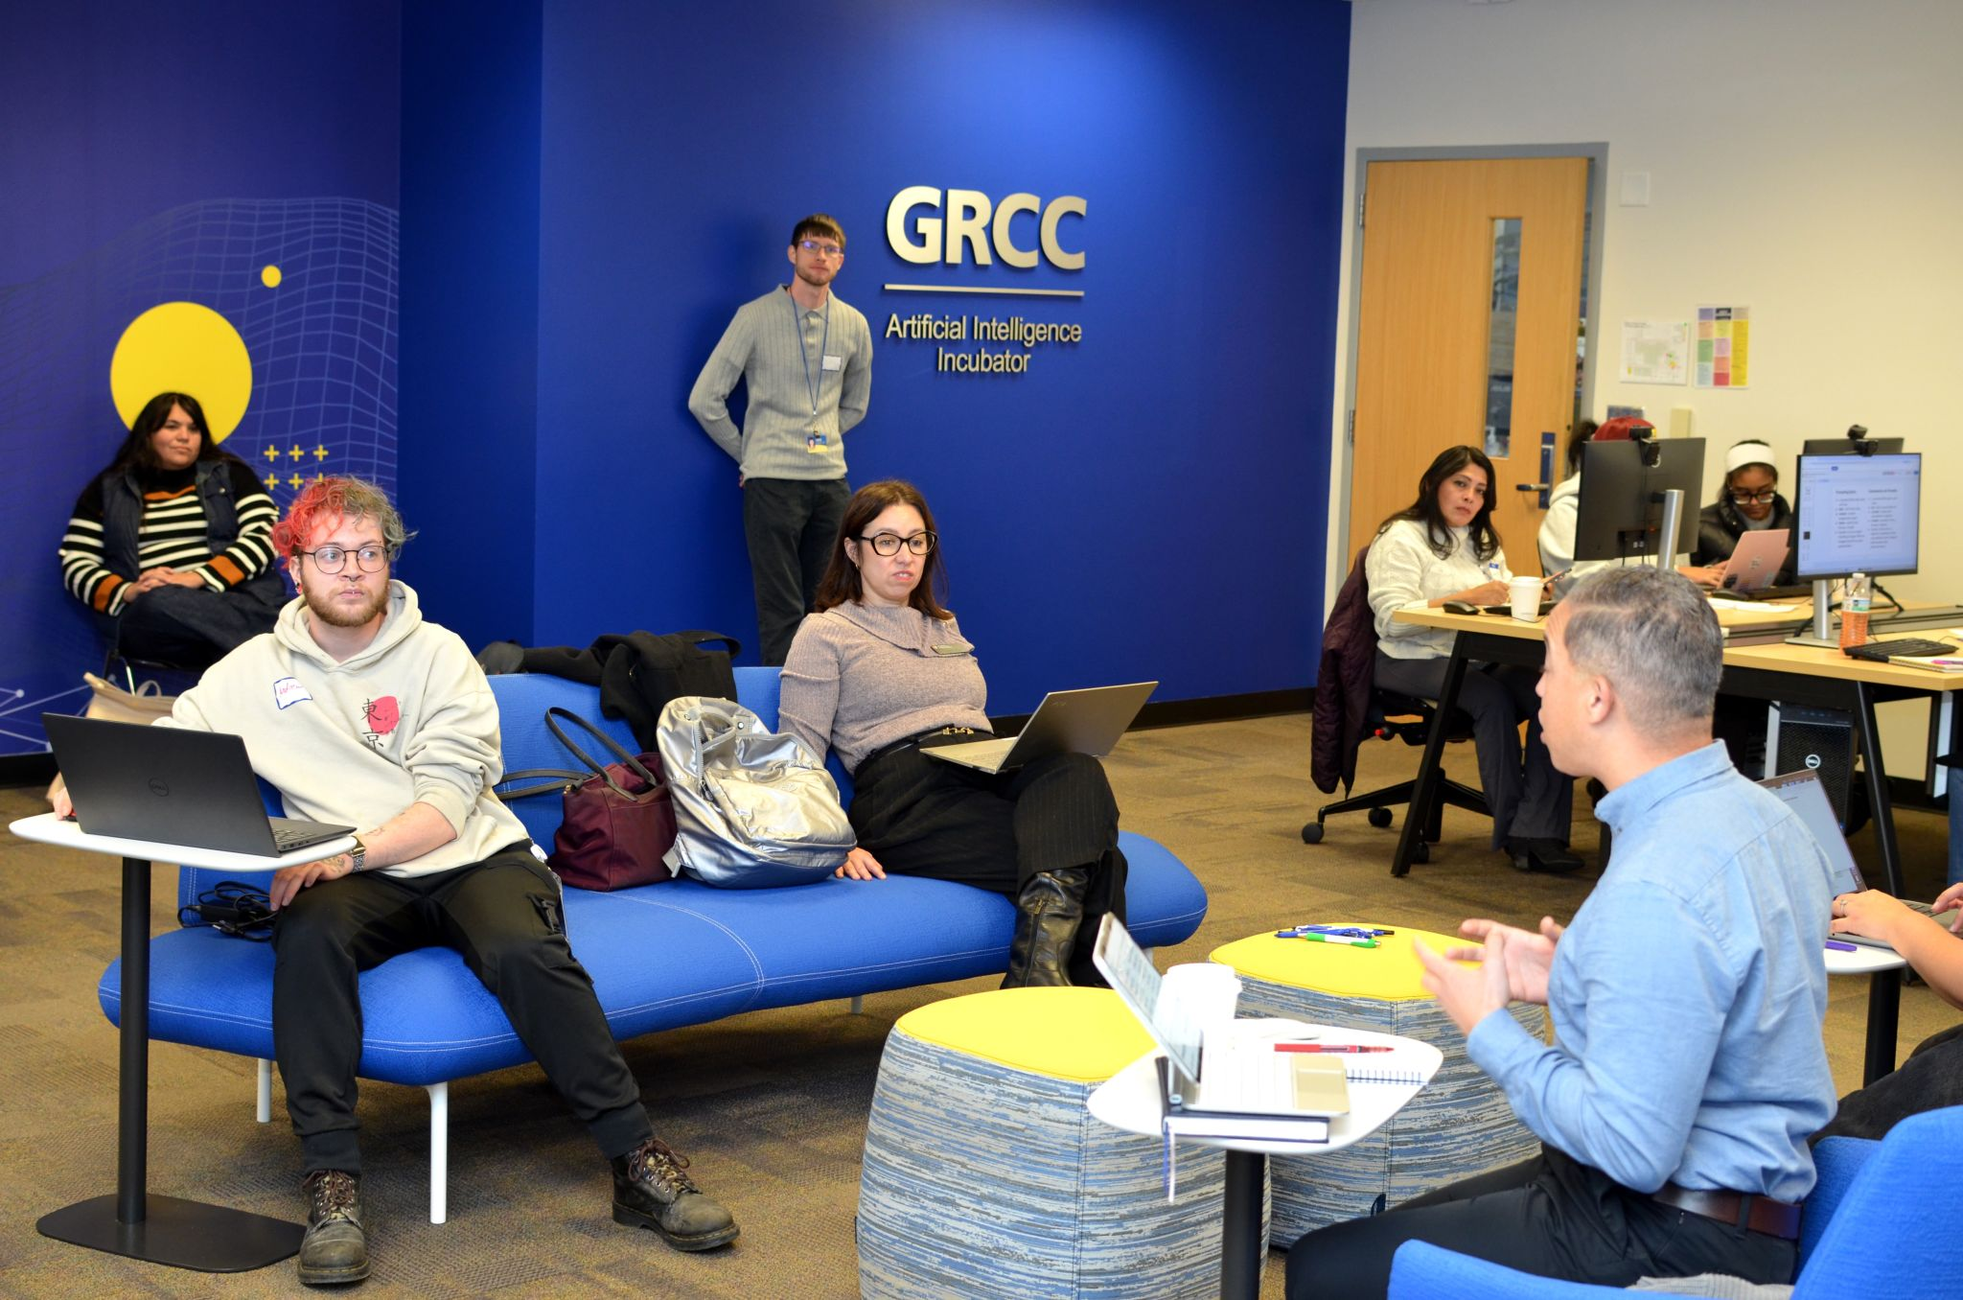
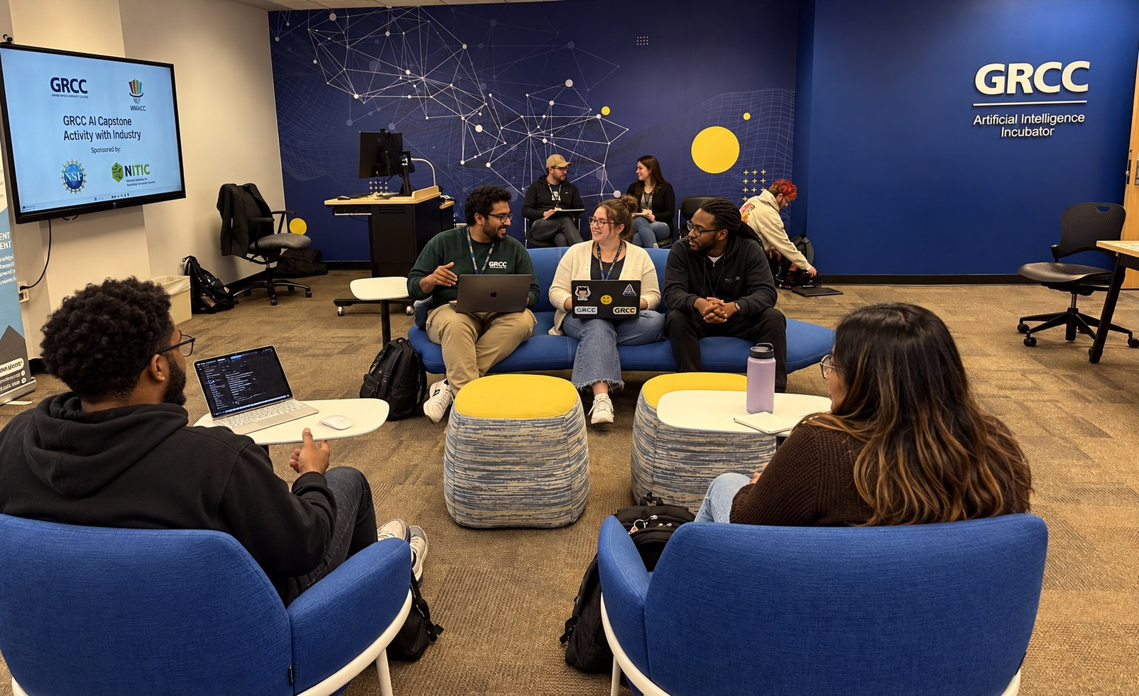
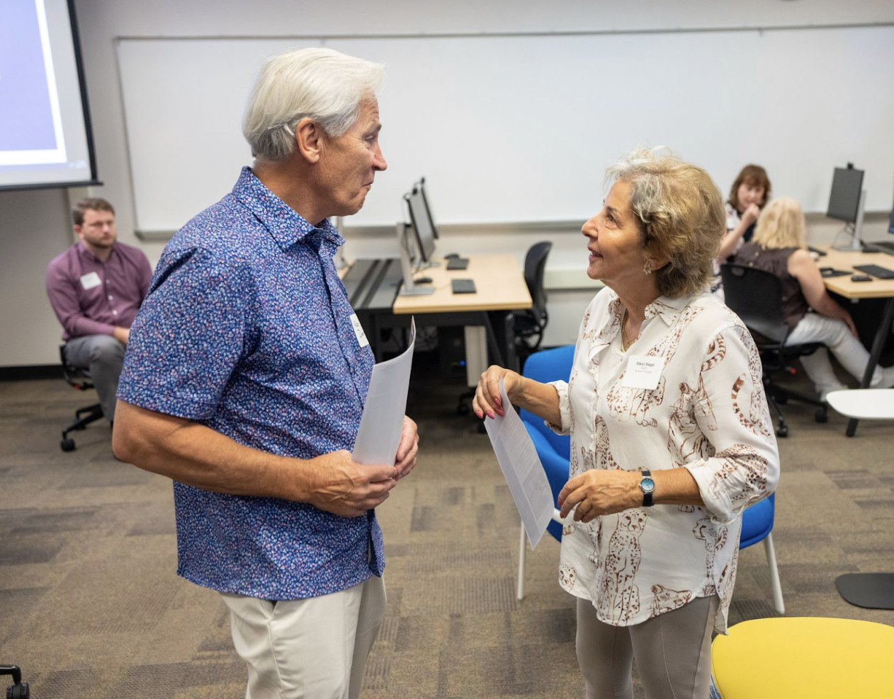
TODAY'S AGENDA
9:00
9:10
9:20
10:15
10:25
10:45
11:45
Welcome and introductions
The state of manufacturing
Computer vision: spot defects
Break
How I run my work with AI
Build your HQ in Copilot
Your turn and what's next
9:00 AM to 12:00 PM. Short talks, lots of hands-on. Your answers before 9:20 become what you build after the break.
Notes:
Set expectations: short talks, lots of hands-on.
The problems they share at 9:10 come back when they build their HQ at 10:45, so keep that list visible.
About 1 minute.

Slide 5
WHAT YOU'LL DO IN 3 DAYS
Each day builds on the one before.
DAY 3
AI agents
Build agents and decide where they help most.
DAY 2
Skills and workflows
Turn your HQ into repeatable skills and workflows.
DAY 1
Your AI HQ
Train an AI to spot defects, then build your own HQ in Copilot.
Notes:
Say: Today you build the foundation, an AI HQ that knows how you work. Day 2 turns it into skills and workflows. Day 3 is agents.
At the end of today, I'll ask where you want to take it, and we'll shape Days 2 and 3 around your answers.
About 1 minute.

Slide 6
THE STATE OF MANUFACTURING
Let's start with you.
Notes:
Transition: before we talk about AI, let's talk about your plants.
About 30 seconds.

Slide 7
WHAT KEEPS YOU
UP AT NIGHT?
Downtime
Quality
Scrap
Hiring
Training
Scheduling
Shout them out. We'll come back to your answers when you build your HQ.
Safety
Yours?
Notes:
🟡 INTERACT: Ask: what keeps you up at night? Let people shout out answers and write them where everyone can see them. Add to the list on the slide.
Save this list. When they build their HQ after the break, each person picks one of these problems.
Connect it to workforce pressure, which leads into the next slide.
About 6 minutes.

Slide 8
THE MANUFACTURING REALITY, 2024 TO 2033
3.8M
1.9M
1 in 2
Now
manufacturing jobs to fill by 2033
of those could go unfilled
open jobs at risk of staying empty
this is already happening, not a future problem
Source: Deloitte and The Manufacturing Institute, April 2024
Notes:
Pause after the numbers. Ask: are you already feeling this hiring pressure?
Source: Deloitte and The Manufacturing Institute, Taking Charge: Manufacturers support growth with active workforce strategies, April 2024. Net need of 3.8 million new manufacturing workers from 2024 to 2033, with about 1.9 million that could go unfilled.
About 2 minutes.

Slide 9
TWO BIG CHALLENGES
1
Workforce shortage
Not enough people to hire and train.
2
Technology adoption gap
The tools exist. Using them is the hard part.
We don't have a technology problem. We have an adoption problem.
Notes:
Let the last line land: we don't have a technology problem, we have an adoption problem.
About 2 minutes.

Slide 10
AI ADOPTION AS A SOLUTION
Why AI, and why now
AI amplifies learning: use it to learn every other technology
Invest in AI training, and you start solving both challenges
No one is coming to save us. We build the solutions ourselves.
Notes:
Say: AI is the one technology that helps you learn all the others. If we invest in AI training, we start closing both gaps at once. And no one is coming to save us, so let's build it ourselves.
Transition: let's start with something you can see working in the next 10 minutes.
About 2 minutes.

Slide 11
COMPUTER VISION
Let's watch AI learn from pictures.
Notes:
Transition: we just talked about the adoption gap. Let's close it a little, with something you can see working in the next half hour.
About 30 seconds.

Slide 12
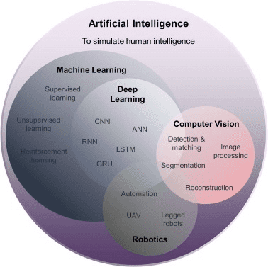
COMPUTER VISION: TEACHING COMPUTERS TO SEE
Computer vision is the part of AI that teaches computers to process and understand images and video.
Identify
Find the part in the picture
Classify
Decide what it is: OK or defective
Segment
Outline exactly where the flaw is
Today's lab is classification: OK or defective.
Notes:
Say: Computer vision is AI that works with pictures and video. Three common jobs: find the part, decide what it is, and outline exactly where the problem is.
Today's lab is the middle one: classification. Is this cast part OK or defective?
Image source: M.Q. Huang et al. (2021), BIM, machine learning and computer vision techniques in underground construction, Tunnelling and Underground Space Technology, Vol. 108.
About 3 minutes.

Slide 13
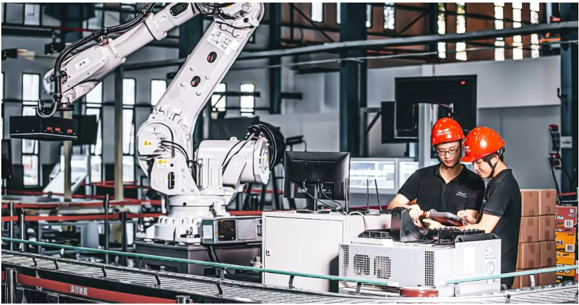
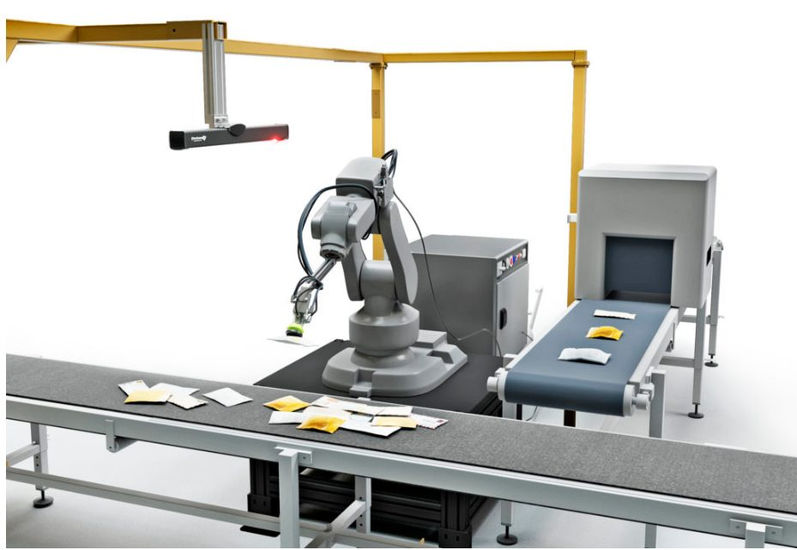
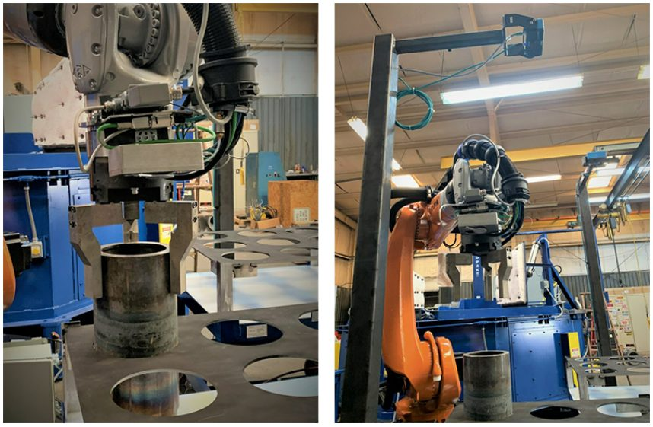
COMPUTER VISION ON THE FLOOR
Quality inspection
Catch defects and parts that are out of spec.
Sorting
Sort parts by size, shape, color, or material.
Robot guidance
Guide pick and place and assembly.
Notes:
Say: The most common use on the floor is quality inspection: finding defects and parts out of spec. Computer vision also sorts parts and guides robots.
Ask: where on your floor do people inspect parts by eye today?
Stress: computer vision supports operators. The inspector still decides what counts as a defect.
Image sources: Novacura (2022), Quality inspections of the production line using computer vision; Atos Group (2017), YouTube; SICK USA (2020), Robot vision and guidance.
About 4 minutes.

Slide 14
GREAT AT,
STRUGGLES WITH
Great at
Consistent on every shift, no fatigue
Faster decisions on the line
Data on every part, not a sample
Spotting safety hazards
Struggles with
Changes in lighting and camera angle
Subtle or rare defects
Upfront cost for cameras and setup
Privacy concerns from the floor
Know both before you buy anything.
Notes:
Say: Computer vision is consistent across every shift and gives you data on every part. But it struggles when the lighting changes, when defects are subtle or rare, and it costs money up front. Lighting matters, and you'll see that in the lab.
About 3 minutes.

Slide 15
HANDS-ON: SPOT THE DEFECT
Train your own model in 30 minutes.
Notes:
Transition: now you'll build one. We'll follow the AI project cycle from start to finish with a real quality dataset.
About 30 seconds.

Slide 16
THE AI PROJECT CYCLE
1
2
3
4
5
6
7
Problem scoping
Data acquisition
Data exploration
Modeling
Evaluation
Deployment
Improve and repeat
Today's problem: is this cast part OK or defective? Each lab step is one stage of the cycle.
Notes:
Walk the cycle once with today's problem. Problem scoping: which defect matters? Data: pictures of good and bad parts. Modeling: Teachable Machine. Evaluation: test pictures it has never seen. Deployment: a live webcam demo.
About 2 minutes.

Slide 17
STEP 1:
GET SET UP
DO
Download casting_data.zip from the guide and unzip it
DO
Go to teachablemachine.withgoogle.com
Get Started > Image Project > Standard image model
Goal: a model that tells OK cast parts from defective ones.
EXPECT
A folder of cast part pictures, already sorted into OK and defective
An empty project with Class 1 and Class 2
AI PROJECT CYCLE: PROBLEM SCOPING
Notes:
The dataset holds pictures of cast parts sorted into ok_front and def_front, with train and test folders.
Cheyenne roams for anyone whose download is blocked. Pair them with a neighbor.
About 4 minutes.

Slide 18
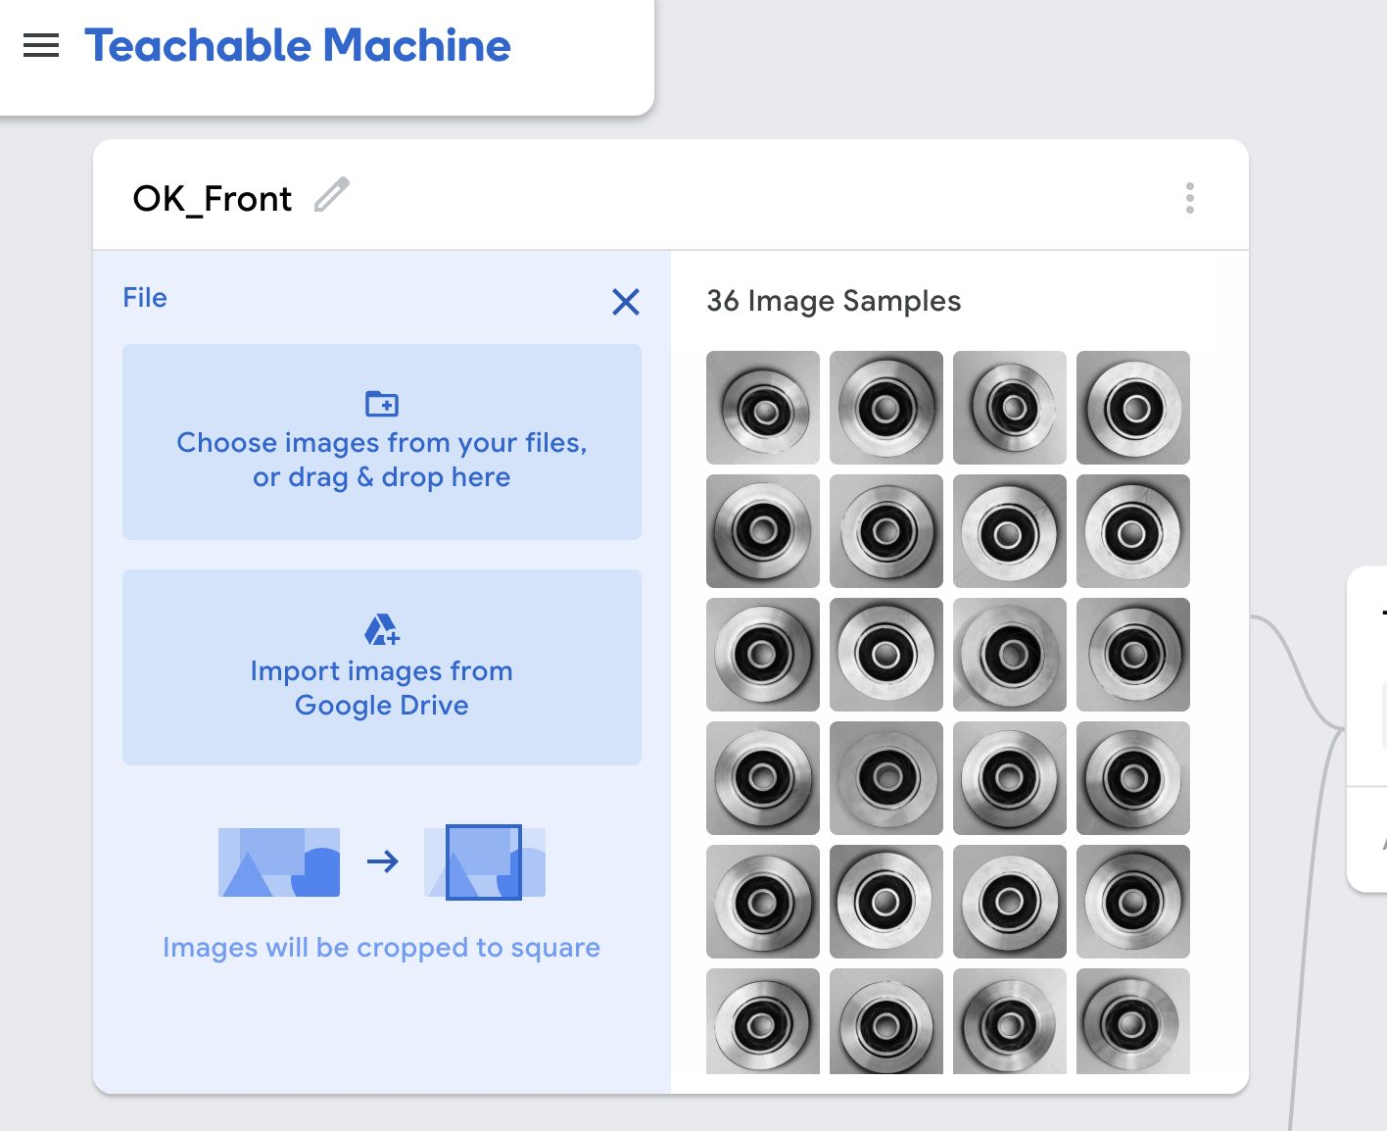
STEP 2: CLASS 1 IS “OK”
DO
Click the pencil icon and rename Class 1 to OK
DO
Click Upload and add the pictures from train/ok_front
AI PROJECT CYCLE: DATA ACQUISITION
Notes:
Class 1 is OK. Upload everything in train/ok_front.
Say: this is the training data. Whatever is in these pictures is all the model will ever know about a good part.
About 3 minutes.

Slide 19
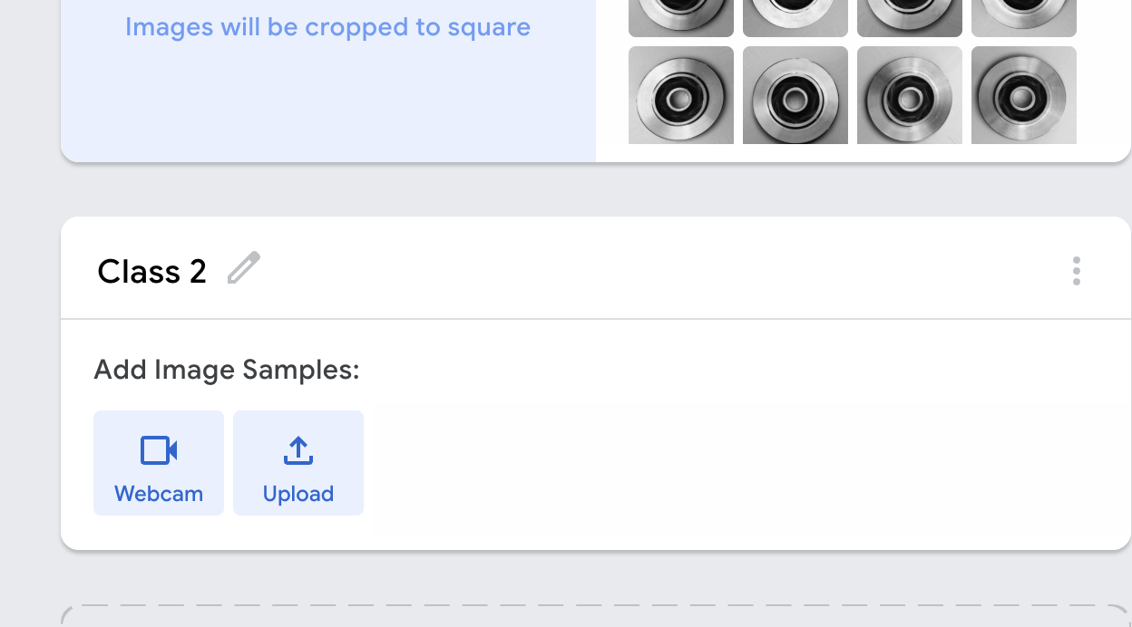
STEP 3: CLASS 2 IS “DEFECTIVE”
DO
Rename Class 2 to Defective
DO
Click Upload and add the pictures from train/def_front
AI PROJECT CYCLE: DATA ACQUISITION
Notes:
Class 2 is Defective. Upload everything in train/def_front.
Say: two classes only, so the model learns one question: OK or defective?
About 3 minutes.

Slide 20
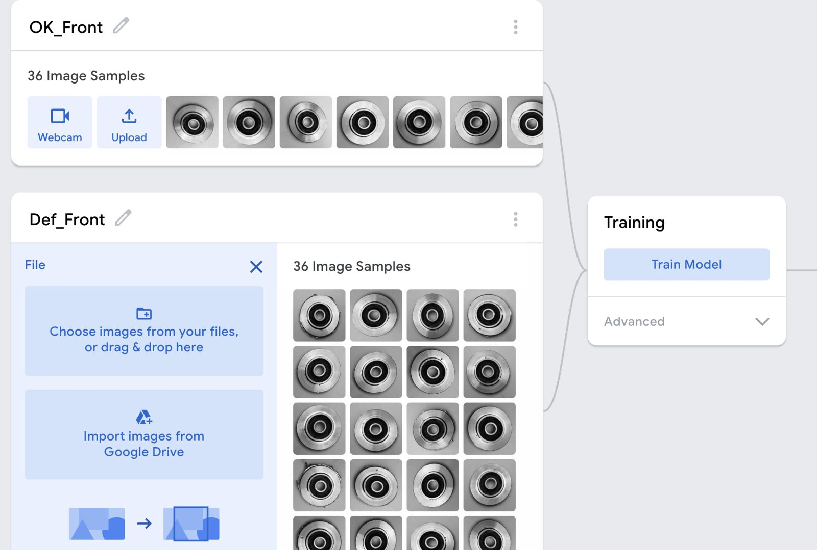
STEP 4:
TRAIN IT
DO
Click Train Model
Keep the browser tab open while it trains.
AI PROJECT CYCLE: MODELING
Notes:
Training takes a minute or two.
Say: it's finding the patterns that separate a good part from a bad one, from nothing but the pictures you gave it.
About 3 minutes.

Slide 21
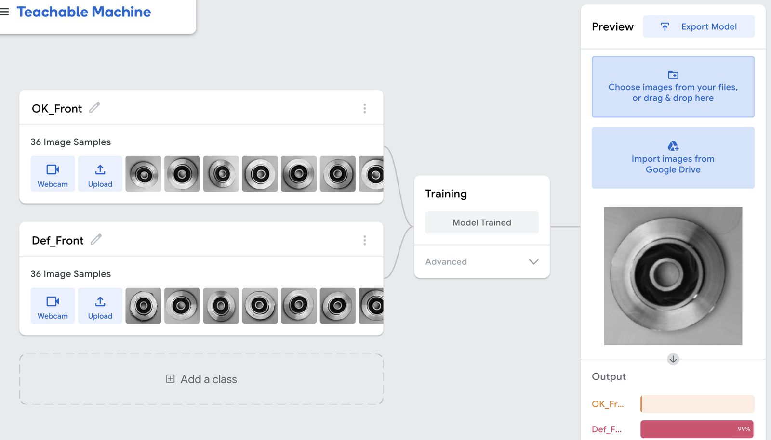
STEP 5: TEST IT ON NEW PARTS
DO
In Preview, switch Webcam to File and upload pictures from the test folders
EXPECT
Most parts sorted correctly
A few it gets wrong. Those are the interesting ones.
AI PROJECT CYCLE: EVALUATION
Notes:
Test with pictures from the test folders, which the model has never seen.
Ask: which defects fooled it? Keep those examples for the debrief.
About 6 minutes.

Slide 22
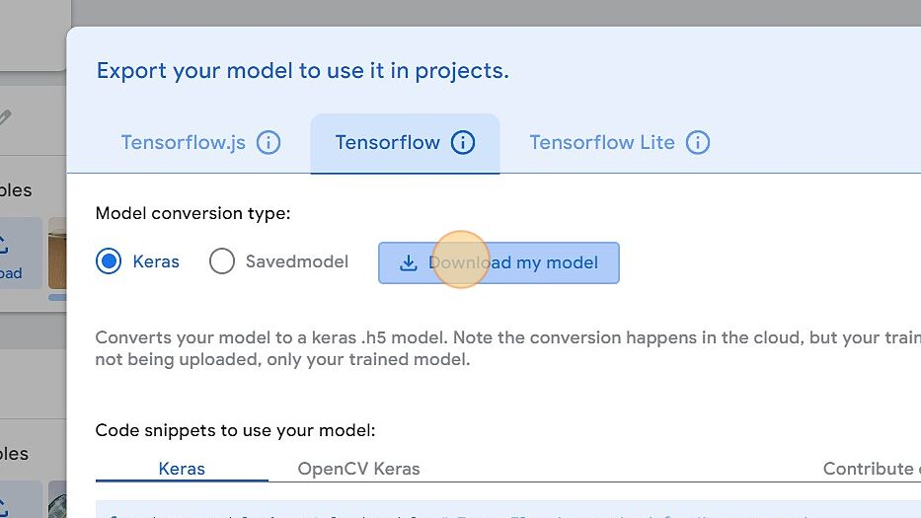
STEP 6: WATCH IT GO LIVE
I'll run this part. The steps are in the guide for later.
DEMO
Export Model > Upload my model, then paste the link into the Codespaces demo
Take it back to work: with a free GitHub account, anyone on your team can run the same demo with a webcam.
AI PROJECT CYCLE: DEPLOYMENT
Notes:
Run this on your laptop while they watch: Export Model, Upload my model, copy the shareable link, paste it into the Day 2 Computer Vision Demo in Codespaces, start it, and hold a part or a picture up to the webcam.
Say: nobody needs to make a GitHub account today. If you want this back at your company, the steps are in the guide.
About 4 minutes.

Slide 23
WHAT DID YOUR MODEL LEARN?
Debrief
What did it get right, and what did it get wrong?
Training data: it only knows the pictures you gave it
Overfitting: great on training pictures, worse on new ones?
Bias: what if every OK picture were bright and every defect dark?
Lighting: what would change on your floor?
Notes:
🟡 INTERACT: Ask each question and let the room answer. Use their mistakes from the test step as examples.
Training data: the model only knows what you showed it. Overfitting: memorizing the training pictures instead of learning the pattern. Bias: if the OK pictures were all brighter, the model might learn brightness, not defects.
Then ask: what would change on your floor? Lighting, angle, speed of the line.
About 6 minutes.

Slide 24
KEY TAKEAWAYS
Start with one painful inspection point
Your data decides what the model learns
Let operations lead, then build confidence with a pilot
Notes:
Say: start small. One painful inspection point, not the whole plant. Your data decides what the model learns. And let the people on the floor lead.
Transition to the break: after the break, the same idea, that data decides what AI learns, applies to the AI tools you use every day.
About 2 minutes.

Slide 25
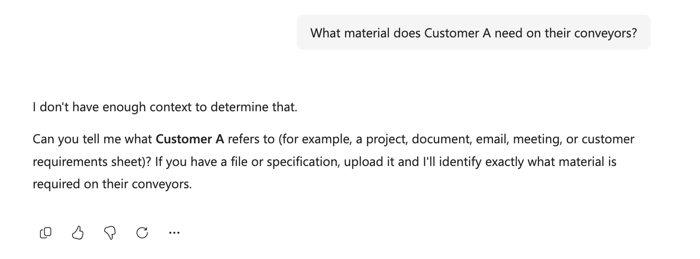
AI FORGETS.
EVERY CHAT STARTS OVER.
Ask Copilot about your own customer, and it has no idea who you mean.
Notice what it asks for: a file or a spec. In other words, context.
Notes:
Live: in a regular chat, outside the notebook, ask: What material does Customer A need on their conveyors?
Say: It has no idea. Every chat starts from zero. And look at what it asks for: a file or a spec. That's context, and that's what this whole session is about.
About 2 minutes.

Slide 26
CONTEXT BEATS PROMPTS
OPTION A
Describe it
Spend 10 minutes typing out how you like your quotes written.
OPTION B
Show it
Hand Copilot three past quotes and say: “Write this one the same way.”
Outcome + Context is the only framework you need. But good context is wasted if you retype it every time.
Notes:
🟡 INTERACT: Show of hands: who would pick Option A? Option B?
Say: Option B wins every time. The examples carry everything you'd forget to say. So the framework is simple: tell it the outcome you want, and give it the right context. But if you have to dig up those three quotes every single time, you'll stop doing it. So the next question is: how do we save it?
About 3 minutes. This comes from my CIS 110 course.

Slide 27
FIND IT. SAVE IT. LET AI KEEP IT.
Good context only pays off if it sticks.
STEP 3
Let AI manage it
You set the rules. AI does the upkeep.
STEP 2
Save it
Put it somewhere that lasts, so you never explain it twice.
STEP 1
Find it
Outcome + Context, with real examples.
Notes:
Say: Step one is finding good context. Step two is saving it, so you're not hunting for it every time. Step three is the one most people never get to: letting AI manage it. You decide what matters, and AI keeps the files current.
These are the three levels of AI memory from CIS 110: memory the tool controls, a project that holds your files, and a system you own.
About 3 minutes.

Slide 28
WHAT YOU SAVE:
THREE PARTS
Instructions Rules that always apply
Claude: CLAUDE.md | Copilot: Customize Copilot, Notebook instructions
Knowledge Reference material
Claude: Resources folder | Copilot: Notebook files
The same three parts work in Claude and in Copilot.
Memory What changes over time
Claude: MEMORY.md | Copilot: Saved memories, memory file
Notes:
Say: When we save context, we're saving three things. Instructions: the rules that always apply. Knowledge: the reference material, like a price list or a past quote. And memory: the facts that change, like a customer's new requirement.
Keep an eye on these three words. Every build step later today adds one of them.
About 3 minutes.

Slide 29
HOW I RUN MY WORK WITH CLAUDE
Root rules
CLAUDE.md
How I want it to work, always and never.
Root memory
MEMORY.md
Active projects and core facts about me.
Workstations
One per area
Each part of my job, with its own rules and memory.
Resources
Inside each HQ
Every file for that HQ: decks, data, documents.
My root folder CLAUDE.md + MEMORY.md
Canvas HQ
NSF ATE Grant
Department Head HQ
Doctoral Program HQ
Claude SMB HQ
TGW HQ
+ 3 more
Each workstation has its own CLAUDE.md, MEMORY.md, and Resources folder.
Notes:
Say: Here's my actual setup. One root folder with my rules and my memory. Then a workstation for each part of my job: courses, the grant, department work, my doctorate. Each one has its own rules, its own memory, and its own files.
This training lives in the NSF ATE Grant workstation, highlighted here. Let's open it.
Point out Resources: every file for an HQ lives there, so the AI always knows where to look. Show only the root files and the NSF ATE Grant folder on screen. Keep the other folders collapsed.
About 4 minutes.

Slide 30
ONE WORKSTATION: NSF ATE GRANT
Where this training lives in my system
Instructions: what belongs here and how to work
Memory: decisions about this training
Resources: the Muskegon decks, datasets, and today's files
Rules that learn: “Added after Jon said...”
Notes:
Open the NSF ATE Grant workstation. Show its CLAUDE.md, then its MEMORY.md, scrolled to the AI for Manufacturing entries.
Say: You're looking at your own training inside my system. And look at these notes: added after Jon said. Every time I correct it, the rule gets written down, so I never correct it twice.
About 3 minutes.

Slide 31
WATCH IT REMEMBER
Live in Claude
I say “remember this” with a real fact
Claude decides where it belongs
MEMORY.md updates on its own
Next time, it already knows
Notes:
Live in Claude: say remember this with a fact that's safe to show the room. Then open MEMORY.md and show the new line.
Say: I didn't open the file. I didn't decide where it goes. Claude did the upkeep. Now let's see how much of this you can do in Copilot.
About 2 minutes. If time is short, skip this slide.

Slide 32
WHAT CARRIES OVER TO COPILOT
 | Claude | Copilot Basic | Copilot Premium*
Root instructions | Yes | Yes | Yes
“Remember this” | Yes | Yes | Yes
Workstations | Yes | Yes | Yes
Knowledge files | Yes | Yes | Yes
Saves memory by itself | Yes | Partly | Yes
Skills | Yes | No | Yes
Scheduled tasks | Yes | No | Yes
Folders inside folders | Yes | No | No
*Premium: Microsoft 365 Copilot with Copilot Cowork turned on, per Microsoft's documentation. Full table in the guide.
Notes:
Say: Here's the honest scorecard. On a Basic account you get the structure: your instructions, your memory, workstations, your files. What you don't get is the automation: Copilot won't save the memory file for you, and there are no skills or schedules.
The Premium column comes from Microsoft's documentation, and it needs Copilot Cowork turned on by your IT team. We haven't tested it here.
About 4 minutes.

Slide 33
HOW COPILOT REMEMBERS
1
You say “remember this”
2
Copilot updates memory
3
Copilot saves*
4
It remembers
*Copilot Basic: paste the update into your memory file and upload it again. Premium with Copilot Cowork saves it for you.
Notes:
Say: Four steps. You say remember this. Copilot figures out where the fact belongs and rewrites the memory. It saves. Next time, it knows.
The asterisk: on a Basic account, step three is you. Copilot writes the update, you paste it into your file and upload it. In Claude, AI manages and saves. In Copilot Basic, AI manages and you save. The upside: nothing gets into your company's memory unless you approve it.
About 2 minutes.

Slide 34
MEET EXAMPLE EQUIPMENT CO.
A fictional company for today's demo
Who
60 people in West Michigan. Custom conveyors for food and industrial plants.
Quoting
Request by email. Engineer scopes it, estimator prices it, quote goes out.
The pain
Customer details live in people's heads and get retyped every quote.
Its HQ
Instructions, a price list, a past quote, and a memory file.
Customers: A, snack food plant. B, pet food plant. C, automotive parts plant.
Notes:
Say: Here's the company we'll use. It's made up, and the prices are made up too, so don't quote me. But does this sound like your week? Requests come in by email, someone works up the estimate, and the important customer details live in people's heads.
Its HQ has the three parts we just talked about: instructions, knowledge, which is the price list and a past quote, and memory.
About 3 minutes.

Slide 35

OPEN THE
GUIDE
Then find this label under your name
Basic: everything today works for you.
Paid: same steps, plus a few extra features.
Everything you paste today is in the guide, with a copy button.
Scan for today's guide
github.com/grcc-resendiz/ai-mcc
Notes:
🟡 INTERACT: Hands up: who sees Copilot Chat (Basic) under their name? Who sees something else? Pair anyone who's stuck with a neighbor, and have Cheyenne help anyone whose Copilot looks different.
Guide link: github.com/grcc-resendiz/ai-mcc
About 3 minutes.

Slide 36
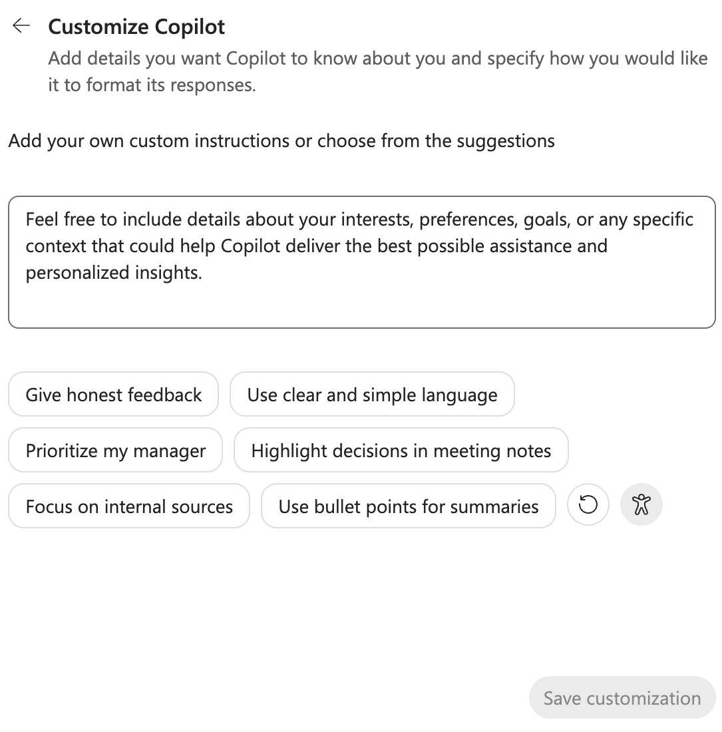
LEVEL 1: LET COPILOT INTERVIEW YOU
1
Paste the interview prompt from the guide
2
Answer 5 quick questions
3
Copy the instructions it writes
4
Gear icon > Personalization > Customize Copilot > Save
ADDS: INSTRUCTIONS
Notes:
Say: Instead of writing your instructions from scratch, let Copilot interview you. It asks five questions: your role, what you use it for, how it should work with you, how answers should look, and the terms it should know. Then it writes your instructions, with four rules always included.
Roam with Cheyenne. When most people are done, ask one or two to read their result out loud.
About 10 minutes.

Slide 37
TEST IT: “REMEMBER THIS”
Your first win
Type the first line
Look for “Memory saved”
Open a new chat, then ask
Look for
Memory saved
ADDS: MEMORY
TYPE
Remember this: I don't take meetings before my second cup of coffee.
THEN ASK
When's a good time to schedule a meeting with me?
Notes:
Say: Let's test it with something everyone can relate to. Type: Remember this: I don't take meetings before my second cup of coffee. Look for Memory saved. Then open a brand new chat and ask: When's a good time to schedule a meeting with me?
If it steers you away from first thing in the morning, your root memory works. And notice it didn't just repeat the fact, it used it.
Check later: Settings, Personalization, Saved memories.
About 5 minutes.

Slide 38
LEVEL 2:
BUILD THE HQ
1
Notebooks > New notebook
Name it Example Equipment Co. HQ
2
Click ... > Instructions
Top right of the notebook
Look for Notebooks. On some screens it says Workspaces.
3
Paste the HQ instructions
From the guide, then Save
ADDS: INSTRUCTIONS
Notes:
Say: Now the workstation. In Copilot it's called a Notebook. On some laptops it already says Workspaces, since Microsoft is renaming it right now. Create it, open Instructions, and paste the HQ instructions from the guide.
About 8 minutes.

Slide 39
ADD KNOWLEDGE AND MEMORY
Download three files from the guide, then one upload.
Example Equipment Co.
Price List
References
KNOWLEDGE
■ Example Equipment Co. Price List.docx
Example Equipment Co.
Past Quote
KNOWLEDGE
■ Example Equipment Co. Past Quote.docx
■ Example Equipment Co. MEMORY.docx
Example Equipment Co.
MEMORY
MEMORY
A re-upload may add a number, like “MEMORY 1.”
Notes:
Say: Download the three files from the guide. In the notebook, open the add window, click the upload icon, and pick all three.
When you project this, the add window shows your recent emails. Open it before class or keep it off screen.
About 7 minutes.

Slide 40
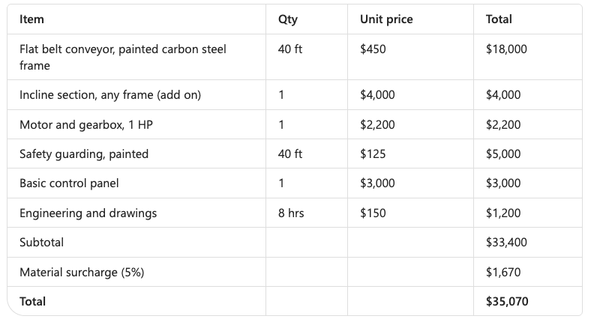
TRY IT, PROMPT 1: DRAFT A QUOTE
TYPE
Draft a quote for this request in the same format as our past quote:
Then paste Customer A's request from the guide.
EXPECT
Our quote format
Painted steel prices
The 5 percent surcharge from memory
Total of about $35,070
The surcharge isn't in the past quote. It came from memory.
Notes:
Type the prompt, then paste Customer A's request.
Say: Watch for three things: our format, our prices, and the surcharge we decided on in October. Nobody typed a single rule; it all came from the context we saved.
Then ask: is this quote right? (Not yet. Copilot doesn't know Customer A's washdown rule. Hold that thought.)
About 4 minutes.

Slide 41
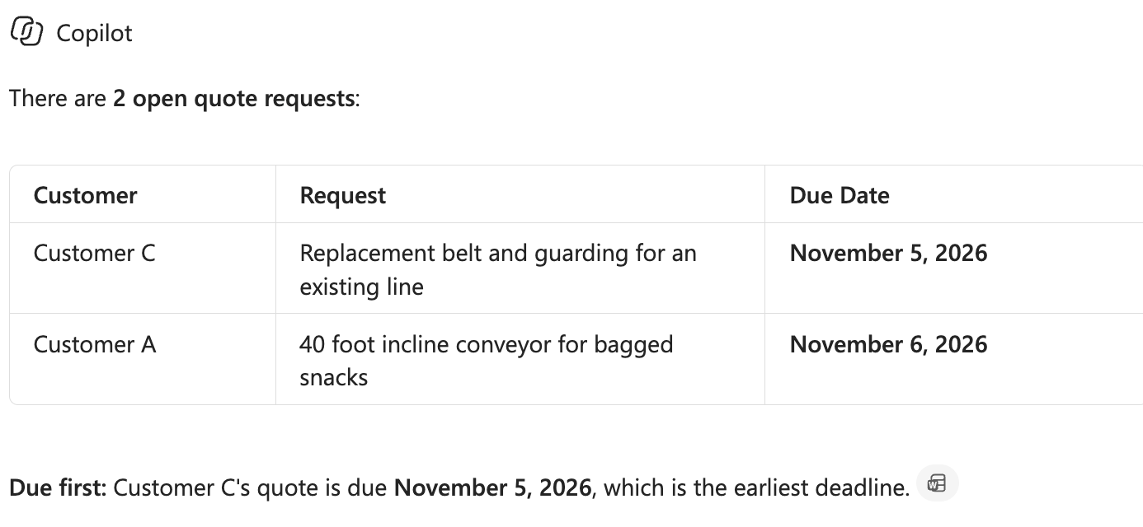
PROMPT 2:
WHAT'S OPEN
TYPE
What quotes are open and what's due first?
EXPECT
Customer C, due November 5
Customer A, due November 6
A still shows as open
Use it like a coordinator, not just a quote machine.
Notes:
Say: Now let's use it like a coordinator.
Then point out: we just quoted Customer A, but it still says open. Memory only changes when we update it. We'll come back to that.
About 2 minutes.

Slide 42
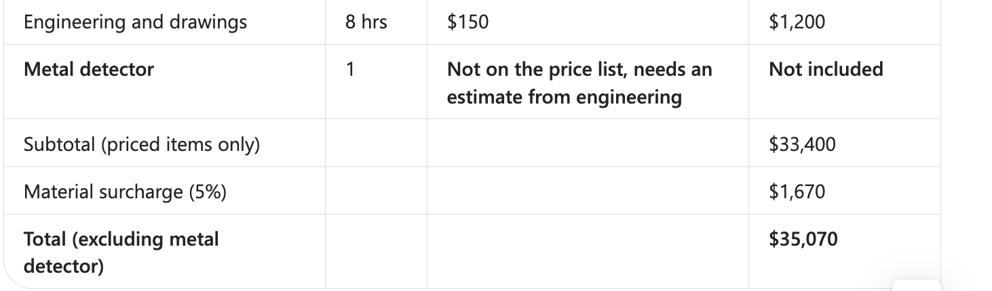
PROMPT 3: THE GUARDRAIL
TYPE
Customer A also wants a metal detector on this conveyor. Add it to the quote.
EXPECT
“Not on the price list, needs an estimate from engineering”
No made up price
Total stays $35,070
One line in the instructions: never give a price that isn't on the price list.
Notes:
🟡 INTERACT: Before you send it, ask the room: what do you think it'll do, make up a number or admit it doesn't know?
Say: One sentence in the instructions, and it held. That's the difference between a tool you can trust with quotes and one you can't. (For your reference: a real food line metal detector runs roughly $25,000.)
About 4 minutes.

Slide 43
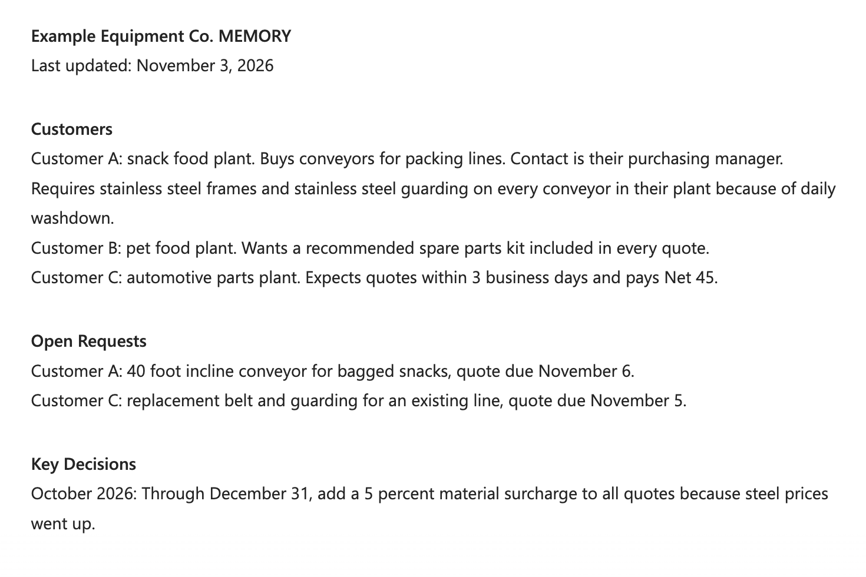
NOW, REMEMBER THIS
TYPE
Remember this: Customer A requires stainless steel frames and guarding on every conveyor in their plant because of daily washdown.
EXPECT
The full memory file comes back
New fact on Customer A's line
Nothing else changed
Notes:
Say: Customer A has a rule we never told Copilot. Watch what it gives back: not just got it, but the whole updated memory file.
Point out that the fact landed exactly where it belongs, and nothing else changed.
About 2 minutes.

Slide 44
SAVE IT: COPILOT WRITES, YOU SAVE
1
Click Copy under Copilot's reply
2
Open the MEMORY file in Word
3
Select all, paste, and save
4
In the notebook: ... > Remove the old file
5
Upload the saved file again
Good to know: the upload may show a number, like “MEMORY 1.” That's fine. On Premium with Copilot Cowork, this whole step is automatic.
Notes:
Say: Copy, paste, save, upload. Thirty seconds. And the upside: nothing gets into my company's memory unless I approve it.
About 2 minutes.

Slide 45
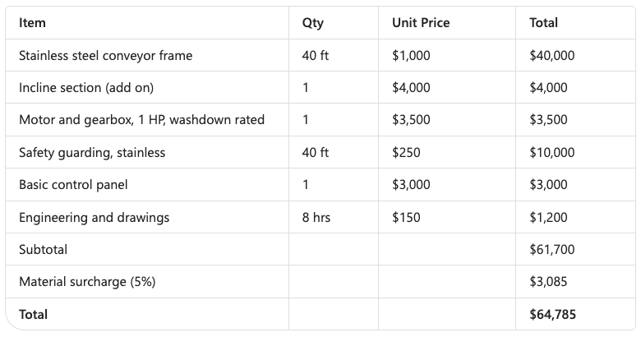
ASK AGAIN
TYPE
Redo the Customer A quote.
EXPECT
Stainless frame and guarding
Washdown motor, on its own
About $64,785
Start a new chat inside the notebook, so nothing carries over from before.
Notes:
Open a new chat inside the notebook before you type.
Say: Same request, same tool. And look: it picked the washdown motor on its own. Nobody told it to; it connected daily washdown to the motor.
About 3 minutes.

Slide 46
BEFORE AND AFTER
 | Before | After
Conveyor frame, 40 ft | $18,000 | $40,000
Guarding, 40 ft | $5,000 | $10,000
Motor | $2,200 | $3,500
Total with surcharge | $35,070 | $64,785
Same request. Same tool. One saved fact nearly doubled the quote.
Notes:
Say: That's a $30,000 difference from one fact. Either money left on the table, or a quote the customer would have rejected.
Before class: make sure the demo notebook has the clean memory file, or the before won't work.
About 2 minutes.

Slide 47
YOUR TURN
Let's build one together
What would you put in memory for your customers?
What rule do your estimators always follow?
Notes:
🟡 INTERACT: This is the main discussion. Ask both questions and type the answers live into the HQ: customer facts with remember this, rules into the instructions. Let the APEC team lead, since they quote every week.
Use the placement test out loud: is that a rule or a fact?
About 10 minutes.

Slide 48
MAKE IT YOURS: FOUR STARTER HQS
Requests and Quotes
Customer requests, estimates, quotes, and follow ups.
Production Data
Line data, shift numbers, graphs, and analysis.
Reports and Communication
Weekly reports, emails, and updates to leadership.
Team
Coaching notes, training plans, and team updates.
All four are in the guide, ready to paste at work.
Notes:
Say: You built one HQ today for a made-up company. At work, start with the one closest to your job. Each starter in the guide has the instructions and a memory file ready to paste.
About 4 minutes.

Slide 49
WHAT'S NEXT
Day 2: turn your HQ into skills and workflows
Bring one task you repeat every week
Day 3: build AI agents and decide where they help
Notes:
Say: Next time, we take the HQ you built and turn it into something that runs on its own: skills and workflows. Bring one real task you repeat every week. And on Day 3, we build agents. Before you leave, tell me where you want to take this, and we'll shape Days 2 and 3 around it.
About 3 minutes.

