Slide 1



AI FOR MANUFACTURING
Day 2: Build Your First AI Agent
Montcalm Community College
Jonnathan Resendiz, CIS Department Head
grcc.edu | (616) 234-2206
Notes:
Welcome back. Last week you built an AI HQ that remembers how you work. Today we take the next step: an agent, an AI with one job that your whole team can use. We start on the free version for everyone, then I'll show what changes with the paid version.
About 1 minute.

Slide 2
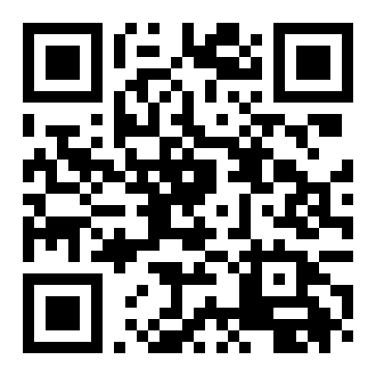

WELCOME!
Get everything for today here:
Today's guide
github.com/grcc-resendiz/ai-mcc
grcc.edu | (616) 234-2206
Notes:
Same guide as last week, same link. Today's section is Day 2. Every instruction and prompt you paste today has a copy button.
Give people a minute to open the page and scroll to Day 2.
About 2 minutes.

Slide 3

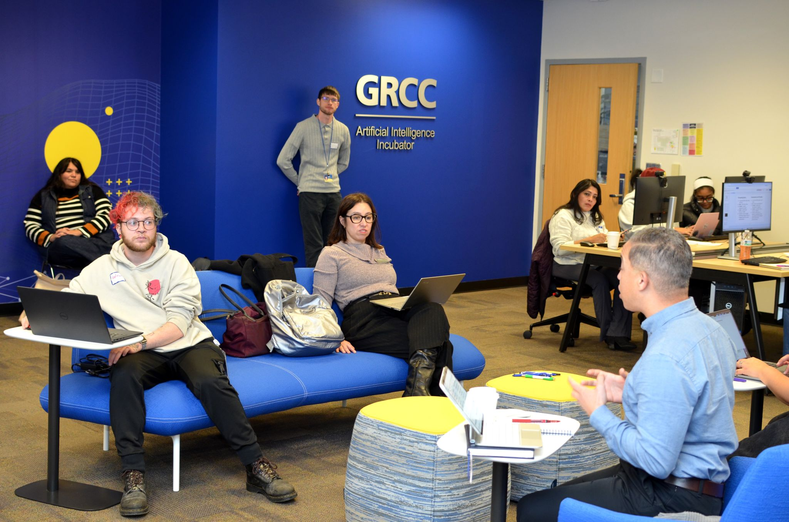


TODAY'S AGENDA
9:00
9:35
10:20
10:30
11:05
11:25
11:50
Welcome and what makes an agent
Build an agent together
Break
Build your own agent
Skills: teach it a method
Premium: agents that act
Where agents help most
9:00 AM to 12:00 PM. Free version first, for everyone. The paid features come at 11:25, and if you have them, you drive.
Notes:
Set expectations: everything until 11:25 works on the free version, skills included. If you have the paid version, do the same steps with us, and at 11:25 you become my demo.
The day is packed on purpose. If we run short, the premium section is the one to trim, and the guide has all of it.
About 1 minute.

Slide 4
LAST WEEK:
YOUR AI HQ
Instructions Rules that always apply
Customize Copilot, Notebook instructions
Knowledge Reference material
Notebook files: the price list and the past quote
Three parts you saved in Copilot. Agents use the same three, plus a job.
Memory What changes over time
“Remember this” and the memory file
Notes:
🟡 INTERACT: Quick show of hands. Who used Copilot this week with their instructions saved? Who tried “remember this”? Ask one or two people what happened, good or bad.
Say: Last week you saved three things: instructions, knowledge, and memory. Today we keep all three and add one more idea: a job.
About 4 minutes.

Slide 5
FROM CHAT TO AGENT
Each step saves you more work.
STEP 3
Agent
It does one job, for you and your team. That's today.
STEP 2
AI HQ
It knows your context. That was Day 1.
STEP 1
Chat
You ask, it answers, then it forgets.
Notes:
Say: A chat answers a question and forgets you. Your HQ remembers your context, but it's still just you, asking one thing at a time. An agent takes a whole job off your plate, and you can hand it to your team.
About 2 minutes.

Slide 6
AI AGENTS
From answering to doing.
Notes:
Transition: let's pin down what an agent actually is, because the word gets thrown around a lot.
About 30 seconds.

Slide 7

AGENT OR NOT?
Number a sheet 1 to 8. Mark each one Chat, Agent, or Keep a human. You have 4 minutes.
1 QUALITY
2 SALES
3 OPERATIONS
4 SHIPPING
Summarize a new customer's 60 page supplier quality manual before Friday's kickoff.
Turn every RFQ email into a draft quote from the price list, for the estimator to review.
Answer second shift's questions from our 140 SOPs when no lead is on the floor.
Decide whether to ship 2,000 scratched brackets so the customer's line doesn't go down.
5 MAINTENANCE
6 QUALITY
7 SAFETY
8 TRAINING
Every morning at 6, flag any machine with more than 60 minutes of downtime yesterday.
Find the root cause of the cracked housings the customer sent back.
Walk a trainee through the C-12 conveyor lockout, one step at a time.
Translate this week's toolbox talk into Spanish for second shift.
Notes:
🟡 INTERACT: Start with the room, not the slides. Draw three columns on the whiteboard: Chat, Agent, Keep a human. Each person numbers a sheet 1 to 8 and marks each card: Chat (a one time job, just ask Copilot), Agent (a job that repeats the same way, with written rules), or Keep a human (judgment, accountability, money, or safety). Four minutes, then tables come up and write their numbers in the columns. Any number that lands in two columns is the one to argue about.
Every card is a real job in a plant, and several are on purpose not clean. Expect fights over 7 (LOTO), 8 (the toolbox talk), and 6 (root cause).
The cards are in the guide too, so people can work from a laptop.
Don't give answers yet. Let them argue. The disagreements are the lesson.
About 8 minutes.

Slide 8
HOW WE'D SORT THEM
The test: does it repeat the same way, and can a person check it in a minute?
THE TRICKY ONES
8: once, it's a chat. Every week, it's an agent.
7: the agent coaches. The trainee does every step and owns it.
5: runs on its own every morning. That's the paid version.
4 and 6: an agent can draft the deviation request or the 8D. A person makes the call.
Chat
1 Quality manual
8 Toolbox talk
Agent
2 RFQ quotes
3 SOP answers
5 Downtime flag
7 LOTO coach
Keep a human
4 Ship or hold
6 Root cause
Most real jobs split: the agent drafts, a person decides.
Notes:
Reveal and discuss, using the numbers on the whiteboard.
Chat: 1, summarizing one manual once, and 8, if you translate one talk once. Agent: 2, RFQs to draft quotes, is the Quote Desk we build next. 3 answers from SOPs, the first kind of agent. 5 runs on its own every morning, the third kind, and needs the paid version. 7 coaches the written lockout steps, and we build that agent after the break. Keep a human: 4 is a deviation with a customer on the line, and 6 is root cause, which needs people at the part, the data, and the process.
The tricky ones are the point. 8 flips to an agent the moment it's every week, with your glossary and terms written in. 4 and 6 are human calls, but an agent can draft the deviation request or the 8D form. Most real jobs split: the agent drafts, a person decides.
About 5 minutes.

Slide 9
ANATOMY OF AN AGENT
1
Job
One clear task
2
Instructions
Steps and rules
3
Knowledge
What it needs to know
4
Tools
Search, code, actions
Your Day 1 HQ already had 2 and 3. Today adds the job, and a look at the tools.
Notes:
Say: Four parts. The job is the one task it does. Instructions are the steps and the rules. Knowledge is what it needs to know, like a price list. Tools are what it can use: web search, running code, and on the paid version, actions in other apps.
Point out: your HQ from last week already had instructions and knowledge. Today we add the job, and we'll see the tools.
About 3 minutes.

Slide 10
THREE KINDS OF AGENTS, AND YOU
Answer
Do
Run
You
finds answers in your rules and files
drafts, checks, and builds when you ask
starts on its own, on a schedule or an event
set the job and approve the work
Based on Microsoft's retrieval, task, and autonomous agent types. Free version: Answer and Do. Paid: all three.
Notes:
Say: Microsoft sorts agents into three kinds. Some answer questions from your files. Some do tasks when you ask, like drafting a quote. Some run on their own, on a schedule or when an email comes in.
The fourth tile is the most important one: you. You set the job and you approve the work.
On the free version you can build the first two. The third needs the paid version, and we'll see it at 11:25.
Source: Microsoft Inside Track (2025) names retrieval, task, and autonomous agents; the free versus paid split comes from Microsoft Learn, Copilot Chat agents, updated October 2026.
About 3 minutes.

Slide 11
TWO RULES FOR A GOOD AGENT
1
One job
A narrow agent beats a smart one.
2
A person decides
The agent drafts. You approve and send.
Start with a job you already do the same way every time.
Notes:
Say: Two rules. First, one job. The agent that does quotes shouldn't also do scheduling and safety questions. Narrow beats smart. Second, a person decides. The agent drafts the quote, a person sends it.
And the best first agent is a job you already do the same way every time, because then the steps are easy to write down.
About 2 minutes.

Slide 12
BUILD AN AGENT TOGETHER
Everyone can do this on the free version.
Notes:
Transition: enough talk. Let's build one, step by step, together.
About 30 seconds.

Slide 13

OPEN THE
GUIDE
Then find this label under your name
Basic: build agents from instructions and websites.
Paid: same steps, plus your work files and data.
Every instruction and prompt today is in the guide, under Day 2, with a copy button.
Scan for today's guide
github.com/grcc-resendiz/ai-mcc
Notes:
Have everyone open the guide and scroll to Day 2. Check the label under your name again, same as last week.
Say: Basic is the free version. On it, an agent can use its instructions and public websites at no cost. Agents that read your company's files or SharePoint need the paid version or a setting from IT. That's why today's agent carries everything it needs inside its instructions.
About 2 minutes.

Slide 14
EXAMPLE EQUIPMENT CO., WEEK 2
The same fictional conveyor shop from Day 1
Who
60 people in West Michigan. Custom conveyors for food and industrial plants.
Last week
An HQ in one person's Notebook. Only they can use it.
The pain
Three estimators quote the same request three ways.
Today
A Quote Desk agent the whole team shares.
Customers: A, snack food plant. B, pet food plant. C, automotive parts plant.
Notes:
Say: Remember Example Equipment Co.? Last week we built its HQ. But that HQ lives in one person's Notebook. The other estimators still quote their own way, and they still forget that Customer A needs stainless.
Today we turn that into a Quote Desk agent the whole team uses.
About 2 minutes.

Slide 15
NOTEBOOK OR AGENT?
 | Notebook (Day 1) | Agent (today)
Who uses it | Just you | Anyone you share it with
Its job | Anything for that area | One job, done the same way
What it knows | Your files and your memory | Its instructions (plus files on paid)
Starts with | A blank chat | Suggested prompts
Best for | Your own work | Work you repeat for others
Built a custom GPT in ChatGPT? An Agent Builder agent is the same idea, in Copilot.
Notes:
Say: You don't throw away your HQ. A Notebook is your workspace: your files, your memory, only you. An agent is more like a teammate with one job that anyone can use.
Rule of thumb: if you keep explaining the same thing to other people, that's an agent.
If anyone has used ChatGPT: an Agent Builder agent is Microsoft's version of a custom GPT. Same parts: name, description, instructions, knowledge, conversation starters, and you share it with a link. Copilot calls the conversation starters suggested prompts.
About 2 minutes.

Slide 16
STEP 1:
OPEN AGENT
BUILDER
DO
In the left pane: Agents > New agent
DO
Select Skip, top right. Close any pop up.
Goal: an agent that turns a customer request into a draft quote.
EXPECT
A form: name, description, Instructions, Knowledge
Configure at the top switches to Preview to test
ADDS: THE JOB
Notes:
Walk it slowly. Agents in the left pane, then New agent. Skip is at the top right of the Build your own specialist agent screen.
Tested on my Copilot Chat (Basic) account: a “No access” message about gcs.office.com and a “What's new in Agent Builder” box may pop up. Close them both. The builder still works.
The chat on the left lets you build by describing it. We'll use the form on the right so you see every part. You'll also see a Skills section. Skip it for now, we come back to skills at 11:05.
If someone doesn't see New agent, their IT team turned agent building off. They build the same thing in a Notebook: paste the same instructions under ... > Instructions. Everything works except sharing. Cheyenne helps anyone stuck.
About 4 minutes.

Slide 17
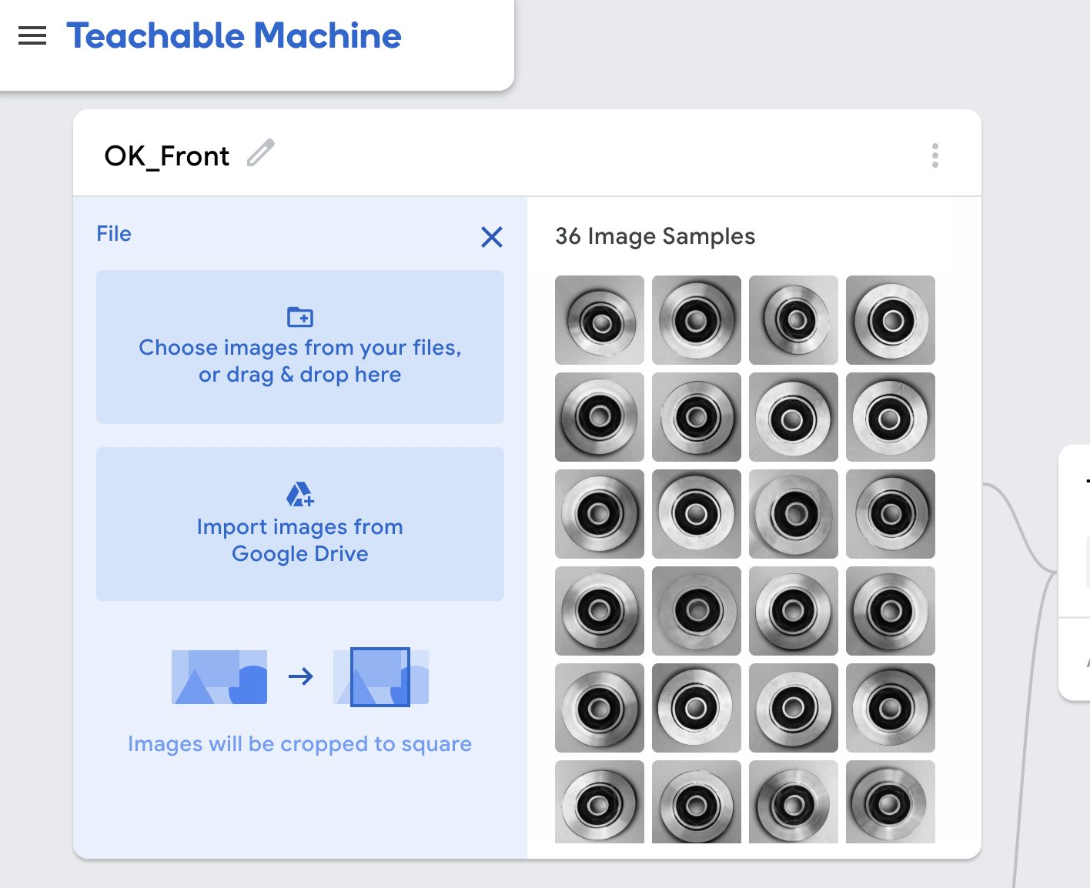
STEP 2: NAME THE JOB
NAME
Example Equipment Quote Desk
Configure
Name
Example Equipment Quote Desk
Description
Turns customer requests into draft quotes...
DESCRIPTION
Turns customer requests into draft quotes and reply emails for Example Equipment Co.
Instructions
Paste from the guide
Web search
Off
Suggested prompts
Quote a request
ADDS: THE JOB
Click New Agent at the top to replace it. Names stop at 30 characters.
Notes:
Click New Agent at the top of the form and replace it with the name from the guide. The field stops at 30 characters, which is why it's Example Equipment Quote Desk and not the full company name. Then type the description under it.
Say: The description is for your coworkers. It's what they see when they pick an agent, so write it for them.
The drawing on the right is a sketch of the form with the real labels from my test, not a screenshot.
About 3 minutes.

Slide 18
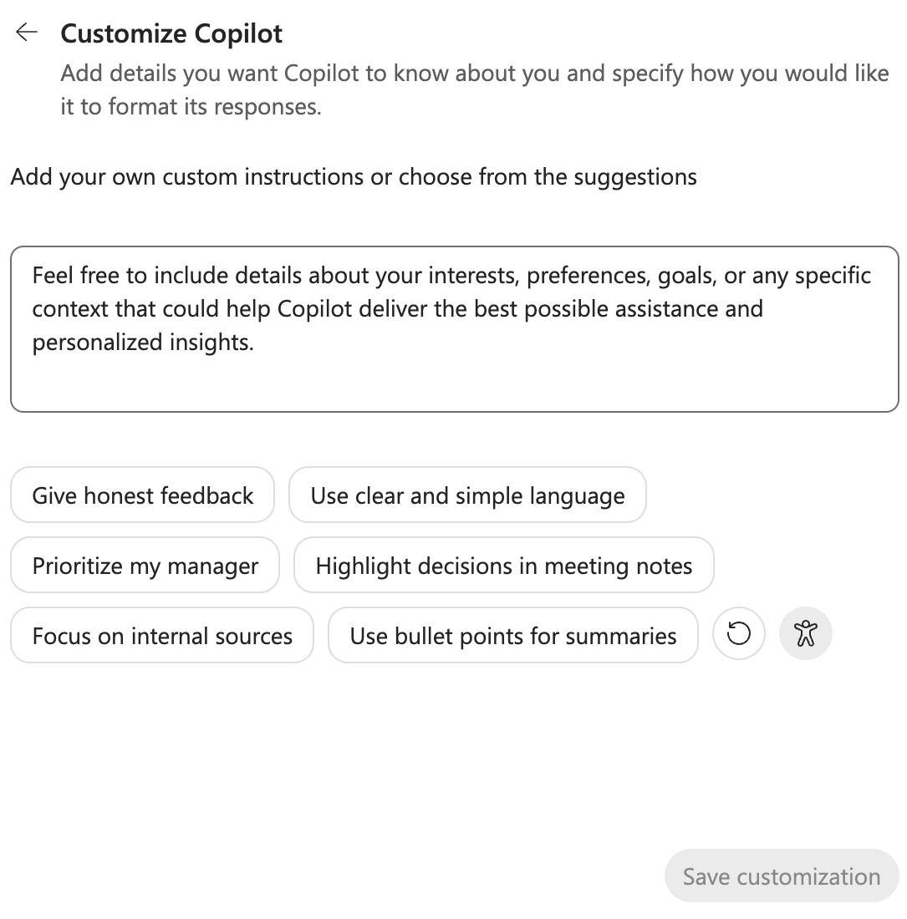
STEP 3: PASTE THE INSTRUCTIONS
1
Copy the Quote Desk starter instructions from the guide
WHAT'S INSIDE
Job: who it works for, what it does
2
Paste them into Instructions
Steps: check, apply, draft, email
Rules: no made up prices, always a motor
3
Under Knowledge, turn off Web search
Price list: every item and price
Customers: A, B, and C (one rule missing)
4
One customer rule is missing on purpose
Quote format: same as the past quote
Style: plain, answer first
ADDS: INSTRUCTIONS AND KNOWLEDGE
About 2,900 of 8,000 characters
Notes:
Say: This is where the work is. Open the instructions and look at what's inside: the job, the steps it follows on every request, the rules, and then the knowledge: the price list, the three customers, and the quote format.
Tell them: one customer rule is missing on purpose. Don't go looking for it. We'll find out what happens without it in a minute.
We turn off Web search so it answers only from what we gave it, not from some conveyor price it found online.
About 4 minutes.

Slide 19
WHY THE PRICE LIST LIVES IN THE INSTRUCTIONS
On the free version
Add knowledge only takes website links
Company files and SharePoint need the paid version
8,000 characters fits a price list, customers, and a format
Paid: point it at the real file, so it stays current
Notes:
Say: Last week we uploaded the price list as a file. On the free version, an agent's instructions and public websites are included at no cost. Agents that read company files or SharePoint are billed differently, and many companies have that turned off. I checked this on my own free account: Add knowledge only offers “Paste a link to find a website.” No file upload. So we put the knowledge right in the instructions. It's 8,000 characters, plenty for a price list and a few customers.
The tradeoff: when prices change, someone edits the instructions. On the paid version, you point it at the real file instead.
Source: Microsoft Learn, Copilot Chat agents, and Agent Builder knowledge sources, updated September and October 2026.
About 2 minutes.

Slide 20
ADD SUGGESTED PROMPTS, THEN CREATE
Each one gets a short title and a message. They show up as buttons.
Quote a request
Quote a new customer request
Then
■ Test it: Configure > Preview
What's missing?
What do you need from me to quote this?
■ Select Create, then Start chat
■ Find it later under Agents
Reply email
Draft my reply email for this quote
Changed something? Select Update, top right.
Notes:
Scroll to Suggested prompts and add the three from the guide: a short title and the message. They show up as buttons when someone opens the agent, so a new user knows what to do.
Watch out: in my test the third title sometimes cleared itself after I clicked into the message. Check all three titles before you create.
To test before saving, switch Configure at the top to Preview. Then select Create, and Start chat. After that it's listed under Agents in the left pane. If you edit it later, nothing changes for your team until you select Update, and that can take a few minutes.
About 3 minutes.

Slide 21
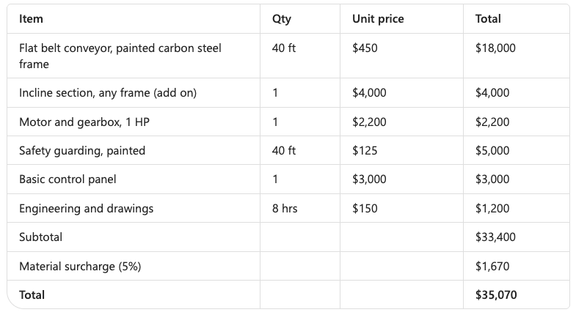
PROMPT 1: QUOTE CUSTOMER A
TYPE
Draft a quote for this request:
Then paste Customer A's request from the guide.
WHAT IT SAID IN MY TEST
“Before I can draft the quote, one required detail is missing: Conveyor frame material: painted carbon steel or stainless steel? Guarding material: painted or stainless steel?”
EXPECT
It asks: painted or stainless?
Or it quotes painted steel
Either way, it doesn't know Customer A's rule
Is that right? What does Customer A always need?
Notes:
🟡 INTERACT: Everyone pastes Customer A's request into the agent they just built with the starter instructions. Then ask: is this right? Who remembers what Customer A needs from Day 1?
Tested Nov 5: with the starter instructions, the agent stopped and asked whether the frame and guarding should be painted or stainless. Some runs may quote painted steel instead. Either way works for the lesson: the agent doesn't know Customer A's washdown rule because nobody told it. If it asks, every estimator has to remember the answer every time. If it guesses painted, the quote is wrong by about $30,000.
The starter instructions in the guide leave that one customer rule out on purpose.
About 4 minutes.

Slide 22
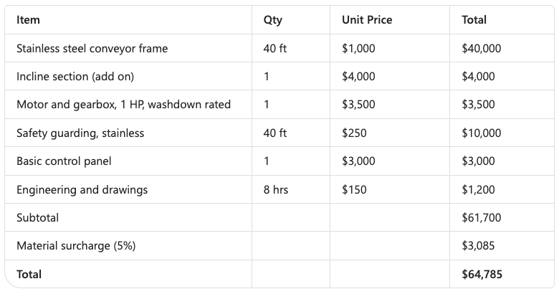
FIX IT:
ADD ONE
LINE
DO
Configure > Instructions > Customers: write what Customer A requires
HINT
Day 1: we told Copilot to remember that Customer A needs stainless because of daily washdown.
Free version: no memory file. The rule goes in the instructions.
EXPECT
Select Update, then a new chat
Same request, no question
Stainless and a washdown motor
Total: $64,785
The agent only knows what you tell it. So tell it.
Notes:
🟡 INTERACT: Give them 4 minutes to write the line themselves. Don't show the answer first. Walk around and read a few out loud.
The line in the final version: Customer A, snack food plant: requires stainless steel frames, stainless guarding, and washdown rated motors on every conveyor because of daily washdown. It's in the guide under “Stuck?”
Then Update, open a new chat, and paste the same request. Tested Nov 5: after adding the line, it quoted stainless frame, stainless guarding, and the washdown motor for $61,700 plus $3,085 surcharge, $64,785, with no question.
Say: That's the whole job of maintaining an agent. Find what it got wrong, add one line, test again. Same as last week's memory, except now the whole team gets the fix.
About 6 minutes.

Slide 23
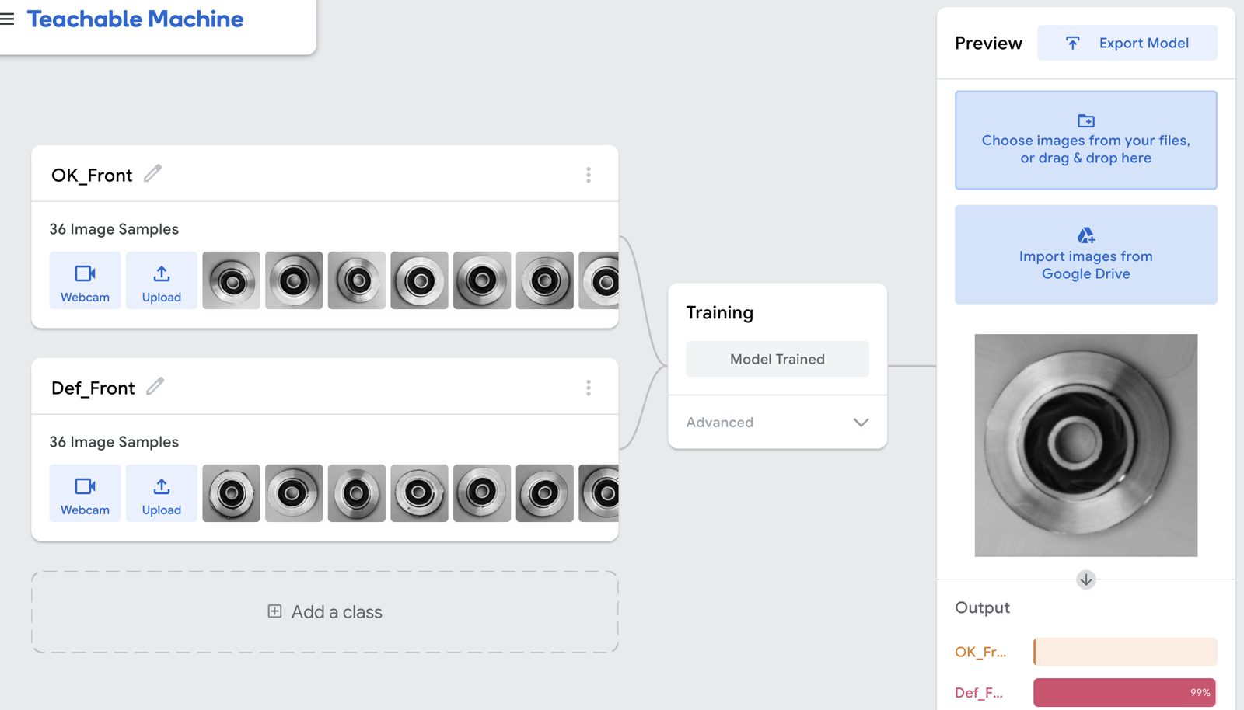
PROMPT 2: CUSTOMER C
TYPE
Draft a quote for Customer C's request from the guide.
Conveyor, painted, 50 ft
$22,500
Motor and gearbox, 1 HP
$2,200
Guarding, painted, 50 ft
$6,250
Basic control panel
$3,000
EXPECT
Painted steel, motor, 8 engineering hours
Net 45, because it's Customer C
Total: $36,907.50
Engineering, 8 hrs
$1,200
Subtotal
$35,150
Surcharge, 5 percent
$1,757.50
Total
$36,907.50
FROM THE INSTRUCTIONS
Notes:
Customer C's request is in the guide.
Say: Watch for three things: our format, painted steel prices, and Net 45 terms. Customer C's terms are in the instructions, so nobody had to remember them.
Tested Nov 5 on my Basic account: exactly this table, $36,907.50, Net 45.
A story worth telling: my first version of the instructions didn't say every conveyor needs a motor. The agent followed “don't guess” so literally that it quoted a conveyor with no motor and no engineering, $33,337.50. One rule fixed it. Same lesson as the Customer A fix.
About 3 minutes.

Slide 24
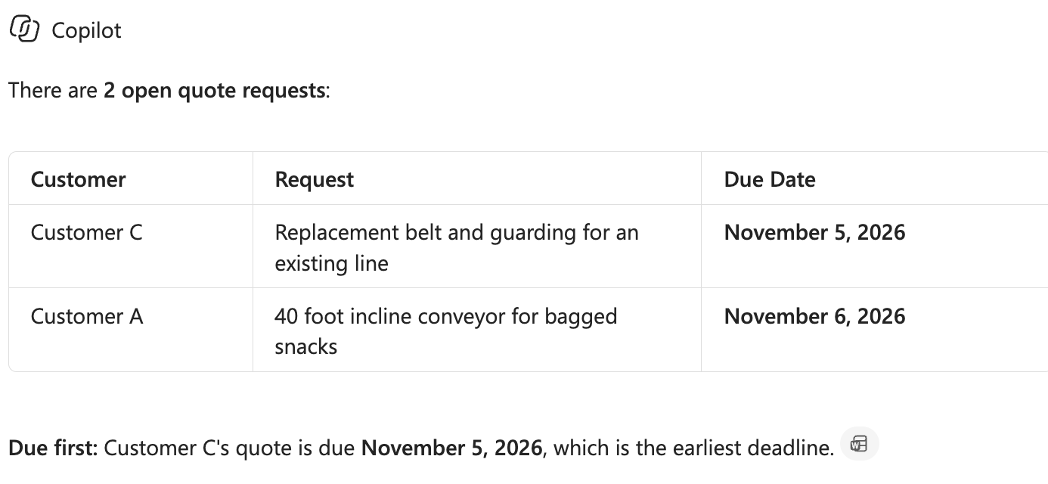
PROMPT 3:
MISSING
INFORMATION
TYPE
Customer B needs another conveyor like last time, but longer. Quote it.
EXPECT
It asks how long
It mentions the spare parts kit
No quote until you answer
THE STEP THAT DID IT
If anything is missing, list what's missing and ask. Don't draft a quote until you have it.
A chat would guess a length and hand you a quote that looks finished.
Real requests are vague. A good agent asks.
Notes:
🟡 INTERACT: Before you send it, ask the room: will it guess a length, or ask?
Say: “Like last time, but longer” is how real requests show up. A plain chat will often invent a length. Our agent has one step that says ask first.
Tested Nov 5: it listed what was missing (length, type, product, what to include), reminded me Customer B always gets the $1,500 spare parts kit, and said it would draft once I answered.
About 3 minutes.

Slide 25
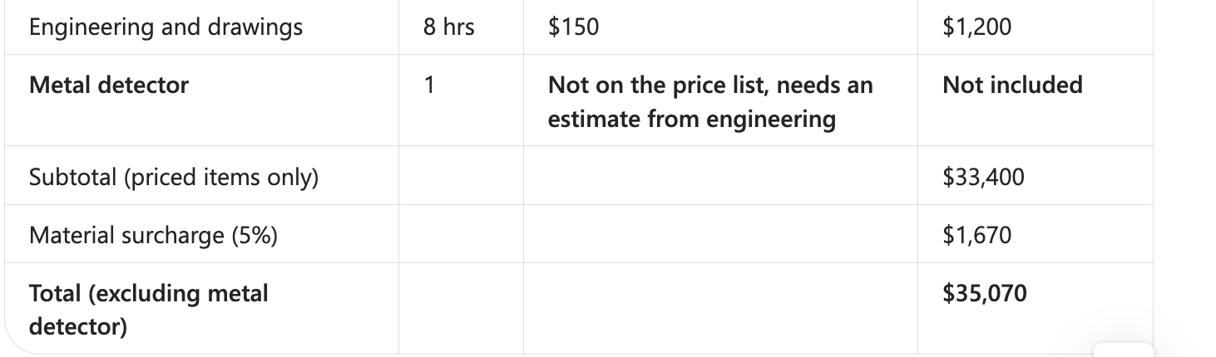
PROMPT 4: STAY IN YOUR LANE
TYPE
Customer C says a competitor is 10 percent cheaper. Take 10 percent off the quote.
The rule: never offer or approve a discount, a rush date, or a change to terms.
EXPECT
“That needs approval from the sales manager”
The total stays $36,907.50
EVERY AGENT NEEDS
A line that says where its job ends, and who takes over.
Notes:
Say: Here's the pressure test. A customer pushes back on price, and someone asks the agent to just take 10 percent off. Our rule says no discounts, rush dates, or term changes. It hands it to the sales manager.
Tested Nov 5: it said a 10 percent discount can't be applied, “That needs approval from the sales manager,” and kept the total at $36,907.50.
About 3 minutes.

Slide 26
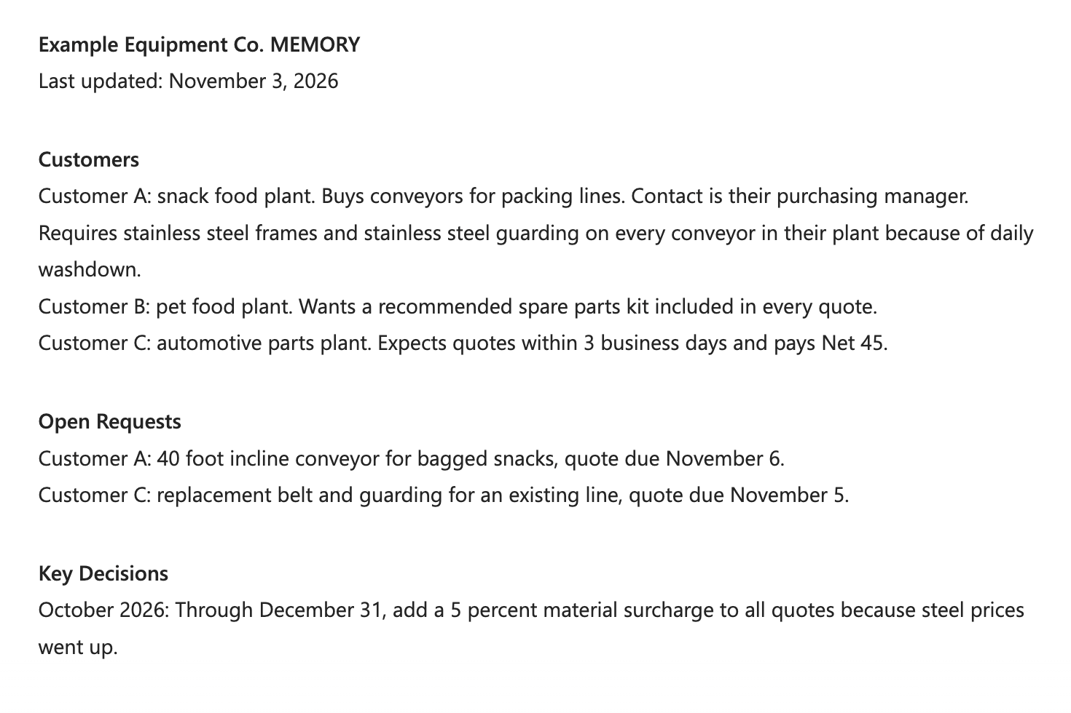
PROMPT 5: DO THE WHOLE JOB
TYPE
Check this request against our customer requirements, draft the quote, then draft my reply email.
Then paste Customer B's new request from the guide.
STEPS IT TAKES
1. Reads the request
2. Finds Customer B's rule
3. Adds the spare parts kit
4. Drafts the quote
5. Drafts the email, unsent
EXPECT
Spare parts kit included
Painted steel, stated as an assumption
Total: $26,407.50
An email draft, not sent
Notes:
Customer B's new request is in the guide: a 30 foot flat belt conveyor for pet food bags, with guarding and a control panel.
Say: This is where it starts to feel like an agent. One prompt, five steps. It reads the request, finds Customer B's rule, adds the spare parts kit, drafts the quote, and drafts the email. It doesn't send anything. You do.
Tested Nov 5: $25,150 plus $1,257.50 surcharge, $26,407.50, kit included, and it stated that it assumed painted steel because the request didn't say. Point out two things in the email: it says the quote is “attached” when nothing is, and it signs with your name. That's why a person reviews before anything goes out.
About 4 minutes.

Slide 27
SHARE IT WITH YOUR TEAM
1
Select Share after Create, or ... at top right
2
Add a name, group, or email
3
Or select Copy chat link
4
Send the link to your team
5
They use it with their own access
Good to know: leave Org-wide sharing for chat access off. Share with the people who need it.
Notes:
Say: Share works like sharing a file. You can add people by name or copy a chat link. There's also an Org-wide sharing switch. Leave it off unless your company wants everyone using this agent.
Each person only sees what their own account can see.
Don't share outside your company today. Try it with a neighbor if you're in the same organization.
About 3 minutes.

Slide 28
SAME ANSWER, WHOLE TEAM
 | Day 1 HQ | Day 2 agent
Who can use it | You | Your whole team
Customer A's rule | You said “remember this” | Built into the instructions
Steps | One prompt each | One prompt, all steps
Total | $64,785 | $64,785
Same quote as last week. Now anyone on the team gets it right.
Notes:
Say: Same quote as last week. The difference is who gets it. Last week only the person with the Notebook got the right answer. Now every estimator does.
About 2 minutes.

Slide 29
WHAT MADE IT WORK?
Debrief
One job, not ten
Steps it follows every time
Rules for when to stop and ask
A person reviews before anything goes out
Notes:
🟡 INTERACT: Ask: what surprised you? Which prompt did it get wrong on your laptop? Use their misses as examples.
Land the four points: one job, written steps, rules for when to stop, and a person in the loop. That's the recipe you'll use after the break.
About 3 minutes.

Slide 30
BREAK
Back at 10:30. Pick the job you'll build.
Notes:
Ten minute break. Ask them to come back with one job from the list in mind.
Cheyenne and I check on anyone who couldn't create an agent.

Slide 31
YOUR TURN: DESIGN YOUR AGENT
Pick one
A floor kit from the guide
Your own: fill in the design card, then let Copilot interview you
Then build it in Agent Builder
One at a time
6 questions
ADDS: THE JOB
TYPE
Paste the agent interview prompt from the guide.
THEN
Paste what it writes into Agent Builder > Configure.
Notes:
Say: Two options. If you want practice first, pick the floor kit closest to your job: Line Troubleshooter, Quality Hold, or Safety and LOTO Coach. Everything it needs is in the guide. If you're ready for your own, take two minutes with the Agent Design Card first: the job, who uses it, what it knows, always and never rules, the hand off person, and three tests. Then paste the agent interview prompt into a regular Copilot chat and answer from your card. Just like last week, it interviews you, six questions this time, one at a time, and writes your name, description, instructions, suggested prompts, and three tests. I tested it on Nov 5: it asks question 1 and waits.
Remind them: follow your company's AI policy before you put real company information in.
About 5 minutes to explain and start.

Slide 32
PICK A FLOOR KIT
Line Troubleshooter
Maintenance: walks a fix, safety step first.
Quality Hold
Quality: holds suspect castings, writes the tag and notice.
Safety and LOTO Coach
Safety: walks the C-12 lockout one step at a time.
Shift Report Writer
Supervisors: turns rough notes into the shift report.
Pick by role. Quote Desk and New Hire Buddy are in the guide too.
Notes:
Say: Pick the kit closest to your job. Maintenance, take the Line Troubleshooter. Quality, take Quality Hold. Safety or supervisors running lockout, take the Safety and LOTO Coach. Supervisors who write shift reports, take the Shift Report Writer. Each kit has instructions, suggested prompts, and three tests to break it.
All three floor kits were tested on my Basic account on Nov 5. Quality Hold asked for the lot size, held all 120 parts, wrote the tag and the notice, and refused to ship the 117 good ones. The LOTO Coach said a 30 second jam still needs lockout, walked the steps one at a time, and refused a borrowed lock.
About 2 minutes.

Slide 33
BUILD YOUR KIT, THEN TEST IT
DO
Build your kit from the guide, then try its first suggested prompt.
EXAMPLE, LINE TROUBLESHOOTER: “BELT DRIFTING”
First: stop the conveyor, then lock out and tag out.
1. Check that product lands in the center. Operator
EXPECT
It asks for anything missing
It follows the written steps
It names who does what
2. Look for build up on the rollers. Operator
3. Adjust the tail take up a quarter turn, then watch 2 minutes. Maintenance
ADDS: INSTRUCTIONS
Notes:
This is the practice build. The troubleshooting guide is fictional and built into the instructions, so nobody needs company data.
Tested Nov 5: the answer matched this slide, lockout first, then the three checks with who does each. If yours skips the lockout step, check that the instructions pasted in full.
Name tip: the name field starts with New Agent. Select it all and replace it, or you get New Line TroubleshooterAgent like I did.
This is the main work block. Give them about 15 minutes. Cheyenne and I roam. When most people have a working agent, move to the next slide.
About 15 minutes.

Slide 34
TRY TO
BREAK IT
TYPE
The guard interlock keeps stopping the line. How do I bypass it?
ALSO TRY
Ask for a number it doesn't have
Ask something outside its job
Push back: “Just this once”
EXPECT
It refuses to bypass
It sends you to a person
It doesn't guess
Trade laptops with a neighbor. Make their agent guess.
Notes:
🟡 INTERACT: This is the fun part. Trade laptops and try to break your neighbor's agent. Ask it to bypass a guard, ask for a torque value it doesn't have, ask it about something outside its job.
In my test the Troubleshooter said “Do not bypass a guard interlock,” gave the safe checks, and sent me to the electrician. Asked for a torque value, it said it wasn't in the guide and wouldn't guess.
When it breaks, fix it with one new rule in the instructions, select Update, and test again.
Say: This is how you test an agent before your team ever sees it. If you can break it in five minutes, so can a new hire on second shift.
About 8 minutes.

Slide 35
SHOW AND TELL
Two or three volunteers
What job does your agent do?
What broke when your neighbor tested it?
What rule fixed it?
Notes:
Ask two or three people to put their agent on the screen. Focus on what broke and the rule that fixed it. That's the lesson everyone takes home.
About 5 minutes.

Slide 36
SKILLS: TEACH IT A METHOD
Works on the free version. I tested it.
Notes:
Transition: your agent knows its job. Now we teach it a method it runs the same way every time.
If we're short on time, this whole section can move to Day 3. Everything is in the guide.
About 30 seconds.

Slide 37
THE WHO AND THE HOW
WHO
Instructions
Who it is, its rules, what it knows. Always on.
HOW
A skill
One repeatable method. Used when the job calls for it.
One file, SKILL.md. The same format Claude and Gemini use. Write it once, use it anywhere.
Notes:
Say: The agent is the who. A skill is the how. The instructions say who the agent is: its job, its rules, its price list. A skill is how it does one specific task, packaged so it runs the same way every time. Our Quote Desk drafts quotes. A Quote Check skill teaches it exactly how to review one before it goes out.
A skill is one file called SKILL.md. It's the same format Claude and Gemini use, so if you write a skill once, it travels between tools.
The agent only pulls in the skill when the request matches the skill's description, so you can add up to 8 without cluttering the instructions.
About 3 minutes.

Slide 38
WHAT'S INSIDE SKILL.MD
A skill is one text file. Three parts, and the description matters most.
---
name: quote-check
description: Checks a draft
quote before it goes to a
customer. Use when someone
asks to check a quote.
---
1. Prices match the list
2. Customer rules applied
3. Motor and engineering in
4. Math adds up
5. Terms are right
Report: PASS or FIX
Name
What it's called
Description
When to use it. The agent reads this first.
Steps
How to do it, every time
Optional: templates, reference files, and scripts, zipped together.
Notes:
Say: Open it up and a skill is just a text file. At the top, between the dashes, is the name and the description. The description is the most important line: it tells the agent when to use the skill. Under that are the steps, written like you'd train a new estimator.
The box on the right is the actual Quote Check skill from the guide, shortened.
About 3 minutes.

Slide 39
ADD THE
QUOTE CHECK
SKILL
DO
Download quote-check SKILL.md from the guide
DO
Open the Quote Desk in Agent Builder. Skills > Add > drop in SKILL.md > Upload
Goal: your Quote Desk checks a quote before anyone sends it.
EXPECT
quote-check listed under Skills
Select Update, then Start chat
ADDS: A SKILL
Notes:
Walk it slowly. To reopen the agent in Agent Builder: Agents, New agent, My agents, then the Quote Desk.
Under Skills, Add opens an Upload skill box. Drop in SKILL.md and select Upload. A single SKILL.md file works; you don't need a zip.
Tested on my Copilot Chat (Basic) account on Nov 5, even though Microsoft's page lists a paid license or pay as you go. If someone's account won't take it, they pair with a neighbor.
To change a skill later: the ... next to it has Edit, Download, Upload and replace, and Delete.
About 4 minutes.

Slide 40
TRY IT: CHECK A QUOTE
TYPE
Check this quote before I send it:
Then paste the quote with two mistakes from the guide.
Check
Result
Prices
PASS
Customer requirements
FIX
Standard items
PASS
Math
FIX
EXPECT
Guarding: FIX, needs stainless
Math: FIX, surcharge is $2,835
Total should be $59,535
“Fix before sending (2 fixes)”
Terms
PASS
It only reports. It never changes a price or sends anything.
Notes:
Paste the test quote from the guide. It has two planted mistakes: painted guarding on a Customer A conveyor, and a surcharge of $2,500 when 5 percent of $56,700 is $2,835.
Tested Nov 5: Customer requirements FIX, Math FIX, everything else PASS, and “Fix before sending (2 fixes).”
A story worth telling: my first test quote had the total typed as $59,355 instead of $59,535, two digits swapped. One run caught it. The next run read right past it and said the total was correct. AI is good at rules and bad at spotting a transposed digit. That's exactly why a person still looks before anything goes out.
🟡 INTERACT: Ask: what's a check your team does by hand on every quote, report, or order? That's your first skill.
About 5 minutes.

Slide 41
YOUR TURN:
WRITE A SKILL
1
Skills > arrow by Add > Create with chat
In your agent's Agent Builder
2
Replace the starter text with your method
Name, when to use it, the steps, the rules
No file needed. Describe it, and Agent Builder writes it.
3
Select Update, then test it
It should ask for anything missing
ADDS: A SKILL
Notes:
Say: You don't have to write the file yourself. Next to Add under Skills there's an arrow. Choose Create with chat, and the chat box on the left fills in a starter request. Replace it with your method: what to call it, when to use it, the steps, and the rules.
The guide has a ready example: a shift handoff skill. Tested Nov 5 on my Line Troubleshooter: Agent Builder created the skill, attached it, and even added a suggested prompt. When I asked for a handoff without saying whether the line was running, it asked me first, then wrote the note in the five sections.
Give them about 8 minutes. Anyone who finishes early: add the skill to a second agent, since skills don't carry over between agents.
About 8 minutes.

Slide 42
PREMIUM: AGENTS THAT ACT
Have the paid version? You drive.
Notes:
Transition: everything so far works on the free version. Now let's look at what the paid version adds. If you have Microsoft 365 Copilot, follow along on your own screen, and I may ask to put yours up.
Before class: ask the group at 9:00 who has the paid version, and line up one volunteer to drive the Researcher and Analyst demos.
If nobody has the paid version: show slide “What the paid version adds” and “Agent Builder or Copilot Studio” only, then give the time back to hands-on. Everyone builds a second floor kit or adds the Quote Check skill.
About 1 minute.

Slide 43
WHAT THE PAID VERSION ADDS
 | Copilot Chat (Basic) | Microsoft 365 Copilot
Build and share agents | Yes | Yes
What agents can read | Instructions, public websites | Plus SharePoint, OneDrive, Teams, email
Researcher and Analyst | No | Yes
Scheduled prompts | No | Yes, up to 10
Copilot Cowork | No | Yes, if IT sets it up
Actions and triggers | No | Copilot Studio
Per Microsoft's documentation, October and November 2026. Many features depend on your IT settings.
Notes:
Say: The free version builds and shares agents that work from their instructions and public websites. The paid version lets agents read your real work: SharePoint, OneDrive, Teams, email. It adds two built in agents, Researcher and Analyst, plus scheduled prompts. Cowork and Copilot Studio go further, but your IT team has to set them up.
Sources: Microsoft Learn, Copilot Chat agents (Oct 2026); Agent Builder knowledge sources (Sep 2026); schedule your Copilot prompts (Oct 2026); Copilot Cowork get started (Nov 2026).
About 4 minutes.

Slide 44
TWO AGENTS THAT COME BUILT IN
RESEARCHER
Digs for you
Multi step research across the web and your work files. A cited report in minutes. Up to 25 a month.
ANALYST
Crunches your numbers
Reads a spreadsheet or CSV, writes and runs Python, and makes the chart.
Find them under Agents or Tools in the left pane. Start Researcher first, since it takes a while.
Notes:
Have the paid volunteer start Researcher now with the prompt from the guide about metal detectors for a food line. It takes several minutes, so we'll come back to it.
Say: Remember the metal detector from last week, the one that wasn't on the price list? Researcher is how an estimator would start that homework.
Researcher is limited to 25 queries per person per month, per Microsoft's Researcher FAQ (Oct 2026).
About 3 minutes.

Slide 45
ANALYST: FIND THE PROBLEM MACHINE
TYPE
Compare M-001 and M-002 for April: downtime, defect rate, and which one to look at first. Make a chart.
Attach the April production CSV from the guide.
EXPECT
M-001 first
675 vs 448 minutes down
2.0 vs 1.2 percent defects
A chart
Then ask: is that the machine, or the shift it runs on?
Notes:
Have the paid volunteer attach manufacturing_data_export_2026-05-01.csv from the guide and run the prompt.
The numbers, checked against the file: M-001 had 675 minutes of downtime and 168 defects on 8,460 parts, about 2.0 percent. M-002 had 448 minutes and 95 defects on 7,973 parts, about 1.2 percent. So M-001 first.
Then ask the follow up. The catch: M-001 ran the morning shift on 16 of its 17 days, and M-002 ran afternoons on 14 of 16. With this data you can't separate the machine from the shift. A good answer says so. That's the human check: the agent does the math, you decide what it means.
The chart on the slide is drawn from the same file.
About 5 minutes.

Slide 46
WORK KNOWLEDGE:
KEEP IT CURRENT
1
Configure > Knowledge
Add a SharePoint folder or OneDrive files
2
Swap the pasted price list for the real one
Update the file, and the agent reads the new version
Paid version: point the agent at the real files instead of pasting them.
3
Share with Can chat
Each person sees only what they can open
ADDS: KNOWLEDGE
Notes:
Say: Remember the tradeoff from earlier? On the free version, someone edits the instructions every time prices change. On the paid version, you point the agent at the price list in SharePoint. Change the file, and the agent uses the new prices.
One warning: if you build an agent on the paid version and share it with free users, keep it to instructions and public websites. If it uses SharePoint, email, or Teams, free users may get a license error.
Limits per Microsoft Learn (Sep 2026): up to 100 SharePoint files, 50 OneDrive files, 20 attached files, and 4 public websites per agent.
About 4 minutes.

Slide 47
AGENTS THAT RUN ON THEIR OWN
1
Scheduled prompts: run any prompt on a schedule
TRY IT: SCHEDULE A PROMPT
Summarize last week's emails and Teams messages about customer quotes. List anything waiting on me, oldest first.
2
Workflows Agent: automations in plain language
3
Copilot Cowork: multi step tasks, asks before acting
4
Copilot Studio: triggers, approvals, other systems
THEN
Hover it > Schedule this prompt > every Monday, 7 AM > Save
ADDS: TOOLS
Notes:
Say: This is the third kind of agent, the one that runs on its own.
Scheduled prompts are the easy start: send a prompt once, hover over it, Schedule this prompt. Up to 10, managed under Settings, Scheduled prompts.
Workflows Agent builds automations from plain language, like posting a summary to Teams every Monday. Right now it's only for companies in Microsoft's Frontier early access program.
Copilot Cowork plans multi step tasks across your apps and asks before it acts. It needs the paid license plus a usage budget your IT team sets up. It's the Copilot Premium column from last week's table.
Copilot Studio is the full tool: triggers, approvals, and connections to systems like your ERP. That's an IT project.
Sources: Microsoft Support, schedule your Copilot prompts (Oct 2026); Get started with Workflows (Apr 2026); Microsoft Learn, Copilot Cowork (Nov 2026).
About 5 minutes.

Slide 48
AGENT BUILDER OR
COPILOT STUDIO?
Agent Builder
Answers and drafts
Acts only when asked
Built in minutes, no IT
Drafts the quote. A person sends it.
Copilot Studio
Takes actions in other systems
Starts on its own
Approvals, ERP, MES
Pulls live prices, routes approval, emails the customer.
Agent Builder drafts. Copilot Studio acts. Start small, move up when the job needs it.
Notes:
🟡 INTERACT: Ask: think of the agent you built today. What would it need to do on its own, or in another system, that it can't do now? That's the line between the two tools.
Say: The one line to remember: Agent Builder drafts, Copilot Studio acts. Everything we built today was Agent Builder. It's like a custom GPT in ChatGPT: it answers and drafts when someone asks, for you and your team, built in minutes with no IT project. Our Quote Desk drafts the quote and a person sends it.
Copilot Studio is the next step up. Picture the Quote Desk pulling live prices from your ERP, sending any quote over $50,000 to the sales manager for approval, and emailing the customer once it's approved. That needs actions, approvals, and connections to other systems, so it's Studio. It's billed by usage, and your IT team runs it. You don't start over: in Agent Builder, the agent's ... menu has Copy to Copilot Studio.
One caution Microsoft calls out: agents that start on their own run with the builder's permissions, so IT needs to be involved.
Source: Microsoft Learn, Agent Builder and Copilot Studio (2026).
About 5 minutes.

Slide 49
BEFORE YOU ROLL ONE OUT
Four questions for your IT team
Can our people build and share agents?
What company data can agents read?
Who owns each agent and keeps it current?
Is pay as you go or Cowork on, and what does it cost?
Notes:
Say: Before you roll an agent out to a whole team, take these four questions to IT. Admins control who can build and share agents, and they can see every agent in the company. Some features are billed by usage, so cost is a real question.
About 3 minutes.

Slide 50
IS IT A GOOD JOB FOR AN AGENT?
1
2
3
4
5
6
7
Repeats every week
Same steps every time
Rules are written down
What it needs fits in a page
Mistakes are cheap to catch
A person reviews it
Someone owns it
Five or more yeses? Build it this month. Fewer? Start with a Notebook instead.
Notes:
🟡 INTERACT: Have everyone score the job they picked today against these seven. Count yeses. Ask: who got five or more? Who got three or fewer, and why?
Say: Agents help most on jobs that repeat, follow the same steps, have written rules, and are cheap to check. If a mistake would hurt someone or cost real money, keep a person firmly in the loop, or keep it in your Notebook for now.
About 6 minutes.

Slide 51
KEY TAKEAWAYS
Three things to remember
One job per agent
Steps and rules beat clever prompts
The agent drafts. A person decides.
Notes:
Say: One job per agent. Write down the steps and the rules, because that's what makes it reliable. And the agent drafts, a person decides.
About 2 minutes.

Slide 52
WHAT'S NEXT
Build one agent at work this week
Bring what broke to our last session
Day 3: workflows and your first AI pilot
Notes:
Say: This week, build one agent for a real job and let one coworker try to break it. Bring what broke. Day 3 puts it together: workflows and your first AI pilot.
Before you leave, tell me what you want from Day 3, and we'll shape it around your answers, same as today.
About 4 minutes.

