Slide 1
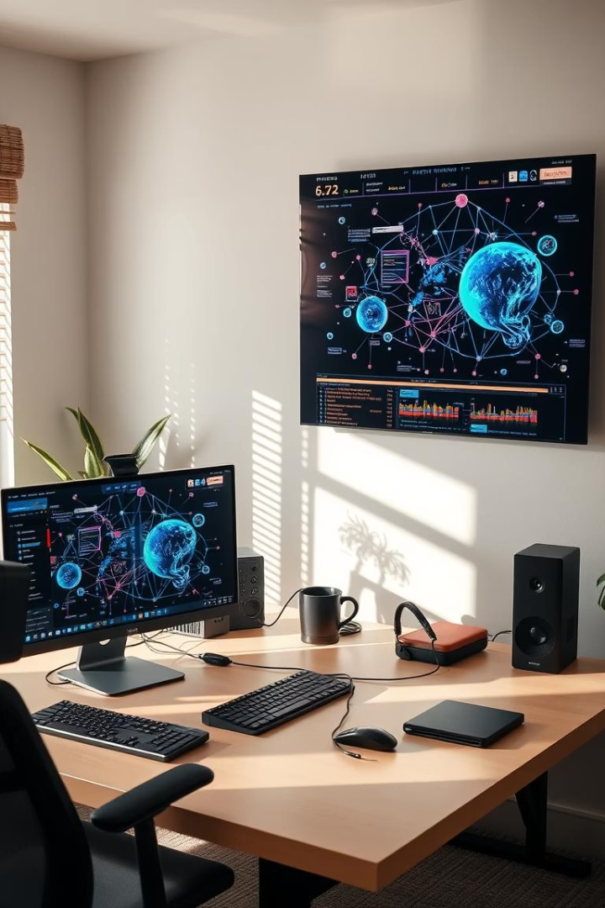
Introduction to Computer Networking
Computer networking links devices for communication and resource sharing. It enables collaboration and data exchange on various scales. Common types include LAN (local), WAN (wide), and MAN (city-wide). Examples range from home wifi setups to vast corporate and city networks.

Slide 2
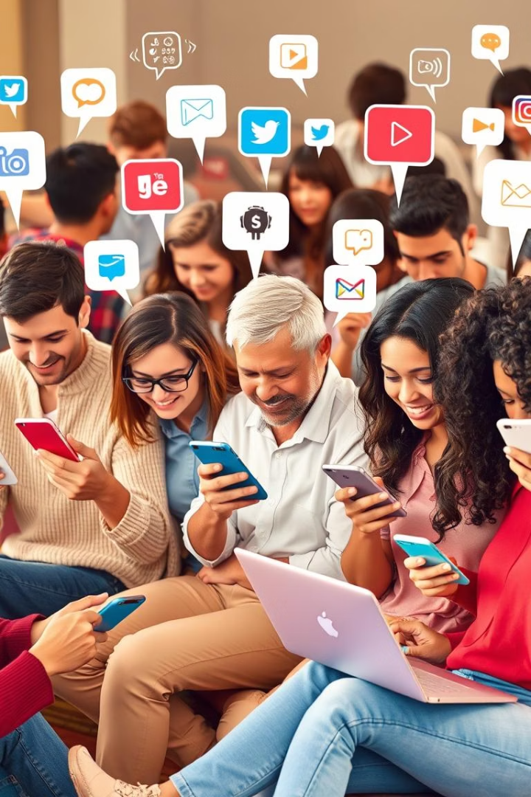
Networking in Daily Life
Social Media
Supports 2.91 billion users on platforms like Facebook and Instagram.
Streaming Services
Networks deliver content to 238 million Netflix subscribers smoothly.
Online Gaming
Low latency connectivity enables games like Fortnite with 80 million players.
Remote Work
VPNs and cloud networking power collaboration from anywhere.

Slide 3
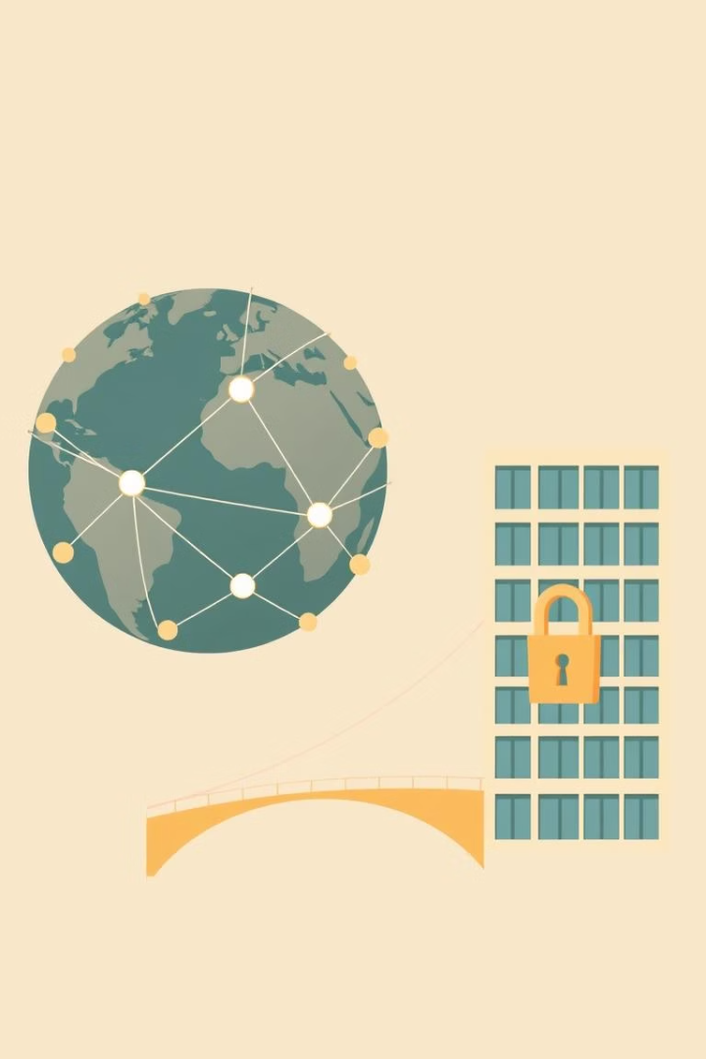
Internet, Intranet, and Extranet
Internet
Global, public, open to everyone; e.g., Google.com.
Intranet
Private for organizations; internal websites for employees only.
Extranet
Controlled access for partners; supplier access to inventory systems.
Key Differences
Accessibility varies with security and intended users.

Slide 4
IP Addresses: The Foundation of Network Communication
What is an IP Address?
IPv4 vs IPv6
Public vs Private IPs
Examples
IPv4 is limited and almost exhausted; IPv6 offers vast address space.
Public IPs access the internet; private IPs work in local networks.
Find your address and understand DHCP server assignments.
A unique numerical label for each device on a network.

Slide 5

Wi-Fi vs Ethernet: Connectivity Options
Feature
Wi-Fi
Ethernet
Convenience
Wireless, mobile
Wired, fixed
Speed
Up to 9.6 Gbps (Wi-Fi 6)
Up to 400 Gbps
Security
WPA3 encryption
Physical cable security
Stability
Susceptible to interference
Highly reliable

Slide 6
Network Devices: The Building Blocks
Router
Switch
Modem
Routes data between different networks; vital for internet access.
Connects devices within the same network for local communication.
Converts signals between ISP and home network for internet.

Slide 7
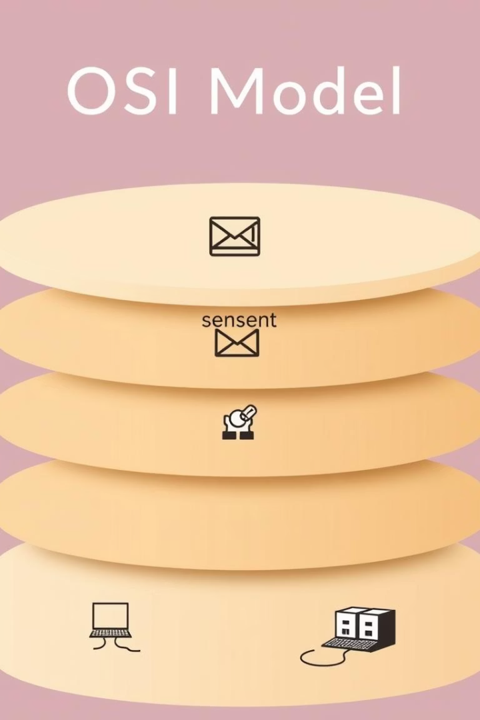



The OSI Model: A Simplified View
Application
User interaction like sending emails.
Network
Data is broken into packets for routing.
Physical
Signals sent over cables or wireless.

Slide 8



Conclusion: The Future of Networking
Emerging Trends
2
5G, IoT, and Software-Defined Networking shape innovation.
Key Concepts
1
Networking is essential for modern communication and collaboration.
Future Role
Networks will advance technology and transform daily life.
3

