Slide 1
Critical Thinking PHIL 145 - 001
Lecture 17: Inductive Reasoning

Slide 2
Causal Inductive Arguments
Causal inductive Argument:
Inductive argument in which the conclusion is a causal claim (a claim that one thing causes another thing).
Clogged arteries cause heart attacks.
A rough surface produces friction.
Passing through a giant blender leads to death.
Winning the lottery makes people happy.
Causal inferences are often an attempt to explain or predict an outcome.
Why we like science: Understanding & Control
PHIL 145 Week 10 Causal Arguments

Slide 3
Causal Inductive Arguments
Cogent arguments in support of causal claims are difficult to come by, and we should take great care when dealing with causal premises.
Issue 1: Ways to express “cause” in English:
C produced E C was responsible for E
C brought about E C led to E
C created E C affected E
C influenced E As a result of A, E occurred
E was determined by C E was the result of C
E was induced by C E was an effect of C
PHIL 145 Week 10 Causal Arguments

Slide 4
Causal Inductive Arguments
Issue 2: Different types of causal relationships
Four possible meanings of “cause”:
Cause as necessary condition (E ⊃ C)
If C is not present, then E can not be present.
Of interest when we’re looking to eliminate an effect.
If there’s human life, there’s oxygen. No oxygen? No life.
Cause as sufficient condition (C ⊃ E)
If C is present, that guarantees that E is present.
Of interest when we’re looking to produce an effect.
If I drop the ball, it will fall. I drop it. So, it falls.
As both necessary & sufficient (E ⊃ C) • (C ⊃ E)
Having a failed pancreas is nec. & suff. for having diabetes.
As a contributing factor – neither necessary nor sufficient on its own – ((E ⊃ C) ∨ (C ⊃ E))
Eating a lot of bacon contributes to being overweight.
PHIL 145 Week 10 Causal Arguments

Slide 5
Causal Inductive Arguments
Issue 2: Different types of causal relationships
Biological & Social Sciences usually deal with causal claims in sense (iv), namely causal factors.
Make progress by uncovering diverse factors that contribute towards a state of affairs, rather than nec & suff conditions.
Correlation ≠ Causation
Correlation is a symmetrical relationship, while causation is asymmetrical.
(A correlates with B) ⊃ (B correlates with A)
But – ( (A causes B) ⊃ (B causes A) )
PHIL 145 Week 10 Causal Arguments

Slide 6
Correlation & Causation
Classifying correlation relationships:
Positive correlation: Higher proportion of Qs than non-Qs are H ⊃ positive correlation between being Q and being H.
More people who study than those who do not study get good grades.
Negative correlation: Smaller proportion of Qs than non-Qs are H ⊃ negative correlation between being Q and being H.
No correlation: About the same proportion of Qs as non-Qs are H ⊃ no correlation between being Q and being H.
Wearing sunglasses at night does not affect ability to keep track of the visions in a person’s eyes. (contra Corey Hart)
Not all pos. or neg. correlations are significant. A significant correlation is one that is reliable.
Reliable: Not likely to have occurred purely by chance.
PHIL 145 Week 10 Causal Arguments

Slide 7
Correlation & Causation
“Men suffer more than women from marital breakdown.”
Vocabulary re: Correlation Claims
Target population: Divorced Men & Divorced Women (in Canada?)
At least two variables with at least two values:
Variables: (1) Gender; (2) Post-marital breakdown experience
A property all members of the population have
Values of the variable:
(1) Man [M] / Woman [W]; (2) Suffering [S] / Not suffering [N]
Variables should be exclusive and exhaustive
(Positive) Correlation Claim:
More men [Qs] than women [non-Qs] have S [say 65% vs. 55%].
“men” and “women” are sub-populations within the target
The proportion of men who suffer from marital breakdown is higher than the proportion of women who suffer from the same.
Being male [Q] correlates with suffering from marital breakdown [S]
PHIL 145 Week 10 Causal Arguments

Slide 8
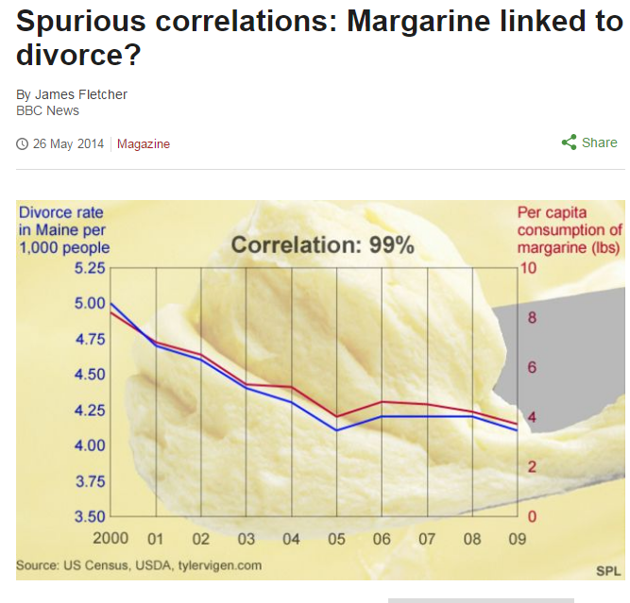
Correlation & Causation
PHIL 145 Week 10 Causal Arguments

Slide 9

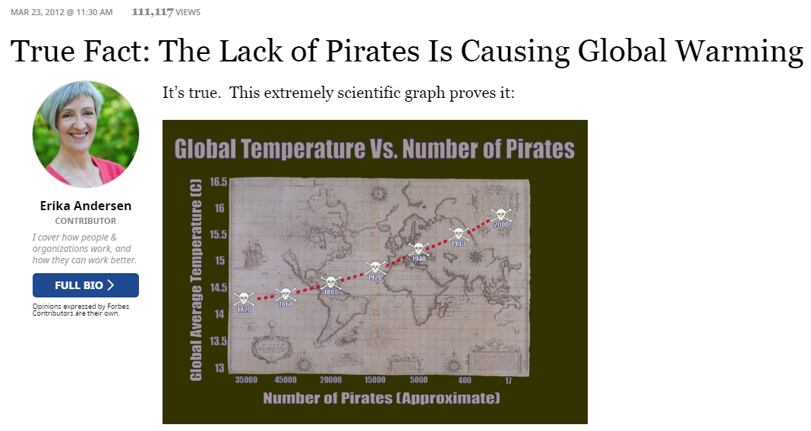
Correlation & Causation
PHIL 145 Week 10 Causal Arguments

Slide 10
Correlation & Causation
When Q is positively correlated with H, then…
Q is a cause of H. OR
H is a cause of Q. OR
The positive correlation of Q and H is a coincidence. OR
Some other factor, X, is a cause of both Q and H.
Can’t conclude that correlation implies causation.
Though from absence of correlation, you can infer absence of causal relationship.
Positive correlation necessary but not sufficient for causation.
(Causation ⊃ Correlation), but NOT (Correlation ⊃ Causation)
To establish (1), need to rule out (2)-(4).
E.g. Neural correlates of consciousness
PHIL 145 Week 10 Causal Arguments

Slide 11
Correlation & Causation
Similarly, when Q is negatively correlated with H…
Can’t conclude that correlation implies causation.
Can’t infer that because Q is negatively correlated with H that Q prevents H from occurring (causes H not to occur).
Eating kimchi negatively correlates with catching the flu.
(Within a population, as kimchi eating goes up, getting the flu goes down)
Again, would have to rule out the three other possibilities.
But could infer that kimchi does not prevent catching the flu from absence of negative correlation between the two.
PHIL 145 Week 10 Causal Arguments

Slide 12
Correlation & Causation
Associations and Links
Diets high in animal fat linked to breast cancer risk.
Suggests, but does not explicitly claim, a causal connection due to ambiguity of “linked” (cause / correlation)
“[W]omen who ate more red meat and high-fat dairy products showed a modestly increased risk of getting the disease.”
714 of 90,000 nurses got breast cancer; 134 were in the high-fat group; 123 were in the low fat group.
Does this justify the conclusion that reducing animal fat in one’s diet is likely to help prevent breast cancer?
Exercise skepticism; carefully investigate data and reasoning in media stories concerning research results.
PHIL 145 Week 10 Causal Arguments

Slide 13
Correlation & Causation
“Men suffer more than women from marital breakdown.”
Vocabulary re: Correlation Claims
Target population: Divorced Men & Divorced Women (in Canada?)
At least two variables with at least two values:
Variables: (1) Gender; (2) Post-marital breakdown experience
A property all members of the population have
Values of the variable:
(1) Man [M] / Woman [W]; (2) Suffering [S] / Not suffering [N]
Variables should be exclusive and exhaustive
(Positive) Correlation Claim:
More men [Qs] than women [non-Qs] have S [say 65% vs. 55%].
“men” and “women” are sub-populations within the target
The proportion of men who suffer from marital breakdown is higher than the proportion of women who suffer from the same.
Being male [Q] correlates with suffering from marital breakdown [S]
PHIL 145 Week 10 Causal Arguments

Slide 14

Mill’s Methods
Mill’s Methods for Identifying Causal Relationships
Method of Agreement – Test for necessary condition. (E ⊃ C)
Focus on cases where E is present. Is C always also present?
If no case of E being present without C, C is likely a cause of E.
If C is absent when E is present, then C is not a cause (necessary condition) of E.
E
 | Stung by Bee | Bit by snake | Stung by Jelly | Died
Harry | Yes | Yes | No | Yes
Jackie | No | Yes | Yes | No
Randolph | Yes | No | Yes | Yes
Farzal | No | No | Yes | No
PHIL 145 Week 10 Causal Arguments

Slide 15
Mill’s Methods
Method of Difference – Test for sufficient condition. (C ⊃ E)
Focus on cases where E is absent. Is C also absent?
If whenever E is absent, C is also absent, C is likely a cause of E.
If C is present when E is absent, C is not a cause (sufficient condition) of E.
 | Stung by Bee | Bit by Snake | Stung by Jelly | Died
Harry | No | No | No | No
Jackie | No | Yes | No | No
Randolph | No | No | Yes | Yes
Farzal | Yes | No | No | No
PHIL 145 Week 10 Causal Arguments

Slide 16
Mill’s Methods
Method of Agreement and Difference – Joint test for necessary and sufficient conditions. (E ⊃ C) • (C ⊃ E)
Look at cases where E is present and where E is absent. Is C also present whenever E is, and absent whenever E is?
If C is present whenever E is, and absent whenever E is, then C is the cause (nec. and suff. condition) of E.
 | Stung by Bee | Bit by snake | Stung by Jelly | Died
Harry | Yes | Yes | Yes | Yes
Jackie | Yes | No | No | No
Randolph | Yes | Yes | No | Yes
Farzal | Yes | Yes | Yes | Yes
PHIL 145 Week 10 Causal Arguments

Slide 17
Mill’s Methods
Mill’s Methods and Scientific Experiments
Establish an experimental group and a control group which are the same in all causally relevant ways.
Note: Both should be representative of the population!
Introduce an agent, C, suspected of being a sufficient cause of E, to the experimental group only.
E.g. Experimental group gets new drug; control group a placebo.
If all members in the experimental group (and none in the control group) exhibit E, then C is likely a sufficient cause of E.
Note: Not necessary if effect can be produced in other ways.
What if only a very high percentage, but not all, of those in the experimental group exhibit E?
PHIL 145 Week 10 Causal Arguments

Slide 18
Inference to the Best Explanation
Inference to the Best Explanation (IBE)
AKA Abductive Arguments – Arguments which lead to explanatory hypotheses (Pierce).
Used in law, archaeology, history, literary interpretation, scientific theorizing, medical diagnosis, etc.
General form:
D (data) exists.
H 1 (hypothesis 1) would explain D.
H 1 would offer the best [available] explanation of D.
Therefore, probably,
H 1.
?
1
2
3
4
PHIL 145 Week 10 Causal Arguments

Slide 19
Inference to the Best Explanation
General form:
D (data) exists.
H 1 (hypothesis 1) would explain D.
H 1 would offer the best [available] explanation of D.
Therefore, probably,
H 1.
Questions:
How can we account for the inference from 3 to 4?
How can we justify 3?
Needs support via a subargument.
?
1
2
3
4
PHIL 145 Week 10 Causal Arguments

Slide 20
Inference to the Best Explanation
What kind of subargument could support 3?
Requires background info about (i) alternative available explanations & (ii) criteria for evaluating explanations.
Minimal criteria for a reasonable empirical explanation:
Plausibility
Empirically adequate – consistent with relevant background knowledge and scientific theorizing.
Probable – given the background info and data.
Not “ad hoc” (for this purpose) – Not merely an attempt to rescue a favoured hypothesis from counterevidence.
E.g. Yellow cars are cooler than other cars. But what about all these really cool non-yellow cars? Their appearance of being cool is illusory – an elaborate deception.
Avoid self-deception / be intellectually honest; don’t use ad hoc hypotheses to justify yourself and avoid responsibility.
PHIL 145 Week 10 Causal Arguments
Notes:
Ad hoc hypothesis – it would not have been accepted except that it was needed for this purpose.
E.g. Come up with an (implausible, non-evidence-based) explanation in order to avoid the force of a more likely explanation which you do not like / which you want to avoid.

Slide 21
Inference to the Best Explanation
What kind of subargument could support 3?
Minimal criteria for an adequate empirical explanation:
Falsifiability
The explanation makes a genuine assertion (one that is compatible with some data and incompatible with other data).
Specifiable evidence that could be encountered would show it false; it is not compatible with anything and everything.
“All human action is motivated by unconscious sexual desire.” (This desire may not be apparent or admitted.)
“All human action is motivated by self-interest.” (Including what (merely) appears to be altruistic behaviour.)
If (a) and (b) are not met, the Hypothesis won’t even be an adequate explanation, let alone the best one.
PHIL 145 Week 10 Causal Arguments

Slide 22
Inference to the Best Explanation
Beyond the Minimum: Defending Premise (3)
To be the best (available) explanation, it must:
Be more plausible than the alternatives.
Given relevant background knowledge.
E.g. Measles is common; a certain tropical disease is very rare. The hypothesis that the patient has measles is more plausible.
Explain more data / have more explanatory power.
The more data H1 makes sense of, the greater it’s scope.
E.g. H1 explains X, Y, Z, while H2 only explains X and Y.
Be more simple (Simplicity is an explanatory virtue).
Requires less additional assumptions.
E.g. Copernican vs. Ptolemaic model of the solar system.
For a cogent, inductive IBE argument, need a sub-argument that supports the claim that H1 is the best.
PHIL 145 Week 10 Causal Arguments

Slide 23
Inference to the Best Explanation
Beyond the Minimum: Defending Premise (3)
Consider these two explanations of the murder of Lee.
H1: Joe killed Lee.
H2: Aliens, together with Lee’s girlfriend, killed Lee. (And planted samples of Joe’s DNA along with a gun with Joe’s fingerprints on it at the crime scene.)
H1 is more plausible than H2.
H1 explains more data than H2.
H2 doesn’t account for the facts that Lee’s blood was found on Joe’s socks in his apartment.
H1 is simpler than H2.
Therefore,
H1 is a better explanation than H2.
PHIL 145 Week 10 Causal Arguments

Slide 24
Inference to the Best Explanation
Inference to the Best Explanation (IBE)
Complete form:
D (data) exists.
H1 is empirically adequate.
H1 is probable (& not ad hoc), given relevant background knowledge and D.
So,
H1 is a plausible explanation of D.
H1 is falsifiable.
Thus,
H 1 (hypothesis 1) would explain D.
H1 is more plausible than available alternatives.
H1 explains more data than available alternatives.
H1 is simpler than available alternatives.
So,
H 1 would offer the best [available] explanation of D.
Therefore, probably,
H 1.
i
+
ii
a
+
b
c
d
e
1
+
2
+
3
4
PHIL 145 Week 10 Causal Arguments

Slide 25
Errors in Causal Reasoning
The Post Hoc Fallacy
AKA post hoc ergo propter hoc fallacy (“after this, therefore because of this”)
The street light goes out after I pass by it.
Therefore,
The street light goes out because I pass by it.
The problem? Your passing by is not causally relevant to street light behaviour.
Fails the G condition: (1) does not give good grounds for (2).
No evidence of correlation provided; no attempt to rule out alternatives; no causal mechanism described.
PHIL 145 Week 10 Causal Arguments

Slide 26
Errors in Causal Reasoning
The fallacy of objectionable cause:
AKA the questionable or false cause fallacy.
A person argues for a causal interpretation based on limited evidence with no attempt to rule out alternative explanations.
The conclusion has been reached in a hasty way; the argument does not satisfy the G condition.
A occurred. [e.g. McGuinty was in office]
B occurred. [e.g. Ontario’s debt increased]
[Both A and B are bad things]
We can plausibly connect A to B in a causal relationship.
Therefore,
A caused B.
PHIL 145 Week 10 Causal Arguments

Slide 27
Errors in Causal Reasoning
Begging the Question in a Causal Account:
A case of begging the question in a situation where there is some causal claim or account in question.
A person assumes the causal conclusion [A is linked with B] or something logically equivalent to the causal conclusion as support for it.
E.g. “Don’t tell me this is genetic. It’s not genetic. Just look at Luigi – he’s so skinny! It’s because he never eats. I remember seeing him at a family gathering – sitting in the corner, barely nibbling on a cracker. I looked at him and I said, ‘No wonder he is so skinny!’ His brother Mario – so nice and fat. Mario always eats well. Why can’t Luigi be like Mario?”
PHIL 145 Week 10 Causal Arguments

Slide 28
Errors in Causal Reasoning
Causal Slippery Slope Arguments:
A fallacy – claims in the premises that some action would be wrong because it would let off a series of side effects ending ultimately in general calamity.
OR: Claims that something would be good because it would give rise to certain exceedingly good effects.
If [A] Vietnam becomes communist, then [B] Laos, Cambodia, Burma, India, and all of Southeast Asia will become communist. Then [C] all Asia will be communist, and after that [D] all Europe and [E] the whole world. So even though the situation in Vietnam might not seem important, we have to stop this thing here, before it goes too far.
A ⊃ B ⊃ C ⊃ D ⊃ E. So, A ⊃ E.
To avoid the fallacy, provide cogent subarguments for the premises (A ⊃ B; B ⊃ C; C ⊃ D; D ⊃ E).
PHIL 145 Week 10 Causal Arguments

Slide 29
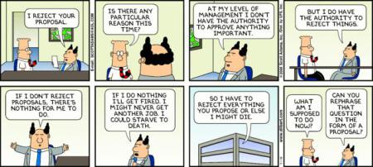
Errors in Causal Reasoning
PHIL 145 Week 10 Causal Arguments

Slide 30
Errors in Causal Reasoning
Questions to be asking:
Is the sample representative? (Where relevant)
Was the data collected in an unbiased way?
Is a positive correlation involved?
Is the correlation significant?
Is a causal relationship being claimed? (If so, of what sort is it?)
Has a plausible causal mechanism been described?
Has a causal claim been supported (have coincidence, the effect of a third factor, etc. been ruled out)?
Have alternative hypotheses / explanations been ruled out?
Is the favoured hypothesis plausible? Is it falsifiable?
Is the favoured hypothesis more probable, of greater explanatory power, simpler than alternatives?
PHIL 145 Week 10 Causal Arguments

