Slide 1
Critical Thinking PHIL 145 - 001
Lecture 16: Inductive Reasoning

Slide 2
Inductive Generalizations
Inductive Generalizations (IG)
The premises describe a number of observed objects or events as having some particular feature.
Based on this observed set of objects / events the conclusion asserts a claim about all (or most) of the objects / events of the same type, namely that they have the feature in question.
85% of polled students at Notre Dame think the football team is great.
So, probably:
85% of all Notre Dame students think the the football team is great.
The word “probably” (or “likely,” etc.) indicates extrapolation from polled (observed) group to entire group.
Inductive arguments give (good) evidence, but never certainty.
(sample)
(target population)
PHIL 145 Week 9 Inductive Arguments

Slide 3
Inductive Generalizations
Inductive Reasoning used in:
Prediction (reasoning from the past to the future)
Retrodiction (reasoning from the present to the past)
E.g. Archaeology – Claim about which dinosaurs went extinct first based on current fossil records.
In Inductive Reasoning, must take into account:
Sample size, relative to the size of the target population.
Sample = observed cases
Population = group being generalized about.
Sampling needed due to size of population or other difficulties in accessing the whole.
Samples (ideally) need to be random.
If every member of the population has an equal chance of being chosen for the sample, then the sample is random.
Often not possible in practice
PHIL 145 Week 9 Inductive Arguments

Slide 4
Inductive Generalizations
Sampling
A larger sample size does not necessarily make an IG stronger. To be adequate, a sample must be representative.
Representative: “The sample is similar to the population in ways relevant to the issue at hand” so that “the items in the sample are typical of the items in the population at large.” (Govier, 259)
Representativeness can substitute for randomness.
Ekos ON Election Poll (June 11, 2014) Conservatives (30.2%); Liberals (36.6%); NDP (21.5%); Green (6.6%)
1332 people interviewed via IVR Telephone
Is this likely to be representative of the population?
PHIL 145 Week 9 Inductive Arguments

Slide 5
Inductive Generalizations
Margin of Error
If a poll is “accurate to within n%, 19 times out of 20” (95% of the time), n represents the margin of error for the sample.
19 times out of 20, the distribution of a property in the population will be in the range of the observed frequency plus or minus the margin of error.
Observed frequency of property: 65%
Margin of error: 2% (based on sample of approximately 2,000)
Actual incidence of property: between 63 and 67% (65% +/- 2%)
Sample Size | Margin of Error
25 | 25%
100 | 10%
500 | 5%
2000 | 2%
10,000 | 1%
How confident are we that our sample
represents our target population?
Rule of thumb →
PHIL 145 Week 9 Inductive Arguments

Slide 6


Inductive Generalizations
Why does randomness assure representativeness?
Assume objective frequency ½ (0.5) ants in colony are blue (diseased).
1 trial (randomly selected) – frequency of blue ants in sample either 1 or 0 (not close to actual, 0.5).
2 trials – four possibilities <red, red>, <blue, blue>, <red, blue>, <blue, red>.
25% chance of frequency 1; 25% of 0; 50% chance of 0.5.
50% chance of getting the right answer.
3 trials – eight possibilities; 1/8 chance of 0 and 1; 3/8 chance of frequencies 0.33 and 0.66.
75% chance of results within 0.17 of the right answer
4 trials – 3/8 chance of 0.5; 7/8 chance of frequency between 0.25 and 0.75
5 – 62% chance of 0.4 or 0.6; 94% chance of between 0.2 and 0.8
25 – 95% chance of between 0.3 and 0.7
100 – 95% chance of between 0.4 and 0.6
250 – 95% chance of between 0.42 and 0.58
500 – 95% chance of between 0.46 and 0.54
PHIL 145 Week 9 Inductive Arguments

Slide 7
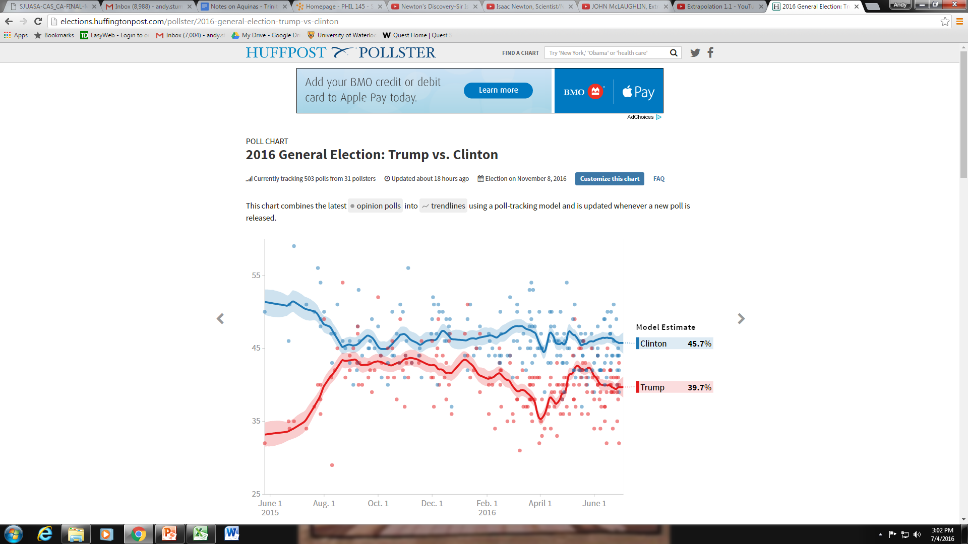
Inductive Generalizations
PHIL 145 Week 9 Inductive Arguments

Slide 8
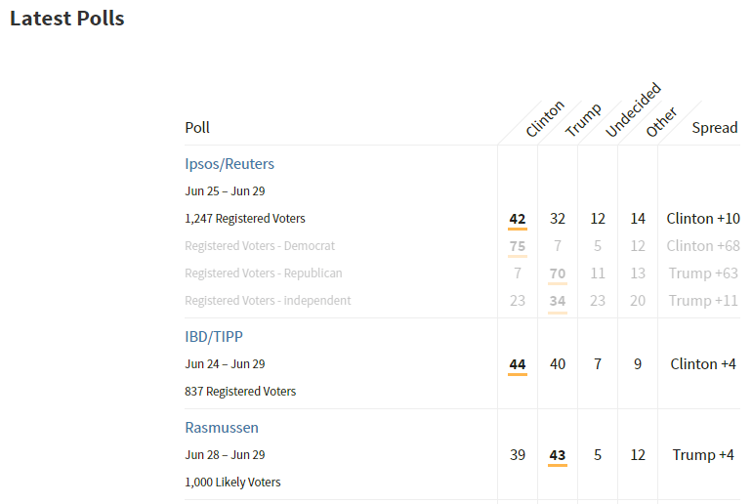
Inductive Generalizations
PHIL 145 Week 9 Inductive Arguments

Slide 9
Inductive Generalizations
Problems of Sampling
More uniform population → stronger IG, because easier to get a representative sample.
More variability in population → Require larger sample size to ensure representativeness.
Paradox of Sampling: How can we know whether the sample is representative unless we already know the whole population?
Always unknowns, but can take steps to minimize effect.
Make sure not to leave out relevant sub-groups.
(E.g. Homeless people who don’t have access to a phone)
Make sure you get people to hand in their surveys.
PHIL 145 Week 9 Inductive Arguments

Slide 10
Inductive Generalizations
Stratified Sampling
Select a sample in such a way that significant characteristics within the population are (approximately) proportionately represented within it.
E.g. Population P is composed of three relevant subgroups: (10% As, 30% Bs, 60% Cs).
E.g. Syrian population: 90% Syrian Arabs; 9% Kurds; 1% Other
Our sample should have the same proportion.
Gallup polling group uses stratified sampling combined with background knowledge of regularities in population to predict political outcomes with fewer members in the sample population being polled.
E.g. The Lancet study (p. 264) – Deaths due to war in Iraq, 2003
Physicians visited randomly selected households in geographically selected clusters in Iraq to inquire about deaths.
PHIL 145 Week 9 Inductive Arguments

Slide 11
Inductive Generalizations
Guidelines for Evaluating Inductive Generalizations
Try to determine what the sample is and what the population is.
If population is not stated, make an inference as to what population is intended, relying on the context for cues.
Note the size of the sample.
If lower than 50, then, unless the population is extremely uniform or itself very small, the argument is weak.
Reflect on the variability of the population with regard to the trait or property, x, that the argument is about.
If population not known to be reasonably uniform with regard to x, the sample should be large enough to reflect the variety in the population.
PHIL 145 Week 9 Inductive Arguments

Slide 12
Inductive Generalizations
Guidelines for Evaluating Inductive Generalizations
Reflect on how the sample has been selected.
If there is a likely source of bias in the selection process, the argument is inductively weak.
For most purposes, samples based on volunteers, college students, or persons of a single gender, race, or social class are not representative.
Evaluate the representativeness of the sample (in light of 1-5).
If you can give good reasons to believe that it is representative of the population, the argument is inductively strong. Otherwise, it is weak.
PHIL 145 Week 9 Inductive Arguments

Slide 13
Statistical Syllogisms
Statistical Syllogism (SS)
Reason from characteristics generally present (or absent) within a certain reference class to a characteristic likely present (or absent) in a member of the reference class.
Most As are Bs. [or] Few As are Bs.
x is an A.
Therefore, probably,
x is a B. [or] x is not a B.
Typically, premise of a SS is derived from the conclusion of an IG.
95% of Notre Dame students are football fans.
Gordon is a Notre Dame student.
So, probably,
Gordon is a Notre Dame football fan.
SS arguments can work in the other direction with low %s.
Compare to A and E
Categorical Forms.
PHIL 145 Week 9 Inductive Arguments

Slide 14
Statistical Syllogisms & Total Evidence
Two provisos needed for a SS to be cogent:
We don’t have further info about x that entails that x is not a B.
We have no good reason to think that x is not a typical A.
If Gordon is a member of a relevant sub-group of Notre Dame students who belong to an anti-jock association, then we would need to know the percentage of the members of that class who are football fans.
Rule of Total Evidence: Must consider an individual within the reference class most relevant to the question at hand. (e.g. Overlap: Notre Dame students + anti-jock)
PHIL 145 Week 9 Inductive Arguments

Slide 15
Statistical Syllogisms & Total Evidence
Medical claims
80% of diabetics with high blood pressure suffer from strokes and heart attacks. You’re a diabetic with high blood pressure. Therefore, you have an 80% chance of suffering a stroke and a heart attack.
Other relevant factors should be included in the reference class to provide accurate expectation:
Smoking, drinking, diet, regular exercise, family history, etc.
Stereotyping
Think of a person only as a member of a group without considering their distinctive features.
E.g. Joni Eareckson Tada – quadriplegic painter.
E.g. Key and Peele’s Solution to Racial Profiling
PHIL 145 Week 9 Inductive Arguments

Slide 16
Induction & Problems with Language
Language Problems in the Context of Induction:
Pseudoprecision: Claims that appear to be precise because of the use of numbers, but cannot be precise because of the impossibility of obtaining knowledge to the level of exactness described.
Examples:
This sour cream will expire on May 9, 2014.
One serving of this pie contains 342 calories.
Research studies show that on the average we use 38% of our brains. Imagine what we could do if only we could tap into that other 62%!
PHIL 145 Week 9 Inductive Arguments

Slide 17
Induction & Problems with Language
Questionable Operational Definitions
Operational definition used in science illicitly.
Danger of unclarity resulting from confusion of stipulated operational definition of the term with the lexical definition commonly used.
Lying means having moist palms and a higher pulse when exposed to a lie detector test. If you fail a lie detector test, you are lying – by definition.
“To the extent that operationalizations are questionable, the conclusions are undermined.” (Govier, 272)
PHIL 145 Week 9 Inductive Arguments

Slide 18
Induction & Problems with Language
Operational definition and pseudoprecision combined:
E.g. A term or phrase that is vague or imprecise is used (e.g. “unfocused hyperactivity”) and a precise measurement is applied (like 40% reduction).
There has been a 40% reduction in unfocused hyperactivity among grade 3 students in Ontario.
Without knowing how “unfocused hyperactivity” has been operationalized, we can’t understand what is being claimed.
The number is misleading; degree of precision unjustified.
PHIL 145 Week 9 Inductive Arguments

Slide 19
Errors in Inductive Reasoning
Common Errors in Inductive Reasoning
The Biased Sample
The sample is selected in a way that ensures it will under- or over-emphasize the characteristics being studied.
Because the sample isn’t random.
E.g. How many Canadians like Justin Trudeau? Taken from a sample of 500 people at a Liberal rally in Kingston.
Or the question in a poll is presented in such a way to guarantee the outcome desired by the poll taker.
E.g. Proving that 98% of people in Waterloo are tech savvy. Survey administered via free downloadable smart phone app.
PHIL 145 Week 9 Inductive Arguments

Slide 20
Errors in Inductive Reasoning
Hasty generalization
The sample referred to in the premise is hopelessly inadequate, given its size relative to the population, to support the conclusion.
E.g. That goose purposefully refused to get out of my way on the bike path. Therefore all geese are venomous monsters.
PHIL 145 Week 9 Inductive Arguments

Slide 21
Errors in Inductive Reasoning
Anecdotal arguments
Attempt to reach a conclusion via inductive generalization based on premises from one person’s experiences.
Spatula City
“I liked the spatulas so much, I bought the company.”
“I tried to use one of their spatula’s on a winter camping trip and it melted in with the pancake mix!”
Problem: G condition – no good grounds to accept a robust conclusion on such a slender basis.
A form of hasty generalization and thus a fallacy.
PHIL 145 Week 9 Inductive Arguments

Slide 22
Errors in Inductive Reasoning
Fallacies of Composition and Division
Deal with inferences between the part and the whole, or members of a group and the group itself.
Both “ignore the fact that, often, a whole is something over and above the sum of its parts; the whole involves, in addition to parts, aspects added due to relationships and structure.” (Govier, 278)
Fallacy of Composition:
A conclusion about a whole or group is reached based on premises about its parts or members.
Each apartment is small. So the whole apartment building is small.
“Smart people working collectively can be dumber than the sum of their brains.” (279)
PHIL 145 Week 9 Inductive Arguments

Slide 23
Errors in Inductive Reasoning
Fallacies of Composition and Division
Fallacy of Division:
A conclusion about a part or member is reached based on premises about the whole or group.
The Blue Jays team is 16 years old. So, each Blue Jays baseball player has been playing baseball for 16 years.
If a group is collectively responsible for wrongdoing, then every individual in that group is responsible…. [I]f the Germans during WWII were collectively responsible for human rights violations, then every individual German is responsible…. But that can’t be right, so we must reject the notion of collective responsibility.
PHIL 145 Week 9 Inductive Arguments

Slide 24
Errors in Inductive Reasoning
Summary
Unrepresentative Samples
Biased Samples
Pseudoprecision
Questionable Operational Definitions
Failing the Rule of Total Evidence (Reference Class)
Hasty Generalization
Anecdotal Arguments
Fallacies of Composition and Division
PHIL 145 Week 9 Inductive Arguments

