Slide 1
Critical Thinking PHIL 145 - 001
Week 3: Looking at Language

Slide 2
Govier Ch 3: Looking at Language
Language is an essential tool of thought and for arguments as well.
At every stage of constructing, understanding, and evaluating argument we have to understand the language.
It is much easier to use language than it is to think critically about it.
Phrases like: regime change or mankind can indicate that there are assumptions that might not be legitimate.
For example, are all regimes bad?
When talking of mankind are we including women in the story?
All of this will matter when evaluating arguments.
PHIL 145 Week 3 Looking at Language

Slide 3

Assertions & Other Linguistic Phenomena
What is asserted often goes beyond the content of the sentences uttered.
We typically consider not only what was said, but also the motive behind why it was said.
Why would someone choose one term over another?
E.g. “Dog” vs. “Dumb Mutt”
Interjections or expletive terms
(Insertion of a word that doesn’t add to the meaning of the statement asserted, but still imposes an attitude or presupposition.)
The Blue Jays will win the Pennant this year.
The damned Blue Jays will win the Pennant this year.
PHIL 145 Week 3 Looking at Language

Slide 4
Assertions & Other Linguistic Phenomena
Direct – declarative / indicative sentences
Assertoric
Indirect – via conversational implicature
Rhetorical Questions
– “Could anything be more obvious?”
Imperative Statements
– “Go and get the stupid mutt!”
Sarcasm
– “Yeah, I love to be treated like dirt.”
Speech Acts
Performative
- Result in accomplishment of some act rather than description of it
“I promise you that x”
“I thee wed” / “I do”
PHIL 145 Week 3 Looking at Language

Slide 5
Rhetorical Effects
Rhetoric: Ways of speaking or writing intended to persuade independently of the strength of the speaker’s argument.
E.g. Conjunctives “and” & “but” – indistinguishable in formal logic, but very different in rhetorical effect:
Louis Riel showed brilliance and Gabriel Dumont was thoroughly competent.
Louis Riel showed brilliance, but Gabriel Dumont was thoroughly competent.
“but” conveys emphasis and value judgment.
Part of critically analyzing arguments is to detect and defuse rhetorical flourishes (make them explicit, so can be evaluated).
PHIL 145 Week 3 Looking at Language

Slide 6

Language & Reality
Interpretation
FACT
PHIL 145 Week 3 Looking at Language

Slide 7
Emotionally Charged Language
A.K.A. “loaded language”
Functions to create a mood or attitude without providing argument or reasons.
Uses connotation or association rather than reasons.
Consider the difference in these two phrases:
“Reform” vs. “Rebellion” (descriptions of a successful political protest)
“Reform” vs. “Diversion of funds”
“Liberation fighter” vs. “Terrorist” vs. “Martyr” (descriptions of a suicide bomber)
PHIL 145 Week 3 Looking at Language

Slide 8
Emotionally Charged Language
Nota Bene:
Complete neutrality in emotional tone is probably impossible, and if possible would make language boring.
Just because an argument has loaded language in it does not mean that the argument is meritless.
It becomes a problem when the emotionally charged language is substituted for a reason which needs to be provided.
PHIL 145 Week 3 Looking at Language

Slide 9
Emotionally Charged Language
Our Side Bias: Using a double-standard to evaluate our own actions and policies in positive terms but similar actions and policies of others in negative terms.
E.g. The Toronto Raptors point guard was having a bad day, but the Cleveland player showed signs of a continual decline in performance.
Argument by Epithet: Supporting a claim by using emotionally charged language rather than any substantive premise.
E.g. You think you deserve better grades? What could be more silly?!
Translate the rhetorical question: Nothing could be more silly!
PHIL 145 Week 3 Looking at Language

Slide 10
Euphemistic Language
Euphemism
Bland, abstract, or polite use of language used to refer to something that would otherwise be embarrassing, demeaning, appalling, or horrible.
Collateral damage – killing of innocents bystanders
Pushing up daisies / kicking the bucket – death
Enhanced coercive interrogation technique – torture (CIA)
Being economical with the truth – lying
PHIL 145 Week 3 Looking at Language

Slide 11
Euphemistic Language
Euphemisms can be funny:
vertically challenged → short
follically challenged → bald
I’m not sweating or farting, I’m perspiring and flatulating!
Euphemisms block thought / understanding when:
used to disguise aspects of reality involving serious matters like harm, torture, false arrests, poverty, war, and humiliation.
E.g. Orwell’s 1984 – Doublespeak
PHIL 145 Week 3 Looking at Language

Slide 12

Euphemistic Language
Quotations from Ch 9 of Animal Farm
“An overly rigid equality in rations is contrary to the principles of Animalism.”
“A readjustment in rations is necessary.”
Euphemism or Emotionally Charged Language?
Squealer
Propaganda Expert
PHIL 145 Week 3 Looking at Language

Slide 13
Ambiguity & Vagueness
Two types of unclear language that gives rise to problems in arguments:
Ambiguity and Vagueness
PHIL 145 Week 3 Looking at Language

Slide 14
Ambiguity & Vagueness
Ambiguity occurs when a single word or phrase term may have several distinct meanings, any of which could fit naturally in the context being used.
E.g. Newspaper headline:
“Home Delivery Sought”
Several natural interpretations of this phrase:
Giving birth at home instead of at the hospital
Getting mail delivered to residences
Having a house delivered
Context helps solve problem of what interpretation to use.
PHIL 145 Week 3 Looking at Language

Slide 15
Ambiguity & Vagueness
Two basic types of ambiguity:
Semantic
Syntactic
Semantic ambiguity has to do with meaning of individual words (or terms); it occurs when a word / term in question has more than one possible meaning.
Can give rise to ambiguous sentences if you don’t know the context.
E.g. Bank or Bug…
E.g. “There is nothing going on between us.” (Bill Clinton)
PHIL 145 Week 3 Looking at Language

Slide 16
Ambiguity & Vagueness
Syntactic ambiguity is due to issues of structure of a phrase or a sentence.
“She kicked me in an unpleasant place.”
The sentence or phrase has different meanings depending on how one understands the sentence structure.
Poor writing often gives rise to syntactic ambiguity
Avoid by writing: “While we were in an unpleasant place, she kicked me,” or “It felt unpleasant to be kicked in the part of my body where she kicked me.”
Understanding arguments – locate the single, proper interpretation of a syntactically ambiguous statement
PHIL 145 Week 3 Looking at Language

Slide 17
Ambiguity
When an argument relies on or has an instance of ambiguity in it, it is a mistake in reasoning:
The fallacy of equivocation.
For example:
I have the right to vote for higher taxes.
Therefore,
I did the right thing voting for higher taxes.
The word ‘right’ is used in two senses, so the premise doesn’t support the conclusion in the way intended by the author.
PHIL 145 Week 3 Looking at Language

Slide 18
Ambiguity
1
+
2
The fallacy of equivocation.
Example 2
Micah White is an atheist.
All atheists lack beliefs.
So,
Micah White lacks beliefs.
Anyone who lacks beliefs can’t be persecuted for their beliefs.
Therefore,
Micah White cannot be persecuted for his beliefs.
3
+
4
5
Equivocates on the word “belief”
Beliefs in a divine being.
- as in (2) and (3)
Beliefs in general.
- as in (4) and (5)
PHIL 145 Week 3 Looking at Language

Slide 19
Ambiguity
The fallacy of equivocation.
Example 2
Micah White is an atheist.
All atheists lack religious beliefs.
So,
Micah White lacks religious beliefs.
Anyone who lacks any beliefs at all can’t be persecuted for their beliefs.
Therefore,
Micah White cannot be persecuted for his beliefs. [that depends on what you mean by “his beliefs”]
PHIL 145 Week 3 Looking at Language

Slide 20
Vagueness
Vagueness:
A lack of distinctness / determinateness of meaning.
Contrast with ambiguity – ambiguous words and phrases have multiple distinct meanings.
Many
20?
100?
3?
Bug₁
Bug₂
Bug₃
PHIL 145 Week 3 Looking at Language

Slide 21
Vagueness
Quantifiers:
Most, some, plenty, lots, many
How many people out of 100 have to vote for me to say that most people did?
Out of 100 people, how many have to like carrots in order to say that many people do?
Useful for expressing generalities, especially when specific figures aren’t available, but can lead to problems (e.g. “Weasel words”):
PHIL 145 Week 3 Looking at Language

Slide 22
Vagueness
Qualifiers, Quantifiers, and Weasel Words
Suppose you’re thinking of buying a small refrigerator from a friend. “How small is it?” you ask. “Pretty small,” your friend replies.
Is your friend’s assertion “The refrigerator is pretty small” true or false?
Context 1: Small compared to most full-sized refrigerators.
Context 2: Small enough to fit in your trunk.
PHIL 145 Week 3 Looking at Language

Slide 23
Vagueness
Weasel words – terms chosen specifically to let the arguer weasel out of any refutation.
A: “This policy will benefit a lot of Canadians.”
B: “What do you mean? It will only benefit a hundredth of one percent of Canadians.”
A: “Well, that’s around three thousand people. That’s a lot of Canadians. Try fitting them all in a phone booth!”
Conclusions like this can be either false (if they’re supposed to be saying something substantive) or trivial (if the terms are used as weasel words)
PHIL 145 Week 3 Looking at Language

Slide 24
Vagueness
Weasel words in advertising
Wendy’s hamburgers – “hot” and “juicy,” and use “premium toppings”
Toothpaste “combats” bad breath
Note: Combatting is consistent with losing!
PHIL 145 Week 3 Looking at Language

Slide 25
Definitions
DEFINITIONS
Attempts to clarify the meanings of terms.
Important re: understanding arguments – needed to understand meanings of premises/conclusions.
E.g. Revised definition of “death”
Practical consequences – can remove the still-beating heart of a “dead” person.
Several kinds of definitions – we shall look at those most important to evaluating arguments and language.
PHIL 145 Week 3 Looking at Language

Slide 26

Definitions
Ostensive Definitions
Explain what a word, X, means by pointing to an example of X.
Trying to give an English definition of a ‘cat’ would be difficult.
Easier to point to the object →
Since one main goal of language is to relate words to the real world, ostensive definitions work quite well.
But this works for some words and not for others
E.g. “cat” but not “sit” or “the”
PHIL 145 Week 3 Looking at Language

Slide 27

Definitions
Reportive or Lexical (Dictionary) Definitions
Goal: to accurately describe how a word is used in a language.
Typically done by clearly explaining the important (essential) properties a things has.
Chair – “a piece of furniture intended to seat one person, usually with a seat supported by legs and a straight back.”
Note that ‘chair’ also has other meanings:
E.g. “As chair, she called the meeting to order.”
PHIL 145 Week 3 Looking at Language

Slide 28
Definitions
Reportive definition guidelines:
Not too broad: Doesn’t count as X more things than are counted as X in ordinary language.
Not too narrow: Doesn’t count as X fewer things than are called X in ordinary usage.
Not couched solely in negative terms unless X itself is negative (e.g. “A Canadian is a non-American non-European”).
Defines X in terms of essential features (those required for a things to count as X), not in terms of incidental features.
Terms used are clearer than the term being defined.
Uses terms sufficiently removed from term being defined to avoid being circular.
PHIL 145 Week 3 Looking at Language

Slide 29
Definitions
Stipulative Definition
When someone specifies what the usage of a word is to be.
Setting out a specific usage for some purpose.
Note: To be useful, must respect conventions (Not Humpty-Dumpty).
E.g. I will use the word “tall” to mean a man over 6 feet.
PHIL 145 Week 3 Looking at Language

Slide 30
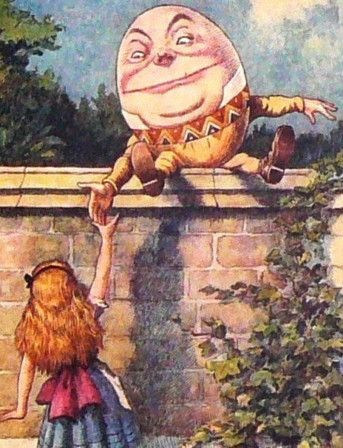
Definitions
"When I use a word," Humpty Dumpty said, in rather a scornful tone, "it means just what I choose it to mean- neither more nor less."
"The question is," said Alice, "whether you can make words mean so many different things."
"The question is," said Humpty Dumpty, “which is to be master-that's all.”
Through the Looking Glass, Ch 6.
PHIL 145 Week 3 Looking at Language

Slide 31
Definitions
Stipulative Definition
Victory by definition (a fallacy):
When a person tries to win an argument by defining the terms how they like instead of how they are used.
E.g. A: All true Scots eat oatmeal.
B: But MacGregor doesn’t eat oatmeal.
A: Well, then MacGregor is no true Scot! [turns initial claim into stipulative definition to save it by ruling out counter-examples]
Often used to distance a group from behaviour of its members.
E.g. No true liberal would support capital punishment
PHIL 145 Week 3 Looking at Language

Slide 32
Definitions
Persuasive Definition
A stipulative definition disguised as a claim or as a reportive definition.
E.g. “Abortion is immoral right from conception, because a baby has a right to life!”
E.g. “Abortion is permissible even in late-term pregnancy because no unconscious collection of cells has a right to life!”
PHIL 145 Week 3 Looking at Language

Slide 33
Definitions
Operational Definitions
A kind of stipulative definition most often used in scientific research.
E.g. A substance is soluble if, and only if, it dissolves when placed in water.
“Soluble” is defined operationally.
PHIL 145 Week 3 Looking at Language

Slide 34
“It isn’t Natural”
Ways in which we disguise our values as biological norms, or otherwise hide our values behind the emotionally positive term “natural” and emotionally negative term “unnatural.”
E.g. Homosexuality; birth control; natural remedies
Need to give arguments; be clear about our criteria and our reasons for preferring it.
Note Hume’s persuasive definition on p. 83.
PHIL 145 Week 3 Looking at Language

Slide 35
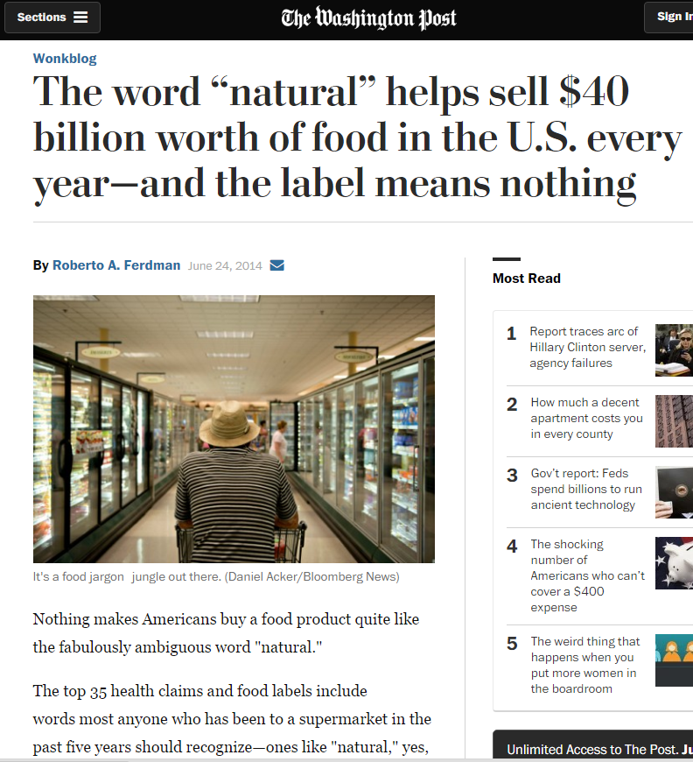
“It isn’t Natural”
PHIL 145 Week 3 Looking at Language

Slide 36
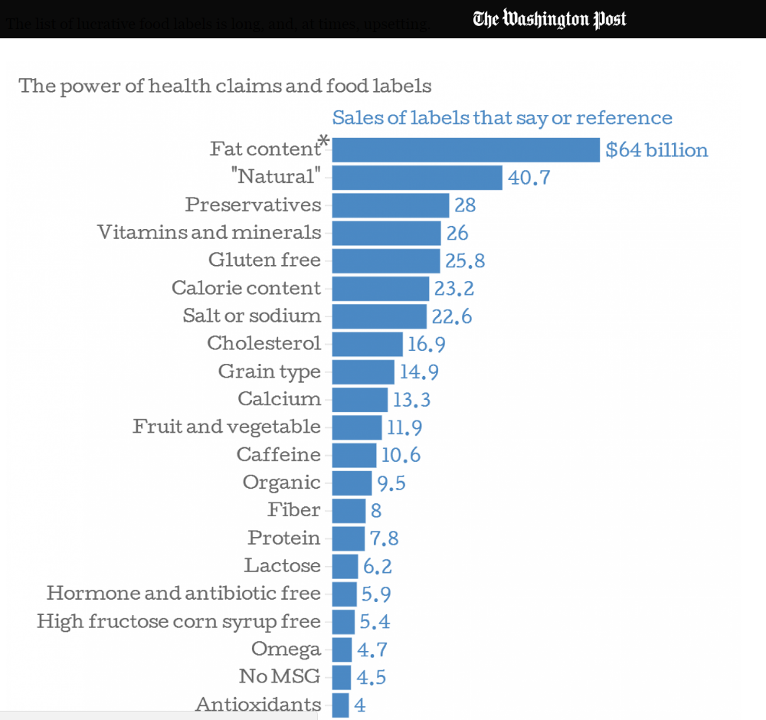
“It isn’t Natural”
PHIL 145 Week 3 Looking at Language

