Slide 1
Critical Thinking PHIL 145 - 001
Week 1: Introduction

Slide 2
The Plan for Today
Go over highlights of the course outline
Make goals and expectations clear
Introduction to Critical Thinking
What is the nature and purpose of this discipline?
Cover (some of) Chapter 1 of your text
What is (and what is not) an argument?
PHIL 145 Week 1: What is an Argument?

Slide 3
Course Outline (Highlights)
Who am I?
Andrew Stumpf
Ph.D. U of Waterloo
Th.D. U of Toronto
Lecturer (STJ / main campus)
Office Hours (SJU 1026): Tu/Th, 10:00-11:00 am; or by appointment.
Email: adhstump@uwaterloo.ca
PHIL 145 Week 1: What is an Argument?

Slide 4
Course Outline (Highlights)
Textbook:
Govier, Trudy. A Practical Study of Argument, 7th edition. Cengage Learning, 2012. Available in the UW Bookstore.
Earlier editions or ebooks may be used.
iClickers are mandatory for this course.
Register on our Learn site
PHIL 145 Week 1: What is an Argument?

Slide 5
Course Outline (Highlights)
Description & Objectives:
From the undergraduate calendar:
“An analysis of basic types of reasoning, structure of arguments, critical assessment of information, common fallacies, problems of clarity and meaning.”
We will be trying to figure out what it means to reason and think well, as well as what reasoning and thinking poorly involves, and how to apply our understanding of these things to various contexts we encounter in our everyday lives.
The course will proceed primarily through lectures and discussions, the lectures being (loosely) based on the textbook with some relevant elaboration by the instructor. We will try to leave time to take up practice questions from the text.
PHIL 145 Week 1: What is an Argument?

Slide 6
Course Outline (Highlights)
Description & Objectives:
Course Goals:
To become familiar with basic terminology and concepts relevant to rational argumentation.
To better understand the strengths and weaknesses of your own reasoning, and those of other people.
To develop skills valuable to reasoning in academic, professional, practical and personal contexts.
PHIL 145 Week 1: What is an Argument?

Slide 7
Course Outline (Highlights)
Tips for Success:
To achieve the course goals, students should be prepared consistently to:
be here on time and stay until class is over;
take notes in class and review them subsequently;
take the initiative in getting notes from another student for any class you miss;
ask in class or during office hours when you are unsure about concepts;
complete assigned readings multiple times, before and after the relevant lecture;
do the practice questions from the text;
revise your approach to the material on the basis of feedback and lectures.
Do not distract others with your electronic devices.
PHIL 145 Week 1: What is an Argument?

Slide 8
Intro to Critical Thinking
Nature of the Discipline
“Critical”
Not “criticizing”, but “careful”.
How to think carefully and clearly, not how to criticize other people.
Greek krisis (judgment)
Q: Why do we need to make a judgment?
A: Because we are rational (moral) agents.
PHIL 145 Week 1: What is an Argument?

Slide 9
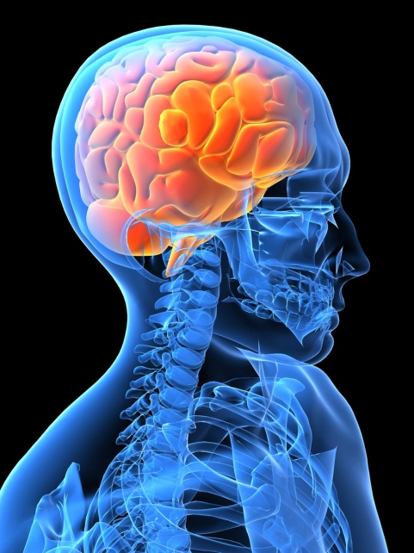

Rational Moral Agents
Beliefs
(& desires,
emotions,
& values)
Choices
Decisions
Importance of
having good beliefs
Impact
Actions
Unreliable beliefs → Misguided action
Need discernment – resist forces seeking to control you by controlling your mind.
PHIL 145 Week 1: What is an Argument?

Slide 10
Rational Moral Agents
If you want discernment / Reliable Beliefs …
Learn to understand & evaluate arguments
PHIL 145 Week 1: What is an Argument?

Slide 11
Models of Critical Thinking
The Filter Model
Me: Seeker of reasonable beliefs.
The World: Repository of facts, some truth-tellers, some stupid people, some liars.
Critical Thinking: A set of skills that filters beliefs – lets truths in but keeps stupidity and lies out.
Question: What are some major sources of our information?
PHIL 145 Week 1: What is an Argument?

Slide 12
Models of Critical Thinking
The Filter Model
Scientists
Family
Government
Professors
Clergy
Authors
Media
Friends
INFORMATION
Critical Thinking
Politicians
Reasonable
Beliefs
Artists
Corporations
PHIL 145 Week 1: What is an Argument?

Slide 13
Models of Critical Thinking
The Metacognition Model
Me: Sometimes seeker of reasonable beliefs, with tendencies to exaggerate, to mislead, to value ideology over accuracy, to be confused, and to be simultaneously overconfident and under-informed.
The World: Filled with other people much like me. (And a few stupid people and liars)
Critical Thinking: The cognitive habit of paying attention to these tendencies in myself and others, and actively seeking to minimize them.
“critical thinking starts at home.” (T. Kenyon, 2008)
PHIL 145 Week 1: What is an Argument?

Slide 14
Models of Critical Thinking
The Metacognition Model
Even if only truths get into your mind, you may still end up believing all sorts of falsehoods. How?
by shading the interpretation of those truths,
by overestimating how much you really know,
by drawing unwarranted inferences from what you’ve been told,
by finding ways to reconcile the falsehoods you generate with the truths you have been given.
“The basic critical reasoning issue is not what gets into your head. The most basic issue is what happens in there.” (ibid)
Not only protecting your mind, but restructuring your own ways of forming and revising beliefs.
PHIL 145 Week 1: What is an Argument?

Slide 15

Models of Critical Thinking
The Metacognition Model
Scientists
Critical Thinking
Government
Family
Professors
Clergy
Authors
Media
Friends
INFORMATION
Politicians
Improved
Cognitive
Habits
Corporations
Artists
PHIL 145 Week 1: What is an Argument?

Slide 16
What is an Argument?
What is Critical Thinking?
In brief, the ability to understand and evaluate arguments.
Two Questions:
What is an argument?
By contrast to other things we do with language
What is a good argument?
By contrast to bad arguments
What is an argument?
PHIL 145 Week 1: What is an Argument?

Slide 17
What is an Argument?
An argument is:
A set of claims in which one or more of them – the premises – are put forward so as to offer reasons for another claim, the conclusion.
Not equivalent to a “fight” or “disagreement.”
Arguments in the sense defined are about providing justification for some belief or other.
A social entity – an effort to persuade someone else of the truth of some claim (the conclusion).
Other purposes: Clarify your own thoughts; show that some belief can be rationally supported; etc.
PHIL 145 Week 1: What is an Argument?

Slide 18
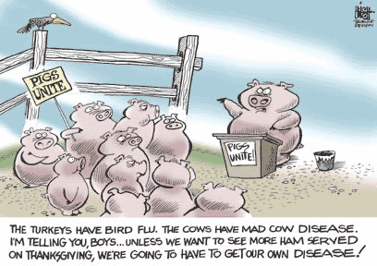
What is an Argument?
Example of an Argument:
PHIL 145 Week 1: What is an Argument?

Slide 19
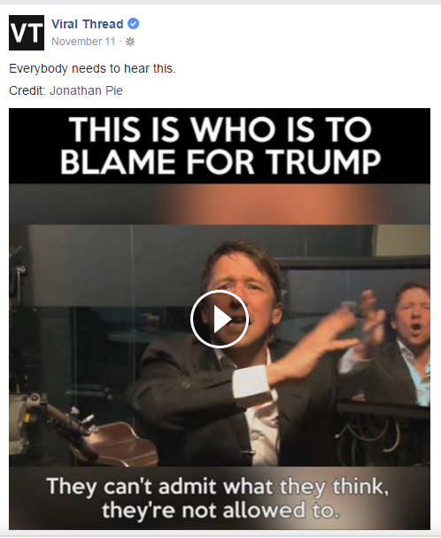
What is an Argument?
PHIL 145 Week 1: What is an Argument?

Slide 20
Arguments as rational persuasion
Rational argument as ideal means of persuasion / conflict resolution
As opposed to (a) deception; (b) psychological manipulation; (c) physical violence…
E.g.
If you don’t believe X [some assertion], Luigi here will beat you with a lead pipe.
Therefore,
X.
PHIL 145 Week 1: What is an Argument?

Slide 21
What is an Argument?
We will treat something as an argument if its context shows that it is intended as an argument.
Balance between
Only successful arguments count as arguments.
Any set of randomly chosen sentences counts as (at least a bad) argument.
PHIL 145 Week 1: What is an Argument?

Slide 22
What is an Argument?
The general framework for an argument is:
Premise 1
Premise 2 …
Premise N (indicates any number of premises)
Therefore,
Conclusion
This form helps make the logical structure of the argument clear.
PHIL 145 Week 1: What is an Argument?

Slide 23
Arguments vs. Opinions
We have to be careful to separate argument from opinions (or mere assertions).
Opinions: beliefs that are usually held with a low degree of confidence.
Assertion: (a) N. A statement presented as true.
(b) V. The act of presenting a statement as true.
Point of argument evaluation: increase confidence in our opinions; have the opinions we do with justification.
Important because what we think affects what we do and how we behave.
PHIL 145 Week 1: What is an Argument?

Slide 24
Why Arguments are Important
Why do you believe what you believe?
Example:
I think marijuana should be legalized. Isn’t it just obvious? Who wouldn’t agree? I mean, it’s marijuana… and it should be legal. Then it wouldn’t be illegal anymore. And that’s the way it should be.
PHIL 145 Week 1: What is an Argument?

Slide 25
Why Arguments are Important
You had better run for it.
Why?
A swarm of locusts is invading.
Prove it.
It was on the news. Plus you can hear them buzzing and see that they are blocking the sunlight.
I don’t accept your argument
PHIL 145 Week 1: What is an Argument?

Slide 26
What is an Argument?
Question: Which of the following are arguments?
Lazy hands make a man poor, but diligent hands bring wealth (Prov. 10:4).
When pride comes, then comes disgrace, but with humility comes wisdom (Prov. 11:2).
A bird in the hand is worth two in a bush.
Since iron is a metal it will expand when heated.
We know the murderer must have left by the back door because nobody came out the front door except the milkman.
What good is it for a man to gain the whole world, yet forfeit his soul?
PHIL 145 Week 1: What is an Argument?

Slide 27

Is there an argument here?
“Come to where the flavor is.
Come to Marlboro Country.”
PHIL 145 Week 1: What is an Argument?

Slide 28

Is there an argument here?
PHIL 145 Week 1: What is an Argument?

Slide 29
Arguments and Indicator Words
Indicator words act as clues as to whether a statement is a premise or conclusion of an argument.
Looking for these indicator words will aid in capturing the logical structure of arguments.
A Few Common Premise Indicator words/phrases:
* since * because
* for * as indicated by
* for the reason that * follows from
* given that * on the grounds that
* from the reason that * as shown by
* given that * may be deduced from
PHIL 145 Week 1: What is an Argument?

Slide 30
Arguments and Indicator Words
A Few Common Conclusion Indicator words/phrases:
* therefore * thus
* so * consequently
* hence * then
* it follows that * it can be inferred that
* in conclusion * accordingly
* proves that * shows that
* indicates that * demonstrates that
There are many indicator words and they are a useful guide to the logical structure of argument, but there are some potential problems.
PHIL 145 Week 1: What is an Argument?

Slide 31
Arguments and Indicator Words
Not all indicator words always indicate something is a premise or a conclusion. E.g., the classic indicator words don’t indicate premises and conclusion in the following:
Since 1998, I have loved coffee ice-cream.
Chuck bought a beer for Al.
He gained 10 pounds because he stopped running.
These function in ways other than as indicator words.
PHIL 145 Week 1: What is an Argument?

Slide 32
Arguments and Indicator Words
Since indicator words don’t always indicate that something is a premise or conclusion, to identify arguments one needs to develop their senses of:
Context
Tone
Logical structure
PHIL 145 Week 1: What is an Argument?

Slide 33
Argument Identification
Here are some common questions to ask while trying to identify arguments in passages of text.
What would be its conclusion if it were to contain an argument?
What is the speaker or writer claiming?
What is his or her fundamental point?
Is some claim actually, or potentially, being disputed?
Are questions of justification being considered?
PHIL 145 Week 1: What is an Argument?

Slide 34
Argument Identification
Example (from your text):
It just disgusts me how many people are willing to stick with science and ignore all the spiritual aspects of life. This is a sad feature of our times – and by the way, it reminds me a little of the ancient Romans, who lived in a very corrupt time. Here’s what they said about the emperor Nero, one of the late Roman emperors. He fiddled while Rome burned – that was it. Well anyway, the point I want to make here is that science does not provide a sufficient guide for human life, because it does not provide us with values. We need values to live our lives by.
PHIL 145 Week 1: What is an Argument?

Slide 35
Argument Identification
Science does not provide us with (spiritual and/or other) values.
We need values to live our lives by.
Therefore,
Science does not provide a sufficient guide for human life.
PHIL 145 Week 1: What is an Argument?

Slide 36
The Essence of Argument
Unlike jokes, stories, exclamations, questions, and explanations, arguments are an attempt to
JUSTIFY
Justification is what separates arguments from these other activities.
Understanding and evaluating arguments is inseparable from critical thinking.
PHIL 145 Week 1: What is an Argument?

Slide 37
Arguments and Non-Arguments
What isn’t an argument?
Sometimes it is important to know what something isn’t in order to understand what it is. Here are a few (more) examples of things that are not arguments.
Two plus two is four.
I love coffee!
Why do I love coffee?
If it rains, I will have another cup of coffee.
None of these sentences is an argument (3, and possibly also 2, is not even an assertion).
PHIL 145 Week 1: What is an Argument?

Slide 38

Arguments and Non-Arguments
(1) is a statement of mathematical fact.
(2) is a claim about my love of coffee.
(3) is a question (questions are never arguments).
(4) is a conditional statement.
If it rains, then I will have another cup of coffee.
Often confused with an argument – ‘then’ looks like a conclusion indicator. But it cannot be broken up:
P1. If it rains. (…?) [or “It rains.”]
Therefore,
C. I will have another cup of coffee.
PHIL 145 Week 1: What is an Argument?

Slide 39
Arguments and Non-Arguments
Conditional sentences
If / then sentences
Cannot be broken into two parts. They are one entire sentence.
A conditional sentence is one that links one or more conditions, specifying that IF one condition holds, another will as well.
Conditionals are often found in arguments, but they NEVER express an argument (on their own).
PHIL 145 Week 1: What is an Argument?

Slide 40
Arguments and Non-Arguments
We will break texts into two categories:
Arguments and Non-arguments
Examples of non-arguments:
Stories, jokes, descriptions, explanations, questions, and exclamations.
PHIL 145 Week 1: What is an Argument?

Slide 41
Arguments and Non-Arguments
Explanation vs. Argument
Arguments and explanations have similar structure and use some of the same indicator words like: thus, therefore, so and because.
But there is an important difference the two.
PHIL 145 Week 1: What is an Argument?

Slide 42
Arguments and Non-Arguments
Arguments attempt to justify a claim or demonstrate that something is true / reasonable.
Jackie clearly went to the gym. How else would she have developed abs like that? Besides, we found her membership card on the kitchen table.
Explanations attempt to explain why something is the case, and attempt to increase understanding.
Jackie went to the gym because she wanted to look buff.
But:
The ice is thicker at the far end of the rink because the ground slopes in that direction.
PHIL 145 Week 1: What is an Argument?

Slide 43
Explanations
There are three general kinds of explanations:
Causal explanations
Explain a fact/event by citing causes that produce it.
Explanations by purpose
Relation to human motives / intentions.
Explanations by meaning
Stating (“explaining”) what a word means.
E.g. Explain the meaning of “logolepsy” by stating that it means “an obsession with words.”
PHIL 145 Week 1: What is an Argument?

