Slide 1
PSYCH 101: Week1, January 9, 2017 Introduction to Psychology: History and Science
AGENDA
Introductions and Business:
Your Prof: Dr. Toni Serafini
Course Syllabus: overview, questions, etc.
Volunteer Note-taker?
Experiential Learning and SONA: Your participation in psychological research
What is Psychology?
The evolution of Psychology
Psychology as a Science, Theory, and Research

Slide 2
Who am I?
Dr. Toni Serafini
Hons BA - Psychology (co-op), University of Waterloo (St. Jerome’s)
M.Sc.- Family Relations and Human Development (Couple and Family Therapy Emphasis), University of Guelph
Ph.D. - Family Relations and Human Development, University of Guelph
Research - Identity development
Clinical - Couple and Family Therapist (private practice)

Slide 3
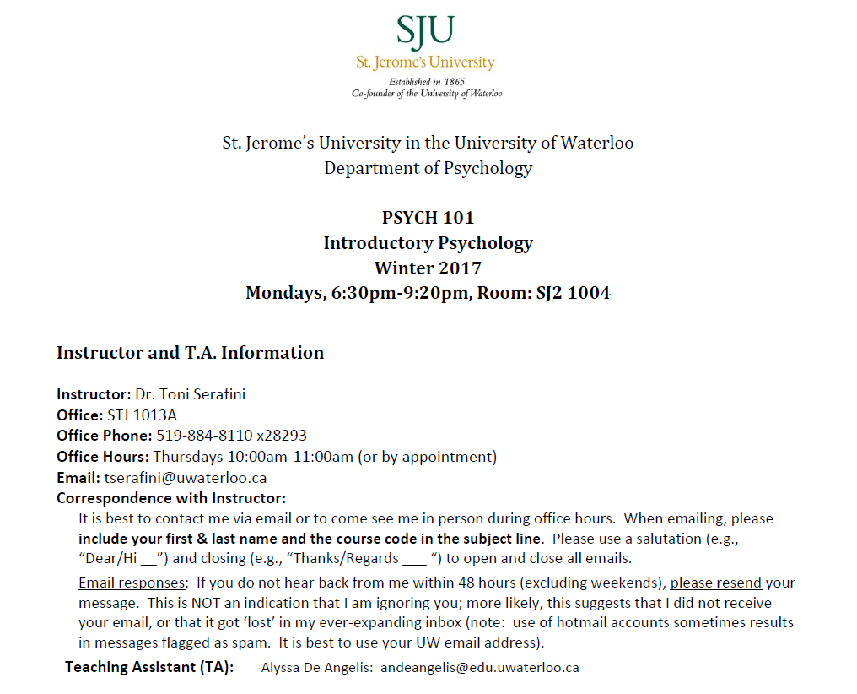

Slide 4
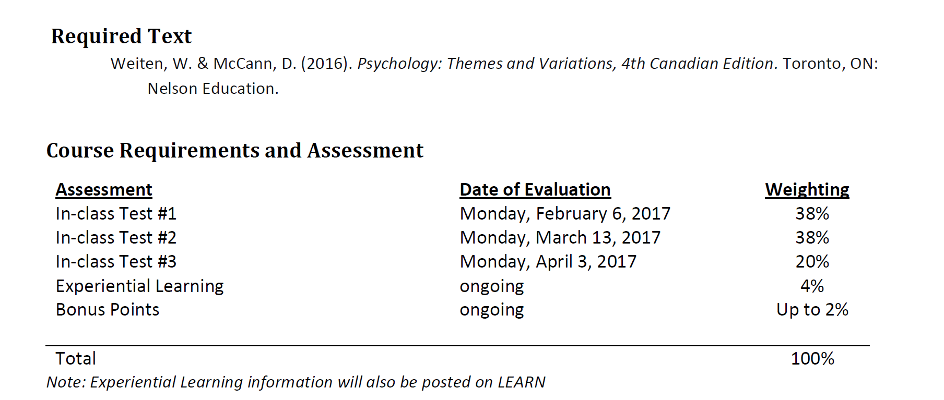

Slide 5

Your Required Course Materials for: PSYCH 101 – Section 3
You will need this text for:
Tests
Reading assignments
Achieving your best possible grade!
Technology/package components

Slide 6
Take Advantage ! Your textbook includes:
Concept Charts booklet helps you visualize the macro-level and drill down to the micro-level, and its free with each new copy of the text. These colour-coded, hierarchically organized charts create snapshots of the chapters allowing you to quickly see the relationships among ideas and sections.
Putting it in Perspective features, which correspond with the findings of a study conducted recently by the APA on Strengthening the Common Core of the Introductory Psychology Course: “…a comprehensive understanding of the mind and behavior is more likely to be achieved by an integration …across different levels/perspectives…”
8 Illustrated Overviews found in the book provide yet another summary that appeals to the more visual learner, and strengthen connections between topics that may seem unrelated.

Slide 7
FREE Additional Study Resources
Have you ever found yourself reading a textbook chapter and not being able to remember what you read?
Do you know how to manage your time?
Need strategies for performing better on tests?
Visit www.dayone.nelson.com/students
and take a first step toward your success!

Slide 8
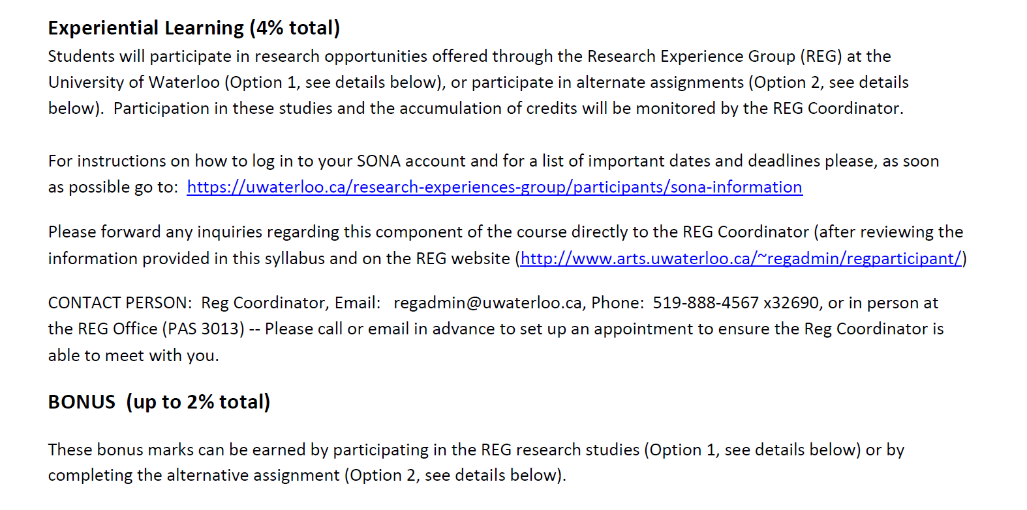

Slide 9

Electronic Devices and Technology
RESPECT …. One another and the learning environment

Slide 10
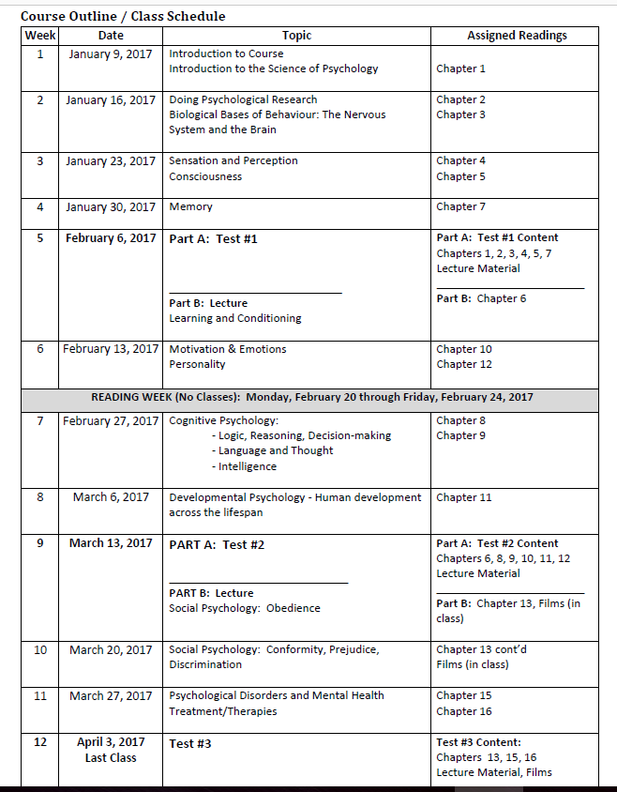

Slide 11
What Is Psychology?
Psychology is the science of behaviour and mental processes
The Nature-Nurture debate

Slide 12
How Did Psychology Begin?
Origins in philosophy:
Socrates: “Know thyself”
Plato and Aristotle: body, mind, and soul
Descartes: “I think therefore I am”
Empiricists (e.g., Locke and Hume): all knowledge linked to experience and comes from our senses

Slide 13
How Did Psychology Begin? (cont’d)
Young science: Began a little more than a century ago
Different schools of psychological thought emerged…
Structuralism
Functionalism

Slide 14

Psychology’s Roots in Canada
1891: First experimental laboratory in the British Empire established by James Baldwin at the University of Toronto
1892: Baldwin helped found the American Psychological Association
1939: Canadian Psychological Association founded
Important Canadian contributions by Brenda Milner and Donald Hebb (both of McGill University)

Slide 15
Who Are These People Called Psychologists
Study all aspects of life
Diverse areas of focus (e.g., research, teaching, clinical work)
What’s the difference between a psychologist and a psychiatrist?

Slide 16
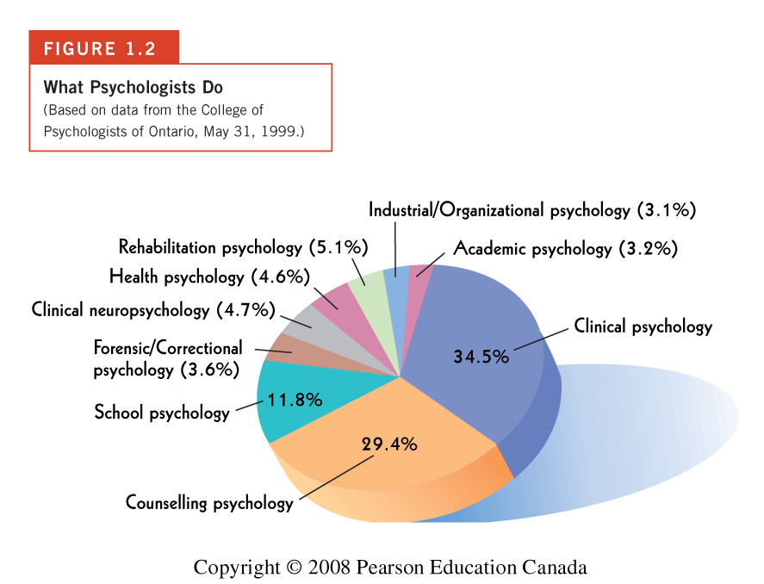

Slide 17
Four Recurring Themes in Psychology
Relationship between brain and behaviour
Nature and nurture
Human diversity
Idea generation and application

Slide 18
What Makes Psychology A Science?
Use of scientific principles, methods and procedures for:
Knowledge development
Prediction

Slide 19
Psychology is Based on 2 Premises:
1. Empiricism: knowledge through careful observation, not ‘logic,’ ‘common sense,’ or ‘intuition’
Note:
There is nothing “common” about “sense”!
2. Theory development: collection of interrelated ideas & observations that describe, explain and predict behaviour or mental processes

Slide 20
The Relationship Between Theory and Research
They inform one another
Theory is foundational.
Provides: rationale, viewpoint, focus for research
What IS theory, exactly??

Slide 21
Theory
The “lens” metaphor
The “map” metaphor
The “map” is not the “territory”
Historically situated and variable
Reflect social and moral thinking of the day
Limited

Slide 22
Theory
The “lens” metaphor
The “map” metaphor
The “map” is not the “territory”
Historically situated and variable
Reflect social and moral thinking of the day
Limited

Slide 23
Major Theoretical Perspectives in Psychology
Psychodynamic
Behaviourist
Humanistic
Cognitive
Biopsychological
Social
Cultural
Evolutionary

Slide 24
Psychodynamic Perspective
Founder: Sigmund Freud
Proposed that unconscious mental processes direct behaviour
Maladjustment is result of anxiety arising from unresolved conflicts in the unconscious
Therapeutic technique: Psychoanalysis

Slide 25
Behaviourism
Founded by John Watson: rejected study of contents of consciousness
Focused on measuring only what is observable
Emphasized scientific study of observable behavioural responses and their environmental determinants
Stimulus → Response

Slide 26
Humanistic Perspective
Developed by Carl Rogers and Abraham Maslow
Individuals motivated by a need for self-actualization
Emphasizes each person’s positive qualities, unique experiences

Slide 27
Cognitive Perspective
Focuses on such processes as perception, memory, and thinking
Mental processes involved in knowing
Ideas/Thoughts → Behaviour

Slide 28
Social Perspective
Focus on how social factors affect both behaviour and mental processes
Deals with social interactions, their origins, and how they impact individuals

Slide 29
Evolutionary Psychology
Based on ideas of Charles Darwin
Assumes behaviours that help organisms adapt will be passed on to successive generations
Reproduction, adaptation, “survival of the fittest”

Slide 30
The Science of Psychology
Psychologists use scientific principles, methods, and procedures to develop a body of knowledge about human behaviour and to ‘predict’ how people behave
Based on 2 premises: empiricism and theory development
HOW do theory and research work together?

Slide 31
Theory and Research
Theory informs the kinds of research questions we ask
We conduct research to test theory
Theory holds researchers accountable – move from just description to interpretation

Slide 32
Doing Research: Three Principles of Scientific Endeavour
Objectivity
Systematic observation
Replicability
Notes:
2

Slide 33
The Scientific Method: Terminology
Operational definitions (clarity, measurability)
Participants or subjects: the organisms whose behaviour is systematically observed in a study
Data (plural)
Statistics used to analyze data
Findings shared through reports at scientific conferences, in scientific journals
Research Design: e.g., cross-sectional, longitudinal

Slide 34
Scientific Method in Psychology
5 STEPS:
State the problem
Develop hypothesis(es)
Design a study
Collect & analyze data
Draw conclusions & report results
Notes:
5

Slide 35
Research Methods and the Multiple Ways Data May be Gathered
Surveys (self-report)
Observational research (watching/observing people, animals)
Interviews
Experiments

Slide 36

Psychology as a Science
More on how to conduct research in Psychology next class…
AND a glimpse into human beings’ most powerful organ:
THE BRAIN
See you next class!

