Slide 1
Temperature Model
Chris and Matt

Slide 2
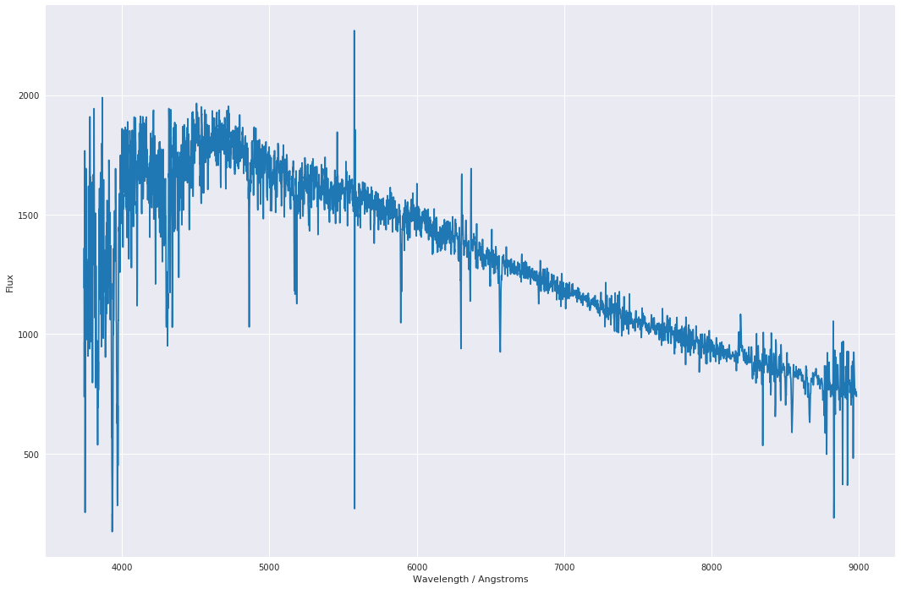
Processing Spectra
Negative flux
Echelle overlap (5570-5590Å)

Slide 3
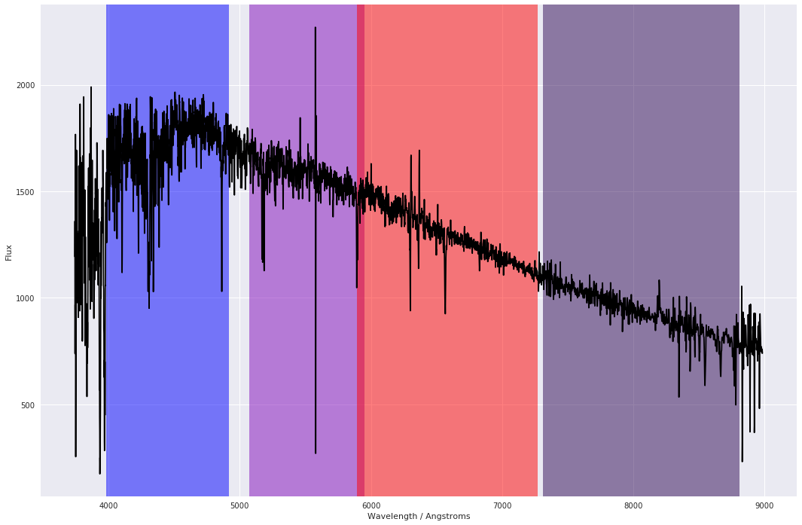
Photometric Features
Blue: 3980-4920Å
Violet: 5070-5950Å
Red: 5890-7270Å
Indigo: 7310-8810Å

Slide 4
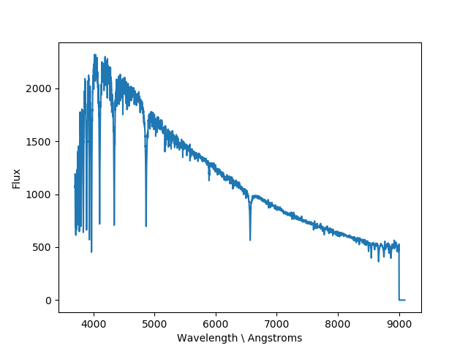
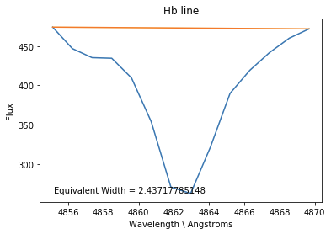
Equivalent Widths
Hα = 6565Å
Hβ = 4863Å
Hγ = 4342Å
Equiv Width = (1-(T/A))*Width

Slide 5
Equivalent Widths
Spectral Line | Wavelength / Å | Temperature / K | Spectral Types
Hα | 6565 | 6,000 – 28,000 | B, A, F
Hβ | 4863 | 6,000 – 28,000 | B, A, F
Hγ | 4342 | 6,000 – 28,000 | B, A, F
He | 3970 | 10,000 - 28,000 | A, F
Mg | 5177 | 3,500 – 6,000 | G, K
K | 3935 | 3,500 – 6,000 | G, K
Na | 5895 | 2,500 - 5,000 | K, M

Slide 6
Creating the Dataframe
CSV batching
NaN imputing
Merging with the catalog of A, F, G and K type stars

Slide 7
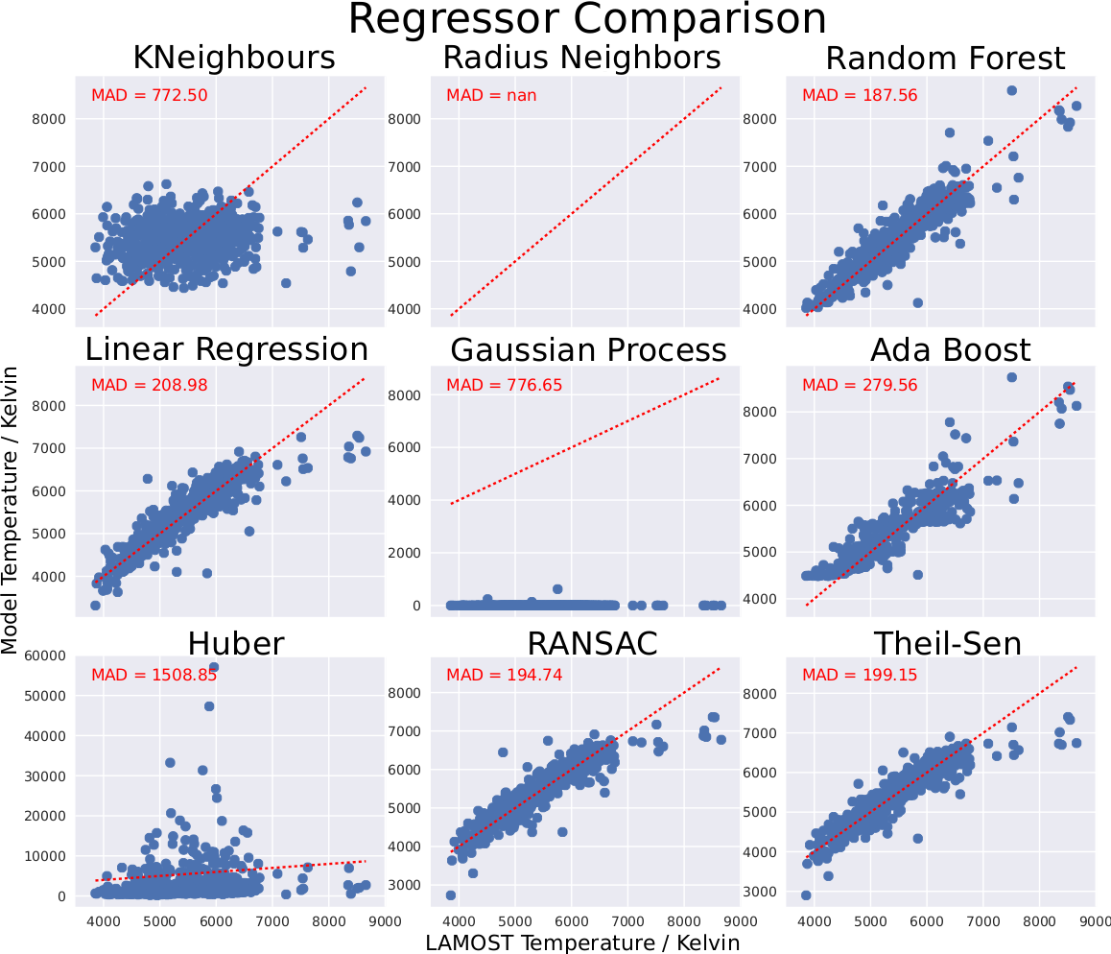
Random Forest

Slide 8
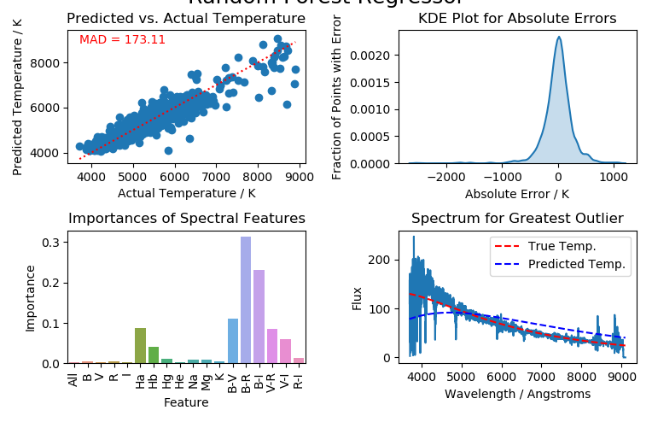
Current Results

Slide 9
Future Improvements
Try to obtain MAD > 150 by adding any future features to this model.
Test model on spectra that are not in the catalog.

Slide 10
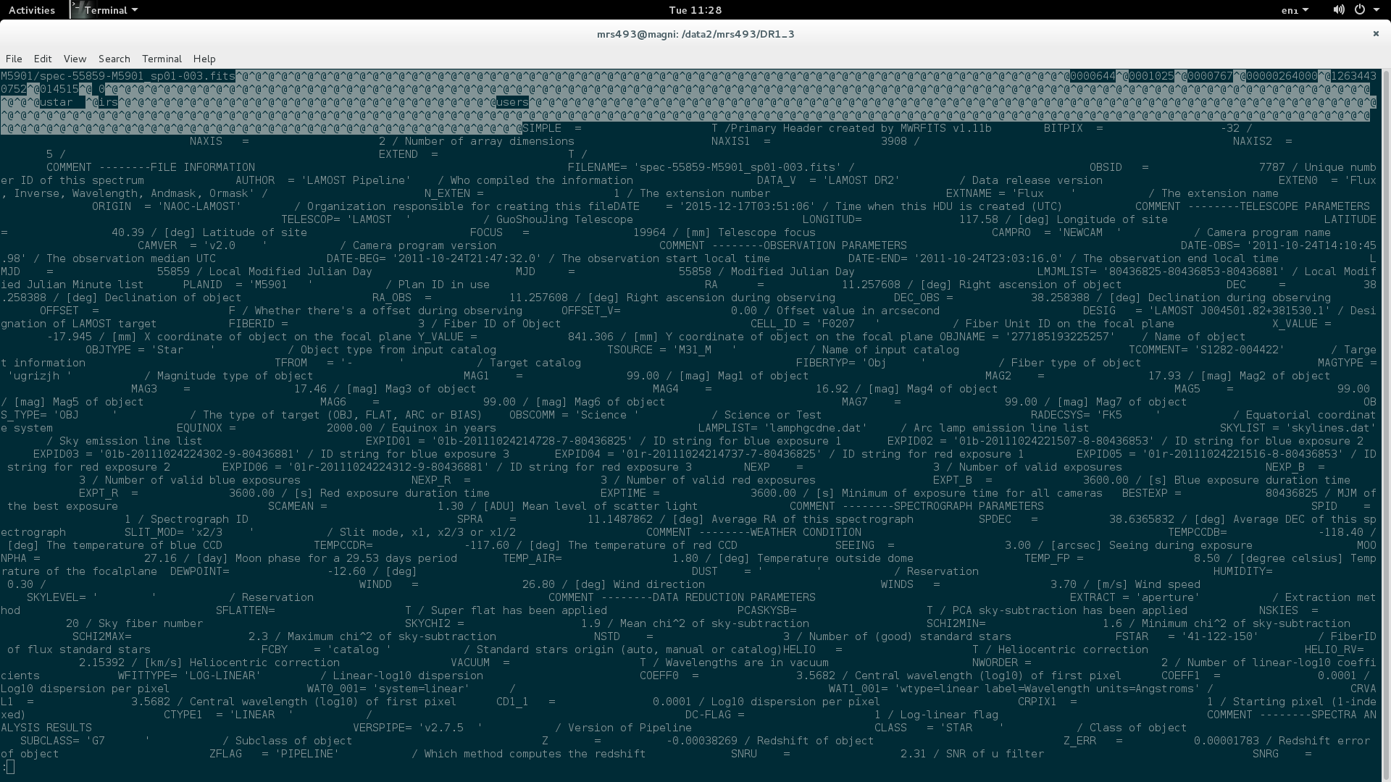
Broken FITS File (@?!)
spec-55859-M5901_sp01-002.fits

