Slide 1




Endomorphic metalanguage and abstract planning for real-time intent recognition
Directors
  Samir Aknine
  Lætitia Matignon
Jury
  Hamamache Kheddouci
  Ivan Varzinczac
Reviewers
  Eva Onainda
  Damien Pellier
LỊRIS
Antoine Gréa
Lyon 1
https://phd.grea.me
12020-01-30T14:00+01
ISO-HE
Notes:
Présentation du jury

Slide 2

Endomorphic metalanguage and abstract planning for real-time intent recognition
LỊRIS Lyon 1 Antoine Gréa
Notes:
Bonjour à tous et merci d’assister à ma soutenance de thèse intitulée Métalangage endomorphique et plannification abstraitee pour la reconnaissance d’intention.
Je suis Antoine Gréa, doctorant à l’université Lyon 1 et durant cette présentation je vais vous exposer mes diverses contributions.

Slide 3
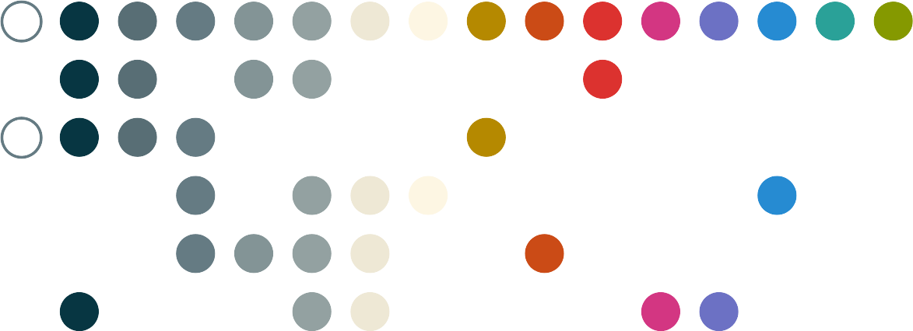
1 Introduction
Notes:
Tout d’abord on va présenter les bases du problème

Slide 4


1.1 A what ?
Dependent people need help !
  Not annoying the person
  Can’t see everything they are doing
How to help without asking ?
  Guessing the intent somehow
Intent recognition
  Observed behavior → Goal
  Using action sequences: Plans
?
1 Introduction
Notes:
De quoi s’agit-il exactement ?
Et ben,
On ne doit pas déranger la personne et l’observation est toujours partielle.
La reconnaissance d’intention c’est quoi ?

Slide 5

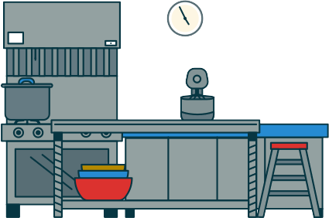
1.2 Kitchen Example
Observation
  Bob goes in the kitchen
Possible goals
  Bob cleans the dishes
  Bob makes tea
  …
Infer the
correct goal
Issues
  Multiple goals
  Interleaving actions
  Partial observations
?
1 Introduction
Notes:
Voici l’example utilisé tout du long de cette présentation.

Slide 6
Plan
1 Introduction
2 Intent Recognition
3 Knowledge Representation
4 General Planning
5 Flexible Online Planning
6 Conclusion
Notes:
Voici le plan pour la suite, on viens de terminer l’introduction et on s’apprête à enchaîner sur la reconnaissance d’intention en tant que discipline.
Ensuite on expliquera en quoi la représentation des connaissances joue un rôle important dans ce domaine.
Le système de représentation de connaissance est alors utilisé pour faire de la plannification générale. Puis sur des algorithmes de plannification particuliers.
On concluera avecla liste des contributions ainsi que sur les perspectives.

Slide 7

2 Intent Recognition
Notes:
Comment faire de la reconnaissance d’intention

Slide 8
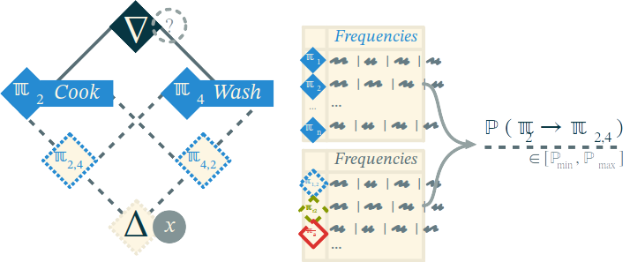
2.1 Logic Approach
Lattice Based : ✔ Fast computations ✘ Exponential growth
(Bouchard et al. 2006)
2 Intent Recognition
Notes:
Approche logique Bouchard
Treilli : objet mathematique ordonné
Parler de la figure.

Slide 9
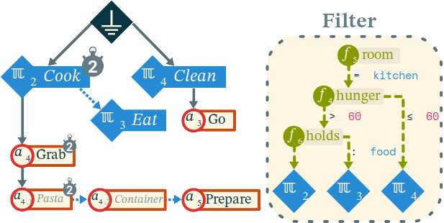
2.2 Stochastic Approach
And/Or and decision tree
  ✔ Accurate & efficient
  ✘ Handmade plan library & tree
(Avrahami et al. 2006)
2 Intent Recognition

Slide 10
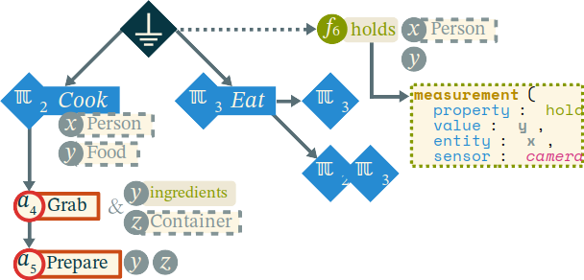
2.3 Grammatical Approach
Valued Grammar : ✔ Versatile ✘ Slow refresh rate (~40s)
(Vidal et al. 2010)
2 Intent Recognition

Slide 11
2.4 Inverted Planning
Observed
Planned
Intent Recognition
  Find the goal of a plan
Planning
  Find the plan to a goal
Theory of Mind
  The easier the plan,
  the more likely the goal
✔
✘
…
(Ramirez et al. 2010)
2 Intent Recognition
Notes:
Planning: On a le but et on cherche le plan
ToM: On se met à la place de l’autre
On observe un plan en cours d’exécution donc partiel

Slide 12
2.5 Framework Stacks
Existing
Contribution
Intent
Recognition
Intent
Recognition
Knowledge
Representation
System
Planner
Planner
Preprocessor /
Compiler
Domain
Description
Knowledge
Description
2 Intent Recognition
Notes:
Le système de connaissance est utilisé à tout les niveau et c’est le même donc on rends la chose plus flexible

Slide 13

3 Knowledge Representation

Slide 14



3.1 Knowledge in Planning
Reification
The act of changing something abstract into something real
Abstraction
(Cambridge Dictionary)
Formalization
tea is not hot;
?
eff
(tea is hot);
Interpretation
a
method
{(a₁ → a₂)};
3 Knowledge Representation
Notes:
Abstraire c’est réduire une entité à ses characteristiques élémentaire pour plus facilement y référer (perte d’info)
Formalization: Exprimer les connaissances en utilisant un language sous-jacent (language hôte)
Inter : Connaître les relation entre entité et ainsi leur définition (circularité)

Slide 15
3.2 Existing Tools
Ontologies
  Based on
  Description Logic
Languages
  RDF
  OWL-(Lite, DL, Full)
  …
Issues
  Reification inefficient
  Higher order knowledge
  Flexibility of the structure
<?xml version="1.0"?>
<RDF>
<Description about="Bob">
<likes>Tea</likes>
<location>Kitchen</location>
</Description>
</RDF>
3 Knowledge Representation

Slide 16
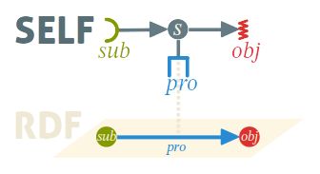
3.3 SELF Structurally Expressive Language Framework
Minimal definition
  Structure is meaning
  Ex: ∀x = x;
More expressive
Native reification
  Express fluents and states in higher order spaces
  Methods for hierarchical planning
Examples:
  s = (bob @ kitchen);
  a pre s;
  a methods
  {go(kitchen) → take(cup)};
(Gréa et al. 2020)
3 Knowledge Representation

Slide 17

4 General Planning

Slide 18
4.1 Classical Planning
Domain
  Fluents
    Formulas over objects
  States
    Properties of the world
    Formulas over fluents
  Actions
    Preconditions
    Effects
Problem
  Initial state
  Goal state
Plan (solution)
  Action sequence
  Order
    Total
    Partial
4 General Planning

Slide 19




4.2 Example
Fluents
  thing taken
  hot water, tea ready
Actions
  take, brew, boil, …
Initial State
Goal State
4 General Planning

Slide 20
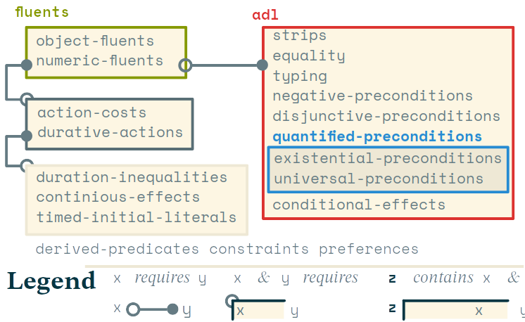
4.3 Existing Frameworks
Standard language: PDDL
  Numerous extensions to the language
  Not used in probabilistic or hierarchical planning
  Most of the time translated into an intermediate language for planners
Temporal
  PDDL+
  ANML
Probabilistic
  PPDDL
  RDDL
Multi-Agent
  MAPL
  MA-PDDL
Hierarchical
  UMCP
  SHOP2
  HDDL
  HPDDL
Ontological
  WebPDDL
  OPT
Hybrids
  SIADEX
4 General Planning
Notes:
HDDL pour HTN Track à l’IPC et converti vers SHOP2 parfois.

Slide 21
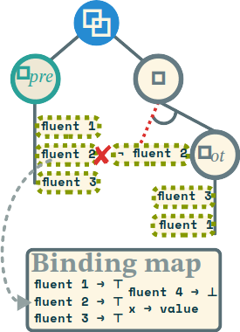
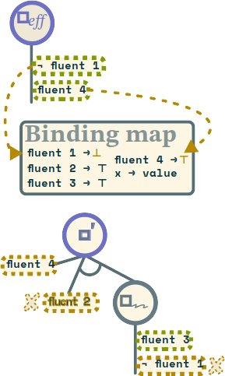
4.4 Factorizing Planning States
States: And/Or trees of Fluents
(Gréa et al. 2020)
4 General Planning
Notes:
On construit un nouvel arbre avec les deux états et on férifie que la valeur ne soit pas “faux”
Application : On construit la conjonction et on enlève tout ce qui est dans l’état courant qui n’est pas compatible en utilisant la carte des correspondances.

Slide 22
4.5 Planning Formalism Revisited
Actions
  Preconditions, Effects
  Constraints
  Cost, Duration, Probability
  Methods
    (eff → pre)
Problem
  Root Action ω
    pre(ω) = a⁰
    eff(ω) = a*
(Gréa et al. 2020)
4 General Planning
Notes:
On construit un nouvel arbre avec les deux états et on férifie que la valeur ne soit pas “faux”
Application : On construit la conjonction et on enlève tout ce qui est dans l’état courant qui n’est pas compatible en utilisant la carte des correspondances.

Slide 23
4.6 General Planning Framework
Search Space
  Starting point
  Iterator
  Heuristic
  Solution predicate
  Solutions
Instances for
  State-transition
  Plan space
  Case based
  Probabilistic
  Hierarchical
𝕤₀
χ_{𝕤}
𝕤₀ = eff(ω) (initial)
χ_{𝕤} = a ∈ A (actions)
q_{𝕤*} = (⊧pre(ω)) (goal)
𝕊= □ (states)
q_{𝕤*}
𝕊*
(Gréa et al. 2020)
4 General Planning

Slide 24
4.7 PDDL vs COLOR
(define (domain tea)
(:requirements :equality :object-fluents)
(:types container, liquid, item)
(:constants no-item – item, water – liquid, cup - container)
(:predicates (hot ?x - liquid))
(:functions (taken) - item)
(:action take
:parameters (?x - item)
:precondition (and (= (taken ?x) no-item))
:effect (and (assign (taken) ?x)))
(:action heat
:parameters (?x - liquid)
:precondition (and (not (hot ?x))
(= (taken ?x) ?x))
:effect (and (hot ?x))
PDDL
"planning.w" = ? ;
take(item) pre (taken(~), ?(item));
take(item) eff (taken(item));
heat(thing) pre (~(hot(thing)), taken(thing));
heat(thing) eff (hot(thing));
make(drink) method (
init(make(drink)) -> take(spoon),
take(spoon) -> put(spoon),
init(make(drink)) -> infuse(drink,water,cup),
infuse(drink,water,cup) -> take(cup),
take(cup) -> put(cup),
put(spoon) -> goal(make(drink)),
infuse(drink,water,cup) -> goal(make(drink)),
put(cup) -> goal(make(drink))
);
COLOR
✘
(Gréa et al. 2020)
4 General Planning
Notes:
Pas de Plannification hierarchique en PDDL

Slide 25
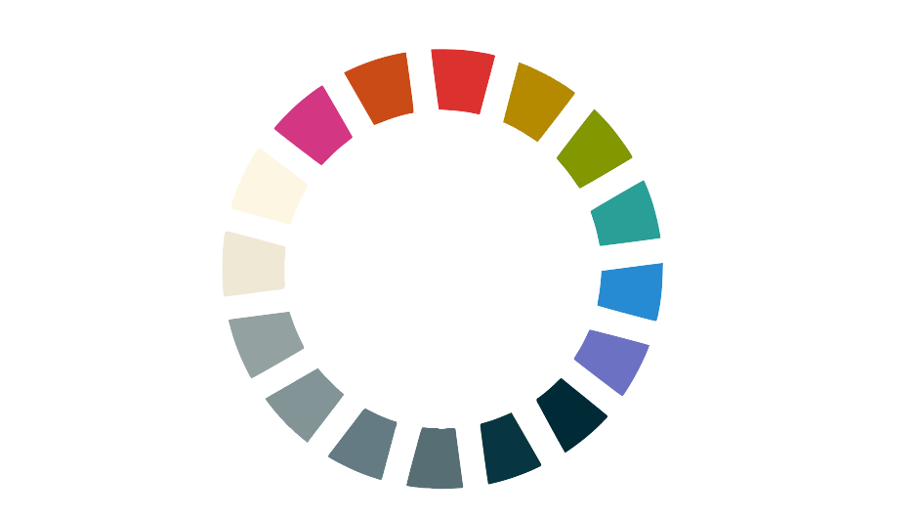
5 Flexible Online Planning

Slide 26
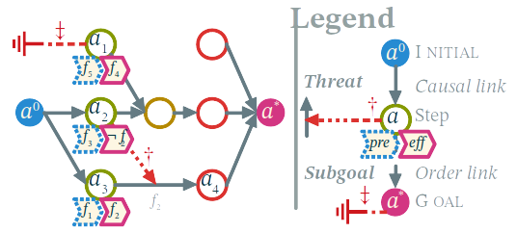
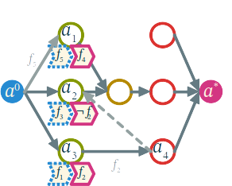
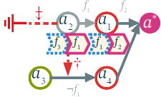
5.1 Plan Space Planning
Exploration by refinements
Flaws
  Subgoals
  Threats
Resolvers
  Side effects
May need backtracking
(Ghallab et al. 2004)
5 Flexible Online Planning

Slide 27
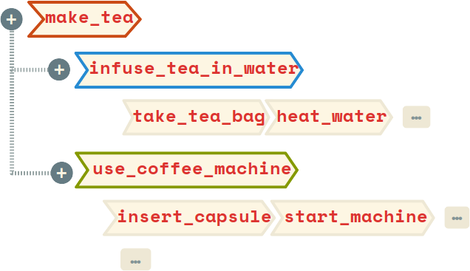
5.2 Hierarchical Task Networks
In an HTN planner, the objective is not to achieve a set of goals but instead to perform some set of tasks.
(Ghallab et al. 2004)
Based on tasks decomposition
  Replace task with method
Numerous approaches
(Ghallab et al. 2004)
5 Flexible Online Planning

Slide 28





5.3 Planning Phases
Available information
Timing constraints
Final application
5 Flexible Online Planning

Slide 29

5.4 Plan Repair Prototype
Partial Order Planner (POP)
Operator dependency graph
Negative refinements
Alternatives & Orphans
Utility Heuristics
take
(sugar)
pour
(sugar)
take
(cup)
pour
(water)
brew
(tea)
boil
(water)
✗
pour
(tea_powder,
infuser)
take
(tea_powder)
✔
Orphan
Alternative
take
(tea_bag)
Subgoal
(Gréa et al. 2016)
5 Flexible Online Planning

Slide 30

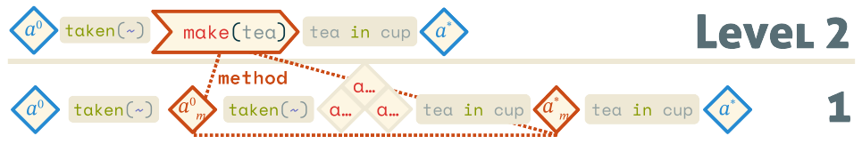
5.5 Abstract Planning
Partial Resolution
  An abstract solution at every level of abstraction
Search by level
  Expansion after completion :
HTN in PSP
Decomposition flaw
  Resolver : Decompose one composite action in the plan
  (Bechon et al. 2014)
(Gréa et al. 2019)
5 Flexible Online Planning

Slide 31
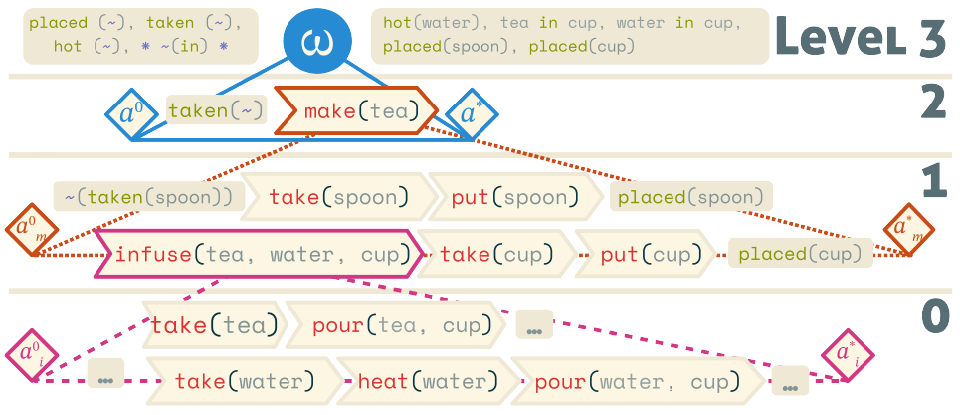
5.6 HEART
Low priority for expansion
Each level is a plan (abstract solution)
Change of level
  Propagation of atomic actions
  Expansion of Composite Equities
(Gréa et al. 2019)
5 Flexible Online Planning

Slide 32
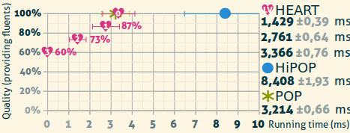
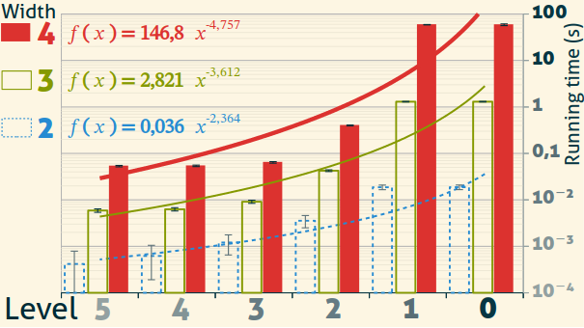
5.7 Results
60% of the fluents before planning
Exponentially faster at high abstraction levels
Faster than HiPOP on some problems
Common problems solved in milliseconds!
(Gréa et al. 2019)
5 Flexible Online Planning

Slide 33
5.8 Toward Intent Recognition
Linearized parallel actions using graph quotient
Abstraction makes it easier (smaller plans)
Backward chaining is inefficient
take
(sugar)
pour
(sugar)
take
(cup)
pour
(water)
boil
(water)
a₁
a₂
(Gréa et al. 2020)
5 Flexible Online Planning

Slide 34

6 Conclusion

Slide 35
6.1 Contributions & Results
SELF: A knowledge description language defined by structure
COLOR: A general framework for planning with its formalization
LOLLIPOP: A plan repair planner for online planning
HEART: A flexible approach to real-time planning for abstract planning
(Gréa et al. 2020)
6 Conclusion

Slide 36

6.2 Perspectives
SELF Improvement
  Improve the instantiation workflow
  Parameterize flexibility performances
Planning Colorized
  Conversion tool from PDDL
Fixing Planning Domains
  Allow HEART to discover new HTN methods (macro-action learning)
6 Conclusion

Slide 37
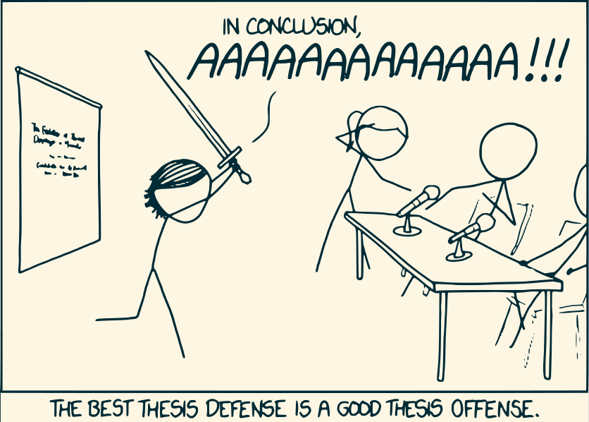
Thanks for listening !

