Slide 1
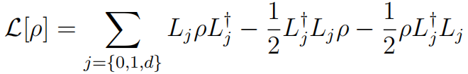

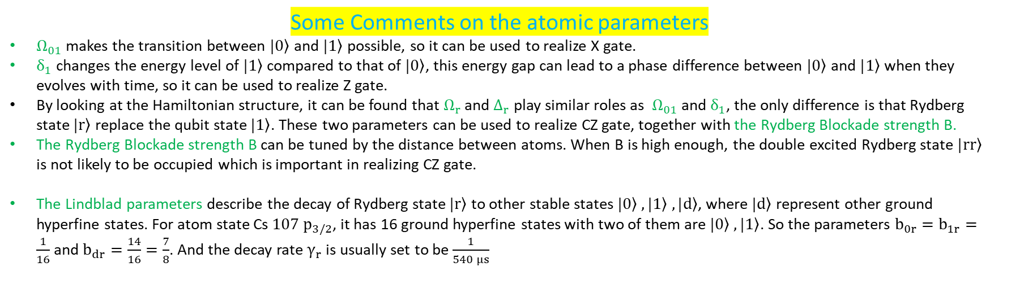
Neutral Atom Qubit(s) Simulations
Single Atom Hamiltonian ( Four-Level System )
Decay of Rydberg state r ( the level 0,1,d are taken to be stable )
Coupling between two atoms
Some Comments on the atomic parameters
$Ω_{01}$ makes the transition between $|\left.0\right\rangle$ and $|\left.1\right\rangle$ possible, so it can be used to realize X gate.
$δ_{1}$ changes the energy level of $|\left.1\right\rangle$ compared to that of $|\left.0\right\rangle$, this energy gap can lead to a phase difference between $|\left.0\right\rangle$ and $|\left.1\right\rangle$ when they evolves with time, so it can be used to realize Z gate.
By looking at the Hamiltonian structure, it can be found that $Ω_{r}$ and $Δ_{r}$ play similar roles as $Ω_{01}$ and $δ_{1}$, the only difference is that Rydberg state $|\left.r\right\rangle$ replace the qubit state $|\left.1\right\rangle$. These two parameters can be used to realize CZ gate, together with the Rydberg Blockade strength B.
The Rydberg Blockade strength B can be tuned by the distance between atoms. When B is high enough, the double excited Rydberg state $|\left.rr\right\rangle$ is not likely to be occupied which is important in realizing CZ gate.
The Lindblad parameters describe the decay of Rydberg state $|\left.r\right\rangle$ to other stable states $|\left.0\right\rangle ,|\left.1\right\rangle ,|\left.d\right\rangle$, where $|\left.d\right\rangle$ represent other ground hyperfine states. For atom state Cs $107 p_{3/2}$, it has 16 ground hyperfine states with two of them are $|\left.0\right\rangle ,|\left.1\right\rangle$. So the parameters $b_{0r}=b_{1r}=\frac{1}{16}$ and $b_{dr}=\frac{14}{16}=\frac{7}{8}$. And the decay rate $γ_{r}$ is usually set to be $\frac{1}{540 μs}$

Slide 2
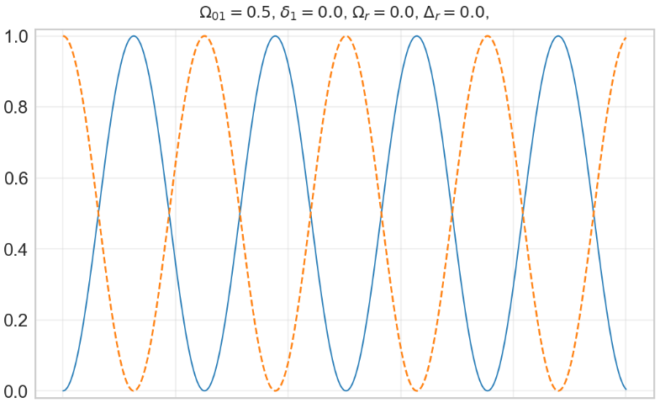
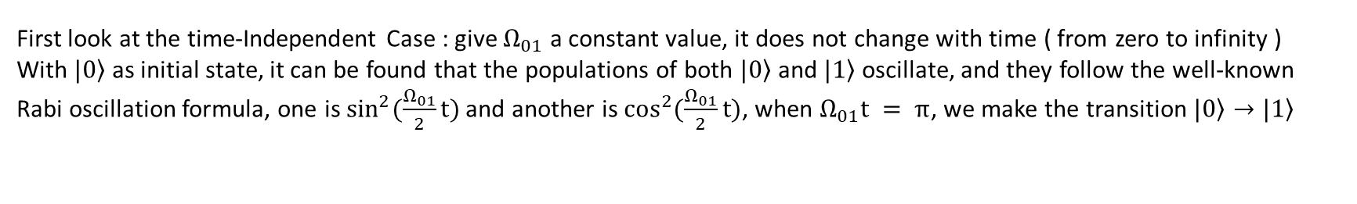
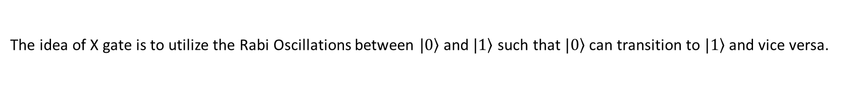
X Gate Realization
The idea of X gate is to utilize the Rabi Oscillations between $|\left.0\right\rangle$ and $|\left.1\right\rangle$ such that $|\left.0\right\rangle$ can transition to $|\left.1\right\rangle$ and vice versa.
First look at the time-Independent Case : give $Ω_{01}$ a constant value, it does not change with time ( from zero to infinity )
With $|\left.0\right\rangle$ as initial state, it can be found that the populations of both $|\left.0\right\rangle$ and $|\left.1\right\rangle$ oscillate, and they follow the well-known Rabi oscillation formula, one is $\sin^{2}(\frac{Ω_{01}}{2}t)$ and another is $\cos^{2}(\frac{Ω_{01}}{2}t)$, when $Ω_{01}t = π$, we make the transition $|\left.0\right\rangle →|\left.1\right\rangle$

Slide 3

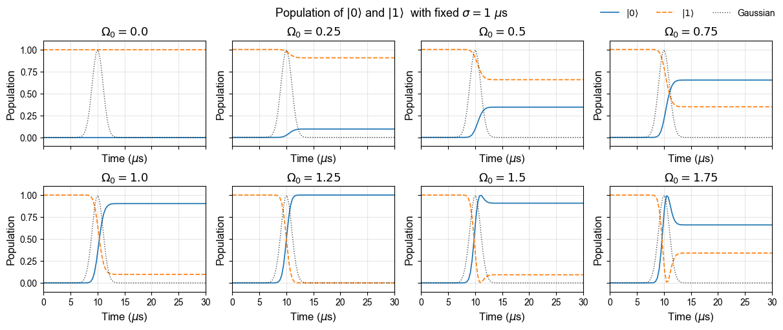
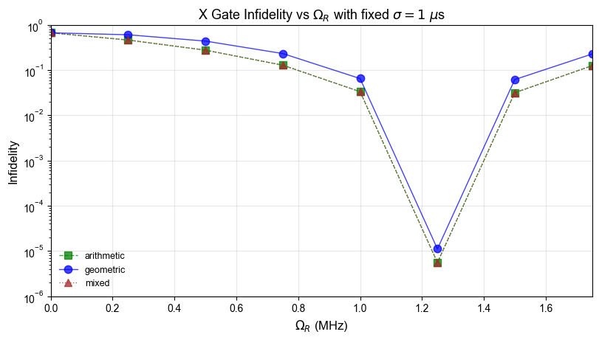
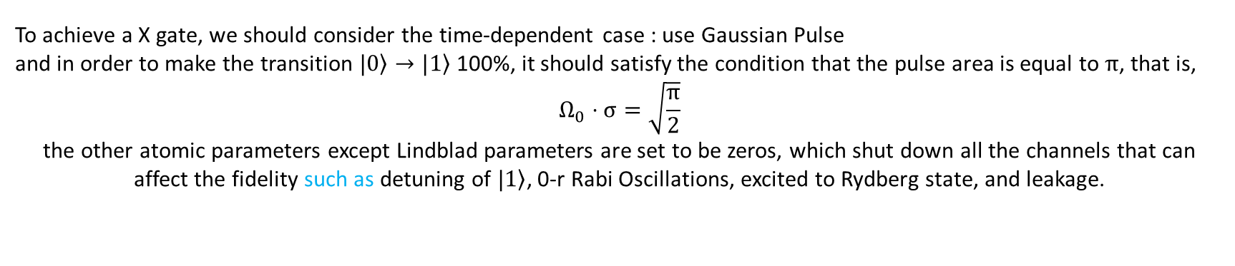
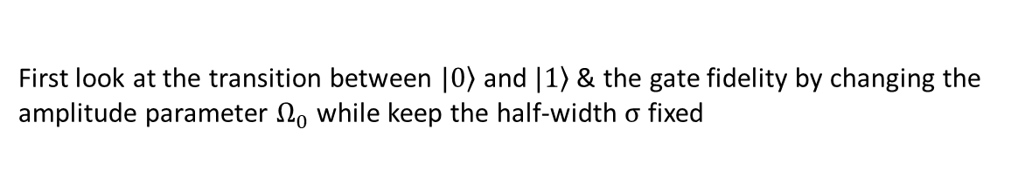
To achieve a X gate, we should consider the time-dependent case : use Gaussian Pulse
and in order to make the transition $|\left.0\right\rangle →|\left.1\right\rangle$ 100%, it should satisfy the condition that the pulse area is equal to $π$, that is,
$$Ω_{0}⋅σ=\sqrt{\frac{π}{2}}$$
the other atomic parameters except Lindblad parameters are set to be zeros, which shut down all the channels that can affect the fidelity such as detuning of $|\left.1\right\rangle$, 0-r Rabi Oscillations, excited to Rydberg state, and leakage.
First look at the transition between $|\left.0\right\rangle$ and $|\left.1\right\rangle$ & the gate fidelity by changing the amplitude parameter $Ω_{0}$ while keep the half-width $σ$ fixed
When $Ω_{0}∼1.25$, the transition is complete ( 100% ), and also the infidelity is lowest at this point, which meets our expectation.

Slide 4
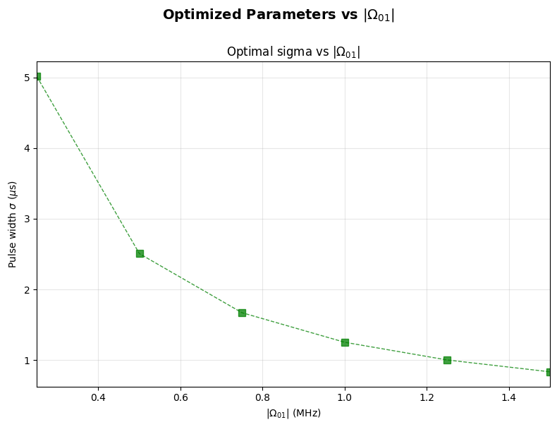
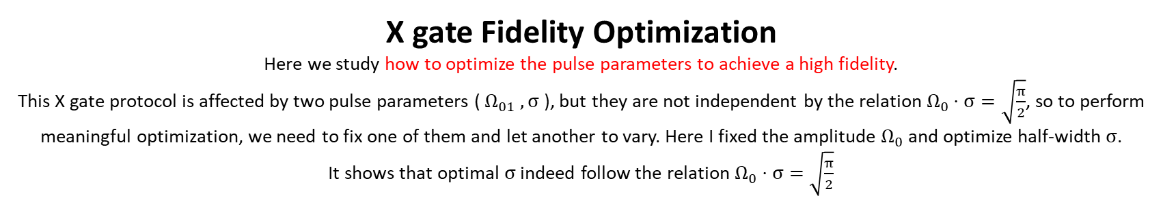
X gate Fidelity Optimization
Here we study how to optimize the pulse parameters to achieve a high fidelity.
This X gate protocol is affected by two pulse parameters ( $Ω_{01} , σ$ ), but they are not independent by the relation $Ω_{0}⋅σ=\sqrt{\frac{π}{2}}$, so to perform meaningful optimization, we need to fix one of them and let another to vary. Here I fixed the amplitude $Ω_{0}$ and optimize half-width $σ$.
It shows that optimal $σ$ indeed follow the relation $Ω_{0}⋅σ=\sqrt{\frac{π}{2}}$

Slide 5

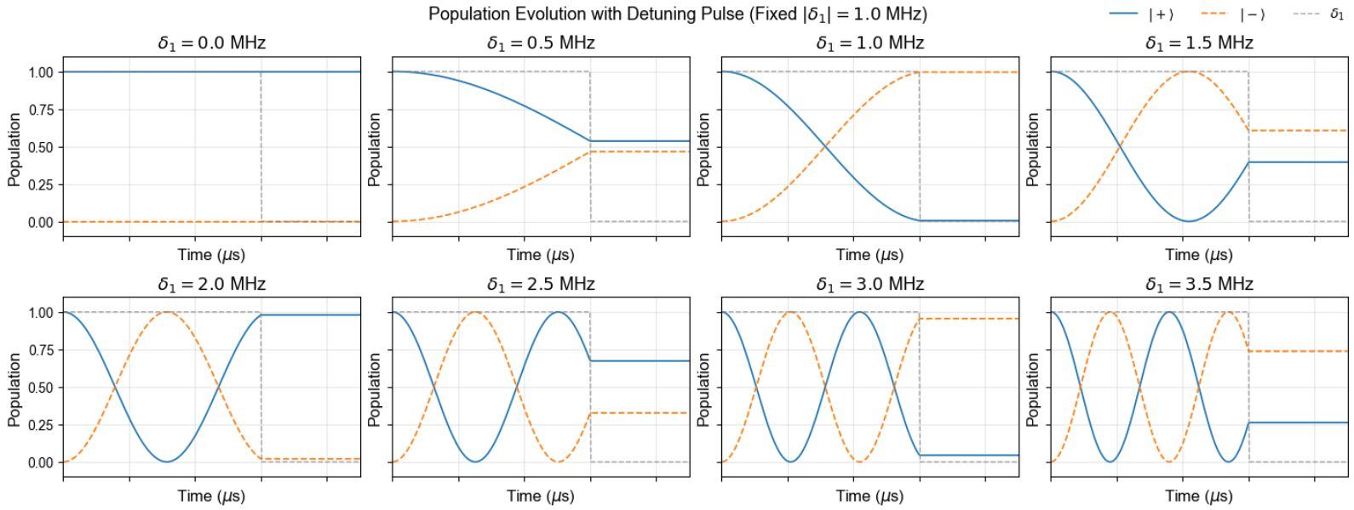
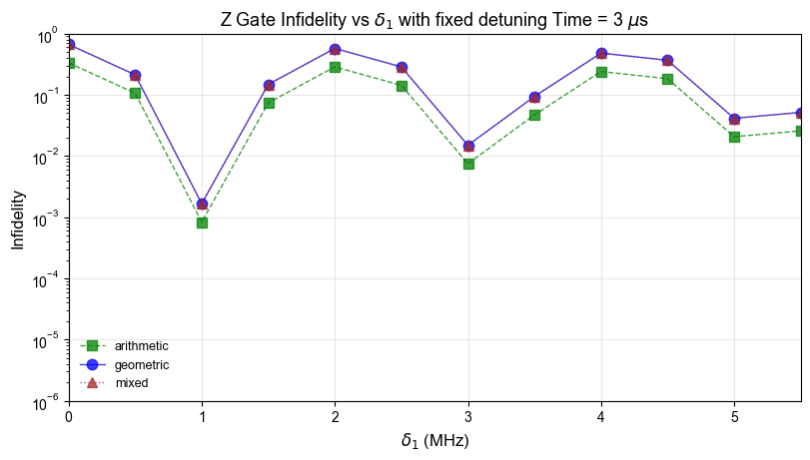
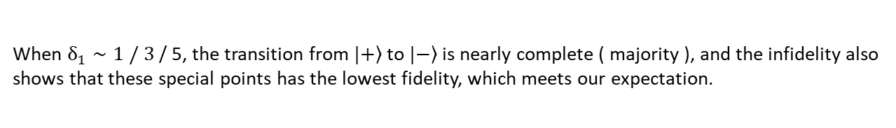
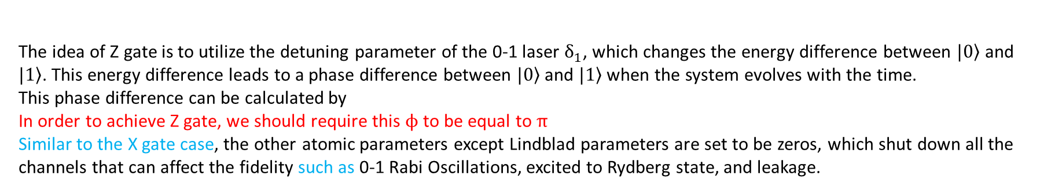
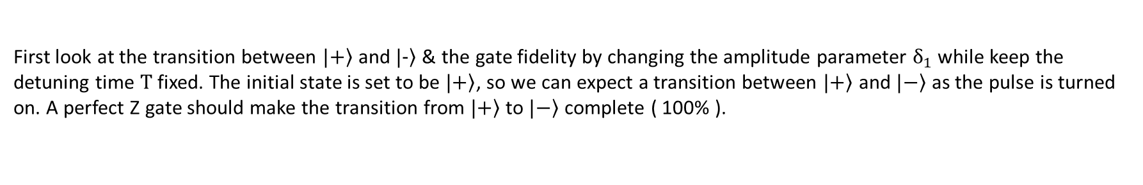
Z Gate Realization
The idea of Z gate is to utilize the detuning parameter of the 0-1 laser $δ_{1}$, which changes the energy difference between $|\left.0\right\rangle$ and $|\left.1\right\rangle$. This energy difference leads to a phase difference between $|\left.0\right\rangle$ and $|\left.1\right\rangle$ when the system evolves with the time. This phase difference can be calculated by
In order to achieve Z gate, we should require this $ϕ$ to be equal to $π$
Similar to the X gate case, the other atomic parameters except Lindblad parameters are set to be zeros, which shut down all the channels that can affect the fidelity such as 0-1 Rabi Oscillations, excited to Rydberg state, and leakage.
First look at the transition between $|\left.+\right\rangle$ and $|\left.−\right\rangle$ & the gate fidelity by changing the amplitude parameter $δ_{1}$ while keep the detuning time $T$ fixed. The initial state is set to be $|\left.+\right\rangle$, so we can expect a transition between $|\left.+\right\rangle$ and $|\left.−\right\rangle$ as the pulse is turned on. A perfect Z gate should make the transition from $|\left.+\right\rangle$ to $|\left.−\right\rangle$ complete ( 100% ).
When $δ_{1}∼1 / 3$ / 5, the transition from $|\left.+\right\rangle$ to $|\left.−\right\rangle$ is nearly complete ( majority ), and the infidelity also shows that these special points has the lowest fidelity, which meets our expectation.

Slide 6
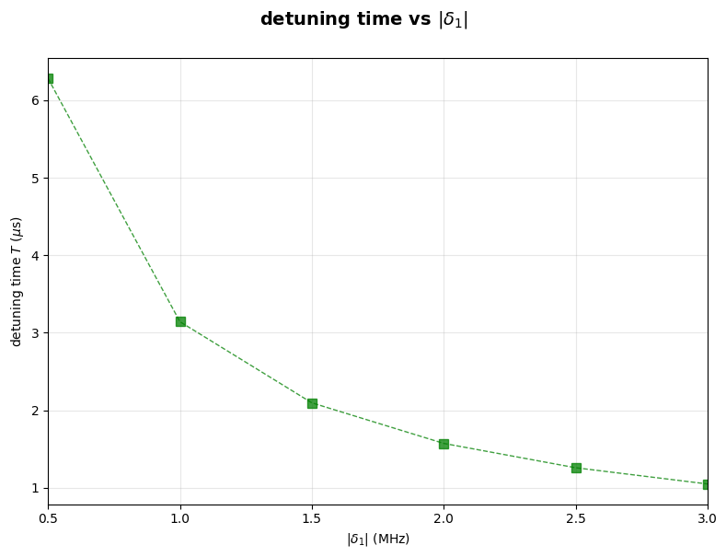
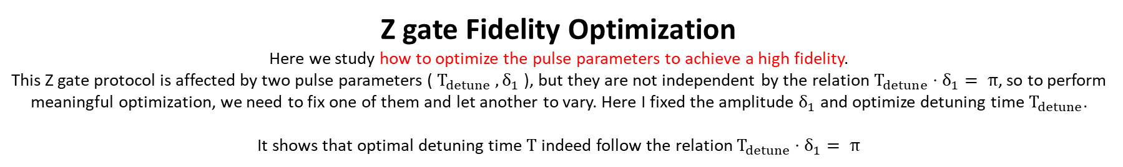
Z gate Fidelity Optimization
Here we study how to optimize the pulse parameters to achieve a high fidelity.
This Z gate protocol is affected by two pulse parameters ( $T_{detune} , δ_{1}$ ), but they are not independent by the relation $T_{detune}⋅δ_{1}= π$, so to perform meaningful optimization, we need to fix one of them and let another to vary. Here I fixed the amplitude $δ_{1}$ and optimize detuning time $T_{detune}$.
It shows that optimal detuning time $T$ indeed follow the relation $T_{detune}⋅δ_{1}= π$

Slide 7
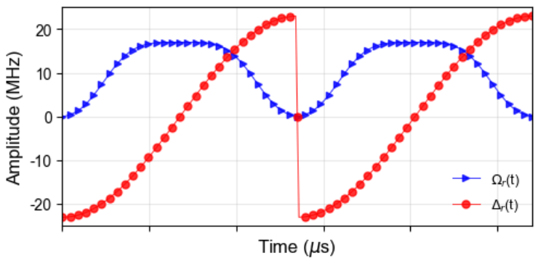
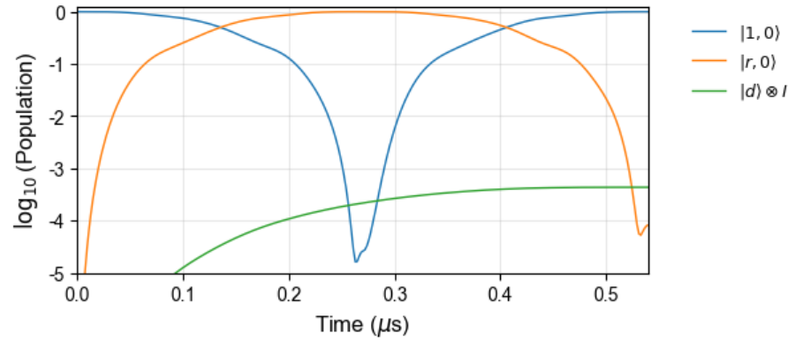
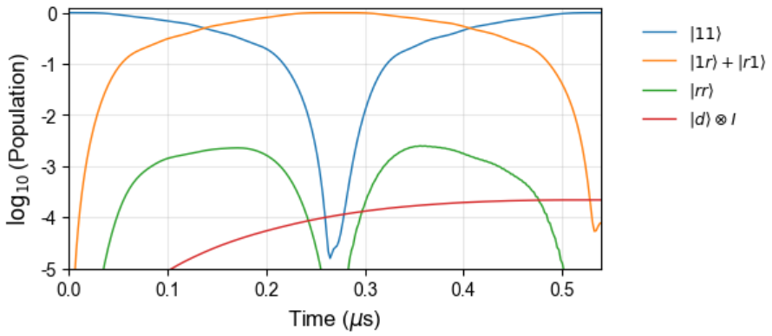
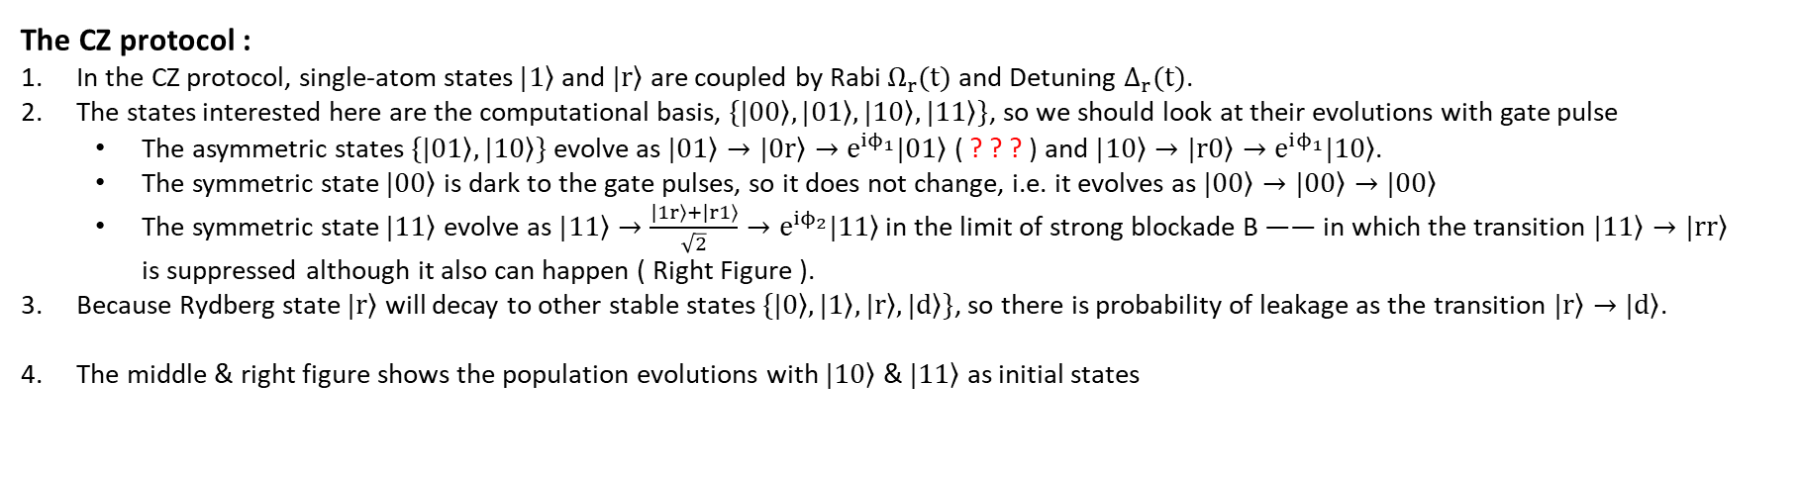
CZ Gate Realization with ARP
The CZ protocol :
In the CZ protocol, single-atom states $|\left.1\right\rangle$ and $|\left.r\right\rangle$ are coupled by Rabi $Ω_{r}(t)$ and Detuning $Δ_{r}(t)$.
The states interested here are the computational basis, $\{|\left.00\right\rangle ,|\left.01\right\rangle ,|\left.10\right\rangle ,|\left.11\right\rangle \}$, so we should look at their evolutions with gate pulse
The asymmetric states $\{|\left.01\right\rangle ,|\left.10\right\rangle \}$ evolve as $|\left.01\right\rangle →|\left.0r\right\rangle →e^{iϕ_{1}}|\left.01\right\rangle$ ( ? ? ? ) and $|\left.10\right\rangle →|\left.r0\right\rangle →e^{iϕ_{1}}|\left.10\right\rangle$.
The symmetric state $|\left.00\right\rangle$ is dark to the gate pulses, so it does not change, i.e. it evolves as $|\left.00\right\rangle →|\left.00\right\rangle →|\left.00\right\rangle$
The symmetric state $|\left.11\right\rangle$ evolve as $|\left.11\right\rangle →\frac{|\left.1r\right\rangle +|\left.r1\right\rangle }{\sqrt{2}}→e^{iϕ_{2}}|\left.11\right\rangle$ in the limit of strong blockade B —— in which the transition $|\left.11\right\rangle →|\left.rr\right\rangle$ is suppressed although it also can happen ( Right Figure ).
Because Rydberg state $|\left.r\right\rangle$ will decay to other stable states $\{|\left.0\right\rangle ,|\left.1\right\rangle ,|\left.r\right\rangle ,|\left.d\right\rangle \}$, so there is probability of leakage as the transition $|\left.r\right\rangle →|\left.d\right\rangle$.
The middle & right figure shows the population evolutions with $|\left.10\right\rangle$ & $|\left.11\right\rangle$ as initial states

Slide 8
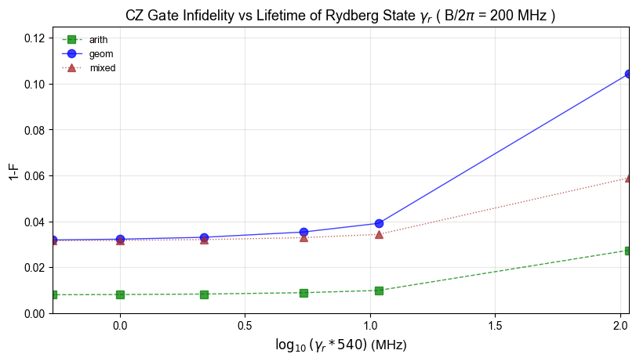
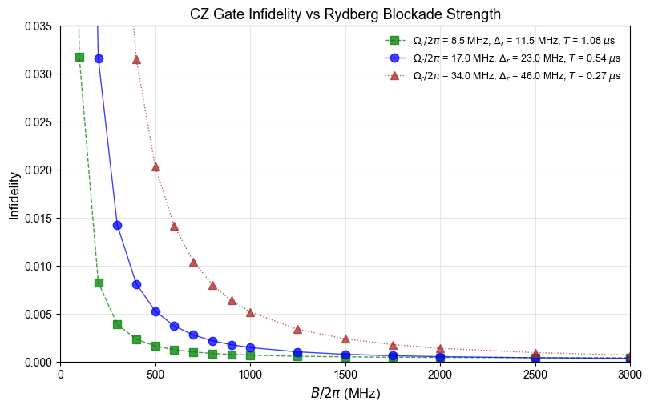
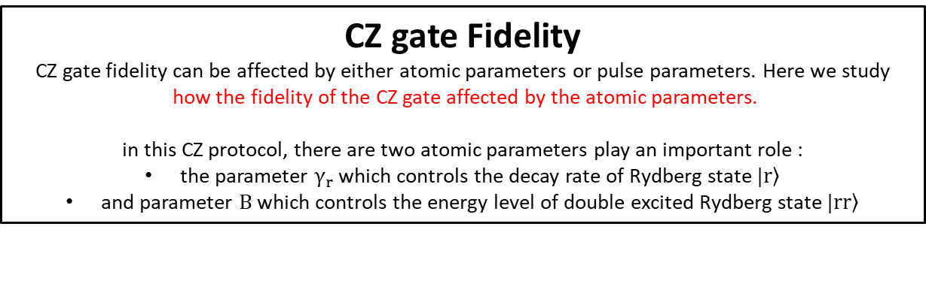
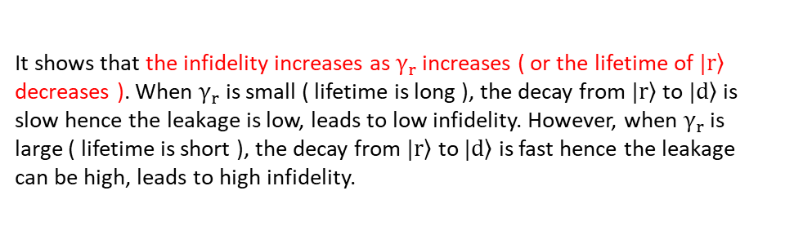
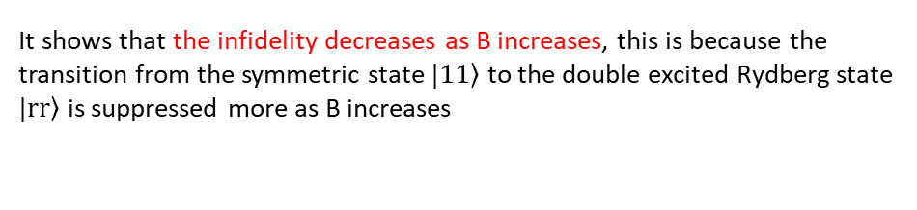
CZ gate Fidelity
CZ gate fidelity can be affected by either atomic parameters or pulse parameters. Here we study
how the fidelity of the CZ gate affected by the atomic parameters.
in this CZ protocol, there are two atomic parameters play an important role :
the parameter $γ_{r}$ which controls the decay rate of Rydberg state $|\left.r\right\rangle$
and parameter $B$ which controls the energy level of double excited Rydberg state $|\left.rr\right\rangle$
It shows that the infidelity increases as $γ_{r}$ increases ( or the lifetime of $|\left.r\right\rangle$ decreases ). When $γ_{r}$ is small ( lifetime is long ), the decay from $|\left.r\right\rangle$ to $|\left.d\right\rangle$ is slow hence the leakage is low, leads to low infidelity. However, when $γ_{r}$ is large ( lifetime is short ), the decay from $|\left.r\right\rangle$ to $|\left.d\right\rangle$ is fast hence the leakage can be high, leads to high infidelity.
It shows that the infidelity decreases as B increases, this is because the transition from the symmetric state $|\left.11\right\rangle$ to the double excited Rydberg state $|\left.rr\right\rangle$ is suppressed more as B increases

Slide 9
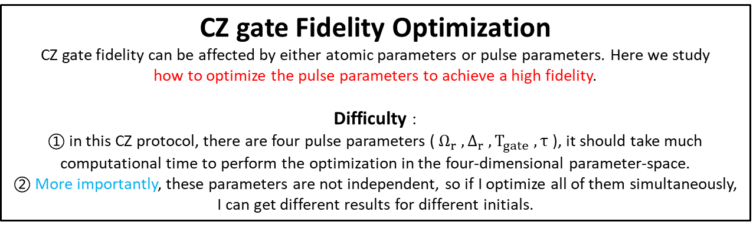
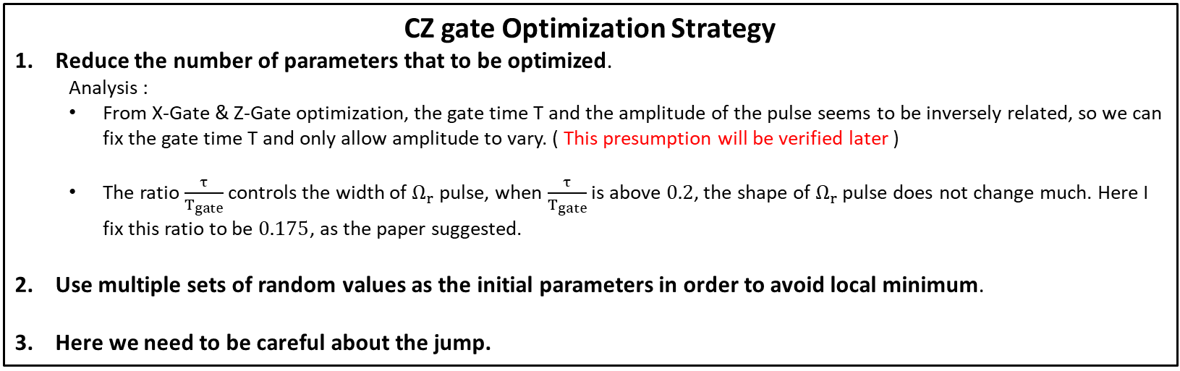
CZ gate Fidelity Optimization
CZ gate fidelity can be affected by either atomic parameters or pulse parameters. Here we study
how to optimize the pulse parameters to achieve a high fidelity.
Difficulty :
① in this CZ protocol, there are four pulse parameters ( $Ω_{r} , Δ_{r} , T_{gate} , τ$ ), it should take much computational time to perform the optimization in the four-dimensional parameter-space.
② More importantly, these parameters are not independent, so if I optimize all of them simultaneously, I can get different results for different initials.
CZ gate Optimization Strategy
Reduce the number of parameters that to be optimized.
Analysis :
From X-Gate & Z-Gate optimization, the gate time T and the amplitude of the pulse seems to be inversely related, so we can fix the gate time T and only allow amplitude to vary. ( This presumption will be verified later )
The ratio $\frac{τ}{T_{gate}}$ controls the width of $Ω_{r}$ pulse, when $\frac{τ}{T_{gate}}$ is above $0.2$, the shape of $Ω_{r}$ pulse does not change much. Here I fix this ratio to be $0.175$, as the paper suggested.
Use multiple sets of random values as the initial parameters in order to avoid local minimum.
Here we need to be careful about the jump.

Slide 10
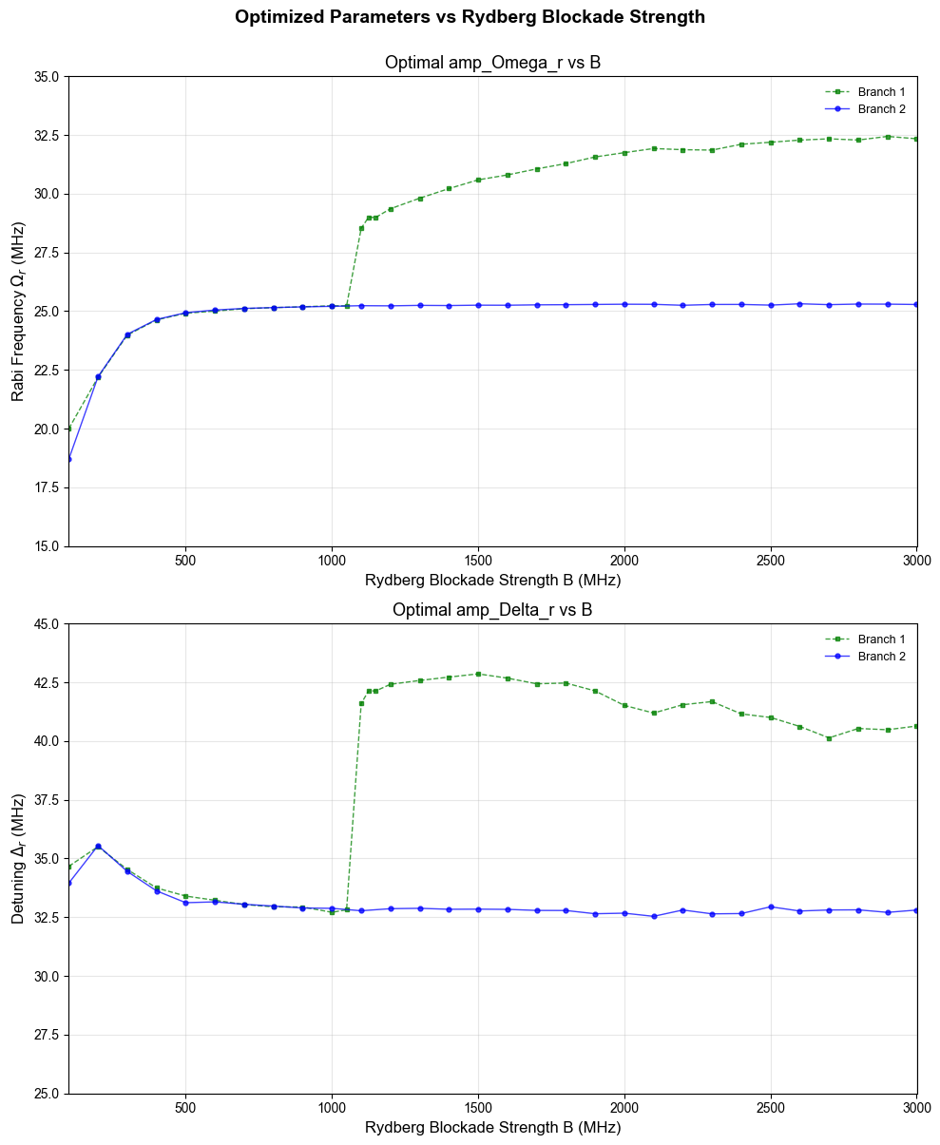
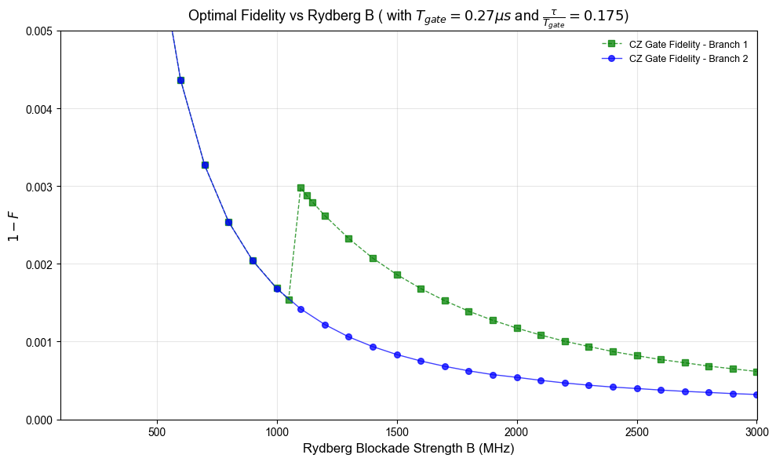
For the case : fix $T_{gate}=0.27 μs$ and $τ/T_{gate}=0.175$
For this case, I found two curves :
one shows a continuous relation between optimal parameters and strength B, the optimal parameters show convergence as B increases.
while another one shows a jump around B = 1100 MHz, and the optimal parameters don’t show a sign of convergence, they fluctuate within a range.
The green one’s fidelity is above the blue one when B is large

Slide 11
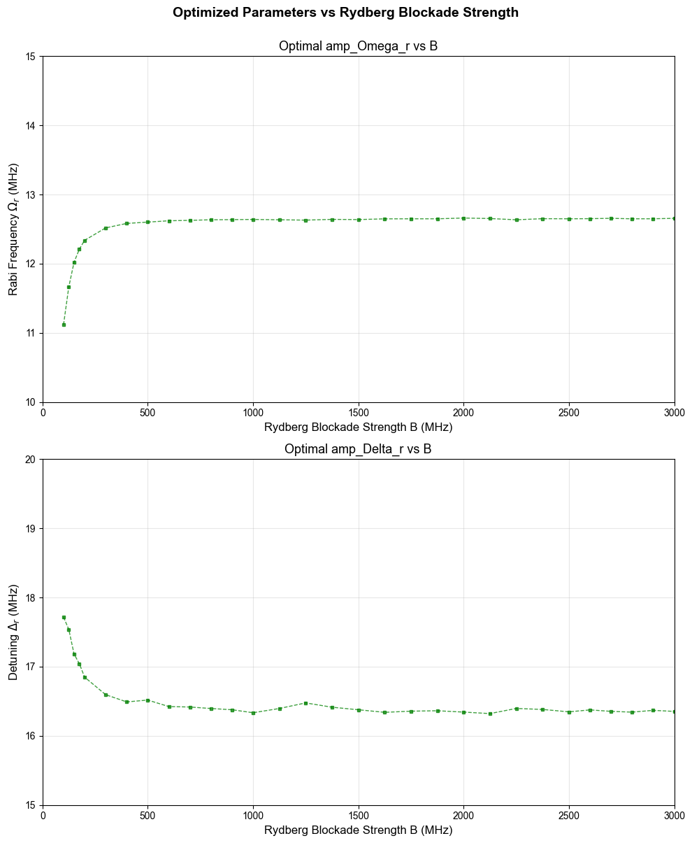
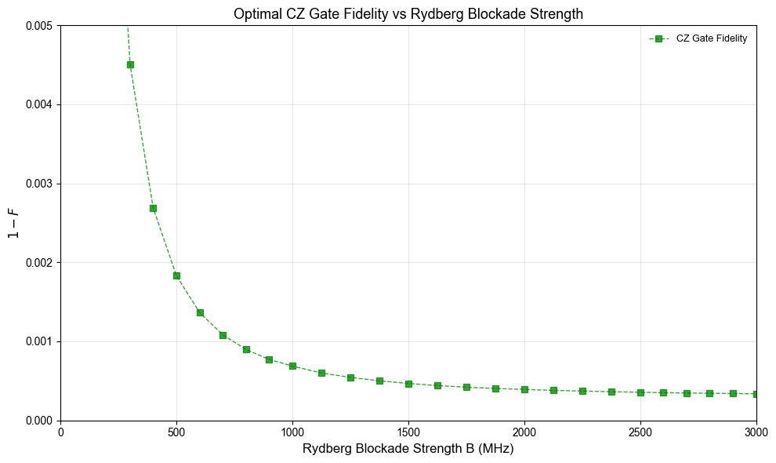
For the case : fix $T_{gate}=0.54 μs$ and $τ/T_{gate}=0.175$
For this case :
There are actually at least two branches, another one I didn’t plot but there is one.

Slide 12
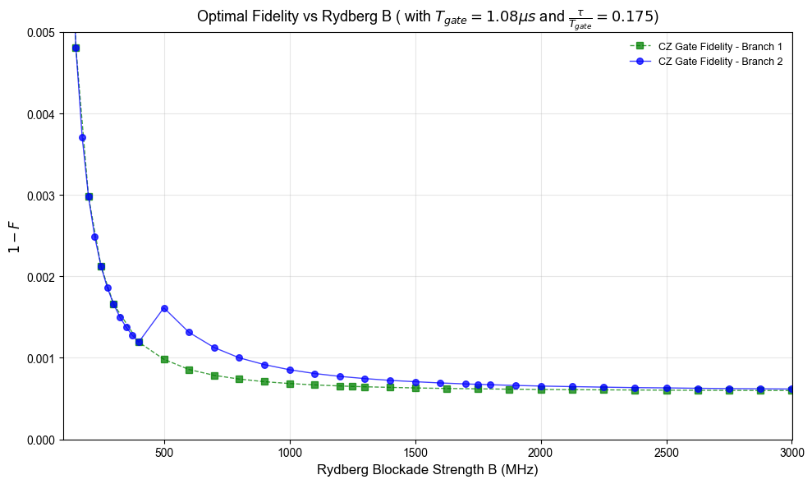
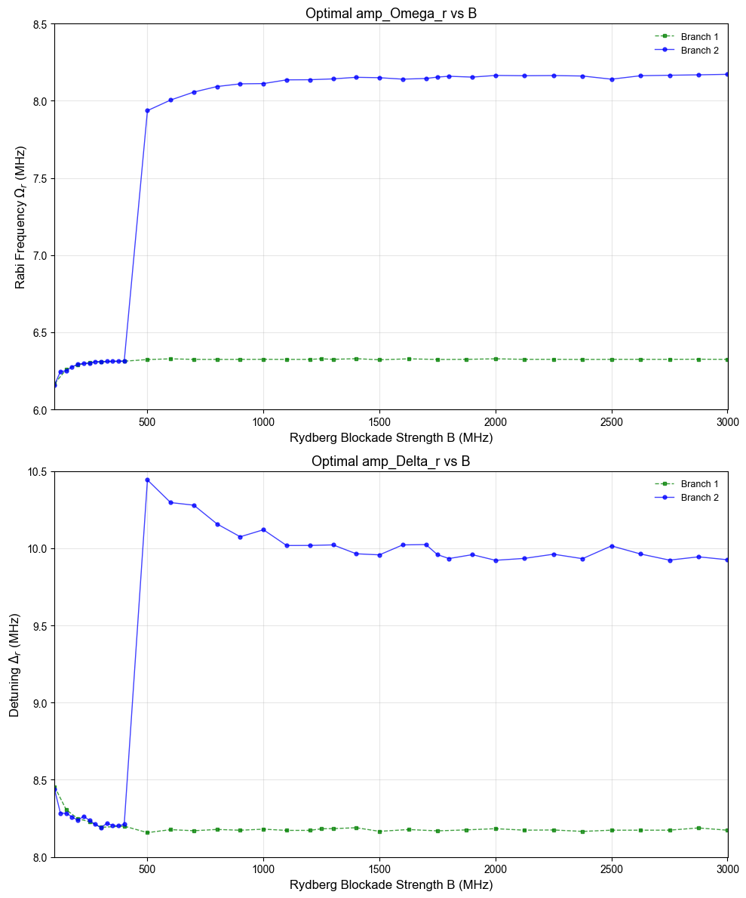
For the case : fix $T_{gate}=1.08 μs$ and $τ/T_{gate}=0.175$
For this case, I found two curves :
one shows a continuous relation between optimal parameters and strength B, the optimal parameters show convergence as B increases.
while another one shows a jump around B = 400 MHz
These two curves are nearly the same where B is small and where B is large enough, the optimal parameters also show convergence as B increases but accompanying with small fluctuations.

Slide 13
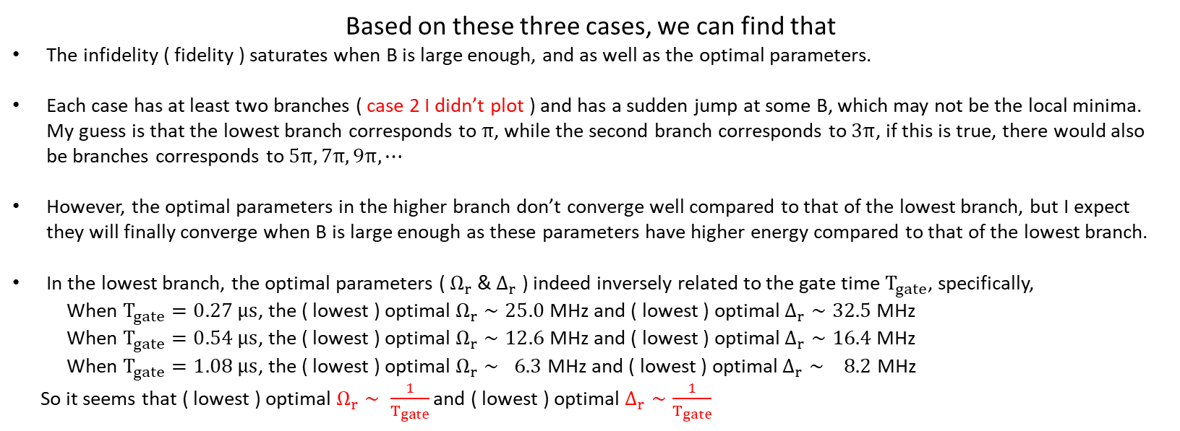
Based on these three cases, we can find that
The infidelity ( fidelity ) saturates when B is large enough, and as well as the optimal parameters.
Each case has at least two branches ( case 2 I didn’t plot ) and has a sudden jump at some B, which may not be the local minima. My guess is that the lowest branch corresponds to $π$, while the second branch corresponds to $3π$, if this is true, there would also be branches corresponds to $5π, 7π, 9π, ⋯$
However, the optimal parameters in the higher branch don’t converge well compared to that of the lowest branch, but I expect they will finally converge when B is large enough as these parameters have higher energy compared to that of the lowest branch.
In the lowest branch, the optimal parameters ( $Ω_{r}$ & $Δ_{r}$ ) indeed inversely related to the gate time $T_{gate}$, specifically,
When $T_{gate}=0.27 μs$, the ( lowest ) optimal $Ω_{r}∼25.0$ MHz and ( lowest ) optimal $Δ_{r}∼32.5$ MHz
When $T_{gate}=0.54 μs$, the ( lowest ) optimal $Ω_{r}∼12.6$ MHz and ( lowest ) optimal $Δ_{r}∼16.4$ MHz
When $T_{gate}=1.08 μs$, the ( lowest ) optimal $Ω_{r}∼ 6.3$ MHz and ( lowest ) optimal $Δ_{r}∼ 8.2$ MHz
So it seems that ( lowest ) optimal $Ω_{r}∼ \frac{1}{T_{gate}}$ and ( lowest ) optimal $Δ_{r}∼\frac{1}{T_{gate}}$

Slide 14
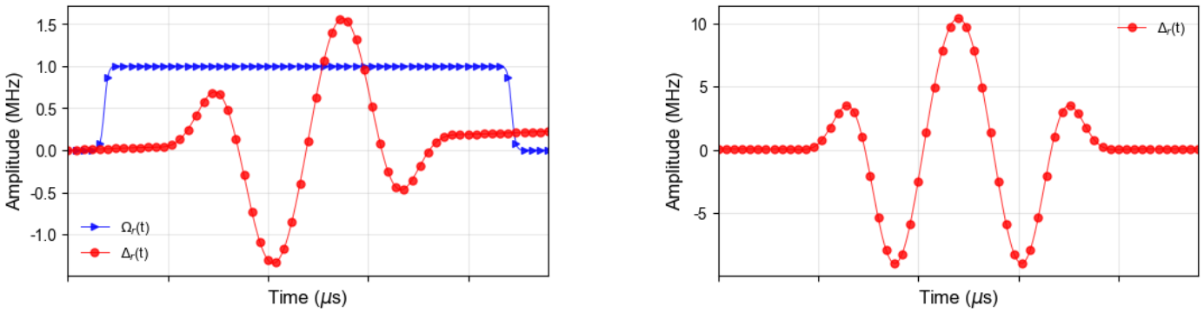
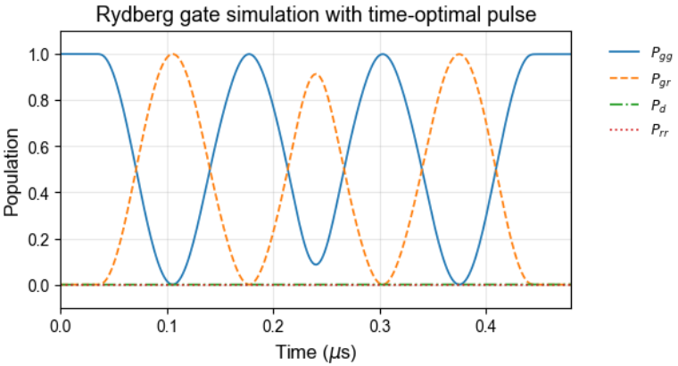
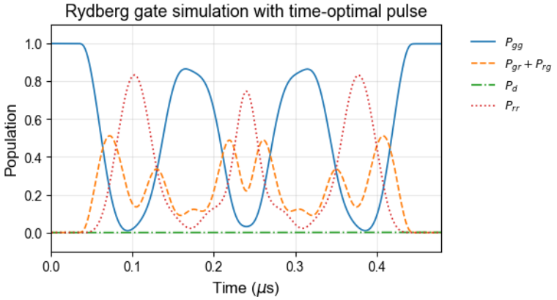
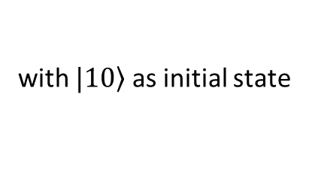
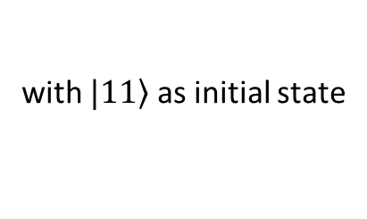
CZ Gate Realization with Time Optimal Pulse
( Not Finished )
with $|\left.10\right\rangle$ as initial state
with $|\left.11\right\rangle$ as initial state
Successfully reproduce the Fig3 in the paper, so the next step is to perform optimization of the pulse.

Slide 15
Stim
5310 : Thursday at 13:00 pm
5310 : Tuesday at 12:30 pm

