Slide 1

The intelligent operating system for your money.
Product & Brand Overview — June 2026

Slide 2



Managing money in Nigeria means juggling a dozen
apps, statements, and a flood of bank SMS alerts
50+
0
?
Bank SMS & email alerts every month
People who enjoy manual spreadsheets
Where did my money actually go?
...that no one has time to read or log
Most give up tracking within weeks
No single, trustworthy picture of spending
The result: people lose touch with their own finances — and miss the small leaks that add up.

Slide 3



Zinkro reads your bank alerts so you don't have to
Three steps. Zero manual entry.
1
2
3
Connect once
→
AI categorizes automatically
→
Personalized insights
Zinkro securely reads SMS & email alerts from GTBank, Access, Zenith and other major banks.
Every transaction is parsed, categorized, and matched to budgets — Feeding, Transport, Rent, Utilities and more.
Weekly reviews, spending forecasts, savings nudges, and an AI assistant that knows your finances.
Track it all, automatically.

Slide 4
Brand Identity
Charcoal
Surface
Electric Blue
#0F1115
#181B22
#3D7FFF
Teal
Off-White
Success
#00D4D4
#F5F6FA
#34D399
“To keep tally, automatically.”
Amber
Coral
Purple
The Pulse Bracket: brackets represent automatic capture; the pulse line represents financial activity.
#FFB84D
#FF6B6B
#9B7EDE
Sora
Headings & display
Inter
Body text & numerals

Slide 5
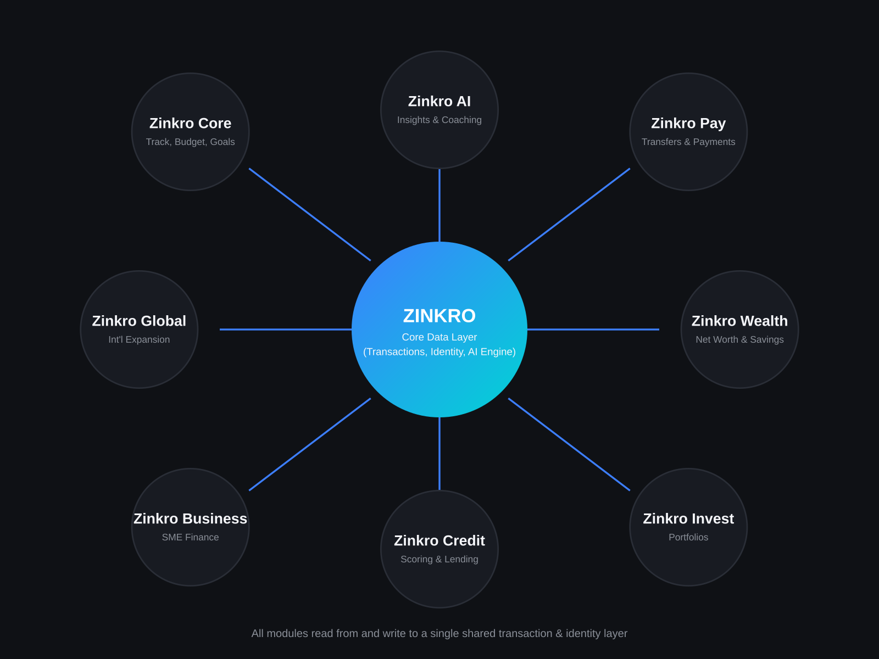
A Unified Design System
One set of tokens, components, and patterns powers mobile and web alike.
1
Dark mode by default
Charcoal canvas with electric blue & teal accents — designed for long, comfortable sessions; light mode fully supported.
2
Consistent component library
Buttons, cards, charts, modals, and AI components share the same tokens for spacing, radius, and color across every screen.
3
Accessible by design
Color combinations meet AA contrast standards; every interactive element has clear focus and hover states.
4
Responsive, mobile to web
The same information architecture scales from a 375px phone frame to a full desktop dashboard with persistent side panels.

Slide 6

Mobile App
Six core screens, one continuous experience

Slide 7
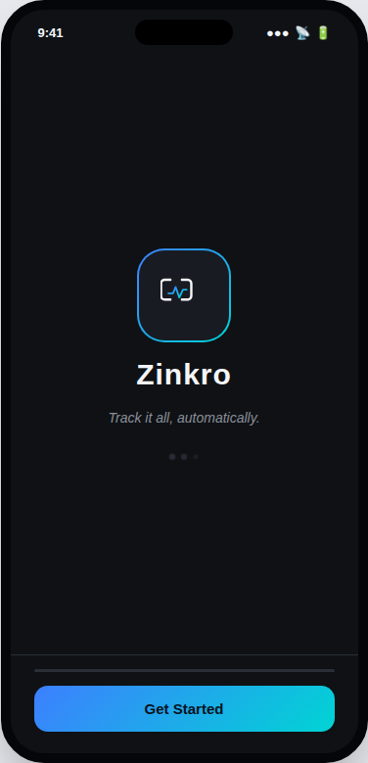
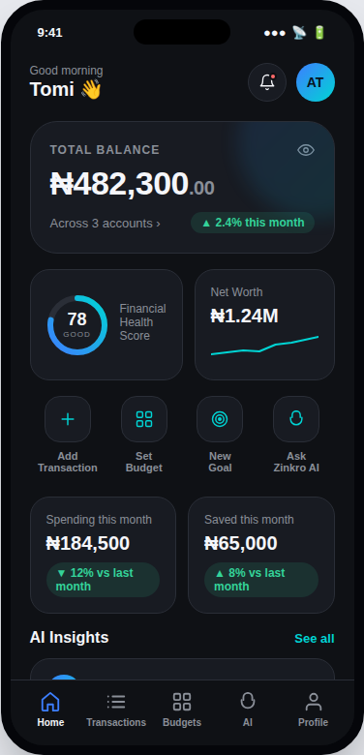
Onboarding & Home Dashboard
Onboarding
Home Dashboard
12-screen guided setup, bank connection & first insights
Balance, spending snapshot, goals & AI highlights at a glance

Slide 8
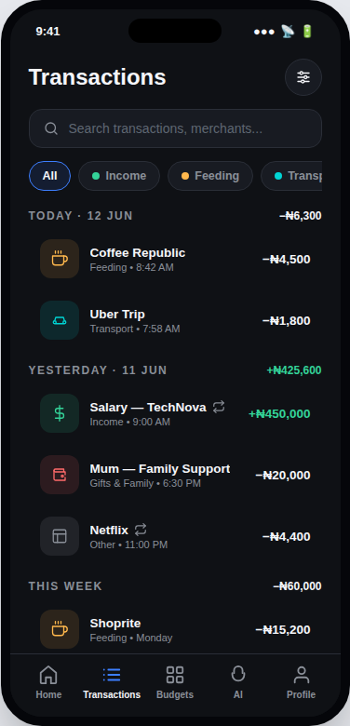
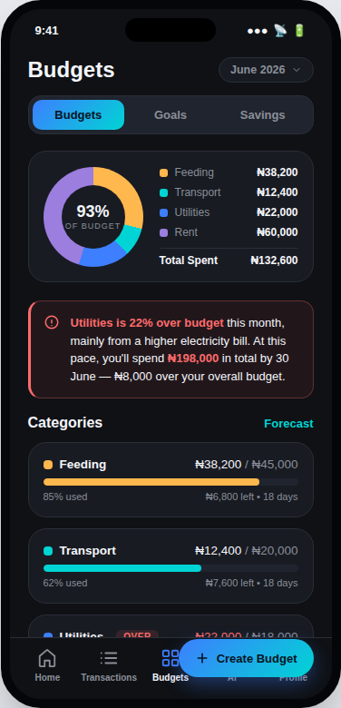
Transactions & Budgets / Goals
Transactions
Budgets, Goals & Savings
Auto-categorized feed with search, filters & detail view
Category budgets, goal rings, and automated savings rules

Slide 9
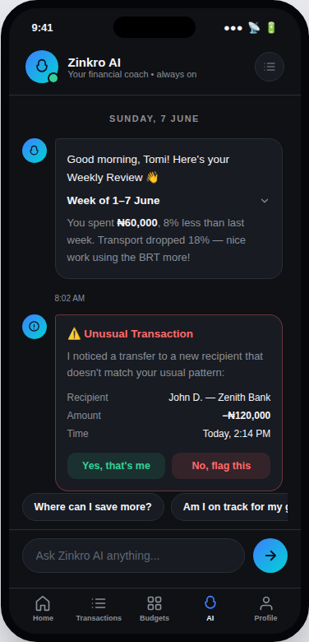
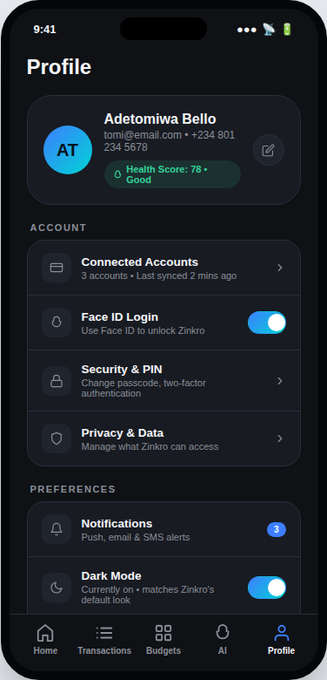
AI Assistant & Profile
AI Assistant
Profile & Settings
Conversational coach with weekly reviews & risk alerts
Account, subscription, referrals — with live Dark / Light mode

Slide 10
Web Platform
The same intelligence, full desktop power

Slide 11
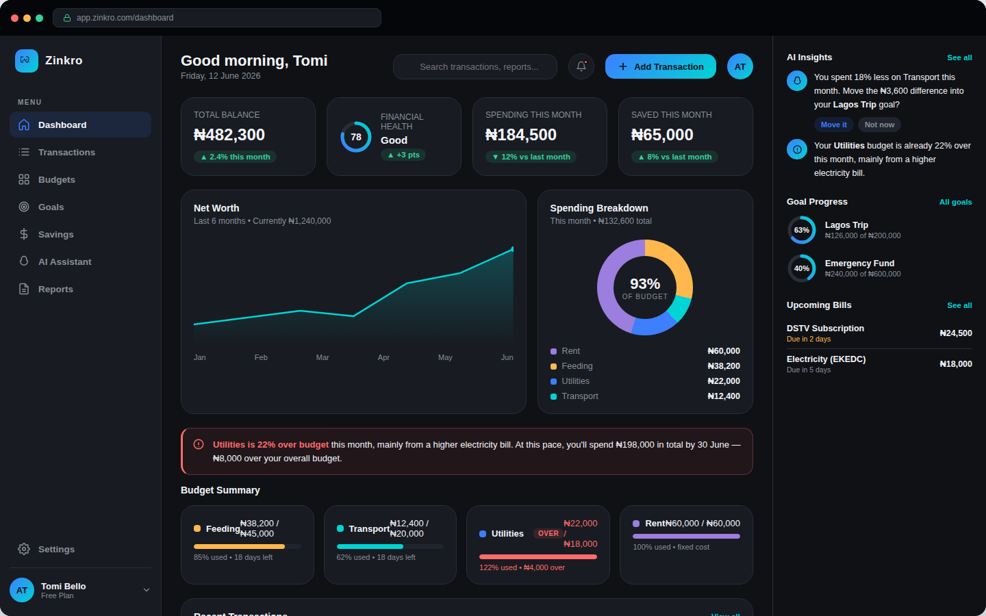
Dashboard
Net worth, spending breakdown, budgets, transactions & AI insights — all in one view

Slide 12
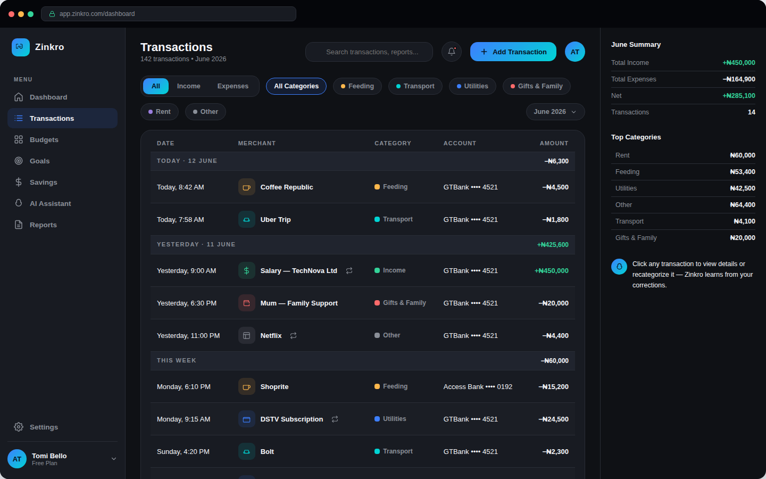
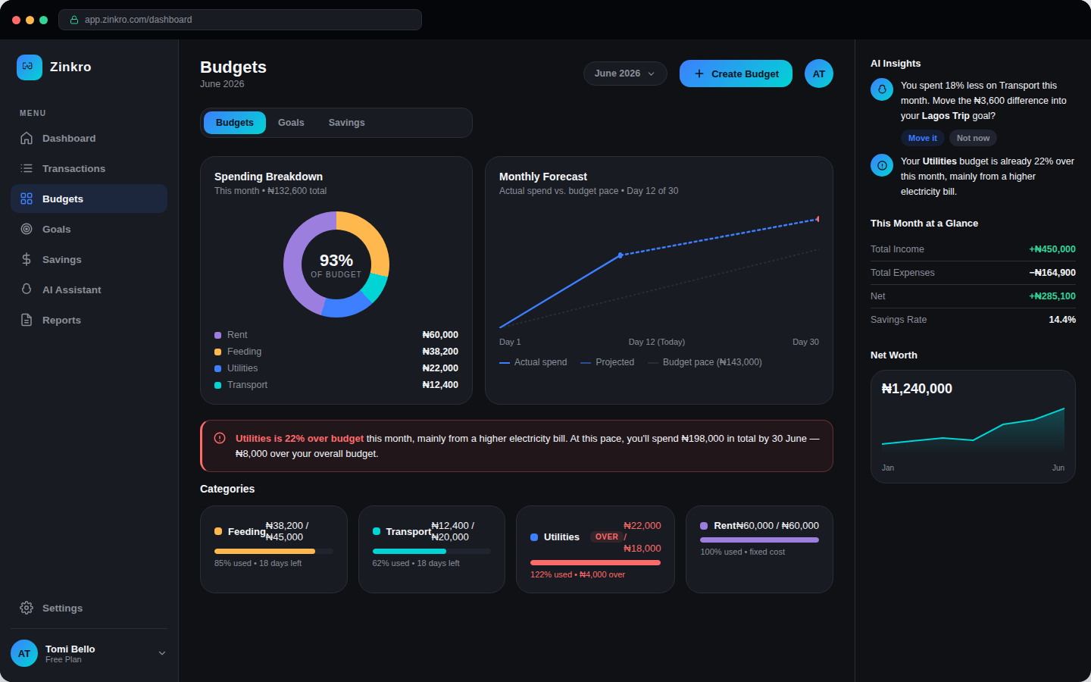
Transactions & Budgets / Goals
Transactions
Budgets, Goals & Savings
Filterable, grouped ledger with a detail panel for recategorizing
Forecast charts, goal progress, and automated savings rules

Slide 13
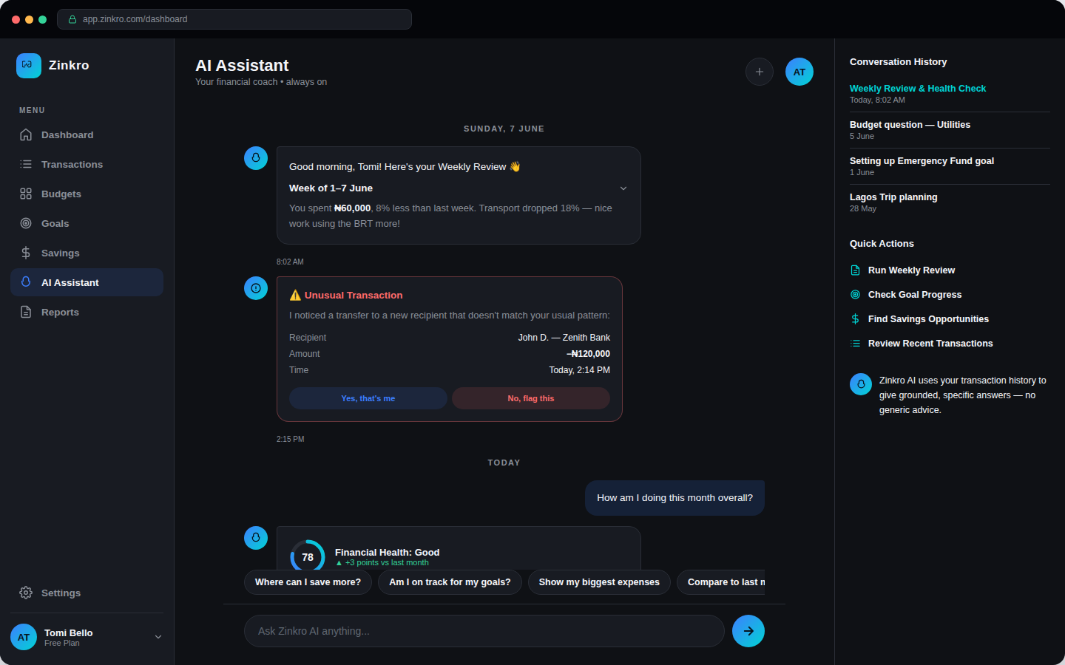
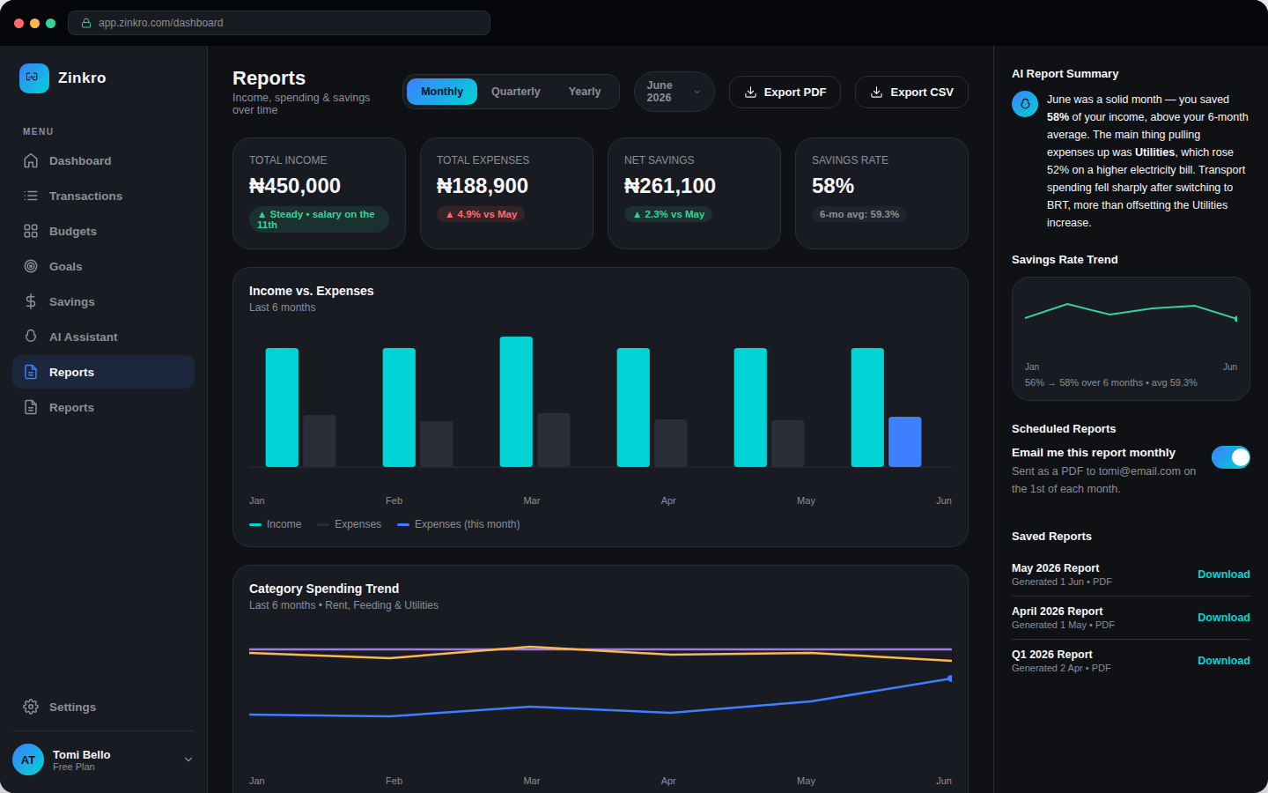
AI Assistant & Reports
AI Assistant
Reports
Full chat experience with conversation history & quick actions
Monthly/quarterly/yearly trends with AI-written summaries & export

Slide 14
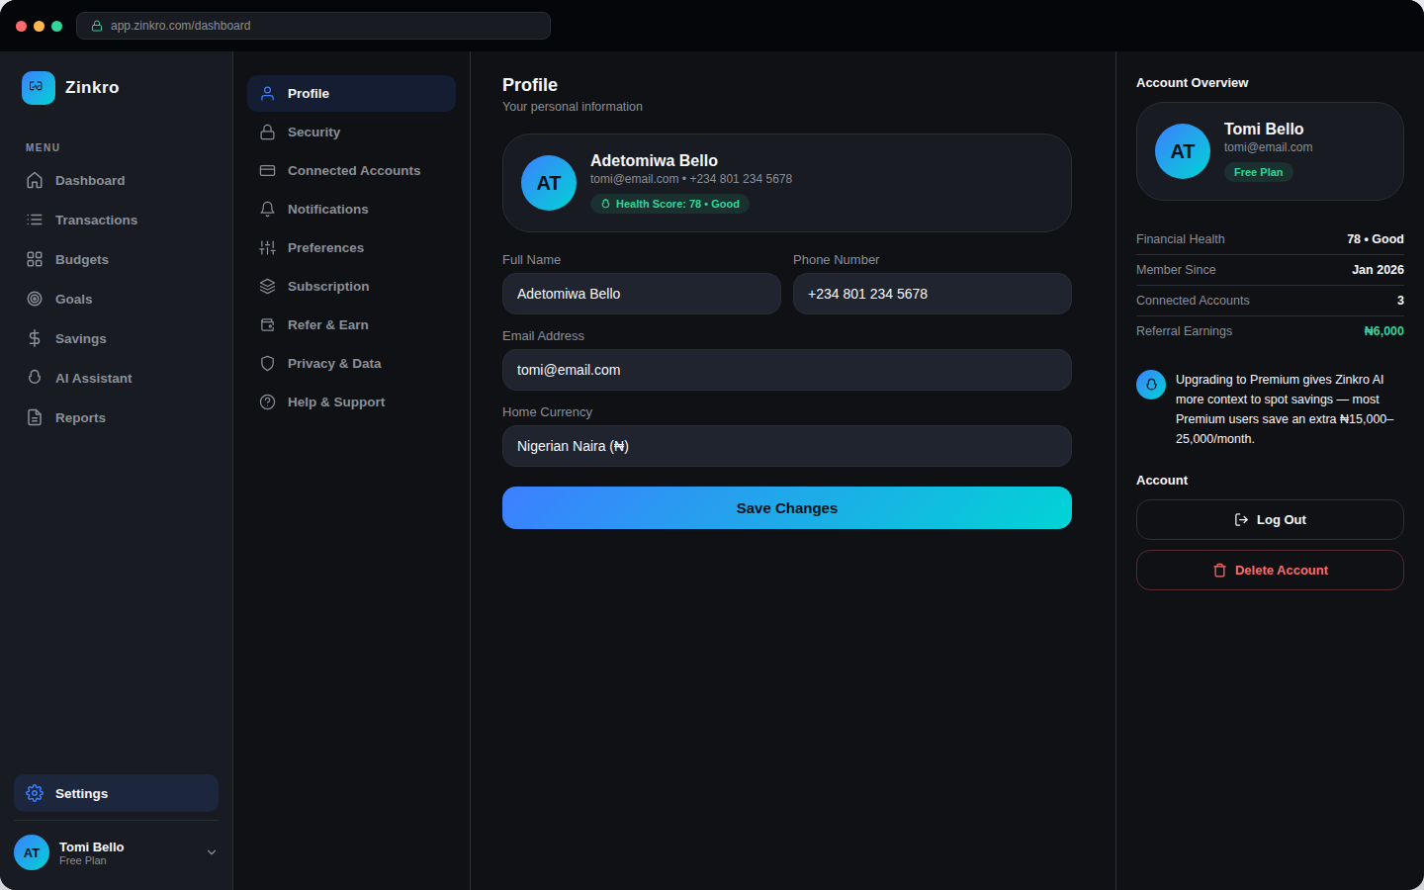
Settings
Profile, security, connected accounts, notifications, billing & live theme switching

Slide 15







Beyond Tracking: The Zinkro Platform
A foundation for a full financial operating system across Africa
Zinkro AI
Wealth
Business
Pay
Conversational financial coach
Net worth & investment tracking
Tools for freelancers & SMEs
Bills, transfers & payments
Invest
Credit
Global
Guided investing & portfolios
Credit scoring & access to loans
Cross-border, multi-currency support

Slide 16
Thank You
Track it all, automatically.
Next Steps
Finalize bank SMS/email parsing pilot with GTBank, Access Bank & Zenith
User testing of mobile onboarding & AI Assistant with target segment
Engineering kickoff for core ledger, categorization engine & web platform
Define sub-brand sequencing: Zinkro AI → Wealth → Pay
zinkro.com • hello@zinkro.com

