Slide 1
Aggregate Functions and Data Partitioning

Slide 2
Collections and aggregate functions
A collection is a grouping of some variable number of data items (possibly zero)
Usually the data items in a collection are of the same type
Aggregate functions are functions that apply to collections, i.e., they consider all these data items in these collections
Applied to a collection, an aggregate function returns a single value

Slide 3
Examples of collections
sets, multisets, dictionaries (maps), relations
vectors, lists, arrays, series
data structures: stacks, queues, hash tables, trees, graphs

Slide 4
Aggregate functions on unordered collections
We will restrict ourselves to aggregate functions on sets, bags, and relations
COUNT (we will often use the notation |A| instead of COUNT(A))
SUM, AVERAGE, MIN, and MAX
COUNT({a,b,c}) = 3; COUNT({{a,c,c,b,b,b}}) = 6
SUM({1, 4, 7}) = 12; SUM({{1,1,1,1,1}}) = 5
AVG({1,4,7}) = 4; AVG({{1,1,1,1,1}}) = 1
MIN({1,4,7}) = MIN({{1,1,1,1,1}}) = 1
MAX({1,4,7}) = 7; MAX({{1,1,1,1,1}}) = 1
MIN({John,Eric,Ann}) = Ann
These aggregate functions are supported in SQL

Slide 5
Applications of aggregate functions
Data analytics
Formulating complex queries
Facilitating efficient query evaluation

Slide 6
Counting the size of a set in SQL
Let R(A1,…,An) be a relation.
Then |R| can be obtained as follows:
Alternatively,
Of course we can restrict the COUNT function to apply to a subset of R by applying a WHERE clause.
SELECT COUNT(*)
FROM R r;
SELECT COUNT(1)
FROM R r;

Slide 7
COUNT examples
“Find the number of courses in which the student with sid 10 is enrolled.”
“Find the number of students who are not enrolled in any CS course.”
SELECT COUNT(*)
FROM Enroll E
WHERE E.sid = ‘s10’;
SELECT COUNT(*)
FROM Student S
WHERE S.Sid NOT IN (SELECT E.Sid
FROM Enroll E, Course C
WHERE E.Cno = C.Cno AND C.Dept = ‘CS’);

Slide 8
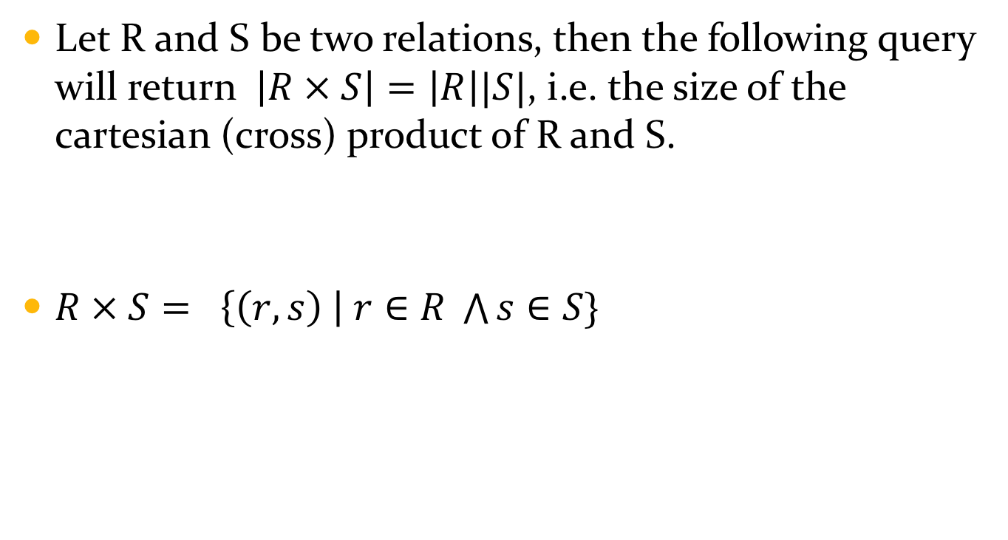
COUNT Example
Let R and S be two relations, then the following query will return $\left|R × S\right|=\left|R\right||S|$, i.e. the size of the cartesian (cross) product of R and S.
$R × S= \left\{\left(r,s\right) \right| r∈R \bigwedge{s∈S\}}$
SELECT COUNT(*)
FROM R r, S s;

Slide 9
COUNT DISTINCT
R
A | B
a | 1
a | 2
b | 1
SELECT COUNT(r1.A) AS Total
FROM R r1, R r2
Total
9
SELECT COUNT(DISTINCT r1.A) AS Total
FROM R r1, R r2
Total
2

Slide 10
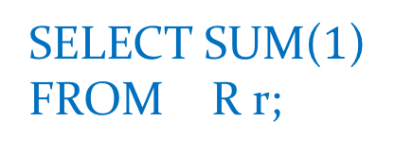
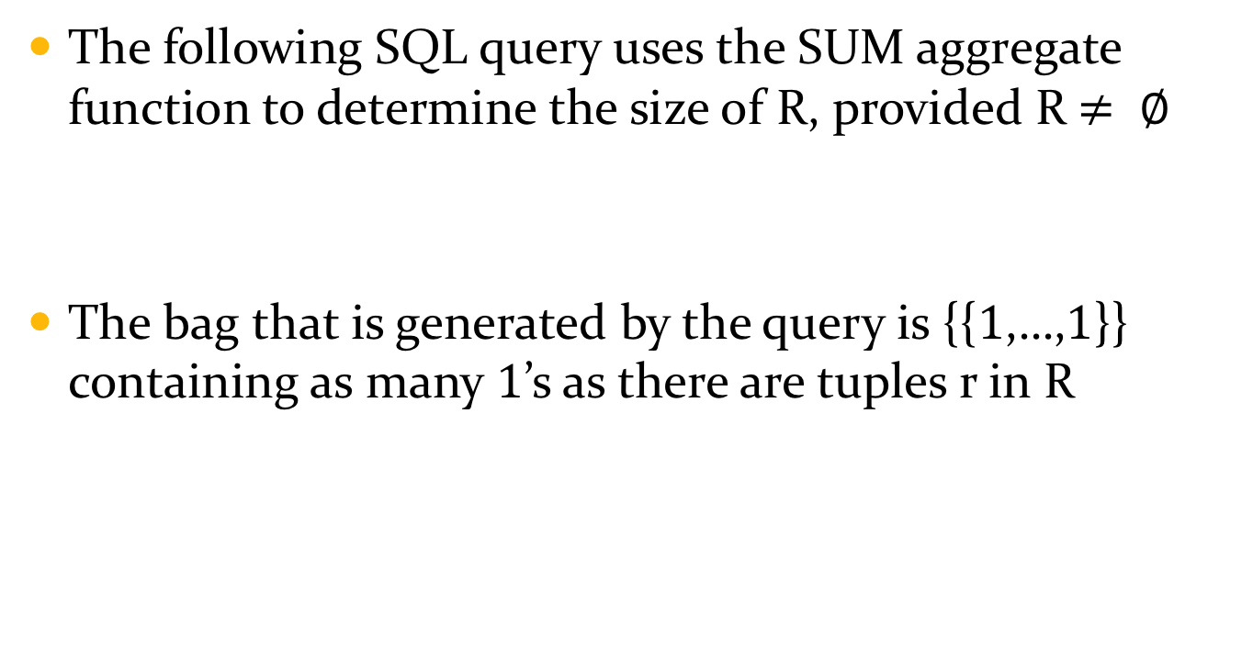
Simulating COUNT with SUM
The following SQL query uses the SUM aggregate function to determine the size of R, provided R$≠ ∅$
The bag that is generated by the query is {{$1$,…,$1$}} containing as many $1$’s as there are tuples r in R
SELECT SUM($1$)
FROM R r;

Slide 11
Example
A
a
b
c
Consider the relation R
|R| = 3
COUNT applies to {{a,b,c}}
SUM applies to {{1, 1, 1}}
If you write the SQL query
the result will be SUM({{2,2,2}}) = 6.
SELECT SUM(2)
FROM R r;

Slide 12


Caveat: empty collection
Consider the relation R
|R| = $0$
COUNT applied to {} gives $0$
SUM applied to {} gives NULL
A
SELECT COUNT(1)
FROM R r;
$$0$$
SELECT SUM(1)
FROM R r;
NULL

Slide 13
MIN and MAX aggregate functions
MIN returns the smallest data item in the bag to which it applies.
MAX returns the largest data item in the bag to which it applies.
Data items can come from any ordered basic domain: integer, float, text
A more general MIN function can be simulated using <= ALL
MAX can be simulated using >= ALL
However, there is a problem if MIN (MAX) is applied to an empty set.
SELECT DISTINCT r.A1,…,r.An
FROM R r
WHERE (r.A1,...,r.An) <= ALL (SELECT r1.A1,...,r1.An
FROM R r1);

Slide 14
CAVEAT: aggregate functions on empty set
Except for COUNT, SQL aggregate functions return a NULL value when applied to an empty set (or bag).
Assume R is the empty relation
Then
returns the relation
However
returns the empty relation
A
SELECT MIN(r.A) AS smallest FROM R r
smallest
NULL
SELECT r.A AS smallest FROM R r WHERE r.A <= ALL(SELECT r1.A FROM R r1)
smallest

Slide 15
Partitioning and counting
“Determine for each student the number of courses taken by that student.”
Enroll
Sid | Cno
s1 | c1
s2 | c1
s1 | c2
s3 | c3
s3 | c4
s1 | c3
Sid | No_Courses
s1 | 3
s2 | 1
s3 | 2

Slide 16
Partition and map count function
(1) First, Partition the Enroll table into cells (blocks) wherein each cell contains all the tuples that have a common sid value.
(2) Next, Map the COUNT function over these cells.
s1 c1
s1 c2
s1 c3
Cell(s1)
COUNT
3
COUNT
1
Cell(s2)
s2 c3
Cell(s3)
s3 c3
s3 c4
COUNT
2

Slide 17
Partition and map COUNT in SQL
(1) The GROUP BY map COUNT method
(2) The user-defined COUNT FUNCTION method
(3) The SELECT COUNT-expression method

Slide 18
The GROUP BY map COUNT method
Partition phase: the GROUP BY operator places each tuple E into the cell identified by its E.Sid value
Map COUNT phase: the COUNT function is mapped over the cells identified by the different possible E.sid values
Map COUNT phase
SELECT E.Sid, COUNT(*) AS No_Courses
FROM Enroll E
GROUP BY(E.Sid)
Partition phase

Slide 19
The user-defined COUNT FUNCTION method
“Define a function with input parameter a student sid and as output the number of courses taken by that student.
Then execute the SQL query
CREATE FUNCTION NumberOfCourses (s TEXT) RETURNS bigint
AS $$
SELECT COUNT(*)
FROM Enroll E
WHERE E.Sid = s;
$$ LANGUAGE SQL;
Map COUNT phase
SELECT S.Sid, NumberOfCourses(S.Sid) AS No_Courses
FROM Student S;
Partition phase

Slide 20
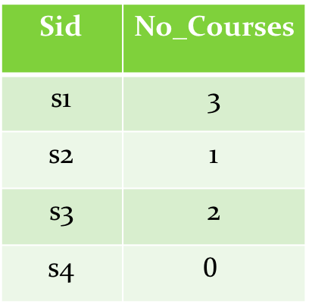
Student
Enroll
Sid
s1
s2
s3
s4
Sid | Cno
s1 | c1
s1 | c2
s1 | c3
s2 | c3
s3 | c3
s3 | c4
SELECT S.Sid, NumberOfCourses(S.Sid) AS No_Courses
FROM Student S;
Sid | No_Courses
s1 | 3
s2 | 1
s3 | 2
s4 | $$0$$
student s4 takes no courses

Slide 21
The SELECT COUNT-expression method
SELECT S.sid, (SELECT COUNT(E.Cno) AS NumberCourses
FROM Enroll E
WHERE E.Sid = S.Sid)
FROM Student S
Observe that the subquery identified by S.Sid appears in the outer SELECT clause.
The COUNT of the result of this subquery is then delivered as a value in the outer SELECT clause.
Notice that this expression must appear between parentheses.
The output of this query is the same as that on the previous slide.
Map phase
Partition phase

Slide 22
Example query
“Find the sid of each student who takes the most courses.”
Using the COUNT FUNCTION method:
SELECT S.sid
FROM Student S
WHERE NumberOfCourses(S.sid) >= ALL (SELECT NumberOfCourses(S1.Sid)
FROM Student S1);

Slide 23
Example query
“Find the sid of each student who take the most courses.”
Using the GROUP BY method:
WITH
NumberOfCoursesbyStudent AS (SELECT E.Sid, COUNT(E.Cno) NumberOfCourses
FROM Enroll E
GROUP BY(E.Sid))
SELECT P.sid
FROM NumberOfCoursesbyStudent P
WHERE P.NumberOfCourses >= ALL (SELECT P1.NumberOfCourses
FROM NumberOfCoursesbyStudent P1);

Slide 24
Example query
“Find the sid of each student who takes the most courses.”
Using the COUNT expression method:
SELECT S.Sid
FROM Student S
WHERE (SELECT COUNT(E.cno)
FROM Enroll E
WHERE E.sid = S.sid) >= ALL (SELECT (SELECT COUNT(E.cno)
FROM Enroll E
WHERE E.sid = S1.sid)
FROM Student S1);

Slide 25

The COUNT-bug of GROUP BY
The result of the following 2 queries is the same. Notice that there is a bug since, if a student sid takes no courses, then (sid, $0$) does not appear in the output.
These two queries give the same result and exhibit the COUNT bug: the tuple (s4,$0$) does not appear in the result.
SELECT S.Sid, Count(E.Cno)
FROM Student S, Enroll E
WHERE S.Sid = E.Sid
GROUP BY(S.Sid)
SELECT E.Sid, COUNT(E.Cno)
FROM Enroll E
GROUP BY (E.Sid)

Slide 26
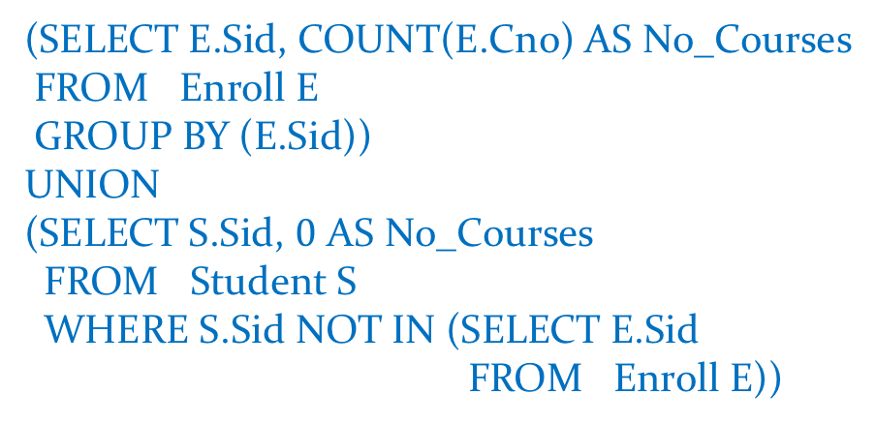

Fixing the COUNT-bug
To fix the COUNT-bug we need to add the (s,$0$) pair if student with sid s takes no courses. This can be done with the UNION operator.
(SELECT E.Sid, COUNT(E.Cno) AS No_Courses
FROM Enroll E
GROUP BY (E.Sid))
UNION
(SELECT S.Sid, $0$ AS No_Courses
FROM Student S
WHERE S.Sid NOT IN (SELECT E.Sid
FROM Enroll E))

Slide 27
Partitioning on different dimensions
Enroll
SELECT E.Sid, COUNT(*)
FROM Enroll E
GROUP BY (E.Sid)
Sid | Cno
s1 | c1
s1 | c2
s1 | c3
s2 | c3
s3 | c3
s3 | c4
SELECT COUNT(*)
FROM Enroll
GROUP BY ()
E.sid
s1 | 3
s2 | 1
s3 | 2
6
E.Sid | E.Cno
s1 | c1 | 1
s1 | c2 | 1
s1 | c3 | 1
s2 | c3 | 1
s3 | c3 | 1
s3 | c4 | 1
SELECT E.Sid, E.Cno, COUNT(*)
FROM Enroll E
GROUP BY (E.Sid, E.Cno)

Slide 28
What can appear in the GROUP BY clause?
Answer: any valid expression over the tuples in the FROM clause.
Partition: there will be as many cells in the partition as there are different values for expression(t1,…,tn)
SELECT …
FROM R1 t1,...,Rn tn
WHERE ...
GROUP BY(expression(t1,...,tn))

Slide 29
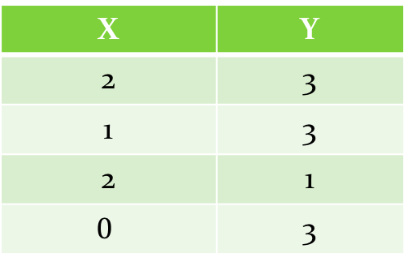
Example: expressions in GROUP BY
S
X | Y
2 | 3
1 | 3
2 | 1
$$0$$ | 3
SELECT s.x + s.y AS sum, COUNT(*) as cell_size
FROM S s
GROUP BY (s.x + s.y)
sum | cell_size
3 | 2
4 | 1
5 | 1
Notice that there are 4 tuples in R assigned to variable s but only 3 different s.x+s.y values: 3, 4, 5. Thus there are only 3 cells in the partition.

Slide 30
Example: expression in GROUP BY
Person
Pid | Age
p1 | 10
p2 | 9
p3 | 12
p3 | 9
SELECT p.age > 10 AS OlderThanTen, COUNT(*)
FROM Person p
GROUP BY (p.age > 10);
OlderThanTen | Count
f | 3
t | 1

Slide 31
Restrictions on SELECT clause in GROUP BY query
In a GROUP BY query, the SELECT clause may only contain aggregate expressions that returns a single value for each cell of the partition induced by the GROUP BY clause.
SELECT AggregateExpression(cell(expression(t1,…,tn)), ...
FROM R t1,...,tn
WHERE condition(t1,…,tn)
GROUP BY (expression(t1,...,tn))

Slide 32
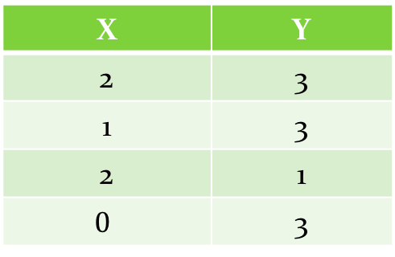
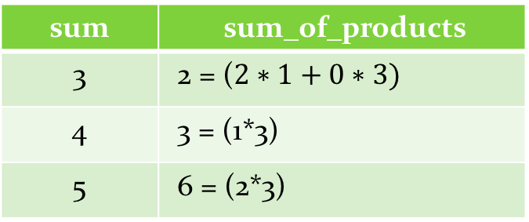
Aggregate expressions in SELECT clause
S
X | Y
2 | 3
1 | 3
2 | 1
$$0$$ | 3
SELECT s.x+s.y AS sum,
SUM(s.x*s.y) AS
sum_of_products
FROM S s
GROUP BY (s.x+s.y)
sum | sum_of_products
3 | 2 = ($2∗1+0∗3)$
4 | 3 = (1*3)
5 | 6 = (2*3)

Slide 33
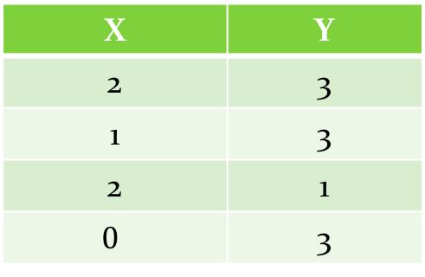
Aggregate expressions in SELECT clause
The following query will raise an error since s.x is not necessarily unique in a cell defined by s.x+s.y values
S
X | Y
2 | 3
1 | 3
2 | 1
$$0$$ | 3
SELECT s.x
FROM S s
GROUP BY (s.x+s.y)

Slide 34
Use case: some simple statistics
Consider an experiment wherein we conduct a set of trials wherein in each trial we throw a pair of dice
Further consider the random variable that returns, for each trial, the sum of the values that appear on the two dice
We then want to determine the frequency of this sum to be a value between 2 and 12.
Finally, we want to compute the expected value of the random variable.

Slide 35
Trials and random variable
Trials
Random Variable
Tid | Dice 1 | Dice 2
t1 | 1 | 3
t2 | 2 | 3
t3 | 1 | 1
t4 | 1 | 6
t5 | 2 | 5
t6 | 1 | 6
t7 | 6 | 5
t8 | 6 | 1
t9 | 4 | 1
Tid | Dice 1 + Dice 2
t1 | 4
t2 | 5
t3 | 2
t4 | 7
t5 | 7
t6 | 7
t7 | 11
t8 | 7
t9 | 5
Notice that some Dice 1 + Dice 2 values occur more frequently than others

Slide 36
Frequency
Suppose that we now want to determine the number of trials that have the same random variable value
Notice that we get different
frequencies across the
different t.Dice1 + t.Dice2 values
SELECT t.Dice1 + t.Dice2 AS RV, COUNT(t.Tid) AS Frequency
FROM Trials t
GROUP BY (t.Dice1 + t.Dice2)
RV | Frequency
2 | 1
4 | 1
5 | 2
7 | 4
11 | 1

Slide 37

Expected value of the random variable Dice1+Dice2
$2∗\frac{1}{9}+4∗\frac{1}{9}+5∗\frac{2}{9}+7∗\frac{4}{9}+11∗\frac{1}{9}$ = 6.11…
The theoretical value is 7
We can get this expected value as follows:
SELECT SUM(Q.RV * Q.NTrials)/(SELECT COUNT(*)
FROM Trials) AS Expectation
FROM (SELECT t.Dice1 + t.Dice2 AS RV,
COUNT(t.Tid) AS NTrials
FROM Trials t
GROUP BY(t.Dice1 + t.Dice2)) AS Q
Expectation
6.11

Slide 38
The HAVING clause in GROUP BY queries
The HAVING clause in a GROUP BY selects those cells from the partition induced by the GROUP BY clause that satisfy an Aggregate Condition.
Only those cells are passed onto the SELECT clause.
SELECT AggregateExpression(Cell(expression(t1,…,tn)), ...
FROM R1 t1, ..., R tn
WHERE condition(t1,...,tn)
GROUP BY (expression(t1,...,tn))
HAVING AggregateCondition(Cell(expression(t1,...,tn)))

Slide 39
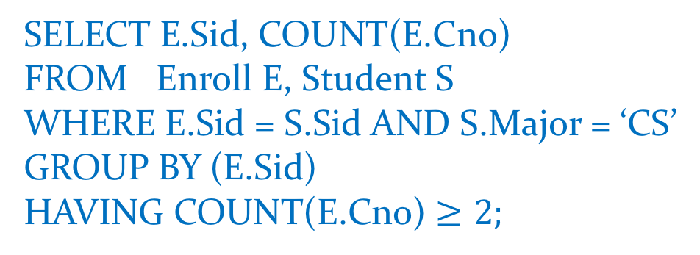
Example: HAVING clause
“For each student who majors in CS determine the number of courses taken by that student, provided that this number is at least 2.”
SELECT E.Sid, COUNT(E.Cno)
FROM Enroll E, Student S
WHERE E.Sid = S.Sid AND S.Major = ‘CS’
GROUP BY (E.Sid)
HAVING COUNT(E.Cno) $≥2;$

Slide 40
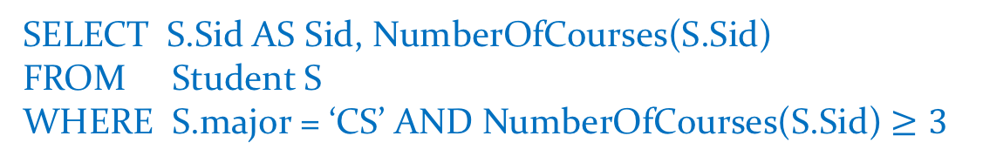
Simulating HAVING clause with user-defined functions in WHERE
“For each student who majors in CS, determine the number of courses taken by that student, provided that this number is at least 3.”
The HAVING condition can be simulated in the WHERE clause with user-defined functions.
SELECT S.Sid AS Sid, NumberOfCourses(S.Sid)
FROM Student S
WHERE S.major = ‘CS’ AND NumberOfCourses(S.Sid) $≥3$

Slide 41
Spreadsheet (Data Cube)
Sid | Cno
s1 | c1
s1 | c2
s1 | c3
s2 | c1
s2 | c2
s3 | c2
s4 | c1

Slide 42
GROUPING sets
It may be desirable to simultaneously generate different partitions and then apply an aggregation
This is supported in SQL via GROUPING sets.
Sid | Cno
s1 | c1
s1 | c2
s2 | c1
s2 | c2
s3 | c1
Sid | Cno | Count
s1 | * | 2
s2 | * | 2
s3 | * | 1
* | c1 | 3
* | c2 | 2
SELECT Sid, Cno, COUNT(*)
FROM Enroll
GROUP BY
GROUPING SETS((Sid),(Cno))

Slide 43
CUBE operation
Sid | Cno | Sum
s1 | c1 | 1
s1 | c2 | 1
s1 | c3 | 1
s2 | c1 | 1
s2 | c2 | 1
s3 | c2 | 1
s4 | c1 | 1
s1 | NULL | 3
s2 | NULL | 2
s3 | NULL | 1
s4 | NULL | 1
NULL | c1 | 3
NULL | c2 | 3
NULL | c3 | 1
NULL | NULL | 7
SELECT Sid, Cno, COUNT(*)
FROM Enroll
GROUP BY GROUPING SETS
((Sid,Cno),(Sid),(Cno),())
SELECT Sid, Cno, COUNT(*)
FROM Enroll
GROUP BY CUBE(Sid,Cno)

Slide 44
WINDOW functions
A window function performs a calculation across a set of tuples that are somehow related to the current tuple
This is comparable to the type of calculation that can be done with an aggregate function
But unlike regular aggregate functions, use of a window function does not cause tuples to become grouped into a single output tuple — the tuples retain their separate identities

Slide 45
Product
Name | Type | Price
bag | accessory | 30
footliner | socks | 10
slippers | housewear | 15
leggings | socks | 7
pijamas | houseware | 25
necklace | accessory | 7
hat | accessory | 15
watch | accessory | 15
“Associate with each product the average price of all the products of that product’s type.”

Slide 46
SELECT name, type, price, AVG(price) OVER (PARTITION BY type)
FROM product;
name | type | Price | Avg
bag | accessory | 30 | 16.75
necklace | accessory | 7 | 16.75
hat | accessory | 15 | 16.75
watch | accessory | 15 | 16.75
pijamas | housewear | 25 | 20
slippers | housewear | 15 | 20
footliner | socks | 10 | 8.5
leggings | socks | 7 | 8.5

Slide 47
Equivalent query
SELECT p.name, p.type, p.price,
(SELECT AVG(p1.price)
FROM product p1
WHERE p1.type = p.type)
FROM product p;

Slide 48
List the rank order of the price of each product among
all the tuples of its type
SELECT name, type, price,
rank() OVER (PARTITION BY type ORDER BY price)
FROM Product;
name | type | price | Rank
necklace | accessory | 7 | 1
watch | accessory | 15 | 2
hat | accessory | 15 | 2
bag | accessory | 30 | 4
slippers | housewear | 15 | 1
pijamas | housewear | 25 | 2
leggings | sock | 7 | 1
footliner | sock | 10 | 2

Slide 49
Equivalent query
SELECT p.name, p.type, p.price,
(SELECT COUNT(1)
FROM product p1
WHERE p1.type = p.type AND
p1.price < p.price) + 1
FROM product p;

Slide 50
Display a running total of the prices by different types
SELECT name, type, price,
SUM(price) OVER (PARTITION BY type ORDER BY price)
FROM Product;
name | type | price | Rank
necklace | accessory | 7 | 7
hat | accessory | 15 | 37
watch | accessory | 15 | 37
bag | accessory | 30 | 67
slippers | housewear | 15 | 15
pijamas | housewear | 25 | 40
leggings | sock | 7 | 7
footliner | sock | 10 | 17

Slide 51
Equivalent query
SELECT p.name, p.type, p.price,
(SELECT SUM(p1.price)
FROM product p1
WHERE p1.type = p.type AND
p1.price <= p.price)
FROM product p;

