Slide 1
Queries with Quantifiers using COUNT function

Slide 2
Queries with quantifiers
Find the sid of each student who takes some CS courses
Find the sid of each student who takes no CS courses
Find the sid of each student who takes not only CS courses
Find the sid of each student who takes only CS courses
Find the sid of each student who takes not all CS courses
Find the sid of each student who takes all CS courses
Find the sid of each student who takes at least half of CS courses

Slide 3
Venn diagram and SQL template
There is a Venn diagram with conditions to express a query with a quantifier
These conditions can be expressed as counting conditions
There is a corresponding SQL statement to express this Venn diagram with condition using the COUNT function

Slide 4


Venn diagram of 2 sets
A-B Left Ear
B-A Right Ear
$A∩B$ Lens
A
B
A - B
A $∩$ B
B - A

Slide 5
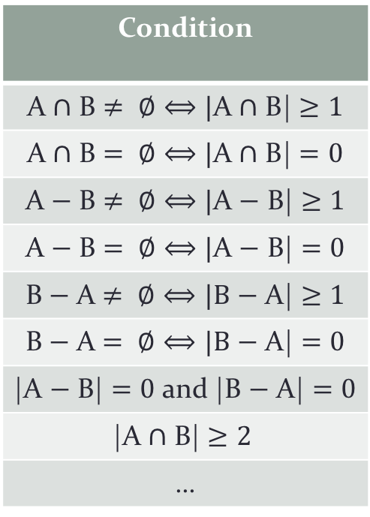

Venn diagram of 2 sets with conditions
Condition
A $∩$ B $≠ ∅⟺|$A $∩$ B| $≥1$
A $∩$ B $= ∅⟺|$A $∩$ B| $=0$
A $−$ B $≠ ∅⟺|$A $−$ B| $≥1$
A $−$ B $= ∅⟺|$A $−$ B| $=0$
B $−$ A $≠ ∅⟺|B$ $−$ A| $≥1$
B $−$ A $= ∅⟺|B$ $−$ A| $=0$
|A $−$ B| $=0$ and |B $−$ A| $=0$
|A $∩$ B| $≥2$
…
A
B
A - B
A $∩$ B
B - A

Slide 6
Venn diagram for our queries
For a student with key sid, CoursesEnrolledIn(sid) denotes the set of courses taken by this student
CS_courses denotes the set of courses offered by the ‘CS’ department
So in our previous Venn diagram
Note that for different values of sid, CoursesEnrolledIn(sid) denote different sets
A = CoursesEnrolledIn(sid)
B = CS_Courses

Slide 7
Venn diagram for our queries
CoursesEnrolledIn(sid)
CS_Courses

Slide 8

SOME
Find sid of each student who takes some CS courses
CoursesEnrolledIn(sid)
CS_courses
$$\left|A∩B\right|≥1$$

Slide 9
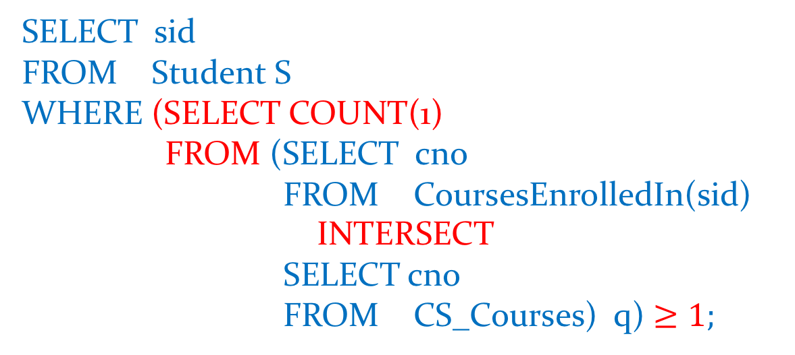
SOME
SELECT sid
FROM Student S
WHERE (SELECT COUNT(1)
FROM (SELECT cno
FROM CoursesEnrolledIn(sid)
INTERSECT
SELECT cno
FROM CS_Courses) q) $≥1;$

Slide 10

NO
Find sid of each student takes no CS courses
CoursesEnrolledIn(sid)
CS courses
$$\left|A∩B\right|=0$$

Slide 11

NO
SELECT sid
FROM Student S
WHERE (SELECT COUNT(1)
FROM (SELECT cno
FROM CoursesEnrolledIn(sid)
INTERSECT
SELECT cno
FROM CS_Courses) q) $=0;$

Slide 12

NOT ONLY
Find sid of each student who takes not only CS courses
CoursesEnrolledIn(sid)
CS courses
$$\left|A−B\right|≥1$$

Slide 13
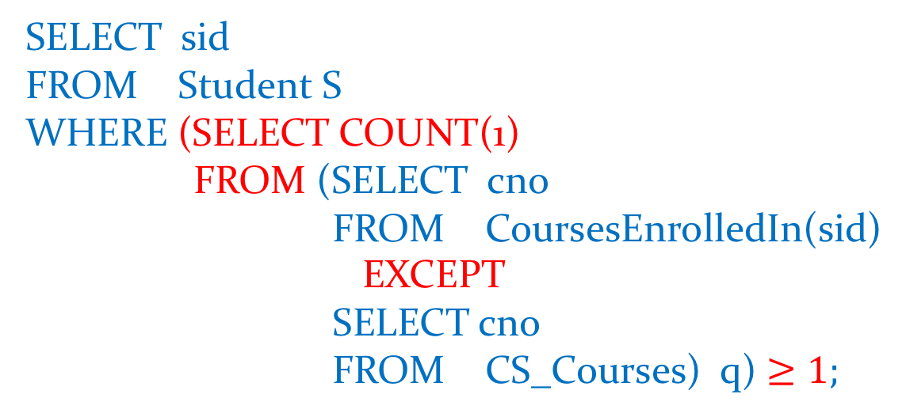
NOT ONLY
SELECT sid
FROM Student S
WHERE (SELECT COUNT(1)
FROM (SELECT cno
FROM CoursesEnrolledIn(sid)
EXCEPT
SELECT cno
FROM CS_Courses) q) $≥1;$

Slide 14

ONLY
Find sid of each student who takes only CS courses
CoursesEnrolledIn(sid)
CS courses
$$\left|A−B\right|=0$$

Slide 15

ONLY
SELECT sid
FROM Student S
WHERE (SELECT COUNT(1)
FROM (SELECT cno
FROM CoursesEnrolledIn(sid)
EXCEPT
SELECT cno
FROM CS_Courses) q) $=0;$

Slide 16

NOT ALL
Find sid of each student who takes not all CS courses
CoursesEnrolledIn(sid)
CS courses
$$\left|B−A\right|≥1$$

Slide 17
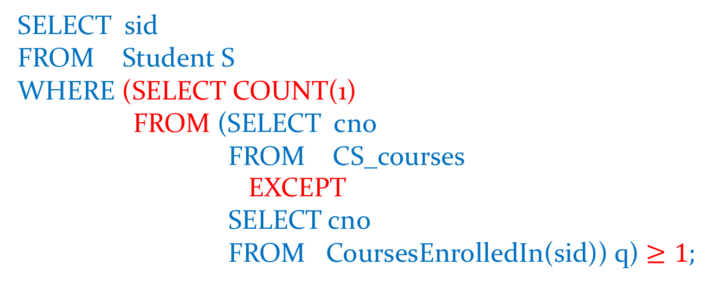
NOT ALL
SELECT sid
FROM Student S
WHERE (SELECT COUNT(1)
FROM (SELECT cno
FROM CS_courses
EXCEPT
SELECT cno
FROM CoursesEnrolledIn(sid)) q) $≥1;$

Slide 18

ALL
Find sid of each student wo takes all CS courses
CoursesEnrolledIn(sid)
CS courses
$$\left|B−A\right|=0$$

Slide 19
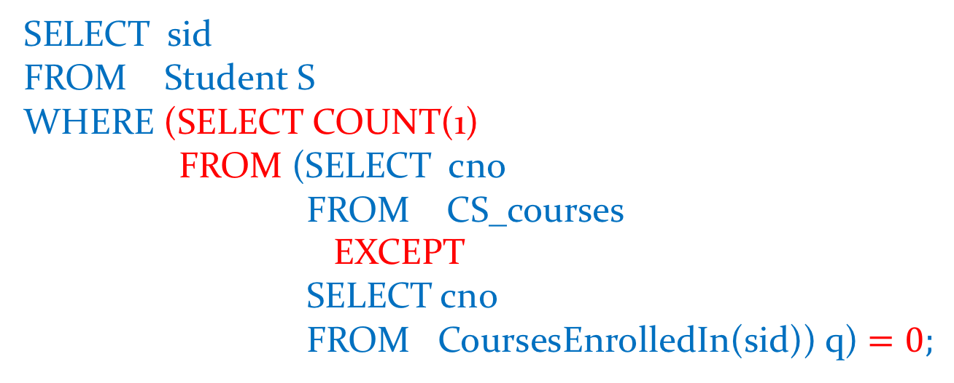
ALL
SELECT sid
FROM Student S
WHERE (SELECT COUNT(1)
FROM (SELECT cno
FROM CS_courses
EXCEPT
SELECT cno
FROM CoursesEnrolledIn(sid)) q) $=0;$

Slide 20
ALL and ONLY
We have multiple quantifiers: ALL and ONLY
These must both be specified in the WHERE clause using the ALL and ONLY quantifier templates:
SELECT S.Sid
FROM Student S
WHERE ALL template AND
ONLY template

Slide 21

At least two
Find sid of each student who takes at least two
CS courses
CoursesEnrolledIn(sid)
CS_courses
$$\left|A∩B\right|≥2$$

Slide 22

At least 2
SELECT sid
FROM Student S
WHERE (SELECT COUNT(1)
FROM (SELECT cno
FROM CoursesEnrolledIn(sid)
INTERSECT
SELECT cno
FROM CS_Courses) q) $≥2;$

Slide 23

All but one
Find sid of each student who takes all but one CS courses
CoursesEnrolledIn(sid)
CS courses
$$\left|B−A\right|= 1$$

Slide 24
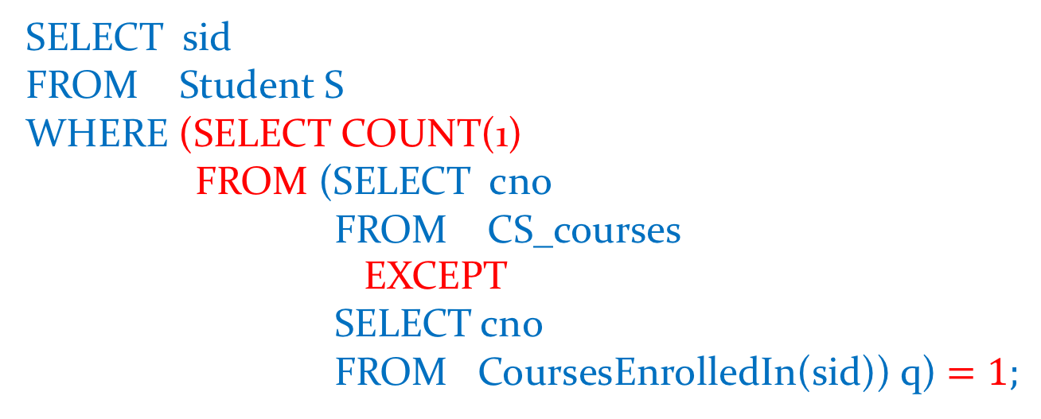
All but one
SELECT sid
FROM Student S
WHERE (SELECT COUNT(1)
FROM (SELECT cno
FROM CS_courses
EXCEPT
SELECT cno
FROM CoursesEnrolledIn(sid)) q) $=1;$

Slide 25

At least half of
Find the sid of each student who takes at least half of
the CS courses
CoursesEnrolledIn(sid)
CS courses
$$\frac{\left|A∩B\right|}{\left|B\right|}≥½$$

Slide 26

At least half of
SELECT sid
FROM Student S
WHERE 2* (SELECT COUNT(1)
FROM (SELECT cno
FROM CoursesEnrolledIn(sid)
INTERSECT
SELECT cno
FROM CS_Courses) q)
$$≥$$
(SELECT COUNT (1) FROM CS_courses)

