Slide 1
Bayesian Data Cleaning

Slide 2
Dataset and What we do
We choose hospital.csv(clean and drity) dataset to do experiments of bayes cleaning.
probabilistic programming language(mainly use Bayesian inference) for leveraging dataset-specific knowledge to clean and normalize dirty data
Effect: we could auto correct and atuo Complete such values: NULL values, typos, duplicates, and inconsis- tencies .

Slide 3
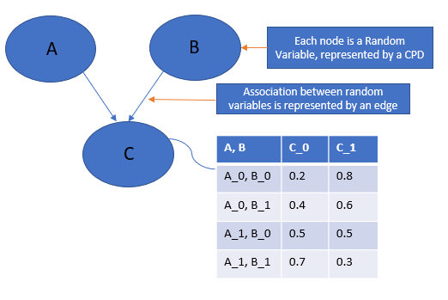
Probabilistic Graphical Models

Slide 4
Probabilistic Graphical Models
Generally, probabilistic graphical models use a graph-based representation as the foundation for encoding a distribution over a multi-dimensional space and a graph that is a compact or factorized representation of a set of independences that hold in the specific distribution.
Two branches of graphical representations of distributions are commonly used, namely, Both families encompass the properties of factorization and independences, but they differ in the set of independences they can encode and the factorization of the distribution that they induce

Slide 5
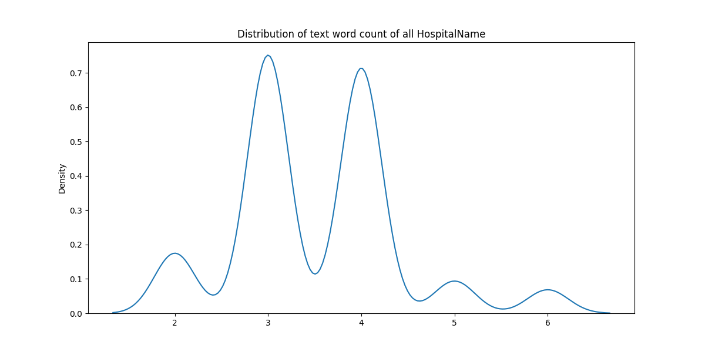
data explore on some column

Slide 6
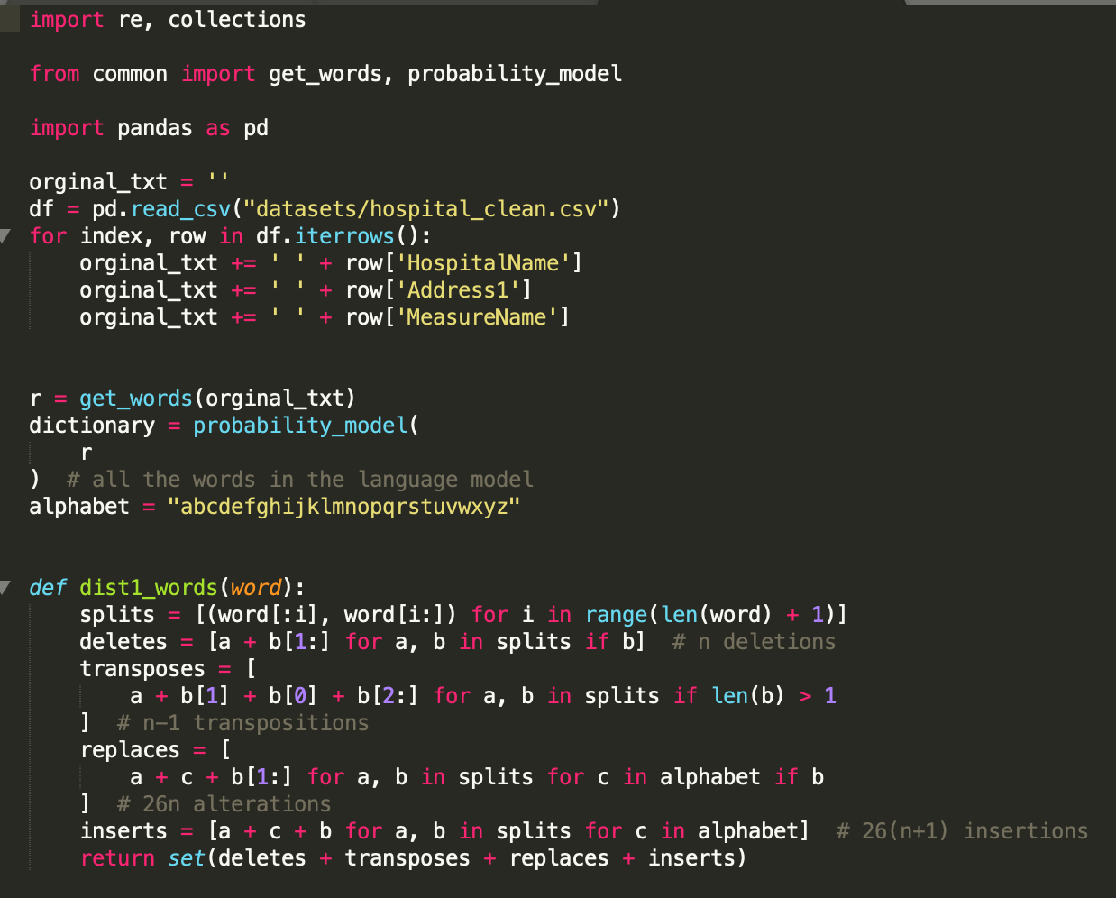
Main algorithm part

Slide 7
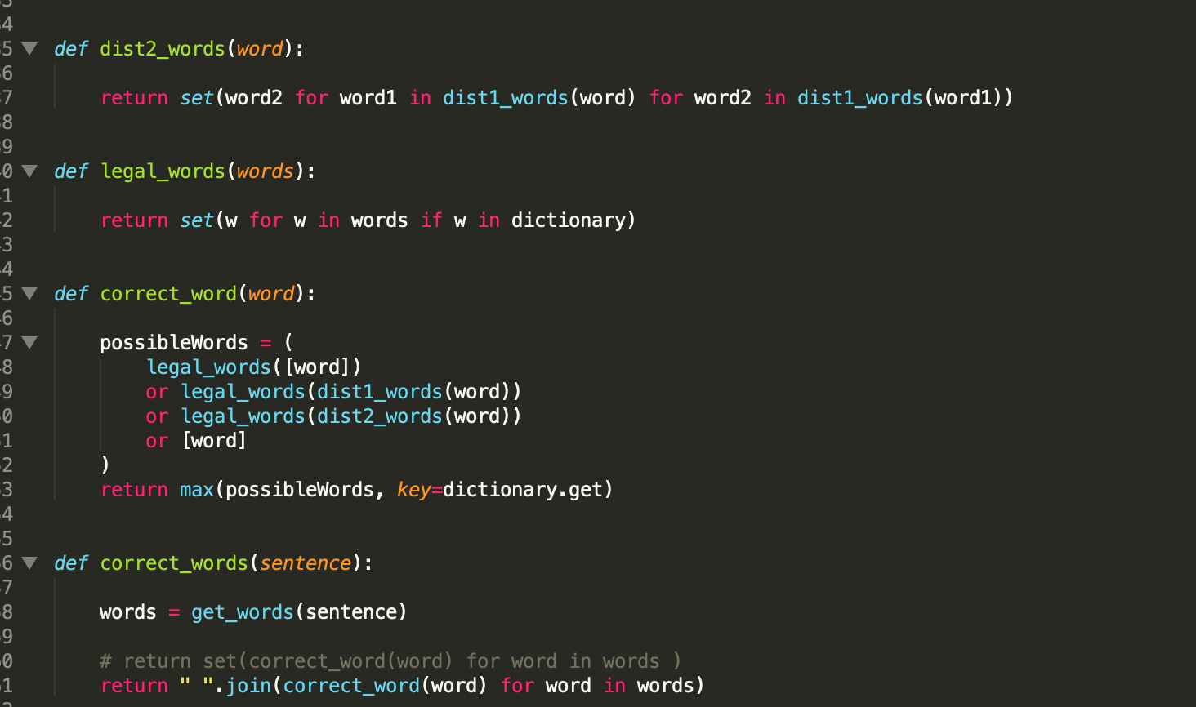
Main algorithm part

Slide 8
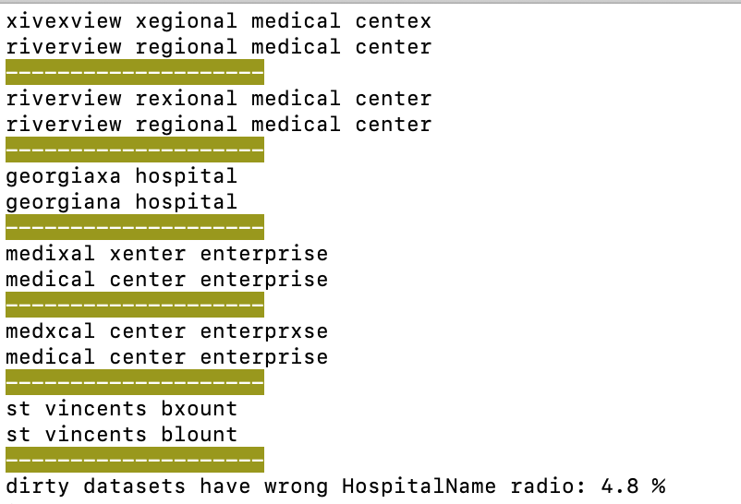
Result for now

