Slide 1
NLP in Question Answering

Slide 2

Dataset we choose to working on:

Slide 3
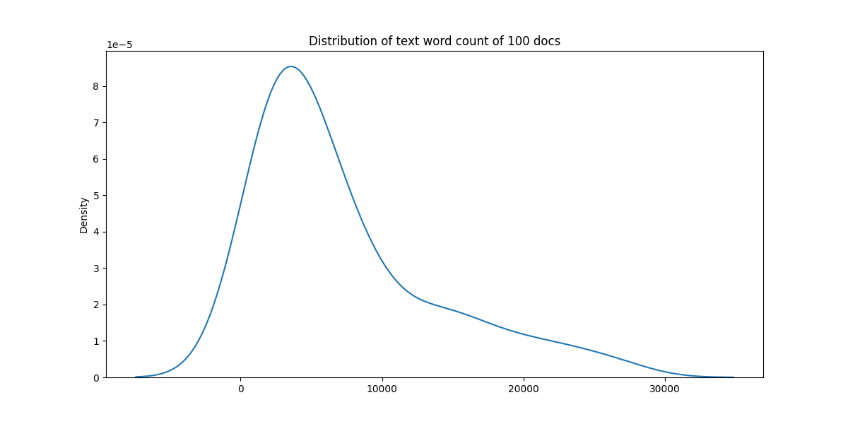
Data explore and anlysis

Slide 4
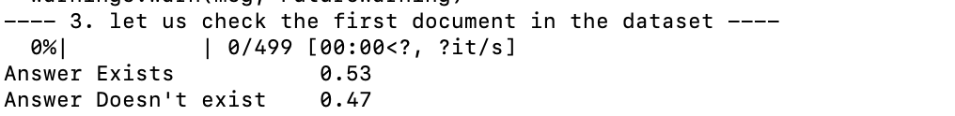

Data explore and anlysis

Slide 5
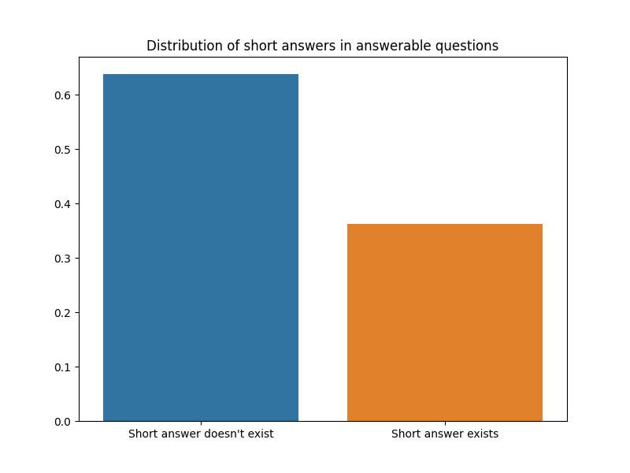

Slide 6
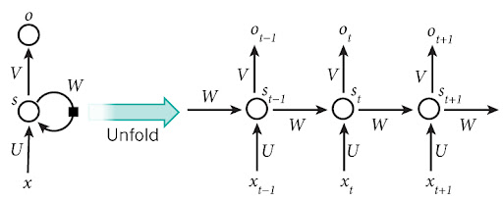
Lstm process:
·

