Slide 1

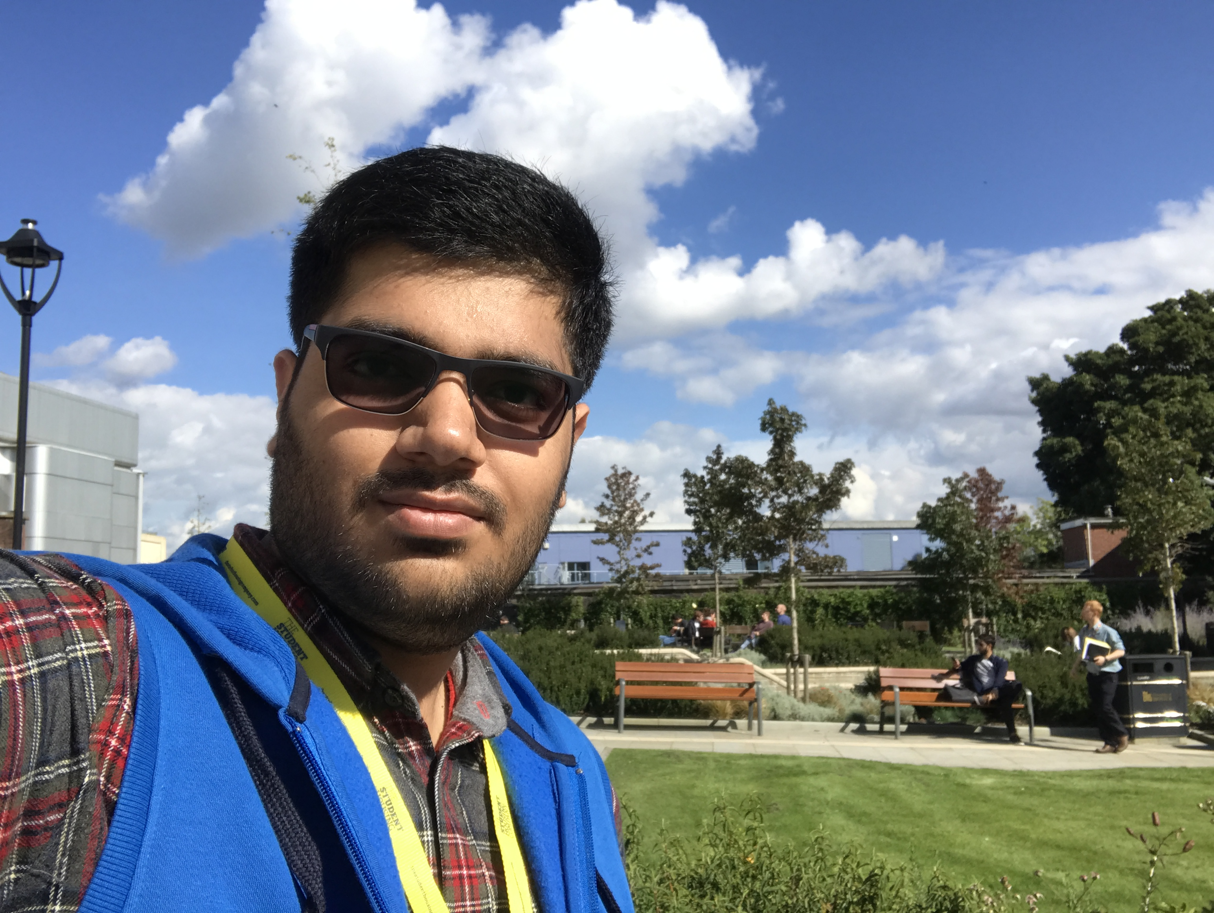
Understanding and Implementing Recurrent Neural Networks using Python
EuroPython, Edinburgh, Scotland 2018
Anmol Krishan Sachdeva
MSc Advanced Computing
University of Bristol
Email id: greatdevaks@gmail.com
Linkedin: https://www.linkedin.com/in/greatdevaks
Twitter: https://www.twitter.com/greatdevaks
GitHub: https://www.github.com/greatdevaks

Slide 2

About Me
Former Software Developer Intern at IBM & an ALL STACK DEVELOPER capable of designing and developing solutions for Mobile, Web, Embedded Systems, and Desktop. Areas of interest are Computational Neuroscience, Deep Learning, and Cloud Computing.
Represented India at International Hackathons like Hack Junction’16, Finland and Hack the North’16, Canada. Got invited for more than a ‘dozen’ of prestigious International Hackathons (PennApps’17, HackNY’17, Hack Princeton’17 and many more) and Conferences.
Professional Certifications
Microsoft Certified Professional
Microsoft Technology Associate
IBM Certified Web Developer
Hewlett Packard Certified Developer
8+ International Publications [Latest work got published in ACM CHI 2018. The project was exhibited in Montreal, Canada.]
Received 6 Honours and Awards (International and National level).

Slide 3
Pre-requisites
Basic understanding of Python language.
Knowledge of Artificial Neural Networks.
Elementary Linear Algebra and Statistics.

Slide 4
Understanding RNNs
Recurrent Neural Networks can be thought of as the Neural Networks which can persist information.
In contrast to the traditional neural networks, RNNs focus on utilizing the sequential information (take into account the history).
These networks have loops in them which enables them to mimic the behaviour of short – term memory.
RNNs are one of the most advanced and complex Supervised Deep Learning Algorithms.

Slide 5
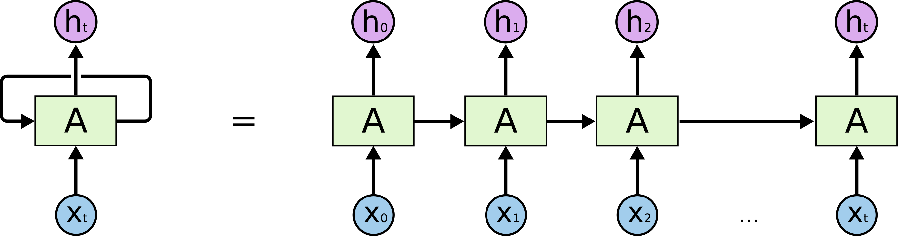
Understanding RNNs (cont.)
Unrolled RNN
RNNs have loops.
Consider RNN as a squashed version of a neural network
Source: http://colah.github.io

Slide 6
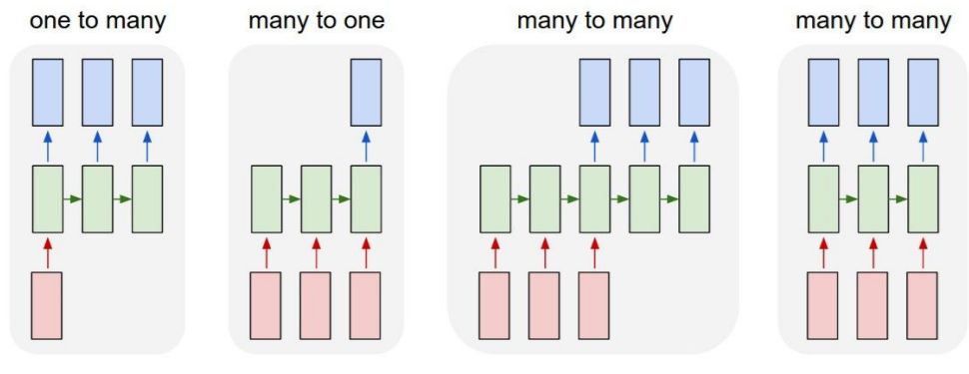
Understanding RNNs (cont.)

Slide 7
Applications of RNNs
Recurrent Neural Networks can be used for a variety of applications:
Subtitle generation or Image captioning
Time series classification
Language Modelling
Speech Recognition
And many more…

Slide 8
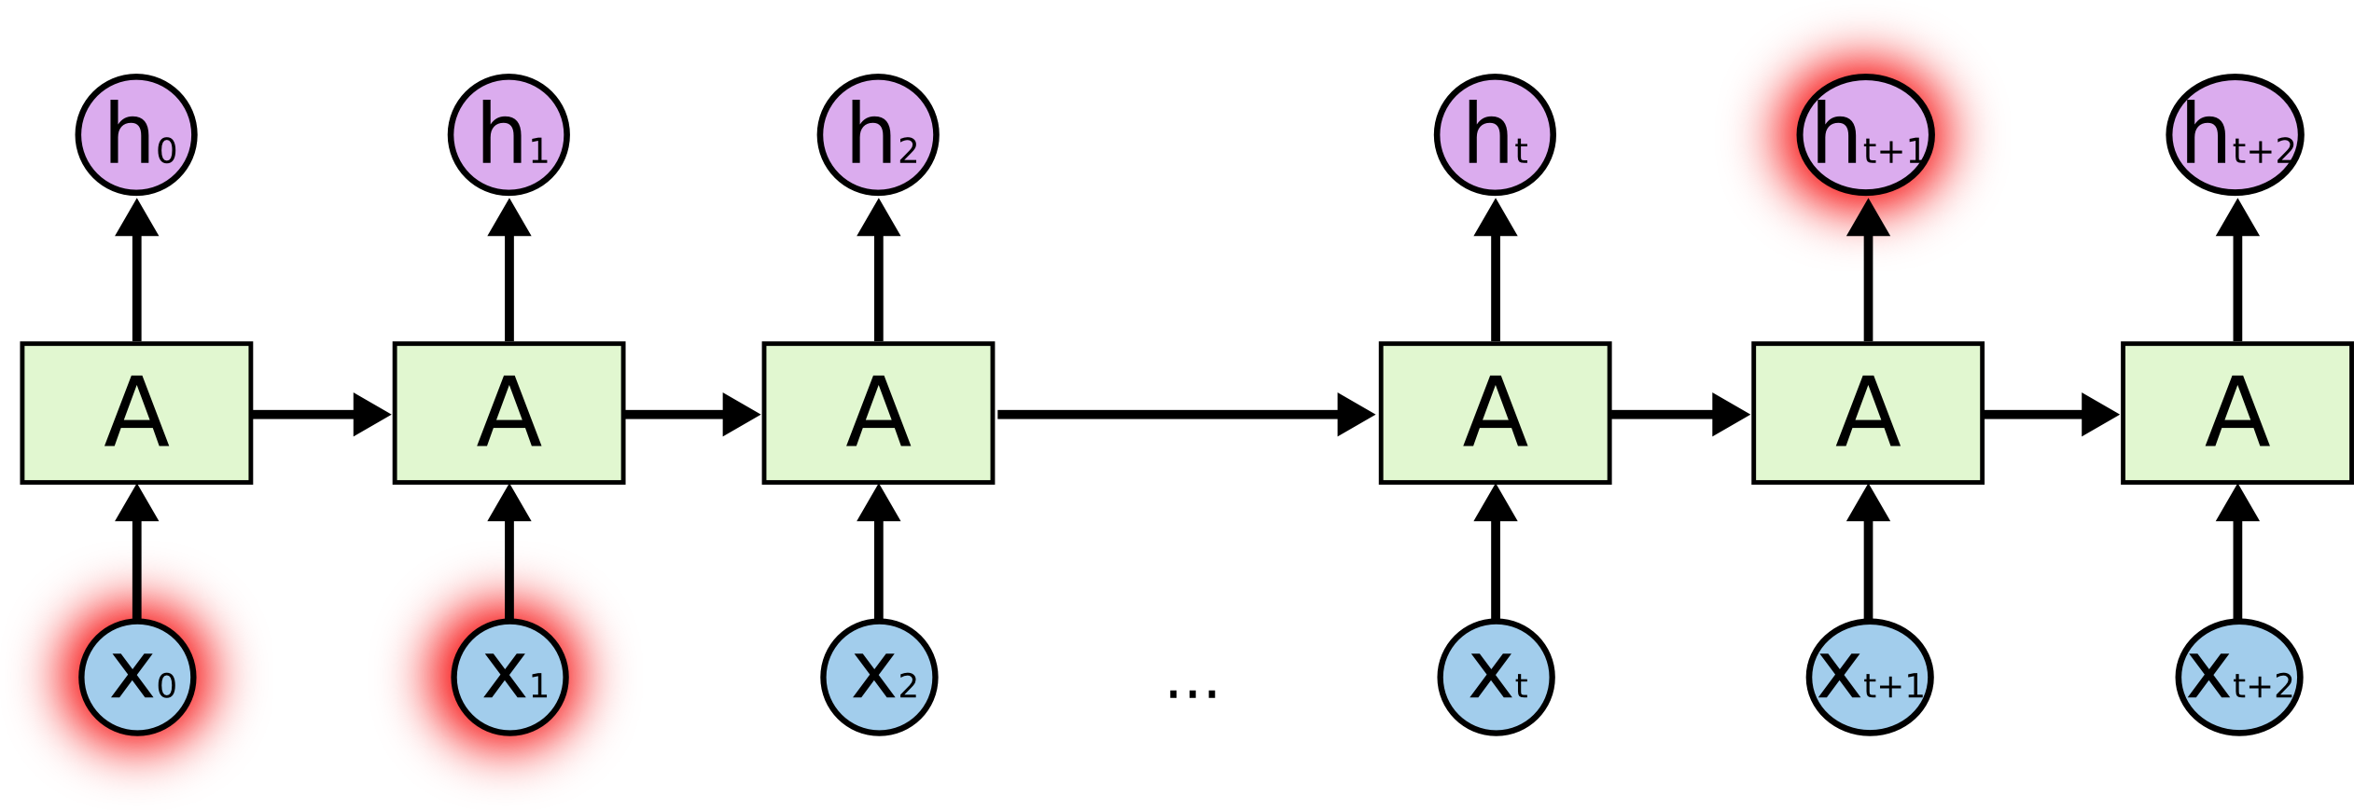
Vanishing Gradient Problem
As RNN grows, it is very difficult to connect the information. Often, adjusting the weights is a problem.
W
W
W
W
In RNNs, Backpropagation is also done and it further adjusts the weights.
Source: http://colah.github.io

Slide 9
Vanishing Gradient Problem (cont.)
Like the Vanishing Gradient Problem, there is also an Exploding Gradient Problem.
Vanishing Gradient Problem occurs if ‘W’ < 1, and the Exploding Gradient Problem occurs if ‘W’ > 1.
To solve the Vanishing and Exploding Gradient Problems, several solutions are there. These are:
For Exploding Gradient Problem:
Truncated Backpropagation
System of Rewards and Penalties
Gradient Clipping
For Vanishing Gradient Problem:
Smart weight initialization
Using Echo State Networks
Using Long Short-Term Memory (LSTM)

Slide 10
Long Short-Term Memory (LSTM)
LSTM is one of the most widely used variant of RNN (that overcomes the problem of Vanishing Gradient).
The approach taken by LSTM is to make ‘W’ = 1.
LSTMs are the RNNs capable of learning Long-term dependencies.

Slide 11
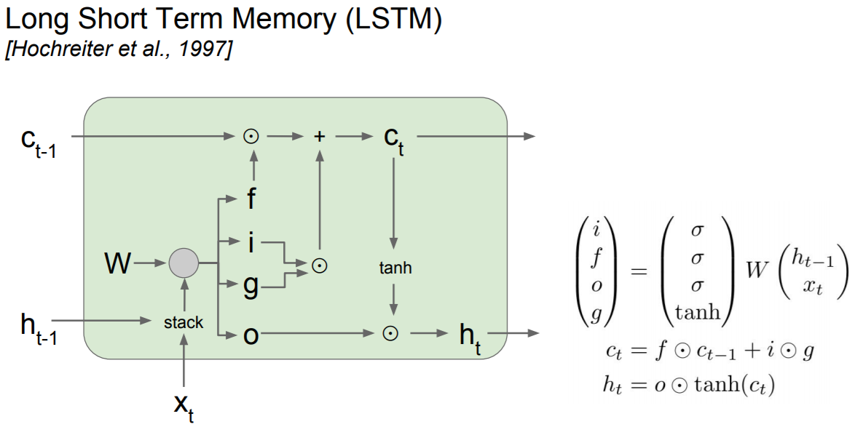
Long Short-Term Memory (LSTM)

Slide 12
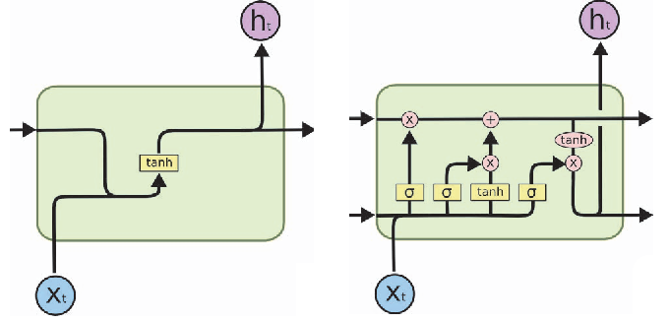
RNN vs. LSTM
RNN
LSTM
Source: http://colah.github.io

Slide 13
Jumping to Implementation
Let’s build the RNN and LSTM Neural Network Model.
Remember that ALL MODELS ARE WRONG BUT SOME ARE USEFUL.
Code available at: LINK WILL BE UPLOADED ON THE SESSION INFO. PAGE.

Slide 14
Acknowledgements
Thanks GeoPython and Prof. Martin Christen for giving me the chance to present.
Thanks Prof. Cian O’Donnell, University of Bristol, UK for being my supervisor and guiding me.
Thanks Mr. Kirill Eremenko and Mr. Hadelin de Ponteves for creating excellent tutorials on Deep Learning.
Thanks Mr. Christopher Olah for writing wonderful blogs and allowing the usage of images (https://colah.github.io).

Slide 15
Thanks a lot for being such a great audience
I am happy to answer any questions…
Anmol Krishan Sachdeva
MSc Advanced Computing
University of Bristol
Email id: greatdevaks@gmail.com
Linkedin: https://www.linkedin.com/in/greatdevaks
Twitter: https://www.twitter.com/greatdevaks
GitHub: https://www.github.com/greatdevaks

