Slide 1

Brainy
by Ananya, Jata, Kai, Michelle, Ziggy
Notes:
Questionnaires not surveys

Slide 2
The problem:
Mental health appointments in BC have unreasonably long wait times.
Source: CTV News, Some Canadians waiting months for public and private mental health services. (December 22, 2022)

Slide 3
Our solution:
Create an LLM driven chat bot that can assist in onboarding patients, gather basic screening information, and suggest appropriate next steps.

Slide 4
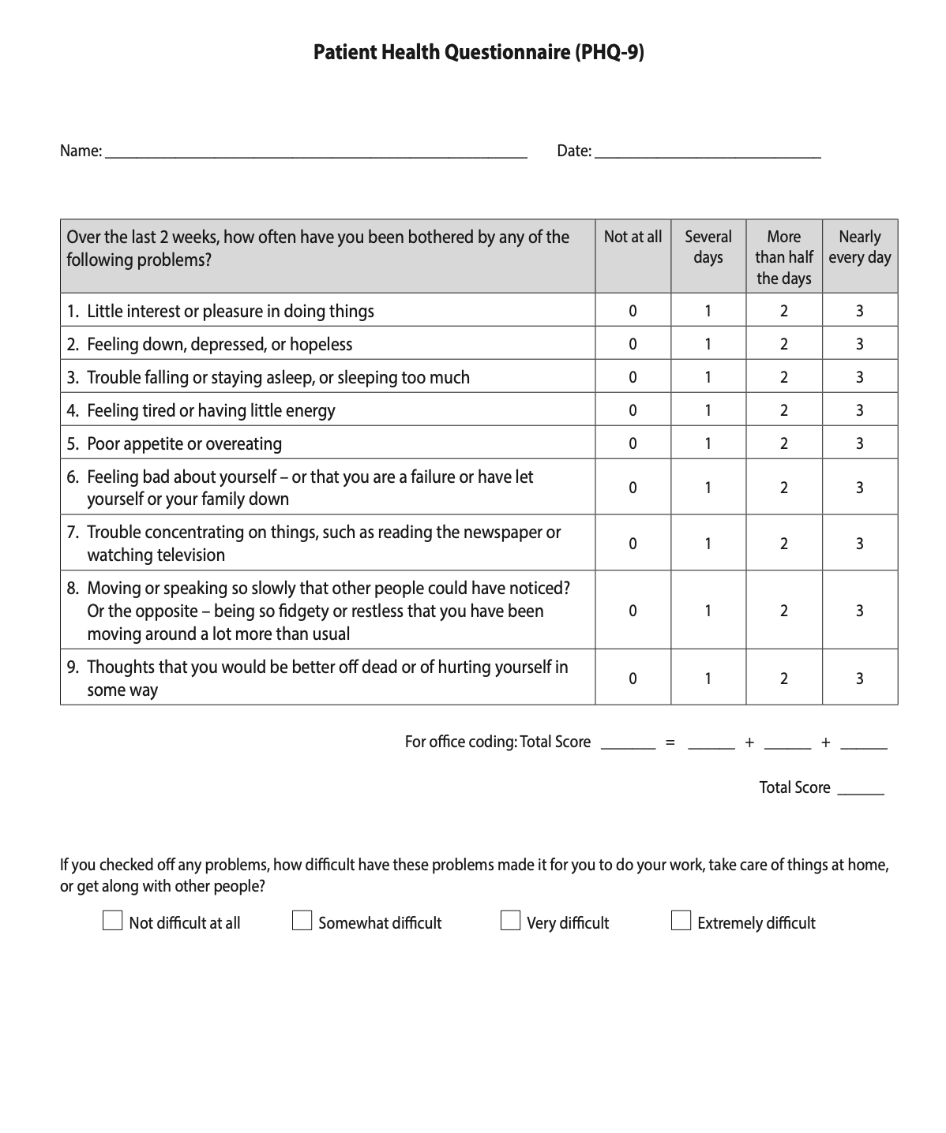
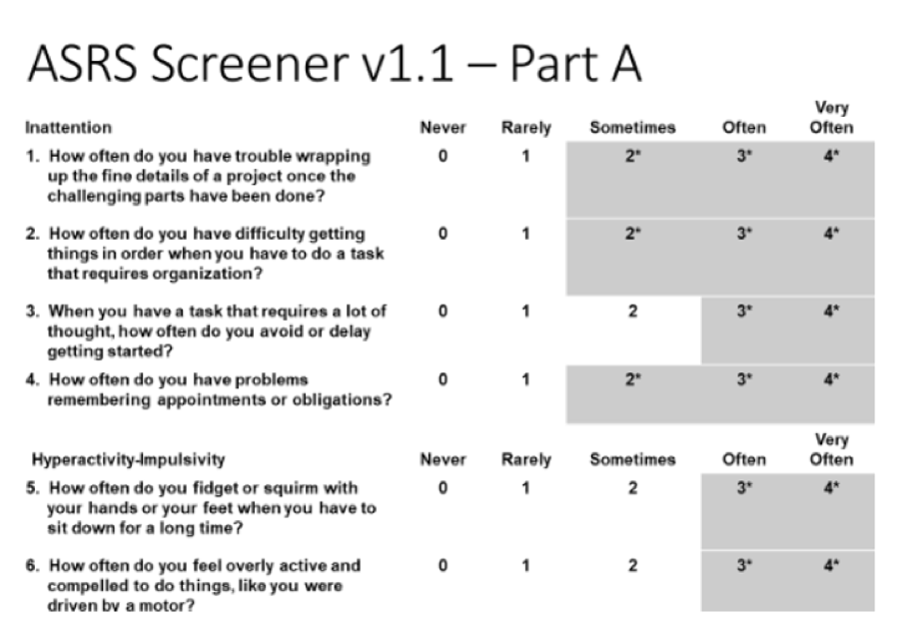
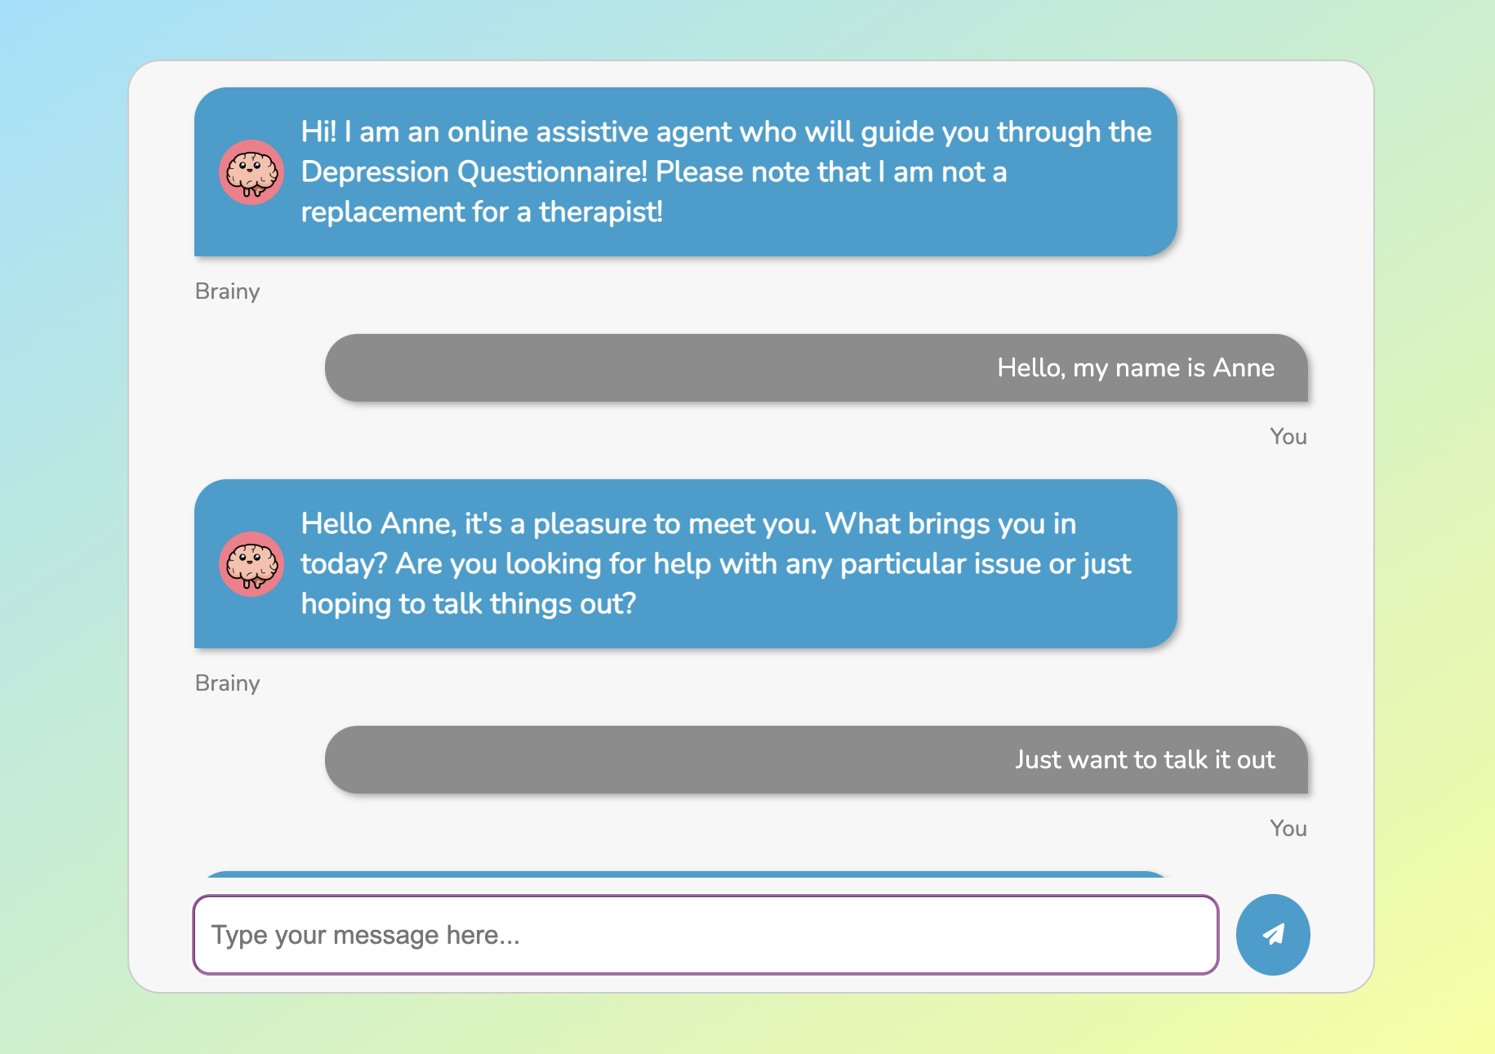
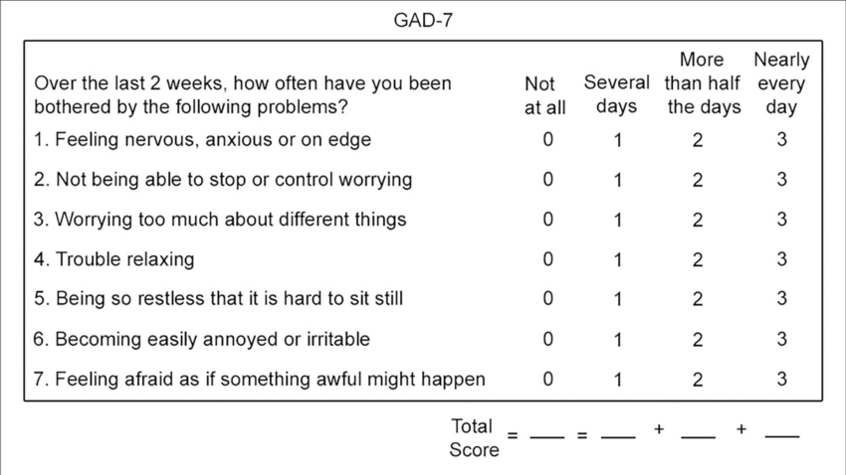
Our solution:
Before
After
Notes:
Currently, you will attend a screening appointment to give background on family history and personal health, and answer questionnaires in your first appointment. This can be done beforehand using our AI, in a less intimidating, conversational format. In order to allow clinicians to focus on post-screening parts of the evaluation.
Uses for physicians:
Friendly and accessible screening tool can assess users needs and urgency.
Specifically trained for medical situations, able to administer screeners, and act with sensitivity
Uses for researchers:
Preliminary screening tool for study participants, useful to gather basic information and administer screening questionnaires.
We originally thought for this as a screening tool for researchers, but realised could be very applicable to clinical contexts.

