Slide 1
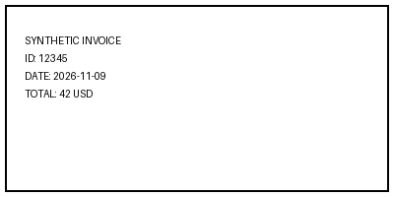
Synthetic slide text. Invoice 12345, total 42 USD.

