Slide 1
GaussML: An End-to-End In-Database Machine Learning System
Speaker：Ji Sun
Date：2024/5/14
Security Level:

Slide 2
In-database AI: Data Refreshness
Real-time Online Scenario
Fraud Identification
Intelligent Ammeter
Hotspot Tracking
Network Opitimizing
Internet Crime. Mining fraud clues from real-time messages, transactions, spatial information and web information
National Electric Schedule. Monitor & Analyze local electric usage, and predict future workload and schedule power in time.
Social Media Mining. Extract hotspot information from social medias, webtables and blogs
Telecommunications.
Optimize the overall quality of service for communications by analyzing workload of routers, status of links, and topology of networks
Compete with time, require high data freshness.
Notes:
Nowadays, fresh & streaming data analysis is popular. I list four applications here,
they are Fraud Identification, where real-time messages analysis is required;
Intelligent Ammeter requires making decision based on the electric usage;
Hotspot tracking need real-time analysis on web data;
Network Optimizing requires analyzing the workload of routers, status of links and topology of networks.
One common feature of these applications is highly dependence on data freshness, they require to do data analysis right after the data manipulation.

Slide 3
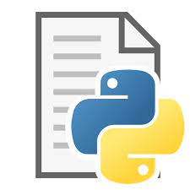
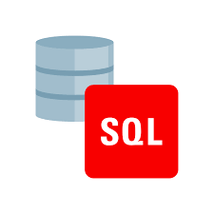

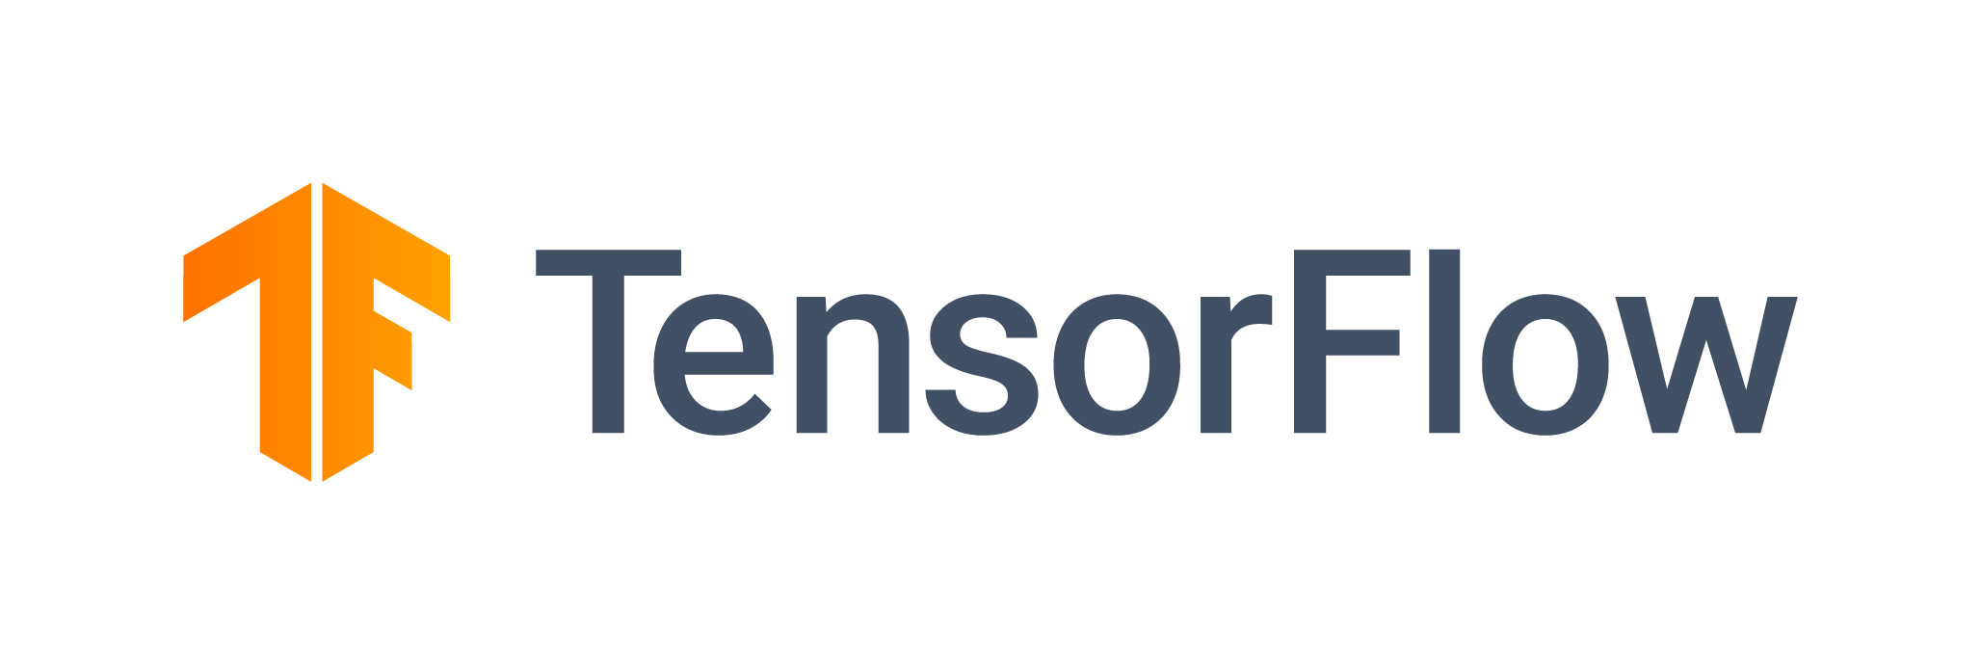





In-database AI: Data Security/Data Efficiency
Low Performance & Low Security for Data Movement
Inefficient Transfer
Model & Data Tamper
DBMS
AI Platform
data leak
Not Easy for Data Analytics
DBMS
Data Leak/Tamper
UDF
Data Transformation
Control logic
Model Inference
SGD Training
Notes:
Data Security is also very important in the Financial and Government scenarios, they prefer making everything be done in a sealed box.
There are generally two ways to use database and AI.
One is to load data from database to the external AI platform, this lines of systems can easily adapt different AI training frameworks without much coding, but the data need to be export outside database (the secure zone)
The other is to write python UDF to do model computing inside database, it has data access permission control, but it may also introduce data tamper code inside database. Moreover, UDF-based methods may generate a large number of middle results, cost of store and fetch them is high.

Slide 4
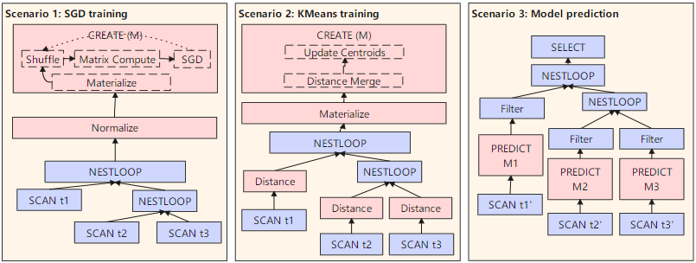
GaussML: Common Use Cases
Scenario 1: preprocessing the dataset for easier training and better representation
Scenario 2: data clustering and the features are splitted on different relations
Scenario 3: the model predicts result are taken as the constraints of filtering data

Slide 5
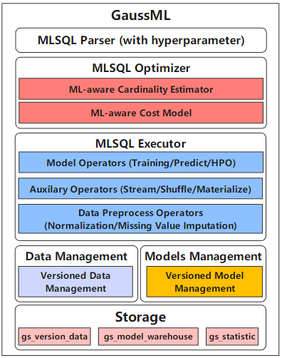
GaussML: Architecture
MLSQL Parser. In this layer, GaussML extends SQL to
support MLSQL by seamlessly integrating machine learning
operations into SQL.
MLSQL Optimizer. In this layer, the optimizer can not only use model-aware cost estimator to find the optimal data visit path and model prediction orders, it also conducts interleaving optimizations between data visit operators and model training operators.
MLSQL Executor. In this layer, we define a set of ML op-
erators to support high performance ML execution. GaussML
supports over 20 popular machine learning algorithms, and
the training executors of these algorithms are composed of
4 basic operators, including matrix computation operator,
statistic operator, gradient descent operator, and distance com-
putation operators

Slide 6
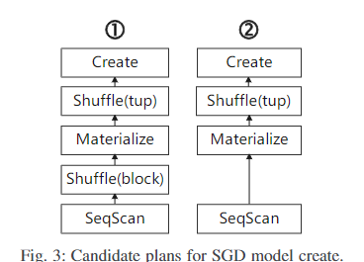
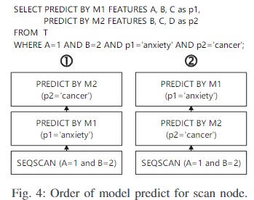
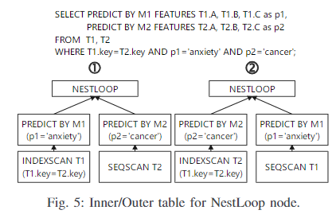
GaussML: Query Planning
Mount ML operators on the plan tree, and make the performance of model training optimal.
Reorder the execution order of ML predicates on one relation based on cost
Estimate the conjunctive predicates with both ordinary conditions and model prediction
Cost model for model prediction expressions. For example, tell the prediction cost difference between XGBoost and decision tree

Slide 7
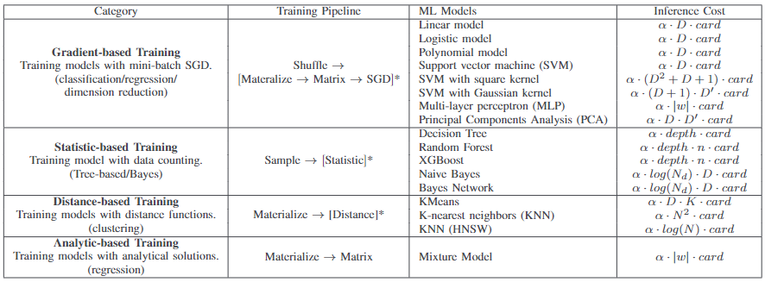
GaussML: Query Execution
Parallel Training
Distributed Training
AUTOML Training
-> Merge Model (16-way) -> Streaming
(type: Local dop: 1/16) -> Train Model -> Materialize -> Seq Scan on T1
-> Streaming (type: GATHER) Node/s: All datanodes -> Streaming (type: BROADCAST) Spawn on: All datanodes -> Recursive Train Model -> Materialize -> Seq Scan on T1
-> Train Model - logistic_regression CTE t -> Select Model -> Streaming (dop: 1/16) -> Train Model - logistic_regression -> Materialize -> SampleResult -> Seq Scan on T1 -> Seq Scan on T1

Slide 8


GaussML: Data Shuffle
Page1
Page2
Page3
Page4
Page5
Single Node
Node1
Node2
Node3
Node4
Node5
Distributed Trained Model
Multiple Nodes
Broadcast

Slide 9
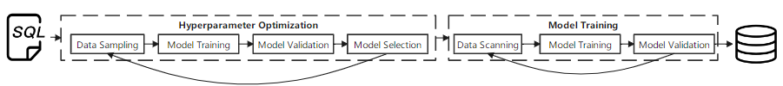
GaussML: Hyper-parameter Optimization
Grid-search: it will try all possible combinations of hyperparameters on training data, and select the best set of hyperparameters. Grid search can guarantee to find the optimal model, but it’s too costly and impossible to be deployed on cost-sensitive relational database.
Random search: it first draws a small set of hyperparameters randomly and then train models on training data. Random search is faster but it’s more likely to miss the optimal hyperparameters.
Hyperband-based HPO*: When creating a model with AUTO-ML on, GaussML first searches candidate hyperparameters from system catalog, and then the engine trains models on sample data in parallel. The executors report model accuracy to the coordinate node after each iteration by using streaming operator. GaussML throws away hyperparameters with errors higher than the average constantly until only one model left.

Slide 10
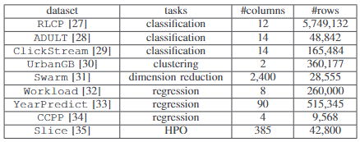
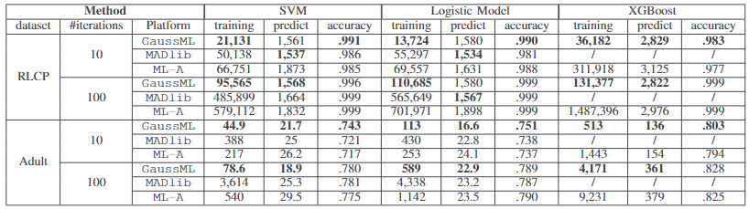
GaussML: Evaluation
Datasets
Methods
GaussML is a system build in native openGauss database, it offers MLSQL interface for end-to-end machine learning applications.
MADlib is a set of ML UDFs customized for relational database, and it’s widely adopted by Postgres, GreenPlum, etc. We also integrate these functions into openGauss for fair evaluation.
ML-A is implemented by using Python script with widely-used machine learning libraries including sklearn, pandas and openGauss connector. They offer Python programming interface.
Comparison training time (ms)/prediction time(ms)/validation accuracy on classification tasks.

Slide 11
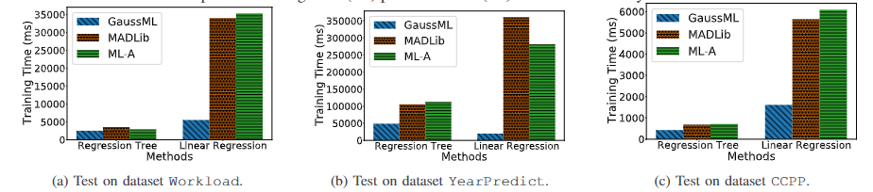
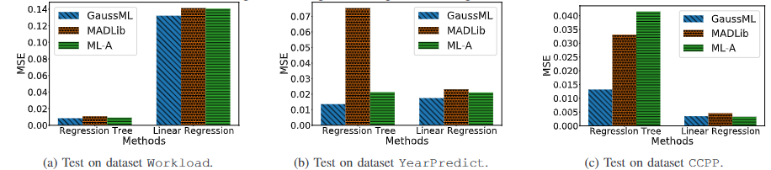
GaussML: Evaluation
Training time comparison on regression tasks.
Mean Square Error comparison on regression tasks

Slide 12
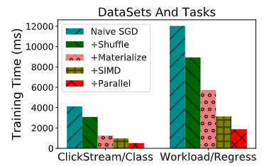
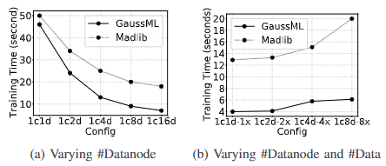
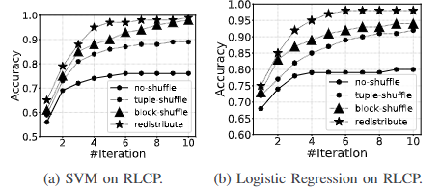
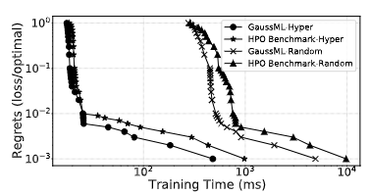
GaussML: Evaluation
Training time comparison with optimizations.
Scalibility of Distributed training
Comparison on shuffle methods
Comparison on training time of HPO

Slide 13


GaussML: Conclusion&Acknowledgement
This paper proposes an end-to-end in-database machine learning system GaussML. GaussML is seamlessly integrated with openGauss database. GaussML offers native MLSQL interface for data analysts, and supports holistic optimization for end-to-end machine learning queries, including model training and model prediction. GaussML introduces an ML-aware cardinality and cost estimator to optimize the SQL+ML query plan. GaussML leverages SIMD and data prefetching techniques to accelerate the ML operators for training. Extensive results on real datasets show that GaussML outperforms counterparts significantly for typical machine learning queries.
Acknowledgement. This paper was supported by National Key R&D Program of China (2023YFB4503600), NSF of China (61925205, 62232009, 62102215)

