Slide 1
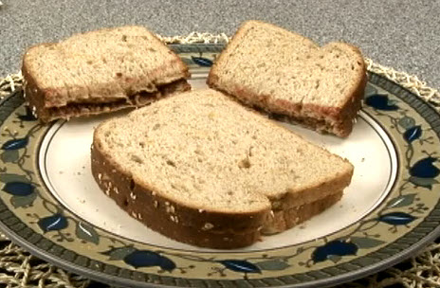
Making a “P and J” sandwich
First , then, next, after that, finally.

Slide 2
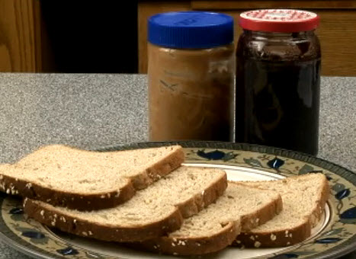
First,
you’ll need some peanut butter, some jelly and some slices of bread.

Slide 3
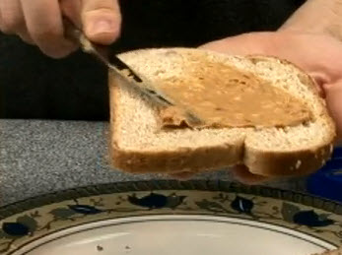
Next,
spread the peanut butter on one slice of bread using a knife.

Slide 4
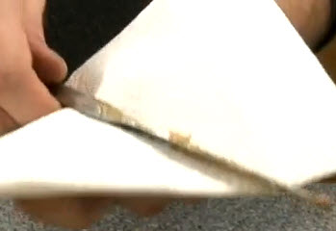
Then,
wipe the knife clean of peanut butter using a napkin.

Slide 5
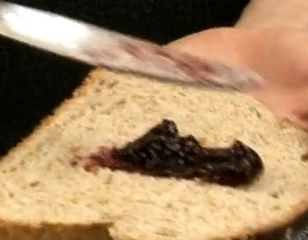
After that,
spread some jelly on the other slice of bread.

Slide 6
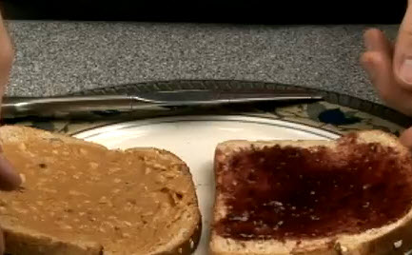
Then,
put the two pieces together with the peanut butter and jelly sides facing each other.

Slide 7
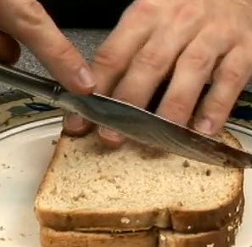
Finally,
cut the sandwich in two with the knife.

Slide 8
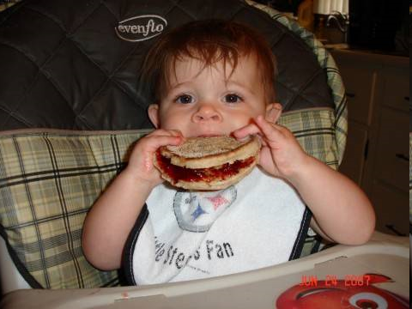
Finally, finally,
put your teeth into it!
Enjoy!

Slide 9
A tip
Don’t use refrigerated peanut butter!
It will tear the bread!
Let the peanut butter warm to room temperature before making your sandwich.

Slide 10
Review / Test
Using the checklist on the next page, listen to your partner tell you how to make a peanut butter and jelly sandwich.
Check each time they tell you something on the list.
1=only gestures. 2= partly understandable
3= clearly stated

Slide 11
Checklist
Steps: How to make a P&J sandwich | 1 | 2 | 3
Get two slices of bread.
Put peanut butter on one.
Put jelly on top of the peanut butter.
Cut the sandwich in half.
Eat the sandwich!

