Slide 1
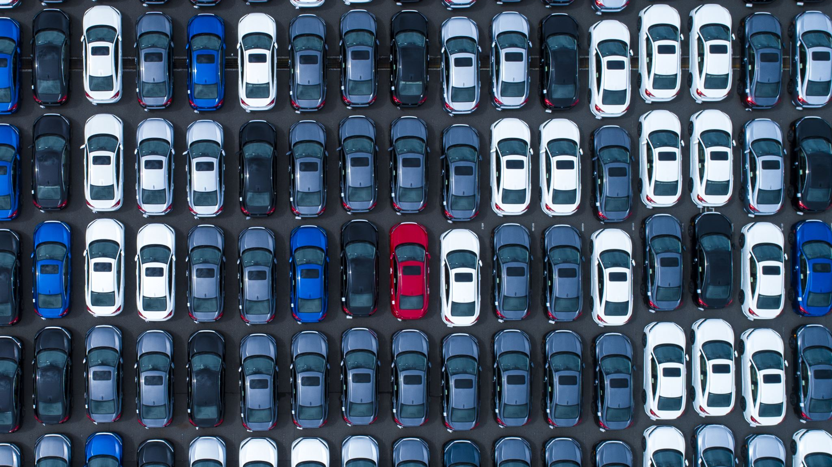
Why are we giving up on gas cars?

Slide 2
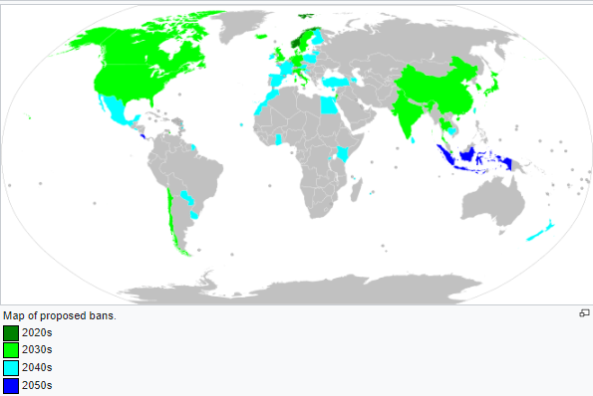
Ban of fossil fuel vehicles strategy
More than 30 countries and world biggest car manufacturers are planning to stop producing fossil fuel cars in near future.
Prohibition of further sales or registration
Prohibition of the fossil fuel cars import
Prohibition of usage
Notes:
Many countries and cities around the world have stated they will ban the sale of passenger vehicles (primarily cars and buses) powered by fossil fuels such as petrol, liquefied petroleum gas and diesel at some time in the future.^{[2][3]} Synonyms for the bans include phrases like "banning gas cars",^{[4]} "banning petrol cars",^{[5]} "the petrol and diesel car ban",^{[6]} or simply "the diesel ban".^{[7]} Another method of phase-out is the use of zero-emission zones in cities.

Slide 3
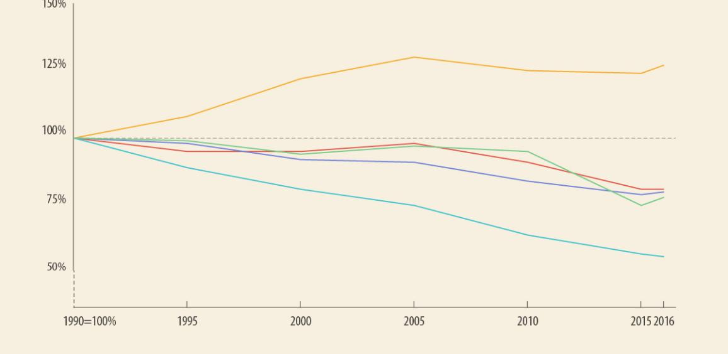
Reason for banning - Pollution
Transport is responsible for nearly 30% of the EU’s total CO2 emissions.
The EU has set a goal of reducing emissions from transport by 60% by 2050 compared to 1990 levels.
Efforts to improve the fuel efficiency of new cars are also slowing. After a steady decline, newly registered cars emitted on average 0.4 grammes of CO2 per kilometre more in 2017 than the year before.
Notes:
Reasons for banning further sale of fossil fuel vehicles include: reducing health risks from pollution particulates, notably diesel PM10s and other emissions, notably nitrogen oxides;^{[8]} meeting national greenhouse gas, such as CO₂, targets under international agreements such as the Kyoto Protocol and the Paris Agreement; or energy independence. The intent to ban vehicles powered by fossil fuels is attractive to governments as it offers a simpler compliance target,^{[9]} compared with a carbon tax or phase-out of fossil fuels.^{[10]}

Slide 4
Pain
There is no “soul” in an electric car, so why they are getting more popular
Why do people want to forget all achievements of fossil fuel engine engineers?
Are we ready to switch fossil fuel cars to electric ones

Slide 5
Goals:
Visualize the benefits of banning fossil fuel cars
1
Try to explain possible effects on the environment
2
Compare sales of electric and gas cars
3

