Slide 1





Great Minds Technology
www.greatmindstechnology.in

Slide 2
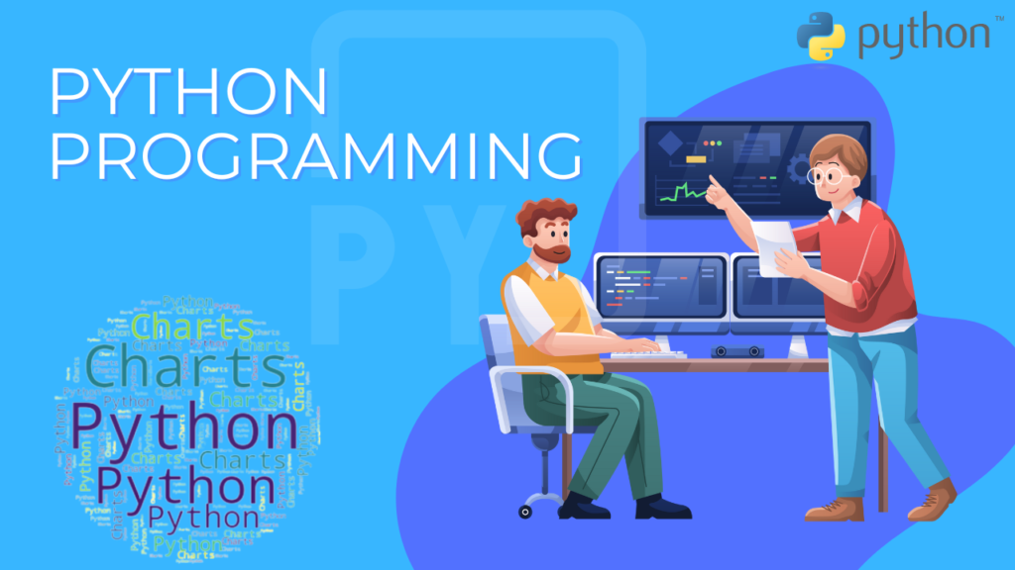
NAME : GOKULA LAKSHMI M
COMPANY : GREAT MINDS TECHNOLOGY
DATE : 14-07-2024
TITLE : PYTHON
Great Minds Technology
www.greatmindstechnology.in

Slide 3
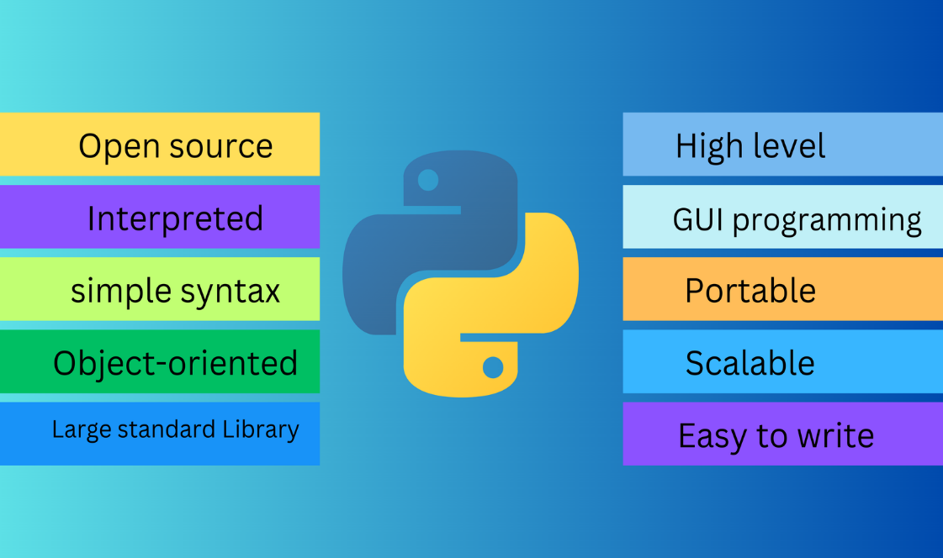
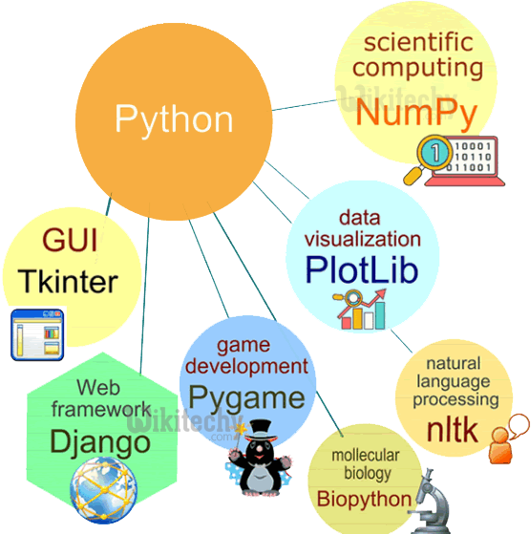
What is Python?
Python is like a friendly, all-purpose toolbox for building software—it’s simple enough for beginners to learn, but powerful enough to run some of the world’s most complex systems.
Great Minds Technology
www.greatmindstechnology.in

Slide 4
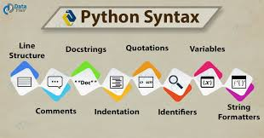
Python syntax?
Python syntax refers to the rules that define how Python programs are written and interpreted. Python is known for its clean and easy-to-read syntax.
INPUT:
# This is a simple Python program
def greet(name): # Function definition
print("Hello,", name) # Indented block
greet("Lakshmi") # Function call
OUTPUT:
Hello, Lakshmi
Great Minds Technology
www.greatmindstechnology.in

Slide 5
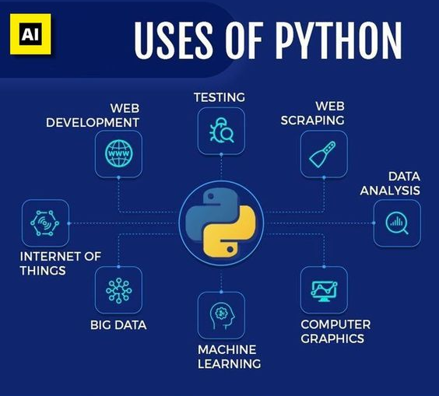
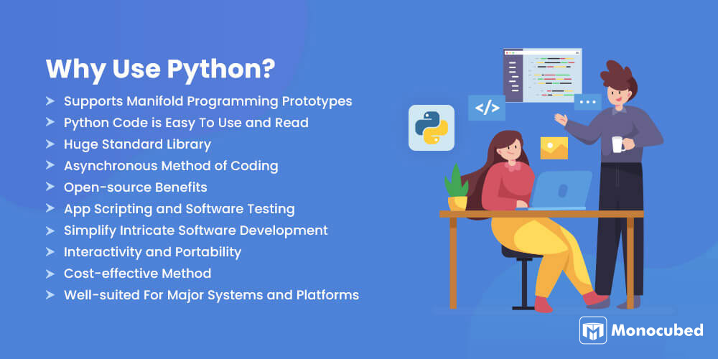
What is the use of python?
· Web Development – Build websites and web apps using frameworks like Django and Flask.
· Data Science & Machine Learning – Analyze data, build models, and implement AI using libraries like Pandas, NumPy, and TensorFlow.
· Automation & Scripting – Automate repetitive tasks and write efficient scripts.
· Software Development – Create desktop apps, backend systems, and prototypes quickly.
· Cybersecurity & Ethical Hacking – Develop security tools and automate vulnerability testing.
Great Minds Technology
www.greatmindstechnology.in

Slide 6
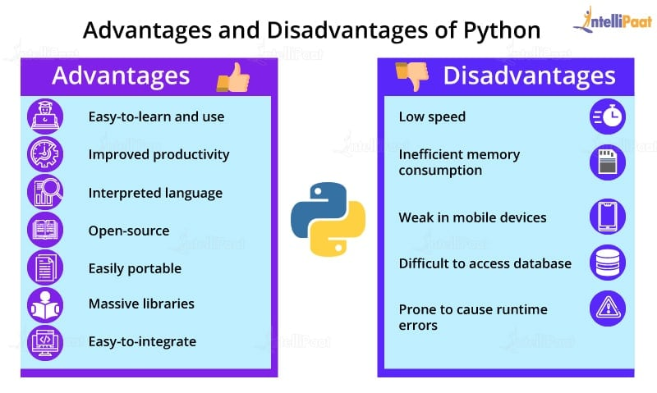
Advantages and Disadvantages of python?
Advantages of Python:
Easy to Learn & Use
Versatile Libraries & Frameworks
Strong Community Support
Disadvantages of Python
Slower Execution Speed
Mobile Development Limitations
Memory Usage
Great Minds Technology
www.greatmindstechnology.in

Slide 7
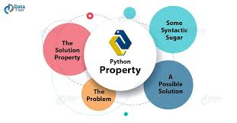
Properties of python?
Interpreted Language
Python code is executed line by line, making debugging easier and faster.
Dynamically Typed
You don’t need to declare variable types; Python determines the type at runtime.
Object-Oriented
Python supports object-oriented programming (OOP) with features like classes, inheritance, and polymorphism.
Great Minds Technology
www.greatmindstechnology.in

Slide 8

APPLICATIONS OF PYTHON:
Great Minds Technology
www.greatmindstechnology.in

Slide 9
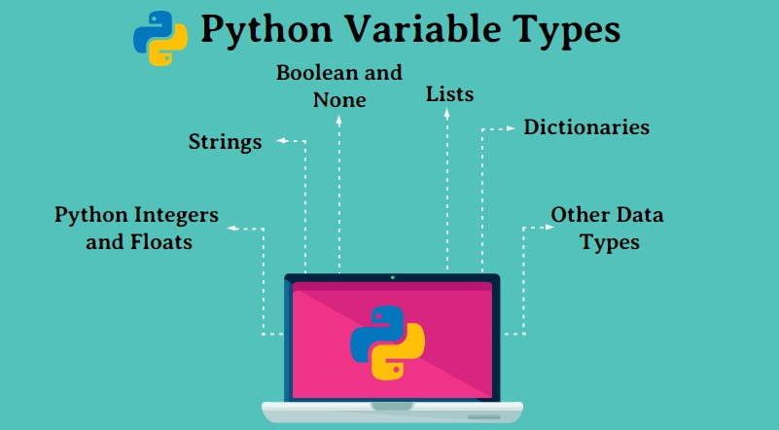
What is variables in python with example?
A variable in Python is a name used to store data. You can assign any value (number, text, etc.) to a variable without declaring its type.
Python is dynamically typed, so it automatically detects the data type based on the assigned value.
name = "Lakshmi" # string
age = 20 # integer
height = 5.4 # float
print("Name:", name)
print("Age:", age)
print("Height:", height)
Name: Lakshmi
Age: 20
Height: 5.4
Great Minds Technology
www.greatmindstechnology.in

Slide 10
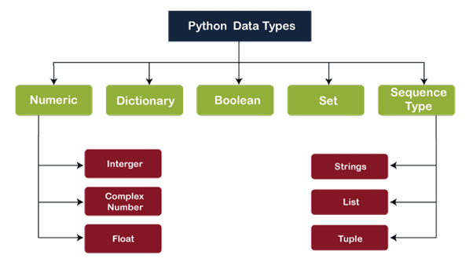
What is data type in python with example?
A data type in Python specifies the type of value a variable holds, such as a number, text, list, etc. Python is dynamically typed, so it automatically detects the data type when you assign a value.
Example:
age = 21 # Integer
height = 5.8 # Float
is_student = True # Boolean
print("Name:", name, "| Type:", type(name))
print("Age:", age, "| Type:", type(age))
print("Height:", height, "| Type:", type(height))
print("Is Student:", is_student, "| Type:", type(is_student))
Name: Gokula | Type: <class 'str'>
Age: 21 | Type: <class 'int'>
Height: 5.8 | Type: <class 'float'>
Is Student: True | Type: <class 'bool'>
Great Minds Technology
www.greatmindstechnology.in

Slide 11
Compare data type and variables in python with example?
Feature | Data Type | Variable
Definition | Tells the kind of value (e.g., int, str) | A named storage for data
Purpose | Classifies the data | Holds and references data
Example | int, float, str, bool, etc. | age = 25, name = "Gokula"
Usage | Helps Python understand how to use data | Used to perform operations using data
Need to Declare | No need to declare type (Python infers) | Assigned using = symbol
Great Minds Technology
www.greatmindstechnology.in

Slide 12
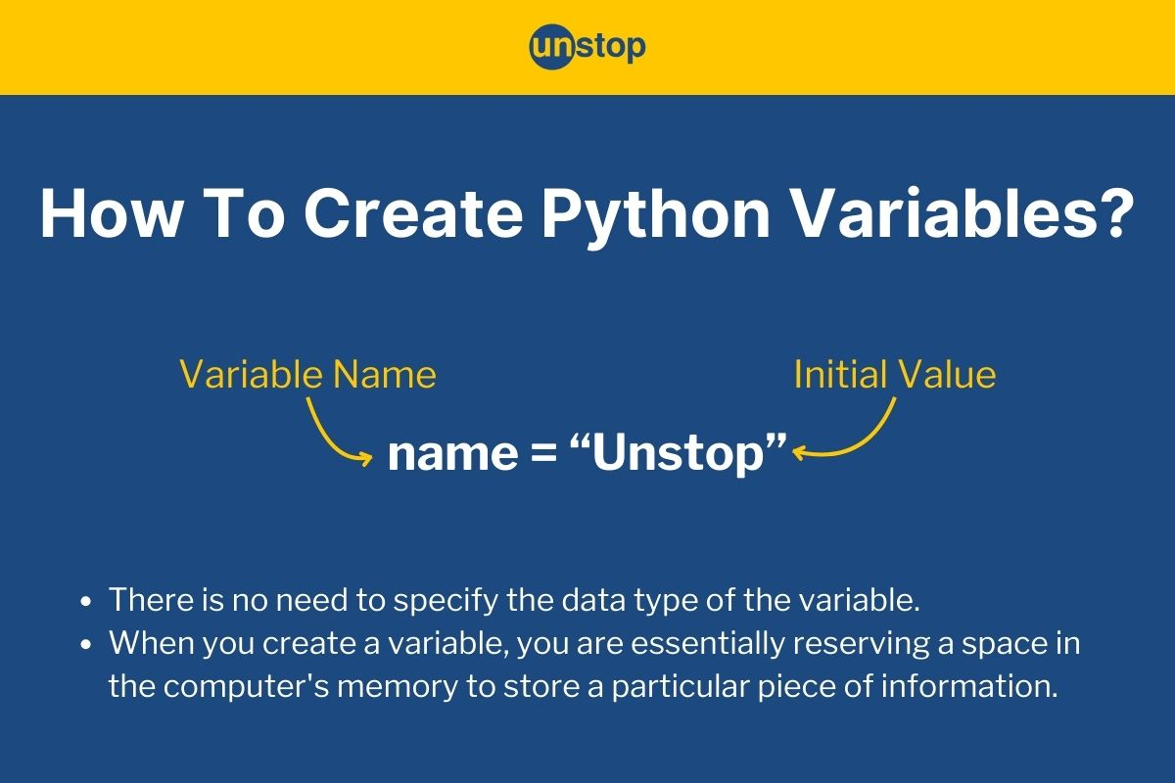
How to create variables in python?
Creating a variable in Python is simple — you just assign a value to a name using the = sign.
variable_name = value
name = "Lakshmi" # string
age = 20 # integer
height = 5.5 # float
is_student = True # boolean
Great Minds Technology
www.greatmindstechnology.in

Slide 13
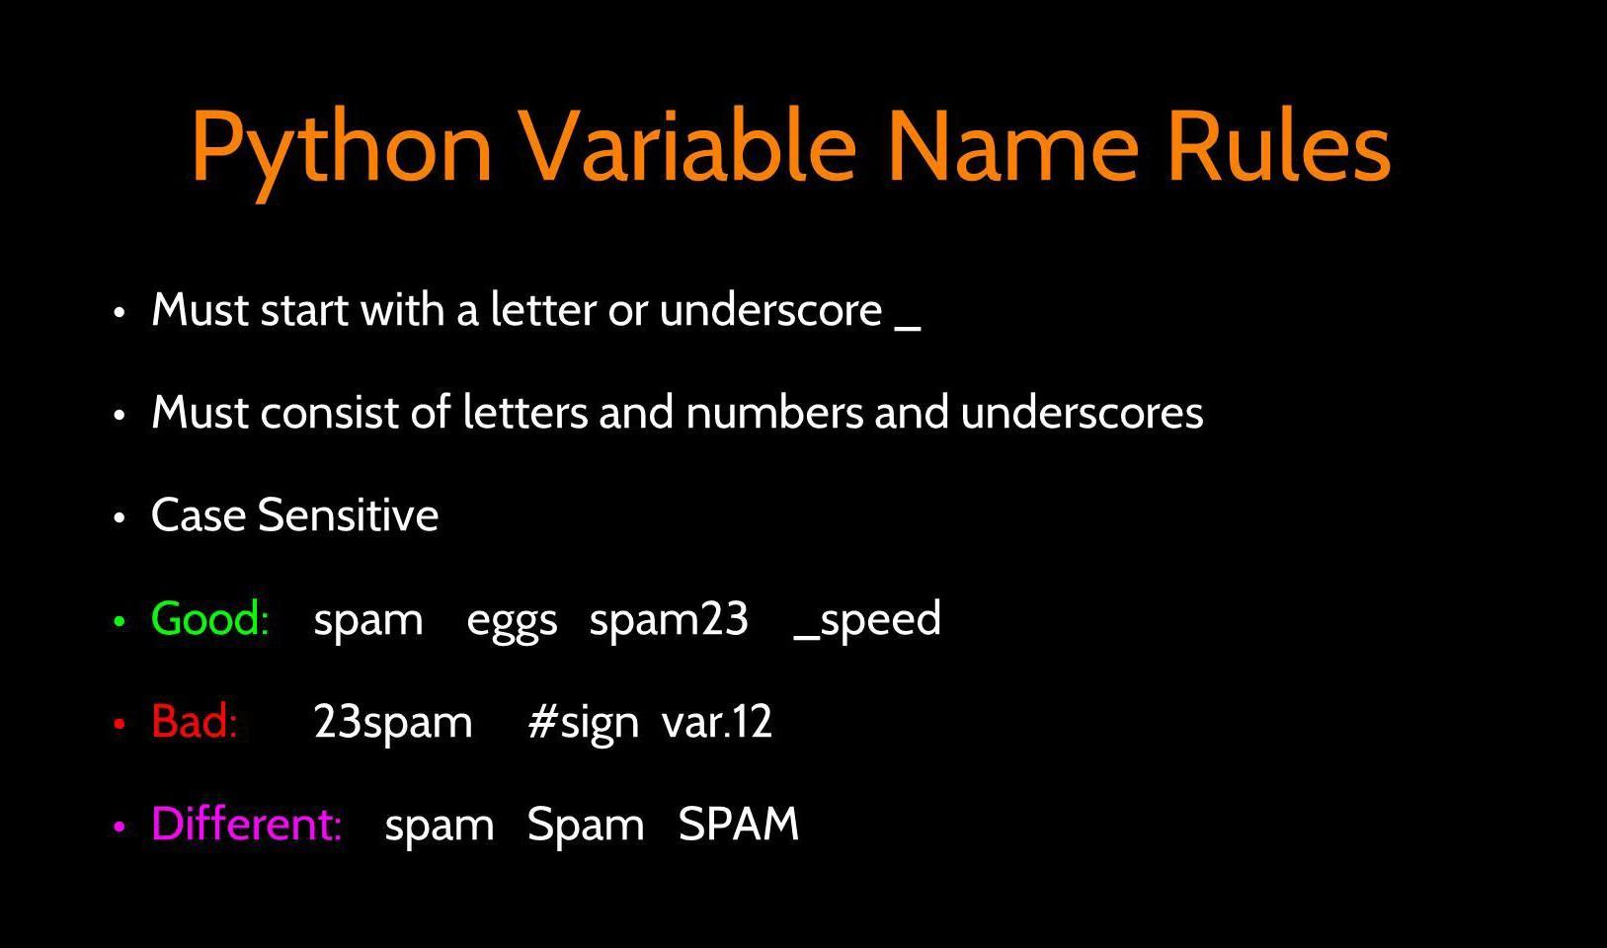
Rules for Naming Variables:
1.Must start with a letter or underscore (_) name, _value 1name (invalid)
2.Can contain letters, numbers, and underscores student_1, total_marks
3.Case-sensitive: Name and name are different variables
INPUT:
name = "Gokula"
age = 22
height = 5.8
print("Name:", name)
print("Age:", age)
print("Height:", height)
OUTPUT:
Name: Gokula
Age: 22
Height: 5.8
Great Minds Technology
www.greatmindstechnology.in

Slide 14
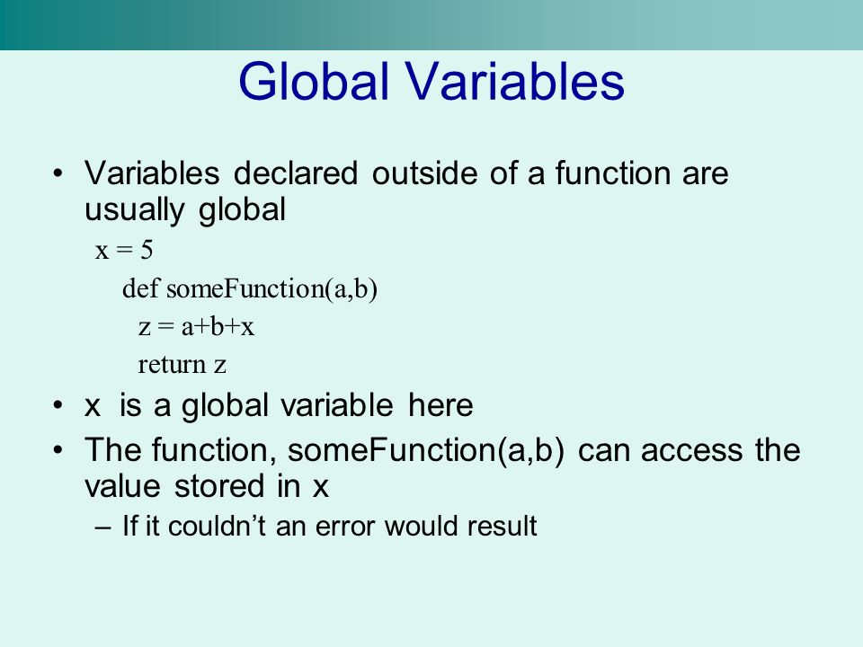
How to assign multiple variables and global variables in python?
Assigning Multiple Variables -You can assign values to multiple variables in a single line.
Assigning different values
a, b, c = 10, 20, 30
Assigning same value to multiple variables
x = y = z = 100
print(a, b, c) # Output: 10 20 30
print(x, y, z) # Output: 100 100 100
Global Variables in Python - A global variable is declared outside any function and can be used anywhere in the program.
Global variable
message = "Hello from outside!"
def greet():
print(message) # Accessing global variable
greet() # Output: Hello from outside!
Great Minds Technology
www.greatmindstechnology.in

Slide 15
Explain the data types with examples in python?
Integer (int) - Represents whole numbers (no decimals).
Float (float) - Represents decimal numbers.
String (str) - Represents text data, enclosed in ' ' or "
Boolean (bool) - Represents True or False values.
List (list) - Represents a collection of values that is ordered and changeable.
Tuple (tuple) - Represents a collection that is ordered and unchangeable (immutable)
Dictionary (dict) - Represents data in key-value pairs.
Set (set) - Represents a collection of unique items, unordered.
Great Minds Technology
www.greatmindstechnology.in

Slide 16
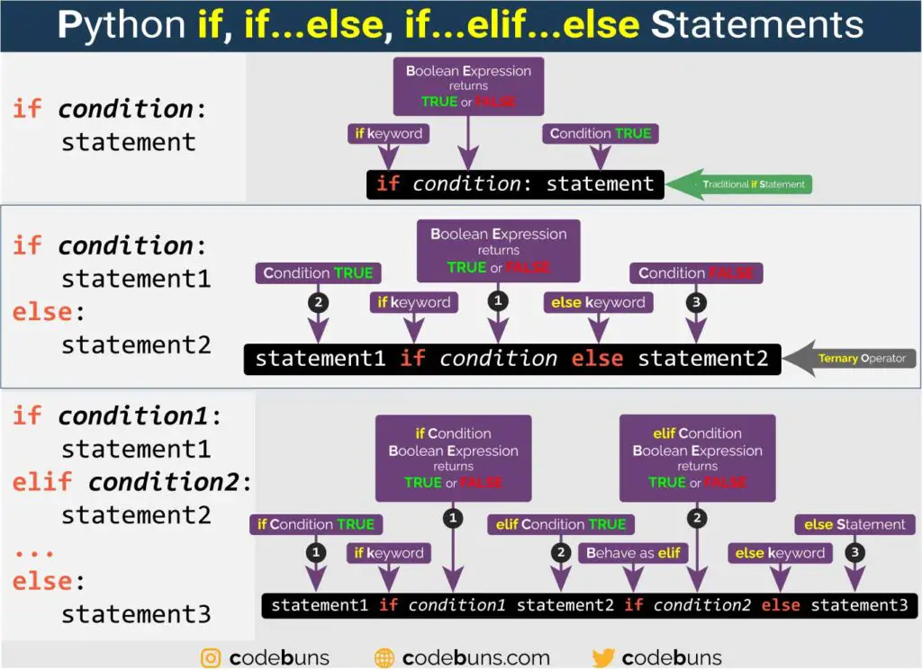
What is conditional statements in python and explain them with example?
A conditional statement in Python is used to perform decision-making in a program. It allows your code to execute certain blocks only if a specific condition is true.
Great Minds Technology
www.greatmindstechnology.in

Slide 17
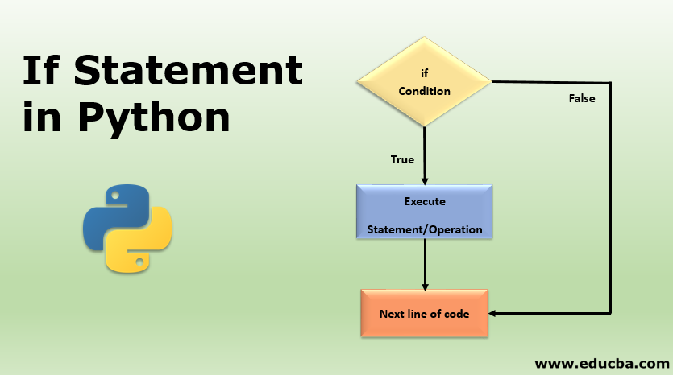
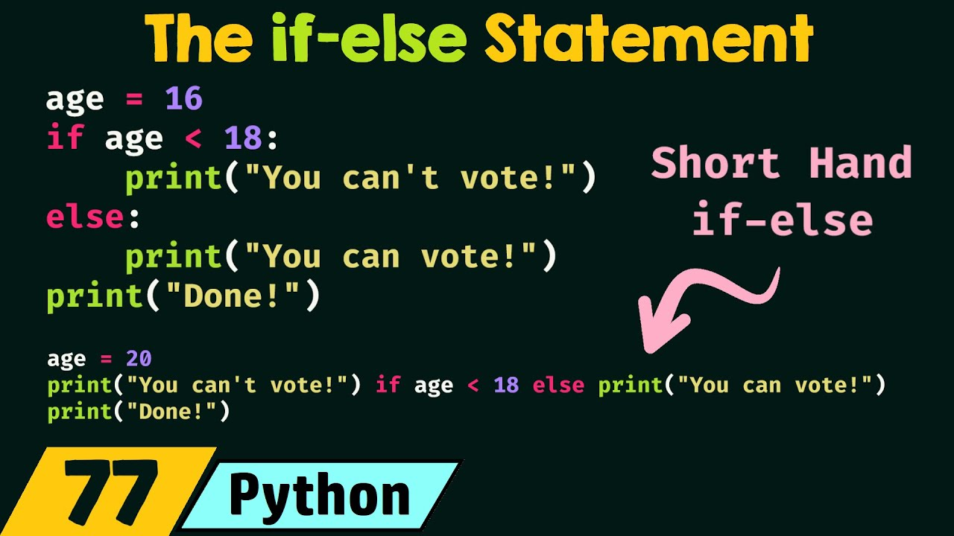
if Statement:
if...else Statement:
Great Minds Technology
www.greatmindstechnology.in

Slide 18
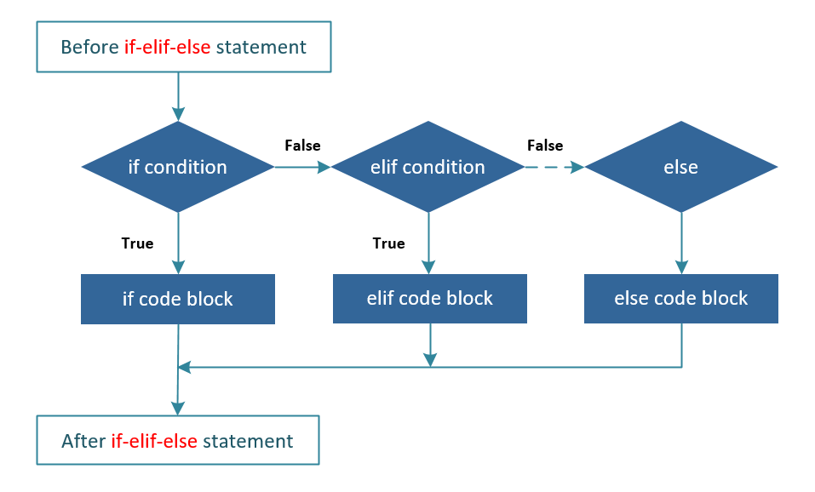
if...elif...else Statement:
Great Minds Technology
www.greatmindstechnology.in

Slide 19
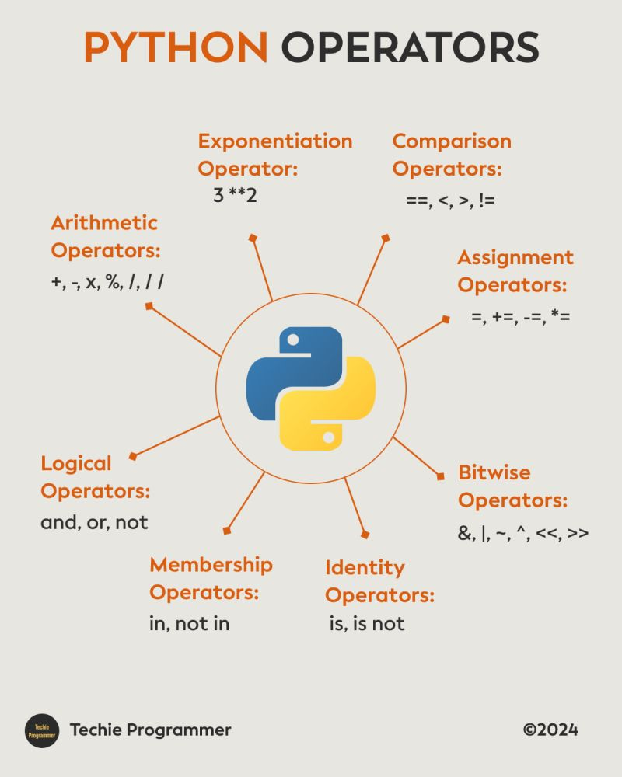
Explain different type of operators with example in python?
Operators are symbols that perform operations on variables and values.
Great Minds Technology
www.greatmindstechnology.in

Slide 20
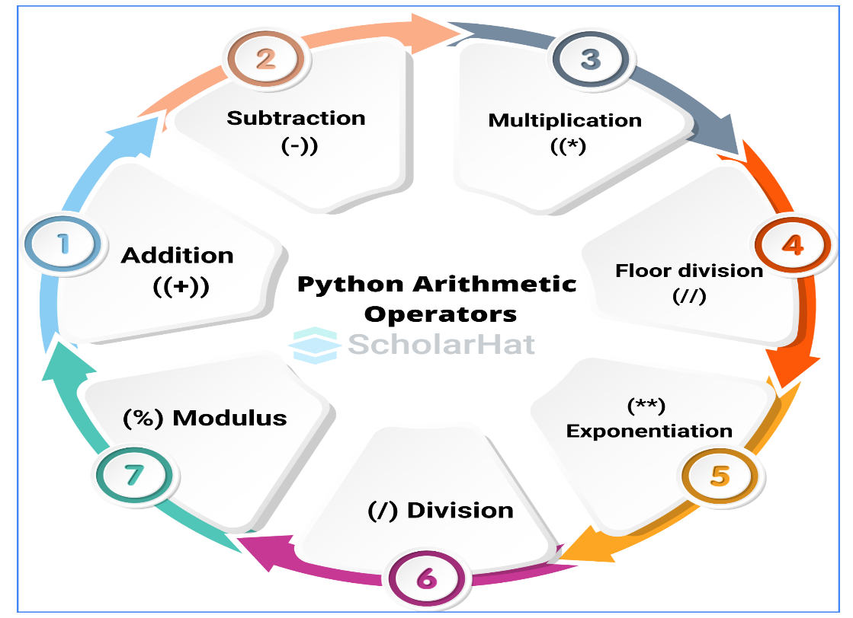
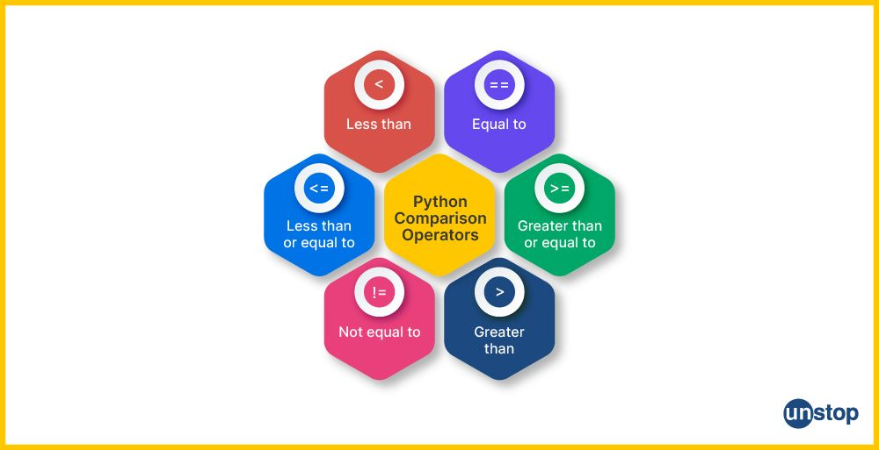
Arithmetic Operators:
Used to perform basic math operations.
Comparison (Relational) Operators:
Used to compare two values
Great Minds Technology
www.greatmindstechnology.in

Slide 21
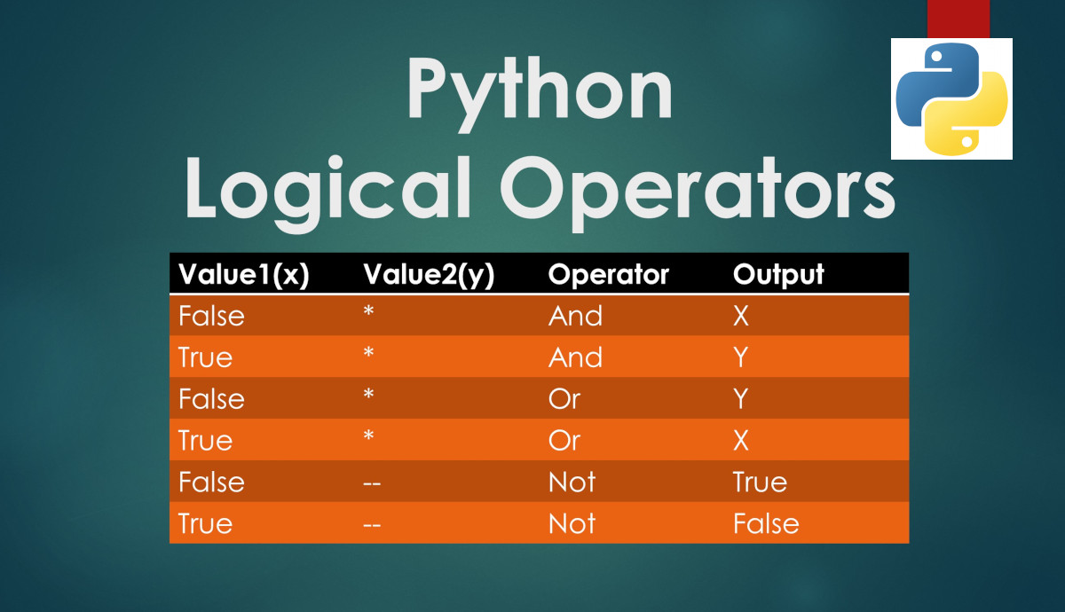
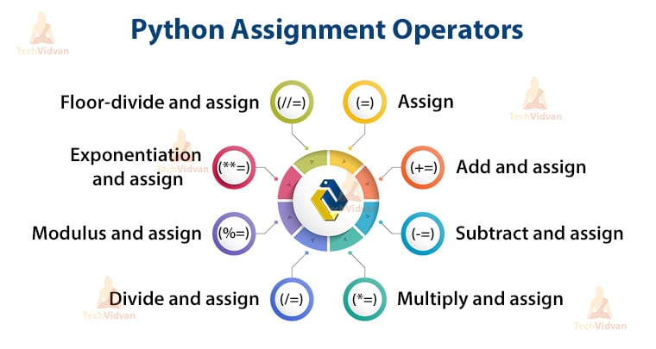
Logical Operators:
Used to combine multiple conditions.
Assignment Operators:
Used to assign values to variables.
Great Minds Technology
www.greatmindstechnology.in

Slide 22
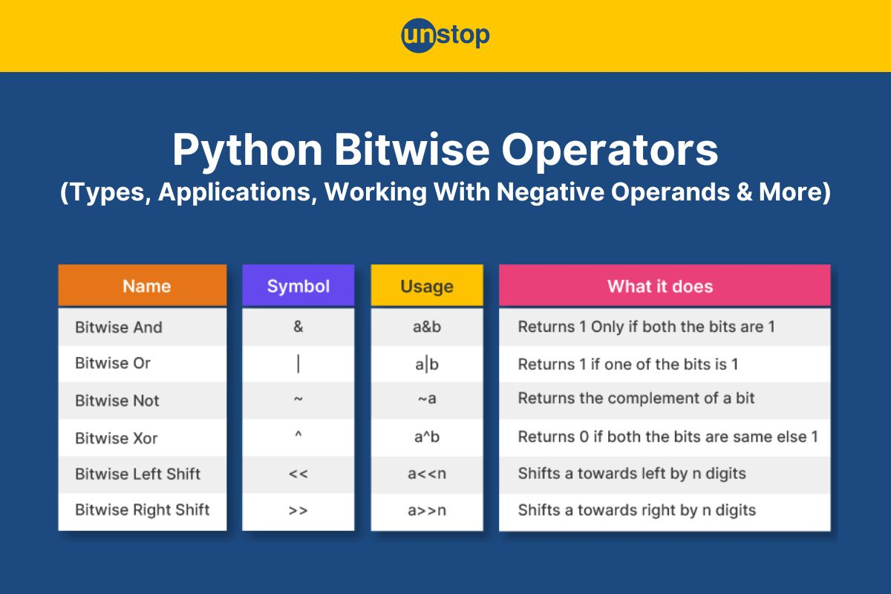

Bitwise Operators:
Operate on binary values.
Membership Operators:
Check if a value exists in a sequence.
Great Minds Technology
www.greatmindstechnology.in

Slide 23
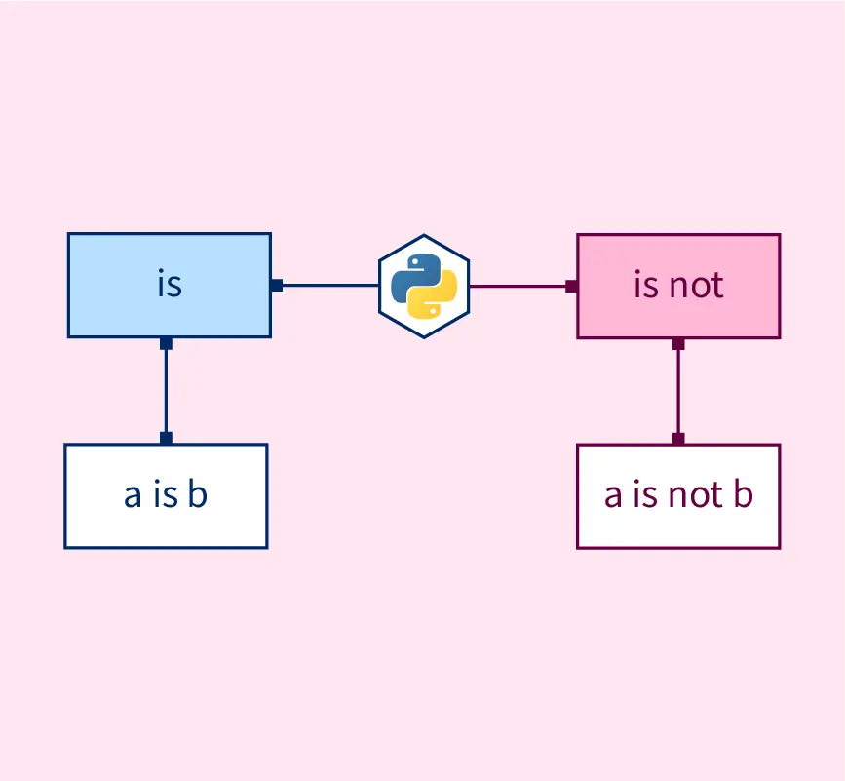
Identity Operators
Compare memory location of objects.
Great Minds Technology
www.greatmindstechnology.in

Slide 24




Thank You
Great Minds Discuss Ideas
Average Minds Discuss Event
Small Minds discuss people
9500101075
info@greatmindstechnology.in
www.greatmindstechnology.in

