Slide 1

UNIVERSITY COLLEGE OF ENGINEERING, BIT CAMPUS,
TIRUCHIRAPPALLI-620024
Bone Fracture Detection Using Machine Learning
Under the guidance of,
DR.I.Shahanas Begum,
Assistant professor,
Department of CSE
Presented By:
Sakthivel.M (810020205502)
Selvakumar.G(810020205316)

Slide 2
INTRODUCTION
Fracture occurs when a heavy force disburse against a bone is tough than the bone can structurally resist. Among the various diseases, detection of bone fracture and its treatment, which affects many people, is becoming increasingly important in today's culture.
Bone fracture is a common problem in most developed countries, and the number of fractures is increasing rapidly
In practice, specialists and radiologists rely heavily on X-ray images to determine whether or not a fracture has occurred, as well as the precise location of the fracture.
The focus of this study is to provide solution to the challenges of detecting fracture or non-fracture bone images

Slide 3
PROBLEM STATEMENT
To collect efficient datasets which include different types xray images.
To identify and optimize the dataset for training the model.
To develop the model using machine learning.
To identify and detecting fracture or non-fracture bone images.

Slide 4
DATASET
The data set we used included 3 different bone parts,
PART | NORMAL | FRACTURED | TOTAL
Elbow | 3160 | 2236 | 5396
Hand | 4330 | 1673 | 6003
Shoulder | 4496 | 4440 | 8936

Slide 5
DATA COLLECTION
Our data contains about 20,000 x-ray images, including three different types of bones - elbow, hand, and shoulder.
The algorithm starts with data augmentation and pre-processing the x-ray images, such as flip horizontal.
The bone fracture detection system consists of four main modules, which are preprocessing, edge detection, feature extraction, and classification.

Slide 6
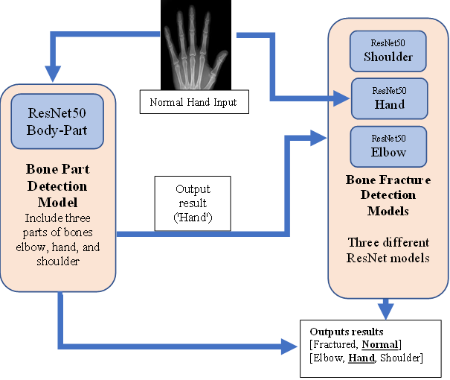
ARCHITECTURE DIAGRAM

Slide 7
DATA FLOW DIAGRAM
Input user X-Ray for Image
Preprocessing
Segmentation
Feature Extraction
Predict Resut
Bone Detection
Classification

Slide 8
INSTALL REQUIREMENTS.txt
customtkinter~=5.0.3
PyAutoGUI~=0.9.53
PyGetWindow~=0.0.9
Pillow~=8.4.0
numpy~=1.19.5
tensorflow~=2.6.2
keras~=2.6.0
pandas~=1.1.5
matplotlib~=3.3.4
scikit-learn~=0.24.2
colorama~=0.4.5
Run mainGUI.PY

Slide 9
MODULES
Data Collection
Data Preprocessing
Data Transformation
Model Development
Model Evaluation

Slide 10
MODEL DEVELOPMENT
Gather a dataset of medical images containing both fracture and non-fracture cases. This dataset should be diverse and representative of the population you're targeting.
Apply the data transformation steps mentioned earlier, including cleaning, normalization, feature engineering, and augmentation.
Choose an appropriate machine learning algorithm for image classification. Convolutional Neural Networks (CNNs) are commonly used for image-based tasks and are likely suitable for bone fracture detection.

Slide 11
MODEL EVALUTION
In terms of classification and detection, this technique has an overall accuracy of 94% to distinguish between fractured and healthy bone, a deep neural network model was created.
After the model is trained, it undergoes model evaluation. It is tested on a separate set of X-ray images not used in training.
The model's accuracy, sensitivity, and specificity in detecting fractures are evaluated by comparing its predictions with the ground truth labels to assess its performance.

Slide 12
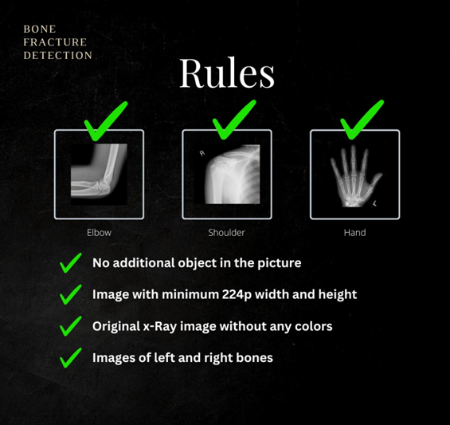
INFO-RULES

Slide 13
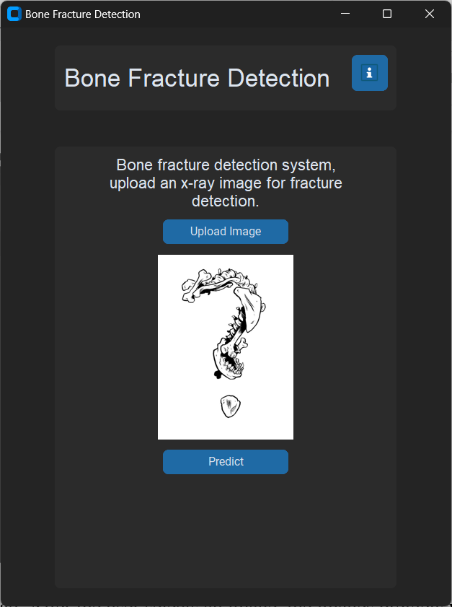
MAIN

Slide 14
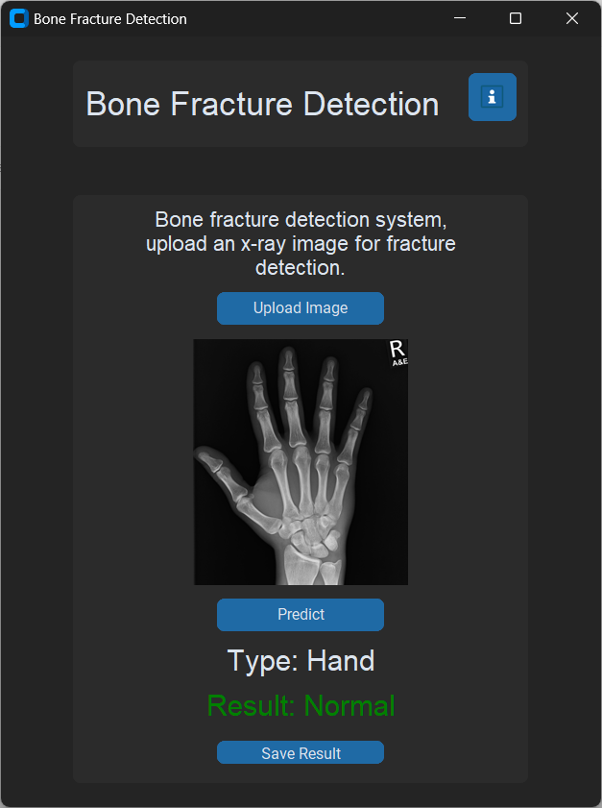
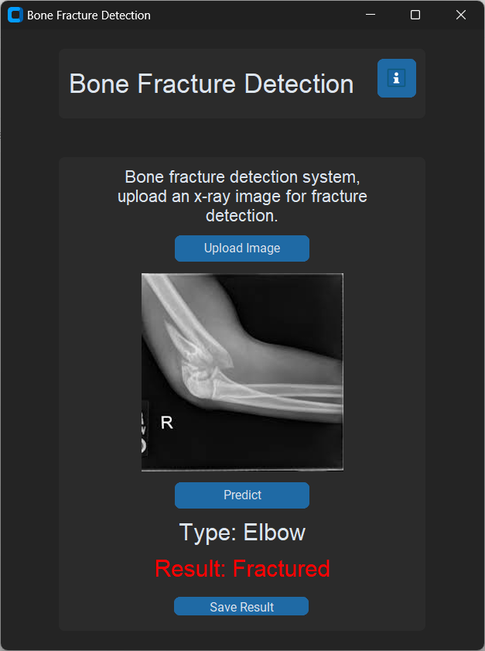
TEST NORMAL & FRACTURED

Slide 15
DATA PREPROCESSING
Our Model was built in such a way that it can pierce through numerical data and analyze it further.
If our Entries aren't properly transformed to a format that our model can appreciate, they'll be discarded.
The first step in resolving this is to scale all of our photographs to argentine proportions.

Slide 16
DATA TRANSFORMATION
Data transformation is a crucial step in preparing data for machine learning models, especially for tasks like bone fracture detection.
Remove any irrelevant or inconsistent data points. This could include removing duplicates, correcting errors, and handling missing values.
Scale the features to a similar range to ensure that no single feature dominates the learning process. Normalization scales the data to a range between 0 and 1, while standardization scales it to have a mean of 0 and a standard deviation of 1.

Slide 17
PROJECT OVERVIEW
The Hough transform was used to determine whether or not a break point exists in the uploaded x-ray image, and a circle was drawn at the breakpoint
Create a 2Darray corresponding to a discrete set of values for ρ and ѳ. Each element in this array is often referred to as accumulator cell.
For each pixel (x, y) in the image and for each chosen value of ѳ, compute ρ from equation (1) and write the result in the corresponding position (ρ,ѳ) in the accumulator array.
The final step was to categorize fracture bone types using classifiers such as KNN, SVM, ANN, and CNN. These classifiers were chosen primarily for their ability to reduce training time while increasing classification accuracy.

Slide 18
REFERENCES
[1] K[1] Myint Wint Wah, Tun KS, Tun HM. Analysis on leg bone fracture detection and classification using x-ray images, 2018;3(3):49-59.
[2]Johari N, Singh N. Bone fracture detection using edge detection technique. Advances in Intelligent Systems and Computing, 584:11–19, 2018.
[3]Kaur T, Garg A. Review of various fractal detection techniques in x- ray images. 2016; 4(2):553–559.
[4]Yangling Ma, Yixin Luo, Bone fracture detection through the two-stage system of Crack Sensitive Convolutional Neural Network, Informatics in Medicine Unlocked 22, 100452,2021.

