Slide 1
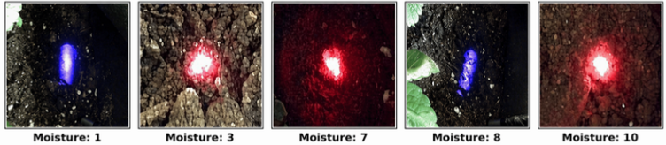
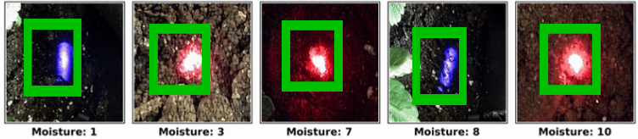
COCO Pre-trained Weights (yolov5s.pt)
Stage I
Multi-Spectral Base Training
UV-Soil-Only-Baseline · UV-Soil-Only-Target
IR-Soil-Only (7c) · UV-Strawberry-Pot (9c)
IR-Pot-Background (5c) · UV-Pot-Background (5c)
Mixed Color and Background (5c)
W1
Best weights
IR-Pot-Background
best.pt
Multi-spectral soil images
D2
Stage II
Pooled Training (COCO init)
UV-Combined: UV-Soil-Only-Baseline
+ UV-Strawberry-Pot
IR-Combined (5c): IR-Pot-Background
+ UV-Pot-Background
Pooled
datasets
Final Detector Model
W3
Stage III
Domain-Specific Fine-Tuning
UV-Combined · IR-Combined (5c)
IR-Soil-Only (7c) · UV-Soil-Only-Target
Mixed Color and Background (5c)
Stage III starts from W1
Final output - detected moisture levels

