Slide 1
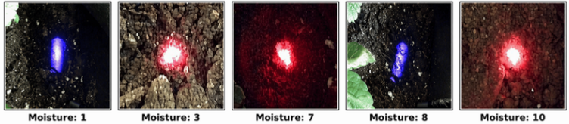
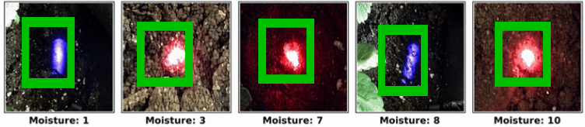
ImageNet Pre-trained Weights
Stage I
Multi-Spectral Base Training
v4 · v4-ir · v4-uv · ir (5c)
5sagf · September · stir-sep
W1
Best weights
(ir / best.pt)
Multi-spectral soil images
W2
Stage II
Domain Adaptation
September · ir (5c) · v4 · 5sagf
v4-sep combined · ir-combined
Adapted
weights
Final Detector Model
W3
Stage III
Combined Fine-Tuning
v4-sep combined · ir-combined
stir-sep (5c) · v4-ir · v4-uv
Final output - detected moisture levels

