Slide 1




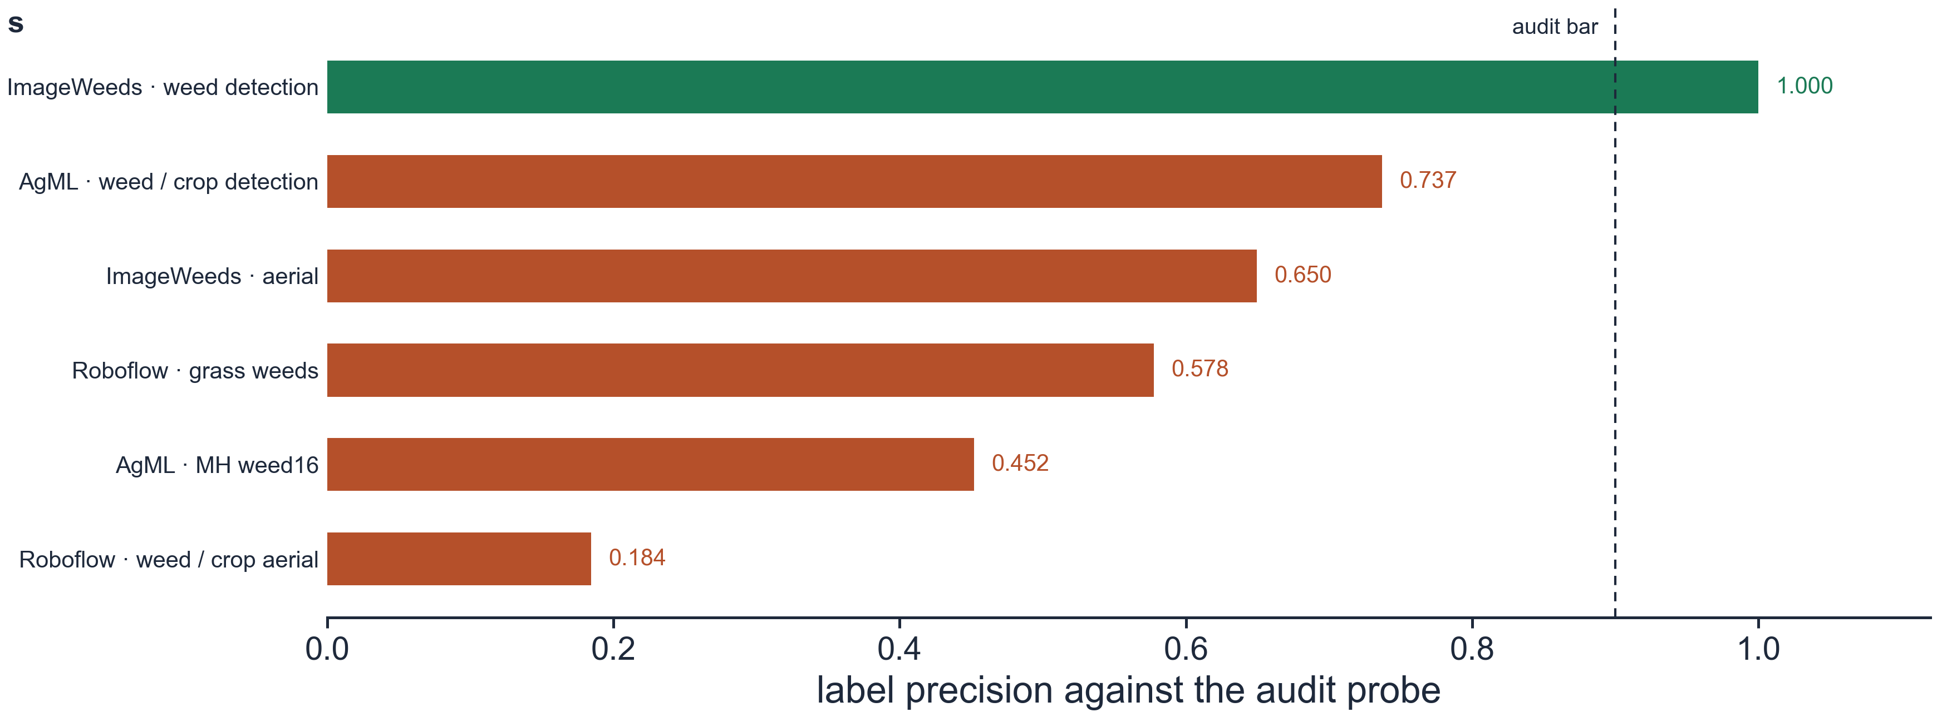

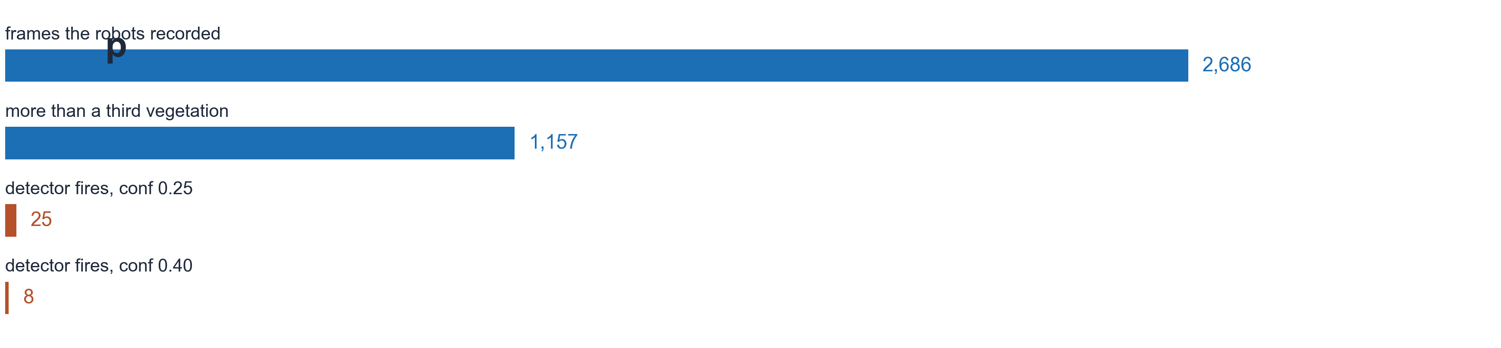
How Much of This Pipeline Can the Agents Run by Themselves?
Harry He · Hongbo Zhang
Department of Engineering Technology · Middle Tennessee State University, Murfreesboro, TN, USA
We spent six months finding out, on our own robots and on PSC Bridges-2. The answer is that collection and training run alone, and judging does not.
The route we actually took
Figure 1. Six months. Four of these eight turns are things that did not work, and two are numbers this project measured, published internally and then withdrew after checking them.
What we collect now
The part that runs alone
The part that does not
Judging does not run alone yet. We froze 162 real failures out of this project's own engineering record and scored every kind of supervision we had. The watchdog the loop was running returned no decision on any of the 149 dev cases.
reviewer
recall
grounded
incidents
scripted watchdog
no decision
—
—
Figure 2. Frames as recorded, unenhanced. Robot 241 has sent 2,238 frames at 640 x 360 and 1 Hz, the laser cart 427, and 75 of the cart's were taken in a field. None of the 2,686 is labelled. The rectangle in the down camera is the cart's fixed work-zone overlay. It is drawn on every frame, including the ones with no vegetation in them.
12 rules
0.095
0.095
116
Qwen2.5-7B
0.823
0.274
113
Qwen3-14B
0.675
0.614
114
Two ground vehicles drive our own crop plots. Robot 241 streams frames, position and attitude; the laser cart carries the weeder and two cameras. 2,686 frames in 26 drives, 91,955 telemetry rows across nine streams, 342 m of GPS track. None of it is labelled, and the cart writes no position at all.
Figure 4. The path as built, from a camera in a crop row to a checkpoint on the cluster. Every stage has run. Three qualifications ride on it. The collector and trainer are paused after a stop-loss on 2026-08-29. The supervisor is advisory and nothing it says is applied. And the last link is not closed: no robot frame has entered training, because none of them is labelled yet.
Qwen3.8-27B
0.702
0.702
57
Collection and training run without a person. A round searches public sources, filters what it finds against a DINOv2 gate, merges into a registry that excludes the holdout by content hash, trains on an H100 allocation and evaluates. Fifteen rounds went through that path and every one reported success.
Recall does not order the reviewers by size. Evidence does. The 7 B has the highest recall on the table and two thirds of what it reports quotes a line that does not exist. That is the size class we had been running.
What fifteen unattended rounds actually did
Does more data help?
harvested added
mAP50-95
n
none, the core
0.8637 ± 0.0027
3
+5,000
0.8609 ± 0.0036
3
+15,000
0.8580 ± 0.0047
3
+40,000
0.8448 ± 0.0018
3
Twelve times the data costs 0.0189, which is 8.2 times the seed spread, and the same eight checkpoints fall on a second weed dataset too. One of six audited web sources clears a 0.90 label-precision bar.
Figure 3. Robot 241, 2026-08-29: one 213 s pass through a crop plot. (h) GPS track from the board fix. (i) IMU heading over the same pass.
Figure 5. (f) Fifteen unattended rounds on a fixed holdout. (g) Round 15's exact dataset, three ways. The first two marks differ only in the starting weights, so their gap is the warm-start chain; the third is the recipe the campaign ran, whose wall-clock cap truncates the cosine, with its three seeds drawn behind it. Sigma throughout is that recipe's own seed spread, 0.0040 over three seeds, propagated to the difference being quoted. Completing the schedule is not the fix -- the second mark sits below the third.
Accuracy fell the whole time. The corpus stopped growing at round three and eight rounds collected nothing while reporting success, so what was left was the chain: each round warm-started from the last one's weights. A control on round 15's own data prices that at +0.0287, 5.1 times this recipe's own seed spread. Completing the truncated schedule does not recover it, which was the obvious fix and the wrong one.
Six audited web sources
Everything we trained, ran, or rejected
Back on our own rows
Figure 8. The deployable checkpoint over every frame the two robots recorded, at the confidence the cart deploys at. There is no ground truth for these frames, so this is the rate at which the detector produces a box at all -- not recall and not precision. Vegetation is excess green over a thumbnail, so "nothing to detect" does not account for it: 1157 frames clear that bar and 21 of them draw a box. 24 of the 25 boxes it does draw are the same class.
Figure 7. The six audited harvested sources. The same probe reads 1.000 on human-labelled CottonWeedDet12, so a source at 0.184 is the data and not the instrument. Only the source at the top clears the bar, and it supplies 3,208 of the 13,527 audited images.
Figure 6. 30 rows in four families, which is 27 distinct models: OWLv2-large and Qwen2.5-7B each appear twice because each does two jobs here. One model is deployed. The zero-shot column is a single deterministic pass per model with no repeats, scored as mAP50 on the 848-image split; the reviewer column is the 149-case dev split, and two of its arms are still running. RF-DETR's score is on a third scale and is never differenced against the rows above it: the one measured offset between two of our evaluators, 0.0239, is larger than the gap on display.
Where this stands today. The collector and trainer are paused after a stop-loss on 2026-08-29, the supervisor is advisory, the laser has never fired at a weed under our control, and none of the 2,686 frames is labelled.
What we ran. Thirty model runs in four families: five detectors trained on our own holdout, two vision models inside the loop, fourteen vision-language models zero-shot, and nine language models as reviewers. That is 27 distinct models, because OWLv2-large and Qwen2.5-7B each do two of those jobs. One is deployed.
How the numbers were made. The 1,977-image holdout was also the validation set during training, so every mAP here is a run's best epoch, a maximum over 21 to 100 evaluations on the set it is reported on. Numbers we withdrew: 0.910 was a data leak found by a check we built after publishing it, 0.9033 is the best of four unseeded runs, and an earlier reading of the ladder as a flat curve is retracted.

