Slide 1
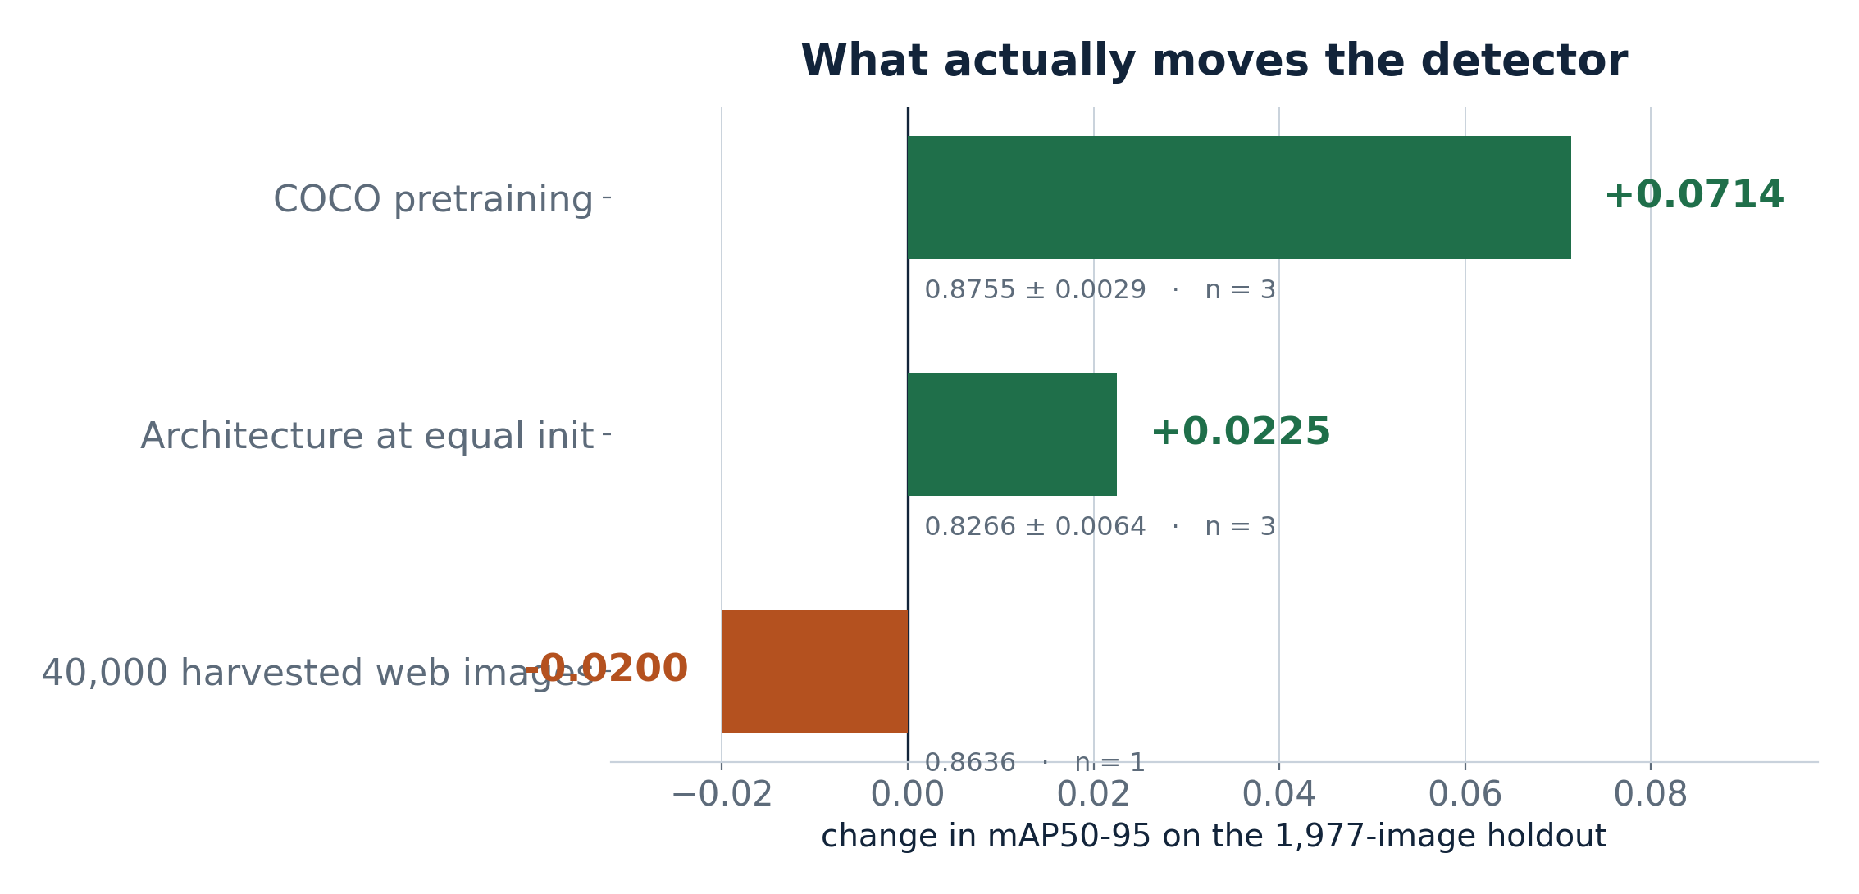
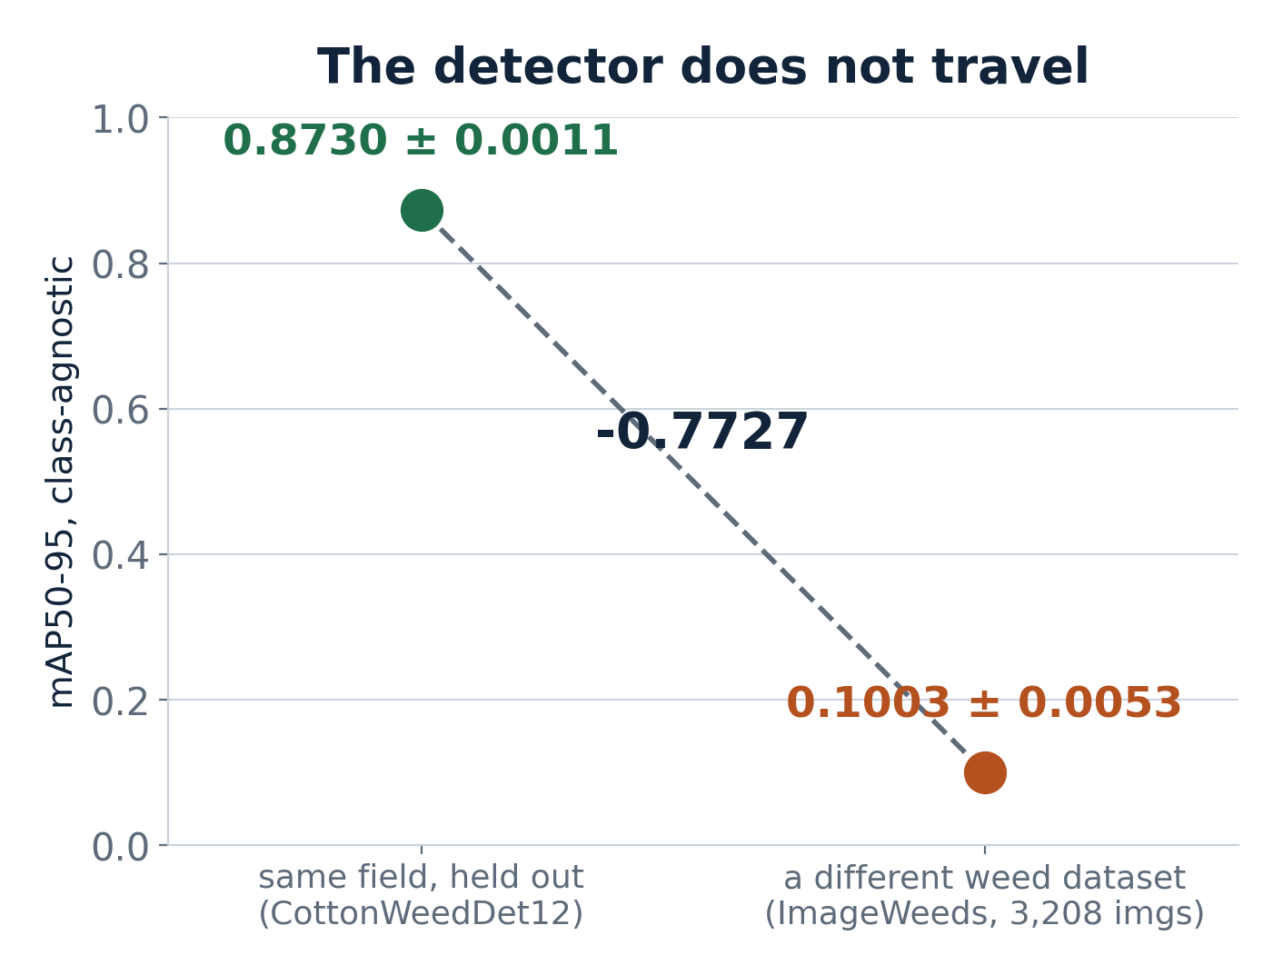
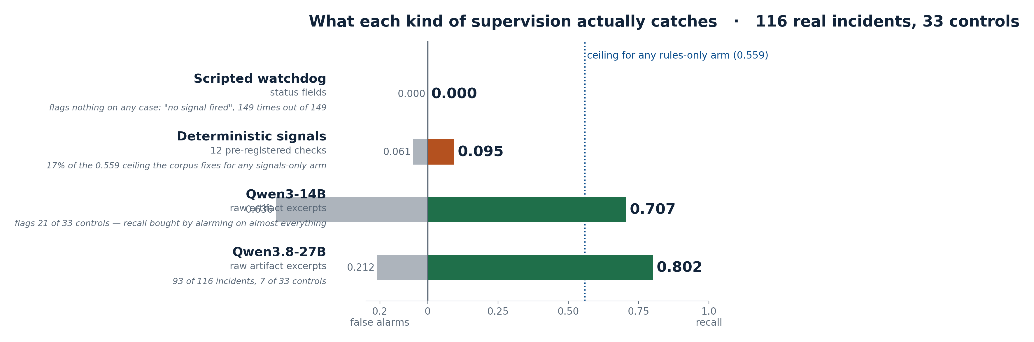
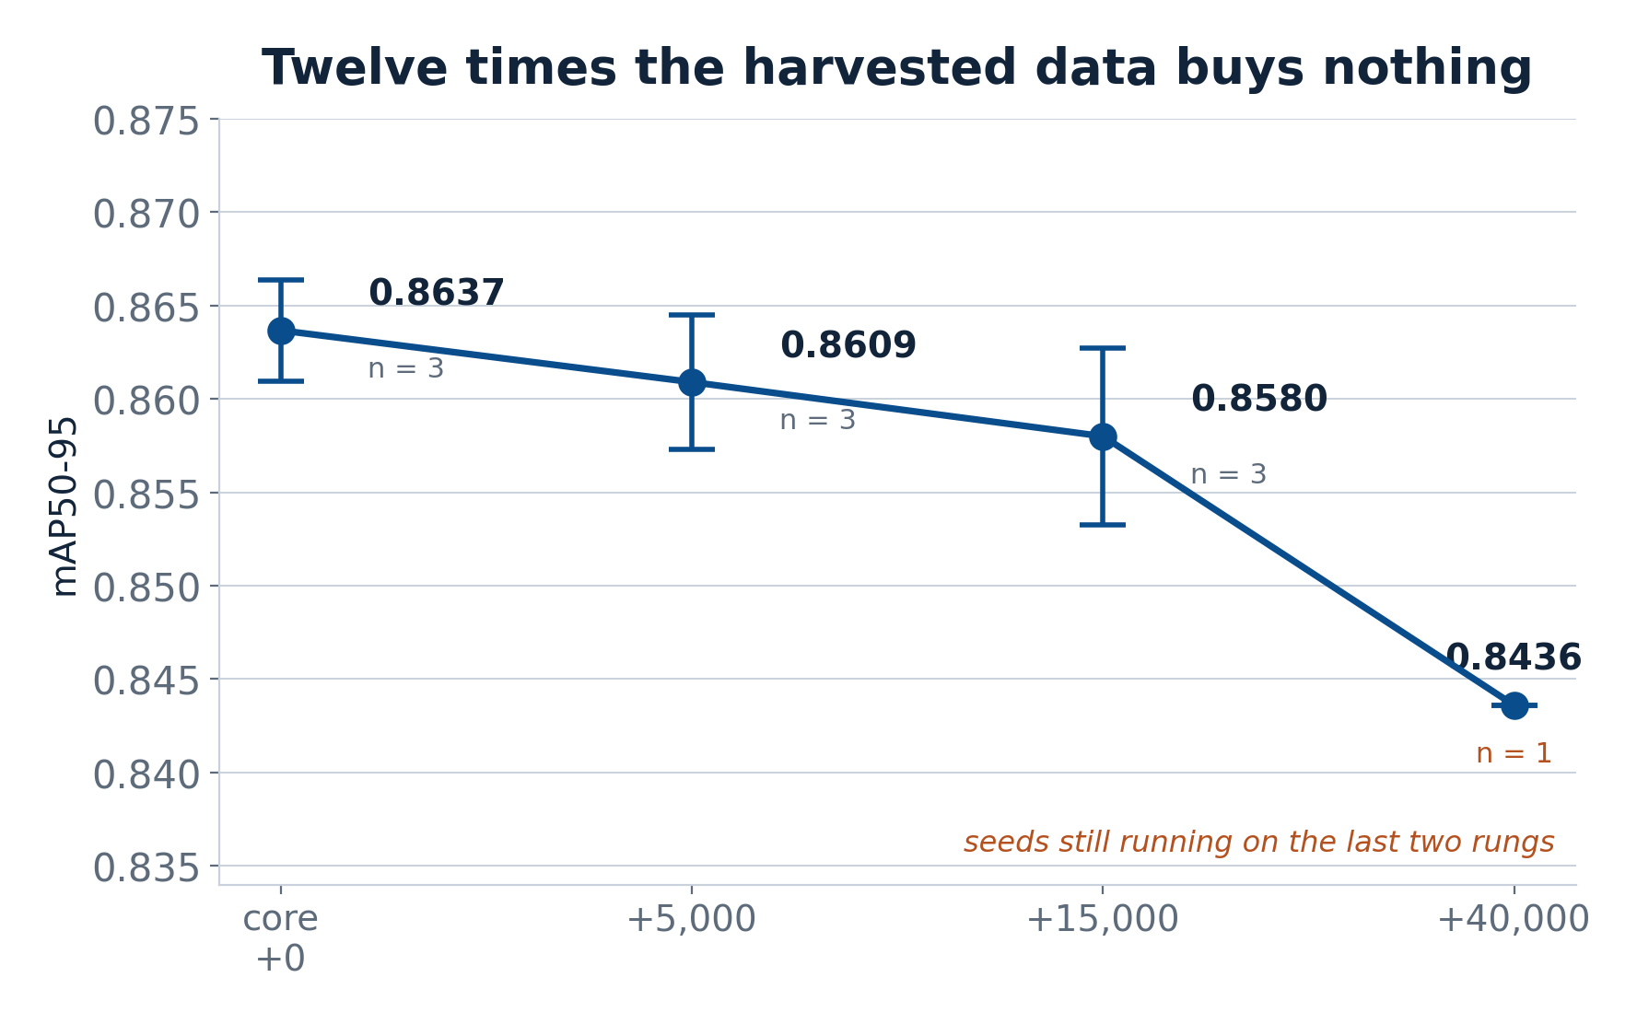
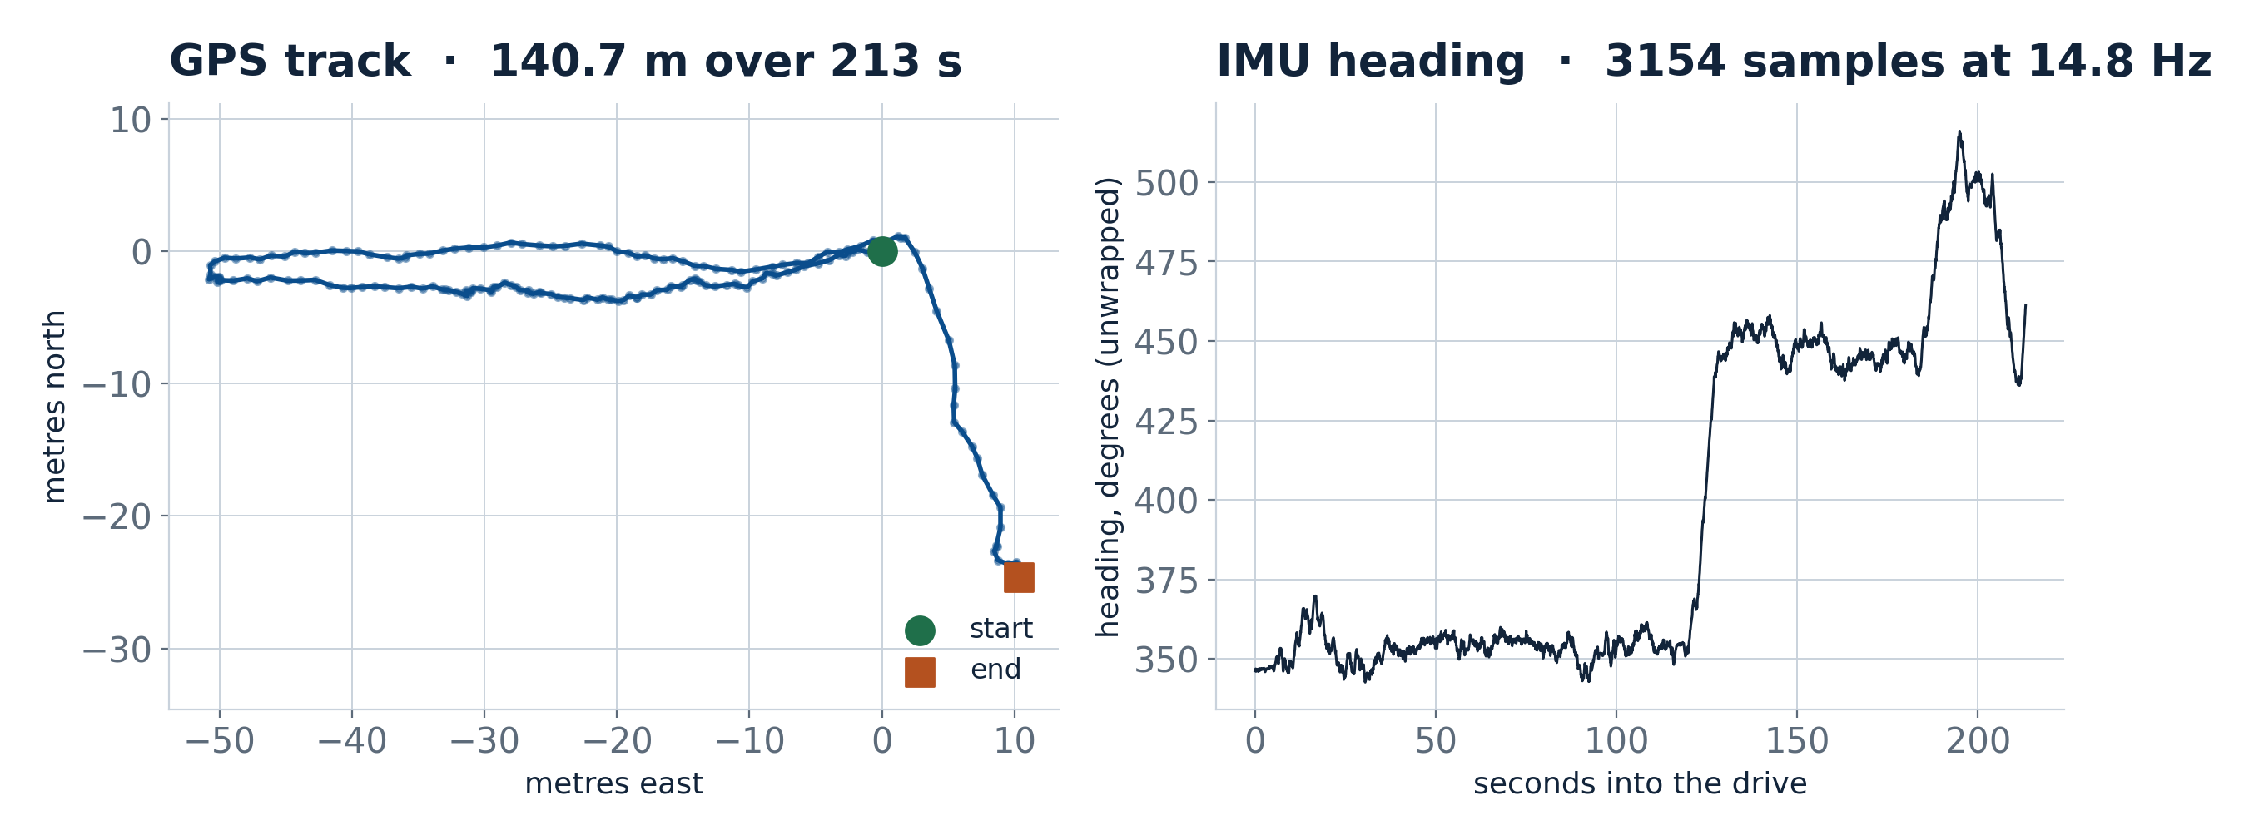
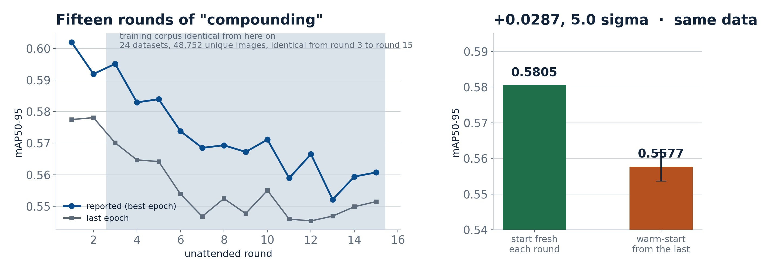
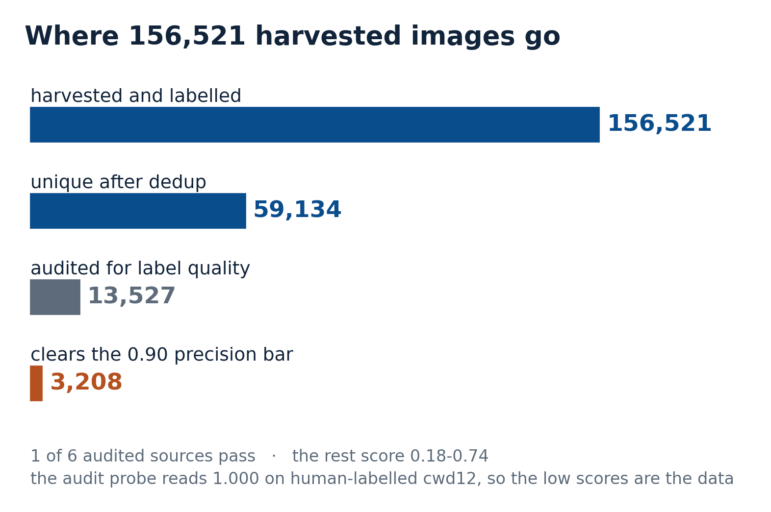
What Actually Moves a Weed Detector
Six months of an autonomous data-harvesting pipeline, instrumented and audited: which levers move accuracy, and which supervision catches failure
Hongbo Zhang¹ Harry He¹ Song Cui²
1 Department of Engineering Technology · 2 School of Agriculture · Middle Tennessee State University, Murfreesboro, TN, USA
+0.0714
0.100
0 of 116
48,752
what COCO pretraining is worth
same detector on another weed dataset
real incidents the scripted watchdog caught
images, unchanged for 13 of 15 rounds
n = 3 seeds each side
from 0.873 in-domain, n = 3
149 cases, it flagged none
while the loop reported progress
ABSTRACT
WHAT MOVES THE DETECTOR
THE GENERALISATION WALL
WHAT SUPERVISION ACTUALLY CATCHES
Autonomous data-harvesting pipelines promise compounding gains: collect, label, retrain, repeat. We built one for cotton-field weed detection — a collector agent and a trainer agent running unattended on an HPC allocation, fed by field robots — and ran it for fifteen rounds. Its dangerous failure mode was not a crash. It was a plausible number.
Audited against a fixed 1,977-image CottonWeedDet12 holdout: the training corpus was identical from round 3 onward, because the collector admitted nothing for eight consecutive rounds while reporting success; the metric nonetheless fell 0.6019 → 0.5607; and a controlled experiment on identical data attributes that decline to warm-start chaining rather than to the data.
Three measurements survive scrutiny at n = 3 seeds: COCO pretraining is worth +0.0714 mAP50-95, architecture at equal initialisation +0.0225, and web-harvested data 0.00 to −0.02. Detection collapses from 0.873 to 0.100 across imaging domains. A model reading raw artifacts catches failures that twelve deterministic checks structurally cannot.
THE PLATFORM
Figure 7. A frozen corpus of 162 real incidents from this project's own history, scored on the dev split: 116 incidents, 33 controls. Bars right of zero are recall, left of zero are false alarms. The scripted watchdog reads status fields and flags nothing, 149 times out of 149. The twelve deterministic checks catch 11. A model reading raw artifact excerpts catches four to eight times more. The dotted line is the ceiling any rules-only arm has on this corpus: 56 of the 127 incidents declare no deterministic signal that could reach them.
Two agents run as separate SLURM jobs against one locked registry: a collector that searches, downloads and pseudo-labels, and a trainer that merges, deduplicates, guards the holdout and trains. Field data arrives over a live uplink from two robots driving crop rows.
CONCLUSIONS
Counted on disk rather than claimed: 2,686 frames across 26 sessions from 2 robots, and none of them labelled. Robot 241 contributes 2,259 frames at 640 x 360, 2026-08-15 to 2026-09-05, camera at 1 Hz, of which 1,704 are genuinely on vegetation or soil. The laser cart contributes 427 frames, of which 75 — one session on 2026-08-29 — are in a field; the rest are indoor bench tests. The laser cart carries no GPS and no IMU: its uplink declares detections, laser, vehicle, system, camera.
Figure 3. Three levers on one holdout and one evaluator. Initialisation is worth three times what architecture is worth, and both dwarf the data-collection lever the whole system was built around. Top two rows n = 3 seeds; bottom row n = 1 with seeds in flight. Source: results/framework/s3_yolo11n/*/results.csv.
1. Initialisation beats architecture beats data. The data-collection lever the system was built around is the weakest of the three, and at +40,000 images it is negative.
2. The detector does not travel. 0.873 in-domain becomes 0.100 on another weed dataset, class-agnostic, same matcher both sides.
3. Web harvest supplies volume, not supervision. One of six audited sources clears a 0.90 label-precision bar.
4. Retrospective supervision needs the artifacts, not the status fields. A scripted watchdog over status fields caught none of 116 real incidents; a model reading the artifacts caught most.
Figure 5. The same three checkpoints, the same matcher on both sides so the evaluator offset cancels: 0.8730 ± 0.0011 in-domain against 0.1003 ± 0.0053 on ImageWeeds. Best species Ragweed 0.9604 → Ragweed 0.0006. An in-domain weed detector does not transfer across imaging domains, and no amount of in-domain data fixes that. Source: results/framework/s6_crossdataset_imageweeds.json.
5. An unattended loop can report success for eight consecutive rounds while collecting nothing. Absence of a failure signal is not evidence of success.
WHY THE LOOP LOOKED LIKE IT WAS LEARNING
LIMITATIONS
The holdout is used as the validation set, so every number is a maximum over many evaluations on the reported set; the optimism is measured (+0.002 to +0.017) but not removed. The tier ladder and the chain control are n = 1 per point with seed repeats in flight. The 27B supervision row is 149 of 149 cases and still running. The supervision corpus was labelled from this project's own engineering record by the same system that wrote the reviewer prompt, and its test split is 13 cases — too small to separate methods. Robot field frames are collected but not yet scored, and none of the 2,686 robot frames is labelled. The laser cart carries no GPS or IMU, so the platform's sensor-fusion story is robot 241 only.
Figure 1. The platform's one unambiguous field drive: robot 241 on 2026-08-29, one pass through a crop plot: rows under black plastic mulch, weeds between rows, bare soil, tree line. 1,013 camera frames at 640 x 360 over 213 s, 211 GPS fixes and 3,154 IMU samples, 140.7 m of track. The trajectory is drawn from the board fix — the platform's own derived GPS preferred a receiver frozen to a single coordinate, so every track it exposed was a motionless point (17 sessions, 1,281 rows, 0.0 m) until that was fixed. Source: uploads/ul_4_09test_49ea7a2a/files/.
WHERE THE HARVESTED DATA GOES
Figure 4. Harvested images added to a clean in-domain core. Flat within the seed band to +15,000, then −0.020 at +40,000 — twelve times the training data for nothing, then a cost. The shaded band is the measured seed std (0.0029), not an assumption. Source: results/framework/s3_tier_v2_*.json.
PROTOCOL
Figure 6. Left: fifteen unattended rounds, reported metric and last-epoch metric. The shaded region is where the training corpus stopped changing — 24 datasets, 48,752 unique images, identical from round 3 to round 15. Right: on round 15's exact dataset, starting fresh scores 0.5805 against the chained recipe's 0.5577 ± 0.0040 (n = 3), a gap of +0.0287 at 5.0 standard deviations with the schedule held constant. The decline is the chain, not the data.
Every in-domain number is mAP50-95 on the same 1,977 images / 3,257 instances of CottonWeedDet12 test+valid, under the Ultralytics validator. That set is also the validation set during training, so each figure is a maximum over 21–100 evaluations on the set it is reported on. We measured the size of that optimism rather than hiding it: +0.002 to +0.017 depending on recipe, and every conclusion above survives re-reading at last-epoch and mean-of-last-five.
Figure 2. 156,521 registry-labelled images collapse to 59,134 unique: 44,750 cross-dataset duplicates and 1,977 holdout stems removed. Of six audited harvested sources (13,527 images) exactly one (3,208 images) clears the 0.90 label-precision bar; the rest score 0.18-0.74. The audit probe reads 1.000 on human-labelled cwd12, so the low scores are the data, not the instrument.

